Slide 1
K-Hiphop Analysis Word cloud, Bar garph, Pie chart
Park, Soomin

Slide 2
Package loading
library (KoNLP) ; library(tm) ; useSejongDic()
library(stringr) ; library(dplyr)
library(wordcloud) ; library(ggplot2) ; library(RColorBrewer)
library(extrafont) ; windowsFonts()
options(digits = 2)
Preprocess 0) nouns extracted & unlisted
txt <- readLines("hiphop.txt")
txt <- str_replace_all(unlist(txt),"[^:alpha:]]", "") # clean up non-txt data
txt_nouns <- sapply(txt, extractNoun, USE.NAMES = F) # extract nouns
txt_nouns <- unlist(txt_nouns) # unlist the dataset
txt_nouns[300:400] # To see the general pattern (Figure 1, slide 3)
Preprocess 1 ) filtering & alphabets processed -> lower to upper
txt_nouns <- Filter(function(x) {nchar(x)>=2}, txt_nouns) # filter less than 2 char data
txt_nouns <- toupper(txt_nouns) # change lower to upper case
txt_nouns[300:400] # To see the general pattern (Figure 2, slide 3)

Slide 3
Figure 1) Preprocess 0
Figure 2) Preprocess 1
[1] "n" "모르겠" "모르겠" "모르겠" "Girl" "I"
[7] "wanna" "get" "dow" "n" "닳도" "록"
[13] "명" "포로" "도망" "치" "이곳" "빠삐"
[19] "용" "나" "흰머리가" "나" "양아치" "끝"
[25] "바람둥이" "한" "닥" "남자" "모르" "너"
[31] "좋았" "지" "Gir" "l" "싫증" "벌"
[37] "레" "나이" "사랑" "은" "1" "모르겠"
[43] "어" "뒤처리" "피눈물" "로맨" "스" "장단"
[49] "gam" "e" "너" "멜로디" "알토와" "소프라"
[55] "노" "우리" "것" "말" "것" "타락"
[61] "꿈" "Eldorad" "o" "너" "눈빛" "입술"
[67] "마르" "지" "오랜만" "림" "이러지도" "저러지도"
[73] "나" "밤" "전" "널" "내" "안"
[79] "원" "Real" "lov" "e" "I" "think"
[85] "I" "wanna" "jus" "t" "고민" "고민“
[91] "He" "y" "I" "Love" "y" "a"
[97] "I" "Love" "y" "a" "I"
[1] "지갑" "어디" "밤하늘" "그대" "그대" "마음"
[7] "시간" "사랑" "사랑" "LONELY" "YO" "집으"
[13] "아저씨" "사실" "사람" "마음" "어딜" "우리"
[19] "아저씨" "사람" "사람" "어딜" "우리" "밤하늘" [25] "그대" "그대" "마음" "시간" "사랑" "사랑"
[31] "LONELY" "YO" "집으" "골목길" "마중" "버스"
[37] "정류" "미용실" "오르막길" "우연" "만화" "사람" [43] "우리" "사랑" "사랑" "그땐" "피곤했" "퍼지"
[49] "한숨" "기분" "나아" "눈물" "노래" "마음"
[55] "이유" "스트레스" "버티" "증발" "아프" "서럽" [61] "눈물" "엄지" "짠해" "소주" "마흔" "어색"
[67] "하게" "담배" "구름" "기침" "웃음" "혼자"
[73] "우린" "친구" "부르" "때론" "우울" "불운"
[79] "나태" "그물" "다들" "자기" "머릿속" "무력"
[85] "현실" "겉돌다" "때론" "유령" "고독" "무덤"
[91] "노래" "서럽" "눈물" "쯤에" "엄지" "혼자"
[97] "오늘" "누군가" "붙잡" "TV" "틀어놓"
# same [300:400] but data changed after filtering nchar(x) less than 2 and lowercase alphabets to uppercase

Slide 4
Preprocess 3) removing insignificant data & filtering
gsub_txt <- c("받\\S*", "겠\\S*", "않\\S*", "처럼\\S*", "면\\S*", "었\\S*", "을\\S*",
"까\\S*", "길\\S*", " ","따\\S*", "\\d+","[:punct:]",'[ㄱ-ㅎ]',"(ㅜ|ㅠ)")
for (i in 1:length(gsub_txt)) {
txt_nouns <- gsub(gsub_txt[i], "", txt_nouns)
} # replacing insignificant data to empty string “” using for loops
txt_nouns <- Filter(function(x) {nchar(x)>=2}, txt_nouns) # filter less than 2 char data
Processed data in a table & Top 10 data in a frame
write(txt_nouns, "rev_hiphop.txt") # save the processed data as a new txt file
rev <- read.table("rev_hiphop.txt") # read the newly made txt
class(rev) # returns a data frame
counts <- table(rev) # convert to a table with number of counts for each
top10 <- as.data.frame( # convert 10 data of highest counts to a data frame
head(sort(counts, decreasing=T), 10))
top10_2 <- top10 %>% # process to include percentage & y-position
mutate(pct= Freq / sum(Freq) * 100) %>%
mutate (ylabel = paste(sprintf("%4.1f", pct), '%', sep = '')) %>%
arrange(desc(rev)) %>%
mutate(ypos = cumsum(pct)- 0.5*pct)

Slide 5
Word Cloud _HipHop
palete <- brewer.pal(10, "Spectral") # assign the color using RColorBrewer
set.seed(123)
par(bg="black") # background color black
wordcloud(names(counts), freq = counts, scale = c(4,0.5), # wordloud (Figure 3, slide 6)
rot.per=0.25, min.freq=10, max.words=100,
random.order=F, random.color=T, colors=palete)
Bar graph & Pie chart _Top 10 words in HipHop
ggplot (top10_2, aes(x=rev, y=pct, fill=rev)) + # bar graph using ggplot2 package
geom_bar (width=0.8, stat="identity") + # (Figure 4, slide 7)
labs(x="Words", y="Percentage (%)", title="Top 10 words in K-HipHop songs")
row.names(top10_2) <- top10_2$rev # assign the row names of table as Top10 words
ggplot (top10_2, aes(x='', y=pct, fill = rev)) + # pie chart using ggplot2 package
geom_bar(width=1, stat='identity') + # (Figure 8, slide 8)
geom_text(aes(y=ypos, label = paste(row.names(top10_2), "\n",ylabel)), color='white') +
coord_polar("y", start=0) +
labs(title="Top 10 words in K-HipHop songs")

Slide 6
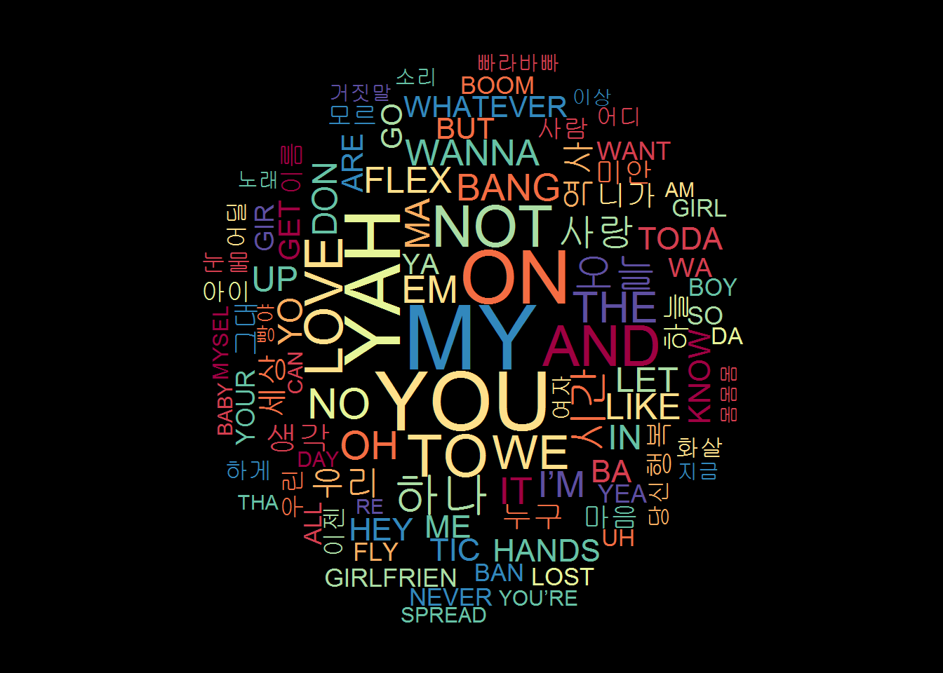
Figure 3. Word cloud, K-Hiphop words analysis

Slide 7
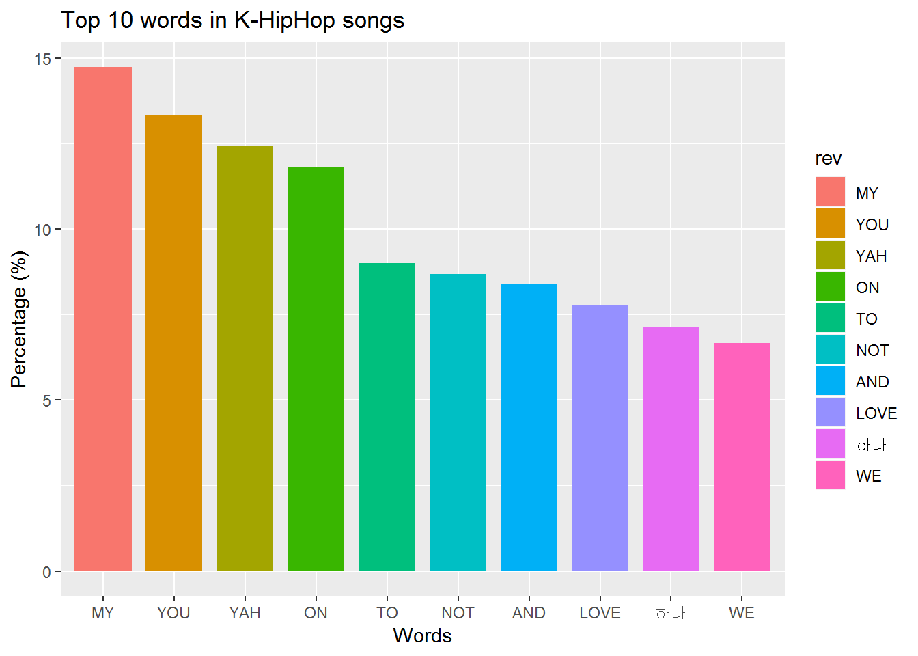
Figure 4. Bar graph, Top 10 words from K-Hiphop words analysis

Slide 8
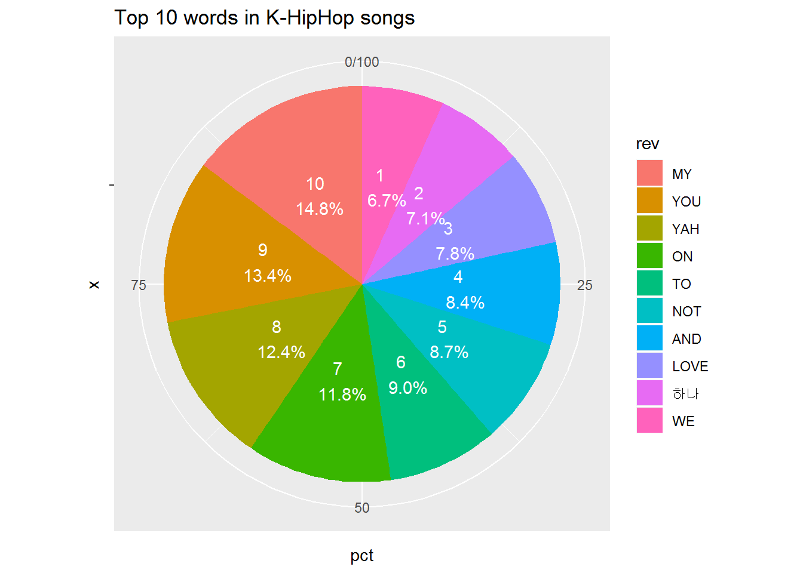
Figure 5. Pie chart, Top 10 words from K-Hiphop words analysis

