Slide 1
Strategies for Fault Tolerance Using DDS
Paul Schmitt
Real-Time Innovations Field Application Engineer

Slide 2
What Is Fault Tolerance?
Fault Tolerance is the ability of a system to continue operating, with little or no degradation in service, in the face of a fault (Ideally, hardware failure or software bug)
Fault Tolerance is a “game of statistics”, in that one needs to Detect the failure and …
Switchover to the Backup to continue ”correct” operation.
Repair the fault within a set Mean Time To Repair (MTTR)
Meaning that: The likelihood of a second fault with in the MTTR is acceptable (i.e., not likely)

Slide 3
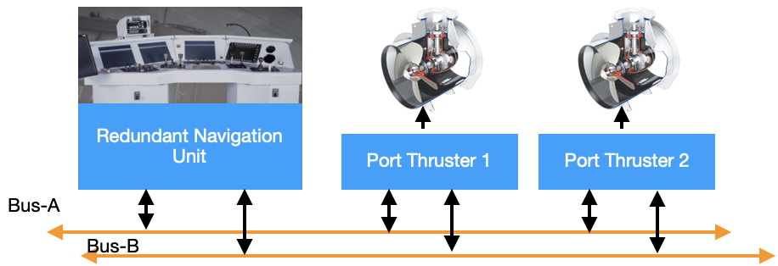
Requirements of Fault Tolerant Approaches (1/3)
Distributed
Especially in a hostile environment, a Single Fault can be the result of fire, flood, or explosion.
Isolated
One fault MUST not be allowed to cascade to the backup or standby units (i.e., create a second fault)

Slide 4
Requirements of Fault Tolerant Approaches (2/3)
End-to-end
Controllers, Actuators, and the Network must be redundant
Timely Detection of Faults in both Primary and Backup Systems
A backup system failing means the system is effectively running simplex (with a fault) until the primary component fails.
Comes back to MTTR and acceptable risk of a second failure
“Timely / Time” is dependent upon YOUR applications requirements and Mission Criticality

Slide 5
Requirements of Fault Tolerant Approaches (3/3)
Timely Switchover to Standby and Standby Roles
“Switchover time” Includes detection, and the Switchover itself (i.e., the time for the Backup or Standby to assume full Primary duties.)
Hot Standby, Warm Standby, Cold Standby
These represent the level of ”readiness” and relatively increase in time required for the backup to take on the Primary role.
Repairable / Field Replaceable Unit (FRU)
MTTR = Fault Detection time + Repair time
To minimize MTTR, usually requires ”hot” replacement (i.e., while the system is operating)
Repair – for software fault, can mean (temporarily) reboot.

Slide 6
Approaches to Redundancy
Simple Duplex Controllers
DDS Ownership Strength Primary and Backup
Three-way Voting
DDS Ownership Strength Primary, Secondary, Tertiary
Three-way Selected Sample – sample by sample “voting”
No Roles, no Ownership strength (shared ownership)
All three controllers send samples equally
Actuator selects DDS sample based on majority agreeing sample
Hardware - so called ”Pair & Spare” (for completeness)
Does not use DDS for Redundancy
Notes:
Approach 2 can be a superset of Approach 1 in that we can allow just 1 or two controllers to boot if three are not detected within a start up window

Slide 7
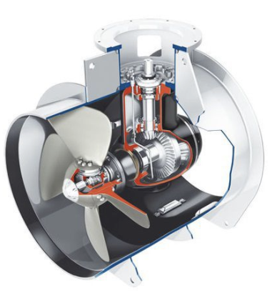
Simple Duplex Redundant Controller
Set Roles w/Thrust Command Ownership Strength
Switchover time based on Deadline, not Ownership Strength intensification time
Backup Strength intensifies to guard against zombie Primary
Helm Controllers
Port Side Thrusters
Primary
Backup
Heartbeat
Thruster 1 & 2 Commands
Connext Databus

Slide 8
Simple Duplex Redundant Controller Attributes
Guards against a hardware and limited software failures.
Some protection against zombie process on Primary
Does not guard against secondary incorrectly assuming Primary Role
Software Bug
Loses contact with heartbeat
Note: you may want this behavior if system communications link is severed to allow each controller to control its link segment
System needs to be reset to recover original Primary in Primary role
ownership strength will eventually rollover

Slide 9
Three-way Voted Redundant Controller
Set Roles w/Thrust Command Ownership Strength
Role is voted for with Majority Vote wins
Switchover time based on Deadline, independent of Voting time
Helm Controllers
Port Side Thrusters
Primary
Primary
Secondary
Secondary
Tertiary
Vote
Vote
Heartbeat
Heartbeat
Thruster 1 & 2 Commands
Connext Databus

Slide 10
Three-way Redundant Controller Attributes
Guards against hardware and limited software failure
Can also guard against zombie Primary process failure
Guards against secondary or tertiary unilaterally assuming control (software bug)
Although requiring a majority vote, Limits but does not eliminate, Secondary or Tertiary increasing ownership strength anyway
Loses contact with heartbeat
Note: you may want this behavior if system communications link is severed to allow each controller to control its link segment
Software is moderately more complex
Software Voting algorithm (leverage Redundancy Layer from GitHub)
Can combine with Backup Role Strength Intensification to guard against Zombie Primary

Slide 11

Three-way Selected Sample
Shared Ownership / No Controller Roles
Actuator/Thruster selects majority Sample
Sets alarm if a minority sample detected
Heartbeat used to alarm system (MTTR)
Helm Controllers
Port Side Thrusters
Controller 1
Controller 2
Controller 3
Heartbeat
Heartbeat
Connext Databus

Slide 12
Three-way Selected Sample Attributes
Guards against hardware failure and software Bugs
Assuming each controller software written by a different vendor (Guards against the same bug being hit on all three controllers at the same time)
NASA did this with the Space Shuttle
Requires more time to process each sample at the Actuator
Software is moderately more complex
Software Selection algorithm (leverage Redundancy Layer from GitHub)

Slide 13
Hardware – “Pair and Spare”
No Primary or Secondary Role
Two Processors on each controller, clock-to-clock comparison
Bus disconnected within one bus clock cycle if comparison fails
Helm Controllers
Port Side Thrusters
Controller 1
Controller 2
=
≠
=
Thruster 1 & 2 Commands
Connext Databus
Notes:
Really guards against Hardware failure – limited software protection if Check-pointing to a transactional data-base is perfromed

Slide 14
Summary
Redundancy Architecture | Cost | Complexity | Detect and overcome Hardware Fault | Detect and overcome Software Fault | Distributed | Switching Time (backup to primary)
Simple Duplex | Lowest | Lowest | Yes | Minimal, Total failure & Zombie Primary | Yes | Deadline based
Three-way voting | Low | Low* | Yes | Better, Basic software integrity checked by vote | Yes | Deadline based
Three-way Selected Sample | Low | Highest (multivendor) | Yes | Yes | Yes | N/A - Per sample selection (Impact performance)
Hardware “Pair & Spare” | High | High / custom hardware | Yes | No | No | Fastest (One CPU / Bus Clock cycle)
* Redundancy Layer code can be leveraged from GitHub minimizing new development

Slide 15
Demo

Slide 16
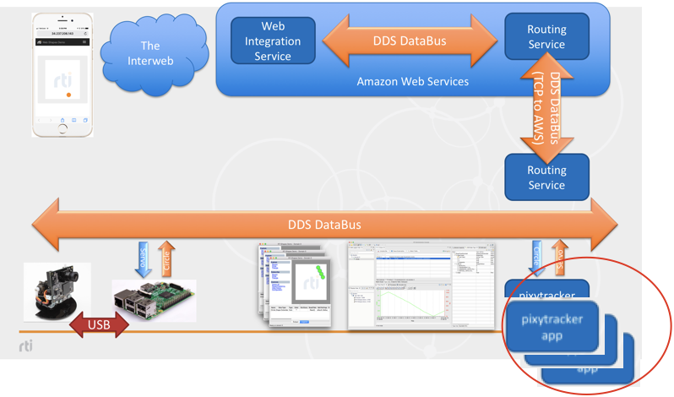
Three-way Voting Pixytracker Demo
Also supports Simple Duplex Redundancy
Runs with 1, 2 or 3 Tracker Apps
Code here

Slide 17
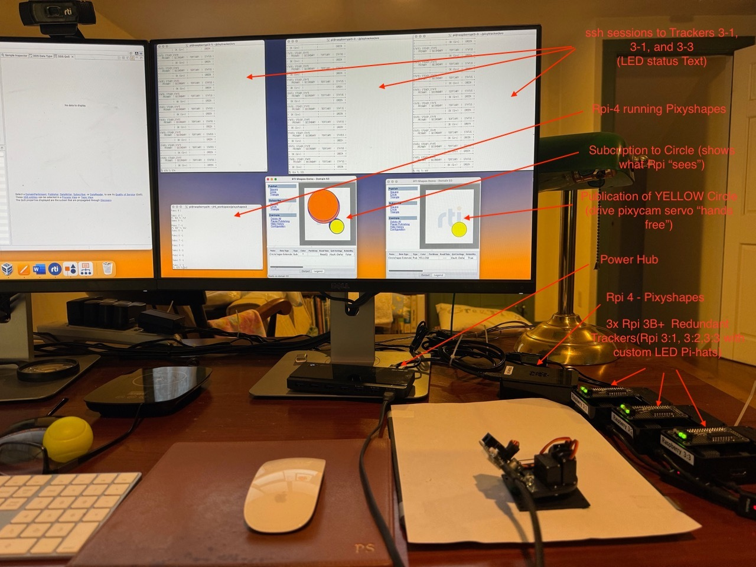
Demo Layout

Slide 18
DDS Mechanisms Discussed
DDS Mechanism | Component Used | Description
Liveliness | Controller Components | Detects a redundant component / participant failure
Ownership | Between Controller and Actuator | Enables the receiving application, independent of the redundancy strategy used to see at most two samples (one on each bus A and B)
Key’d data | Controller Components | Enables redundant components to use liveliness to detect each controller in a 3-way voting system
Match on Publisher | Controller Components | Enables the system to determine how many controllers are active.
Durability | Controller Components | Allows a so called “Late Joiner” to be a part of a running system. This may include obtaining system state or a number of previous samples to integrate to quickly get within the acceptable error value to become a Hot Standby.
Explicit Application Level Acknowledgement | Controller Components | Discussed above, but not suitable for this application due to the fact that only one heartbeat instance is sent from each controller causing head-of-line blocking (and we have full duplex heartbeats)

Slide 19
Thank You!
Paul Schmitt
paul.schmitt@rti.com
LinkedIn: www.linkedin.com/in/paul-schmitt-mass

