Slide 1
Real Time Innovations Tactical Microgrid Example
April 9, 2021
RTI makes the world run better
Revision 1.7

Slide 2

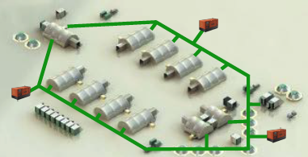
Tactical Microgrid – Power for FOBs
Distributed / Resilient
No single target for the enemy
“Elastic” Power as needed (Teams come and go)

Slide 3
TMS Example - Discovery
DEVICE STATE
DEVICE(S)
CONTROLLER(S)
QoS Publish Last
New Device Announces Itself
DeviceInfo
QoS Medium
(w/DeviceID)
Track DevID
Heartbeat (periodic)
(DeviceID)
QoS – Publish Last
DeviceInfo
DISCOVERY
(w/DeviceID)
QoS – Medium
Controller Selection
Heartbeat (periodic)
(DeviceID)
ControllerID
ActiveMicrogrid ControllerState
(DeviceID,
ControllerId)
Master Controller Selected
QoS Publish Last
Note: Device and Controller independently start discovery and are not order dependent. Controller Selection is dependent upon Contoller DeviceInfo and Heartbeat.

Slide 4
TMS Example – Power-Up Authorization
DEVICE STATE
DEVICE(S)
CONTROLLER(S)
QoS Command
AuthorizationTo EnergizeRequest
(DeviceID)
QoS Response
CFT (related RequestId)
AuthorizationTo EnergizeReply
PowerUp Authorization
(w/DeviceID)
AuthorizationTo EnergizeResult

Slide 5
TMS Example – Energize
DEVICE STATE
DEVICE(S)
CONTROLLER(S)
QoS Command
CFT (targetID)
EnergyStartStop Request
QoS Reply
(w/TargetID)
Reply (and Change State)
(DeviceID)
Energize
QoS PublishLast
EnergyStartStop State
(DeviceID)
(On Change of State)

Slide 6
TMS Example – SteadyState. Shutdown, Error
DEVICE STATE
DEVICE(S)
CONTROLLER(S)
QoS Medium
SteadyState
Heartbeat (periodic)
(DeviceID)
QoS – Medium
Heartbeat (periodic)
(DeviceID)
Shutdown
CTRL-C
CTRL-C
Unexpected Response / Event
Unexpected Response / Event
Error

Slide 7
Thank You!
Probe-Pro’s team

Slide 8
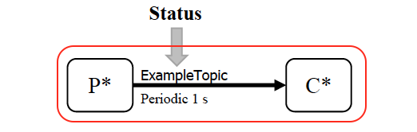
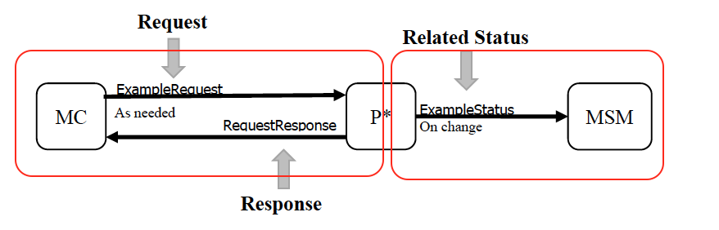
Software Components
Tactical Microgrid Spec (TMS)
Data Patterns
Publish Once (Durable)
Periodic
Request / Response
On-Change
Custom (Not implemented)
Topics
Distributed Data Service (DDS)
Customer Legacy System
Gateway Module / Interface between TMS/DDS and Legacy Communications

Slide 9
Current Status
https://github.com/psmass/tms

