Slide 1
Modeling Magnetic Morphologies of Star-Forming Regions
Kenji Emerson
SMA-ASIAA/Akamai 2018

Slide 2
Presentation Overview
Overview
Theory
Modeling Observations
Implementation
Simulation Results
Summary
Overview
Theory
Modeling Observations
Implementation
Simulation Results
Summary

Slide 3
Importance of Magnetic Fields
Overview
Theory
Modeling Observations
Implementation
Simulation Results
Summary
Magnetic braking
Protoplanetary disk collapse contains too much angular momentum.
Cloud Support
Magnetic fields prevent the collapse of gas clouds below a specific critical mass.
Scattering
Magnetic fields may be contaminated by scattering effects.

Slide 4
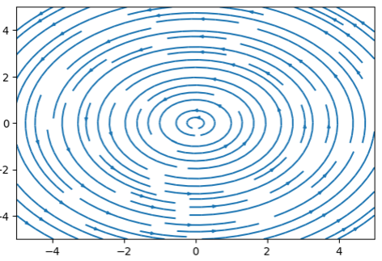
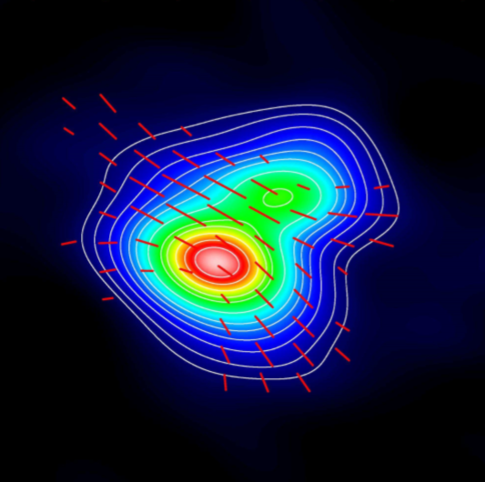
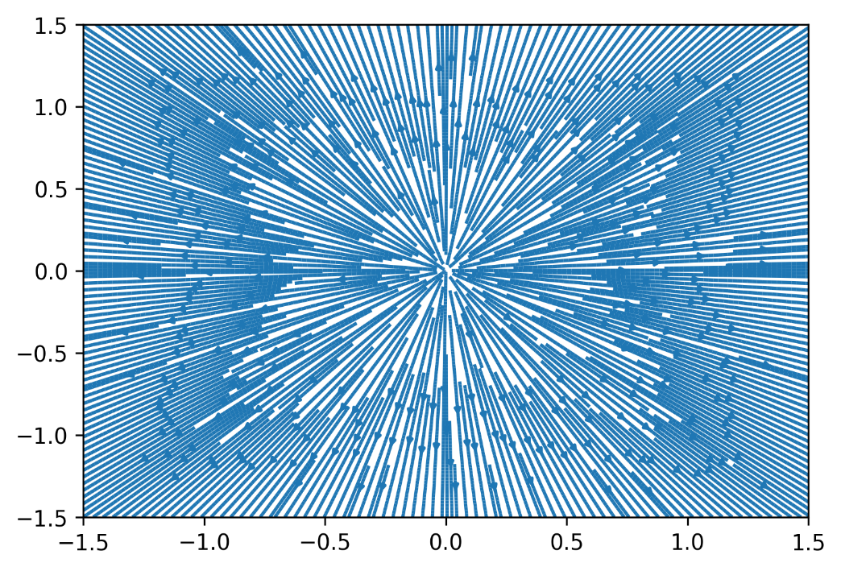
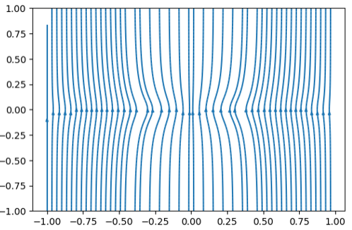
Modeling B-field Components
Overview
Theory
Modeling Observations
Implementation
Simulation Results
Summary

Slide 5
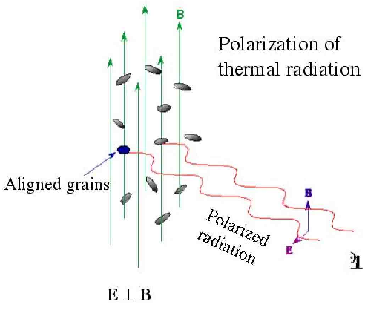
Determining B-fields via Dust
Overview
Theory
Modeling Observations
Implementation
Simulation Results
Summary

Slide 6
Project Aims
Overview
Theory
Modeling Observations
Implementation
Simulation Results
Summary
Create an algorithm/program to simulate observations.
Protoplanetary star-forming regions.
Simulate polarimetry observations.
Simulation must allow for a completely customizable object and sightline parameters:
Object parameters:
Cloud geometry
Magnetic field
Density profile
Polarization function
Sightline parameters:
Location
Field of view

Slide 7
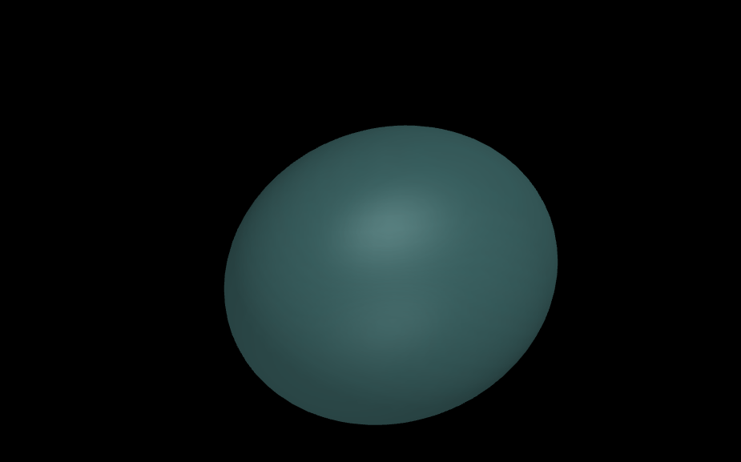
A Dust Cloud
Overview
Theory
Modeling Observations
Implementation
Simulation Results
Summary

Slide 8
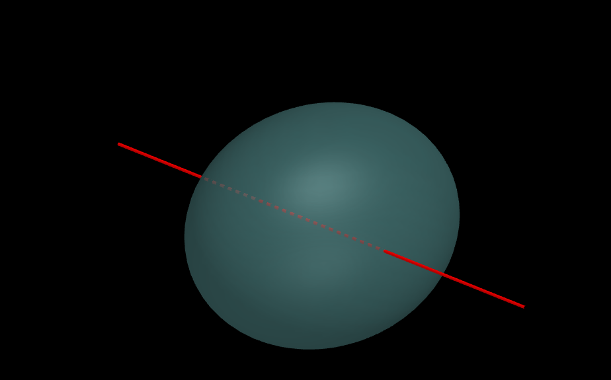
A Dust Cloud with a Sightline
Overview
Theory
Modeling Observations
Implementation
Simulation Results
Summary

Slide 9
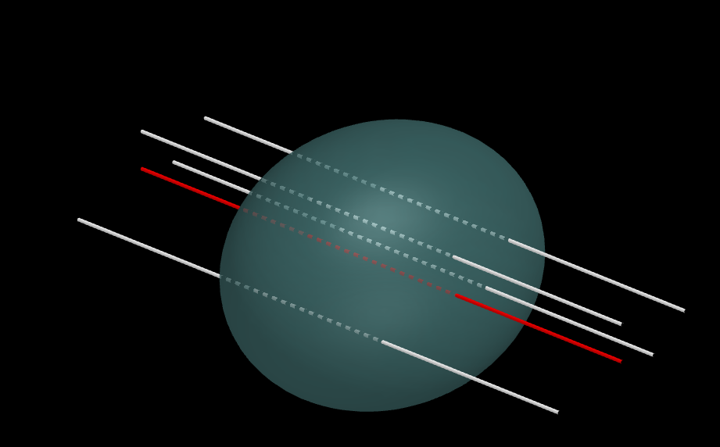
A Dust Cloud with Many Sightlines
Overview
Theory
Modeling Observations
Implementation
Simulation Results
Summary

Slide 10
Simulation Implementation Structure
Overview
Theory
Modeling Observations
Implementation
Simulation Results
Summary
ObservingRun
ProtostarModel
Magnetic Field
Density Profile
Sightline
Astropy SkyCoord
Cloud Geometry
Polarization Function
Astropy SkyCoord

Slide 11
ObservingRun Algorithm
Overview
Theory
Modeling Observations
Implementation
Simulation Results
Summary
Make random sightlines
Generate a uniform 2D yz/RA-DEC grid of sightlines
Integrate physical values along sightlines
Over all regions within the cloud
Over all functions/fields (intensity, magnetic, polarization)
Create Contour Plots for Stokes I,Q,U & Angle
Derive E-field from integrated B-field and intensity
Make appropriate colored contours, auto-scale color bars
Generate based on field of view and primary sightline

Slide 12
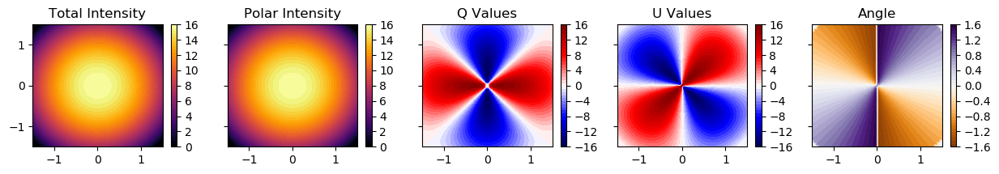
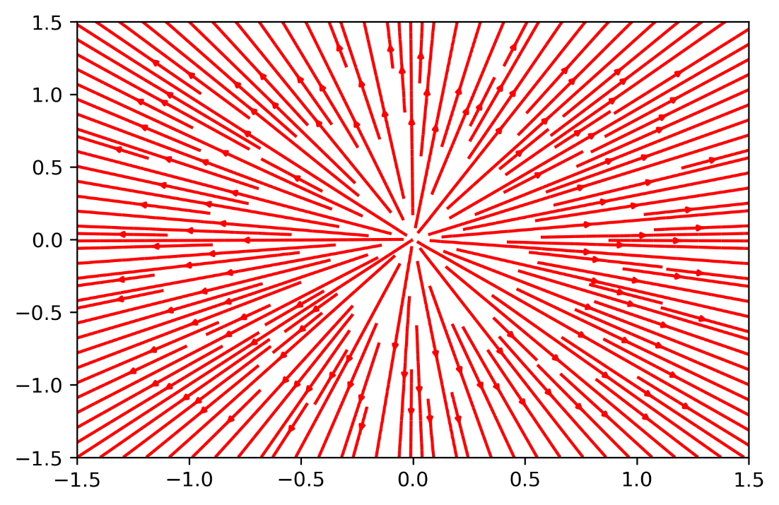
Results
Overview
Theory
Modeling Observations
Implementation
Simulation Results
Summary
Circular

Slide 13
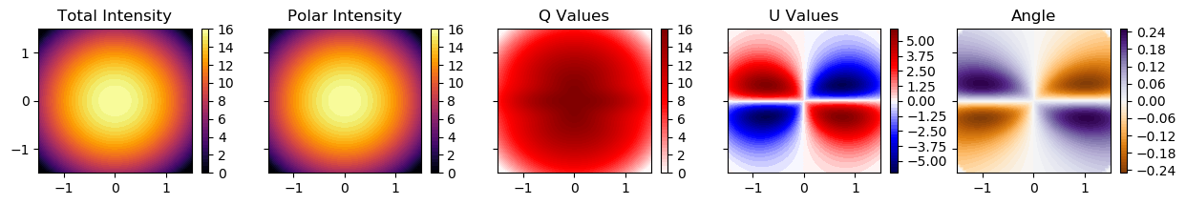
Results
Overview
Theory
Modeling Observations
Implementation
Simulation Results
Summary
Circular
Hourglass

Slide 14
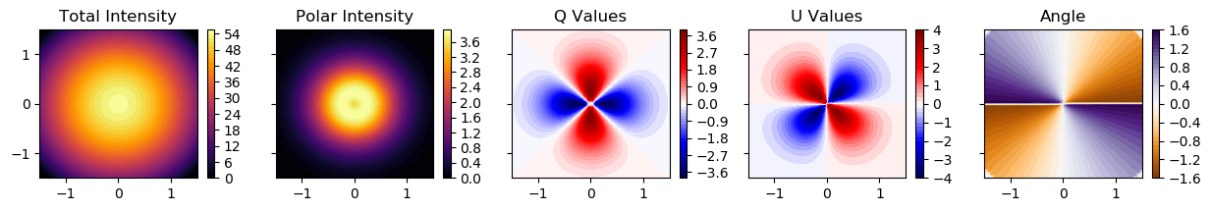
Results
Overview
Theory
Modeling Observations
Implementation
Simulation Results
Summary
Monopole

Slide 15
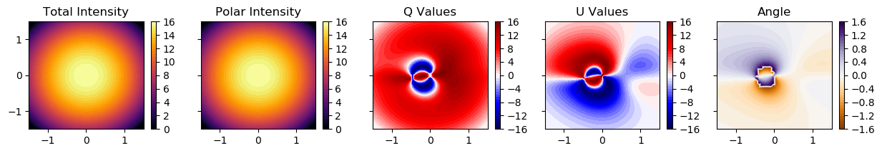
Results
Overview
Theory
Modeling Observations
Implementation
Simulation Results
Summary
Monopole
Composite

Slide 16
Summary
Overview
Theory
Modeling Observations
Implementation
Simulation Results
Summary
The generalized function for modeling magnetic morphologies is functional.
Plots of I,Q,U values are logical and consistent.
Implementation is scalable and portable (written purely in Python with Anaconda packages).
Source code is publicly available with documentation:
https://github.com/psmd-iberutaru/Akamai_Internship

Slide 17
Future Progress
Overview
Theory
Modeling Observations
Implementation
Simulation Results
Summary
Compare simulated models to real observed polarization data.
Test different combinations of the three magnetic fields.
Add new magnetic field functions.
Use different cloud shapes, density profiles, and polarization functions.

Slide 18
Acknowledgments
Smithsonian Submillimeter Array
Academia Sinica Institute of Astronomy and Astrophysics
Mentor: Ramprasad Rao
Akamai Workforce Initiative program
The Thirty Meter Telescope International Observatory
The Air Force Office of Scientific Research
Hawai‘i STEM Learning Partnership at Hawaiʻi Community Foundation
The Monty Richards Hawaiʻi Island – Bank of Hawaiʻi Foundation
The Daniel K. Inouye Solar Telescope
National Science Foundation
The University of Hawaiʻi at Hilo
Canada-France-Hawaiʻi Telescope

