Slide 1
Magnetic Morphologies of Star-Forming Regions
Kenji Emerson, SMA-ASIAA/Akamai 2018 Project:

Slide 2
Why are magnetic fields important?
Magnetic braking
Protoplanetary disk collapse contains too much angular momentum

Slide 3
Why are magnetic fields important?
Magnetic braking
Protoplanetary disk collapse contains too much angular momentum
Cloud Support
Magnetic fields prevent the collapse of gas clouds below a specific critical mass.

Slide 4
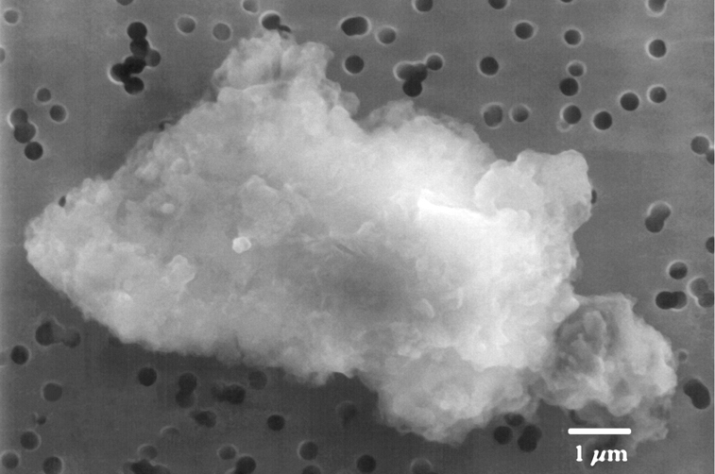
Determining Magnetic Fields via Dust
Example of interplanetary dust.

Slide 5
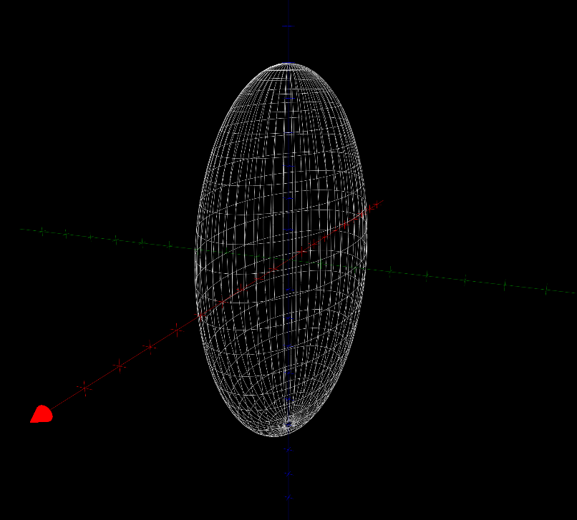
Determining Magnetic Fields via Dust
Example of interplanetary dust.
Interstellar dust is of similar shape, we approximate it as a oblong ellipsoid.

Slide 6
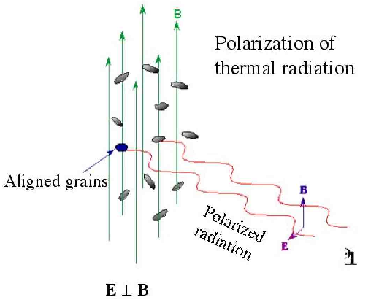
Determining Orientation of Dust

Slide 7
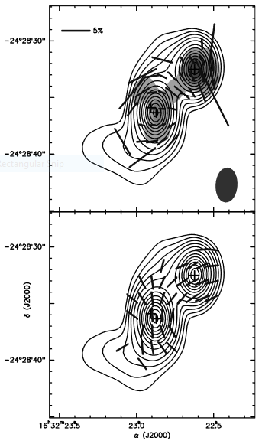
Polarization Data
Rao et. al. 2009

Slide 8
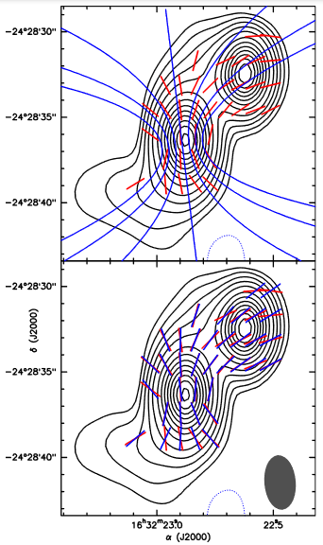
Polarization Data
Rao et. al. 2009

Slide 9
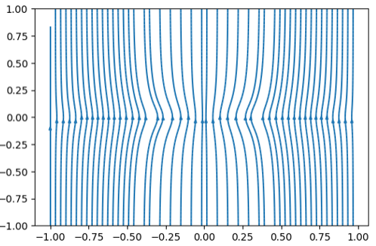
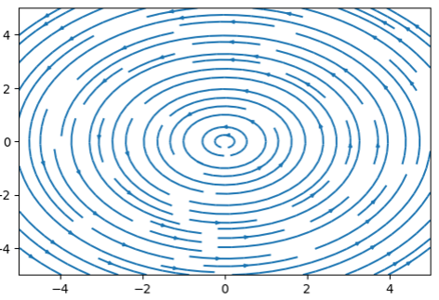
Personal Contribution

Slide 10
Acknowledgements
Akamai Workforce Initiative program
The Thirty Meter Telescope International Observatory
The Air Force Office of Scientific Research
Hawai‘i STEM Learning Partnership at Hawai‘i Community Foundation
The Monty Richards Hawaiʻi Island Community Award
The Daniel K. Inouye Solar Telescope
National Science Foundation
The University of Hawaiʻi at Hilo
Canada-France-Hawaiʻi Telescope
Smithsonian Submillimeter Array
Mentor: Ramparsed Rao

