Slide 1
Modeling Magnetic Morphologies of Star-Forming Regions
Kenji Emerson, SMA-ASIAA/Akamai 2018 Project:

Slide 2
Presentation Flow
Overview
Theory
Modeling Observations
Implementation
Results and Figures
Conclusions
Overview:
Scope of the project, overall details.
Theory:
Describe the science behind the project.
Modeling Observations:
A deeper introduction to the methodology of the project’s theory.
Implementation:
Discuss the method of implementing the solution(s) of the project.
Results and Figures
The results from the implemented solution to the project.
Conclusions
Final considerations.

Slide 3
General Picture
Overview
Theory
Modeling Observations
Implementation
Results and Figures
Conclusions
Create an algorithm/program to simulate observations.
Protoplanetary star-forming regions.
Simulate polarimetry observations.
Simulation must allow for a completely customizable object and sightline parameters:
Object parameters:
Cloud geometry
Magnetic field
Density profile
Polarization function
Sightline parameters:
Location
Field of view

Slide 4
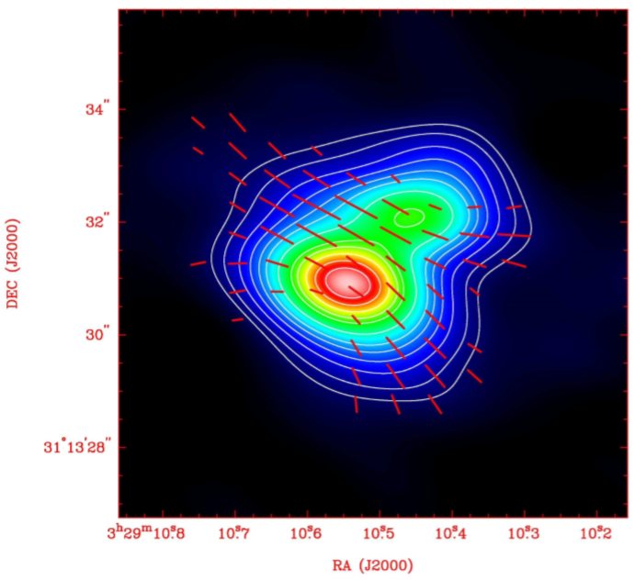
General Picture
Overview
Theory
Modeling Observations
Implementation
Results and Figures
Conclusions
Create an algorithm/program to simulate observations.
Protoplanetary star-forming regions.
Simulate polarimetry observations.
Simulation must allow for a completely customizable object and sightline parameters:
Object parameters:
Cloud geometry
Magnetic field
Density profile
Polarization function
Sightline parameters:
Location
Field of view

Slide 5
Importance of Magnetic Fields
Overview
Theory
Modeling Observations
Implementation
Results and Figures
Conclusions
Magnetic braking
Protoplanetary disk collapse contains too much angular momentum.
Cloud Support
Magnetic fields prevent the collapse of gas clouds below a specific critical mass.
Scattering
Magnetic fields may be contaminated by scattering effects.

Slide 6
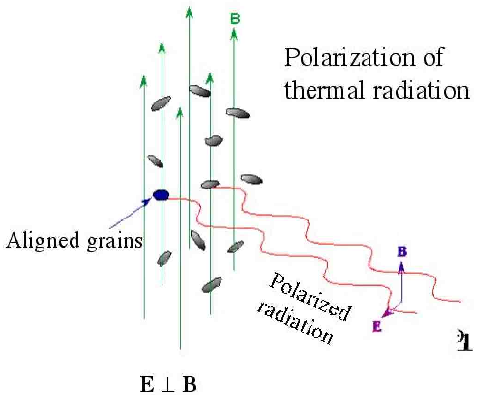
Determining B-fields via Dust
Overview
Theory
Modeling Observations
Implementation
Results and Figures
Conclusions

Slide 7
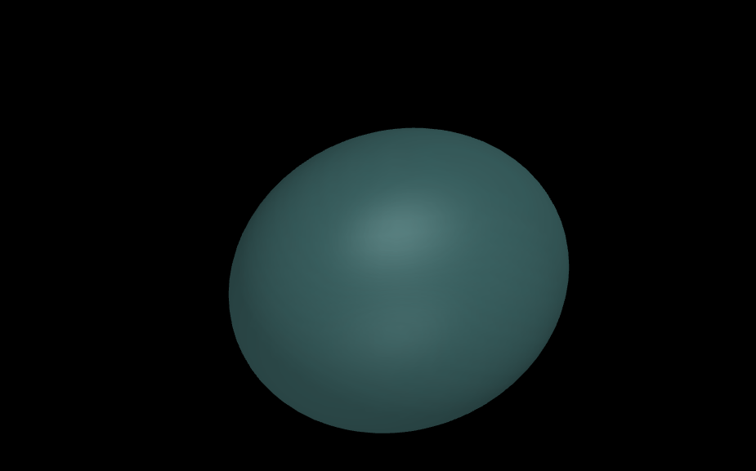
A Dust Cloud
Overview
Theory
Modeling Observations
Implementation
Results and Figures
Conclusions

Slide 8
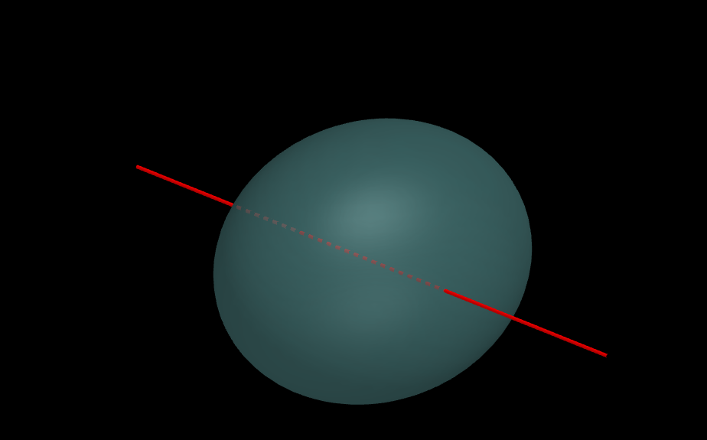
A Dust Cloud with a Sightline
Overview
Theory
Modeling Observations
Implementation
Results and Figures
Conclusions

Slide 9
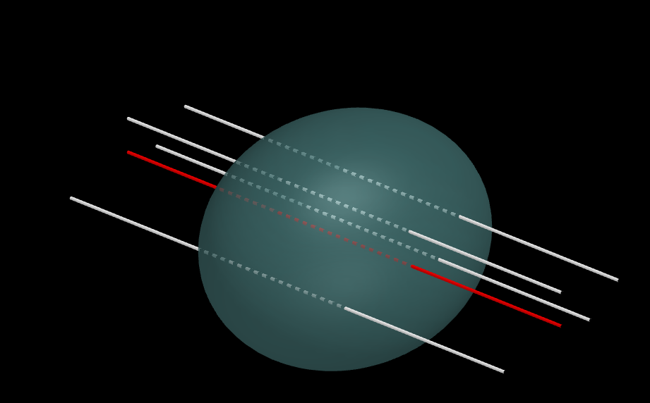
A Dust Cloud with Many Sightlines
Overview
Theory
Modeling Observations
Implementation
Results and Figures
Conclusions

Slide 10
Simulation Implementation Structure
Overview
Theory
Modeling Observations
Implementation
Results and Figures
Conclusions
ObservingRun
ProtostarModel
Magnetic Field
Density Profile
Sightline
Astropy SkyCoord
Cloud Geometry
Polarization Function
Astropy SkyCoord

Slide 11
ObservingRun Functionality
Overview
Theory
Modeling Observations
Implementation
Results and Figures
Conclusions
Make random sightlines
Generate a uniform 2D yz/RA-DEC grid of sightlines
Integrate
Over all regions within the cloud
Over all functions/fields (intensity, magnetic, polarization)
Plot Stoke’s I,Q,U, and Angle Contours
Derive E-field from integrated B-field and intensity.
Make appropriate colored contours, auto-scale color bars.
Generate based on field of view and primary sightline

Slide 12
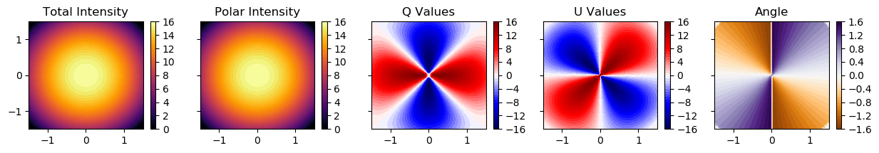
Results
Overview
Theory
Modeling Observations
Implementation
Results and Figures
Conclusions
Circular

Slide 13
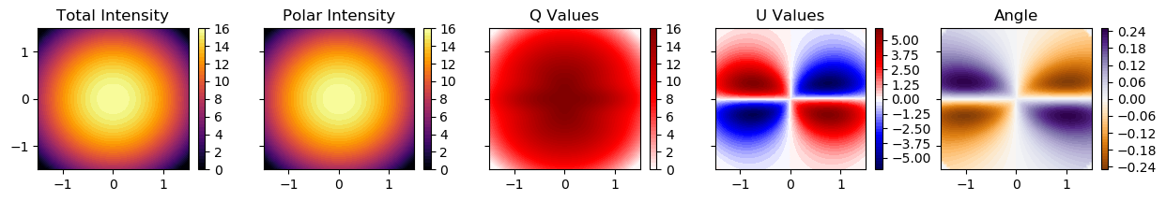
Results
Overview
Theory
Modeling Observations
Implementation
Results and Figures
Conclusions
Circular
Hourglass

Slide 14
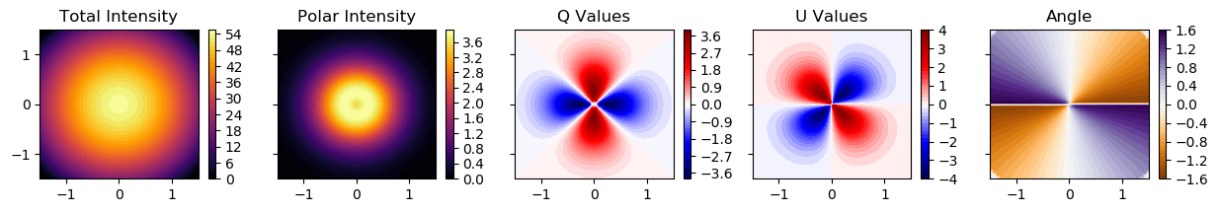
Results
Overview
Theory
Modeling Observations
Implementation
Results and Figures
Conclusions
Monopole

Slide 15
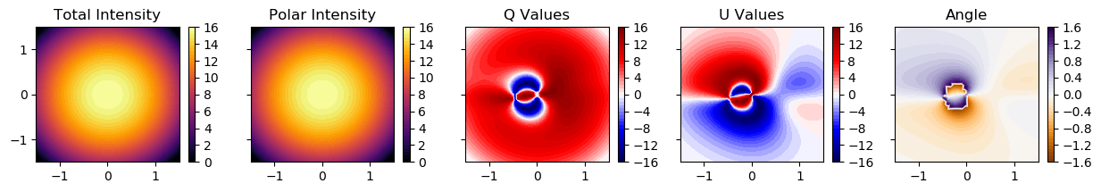
Results
Overview
Theory
Modeling Observations
Implementation
Results and Figures
Conclusions
Monopole
Composite

Slide 16
Conclusions
Overview
Theory
Modeling Observations
Implementation
Results and Figures
Conclusions
The generalized function for modeling magnetic morphologies is functional.
Plots of I,Q,U values are logical and consistent.
Implementation is scalable and portable (written purely in Python with Anaconda packages).
Source code is publicly available with documentation:
https://github.com/psmd-iberutaru/Akamai_Internship

Slide 17
Acknowledgements
Akamai Workforce Initiative program
The Thirty Meter Telescope International Observatory
The Air Force Office of Scientific Research
Hawai‘i STEM Learning Partnership at Hawaiʻi Community Foundation
The Monty Richards Hawaiʻi Island – Bank of Hawaiʻi Foundation
The Daniel K. Inouye Solar Telescope
National Science Foundation
The University of Hawaiʻi at Hilo
Canada-France-Hawaiʻi Telescope
Smithsonian Submillimeter Array
Academia Sinica Institute of Astronomy and Astrophysics
Mentor: Ramprasad Rao

