Slide 1
Discovering Spatial and Temporal Links among RDF Data
Panayiotis Smeros and Manolis Koubarakis
WWW2016 Workshop: Linked Data on the Web (LDOW2016)
April 12, 2016 - Montréal, Canada

Slide 2
Outline
Introduction
Background
Developed Methods
Implementation
Experimental Evaluation
Conclusions

Slide 3
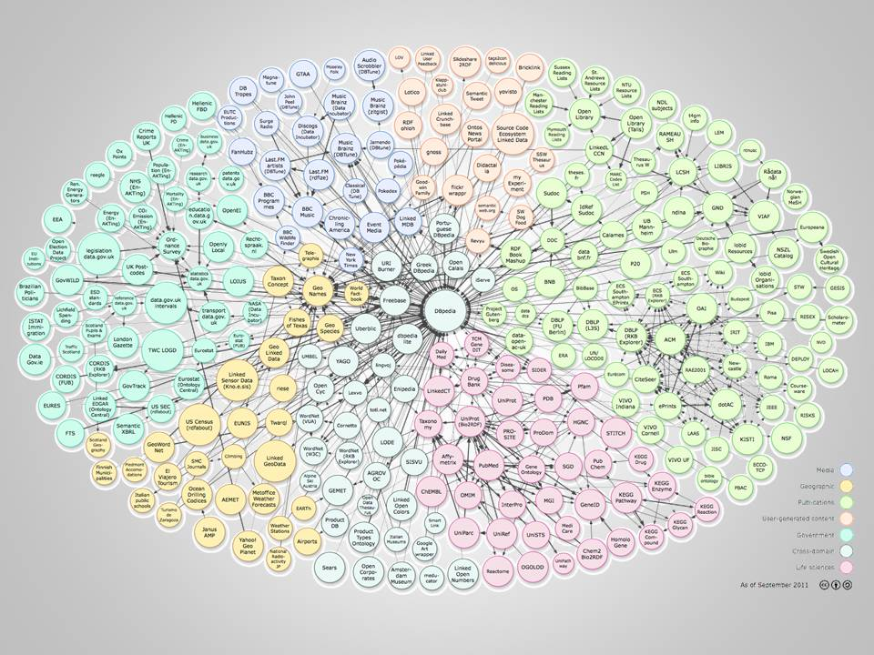
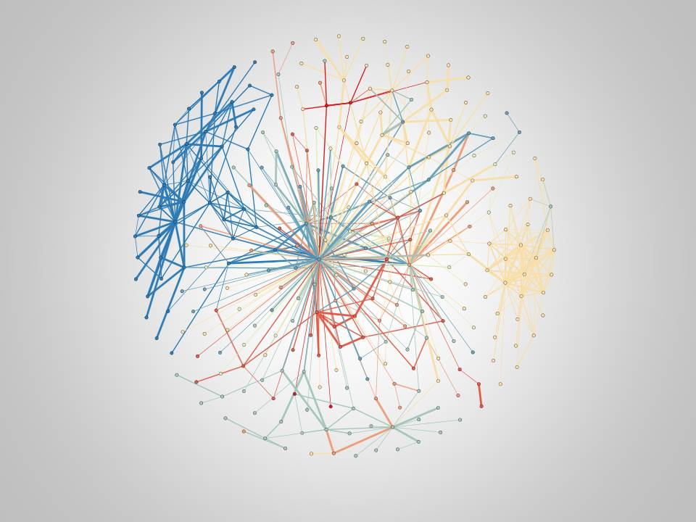
Spatial and Temporal Link Discovery
Establish semantic relations (links) between entities
Source
Source
Enrich the information of datasets with
Geospatial and Temporal characteristics

Slide 4




From Locations to Complex Geometries
Geonames, OpenStreetMap, etc. are dominated by location (point) information
GeoSPARQL Standard
Datasets with rich geospatial and temporal information
Corine Land Cover (http://datahub.io/dataset/corine-land-cover)
Urban Atlas (http://datahub.io/dataset/urban-atlas)
Products from Satellite Images (http://datahub.io/dataset/sentinel2)
State-of-the-art works focus on distance based (similarity) relations
More spatial and temporal relations can be discovered!

Slide 5
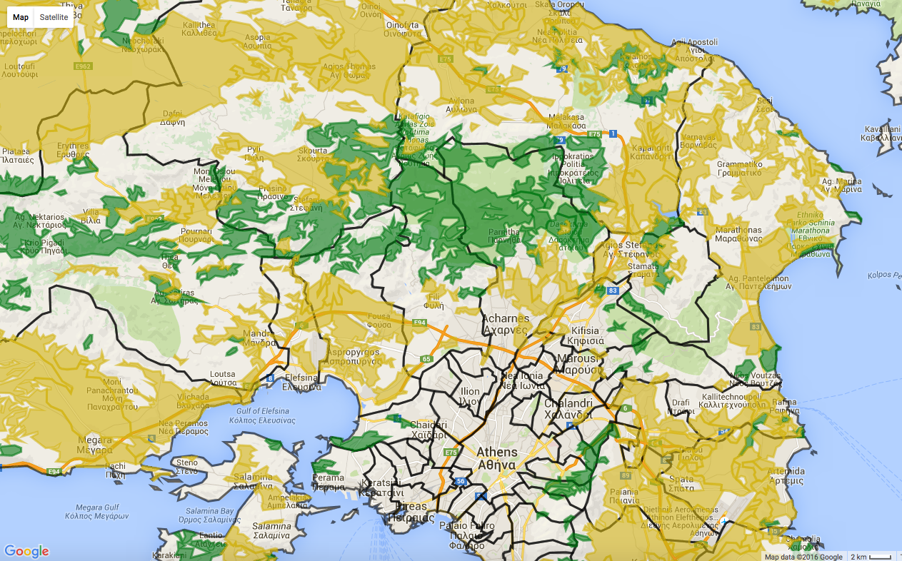

Link Discovery in Fire Monitoring (Example)
Land Cover Municipalities Fire

Slide 6
Link Discovery in Fire Monitoring (Example)
Land Cover Municipalities Fire
threatens

Slide 7
Link Discovery in Fire Monitoring (Example)
Land Cover Municipalities Fire
intersects

Slide 8
Heterogeneity: Geospatial Datasets
_:1 rdf:type geo:Geometry .
_:1 geo:hasGeometry
"<http://www.opengis.net/def/crs/EPSG/0/4326>
POINT(10 20)"^^geo:wktLiteral .
_:1 rdf:type strdf:Geometry .
_:1 strdf:hasGeometry
"<gml:Point crsName="EPSG:2100"><gml:coordinates>10,20
</gml:coordinates></gml:Point>"^^strdf:GML .
_:1 rdf:type wgs84Geo:Point .
_:1 wgs84Geo:lat “10“^^xsd:double .
_:1 wgs84Geo:long “20“^^xsd:double .
GeoSPARQL
stRDF
W3C GEO

Slide 9

Heterogeneity: Geospatial Datasets
_:1 rdf:type geo:Geometry .
_:1 geo:hasGeometry
"<http://www.opengis.net/def/crs/EPSG/0/4326>
POINT(10 20)"^^geo:wktLiteral .
_:1 rdf:type strdf:Geometry .
_:1 strdf:hasGeometry
"<gml:Point crsName="EPSG:2100"><gml:coordinates>10,20
</gml:coordinates></gml:Point>"^^strdf:GML .
Different Vocabularies
GeoSPARQL
stRDF

Slide 10
Heterogeneity: Geospatial Datasets
_:1 rdf:type geo:Geometry .
_:1 geo:hasGeometry
"<http://www.opengis.net/def/crs/EPSG/0/4326>
POINT(10 20)"^^geo:wktLiteral .
_:1 rdf:type strdf:Geometry .
_:1 strdf:hasGeometry
"<gml:Point crsName="EPSG:2100"><gml:coordinates>10,20
</gml:coordinates></gml:Point>"^^strdf:GML .
Different Vocabularies
Different Serializations of Geometries
GeoSPARQL
stRDF

Slide 11
Heterogeneity: Geospatial Datasets
_:1 rdf:type geo:Geometry .
_:1 geo:hasGeometry
"<http://www.opengis.net/def/crs/EPSG/0/4326>
POINT(10 20)"^^geo:wktLiteral .
_:1 rdf:type strdf:Geometry .
_:1 strdf:hasGeometry
"<gml:Point crsName="EPSG:2100"><gml:coordinates>10,20
</gml:coordinates></gml:Point>"^^strdf:GML .
Different Vocabularies
Different Serializations of Geometries
Geometries expressed in Different Coordinate Reference Systems (CRS)
GeoSPARQL
stRDF

Slide 12
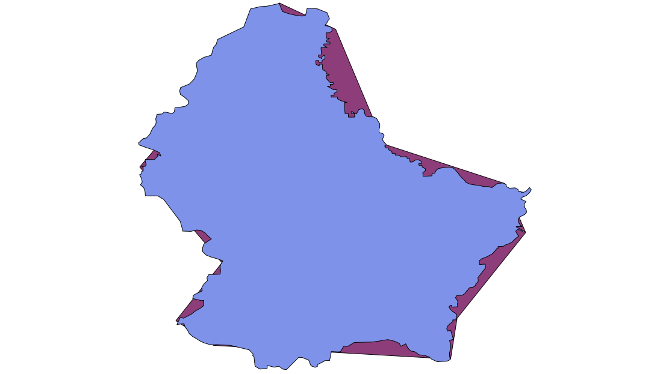
Heterogeneity: Geospatial Datasets
source

Slide 13
Heterogeneity: Geospatial Datasets
Different Sampling Values
Different Granularity
Different Rounding Effects
source

Slide 14
Heterogeneity: Temporal Datasets
_:1 ex:hasBirthday "1989-09-24T11:05:00+01:00"xsd:dateTime .
_:1 ex:hasAffiliation ex:UoA
"[2007-09-01T00:00:00+03:00, 2015-08-31T00:00:00+04:00)"^^strdf:Period .
RDF
stRDF

Slide 15
Heterogeneity: Temporal Datasets
_:1 ex:hasBirthday "1989-09-24T11:05:00+01:00"xsd:dateTime .
_:1 ex:hasAffiliation ex:UoA
"[2007-09-01T00:00:00+03:00, 2015-08-31T00:00:00+04:00)"^^strdf:Period .
Different Vocabularies
RDF
stRDF

Slide 16
Heterogeneity: Temporal Datasets
_:1 ex:hasBirthday "1989-09-24T11:05:00+01:00"xsd:dateTime .
_:1 ex:hasAffiliation ex:UoA
"[2007-09-01T00:00:00+03:00, 2015-08-31T00:00:00+04:00)"^^strdf:Period .
Different Vocabularies
Different Time Zones
RDF
stRDF

Slide 17
Heterogeneity: Temporal Datasets
_:1 ex:hasBirthday "1989-09-24T11:05:00+01:00"xsd:dateTime .
_:1 ex:hasAffiliation ex:UoA
"[2007-09-01T00:00:00+03:00, 2015-08-31T00:00:00+04:00)"^^strdf:Period .
Different Vocabularies
Different Time Zones
Time Instants and Periods
RDF
stRDF

Slide 18
Outline
Introduction
Background
Developed Methods
Implementation
Experimental Evaluation
Conclusions

Slide 19
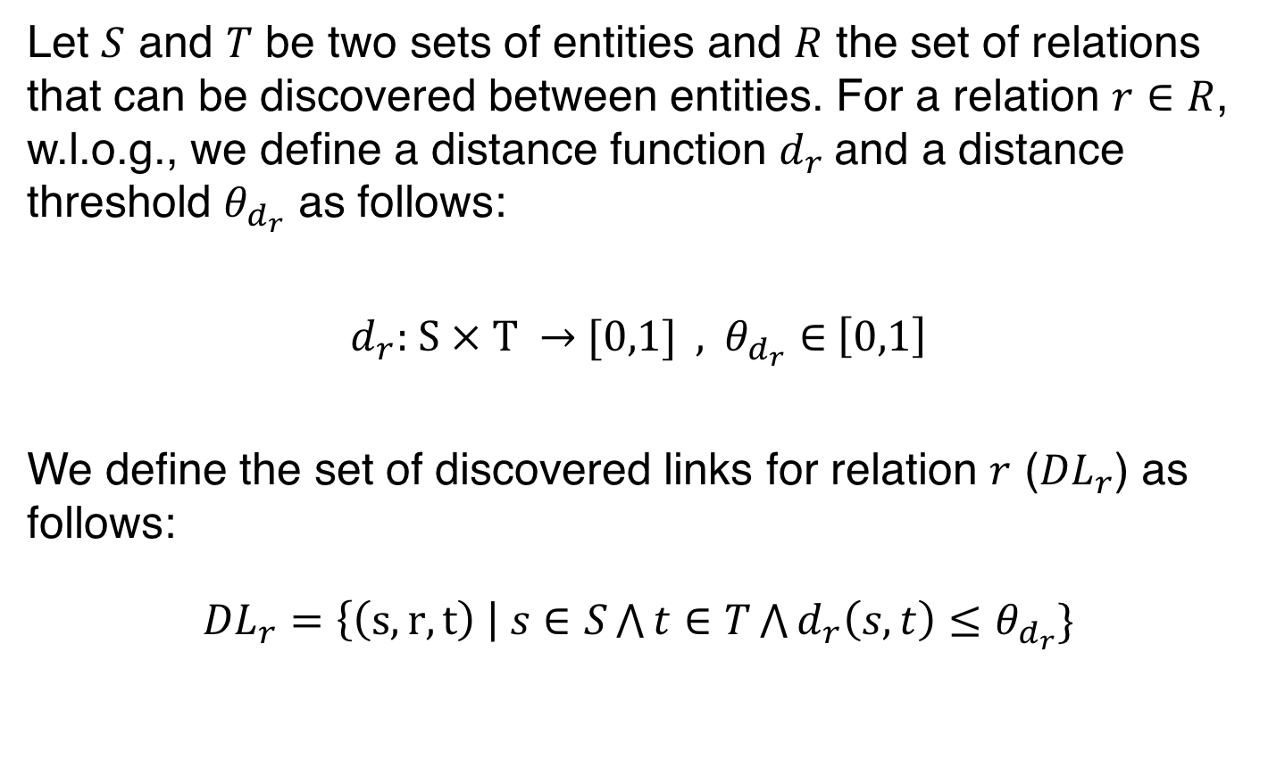
Link Discovery (Definition)
Let $S$ and $T$ be two sets of entities and $R$ the set of relations that can be discovered between entities. For a relation $r∈R$, w.l.o.g., we define a distance function $d_{r}$and a distance threshold $θ_{d_{r}}$ as follows:
$d_{r}\text{: }\text{S}\text{ × }\text{T} →$ [0,1] , $θ_{d_{r}}∈$ $\left[0,1\right]$
We define the set of discovered links for relation $r$ (${DL}_{r}$) as follows:
${DL}_{r}=\left\{\left(s, r, t\right) \right| s∈S\bigwedge{t∈T\bigwedge{d_{r}\left(s,t\right)≤θ_{d_{r}}}}$}

Slide 20
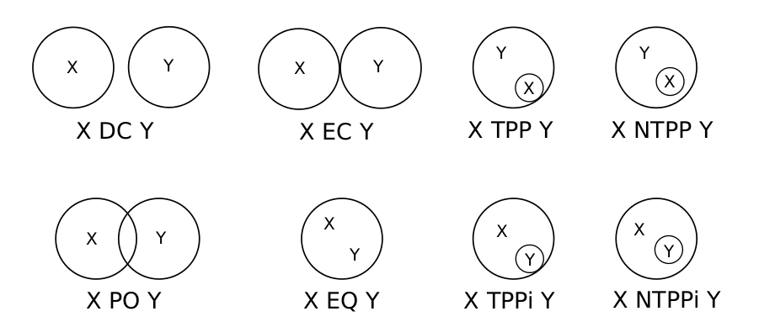
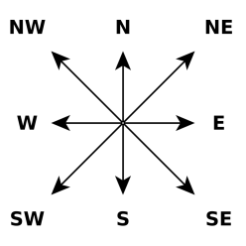
State-of-the-art Spatial Relations
Dimensionally Extended 9-Intersection Model
Egenhofer’s Model
OGC Simple Features Model
Region Connection Calculus
e.g., RCC8
Cardinal Direction Calculus
Intersects, Overlaps, Equals, Touches, Disjoint, Contains,
Crosses, Covers, CoveredBy and Within

Slide 21
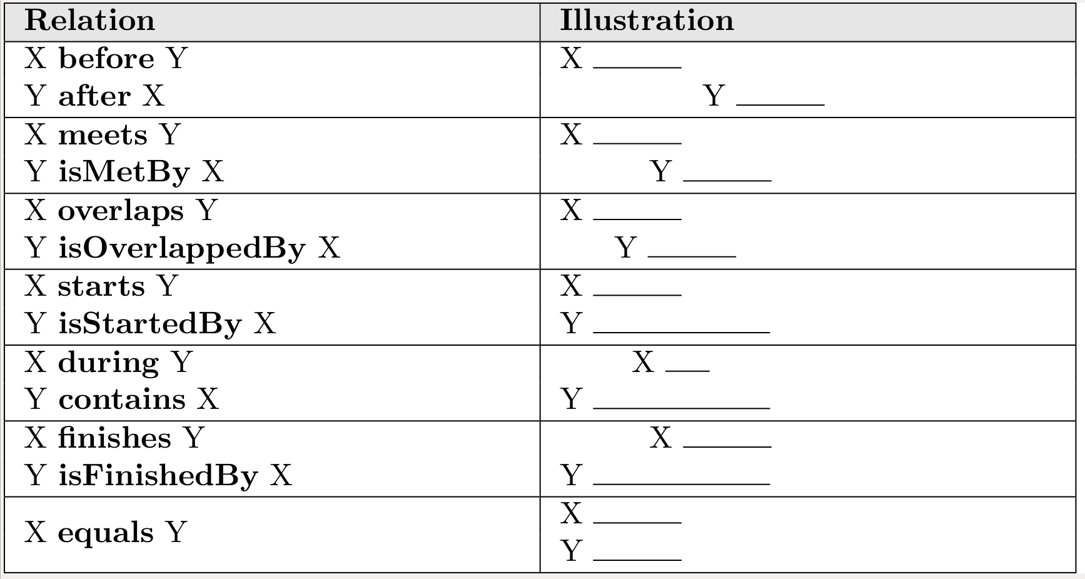
State-of-the-art Temporal Relations
Allen’s Interval Calculus

Slide 22
Outline
Introduction
Background
Developed Methods
Implementation
Experimental Evaluation
Conclusions

Slide 23
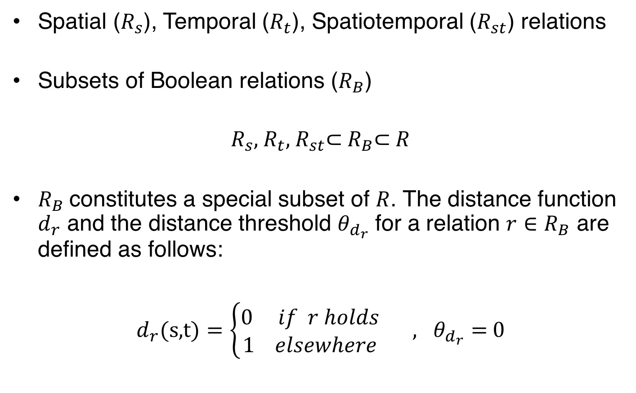
Introduced Relations
Spatial ($R_{s}$), Temporal ($R_{t}$), Spatiotemporal ($R_{st}$) relations
Subsets of Boolean relations ($R_{B}$)
$R_{s}$, $R_{t}$, $R_{st}$⊂ $R_{B}\text{⊂ }R$
$R_{B}$constitutes a special subset of $R$. The distance function $d_{r}$ and the distance threshold $θ_{d_{r}}$ for a relation $r∈R_{B}$ are defined as follows:
$d_{r}\text{(}\text{s}\text{,}\text{t}\text{)}=\left\{\begin{matrix}0 if r holds \\ 1 elsewhere\end{matrix}\right. , θ_{d_{r}}=$ 0

Slide 24
Introduced Transformations (1/2)
Vocabulary Transformation
converts the vocabulary of geometry literals into GeoSPARQL
Serialization Transformation
converts the serialization of geometries into WKT
CRS Transformation
converts the CRS of geometries into the World Geodetic System (WGS 84)
Validation Transformation
converts not valid geometries (e.g., self-intersecting polygons) to valid ones
Simplification Transformation
simplifies geometries according to a given distance tolerance

Slide 25
Introduced Transformations (2/2)
Envelope Transformation
computes the envelope (minimum bounding rectangle) of geometries
Area Transformation
computes the area of geometries in square metres
Points-To-Centroid Transformation
computes the centroid of a cluster of points
Time-Zone Transformation
converts the time zone of time elements to Coordinated Universal Time (UTC)
Period Transformation
converts time instants to periods with the same starting and ending point

Slide 26
Techniques for Checking the Relations
Cartesian Product Technique (Naive)
Exhaustive checks between the pairs of the entities of datasets
Complete
Complexity: O(|S||T|) checks
Blocking Technique
Decreases the number of checks
Divides the entities into blocks
Complexity: O(|S||T|) checks (worst case), O(|L|) checks (best case)
* |S|, |T|: number of entities in datasets S and T; |L|: number of links between datasets S and T

Slide 27
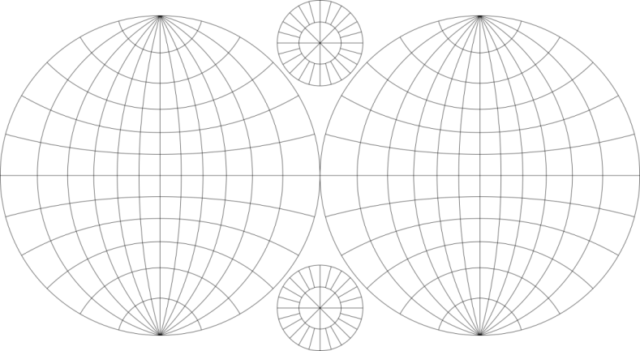
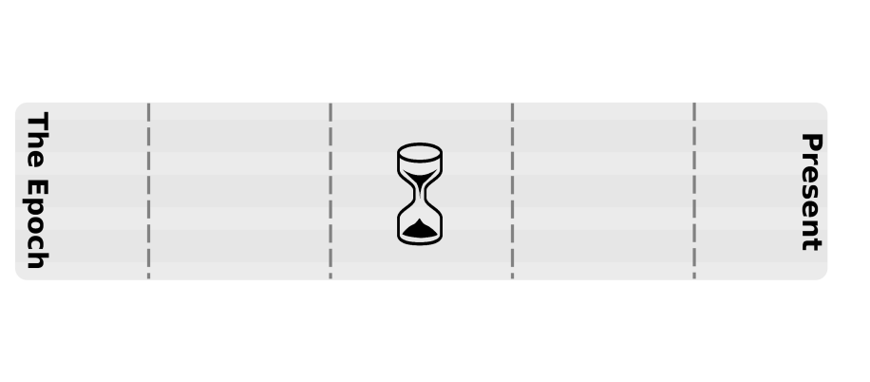
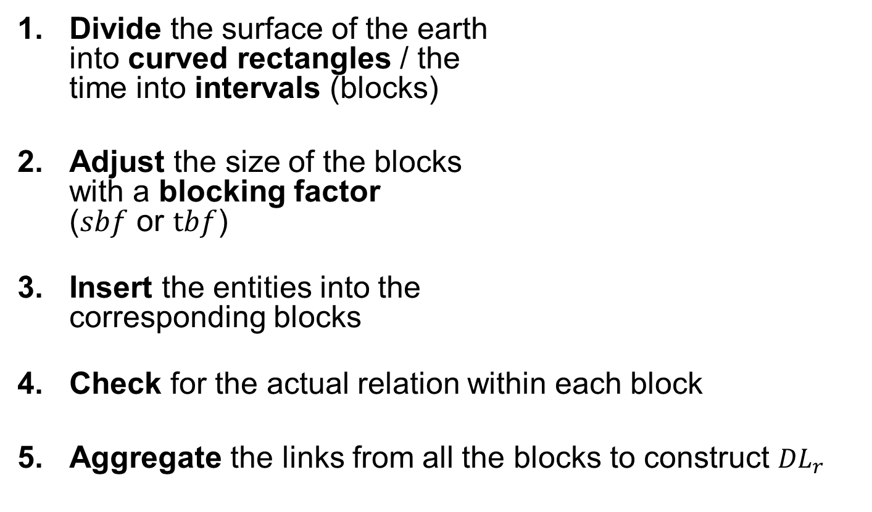
Blocking Technique (algorithm)
Divide the surface of the earth into curved rectangles / the time into intervals (blocks)
Adjust the size of the blocks with a blocking factor ($sbf$ or $tbf$)
Insert the entities into the corresponding blocks
Check for the actual relation within each block
Aggregate the links from all the blocks to construct ${DL}_{r}$

Slide 28
Blocking Technique (algorithm)
e1
b1
b2
b3
b4
e2
e1: b1, b2
e2: b2, b4
e1
e1: b1, b2
e2: b2
e2
b1
b2

Slide 29
Blocking Technique (algorithm)
Divide the surface of the earth into curved rectangles / the time into intervals (blocks)
Adjust the size of the blocks with a blocking factor ($sbf$ or $tbf$)
Insert the entities into the corresponding blocks
Check for the actual relation within each block
Aggregate the links from all the blocks to construct ${DL}_{r}$

Slide 30
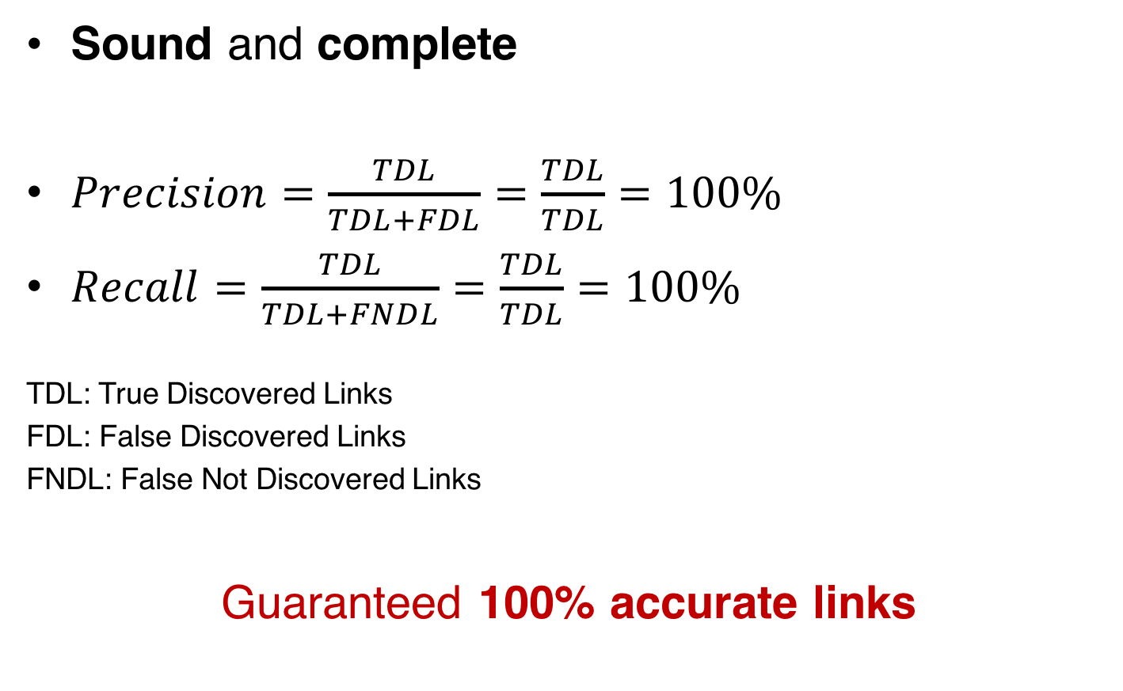
Blocking Technique (accuracy)
Sound and complete
$Precision=\frac{TDL}{TDL+FDL}=\frac{TDL}{TDL}=100\%$
$Recall=\frac{TDL}{TDL+FNDL}=\frac{TDL}{TDL}=100\%$
TDL: True Discovered Links
FDL: False Discovered Links
FNDL: False Not Discovered Links
Guaranteed 100% accurate links

Slide 31
Outline
Introduction
Background
Developed Methods
Implementation
Experimental Evaluation
Conclusions

Slide 32
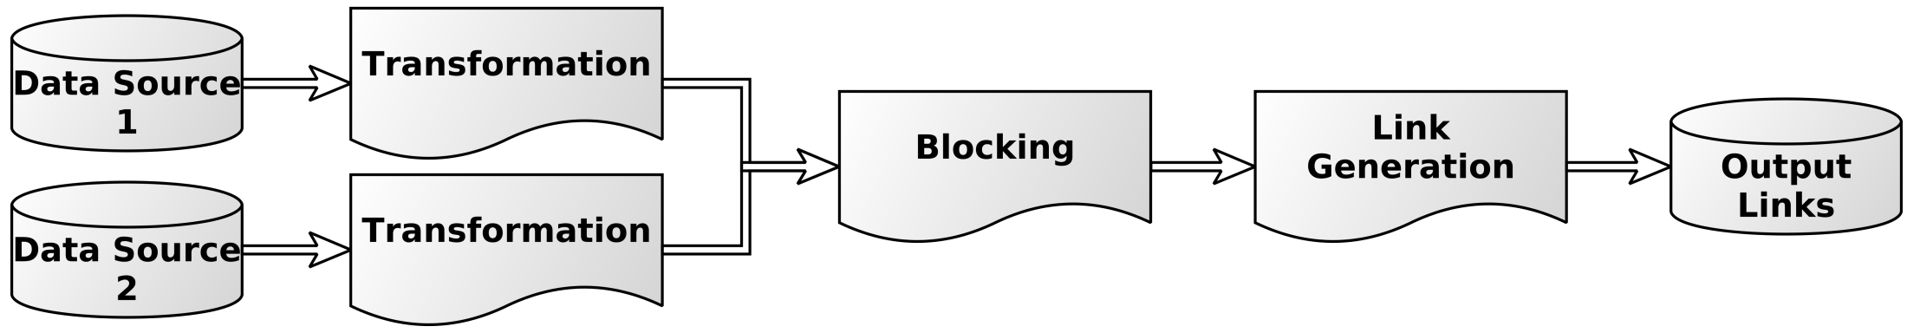
Extensions to the Silk Framework

Slide 33
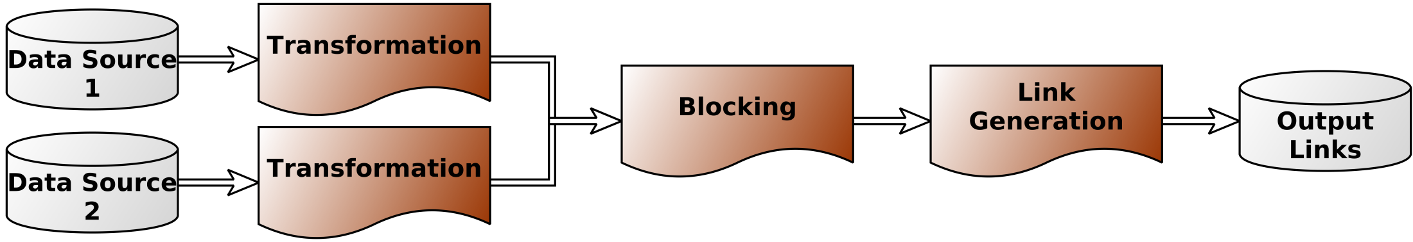
Extensions to the Silk Framework
Implemented as Plugins
Transparent to all the applications of Silk (Single Machine, MapReduce and Workbench)
Included in the the default Silk distribution (from release 2.6.1 and above)
https://github.com/silk-framework/silk

Slide 34
Outline
Introduction
Background
Developed Methods
Implementation
Experimental Evaluation
Conclusions

Slide 35
Real-world Scenario (Fire Monitoring)
Which fires (hotspots) threaten forests?
Which municipalities are threatened by fires?
Using Silk: Discover the relation intersects between HG-GAG and HG-CLCG
Dataset | #Entities | Geometries |  | Time Elements
 |  | Type | #Points | Type | #Instants
Municipalities from Greek Administrative Geography (GAG) | 325 | Polygons | 979,929 | Periods | 650
Forests from CORINE Land Cover of Greece (CLCG) | 4,868 | Polygons | 8,004,058 | Periods | 9,736
Hotspots of Greece (HG) | 37,048 | Polygons | 148,192 | Instants | 37,048

Slide 36
Real-world Scenario (Fire Monitoring)
Land Cover (CLCG) Municipalities (GAG) Fire (HG)
intersects

Slide 37
Environment of Experiments
Single machine environment
2 Intel Xeon E5620 processors, 12MB L3 cache, 2.4 GHz, 32 GB RAM, RAID-5. 4 disks, 32 MB cache, 7200 rpm
Distributed environment
cluster provided by the European Public Cloud Provider Interoute (1 Master Node + 20 Slave Nodes: 2 CPUs, 4GB RAM, 10GB disk)
More details: http://silk.di.uoa.gr

Slide 38
Experiment 1: Adjusting the Spatial Blocking Factor (sbf)

Slide 39
Experiment 2: Adjusting the number of Entities per Dataset

Slide 40
Outline
Introduction
Background
Developed Methods
Implementation
Experimental Evaluation
Conclusions

Slide 41
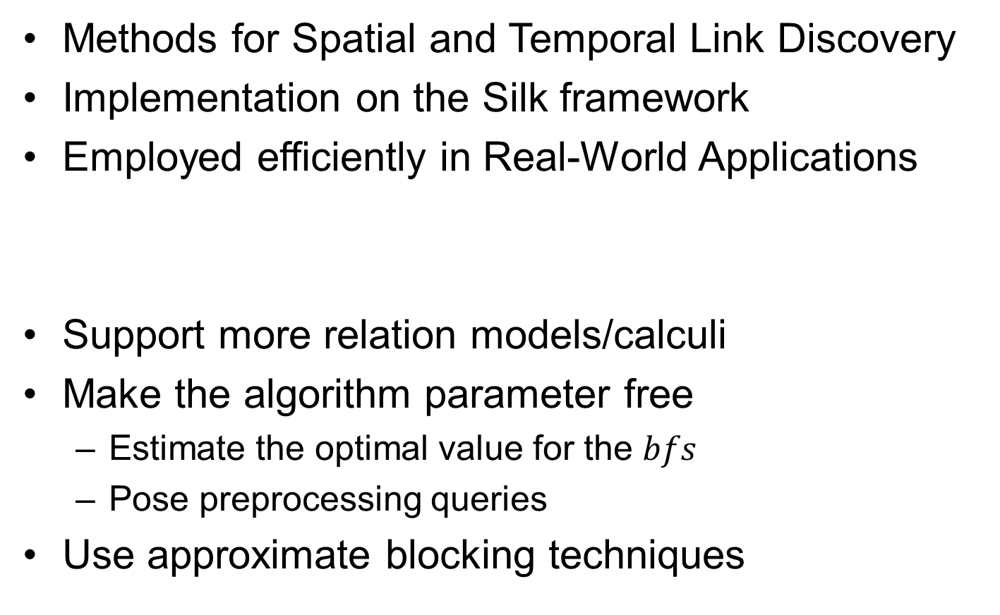
Conclusions & Future Work
Methods for Spatial and Temporal Link Discovery
Implementation on the Silk framework
Employed efficiently in Real-World Applications
Support more relation models/calculi
Make the algorithm parameter free
Estimate the optimal value for the $bfs$
Pose preprocessing queries
Use approximate blocking techniques

Slide 42
Thanks for your attention! Questions?

