Slide 1
deepschema.org: An Ontology for Typing Entities in the Web of Data
Panayiotis Smeros, Amit Gupta, Michele Catasta and Karl Aberer
LDOW ’17. 3 April, 2017. Perth, WA, Australia.

Slide 2




What is deepschema.org?
Class Hierarchy, Taxonomy
Describes all the possible environments than an entity exists in
Comprises information from Wikidata and schema.org
Main features:
generic, cross-domain
rich, evolving as fast as the Web
traversable
accurate

Slide 3
Related Work
YAGO Taxonomy
rich, evolving as fast as the Web
traversable
accurate
<wikicat_People_murdered_in_British_Columbia> rdfs:subClassOf <wordnet_person_100007846> .
Dbpedia Ontology
rich, evolving as fast as the Web
traversable
accurate
Manually constructed; Only 685 classes
Wikidata Class Hierarchy
rich, evolving as fast as the Web
traversable
accurate
Crowdsourced schema; No tree structure
schema.org
rich, evolving as fast as the Web
traversable
accurate
Manually constructed;
Used by billions of web pages
deepschema.org

Slide 4
Wikidata Class Hierarchy

Slide 5



Wikidata Class Hierarchy
Extraction Phase
RDFS Entailment Rules
A rdf:type B ⇒ class(B)
A rdfs:subClassOf B ⇒ class(A) ∧ class(B) ∧ subclass(A, B)
rdfs:subClassOf ≡ P279 (subclass of)
rdfs:type ≡ P31 (instance of)
Filtering Phase
Keep deepschema.org generic
Ontologies from domain-specific KBs
B
B
A
A
Classes with no English label

Slide 6
Structure of the Class Hierarchy
One subgraph contains 96% of the total classes and 97% of the total subclass relations
Classes | 123,033
Subclass Relations | 126,688
Disconnected Subgraphs | 4,263
Root Classes | 14,084
Leaf Classes | 102,434
Avg num of Subclasses per Class | 1.03
Avg depth of Hierarchy | 7.93

Slide 7
Number of Instances per Wikidata Class
The first class with more direct than inherited instances is human

Slide 8
Language Coverage of Wikidata Classes
support of 350 languages
For a non-English class hierarchy we get at least ~50% loss of information

Slide 9
Number of Classes per Wikidata External Contributor
50% of the classes has no provenance information

Slide 10
Integration with schema.org

Slide 11
Integration Heuristics
Exact Match
(language)^{w} → (Language)^{s}
Lemma Match
(languages)^{w} → (Language)^{s}
Head Match
(Kalapuyan languages)^{w} → (Language)^{s}
Vector Cosine Similarity
(warehouse)^{w} → (Store)^{s}
Head Similarity
(Survey motor boat)^{w} → (Vessel)^{s}
Subclass/Instance Similarity

Slide 12
Resulting pairs
deepschema.org
Cosine Similarity Threshold | # of pairs
0.5 | 15,112
0.6 | 8,494
0.7 | 7,329
0.8 | 6,120
0.9 | 5,586
schema.org
Wikidata
subClass
equivalentClass

Slide 13
Evaluation
(Accuracy, Traversability and Genericity)

Slide 14
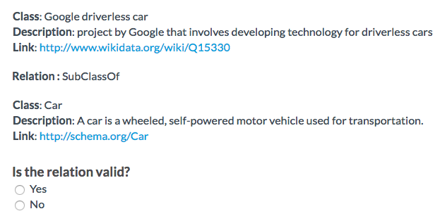
Accuracy: Crowdsourcing Evaluation
CrowdFlower Platform
~100 workers
Majority Voting (2 out of 3)

Slide 15
Accuracy: Crowdsourcing Evaluation
Wikidata: 92%
schema.org: 100% (assumed)
YAGO (Wikipedia Categories - WordΝet): 95%
PARIS (YAGO - DBpedia): 90%
Comparable with integration techniques for similar data sources

Slide 16
Traversability
False class definition ☹
partOf relations interpreted into subclassOf
Topic not covered by schema.org ☺
Class Child Abuse

Slide 17
Genericity
Oxford English Dictionary
3000 most frequent English words
Nouns and Noun Phrases
81% coverage

Slide 18

Conclusions & Future Work
Integrate more data sources
Facebook’s Open Graph
Include customizable filters
Control the granularity of the ontology
Choose specific topics of interest
Employ deepschema.org in use-cases
Discover the appropriate type (class) of an entity, given a context
deepschema.org
generic, cross-domain
rich, evolving as fast as the Web
traversable
accurate

Slide 19
Thanks for your attention! Questions?

