Slide 1
SciClops Detecting and Contextualizing Scientific Claims for Assisting Manual Fact-Checking
Panayiotis Smeros (EPFL)
Carlos Castillo (UPF)
Karl Aberer (EPFL)
International Conference on Information and Knowledge Management (CIKM’21). Queensland, Australia. 1-5 November 2021.

Slide 2





Post-truth Discourse
Ibuprofen can worsen COVID19 symptoms
2K Citations
Avoid Ibuprofen when possible
40K Retweets & Likes
WHO does not recommend against the use of Ibuprofen
8K Retweets & Likes
Political Agendas
Misinterpretation
Selective Amplification

Slide 3





Context is Everything
Granularity
Scientific Literature
SciLens (WWW '19, VLDB '20)
Heterogeneous indicators denote the credibility
of news articles
Source Adherence
Diffusion Patterns
Content
Writing Style
Quotes
Sources
Articles
Claims
Social Media
Reach
Stance
Check-Worthy Claim
SciClops (CIKM '21)
Multifaceted context supports the verification of claims
Related News
Related Papers
Fact-Checked Claims

Slide 4



Claim Extraction
Sentence Classification Model

Slide 5
Claim Extraction: Methodology
Heuristics (Grammar-Based & Context-Based)
Global Embeddings
Random Forest
Contextualized Embeddings
BERT
SciBERT (BERT + SemanticScholar)
Domain-Specific Contextualized Embeddings
NewsBERT (BERT + million-headlines) New!
SciNewsBERT (SciBERT + million-headlines) New!

Slide 6
Claim Extraction: Datasets
Training
UKP ∪ IBM
Argumentation Mining
Subsets
Generic (~22K samples)
Scientific (~32K samples)
Testing
Crowd Experiment
700 sentences
3 workers/sentence
Weak Agreement
125 claims / 174 non-claims
Strong Agreement
82 claims / 242 non-claims

Slide 7
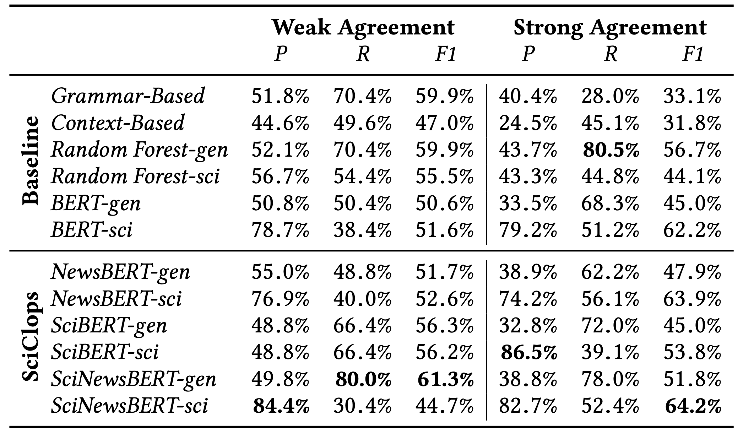
Claim Extraction: Evaluation
Best model: BERT (with domain-specific finetuning)
Lighter yet decent model: Random Forest

Slide 8



Claim-Paper Clustering
Content- & Graph-Based Model

Slide 9

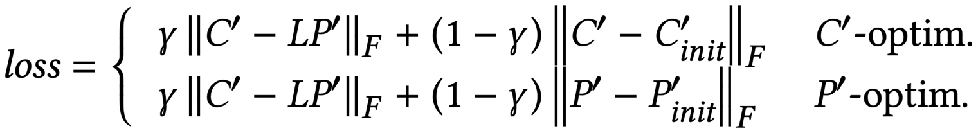
Claim-Paper Clustering: Methodology
Content-Based (Baseline)
LDA, GSDMM
GMM, K-Means
Graph-Based
Optimization
Regularizer penalizes uniformity
Hybrid
Alternate Optimization
Considers both content and graph modalities

Slide 10
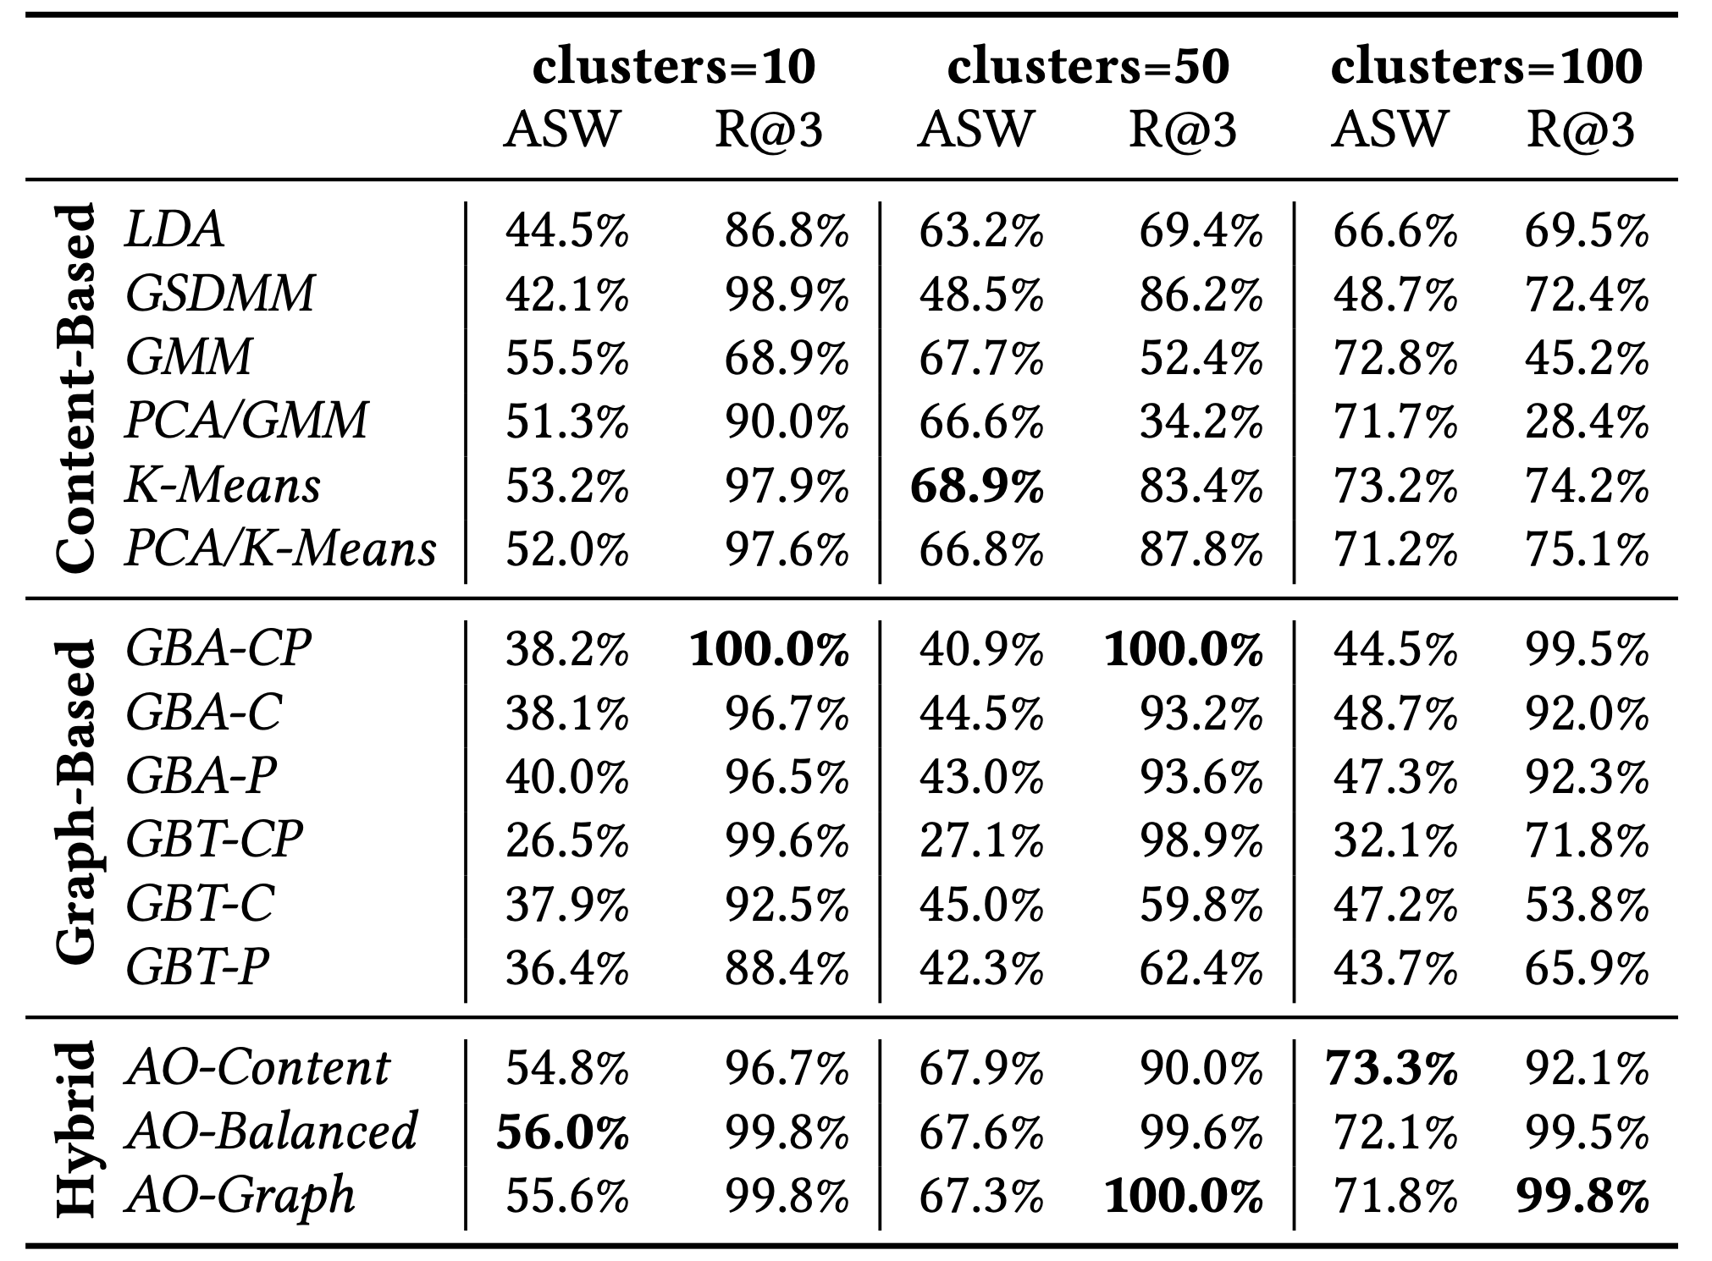
Claim-Paper Clustering: Evaluation
Average Silhouette Width (Semantic Coherence)
Link-Based Recommendation Recall@3 (Interconnection Coherence)
Best Model: Hybrid (with both modalities considered equally)

Slide 11
Check-Worthy Claim Ranking

Slide 12
Check-Worthy Claim Ranking
Knowledge Graph (CDC vocabulary)
Graph Topology
Causality-Based (e.g., symptoms vs diseases)
Aspect-Based (e.g., COVID19: origin & mortality rate)
Graph Weighting
Social Media popularity & News Outlet reputation
Claim Ranking
Betweenness Centrality or in-Degree

Slide 13
Overall Evaluation

Slide 14
Overall Evaluation: Top-40 Claims
 | RMSE
Non-Experts Without Context | 1.97
Non-Experts With Enhanced Context | 1.54
ClaimBuster | 1.74
Google Fact Check Explorer | 2.79
Experts | 1.02
Non-Experts + Enhanced Context > Commercial Systems
Enhanced Context = accuracy↑ confidence↑ effort↑

Slide 15



Overall Evaluation: Case Study
Contradictory Claims
“Marijuana does not treat chronic pain or post-traumatic stress disorder”
“Marijuana can help battle depression, anxiety, post-traumatic stress disorder, and even addictions to alcohol and painkillers”
Scientific Paper (Enhanced Context provided by SciClops)
“Marijuana use is associated with worse outcomes in symptom severity and violent behavior in patients with posttraumatic stress disorder”
 | CNN Claim | Men’s Journal Claim
Non-Experts Without Context | Borderline | Borderline
Non-Experts With Enhanced Context | Valid | Highly Invalid
ClaimBuster | Valid | Borderline
Google Fact Check Explorer | N/A | N/A
Experts | Highly Valid | Highly Invalid
Only Non-Experts with Enhanced Context identified Men’s Journal’s claim as Invalid

Slide 16
Put an eye on SciClops!
BERT-based models can effectively detect scientific claims only after domain-specific finetuning
We must exploit both content and graph modalities to build coherent claim-paper clusters
We can rank claims based on their check-worthiness using a custom Knowledge Graph
Non-experts with the appropriate context perform similarly to experts and commercial fact-checking systems
Thanks freepik.com for the images!
Thank you!

