Slide 1
SciLens Evaluating the Quality of Scientific News Articles Using Social Media and Scientific Literature Indicators
Panayiotis Smeros (EPFL)
Carlos Castillo (UPF)
Karl Aberer (EPFL)
The Web Conference 2019, San Francisco, USA

Slide 2
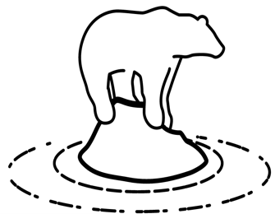

Fake Scientific News…
obesity
biscuits
aspirin
rice
hazelnuts
gold
Causes or Cures Cancer?
★☆☆☆☆
★☆☆☆☆
★☆☆☆☆
…Fake Scientific News Everywhere
★★★☆☆
(Semi) Automatic Assessment
SciLens Evaluation Methodology and Framework
?
Domain Agnostic

Slide 3




SciLens Overview
Contextual
Data Collection
Quality
Indicators
Evaluation
Scientific Literature
Scientific Literature
Source Adherence
Diffusion Graph
Semi Automatic
Indicators
★★★★☆
★★☆☆☆
☺☺
News
Articles
Baseline
Quote Based
Article’s Content
Social Media
Reach
Stance
★★★☆☆
Fully Automatic
Social Media

Slide 4



Contextual Data Collection
Seed Keywords
Assessing Nutritional Quality and Adherence to the Gluten-free Diet in Children and Adolescents with Celiac Disease
Diffusion Graph
NutritionFacts.org
WordNet
Study suggests young people with celiac disease may be eating too much processed gluten-free food
Pruning
Merging
3K keywords
Parents! Check out this new study on celiac disease!
Social Media Provider
DataStreamer.io
49K tweets
12K news articles
24K scientific papers
(Available on scilens.epfl.ch)

Slide 5
Quality Indicators

Slide 6

Quality Indicators (Article’s Content)
Quote-Based
Person Quotes
“Weasel’’ Quotes
Academic Mentions
quote
quotee
quotee affiliation
<FirstName LastName>, registered dietitian and associate professor at the Department of Agricultural Food and Nutritional Science in University of Alberta
...
Processed, gluten-free foods are very high in fats and carbohydrates because that's what gives them the flavouring and improved texture, said <LastName>.
Quote Extraction
Baseline
Title (Clickbait, Sentiment)
Article Readability
Article Length
Article Bylined?
1) Complex Regular Expressions with PoS and NER tags combined with:
say survey researcher reporting verbs claim, “study” terms analysis, “scientist” terms expert prove report director analyze discovery professor
2) Disambiguation of Persons and Organizations

Slide 7

Quality Indicators (Scientific Literature)
Should You Be Taking a Curcumin or Turmeric Supplement?
Combination of α-Tomatine and Curcumin Inhibits Growth and Induces Apoptosis in Human Prostate Cancer Cells
A PLOS ONE study did find, however, that a combination of curcumin and tomatine, an antifungal and anticancer compound in tomatoes, inhibited cell growth of prostate cancer.
Curcumin and α-tomatine alone or in combination had a small inhibitory effect on the growth of non-tumorigenic prostate epithelial RWPE-1 cells.
Fitness Magazine
PLOS ONE
Primary Source Classifier
Diffusion Graph
Personalized PageRank
Betweenness
In/Out Degree
Alexa Rank
Metrics
Jaccard similarity of the entities/dates/numbers/percentages
Cosine similarity of the GloVe embeddings
Hellinger similarity of the LDA topic vectors
Relative difference of the length in words
Granularity
Full article
Paragraph
Sentence
We consider:
positive pairs: single source = primary source
negative pairs: random samples
primary source of a multi-sourced article: the source with maximum probability

Slide 8




Quality Indicators (Social Media)
Food Babe
Monsanto Is Scrambling To Bury This Breaking Story – Don’t Let This Go Unshared!
Dangerous Glyphosates Have Infiltrated Your Pantry -- Monsanto Is Scrambling To Bury This Breaking Story
Monsanto Is Scrambling To Bury This Breaking Story – Don’t Let This Go Unshared!
that is false. She is just using their name for click-bait. Most shocking secret they don't want you to know
fooled by the foodbabe:
that is just a clickbait to sell her stuff. Do you have a more reliable source?
Stance Classifier
Popularity
Likes/Retweets/Replies
Followers/Followees
Spatial/Temporal Coverage
Datasets
SemEval 2016 (general purpose)
300 tweets annotated by crowdworkers (domain specific)
Features
total/positive/negative/negation words
total/fact-checking URLs
question/exclamation marks
similarity/sentiment of the reply and the original post
Average stance of multi-replies

Slide 9
Evaluation

Slide 10

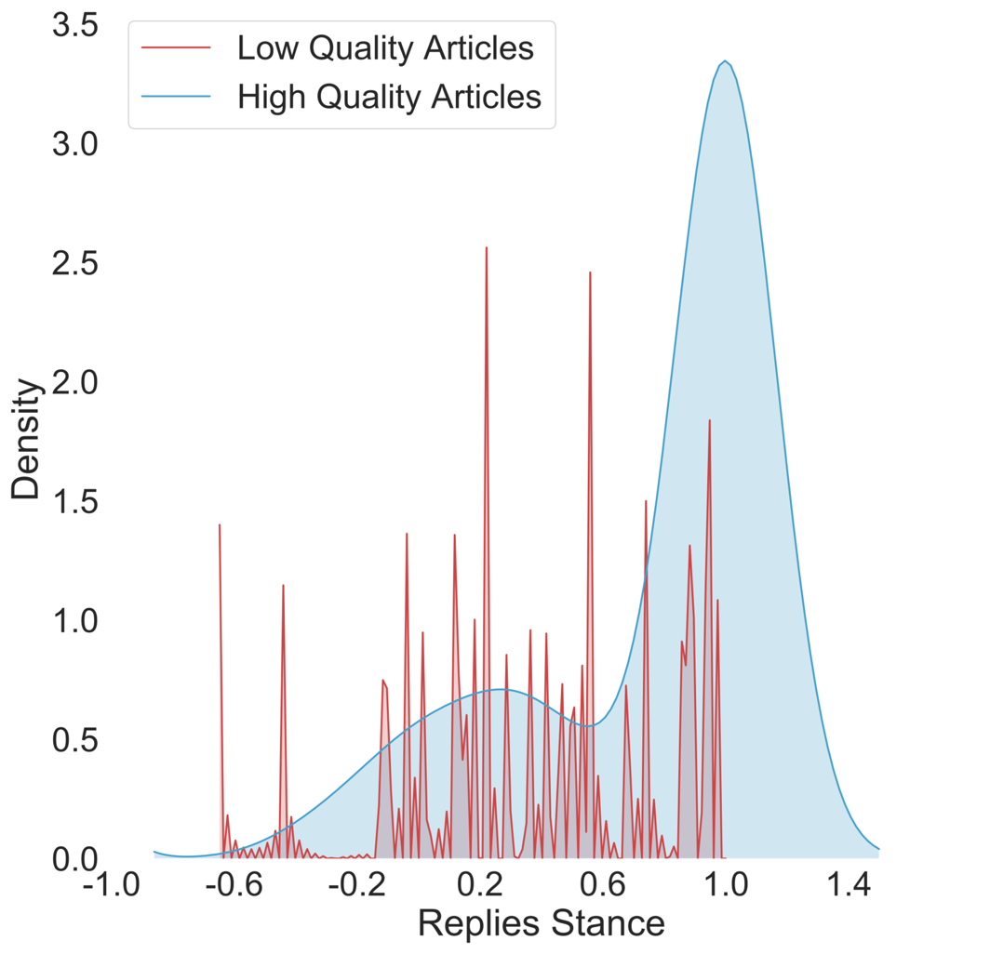
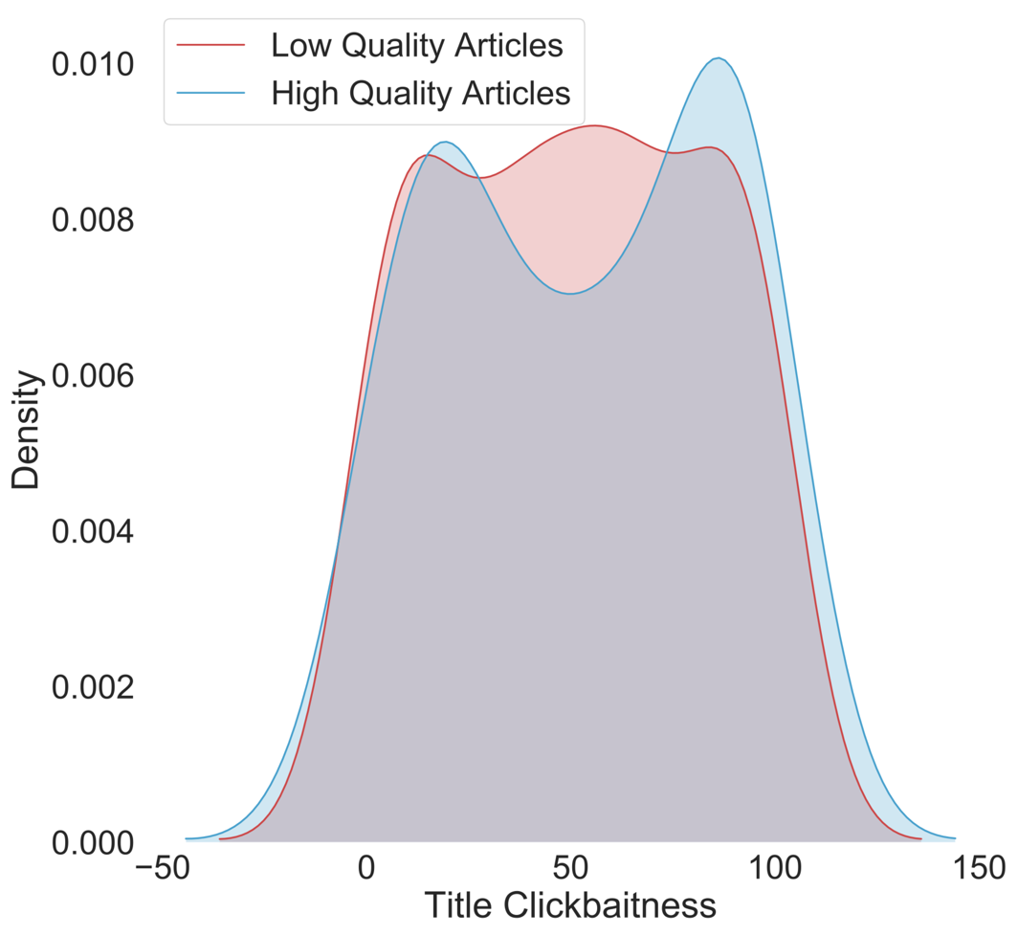
Evaluation (Indicators Utility)
evidence-driven science coverage
★★★★★ | ★★★★☆ | ★★★☆☆
★★★★☆ | ★★★☆☆ | ★★☆☆☆
★★★☆☆ | ★★☆☆☆ | ★☆☆☆☆
compelling to read
scientific quality
Replies Stance is more informative than
Title Clickbaitness

Slide 11
Evaluation (Experts vs Non-Experts)
20 articles/topic
cross-check
Alcohol, Tobacco & Caffeine (ATC)
CRISPR
★★★☆☆
2 experts/topic
update
Experts (Ground-Truth)
Non-Experts (Indicators)
Non-Experts (No Indicators)
Automatic (Model trained on Indicators)
 | RMSE (ATC) | RMSE (CRISPR)
Non-Experts (Indicators) | 1.00 | 0.96
Non-Experts (No Indicators) | 1.10 | 1.96
Automatic | 1.00 | 0.85
Indicators help Non-Experts judge better
Automatic Model judges better than Non-Experts

Slide 12



Take away
scilens.epfl.ch
Code of SciLens is… opensource
(also data, expert evaluations…)
Thank you and hope you... enjoyed the SciLens!
Thanks freepik.com for the images!

Slide 13
Backup

Slide 14
Evaluation (Indicators Computation)
 | Precision | Recall | F1
Quote Marks (Baseline) | 100% | 8.3% | 15.3%
Simple Extraction | 81.8% | 45.0% | 58.1%
Extraction & Disambiguation | 90.9% | 50.0% | 64.5%
Quote Extraction
 | SVM | RF | NN
Document-level | 88.8% | 87.4% | 88.8%
Paragraph-level | 88.9% | 82.5% | 88.4%
Sentence-level | 87.8% | 82.5% | 88.2%
All three combined | 91.1% | 93.5% | 91.3%
 | Supporting/ Commenting | Contradicting/ Questioning
Supporting/Commenting | 80.65% | 19.35%
Contradicting/Questioning | 19.51% | 80.49%
Source Classification (accuracy)
Stance Classification (confusion matrix)

Slide 15
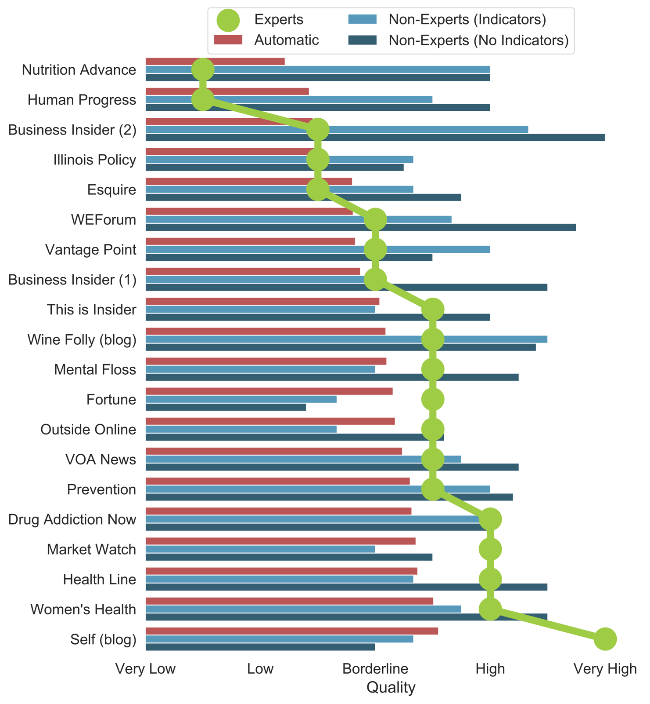
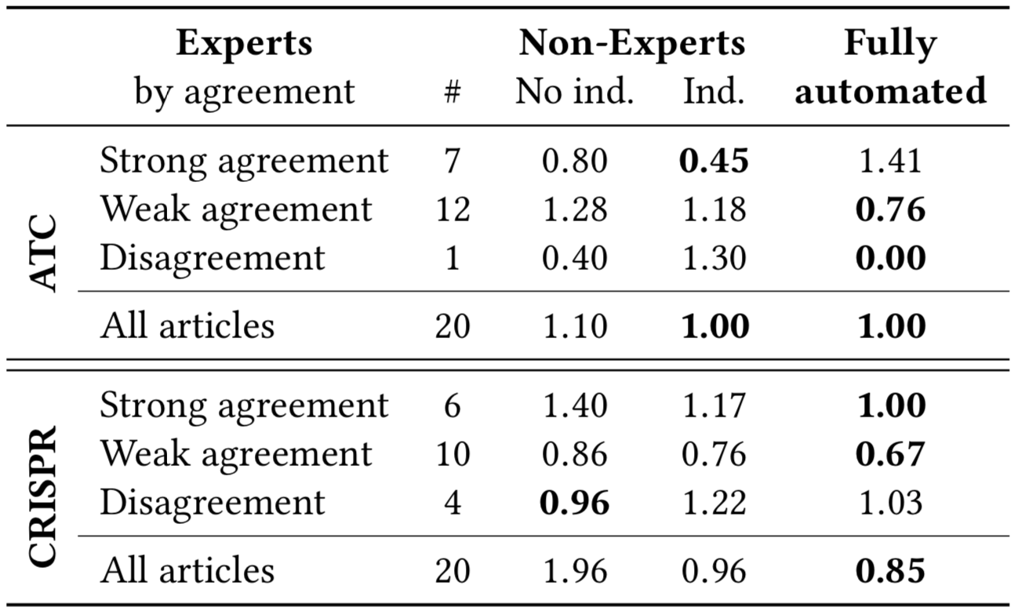
Experts vs Non-Experts

Slide 16
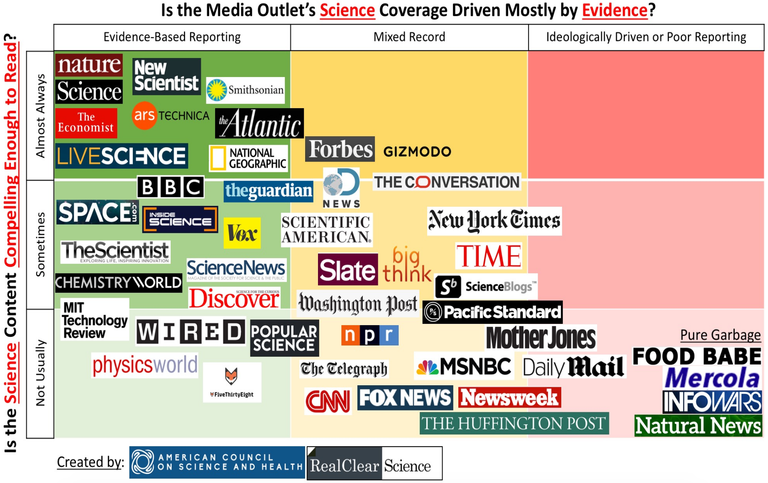
American Council on Science and Health

