Slide 1



VK26-IITH-SM-0180
github.com/psmithul/tensegrity-rover
Notes:
Build basis: the supplied 43-line BOM totals INR 44,069.06, without a reserve. The team confirmed four driven wheels and two passive wheels, six DS3225 preload servos, Teensy 4.0 and Raspberry Pi Pico. The 30 kg mass and 6 mm screw travel are design targets. The CAD images remain reference geometry. The team proposal and CY06 drawings establish the inspection-rover concept.

Slide 2
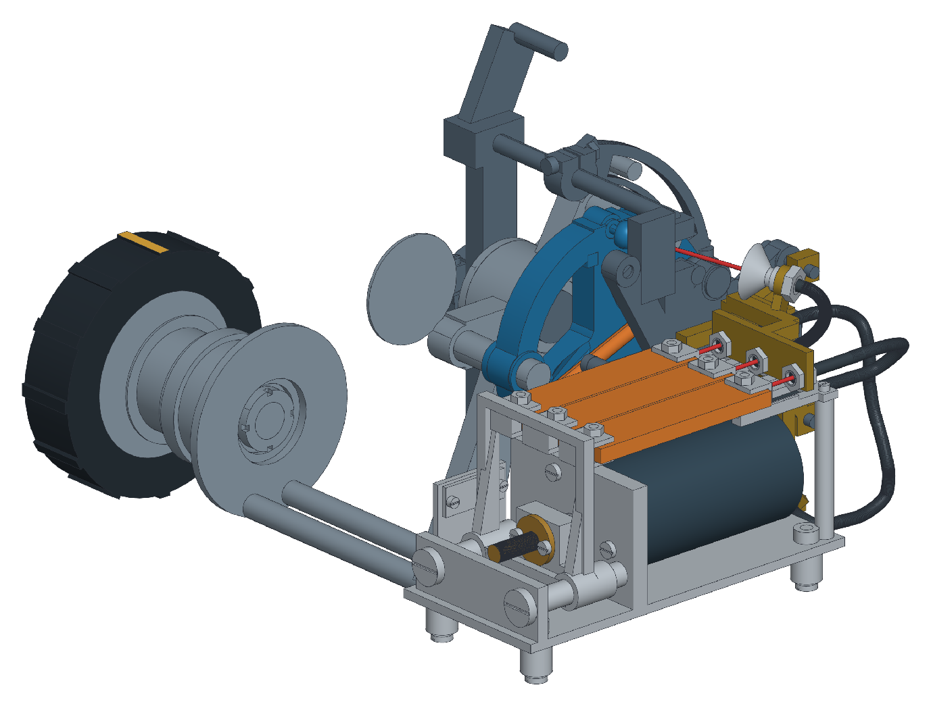
Problem Context
Project overview
Adaptive tensegrity suspension
for rough-terrain inspection
Team ID: VK26-IITH-SM-0180
Track: Sustainable Mining
Autonomous Subterranean & Rough-Terrain Exploration
Faculty mentor: Sanjeevi Nakka
Problem
Rough ground shakes the cameras and electronics carried by an inspection rover. Slowing down can reduce excitation, but increases the time needed to cover a route.
Target users: mine-inspection teams and rough-terrain robotics developers.
CAD of one complete suspension joint [AI Edited Image]
Core innovation: change joint preload using measured vibration, then select a suitable travel speed.
Notes:
Build basis: the supplied 43-line BOM totals INR 44,069.06, without a reserve. The team confirmed four driven wheels and two passive wheels, six DS3225 preload servos, Teensy 4.0 and Raspberry Pi Pico. The 30 kg mass and 6 mm screw travel are design targets. The CAD images remain reference geometry. The problem is vibration reaching inspection cameras and electronics over uneven ground. The image and its AI-edited label are retained from the team-edited source deck.

Slide 3
User Journey
Before: fixed suspension
Rover reaches
rough ground
Vibration rises
Operator reduces
speed
Route takes
longer
Illustrative travel time: 10 m takes 100 s at 0.10 m/s, or 200 s after slowing to 0.05 m/s.
After: vibration-aware preload and speed control
Measure chassis
vibration
Stop.
Change preload
Verify position
and holding locks
Recheck vibration.
Choose speed
Test goal: at least 20% lower chassis RMS acceleration at matched speed than fixed preload.
Notes:
Build basis: the supplied 43-line BOM totals INR 44,069.06, without a reserve. The team confirmed four driven wheels and two passive wheels, six DS3225 preload servos, Teensy 4.0 and Raspberry Pi Pico. The 30 kg mass and 6 mm screw travel are design targets. The CAD images remain reference geometry. The travel-time illustration uses 10 m / 0.10 m/s = 100 s and 10 m / 0.05 m/s = 200 s. It excludes acceleration and adjustment stops. The 20% RMS reduction is an initial test goal, not an achieved result.

Slide 4
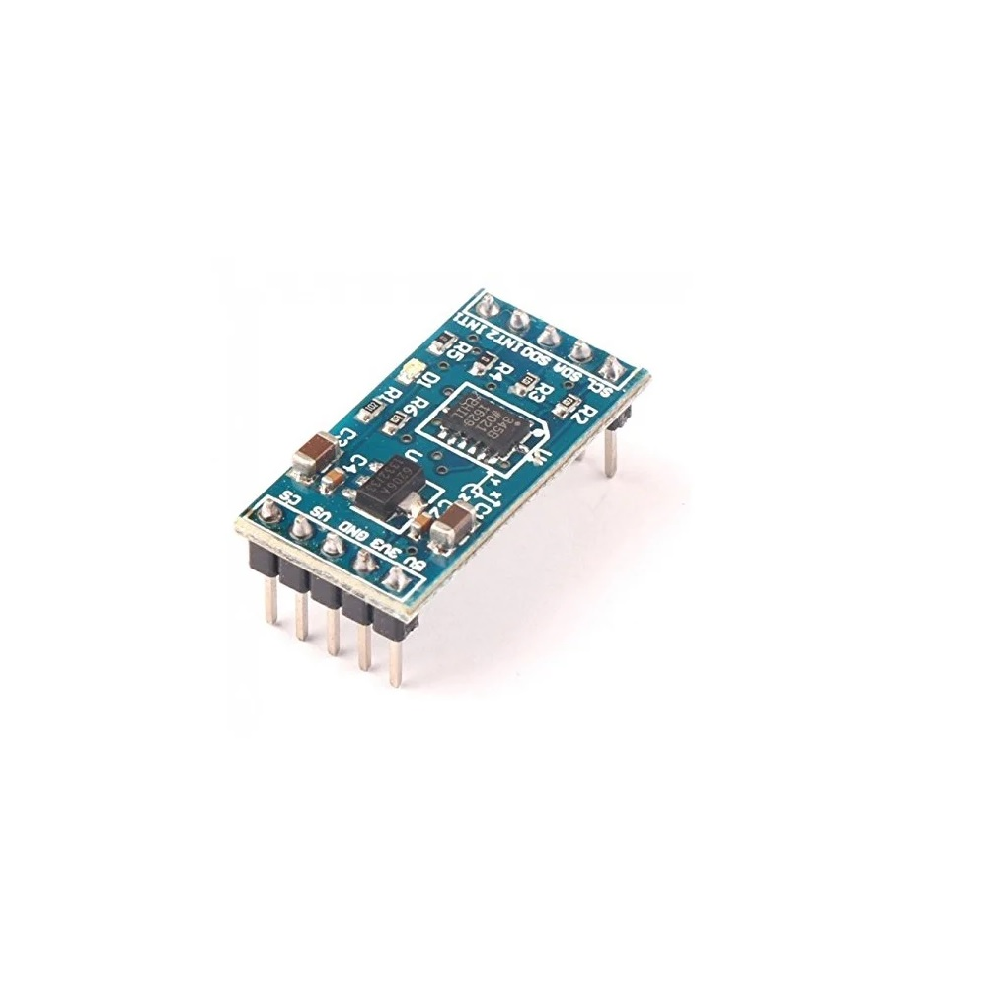
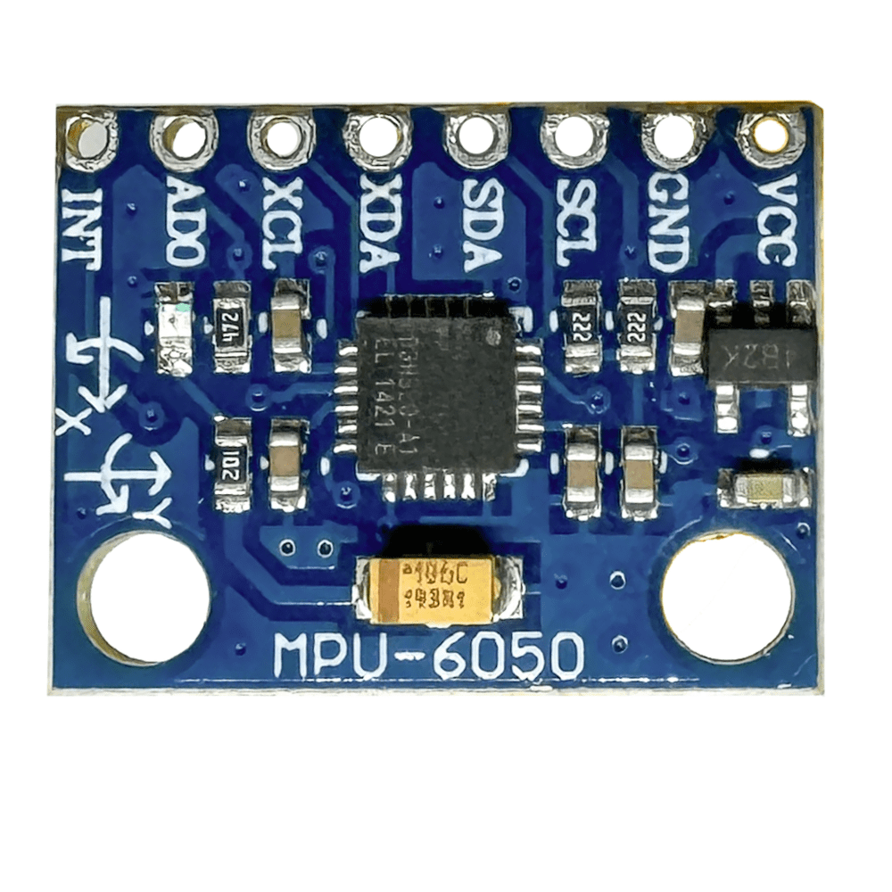
System Architecture & Specs
Mechanical structure
520 mm chassis, 6 suspension joints
83 mm wheels
Teensy 4.0 + Pico RP2040
Vibration, logging and drive control
3S LiPo, 11.1 V nominal
Regulation, isolation and E-stop
3 ADXL345 + MPU6050
Chassis and left/right middle carriers
6 DS3225 preload servos
6 PCA9685 command boards
4 Johnson 300 rpm drives
4 BTS7960, 2 passive wheels
Teensy handles vibration and preload commands. Pico controls four drive motors. Stop before adjusting preload, verify the holding locks and then recheck vibration. ESP32-CAM provides the camera view.
Testing: log three ADXL345 sensors at 800 samples/s on the chassis and two middle carriers. Use the listed OE-28 as one reference-wheel encoder. Repeat fixed and adaptive tests at matched speed.
ADXL345 MPU6050
Notes:
Build basis: the supplied 43-line BOM totals INR 44,069.06, without a reserve. The team confirmed four driven wheels and two passive wheels, six DS3225 preload servos, Teensy 4.0 and Raspberry Pi Pico. The 30 kg mass and 6 mm screw travel are design targets. The CAD images remain reference geometry. Proposed controller roles: Teensy handles vibration logging and preload commands; Pico controls the four DC drives. Three ADXL345 sensors measure vibration and MPU6050 provides attitude. One OE-28 is listed, so four independent measured wheel speeds are not claimed. ESP32-CAM is the camera. Sources: https://www.pjrc.com/store/teensy40.html https://datasheets.raspberrypi.com/pico/pico-datasheet.pdf https://www.nxp.com/docs/en/data-sheet/PCA9685.pdf

Slide 5
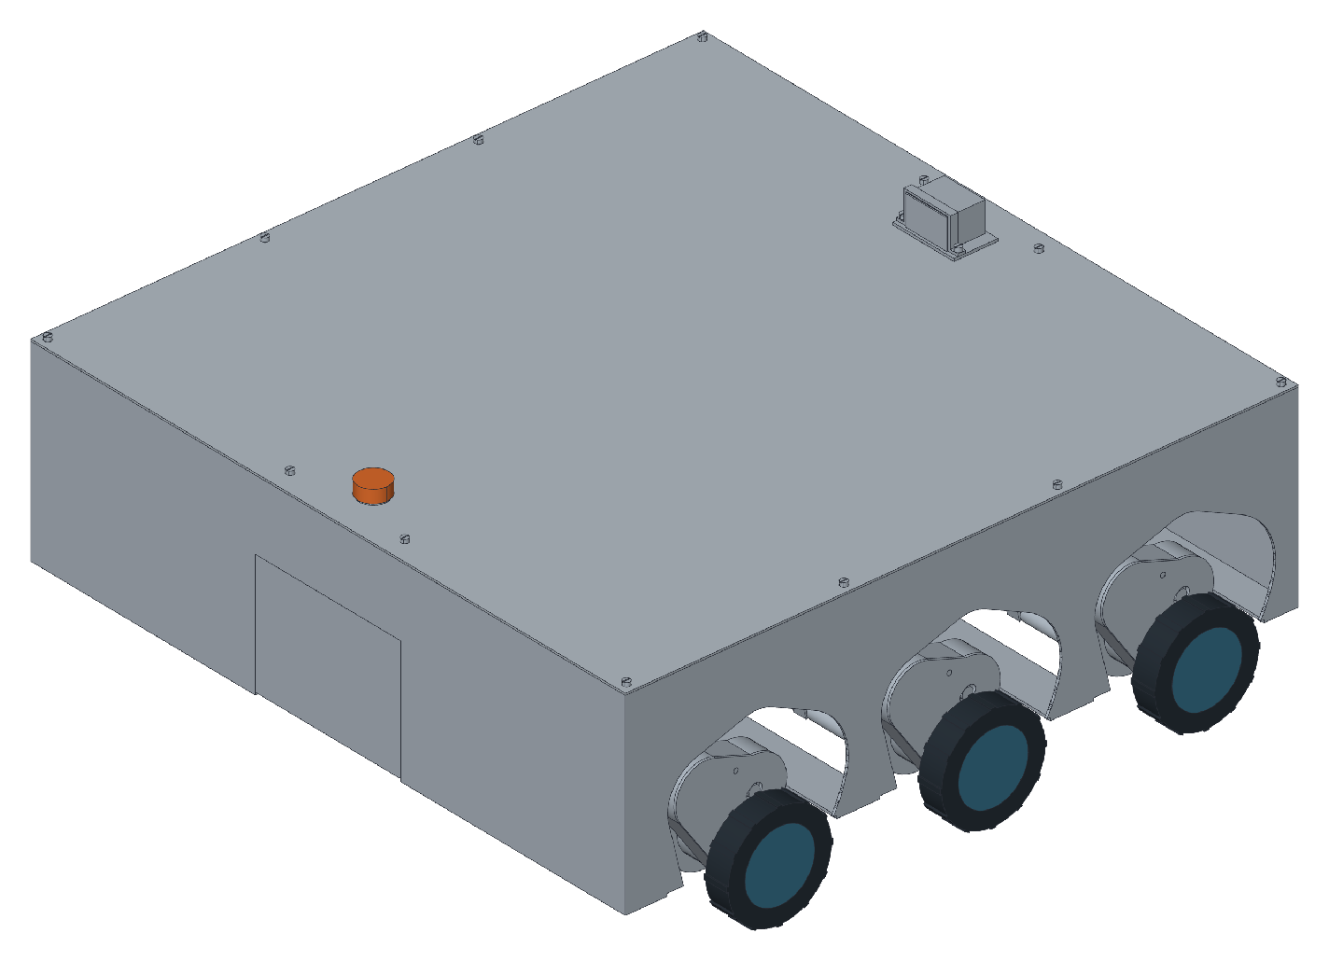
System Architecture & Specs
Parameter | BOM specification / design target
Total mass | 30 kg design case, including battery and payload
Geometry | 520 mm chassis, six 83 mm wheels
Suspension | 6 passive joints, 6 DS3225 preload servos
Wheel drives | 4 × Johnson 12 V, 300 rpm; 2 passive wheels
Motor control | 4 × BTS7960; 6 × PCA9685
Controllers | Teensy 4.0 + Raspberry Pi Pico RP2040
Sensors / links | 3 ADXL345, MPU6050; SPI, I²C and UART
Travel speed | 1.304 m/s at nominal 300 rpm, before load losses
Battery / energy | 2 × 11.1 V, 2.5 Ah LiPo; 27.75 Wh per pack
Complete rover CAD [AI Edited Image]
Preload: 6 mm travel on the M6 × 0.5 screw requires 12 turns.
Notes:
Build basis: the supplied 43-line BOM totals INR 44,069.06, without a reserve. The team confirmed four driven wheels and two passive wheels, six DS3225 preload servos, Teensy 4.0 and Raspberry Pi Pico. The 30 kg mass and 6 mm screw travel are design targets. The CAD images remain reference geometry. Motion calculations assume 1:1 drive transmission: circumference = pi × 0.083 = 0.260752 m; speed at nominal 300 rpm = 1.303761 m/s. Targets of 0.05 and 0.10 m/s require 11.505 and 23.010 wheel rpm. These are arithmetic values, not measured loaded speeds. The supplier catalogue lists 34.2 Ncm = 0.342 Nm motor torque; four equal drives give an ideal 32.964 N of traction before losses. No terrain or slope capability is claimed. Each linked 3S 2500 mAh, 3C pack has 11.1 × 2.5 = 27.75 Wh nominal energy and a 7.5 A continuous rating. Two purchased packs total 55.5 Wh of inventory. An initial proposal uses one active pack and one disconnected spare; no combined pack arrangement or runtime is approved. Retained screw travel: 6 / 0.5 = 12 revolutions. Confirm actual servo output rotation, transmission and adjustment time. Sources: https://robu.in/product/grade-a-quality-orange-12v-300-rpm-johnson-geared-dc-motor/ https://robu.in/product-category/johnson-motor/ https://robu.in/product/orange-11-1v-2500mah-3c-3s-tx-lithium-polymer-battery-pack-with-jst-bec-connector/ https://www.dsservo.com/d_file/DS3225%20datasheet.pdf

Slide 6
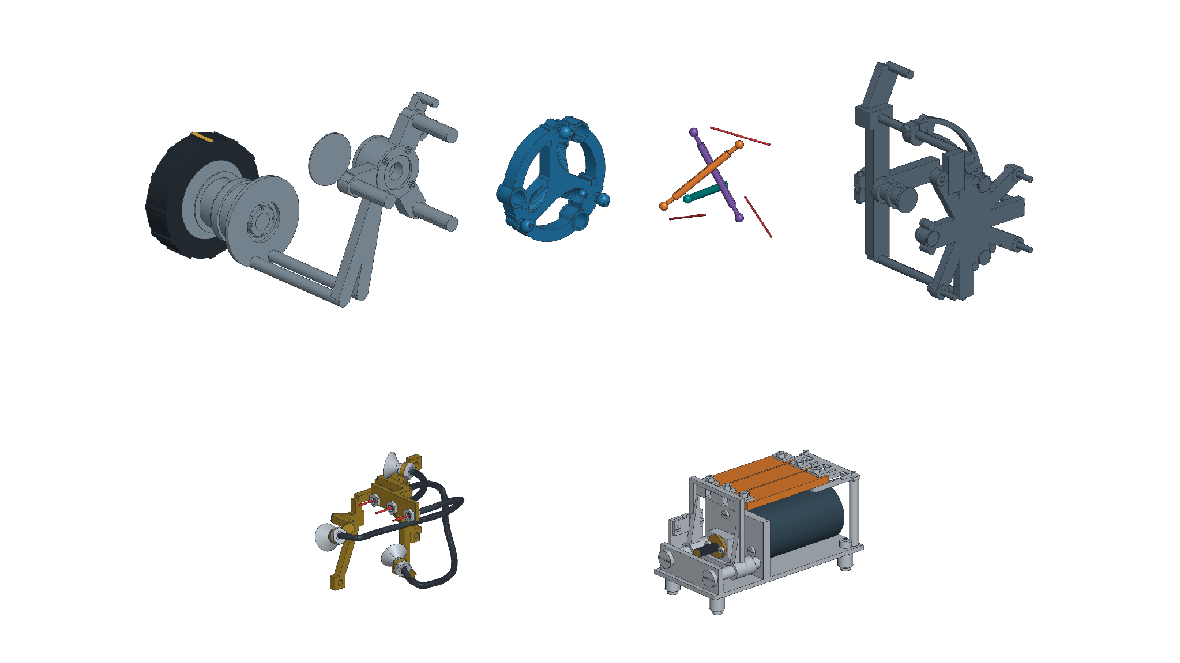
CAD Design & Mechanical Specs
Assembled joint
Exploded mechanical components
Wheel carrier
Floating frame
Compression struts
Fixed frame
Wheel
Tension cable
Elastic strips
Preload motor
Cable guides
Lead screw
Load path
Suspension motion
Variable stiffness
Rigid struts carry compression. Cable and elastic paths carry tension through supported anchors and guides.
A bump rotates the carrier about the suspension pivot. Struts reorient and elastic paths extend; wheel spin drives travel.
Six servos are planned for preload adjustment. The screw-travel target remains 6 mm. Verify the output rotation, linkage and positive holding lock.
[AI Edited Images]
Notes:
Build basis: the supplied 43-line BOM totals INR 44,069.06, without a reserve. The team confirmed four driven wheels and two passive wheels, six DS3225 preload servos, Teensy 4.0 and Raspberry Pi Pico. The 30 kg mass and 6 mm screw travel are design targets. The CAD images remain reference geometry. The bearing-guided tensegrity-inspired joint uses compression struts and pretensioned cable/elastic paths. Terrain-induced carrier rotation deforms the elastic paths; wheel spin is a separate degree of freedom. Six servos are planned for preload adjustment while stopped. The CAD image still shows a gearmotor/screw concept, with projected part locations used for the labels. The motor and selected thrust-bearing interfaces require adaptation. The lead screw is inside the opaque assembly. Exploded positions identify parts rather than operating poses. Stiffness, damping and loaded travel remain to be measured. Research sources: https://doi.org/10.5194/ms-4-139-2013 and https://doi.org/10.1002/aisy.202200025 .

Slide 7
CAD Design & Mechanical Specs
Preliminary load screening
Material and manufacturing choices
Load case | Calculation
30 kg rover weight | 30 × 9.81 = 294.30 N
Six equal wheel contacts | 294.30 / 6 = 49.05 N per wheel
Three equal wheel contacts | 294.30 / 3 = 98.10 N per wheel
Provisional 3× static screen | 3 × 98.10 = 294.30 N per wheel
65 mm perpendicular lever | 294.30 × 0.065 = 19.13 Nm
Solid Ø12 mm, bending only | 32M/(πd³) = 112.8 MPa
Part group | Proposed route / reason
Loaded frames and plates | Flat-cut aluminium, final grade verified before release
Shafts, hubs and bearing seats | Metal shafts and hubs. Adapt thrust seats to 51100 bearings, 10 × 24 × 9 mm.
Trays, covers and sensor mounts | PETG printing for low loads and repairability
Elastic elements / tyre trials | TPU or cut elastomer, force/creep tests required
Critical locations: suspension-pivot shaft, bearing seats, ball-link ends, cable anchors and preload-nut supports.
Stock: 3 kg PETG and 1 kg TPU. Aluminium: 7.128 kg sheet/plate + 1.018 kg hub bar = 8.146 kg raw stock.
Notes:
Build basis: the supplied 43-line BOM totals INR 44,069.06, without a reserve. The team confirmed four driven wheels and two passive wheels, six DS3225 preload servos, Teensy 4.0 and Raspberry Pi Pico. The 30 kg mass and 6 mm screw travel are design targets. The CAD images remain reference geometry. Hand calculations use g = 9.81 m/s². Weight = 294.30 N. Equal six-contact and three-contact loads are 49.05 N and 98.10 N. A provisional factor of three on the latter gives 294.30 N per wheel. A 65 mm perpendicular arm gives 19.1295 Nm. A solid 12 mm shaft gives 112.763 MPa nominal bending stress, excluding holes, stress concentrations, fatigue and buckling. These screens are not FEA or a certified capacity. At an assumed aluminium density of 2700 kg/m³, the three sheet/plate blanks weigh 1.944 + 3.888 + 1.296 = 7.128 kg. The 40 mm diameter × 300 mm bar weighs 1.018 kg, bringing raw aluminium to 8.146 kg. These are stock allowances, not finished rover mass. The BOM has 24 radial bearings of 12 × 28 × 8 mm. Its six 51100 thrust bearings are 10 × 24 × 9 mm and need revised seats, journals and covers. Source: https://eshop.ntn-snr.com/en/product/51100-SNR/51100

Slide 8
Electronics Schematics & BOM
3S LiPo pack
11.1 V nominal
Fuse / isolator
INA219 sense path
NC E-stop
Motor-power relay
4 BTS7960 boards
4 wheel-drive motors
5 V / 3.3 V regulation
Teensy 4.0 + Pico
6 PCA9685 / 6 preload servos
Sensors, one OE-28 and SD
Interface | Pin / channel assignment
Wheel drives / encoder | Pico GP2–9: four RPWM/LPWM pairs. OE-28 A/B: GP10/11.
Controller link / vibration SPI | Pico UART0 GP0/1 to Teensy Serial1 0/1. SPI 13/11/12; ADXL CS2/3/4, SD CS5.
Preload servo commands | Six PCA9685: 0x40, 0x42–0x46. CH0 on each board, 50 Hz, one servo per joint.
I²C, limits and locks | Teensy SDA18/SCL19. MCP0x20/21, MPU0x68, INA0x41. 12 NC limits + 6 lock inputs.
Analog feedback / disable | Teensy A0/A1: 8 driver diagnostics + 6 Hall inputs. Pins 6/7: driver buffer / PCA disable.
Notes:
Build basis: the supplied 43-line BOM totals INR 44,069.06, without a reserve. The team confirmed four driven wheels and two passive wheels, six DS3225 preload servos, Teensy 4.0 and Raspberry Pi Pico. The 30 kg mass and 6 mm screw travel are design targets. The CAD images remain reference geometry. Proposed wiring, not a released EDA schematic. Pico GP2/3, GP4/5, GP6/7 and GP8/9 provide the four RPWM/LPWM pairs. One conditioned OE-28 encoder uses GP10/11. Cross the UART link: Pico GP0 TX to Teensy pin 0 RX1; Teensy pin 1 TX1 to Pico GP1 RX. Teensy SPI uses SCK13, MOSI11 and MISO12; ADXL chip selects are 2/3/4 and microSD CS5. I²C uses SDA18/SCL19. Six PCA9685 boards use addresses 0x40 and 0x42–0x46, one CH0 at 50 Hz per servo. INA219 uses 0x41, MCP23017 uses 0x20/0x21 and MPU6050 uses 0x68. The PCA address gap avoids an INA219 conflict. Two analog mux banks feed A0/A1 with eight BTS diagnostic signals and six Hall signals; a qualified battery divider can use A2. MCP 0x20 allocates GPA0 to common arm and GPA1–7/GPB0–4 to twelve NC limits. MCP 0x21 allocates GPA0–5 to six lock inputs and GPB0–3 to shared mux selection. Pins 6/7 control the driver-buffer and PCA output disables. All MCU, I²C and ADC signals must remain within 3.3 V limits. Output buffers do not protect return inputs. Six simultaneous servo stalls at the standard datasheet value of 1.9 A at 5 V total 11.4 A, exceeding the listed 5 A converter. Confirm the actual servo variant and qualify supply capacity and cooling. Do not power servos directly from 3S LiPo or charge LiPo with the listed VRLA charger. The INA219 module does not establish a 50 A current path; confirm the shunt, range and wiring. Only one encoder and one ring magnet are listed, so feedback coverage remains incomplete. Sources: https://www.pjrc.com/store/teensy40.html https://datasheets.raspberrypi.com/pico/pico-datasheet.pdf https://www.nxp.com/docs/en/data-sheet/PCA9685.pdf https://www.ti.com/lit/ds/symlink/ina219.pdf https://www.dsservo.com/d_file/DS3225%20datasheet.pdf

Slide 9
Electronics Schematics & BOM
Supplied BOM total: ₹44,069.06
Full source BOM
Part / model | Qty | Unit ₹ | Line ₹ | Supplier | Delivery
Johnson 12 V, 300 rpm motor | 4 | 583.00 | 2,332.00 | Robu | RFQ
DS3225 preload servo | 6 | 1,409.00 | 8,454.00 | Robu | RFQ
PCA9685 servo driver | 6 | 249.00 | 1,494.00 | Robu | RFQ
BTS7960 H-bridge driver | 4 | 329.00 | 1,316.00 | Robu | RFQ
Raspberry Pi Pico RP2040 | 1 | 384.00 | 384.00 | Robu | RFQ
Teensy controller | 1 | 2,785.00 | 2,785.00 | Robocraze | RFQ
ADXL345 accelerometer module | 3 | 255.00 | 765.00 | Robocraze | RFQ
MPU6050 sensor module | 1 | 173.00 | 173.00 | Robokits | RFQ
Encoder circuit set | 1 | 300.00 | 300.00 | Unquoted | RFQ
74HCT245 buffer | 4 | 149.00 | 596.00 | Robu | RFQ
MCP23017 I/O expander | 2 | 332.00 | 664.00 | FlyRobo | RFQ
CD74HC4067 analog mux | 2 | 50.00 | 100.00 | Robu | RFQ
Input conditioning circuit set | 1 | 400.00 | 400.00 | Unquoted | RFQ
Linear Hall sensor module | 6 | 40.00 | 240.00 | Robu | RFQ
KW11 NC limits, pack of 2 | 6 | 29.00 | 174.00 | Robu | RFQ
SPI microSD reader | 1 | 40.00 | 40.00 | FlyRobo | RFQ
16 GB Class 10 microSD | 1 | 499.00 | 499.00 | Hubtronics | RFQ
Li-Po battery | 2 | 1,700.00 | 3,400.00 | Robu | RFQ
13.8 V VRLA charger | 1 | 249.00 | 249.00 | MakerBazar | RFQ
EF40-1A-12V power relay | 1 | 76.70 | 76.70 | Rajiv Elec. | RFQ
Relay connection set | 1 | 70.00 | 70.00 | Rajiv/local | RFQ
NC emergency-stop switch | 1 | 109.00 | 109.00 | Robu | RFQ
Part / model | Qty | Unit ₹ | Line ₹ | Supplier | Delivery
K800 ring magnet | 1 | 29.00 | 29.00 | Robu | RFQ
5 V DC/DC regulator | 1 | 93.00 | 93.00 | FlyRobo | RFQ
3.3 V regulator set | 1 | 50.00 | 50.00 | Unquoted | RFQ
ESP32-CAM camera | 1 | 750.00 | 750.00 | Robocraze | RFQ
Power harness set | 1 | 900.00 | 900.00 | Robu/local | RFQ
Signal harness set | 1 | 700.00 | 700.00 | ProBots | RFQ
NC lock switches, pack of 2 | 3 | 29.00 | 87.00 | Robu | RFQ
Battery energy measurement kit | 1 | 139.00 | 139.00 | Robu | RFQ
OE-28 rotary encoder | 1 | 500.00 | 500.00 | Robu | RFQ
Aluminium sheet and plate | 1 | 3,304.00 | 3,304.00 | Rajesh Al. | RFQ
Aluminium Ø40×300 mm bar | 1 | 708.00 | 708.00 | Rajesh Al. | RFQ
Steel and brass stock | 1 | 1,534.00 | 1,534.00 | India stock | RFQ
40×20×2 mm lock tube | 2 | 206.50 | 413.00 | Manish St. | RFQ
Polymer stock | 1 | 1,062.00 | 1,062.00 | Robu/local | RFQ
PETG 1 kg spool | 3 | 798.86 | 2,396.58 | DreamPoly. | RFQ
TPU 95A 1 kg spool | 1 | 1,414.82 | 1,414.82 | 3D Master | RFQ
Tension cable and fittings | 1 | 944.00 | 944.00 | EBMP India | RFQ
Radial bearing 12×28×8 mm | 24 | 21.00 | 504.00 | Omrook | RFQ
51100 thrust bearing | 6 | 102.66 | 615.96 | Omrook | RFQ
M2-M6 fasteners and inserts | 1 | 2,832.00 | 2,832.00 | Local stock | RFQ
Assembly consumables | 1 | 472.00 | 472.00 | Joy Guru | RFQ
Notes:
Build basis: the supplied 43-line BOM totals INR 44,069.06, without a reserve. The team confirmed four driven wheels and two passive wheels, six DS3225 preload servos, Teensy 4.0 and Raspberry Pi Pico. The 30 kg mass and 6 mm screw travel are design targets. The CAD images remain reference geometry. All 43 quantities, unit prices and line totals are retained from the supplied deck. Items 1–31 total INR 27,868.70 and items 32–43 total INR 16,200.36, summing to INR 44,069.06. No shipping, reserve or additional workshop charge is inserted. The servo description is shortened without changing its quantity, price or supplier link. The linked listing names an 180-degree version; the team expects greater rotation, so the delivered variant must be confirmed. Compatible charging, servo power, current measurement and mechanical interfaces remain build-release items. Procurement source: https://docs.google.com/spreadsheets/d/1MgeOaRzbr-E_Y6dmaOskiG0FE6D-4ZNo4FLduEJ5raw/edit?gid=2130847794#gid=2130847794

Slide 10
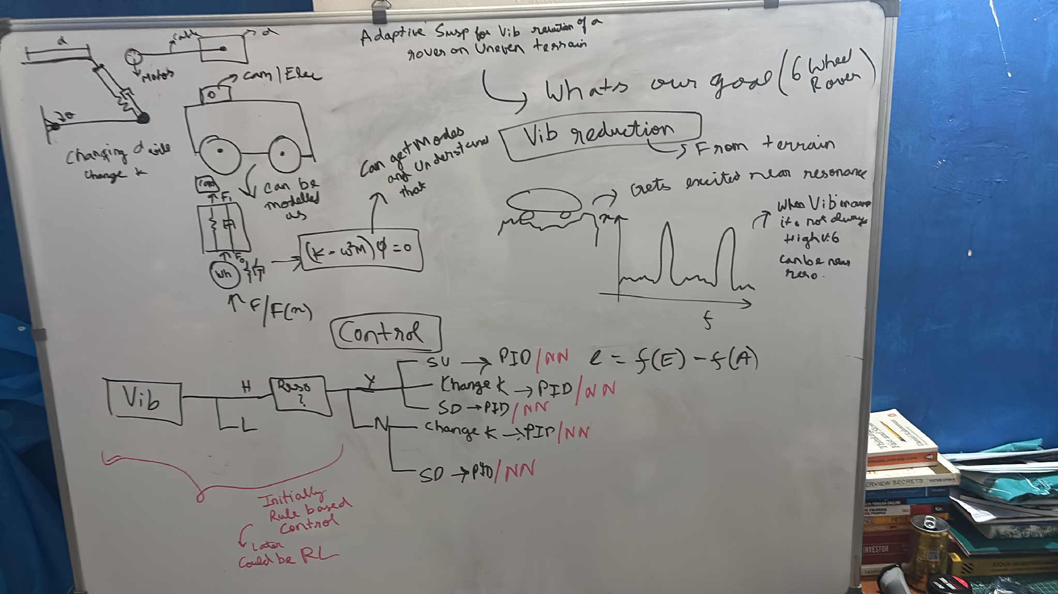
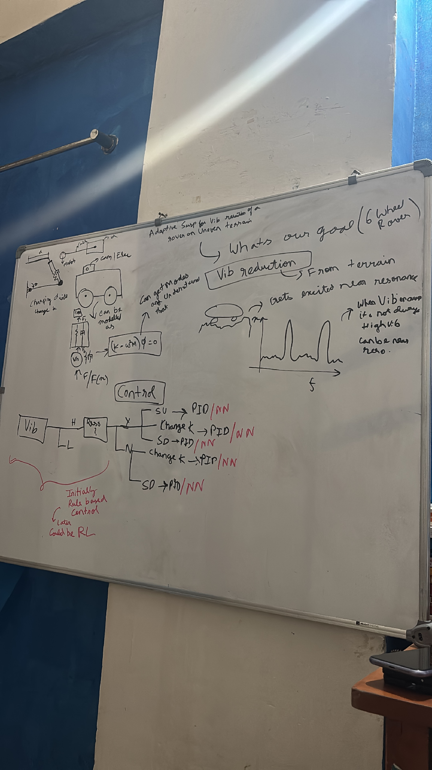
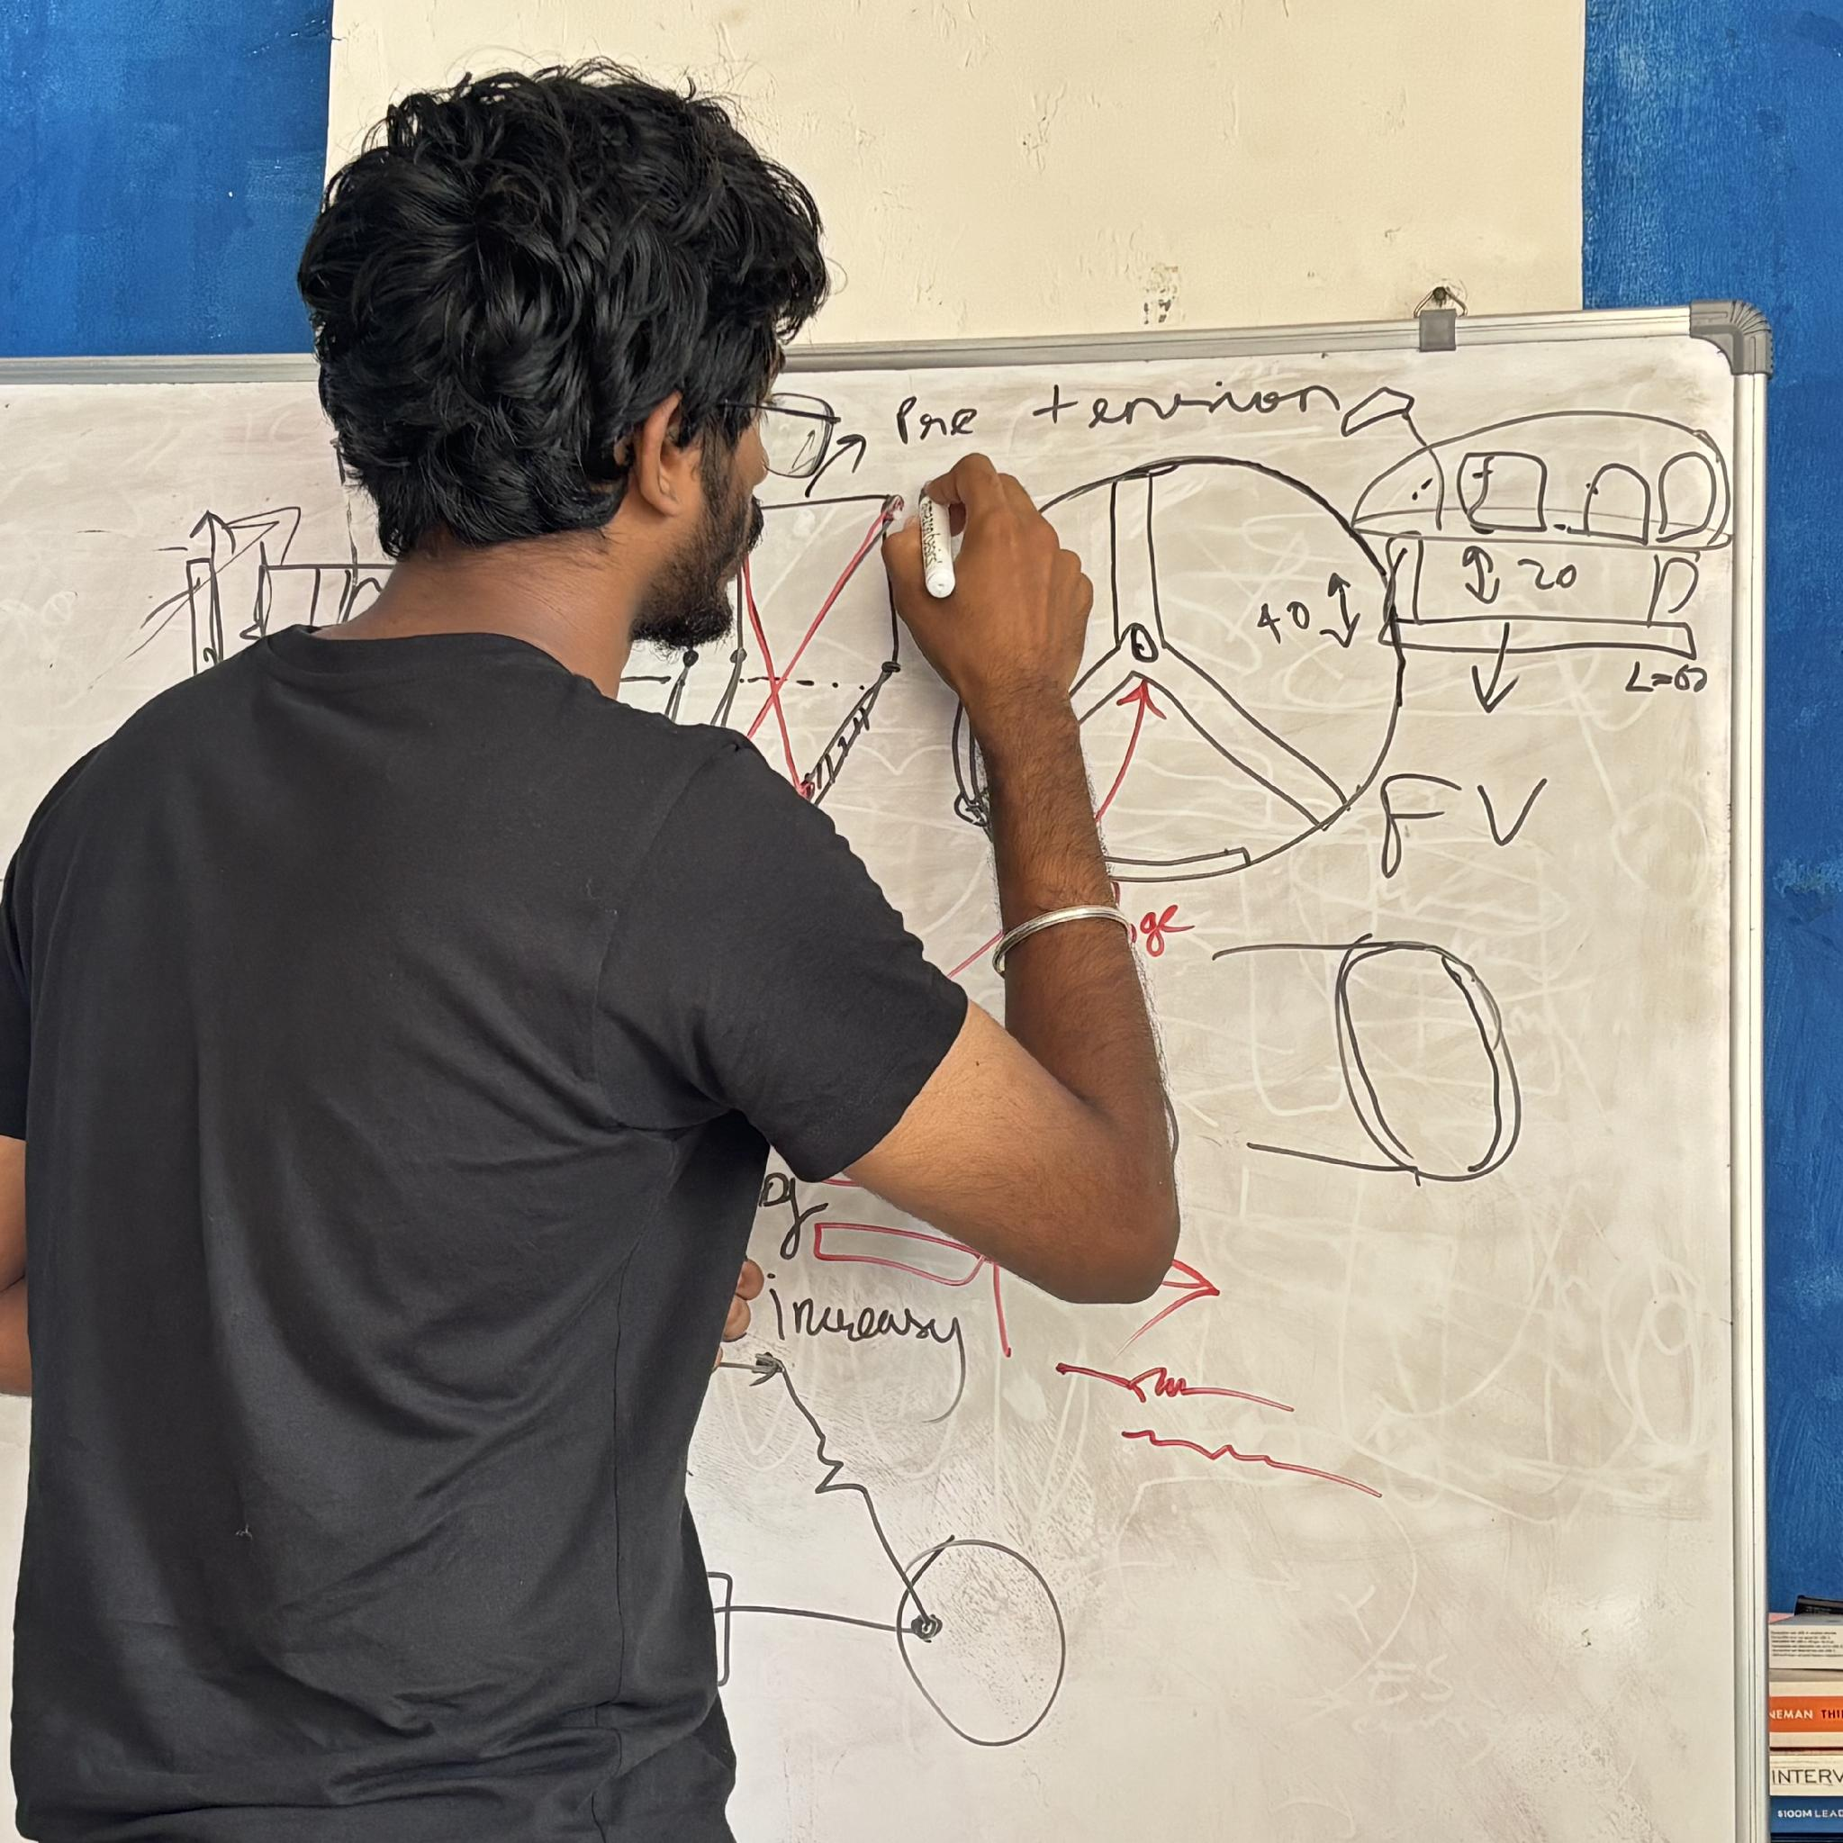
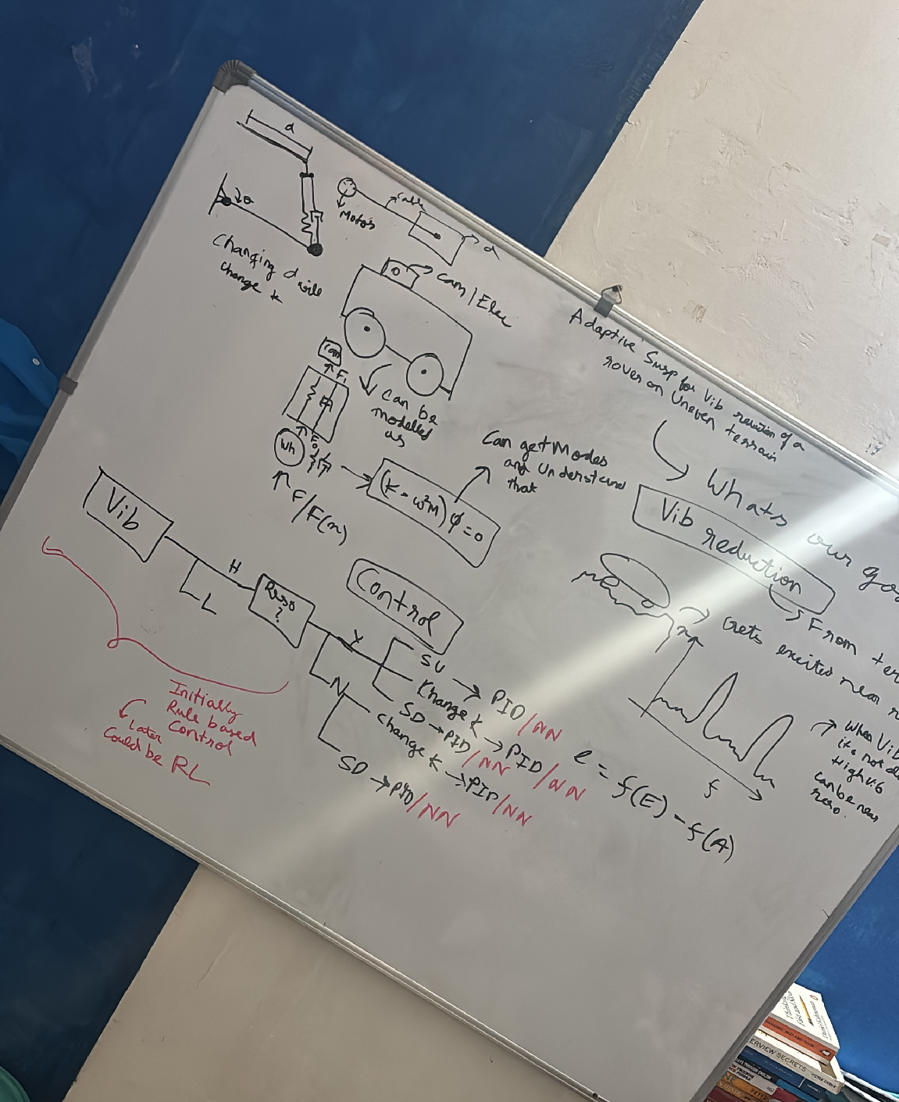
Maker Journey
From the vibration problem to a suspension concept
Identify vibration and resonance
Compare speed and stiffness
Identify vibration and resonance
We first asked whether to slow the rover down or change the suspension response. The sketches led us to adjustable preload and a simple rule-based controller. The next step is to measure the joint response before tuning the controller.
Sketch preload and wheel loads
Notes:
Build basis: the supplied 43-line BOM totals INR 44,069.06, without a reserve. The team confirmed four driven wheels and two passive wheels, six DS3225 preload servos, Teensy 4.0 and Raspberry Pi Pico. The 30 kg mass and 6 mm screw travel are design targets. The CAD images remain reference geometry. The team-edited whiteboard photographs and their layout are preserved. They document design discussion about vibration, resonance, speed and stiffness. The first controller is proposed as rule based. NN/RL remain explored options, not implemented results.

Slide 11
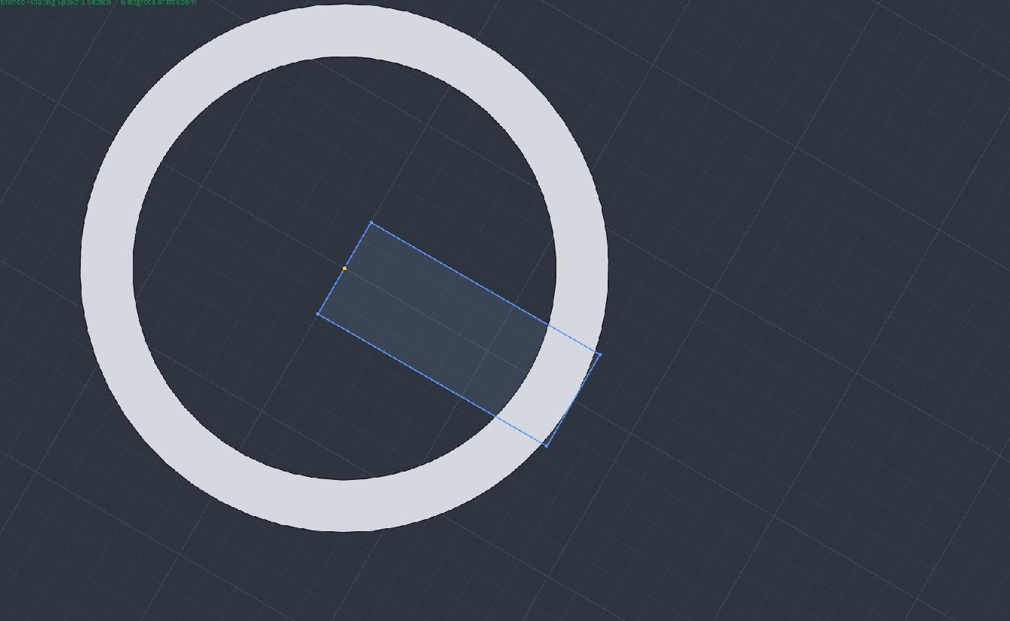
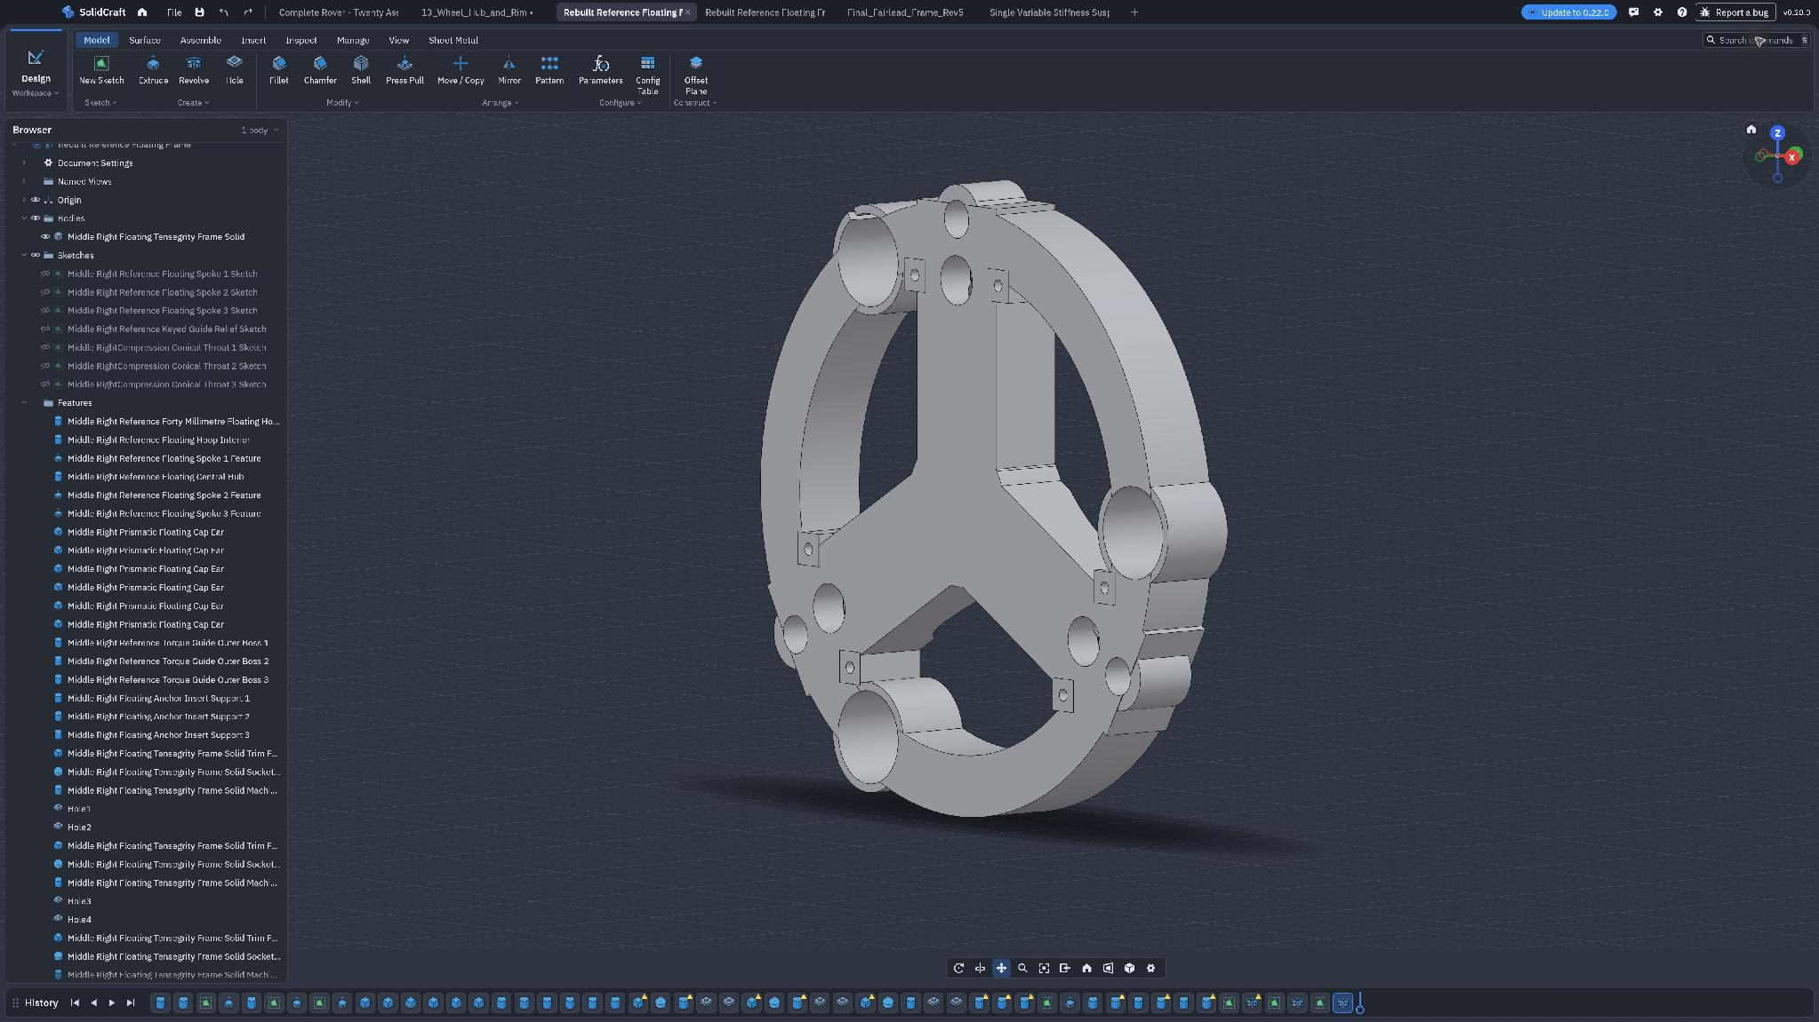
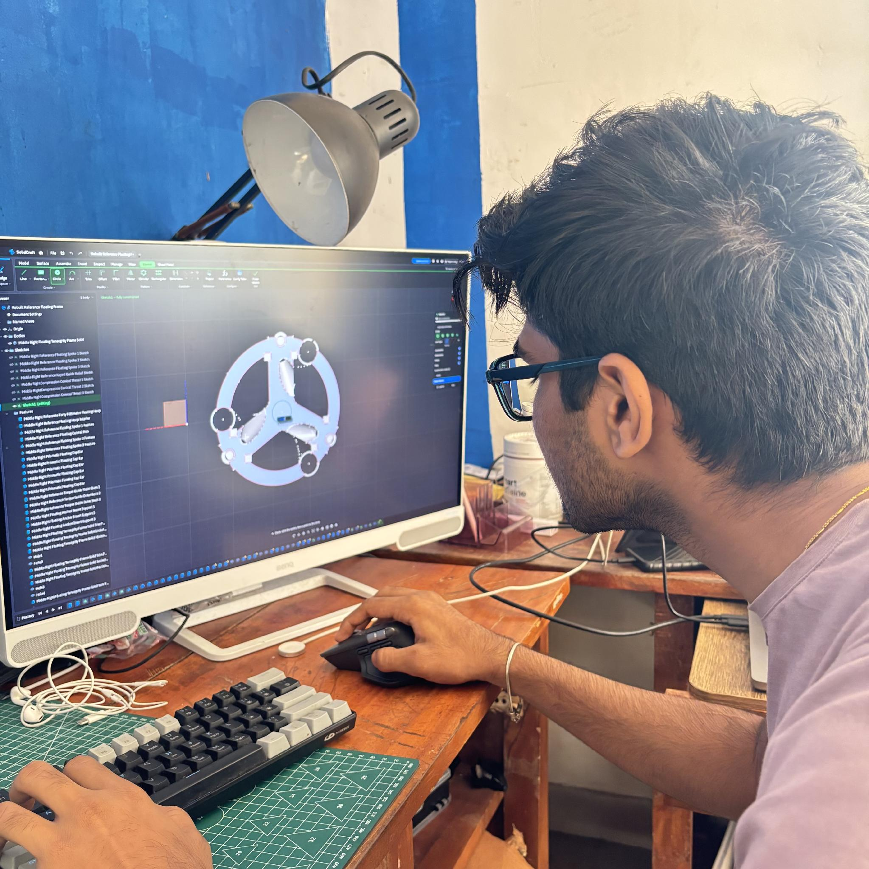
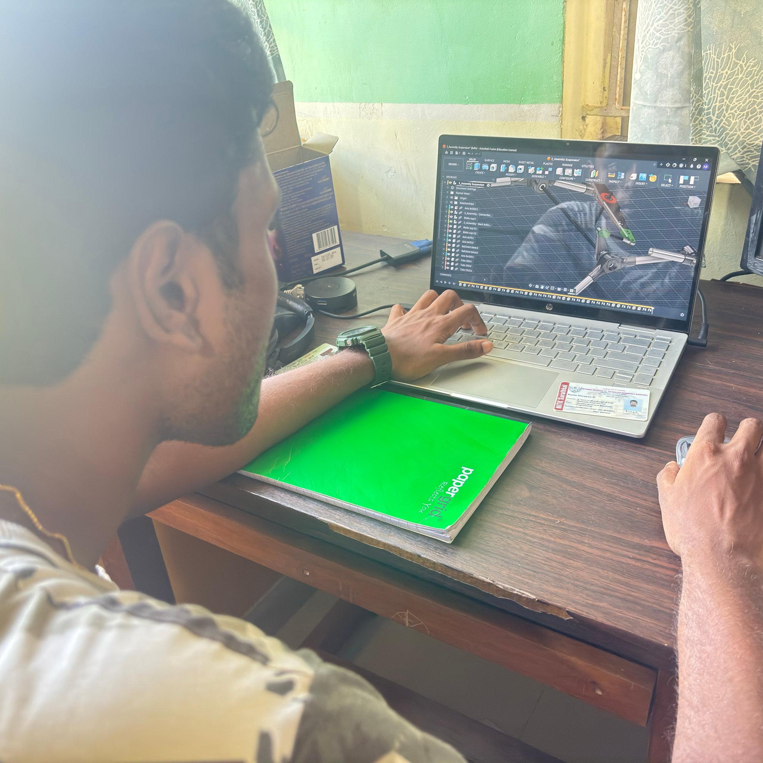
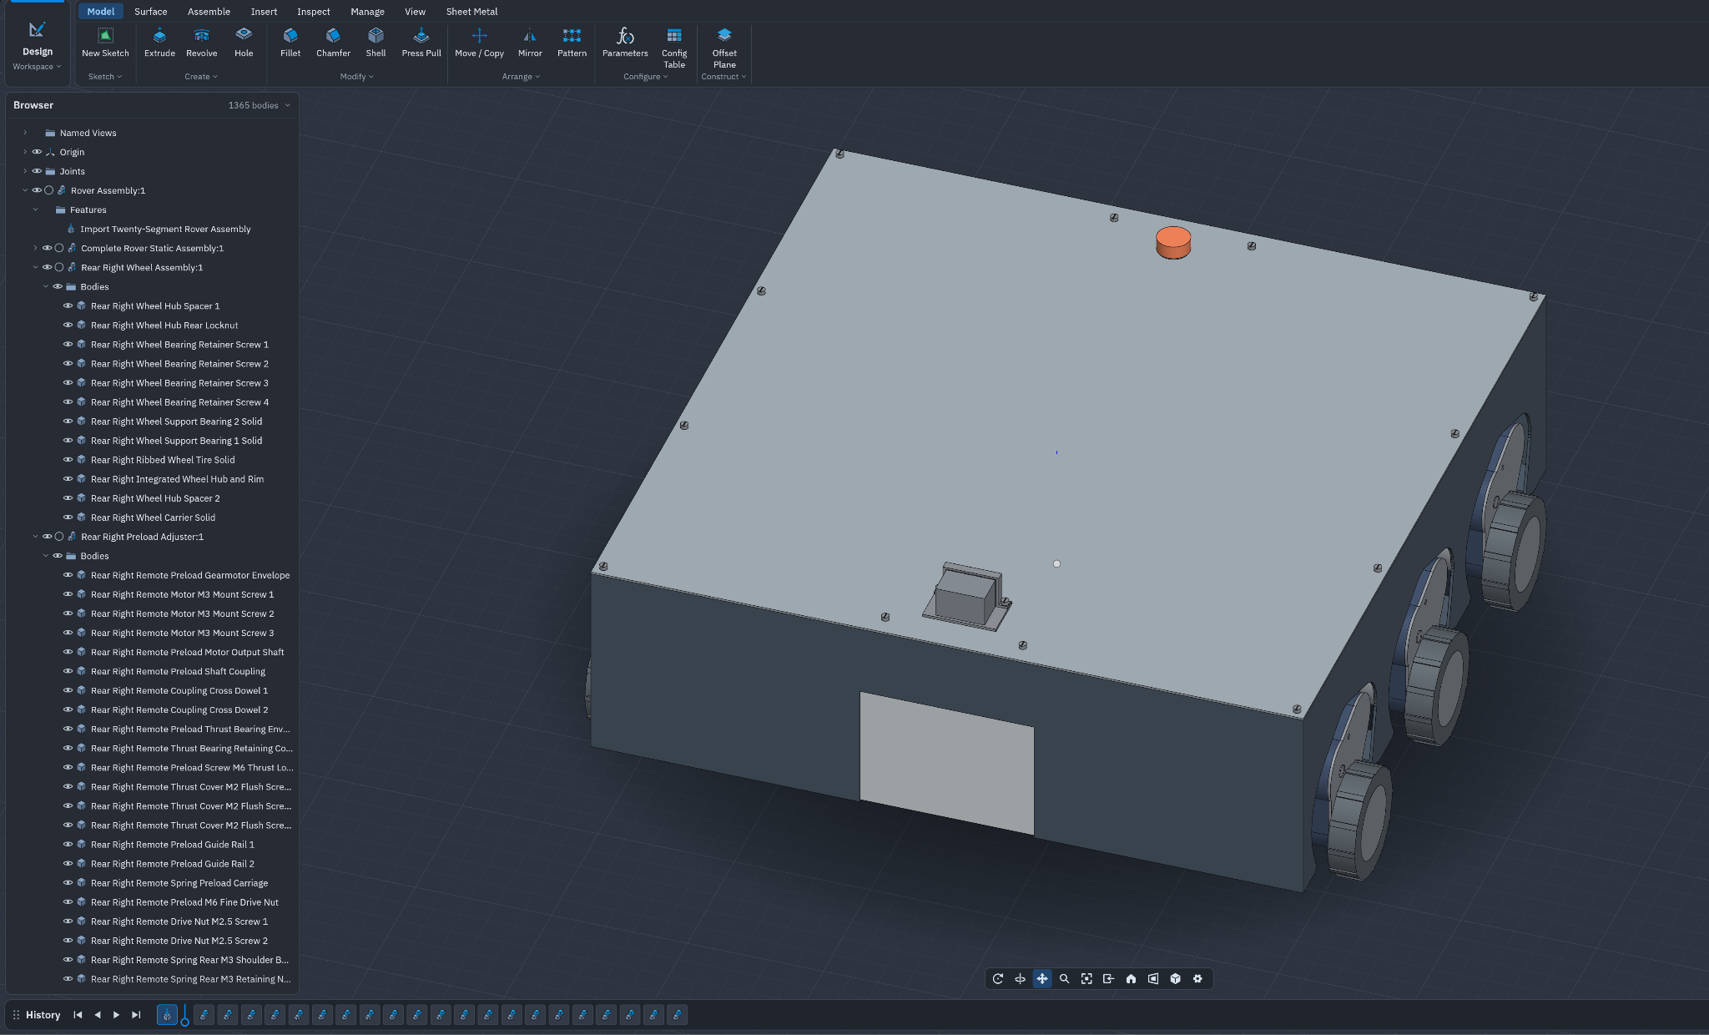
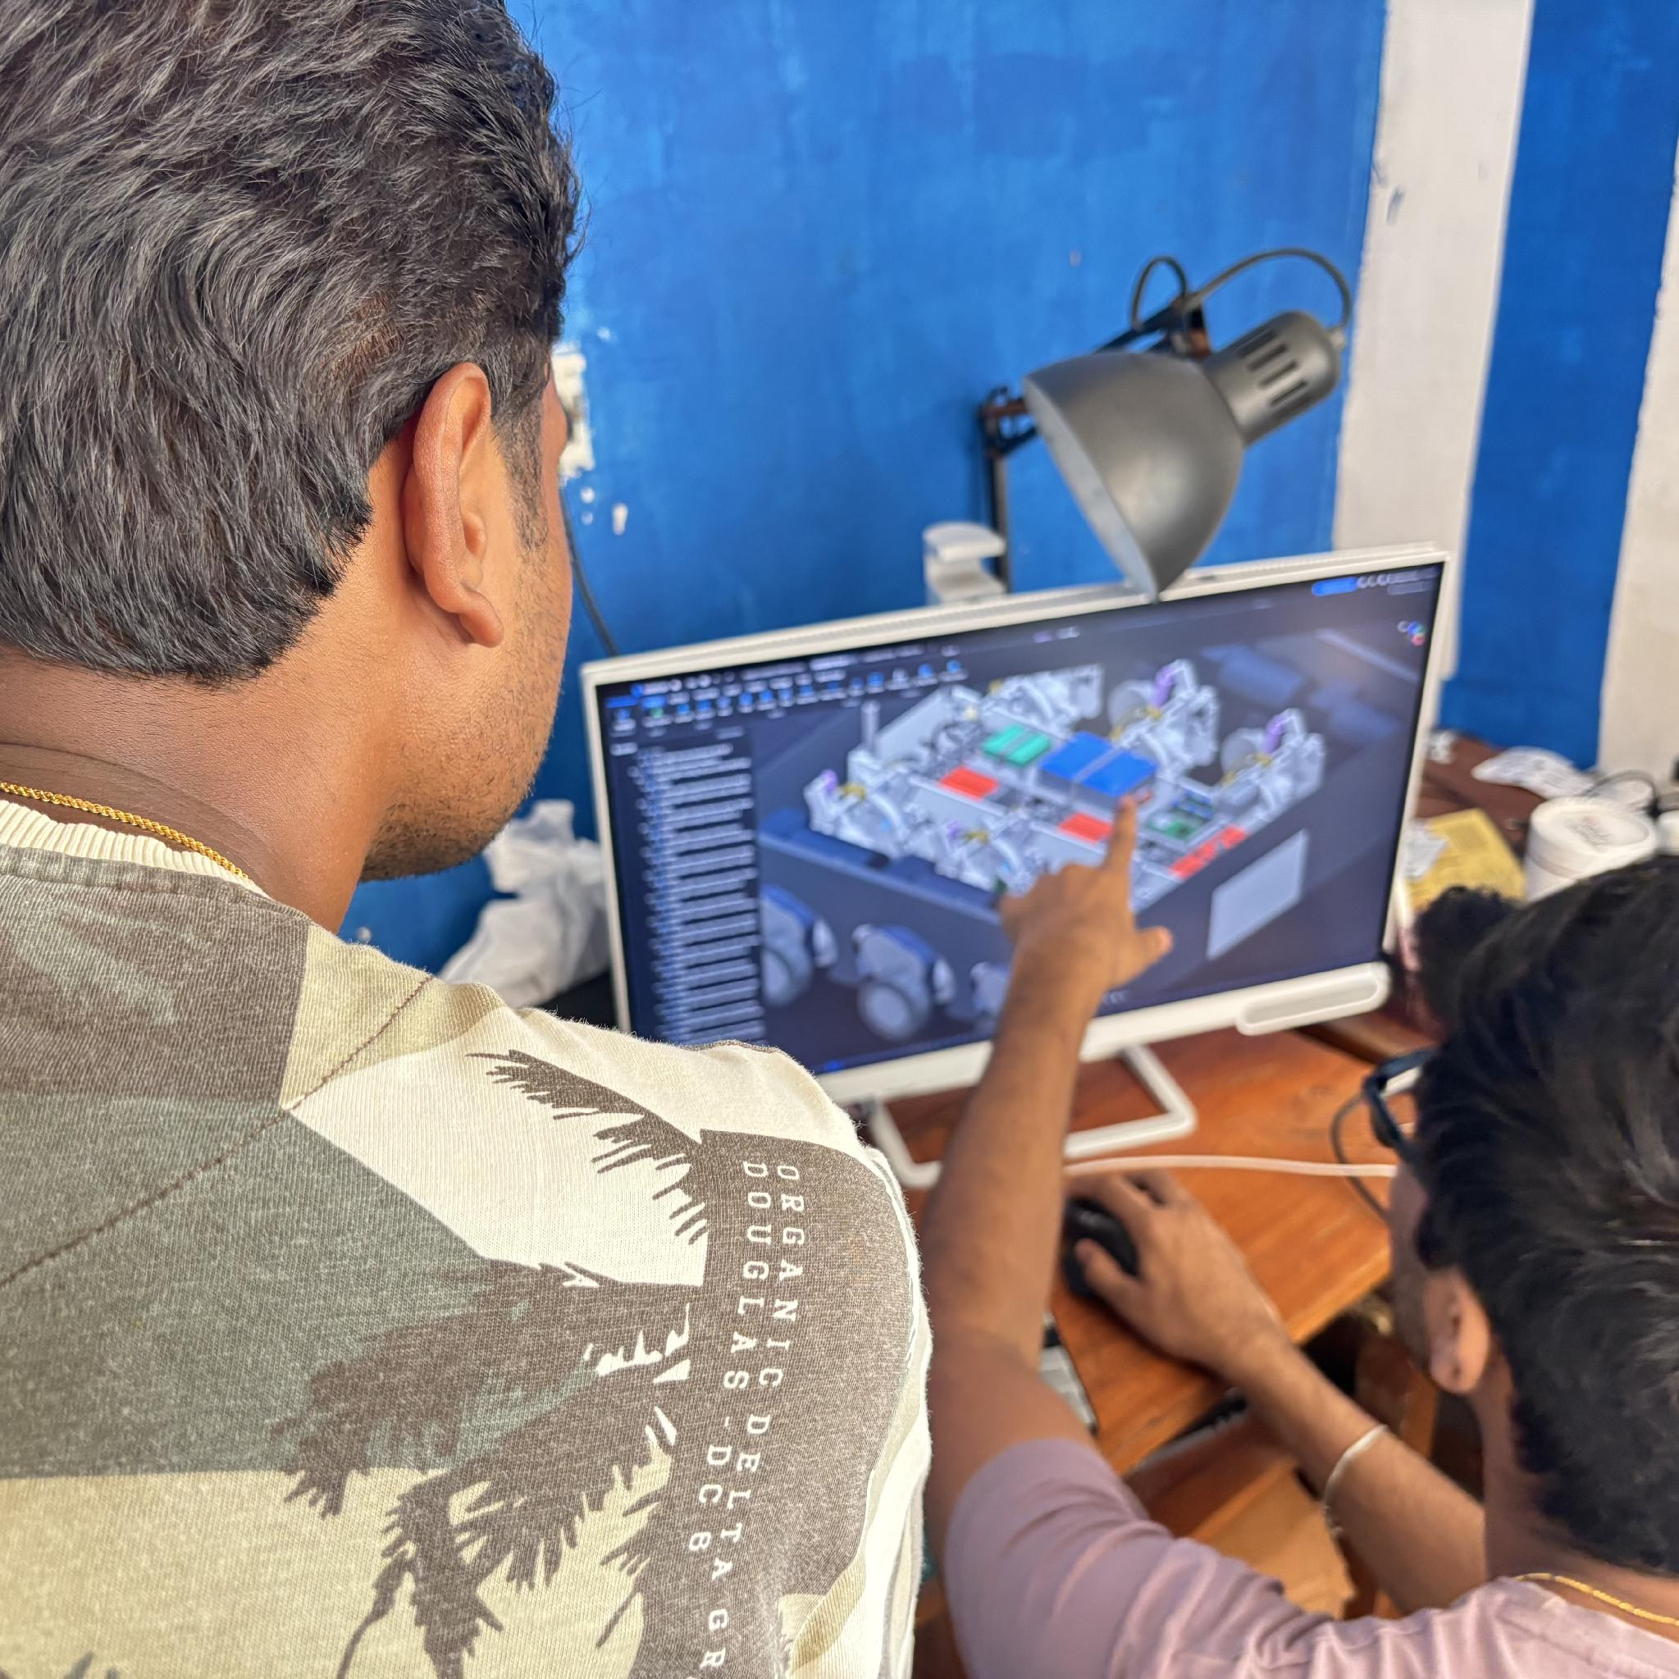
Maker Journey
Floating frame: sketch to finished part
Original spoke sketch
Finished frame and feature tree
Frame modelling
Original spoke sketch
Final model Feature Tree
Complete rover CAD review
Raw STEP models
Notes:
Build basis: the supplied 43-line BOM totals INR 44,069.06, without a reserve. The team confirmed four driven wheels and two passive wheels, six DS3225 preload servos, Teensy 4.0 and Raspberry Pi Pico. The 30 kg mass and 6 mm screw travel are design targets. The CAD images remain reference geometry. The team-edited software screenshots and CAD-review photographs are preserved. They show the original sketch, floating-frame feature tree and complete-rover reference model. The floating-frame native source contains 53 features including seven sketches. These images do not establish physical fabrication, FEA or validated BOM compatibility. The native CAD and STEP files are unchanged.

Slide 12
Safety & Hazard Mitigation
Failure mode | Hazard | Physical / software protection
Cable or elastic element breaks | Loss of elastic support | Retained ends, hard stops and residual-support load test
Preload servo loss, stall or jam | Preload drift, overtravel or heating | Hard stops, 12 NC end limits and 6 lock inputs. Qualify servo supply and positive holding locks.
IMU / logger fault or lost radio | Unsafe control command | Watchdog stops PWM and enters a stopped state
Wheel stall / H-bridge heat | Overcurrent and overheating | Qualify four drive branches for fusing, current cutoff and thermal protection. Test startup and stall loads.
Battery or wiring fault | Fire or electric damage | Use a compatible 3S LiPo balance charger and discharge protection. The listed VRLA charger is incompatible.
Physical fail-safes
Design guidelines considered
We will fit an NC emergency stop to cut wheel and servo power independently of firmware, and test manual reset, holding locks and guarded access.
ISO 12100, ISO 13850 and IEC 60529. Bench-check safe reset, power loss and all six holding locks before loaded travel.
Notes:
Build basis: the supplied 43-line BOM totals INR 44,069.06, without a reserve. The team confirmed four driven wheels and two passive wheels, six DS3225 preload servos, Teensy 4.0 and Raspberry Pi Pico. The 30 kg mass and 6 mm screw travel are design targets. The CAD images remain reference geometry. The FMEA describes proposed controls, not completed certification. Four drive branches and six servo loads replace the earlier twelve-DC-motor configuration. Qualify fuses, isolation, E-stop power removal, manual reset, servo holding behaviour and mechanical locks. PCA output disable is not a power disconnect or holding brake. ISO 12100, ISO 13850 and IEC 60529 are design references; no ingress, mine or safety certification is claimed.

Slide 13
Roadmap
Build and qualify one joint before repeating it six times
Month | Build and integration work | Exit gate
1 | Confirm servo rotation, 6 mm travel, 51100 seats and power/charger interfaces. Make one joint. | Demonstrate travel, locking, force response and temperature under staged loads
2 | Build six joints, four driven and two passive wheels. Fit 4 BTS7960, 6 PCA9685 and the controllers. | Verify E-stop, end limits, locks, converter margin and staged static loads
3 | Calibrate 3 ADXL345, MPU6050 and the listed encoder. Qualify Hall feedback and implement control. | Reliable logs, repeatable preload settings and safe fault handling
4 | Repeat fixed and adaptive tests on the same rough track, speed and payload. | Compare vibration, total route time and energy. Retain the raw logs
Stage 3 target: a working rover ready for a controlled rough-terrain demonstration, supported by repeatable test data.
Notes:
Build basis: the supplied 43-line BOM totals INR 44,069.06, without a reserve. The team confirmed four driven wheels and two passive wheels, six DS3225 preload servos, Teensy 4.0 and Raspberry Pi Pico. The 30 kg mass and 6 mm screw travel are design targets. The CAD images remain reference geometry. The roadmap is a future four-month plan. Qualify one joint, the 6 mm stroke target, servo output, bearing interfaces and safe power before replication. Then assemble four driven and two passive wheels, calibrate sensors, qualify feedback and compare fixed/adaptive operation on a controlled track. Stage 3 readiness is a target.

Slide 14
Technical Challenges & Risks
Constraint | Evidence / current limitation
30 kg in a compact chassis | 294.3 N provisional wheel screen and 19.13 Nm arm moment.
Servo and bearing interfaces | 6 mm screw travel requires 12 turns. Confirm servo output rotation. The selected 51100 thrust bearings need revised seats.
Stiffness, friction and damping | Preload response depends on elastic force and guide friction. No measured stiffness or damping curve yet.
Drive and feedback coverage | 300 rpm gives 1.304 m/s nominal at 83 mm. Creep needs 11.5–23.0 rpm. One encoder and one magnet are listed.
Battery and servo power | Six servos can demand 11.4 A at 5 V stall against a listed 5 A converter. The VRLA charger is incompatible with 3S LiPo.
Notes:
Build basis: the supplied 43-line BOM totals INR 44,069.06, without a reserve. The team confirmed four driven wheels and two passive wheels, six DS3225 preload servos, Teensy 4.0 and Raspberry Pi Pico. The 30 kg mass and 6 mm screw travel are design targets. The CAD images remain reference geometry. Release risks include loaded strength, servo output range and holding capacity, thrust-bearing fit, low-speed drive control, limited feedback and safe power. The standard servo-current comparison is 6 × 1.9 A = 11.4 A at 5 V stall against the listed 5 A converter. Sequential commands do not establish adequate holding-current capacity. Motor torque and current ratings do not establish a tested 30 kg rover rating. Sources: https://robu.in/product-category/johnson-motor/ https://www.dsservo.com/d_file/DS3225%20datasheet.pdf https://robu.in/product/orange-11-1v-2500mah-3c-3s-tx-lithium-polymer-battery-pack-with-jst-bec-connector/ https://eshop.ntn-snr.com/en/product/51100-SNR/51100

Slide 15
Potential Solutions & Risk Mitigation
Risk | Primary action | Fallback
Concentrated load / print creep | Metal shafts, loaded frames and bearing seats. Qualify the new 51100 seats and one loaded joint. | Increase section or replace critical printed parts with flat metal
Cable friction or wear | Measure tension loss and sweep travel at each preload. Use supported direction changes. | Increase guide radius or use a rated pulley
Servo travel or holding fails | Verify 12 screw turns for 6 mm travel. Unload one joint, adjust and confirm the positive lock. | Revise the servo output or transmission after measuring torque and stroke
Low-speed drive / limited feedback | Test four motors at 11.5–23.0 wheel rpm. Use one reference encoder and repeated timed track runs. | Review reduction and encoder coverage before speed-control release
Power and charger integration | Match a 3S LiPo charger and qualify servo current, regulator cooling, shunt and emergency power removal. | Keep fixed preload and hold loaded tests until the power design passes
Notes:
Build basis: the supplied 43-line BOM totals INR 44,069.06, without a reserve. The team confirmed four driven wheels and two passive wheels, six DS3225 preload servos, Teensy 4.0 and Raspberry Pi Pico. The 30 kg mass and 6 mm screw travel are design targets. The CAD images remain reference geometry. The mitigation table defines proposed release gates. Any required changes to charging, regulation, transmission or feedback must be selected and costed before fabrication. The supplied BOM is not silently increased. Reduced speed or firmware disable is not a substitute for compatible power or structural holding locks.

Slide 16
References & Sources
Research and background sources
O. M. Anubi, D. R. Patel and C. D. Crane III. (2013). A new variable stiffness suspension system: passive case.
Mechanical Sciences, 4, 139–151.
https://doi.org/10.5194/ms-4-139-2013
D. Zappetti, Y. Sun, M. Gevers, S. Mintchev and D. Floreano. (2022).
Dual Stiffness Tensegrity Platform for Resilient Robotics. Advanced Intelligent Systems, 4(7), 2200025.
https://doi.org/10.1002/aisy.202200025
S. Lessard, J. Bruce, E. Jung, M. Teodorescu, V. SunSpiral and A. Agogino. (2015).
A light-weight, multi-axis compliant tensegrity joint. arXiv:1510.07595v1.
https://arxiv.org/html/1510.07595v1
ScienceDirect Topics. Tensegrity - an overview. Engineering topic reference.
https://www.sciencedirect.com/topics/engineering/tensegrity
Project sources: team proposal, CY06 drawings, CAD, screenshots and development photos. Sensor photos: RoboticsDNA. Technical sources: ADXL345, MPU6050, RP2040, Teensy, PCA9685, MCP23017, INA219 and DS3225 documentation. Costs: supplied 43-line BOM.
github.com/psmithul/tensegrity-rover
Sensor module sources: RoboticsDNA
AI assistance was used to prepare this presentation and generate some images without backgrounds.
Notes:
Build basis: the supplied 43-line BOM totals INR 44,069.06, without a reserve. The team confirmed four driven wheels and two passive wheels, six DS3225 preload servos, Teensy 4.0 and Raspberry Pi Pico. The 30 kg mass and 6 mm screw travel are design targets. The CAD images remain reference geometry. Research references are retained: Anubi et al. (2013), https://doi.org/10.5194/ms-4-139-2013; Zappetti et al. (2022), https://doi.org/10.1002/aisy.202200025; Lessard et al. (2015), https://arxiv.org/html/1510.07595v1; and the ScienceDirect Topics overview, https://www.sciencedirect.com/topics/engineering/tensegrity. Technical sources: https://docs.google.com/spreadsheets/d/1MgeOaRzbr-E_Y6dmaOskiG0FE6D-4ZNo4FLduEJ5raw/edit?gid=2130847794#gid=2130847794 https://robu.in/product/grade-a-quality-orange-12v-300-rpm-johnson-geared-dc-motor/ https://robu.in/product-category/johnson-motor/ https://robu.in/product/orange-11-1v-2500mah-3c-3s-tx-lithium-polymer-battery-pack-with-jst-bec-connector/ https://www.dsservo.com/d_file/DS3225%20datasheet.pdf https://www.pjrc.com/store/teensy40.html https://datasheets.raspberrypi.com/pico/pico-datasheet.pdf https://www.nxp.com/docs/en/data-sheet/PCA9685.pdf https://www.ti.com/lit/ds/symlink/ina219.pdf https://eshop.ntn-snr.com/en/product/51100-SNR/51100 The final visible disclosure follows the team request: AI assistance was used to prepare this presentation and generate some images without backgrounds. The team-labelled AI-edited images are retained. No physical test, FEA or modelling-history evidence is invented.

