Slide 1


Slide 2
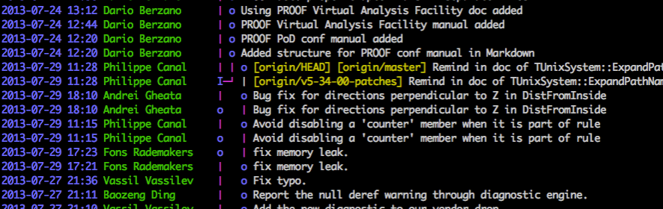

1. Employee: I have no idea what this bug is about! Let me query the bot to find the person who worked on it last time.
3. It seems Mr. Philippe Canal made this change which causes the error! Now I know who to contact.
2. Bot: Let me lookup the git and get the people who worked on this file using Git Blame.
Error!!

Slide 3

3. Manager: Oh nice! So I have a list of employees to choose from
1. Manager: This issue seems to be NEW!! Let me query/ call the bot to find an employee for it.
Commit history
Git labels and topics
2. Bot: Let me see the git hub commits to match the topics that employees have worked on.

Slide 4
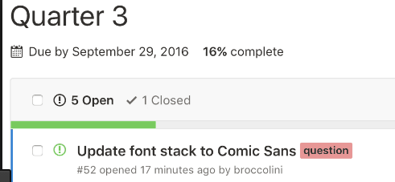
1. Manager: @Bot give me the due dates for all the issues handled this month as we are towards the end of the quarter!
3. Oh! It seems we are lacking on the timeline, we need to speed up.
4
2. Bot: This is what I fetched from your git tool. Here is a list of all the issues you have due soon.

