Slide 1
CARKLAUS
To learn and develop new skills
Problem Statement- Business innovation
18.05.2022

Slide 2
Why?
In this technology world, identifying and solving the problem is the required skill to survive. I chose this problem statement because I am interested to implement ideas. I take this as an opportunity to turn my ideas into business.

Slide 3
User Segment & Pain Points
Early adopters often become opinion leaders or have an influence on the new technology because they are the first to use it and provide feedback.

Slide 4
Current Landscape
Most products are competing with alternatives. Alternatives are the other ways your target audience are solving the problem today.

Slide 5
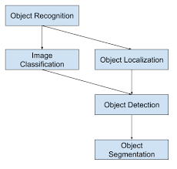
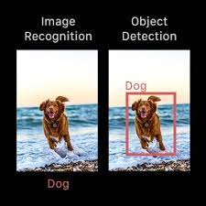
DEMO
Identifying Object using AI- We can identify objects using Artificial Intelligence
Methodology
Applications-
Face detection,
Video surveillance,
Crowd counting,
Self-driving,
Blind People
https://www.youtube.com/watch?v=MyvOfDFZvgE
https://www.youtube.com/watch?v=M3T5diI7nzQ

Slide 6
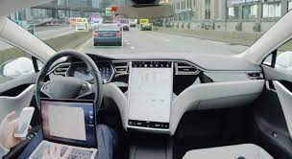
Key Differentiators & Adoption Plan
One of the most apparent use cases for Object Detection is within self-driving cars.

Slide 7
Future Vision
It will be very useful for the blind people and people with the lesser vision. I hope this product makes a new change to the world.

Slide 8
Aha Ahaa!
Better to laugh at failure:)

Slide 9
Thank You
SNEHA P

