Slide 1
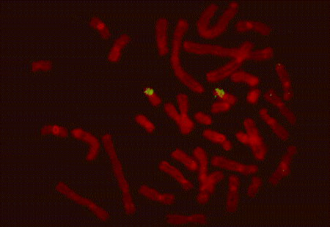
Chapter 7: Estimation of indexes for breeding values
Breeding value estimation
Accuracy
Formulas
Examples
Gene markers
BLUP
Notes:
This chapter will show how to estimate an index for an animal’s breeding value.
First a little about breeding value estimation and the accuracy of this estimation. Next the presentation of simple formulas for calculating these values and examples of application of the formulas.
We will show, how to include information from gene markers in the calculation of breeding values, and which effect the gene markers can have on the accuracy of the breeding value estimation.
Additional methods on how to estimate the breeding value exist. BLUP is used to a large extent and therefore it will be brifly presented in this chapter.

Slide 2
Breeding value estimation
Goal: Selection of the best animals
Ranging on the basis of genetic superiority
Accuracy
Notes:
The goal of the breeding work is to select the best animals for breeding. The best animals are the animals, which are genetically superior to the others with respect to the traits that are being selected for. But how are these animals selected?
A precondition for selecting the best animals is to know which ones are the best. The animals will also be ranged in relation to one another on the basis of their genetic superiority. The best way to measure an animal’s genetic superiority is to look at its breeding value. Or, in other words, the breeding value tells us how much an animal is worth as breeding animal. Thus the breeding value estimation plays a central role in the breeding work. Selection is meaningless if there is no information on the breeding values.
A breeding value estimation can have a larger or smaller degree of accuracy, but it is important to keep in mind, that the breeding value estimation is the best way of making assumptions about an animal’s true breeding value. Statistical errors always occur on the breeding value estimation of an animal. The larger the standard error, the smaller the response obtained from a given selection, since the ranging error of the animal is increased. This is very abstract, but the following examples should make this easier to understand.

Slide 3
Accuracy of breeding value estimation
Statistical model
Data
Notes:
Two conditions are of importance when an accurate breeding value estimation is needed?
The statistical model, which is used to estimate the breeding value, and the data material used in the breeding value estimation.
The statistical model, which is utilized can be more or less correct concerning the environmental effects. The better the corrections, the higher the accuracy.
The accuracy of the breeding value estimation can be improved by increasing the amount of data. In practice that means to include data from more offspring, more sibs and/or other relatives.

Slide 4
Calculation of index (I) for breeding value
I = b_{A/I} (‾Pg -‾Ppop)
b_{A/I} = (na’h²)/(1+(n-1)t)
t = ah²+c²
Notes:
How are the breeding value estimates calculated in practice? To make it simple we start off with one trait. The phenotypic measurements of this trait are done on either the individual or its relatives.
An individual’s breeding value is calculated as the regression of the individual’s true breeding value (i.e.. genotype) on the phenotypic measurements. The breeding value, A, is equal to the regression coefficient, b_{A/P} multiplied by the difference between the average of n measurements, Pg, and the population average, P-bar.
The regression coefficient, b_{A/P} is by definition equal to the co-variance between the dependent variable, A (the breeding value), and the independent variable, P, and variance of the independent variable P.
The regression coefficient can also be expressed by this ratio: The number of observations, n, times the relationship coefficient, a’, times the heritability, divided by 1 plus (n-1) times the intra class correlation, t. The intra class correlation is calculated as the relationship between the individuals (observations), a, times the heritability plus the common environmental factor, c².

Slide 5
Accuracy of breeding value index
r_{IA}: Accuracy
r_{IA} = (a’b_{A/I})^{½}
r²_{IA} = a’b_{A/I}
Notes:
When the regression coefficient b_{A/P} is calculated, it is easy to calculate the accuracy. The accuracy has the symbol r_{IA} , and can be found as the square root of the product of the relationship coefficient, a’, and the regression coefficient.
It has to be brought to our attention, .…that ironically there is a bit of ambivalence to the term accuracy. Sometimes it is assumed to be (r_{IA})² and in most cases r_{IA}. The correct name for (r_{IA})² is the coefficient of determination.
Meanwhile there should be no doubt - ’accuracy’ of breeding value estimation is equal to the correlation between the index and the true breeding value, r_{IA}.

Slide 6
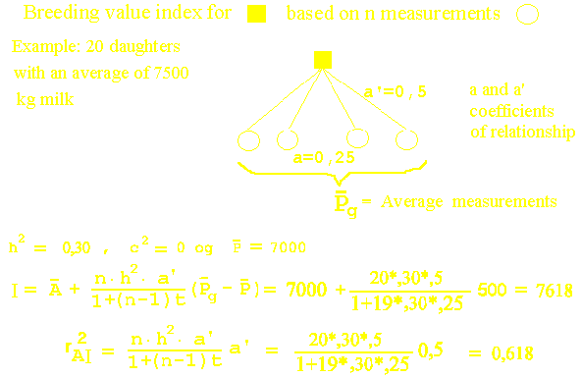
Example of estimation of breeding value based on a group of daughters
Notes:
Here is a simple example of how to use the derived formulas.
The index for breeding value of a bull for milk yield based is on the records of yield from 20 of its daughters. The coefficient of relationship, a’, is 0.5, and the daughters’ coefficient of relationship, a, is 0.25. The heritability of milk yield is 0.3, and the common environmental effect, c², is 0. The average milk yield in the population is 7000 kg.
The daughters have an average yield of 7500 kg, that is a deviation of 500 kg. from the population average.
The index for the bull is as follows: 20 daughters times a heritability of 0.3 times the relationship coefficient of 0.5 divided by 1 plus 19 times 0.3 times the relationship between the daughters, 0.25. All this multiplied by the deviation of 500 kg., and added the population average of 7000 kg. to obtain the absolute breeding value of 7618 kg.
The squared accuracy, r²_{AI} is 0.618.
By means of the general formula for breeding value estimation many special cases can de derived. Most interesting is the fact that in the calculation of breeding value from a record of the animal itself, both the regression coefficient and the squared accuracy is equal to the heritability.

Slide 7
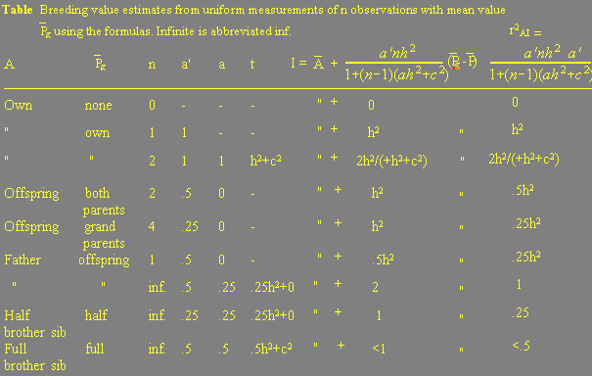
Special case with uniform relationship
Notes:
Now some additional examples of other measurements with uniform relationship conditions, using the general formula for breeding value estimation as shown on the slide.
Line 1 in the table corresponds to the formula with 0 observations, and the index is equal to the population mean with an accuracy of 0. This gives the 'basis' for evaluation of all the other indexes.
Line 2 in the table corresponds to a very common situation, which is normally called a phenotype test. The animal’s breeding value is based on measurements of the animal - the equation is:
I = A(bar) + h²(P -P(bar)) with a squared accuracy of h².
Line 3 shows two measurements of the animal, it could be litter size from first and second litter. The correlation between repeated measurements is called the coefficient of repeatability. This always contains some common environmental effects for the two measurements.
Line 4 shows the relationship between the average of the parents and the offspring. In section 6.4 this relation was used in the estimation of the heritability. So it comes as no surprise to see the same relationship again.
Line 7 shows the evaluation of a father based on an infinite number of offspring, details of this is found on the next slide.

Slide 8
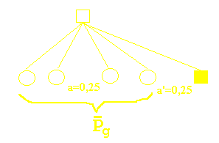
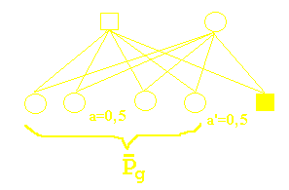
Special case with uniform relationship
Half- and full sibs used to estimate breeding value and
relevant relationship coefficients
Notes:
Breeding value calculation based on half sib offspring corresponds to the definition of breeding value, and from an infinite number of offspring gives the weight factor 2 and accuracy 1, independent of the size of the heritability. This is the best information source when having low heritability and a large number of offspring.
By breeding value estimation based on full sibs, the figure shows that a father, a mother or a full sib get the same breeding value estimate and the same accuracy. The maximum accuracy is in this case 0.5, even if there is an infinite number of offspring.

Slide 9
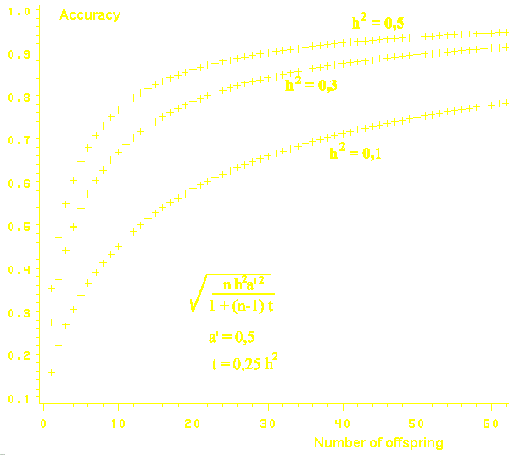
Accuracy: In relation to number of measurements and heritability
Notes:
This slide shows the accuracy of breeding value estimation based on offspring, as function of the number of offspring. As can be seen, the accuracy increases when the number of offspring increases. When there is a great number of offspring, the curve flattens when approaching one.
Furthermore, the slide shows that the accuracy depends on the heritability of the trait. The higher the heritability, the higher the accuracy.
This means, that for traits with a heritability of 0.5, the estimate is as good as it can be for 50 offspring. When the trait, on the contrary, has really low heritability, the accuracy still improves when having as much as 1000 offspring.

Slide 10
Accuracy: In relation to relationship and heritability
Genetic relationship
Connectedness
Recording from controlled and uniform environmental conditions
Heritability Size Examples
height Larger than 45 %, Fat deposition, fat % in milk
Low Smaller than 10 %, Reproduction traits
Middle 15-40 %, Growth
Notes:
Furthermore, the accuracy of a breeding value estimate also depends on how closely related the individual is with the animals which have records.
In chapter 12 we discuss how the quality of the data can be improved by using different breeding measures. By using artificial insemination the data gets a better genetic structure. Often the term “connectedness” is used when describing how well the data is spread across the herds.
The technical accuracy can be improved, if the recordings are done under well controlled and uniform environmental conditions, as it is the case in breeding research stations. This will be further discussed in chapter 12.
By investigating the formula for accuracy the following is derived:
1) When dealing with high heritability the individual’s own record is a good source of information.
2) When dealing with low heritability many records can compensate for low accuracy in a single record. Many records are only available by using large groups of offspring, where the animals occur either as offspring or as full- or half sib.
High heritability in a trait is always more than 45 %, as for instance back-fat or fat percent in milk. The heritabiliy is low when it is below 10%, as for instance reproduction traits and disease resistance. Middle-size heritability is from 15-40 %, as for instance growth traits.

Slide 11
Pedigree information - the two parents’ index
I = (I_{far}+ I_{mor})/2
r²_{IA} = (r_{IA,far}² + r_{IA,mor}² )/4
Notes:
If breeding value estimates are calculated for the parents, the breeding value index for an offspring can be calculated as shown: by adding the parents’ index and divide it by two.
Thus the index for an individual is the average of the two parents’ breeding value. The squared accuracy on the index is the sum of the parents’ squared accuracy divided by 4.
It is clear that the squared accuracy on the pedigree information can not be more than 0.5, as 1 plus 1 divided by 4 equals ½ .
If there is only information from one of the parents, the population mean value and the accuracy 0 is used for the unknown parent.

Slide 12
New information sources: Gene markers
Phenotypic records (with all related)
Other records than phenotypic records – i.e. gene markers
Notes:
It has now been shown how information from a group of uniformly related individuals is utilized, but in practise information from all other relatives is of interest. Additional information from gene markers should also come in the future.
The next example is of phenotype information combined with a gene marker.

Slide 13
Formulas for use of gene markers
h²: Total heritability
h₁² : Heritability of gene marker
M: Marker effect
P: Phenotypic value.
I = P_{pop}+ [(1-h²) / (1-h₁²)] ×[M-P_{pop}]
+ [(h²-h₁²)/(1-h₁²)] ×[P-P_{pop}]
r²_{AI} = [(h₁²/h²)+h²-2h₁²]/(1-h₁²)
Notes:
A formula for breeding value estimation can be developed, this includes the extra information contributed by a gene marker.
The formula consists of 3 parts, which are added together. The first part is the population average. The second is the relative marker effect times 1 minus the heritability divided by 1 minus the heritability for the marker on its own. The third is the phenotype records’ deviation from the population average times the heritability minus the heritability for the marker gene divided by 1 minus the heritability for the marker.
A formula for the accuracy can also be derived. As seen, this is a function of the heritability and the heritability for the marker.

Slide 14
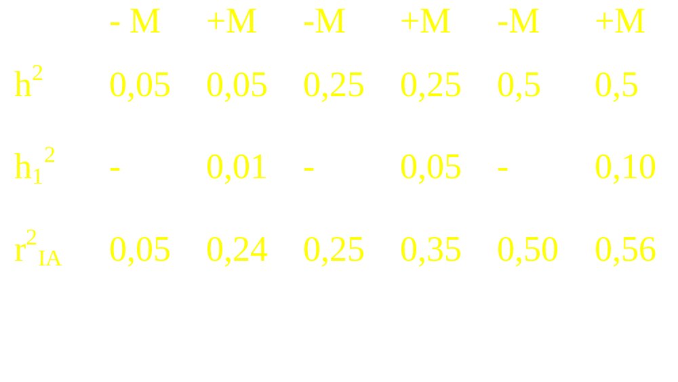
Heritability and use of gene markers
Low h² ⇒ use of markers influences the effect on the accuracy
Notes:
Now a practical example: how does the effect of using a gene marker on the accuracy by breeding value estimation depend on the size of the heritability. In the three examples the gene marker has a 20 % share of the heritability.
First a trait with a low heritability of 0.05 (column 1 in the slide). The heritability for the marker is 0.01. By inserting the numbers into the formula for accuracy, the accuracy squared is increased from 0.05 to 0.24.
Secondly a trait with a medium heritability of 0.25. Thus the improvement of the accuracy squared by use of the marker is less, from 0.25 to 0.35.
For a trait with a high heritability of 0.5, the improvement is even smaller. The accuracy squared has increased from 0.5 to 0.56.
The conclusion must be that a gene marker is more significant for traits with low heritability. Therefore it is clear that testing for gene markers for disease resistance should have a high priority, as disease traits typically have low heritability. In chapter 12 the use of gene markers will be discussed more detailed.

Slide 15
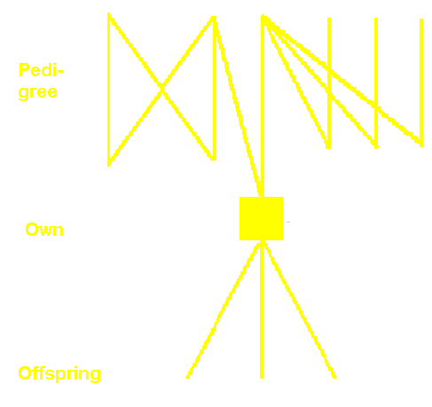
Direct update of breeding value estimates
The two parents
I₁ = in - A_{pop}
r²_{AI,1}
Own records
I₂ = in - A_{pop}
r²_{AI,2}
Offspring
I₃ = in - A_{pop}
r²_{AI,3}
Notes:
So far only conditions where all information can be weighted equally have been considered, as for instance a group of offspring. For a better utilization of the information it is possible to make an equation for each information and then estimate the weight factors for each information before calculating an index, this is the case in the BLUP system.
The same can be done by updating directly, but this will result in a simpler form. The updating utilizes the fact that, in principle, only three types of information of the breeding value of an animal exist – from respectively the parents, the animal itself (own) and its offspring.
The three types of indices are calculated as deviations from the population mean value.
Information from half and full sibs are contained in the parents’ breeding values, but there is a problem: the parents’ breeding values can only be utilized once. So if one of the parents has additional offspring, the breeding value has to be re-estimated.
Information from the ‘own’ records can be included as they become available, for instance at the first, the second and the third lactation. The same is true for the offspring, it can be included as it comes.
The last two conditions are responsible for the naming of the method “direct updating”

Slide 16
Direct update (DOA)
Calculation of a new index, I_{c}, from I_{x} and I_{y}
I_{c} = b_{x}I_{x} + b_{y}I_{y}
x = 1,2,3 or c
y = 1,2,3 or c
Notes:
The part index - which can come from either parent, own or offspring; - or an earlier combination index - can be combined by means of weight factors, the b’s, which weight and how important the part index is for the joint breeding value estimate. The magnitude of the weight factor depends on the accuracy of the respective breeding value estimate.
Now for the formulas for calculating these weight factors.

Slide 17
Weight factors (b’er) and accuracy
b_{x} = 1-r²_{AIy}/(1-r²_{Ix,Iy})
b_{y} = 1-r²_{AIx}/(1-r²_{Ix,Iy})
r²_{IA,c} = (r²_{AIx}+ r²_{AIy}-2r²_{Ix,Iy})/(1-r²_{IxIy})
r²_{Ix,Iy} = r²_{AIx} × r²_{AIy}
Notes:
This slide shows how the weight factors are calculated.
First it is clear that the correlation between index x and index y is combined by a simple multiplication.
This is possible because all the animals with records are only related trough the animals of which the breeding value is estimated. Thus the different part-indecies are independent and therefore can be multiplied.

Slide 18
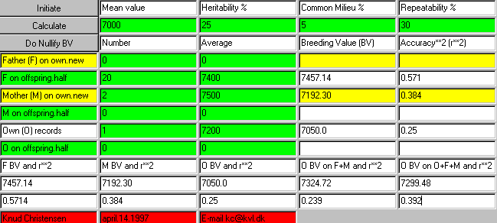
Example of ’Direct update of breeding values’ of milk yield
Based on father’s, offspring’s, mother’s and own yield
Notes:
Here is an example of direct updating of an index for milk yield, based on father’s, offspring’s, mother’s and own yield.
An applet in which the three-part indecies are calculated is applied.
The father’s index is symbolized by F BV, and is calculated on the basis of 20 offspring with an average yield of 7400 kg milk.
The mother’s index is based on two lactations with a yield of 7500 kg milk on average.
Own index is based on one lactation with an average yield of 7200 kg milk.
The population average is 7000 kg milk, the heritability is 25% and the coefficient of repeatability is 30 %.
In the last two lines of the applet the combination index is calculated. First the combination of the two parents’ index, and finally the combination of the parent index and own index.
The combination index is 7299.48 kg milk, with a squared accuracy of 0.392.

Slide 19
BLUP, Animal Model
Best: Minimize var[I- E(I)]
Linear: Linearity between the model parameters
Unbiased: E(I) = true breeding value
Prediction
Notes:
In the modern breeding work, most breeding value estimates are calculated by means of the BLUP-method. The Animal Model is an example of a BLUP model.
BLUP is an abbreviation of Best Linear Unbiased Prediction. ‘Best’ is a reference to the method which gives the best estimates for the breeding value, or to put it more precisely, this minimizes the variance of difference between the estimates and the true breeding values.
‘Linear’ means that there is a linear relation between parameters in the statistical model.
‘Unbiased’ means that the breeding value estimates are central, that they are expected to be normally distributed with the true breeding value as mean value.
‘Prediction’ normally refers to the future. But prediction also refers to the estimation of realized values of a random variable drawn from a population with known variance- and co-variance-structure.
A simpler and less precise formulation: ‘prediction’ is estimation of a given value of a random variable. It is better to use the expression ‘prediction of breeding values’, but ‘breeding value estimates’ are commonly used.
With BLUP the breeding values are calculated for all animals simultaneously, and at the same time environmental effects can be corrected for.
The theory behind BLUP is comparatively complex, and the BLUP method demands a lot of calculations.
All the earlier simple methods for breeding value estimation have the properties of the BLUP method, but especially when dealing with animals with scarce information, it is a great advantage that all information can be utilized by using BLUP.

Slide 20
Standardization of index
Absolute value: I_{abs} = from all mentioned sources
Relative value: I_{rel} = I_{abs} - P_{pop}
Standardized value:
I_{stand} = (I_{abs} -‾Ppop)/σ_{P} ~ N(0.1)
Notes:
Normally, the calculated breeding values are expressed in absolute units. For instance, the breeding value for a bull’s daily weight gain from birth to 1. year is 1100 gram/day.
A lot of people have difficulties evaluating whether this is good or bad, as they lack the average with which to compare. Therefore is it common to calculate the breeding values on the basis of the population average. Thus reaching a relative measure for the breeding value in comparison to the population average. If the population average is, for instance, 1000 g. in growth per day, the relative growth in this example would be 100 g. This corresponds to a relative breeding value of ca. 50 g. per day on average for the individual’s offspring. Further more, the breeding value can be standardized by dividing it by the population standard deviation. The standardized breeding values are now normally distributed with the mean value 0 and a standard deviation of 1.
To complicate things, different countries have different ways presenting the breeding values. In Denmark we use index. The indecies are standardized breeding values, which are multiplied by a desired standard error of 5 and added to a desired mean value, most often at 100. Thus an animal with an index of 100 corresponds to an average animal for the trait in question.
The breeding value of an animal is not constant. Not only new records can change the breeding value estimate, but typically also the population average will change due to selection. When the average of all breeding values must be 100 in every calculation, thus a specific animal breeding value will decrease in each calculation, as the average of the population’s absolute breeding value increases due to selection. Contrary to Denmark, some countries choose to have a permanent base due to this phenomenon, in order to keep the population average from changing. This is the case in North America.

