Slide 1
Mom And Me
Round Trip JSON Application
by Percy Gabriel Soliz Rodriguez

Slide 2
Mom And Me
Mom and Me is a web based application designed for future mothers who would like to get relevant tips during different development stages of their baby keep and track off following things:
Nutritional needs
Physical development
Catalog of symptoms
Possible Names
Most functions of the application will be divided on weekly basis starting from week 1 to week 40. The mother will enter her expected date of delivery at the time of signing up and the system will calculate the start and end date of each week as per the due date.

Slide 3




Development Environment
Eclipse Neon
(http://www.eclipse.org/downloads/eclipse-packages/)
Git (https://git-scm.com/)
EGit (http://www.eclipse.org/egit/)
Nodeclipse (http://www.nodeclipse.org/)

Slide 4



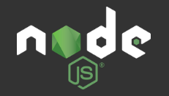
Development Environment
MongoDB (https://www.mongodb.com/)
ExpressJS (http://expressjs.com/)
JQuery (https://jquery.com/)
NodeJS (https://nodejs.org/)

Slide 5
MongoDB
MongoDB (from humongous) is a free and open-source cross-platform document-oriented database program. Classified as a NoSQL database program, MongoDB avoids the traditional table-based relational database structure in favor of JSON-like documents with dynamic schemas (It calls the format BSON), making the integration of data in certain types of applications easier and faster. MongoDB is developed by MongoDB Inc. and is free and open-source, published under a combination of the GNU Affero General Public License and the Apache License.
(https://en.wikipedia.org/wiki/MongoDB)

Slide 6
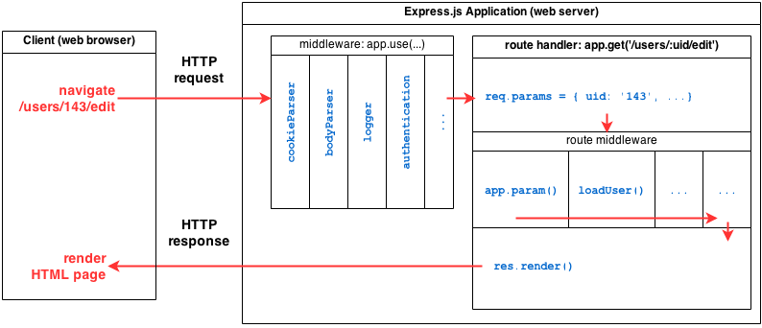
ExpressJS
ExpressJS is a complete web framework solution. It has HTML template solutions (jade, ejs, handlebars, hogan.js) and CSS precompilers (less, stylus, compass). Through middlewares layers, it handles: cookies, sessions, caching, CSRF, compression and many more.
(http://adrianmejia.com/blog/2014/10/01/creating-a-restful-api-tutorial-with-nodejs-and-mongodb/)

Slide 7
JQuery
jQuery is a fast, small, and feature-rich JavaScript library. It makes things like HTML document traversal and manipulation, event handling, animation, and Ajax much simpler with an easy-to-use API that works across a multitude of browsers. With a combination of versatility and extensibility, jQuery has changed the way that millions of people write JavaScript.
(https://jquery.com/)

Slide 8
NodeJS
Node.js is an open-source, cross-platform JavaScript runtime environment for developing a diverse variety of tools and applications. Although Node.js is not a JavaScript framework, many of its basic modules are written in JavaScript, and developers can write new modules in JavaScript. The runtime environment interprets JavaScript using Google's V8 JavaScript engine.
Node.js has an event-driven architecture capable of asynchronous I/O. These design choices aim to optimize throughput and scalability in Web applications with many input/output operations, as well as for real-time Web applications (e.g., real-time communication programs and browser games).
(https://en.wikipedia.org/wiki/Node.js)

Slide 9
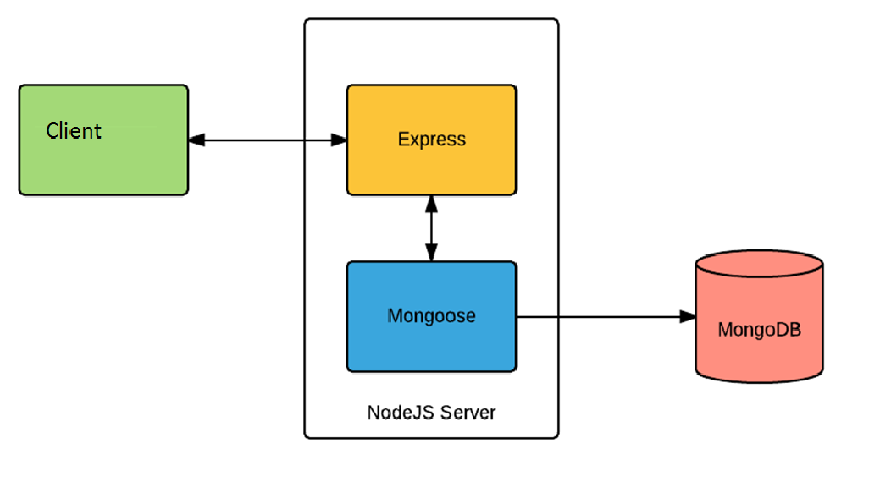
Architecture
(https://dzone.com/articles/mean-stack-apps-explained-for-java-developers)

