Slide 1
Mom And Me
Percy Gabriel Soliz Rodriguez
Saharsh Salazar Patel
Sarchina Kumari

Slide 2


Introduction
Mom and Me is a web based application designed for future mothers who would like to get relevant tips during different development stages of their baby keep and track off following things:
Nutritional needs
Physical development
Photo albums
Possible symptoms
Items needs
Most functions of the application will be divided on weekly basis starting from week 1 to week 40.

Slide 3
Development Environment
Eclipse Neon (http://www.eclipse.org/downloads/eclipse-packages/)
Git (https://git-scm.com/)
EGit (http://www.eclipse.org/egit/)
Bitbucket (https://bitbucket.org/)
Nodeclipse (http://www.nodeclipse.org/)
MongoDB (https://www.mongodb.com/)
ExpressJS (http://expressjs.com/)
AngularJS (https://angularjs.org/)
NodeJS (https://nodejs.org/)

Slide 4


MongoDB
MongoDB (from humongous) is a free and open-source cross-platform document-oriented database program.
Published under a combination of the GNU Affero General Public License and the Apache License.
Classified as a NoSQL database program, MongoDB avoids the traditional table-based relational database structure in favor of JSON-like documents with dynamic schemas (It calls the format BSON)
Making the integration of data in certain types of applications easier and faster.
(https://en.wikipedia.org/wiki/MongoDB)

Slide 5
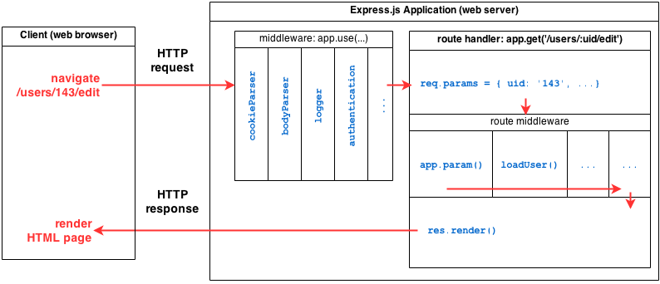
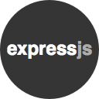
ExpressJS
ExpressJS is a complete web framework solution.
It has HTML template solutions (jade, ejs, handlebars, hogan.js) and CSS precompilers (less, stylus, compass).
Through middlewares layers, it handles: cookies, sessions, caching, CSRF, compression and many more.
(http://adrianmejia.com/blog/2014/10/01/creating-a-restful-api-tutorial-with-nodejs-and-mongodb/)

Slide 6
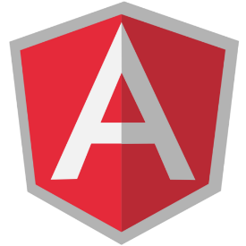
AngularJS
AngularJS (commonly referred to as "Angular" or "Angular.js") is a complete JavaScript-based open-source front-end web application framework
Mainly maintained by Google and by a community of individuals and corporations to address many of the challenges encountered in developing single-page applications.
The JavaScript components complement Apache Cordova, the framework used for developing cross-platform mobile apps.
It aims to simplify both the development and the testing of such applications by providing a framework for client-side model–view–controller (MVC) and model–view–viewmodel (MVVM) architectures.
(https://en.wikipedia.org/wiki/AngularJS)

Slide 7
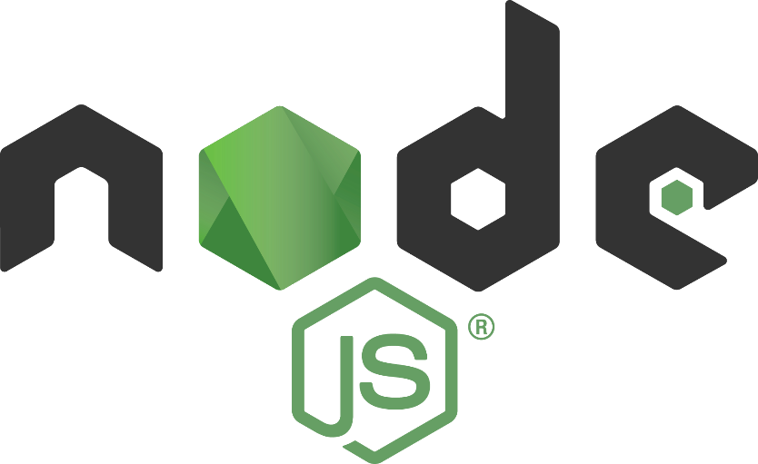
NodeJS
Node.js is an open-source, cross-platform JavaScript runtime environment for developing a diverse variety of tools and applications.
Although Node.js is not a JavaScript framework, many of its basic modules are written in JavaScript, and developers can write new modules in JavaScript.
The runtime environment interprets JavaScript using Google's V8 JavaScript engine.
Node.js has an event-driven architecture capable of asynchronous I/O. These design choices aim to optimize throughput and scalability in Web applications with many input/output operations, as well as for real-time Web applications (e.g., real-time communication programs and browser games).
(https://en.wikipedia.org/wiki/Node.js)

Slide 8

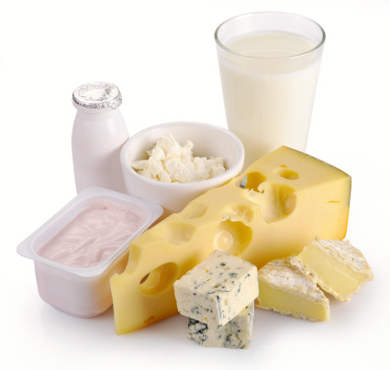
MEAN
MEAN is a free and open-source JavaScript software stack for building dynamic web sites and web applications.
Because all components of the MEAN stack support programs are written in JavaScript, MEAN applications can be written in one language for both server-side and client-side execution environments.
Components
MongoDB, a NoSQL database
Express.js, a web application framework that runs on Node.js
Angular.js, a JavaScript MVC framework that runs in browser JavaScript engines
Node.js, an execution environment for event-driven server-side and networking applications
(https://en.wikipedia.org/wiki/MEAN_(software_bundle))

Slide 9
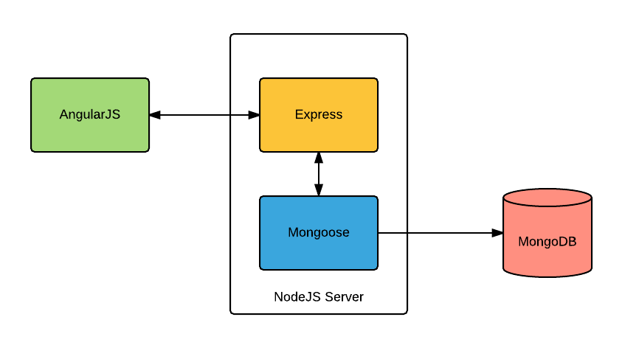
MEAN
(https://dzone.com/articles/mean-stack-apps-explained-for-java-developers)

