Slide 1
DATA MINING PROJECT - Group 04
Cleaning, Preprocessing and Exploring Data
for Safe Driver Prediction
COURSE TITLE : CS685A - Data Mining
COURSE INSTRUCTOR : Prof. Arnab Bhattacharya
TEAM MEMBERS :
JAYANT GANGWAR (180327) PARTH SOMANI (180503)
SHIVAM TULSYAN (180723)

Slide 2
INTRODUCTION
This project aims at getting a good insight in the data for the Safe Driver Prediction.
It focuses mainly on preparing the data for modeling.
The project can be classified into these following main sections:
Visual inspection of data
Defining the metadata
Descriptive statistics
Handling imbalanced classes
Checking Data quality
Exploratory data visualization
Feature engineering
Feature selection
Feature scaling

Slide 3
DATA Description
DATA Management
Features belonging to similar groupings are tagged accordingly in the feature titles, i.e., (ind, reg, car, calc…)
This titles include a postfix either bin to indicate binary features and cat to indicate categorical features.
Features without any postfix are either ordinal or continuous.
Entries missing in the original observation are indicated by -1.
The target column signifies if that policy holder filed a claim or not.
For better data management, the features are categorized on multiple grounds. This helps to select specific variables for tasks like analysis, visualization, modeling etc.
Following are the grounds and categories used :
role : input, ID, target
level : nominal, interval, ordinal, binary
keep : True, False
data_type : integer, float

Slide 4
Handling Imbalanced Classes
As the proportion of records with target=1 is far less than target=0. This can lead to a model that has great accuracy but does have any added value in practice. Two possible general strategies to deal with this problem are:
Oversampling records with target=1
Under-sampling records with target=0
As we have a rather large training set, we can go for under-sampling.
After this handling the dataset has target=0, 9 times, it has target=1.

Slide 5
Handling Data Quality
Following are the measures taken to improve data quality and handle missing values :
ps_reg_03 (continuous) has missing values for 18% of all records. Replacing these by respective mean of the feature column.
ps_car_12 (continuous) has only 1 records with missing value. Replacing these by respective mean of the feature column.
ps_car_14 (continuous) has missing values for 7% of all records. Replacing these by respective mean of the feature column.
ps_car_11 (ordinal) has only 5 records with missing values. Replacing these by respective mode of the feature column.
ps_car_03_cat and ps_car_05_cat have a large proportion of records with missing values. Removing these features from the dataset altogether.
For the other categorical features with missing values, we can leave the missing value -1 as such.

Slide 6
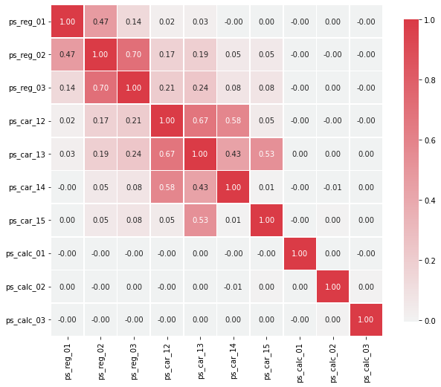
Exploratory Data Visualization
For checking the correlations between interval features, heatmap is a good way to visualize the correlation between features.
Following features are found to have strong correlations:
ps_reg_02 and ps_reg_03 (0.7)
ps_car_12 and ps_car13 (0.67)
ps_car_12 and ps_car14 (0.58)
ps_car_13 and ps_car15 (0.67)
Heatmap of interval features

Slide 7
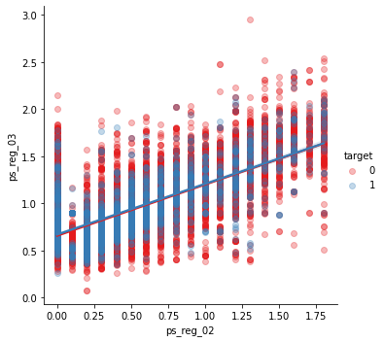
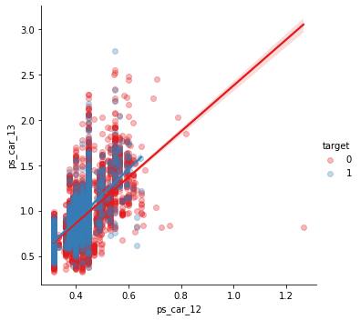
Using pair plots to visualize relationship between features

Slide 8
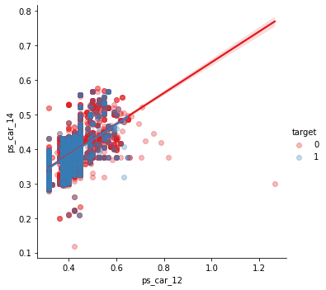
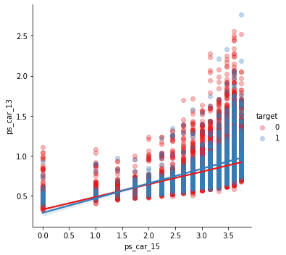
Using pair plots to visualize relationship between features

Slide 9
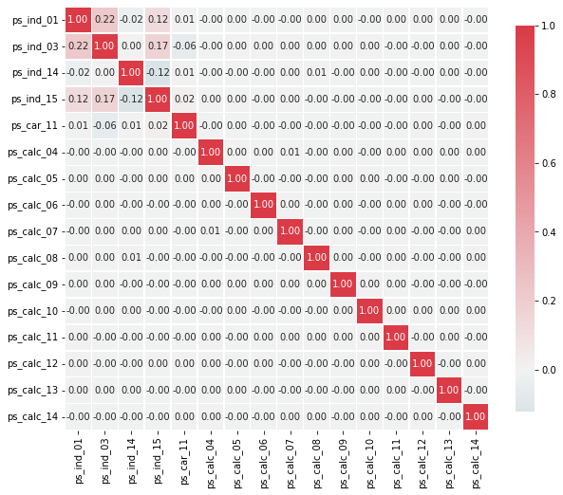
Exploratory Data Visualization
For the ordinal variables we do not see many correlations. We could, on the other hand, look at how the distributions are when grouping by the target value.
Heatmap of ordinal features

Slide 10
Feature Selection
Feature Scaling
We can start with removing features with no or a very low variance. But if we would remove features with less than 1% variance, we would remove 31 variables. We would lose rather many variables if we would select based on variance. As we do not have so many variables, we'll let the classifier chose. For data sets with many more variables this could reduce the processing time. We'll base, feature selection on the feature importances of a random forest. Setting a threshold on the level of feature importance manually. But we'll simply select the top 50% best variables.
Feature Scaling is a technique to standardize the independent features present in the data in a fixed range. We can apply standard scaling to the training data. Some classifiers perform better when this is done. We used Feature Standardization method which makes the values of each feature in the data have zero-mean (when subtracting the mean in the numerator) and unit-variance.

Slide 11
THANKS!

