Slide 1
LuK 2.0 A crowdsourced edge solution for Amber Alert

Slide 2
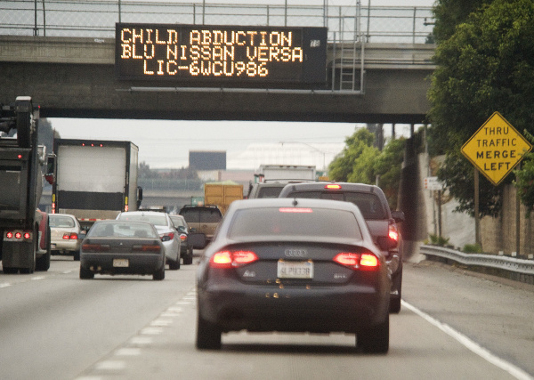
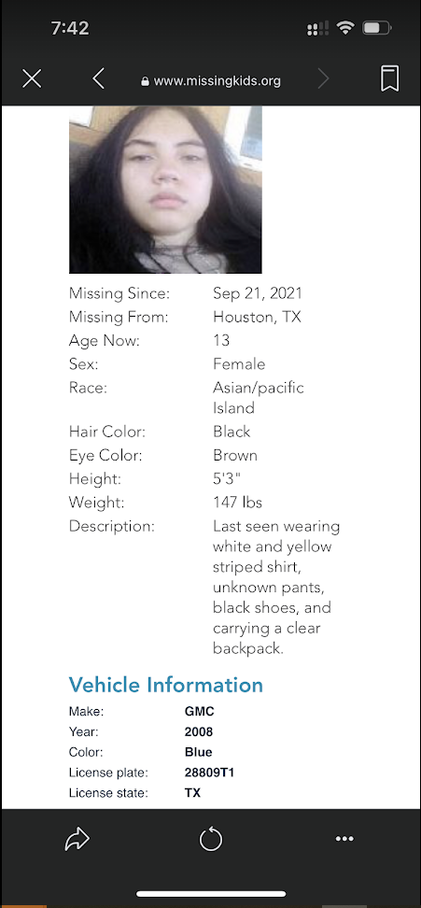
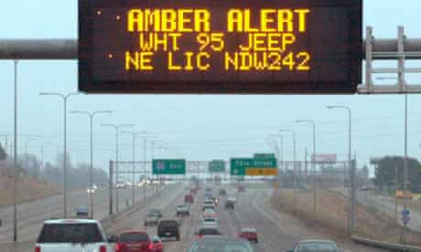
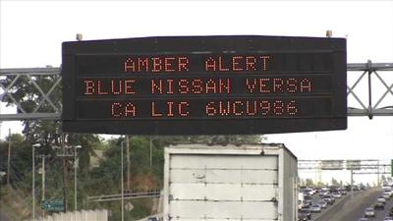
Amber Alert
Amber Alert is one of the most effective tool to look for missing children. These alerts are distributed via different channels, including electronics traffic control signs (as shown below).
Unfortunately, it is almost impossible to remember the details (like license plate number) and look for the car (matching license plate number), while driving. Here, let me introduce LuK, a technology solution, which can automate these steps.

Slide 3
What is LuK?
LuK is a small edge device with camera.
LuK can be mounted in car dashboard to record video of the traffic.
LuK can process real time video stream using on-board ML model to identify all license plate numbers.
LuK can pull Amber Alert details (like License plate number) from the cloud and match with live recorded traffic data.
LuK can generate mobile notification, once match is found.
LuK can push data to cloud to generate aggregated dashboard with matching data.

Slide 4
What is new in LuK 2.0?
Due to the time constraint, the LuK 1.0 was developed as a mobile phone-based solution. The LuK 2.0 will be developed using a real edge device, where the matching logic (powered by a ML model) will be implemented in a chip.
The current aspiration is to use ESP32-Cam chip for this project. The chip has the capability of recording videos and running light-weight ML model on-board. But the constraint is its very small footprint - only 520KB RAM, 4MB Pseudostatic RAM and 32MB Flash memory. So, we may decide to use some other more powerful chip as this edge device.

Slide 5






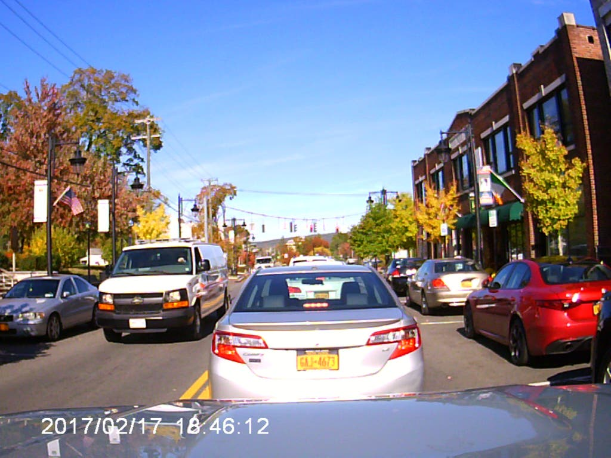


High-level dataflow architecture
1
2
6
8
Active
Amber Alert
Active
License Plate
Call 9-1-1
Matched
License Plate Number
(mobile)
Deactivated
Amber Alert
Deactivated
License Plate
Process live Amber Alert data
Matching Logic
Show Alert
Call Authority
A
D
Matched
License Plate Number (dashboard)
E
G
7
5
Identified License
Plate Number
3
4
Capture video stream
from the dashboard camera
Create Image stream
to be processed
Record Live Traffic Data
Extract License Plate Number
Aggregated Dashboard
B
C
F
LuK

Slide 6
Ownership – Data Transfer
Id | Name | Owner | Status | Target Date | Comment
1 | Active/Deactivated Amber Alert | Akshita Agarwalla
2 | Active/Deactivated license plate | Akshita Agarwalla
3 | Capture video stream from the dashboard camera | Tony Faulds
4 | Create image stream to be processed | Tony Faulds
5 | Identified license plate number | Tony Faulds
6 | Matched license plate number (mobile) | Debanjana Baksi
7 | Matched license plate number (dashboard) | Debanjana Baksi
8 | Call 9-1-1 | TBD

Slide 7
Ownership – Processing Logic
Id | Name | Owner | Status | Target Date | Comment
A | Process live Amber Alert data | Akshita Agarwalla
B | Record Live Traffic Data | Tony Faulds
C | Extract License Plate Number | Tony Faulds | WIP
D | Matching Logic | Akshita Agarwalla
E | Show Alert | Debanjana Baksi | WIP
F | Aggregated Dashboard | TBD
G | Call Authority | TBD

Slide 8
1. Active/Deactivated Amber Alert
In case of emergency, Amber alert is generated and broadcasted using multiple mediums, like FB Group, via open API, broadcasted to registered phone etc.
A typical alert contains multiple data points for the missing person, like name, age, sex, hair color, height weight etc. It also optionally contains the image of the missing person and vehicle information.
The purpose of this data transition layer is to periodically (frequency : tbd) check external Amber Alert system to look for active amber alert data and pass it to the next processing unit.
Note, it should also pull data for recently deactivated amber alert, so that the ‘search operation’ for that alert can be stopped.

Slide 9
2. Active/Deactivated License Plate
<Enter details like description, input/output, processing logic, special consideration etc. etc.>

Slide 10
3. Capture Video Stream from Dashboard Camera
<Enter details like description, input/output, processing logic, special consideration etc. etc.>

Slide 11
4. Crete Image Stream to be processed
<Enter details like description, input/output, processing logic, special consideration etc. etc.>

Slide 12
5. Identified License Plate Number
<Enter details like description, input/output, processing logic, special consideration etc. etc.>

Slide 13
6. Matched License Plate Number (mobile)
<Enter details like description, input/output, processing logic, special consideration etc. etc.>

Slide 14
7. Matched License Plate Number (dashboard)
<Enter details like description, input/output, processing logic, special consideration etc. etc.>

Slide 15
8. Call 9-1-1
<Enter details like description, input/output, processing logic, special consideration etc. etc.>

Slide 16
A. Process Live Amber Alert Data
This processing unit will process all received active amber alert data to maintain an ‘active list of license plate numbers’, for which the ‘search operation’ should be conducted. Each record in that list should contain following data points.
Alert Id
Date/Time, when the alert was generated
Location, for which the alert was generated
License place number
Date/Time, when the alert was deactivated = NULL
The process unit will also process all recently deactivated amber alert data to update the ‘active list of license plate numbers’, by making a change in the corresponding record – enter date/time of deactivation of the alert.

Slide 17
B. Record live traffic data
<Enter details like description, input/output, processing logic, special consideration etc. etc.>

Slide 18
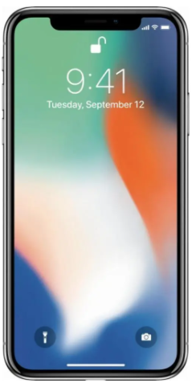
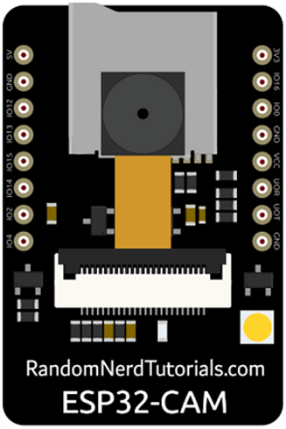
C. Extract License Plate Number
This is a pre-trained ML model running in an edge device to detect available license plate numbers from a given list of images. There are three major challenges to develop this model.
It should be fast (to process a stream of images)
It should be accurate (to identify all available license plate numbers from an image)
It should have small foot-print to fit in a small edge device
LuK
Edge Device
???????
Mobile phone
as the edge device
ESP32-Cam
as the edge device
Cost, Energy efficiency, Ease to deploy
Foot-Print, Accuracy, Ease to train a model

Slide 19
D. Matching Logic
<Enter details like description, input/output, processing logic, special consideration etc. etc.>

Slide 20
E. Show Alert
<Enter details like description, input/output, processing logic, special consideration etc. etc.>

Slide 21
F. Aggregated Dashboard
<Enter details like description, input/output, processing logic, special consideration etc. etc.>

Slide 22
G. Call Authority
<Enter details like description, input/output, processing logic, special consideration etc. etc.>

Slide 23
Appendix

Slide 24

Future Reference
What is Amber Alert
Missing Children Statistics (2021)
2019 Amber Alert Report
Source Code (github)

