Slide 1


The Use of Fractional Polynomials in Multivariable Regression Modeling
Patrick Royston
MRC Clinical Trials Unit,
London, UK
Willi Sauerbrei
Institut of Medical Biometry and Informatics
University Medical Center Freiburg, Germany
Part I - General considerations and
issues in variable selection

Slide 2
The problem …
“Quantifying epidemiologic risk factors using non-parametric regression: model selection remains the greatest challenge”
Rosenberg PS et al, Statistics in Medicine 2003; 22:3369-3381
Trivial nowadays to fit almost any model
To choose a good model is much harder

Slide 3
Motivation (1)
Often have (too) many variables
Which variables should be selected in a
‚final‘ model?
‚Unimportant‘ variable included ⇒ overfitting
‚Important‘ variable excluded ⇒ underfitting

Slide 4
Motivation (2)
Often have continuous risk factors in epidemiology and clinical studies – how to model them?
Linear model may describe a dose-response relationship badly
  ‘Linear’ = straight line = β₀ + β₁ X + … throughout talk
Using cut-points has several problems
Splines recommended by some – but are not ideal
Discussed in part 2, here in part 1 it is assumed that the linearity assumption is justified.

Slide 5
Overview
Regression models
Before model building starts
Variable selection procedures
Estimation after variable selection
Shrinkage
Complexity
Reporting
Summary
Situation in mind:
About 5 to 20 variables, sample size ‚sufficient‘

Slide 6
Observational Studies
Several variables, mix of continuous and (ordered) categorical variables, pairwise- and multicollinearity present
  Model selection required
Use subject-matter knowledge for modelling ...
... but for some variables, data-driven choice inevitable

Slide 7
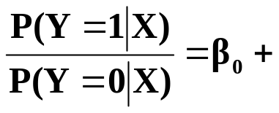
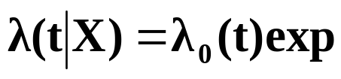
Regression models
X=(X₁, ...,X_{p}) covariate, prognostic factors
g(x) = ß₁ X₁ + ß₂ X₂ +...+ ß_{p} X_{p} (assuming effects are linear)
normal errors (linear) regression model
Y normally distributed
E (Y|X) = ß₀ + g(X)
Var (Y|X) = σ²I
logistic regression model
Y binary
Logit P (Y|X) = ln
survival times
T survival time (partly censored)
Incorporation of covariates
g(X)
(g(X))

Slide 8
Central issue
To select or not to select (full model)?
Which variables to include?

Slide 9





Which variables should be included?
Effect of underfitting and overfitting
Illustration by simp le example in linear regression models (mean of 3 runs)
3 predictors r_{1,2} = 0.5, r_{1,3} = 0, r_{2,3} = 0.7, N = 400, σ² = 1
Correct model M₁ y = 1 . x₁ + 2 . x₂ + ε
 | M₁ (true) | M₂ (overfitting) | M₃ (underfitting)
 | 1.050 (0.059) | 1.04 (0.073) | -
 | 1.950 (0.060) | 1.98 (0.105) | 2.53 (0.068)
 | - | -0.03 (0.091) | ₋
 | 1.060 | 1.060 | 1.90
R² | 0.875 | 0.875 | 0.77
M₂ overfitting y = ß₁x₁ + ß₂x₂ + ß₃x₃ + ε
Standard errors larger (variance inflation)
M₃ underfitting y = ß₂x₂ + ε
‚biased‘, different interpretation, R² smaller, stand. error (VIF↓, ↑)?

Slide 10
Building multivariable regression models –
Preliminaries 1
  ‚Reasonable‘ model class was chosen
  Comparison of strategies
    Theory
        only for limited questions, unrealistic assumptions
    Examples or simulation
      Examples from literature
        simplifies the problem
        data clean
        ‚relevant‘ predictors given
        number predictors managable

Slide 11
Building multivariable regression models –
Preliminaries 2
  Data from defined population, relevant data available (‚zeroth problem‘, Mallows 1998)
  Examples based on published data
  rigorous pre-selection → what is a full model?

Slide 12
Building multivariable regression models –
Preliminaries 3
  Several ‚problems‘ need a decision before the analysis can start
  Eg. Blettner & Sauerbrei (1993), searching for hypotheses in a case-control study (more than 200 variables available)
  Problem 1. Excluding variables prior to model building.
  Problem 2. Variable definition and coding.
  Problem 3. Dealing with missing data.
  Problem 4. Combined or separate models.
  Problem 5. Choice of nominal significance level and selection procedure.

Slide 13
Building multivariable regression models –
Preliminaries 4
More problems are available,
see discussion on initial data analysis in Chatfield (2002) section ‚Tackling real life statistical problems‘ and
Mallows (1998)
‚Statisticians must think about the real problem, and must make judgements as to the relevance of the data in hand, and other data that might be collected, to the problem of interest ... one reason that statistical analyses are often not accepted or understood is that they are based on unsupported models. It is part of the statistician’s responsibility to explain the basis for his assumption.‘

Slide 14
Aims of multivariable models
Prediction of an outcome of interest
Identification of ‘important’ predictors
Adjustment for predictors uncontrollable by experimental design
Stratification by risk
... and many more

Slide 15
Classes of multivariable models
1. The model is predefined. All that remains is to estimate the parameters and check the main assumptions.
2. The aim is to develop a good predictor. The number of variables should be small.
3. The aim is to develop a good predictor. Limiting the model complexity is not important.
4. The aim is to assess the effect of one or several (new) factors of interest, adjusting for some established factors in a multivariable model.
5. The aim is to assess the effect of one or several (new) factors of interest, adjusting for confounding factors determined in a data-dependent way by multivariable modelling.
6. Hypothesis generation of possible effects of factors in studies with many covariates.

Slide 16
Multivariable models - methods for variable selection
Full model
  variance inflation in the case of multicollinearity
    Wald-statistic
Stepwise procedures ⇒ prespecified (α_{in}, α_{out}) and
actual significance level?
    forward selection (FS)
    stepwise selection (StS)
    backward elimination (BE)
All subset selection ⇒ which criteria?
    C_{p} Mallows
    AIC Akaike Information Criterion
    BIC Bayes Information Criterion
Bayes variable selection
MORE OR LESS COMPLEX MODELS?
WHAT ABOUT THE FUNCTIONAL FORM?

Slide 17
Stepwise procedures
Central Issue: significance level
Criticism
FS and StS start with ‚bad‘ univariate models (underfitting)
BE starts with the full model (overfitting),
less critical
Multiple testing, P-values incorrect

Slide 18

All subset selection
(normal errors regression model)
criteria for best model
- fixed number of covariables: R² = 1 - (SSE / SYY)
- models with different number of covariables (p)
i) Mallows' C_{P} = (SSE / ) - n + p 2
ii) Akaike's AIC = n ln (SSE / n) + p 2
iii) BIC = n ln (SSE / n) + p ln (n)
fit penalty
other criteria with minor variations
Several approaches transferred for generalized linear models and models for survival data

Slide 19
Other procedures
Variable clustering
Incomplete principal components
Change-in-estimate
Bootstrap selection
Selection and shrinkage (Lasso, Garotte, ...)

Slide 20
Theoretical results for model building strategies:
'Exact distributional results are virtually impossible to obtain, even for simplest of common subset selection algorithms'
Picard & Cook, JASA,1984

Slide 21
"Recommendations" from the literature
(up to 1990, after more than 20 years of use and research)
  Mantel (1970)
  '... advantageous properties of the stepdown regression procedure (BE) ...‚ in comparison to StS
  Draper & Smith (1981)
  '... own preference is the stepwise procedure. To perform all regressions is not sensible, except when there are few predictors'
  Weisberg (1985)
  'Stepwise methods must be used with caution. The model selected in a stepwise fashion need not optimize any reasonable criteria for choosing a model. Stepwise may seriously overstate significance results'
  Wetherill (1986)
  `Preference should be given to the backward strategy for problems with a moderate number of variables‚ in comparison to StS
  Sen & Srivastava (1990)
  'We prefer all subset procedures. It is generally accepted that the stepwise procedure (StS) is vastly superior to the other stepwise procedures'.

Slide 22
Harrell 2001, Regression Modeling Strategies
Stepwise variable selection ...if ... just been proposed ... likely be rejected because it violates every principle of statistical estimation and hypothesis testing.
... no currently available stopping rule was developed for data-driven variable selection. Stopping rules as AIC or Mallows´ C_{p} are intended for comparing only two prespecified models.
Full model fits have the advantage of providing meaningful confidence intervals using standard formulas
... Bayes several advantages ...
LASSO-Variable selection and shrinkage
…AND WHAT TO DO?

Slide 23
Variable selection
All procedures have severe problems!
Full model? No!
Illustration of problems
Too often with small studies
(sample size versus no. variables)
Arguments for the full model
Often by using published data
Heavy pre-selection!
What is the full model?

Slide 24

Type I error of selection procedures
Actual significance level (linear regression model)
For all-subset methods in good agreement with asymptotic results for one additional variable (Teräsvirta & Mellin, 1986)
- for moderate sample size only slightly higher than
BE ~ α_{in}
All-AIC ~ 15.7 %
All-BIC ~ P ( > ln (n))
0.032 N = 100
0.014 N = 400
Increases with correlation to variable with effect (‚wrong‘ variable selected)

Slide 25
Backward elimination is a sensible approach
Significance level can be chosen depending on the modelling aim
Reduces overfitting
Of course required:
Checks
Sensitivity analysis
Stability analysis

Slide 26
Different selection procedures, same results??
SHOCK
Risk factors for CHD
N=7088, 456 events (McGee et al. 1984)
Selection | Factor
method | Calories | Protein | Fat | Carbohydrates
Full model | XX | X | X
BE | XXX |  | XX
SS |  |  |  | XXX
β/SE | 3.05 | 2.14 | 2.43 | 1.13
X – 5%; XX – 1%; XXX – 0.1%
Extreme situation, strong correlation! Selection sensible?
Just estimate the parameters in the model with 4 variables

Slide 27
Another SHOCK
Prognostic factors for multiple myeloma, N = 65, 26% cens, Kuk (1984)
 |  |  | BE (0.05) | StS (0.05)
1 |  |  | X | X
2 |  |  |  | X
3 |  |  | X
4 |  |  | X
5
6 |  |  | X
7 |  |  | X
8
9
10
11
12 |  |  | X
13 |  |  | X
14
15
16
Full model (5%) | AII - AIC
X | X
X | X
 | X
 | X
X | X
 | X
X | X
X | X

Slide 28
More realistic and typical situation
Prognostic factors for brain tumor (glioma, N=413, 274 deaths)
15 variables, multicollinearity
Compare models selected with BE and StS
Consider different significance levels (0.01, 0.05, 0.10, 0.157)
Compare AIC with BE (0.157)
All models include X₃, X₅, X₆, X₈ (call it M_{B})
(in the full model these 4 variables have p < 0.05,
no other variable with p < 0.05).

Slide 29
Glioma study – models selected
Procedure | Sign. level | Model selected
BE | 0.01 | M_{B}
StS | 0.01 | M_{B}
BE | 0.05 | M_{B}+ X₁₂
StS | 0.05 | M_{B}+ X₁₂
BE | 0.10 | M_{B}+ X₁₂ + X₄ + X₁₁ + X₁₄
StS | 0.10 | M_{B}+ X₁₂ + X₁
BE | 0.157 | M_{B}+ X₁₂ + X₄ + X₁₁ + X₁₄ + X₉
StS | 0.157 | M_{B}+ X₁₂ + X₄ + X₁₁ + X₁₄ + X₉
AIC | − | M_{B}+ X₁₂ + X₄ + X₁₁ + + X₉ + X₁₃

Slide 30
Glioma study
Estimation after selection
413 patients (274 events) with complete data
Var
 | full | BE(0.05)
X₁ | -0.09
X₂ | -0.06
X₃ | 0.31 | 0.38
X₄ | 0.12
X₅ | 0.45 | 0.43
X₆ | -0.14 | -0.16
X₇ | -0.02
X₈ | -0.31 | -0.33
X₉ | -0.10
X₁₀ | 0.04
X₁₁ | 0.12
X₁₂ | -0.13 | -0.14
X₁₃ | 0.03
X₁₄ | 0.11
X₁₅ | -0.07
For several variables SE are (much) smaller in the model with 5 variables

Slide 31
Problems caused by variable selection
  Biased estimation of individual regression parameter
  Overoptimism of a score
  Under- and Overfitting
  Replication stability (see part 2)
Severity of problems influenced by complexity of models selected
Specific aim influences complexity

Slide 32

Estimation after variable selection is often biased
  Reasons for the bias
  1. Omission Bias
  True model Y = X₁ β₁ + X₂ β₂ + ε
  Decision for model with subset X₁
  Estimation with new data
  E ( ) = β₁ + (X₁' X₁)⁻¹ X₁X₂ β₂
  |............................|
  Omission bias
  2. Selection Bias
  Selection and estimation from one data set
  Copas & Long (1991)
  Choice of variables depends on estimated coefficients rather than
  their true values. X is more likely to be included if the regression
  coefficient is overestimated.
  Miller (1990)
  Competition Bias: Best subset for fixed number of parameters
  Stopping Rule Bias: Criterion for number of parameters
  ...the more extensive the search for the choosen model the greater the
  selection bias

Slide 33
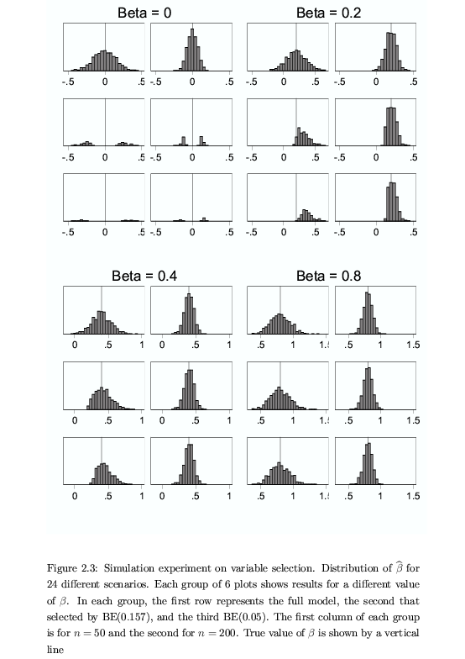
Selection bias: a problem of small sample size
n=50 n=200 n=50 n=200
Full
BE(0.05)
% incl. 4.2 4.0 28.5 80.4

Slide 34
Selection bias: a problem of small sample size (cont.)
n=50 n=200
Full
BE(0.05)
% incl. 100 100

Slide 35
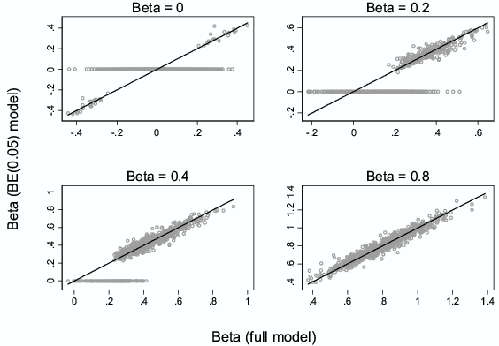
Selection bias
Estimate after variable selection with BE (0.05)
Simulation 5 predictors, 4 are ‚noise‘

Slide 36
Estimation of the parameters from a selected model
Uncorrelated variables (F – full, S - selected)
no omission bias
Z= β/ SE
in model if (approximately)
|Z| > Z(α) (1.96 for α=0.05)
if selected
β_{F} ≈ β_{S}
no selection bias if
|Z| large (β strong or N large)
selection bias if
|Z| small (β weak and N small)

Slide 37
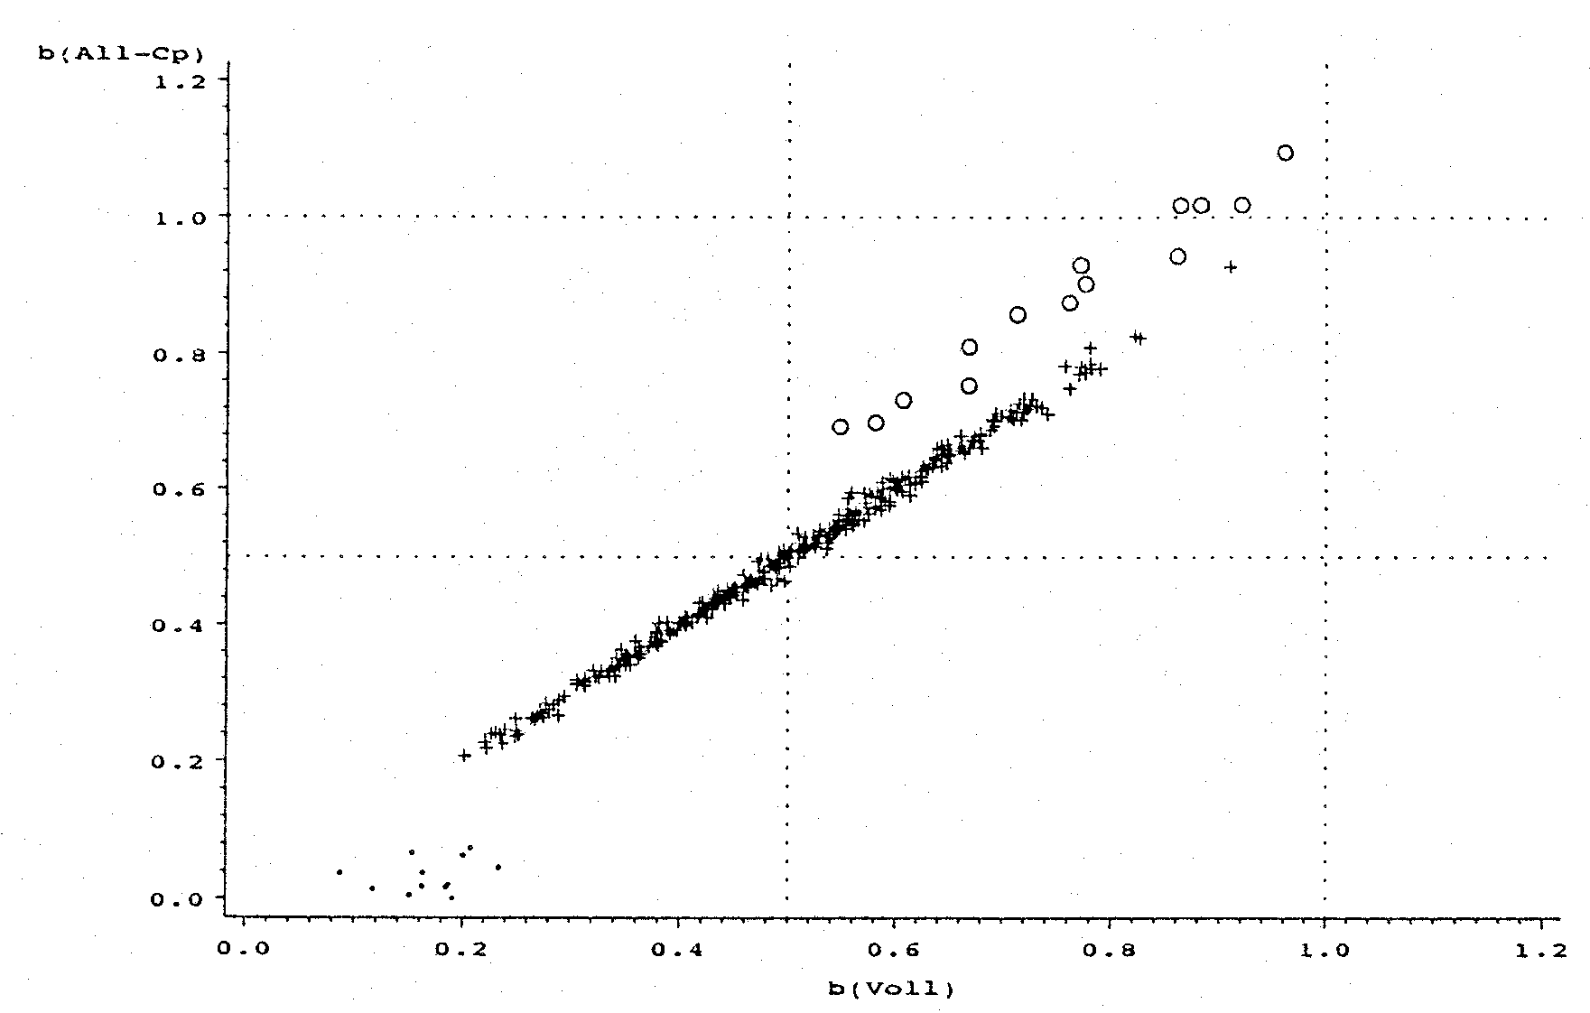
Selection and omission bias
Correlated variables, large sample size
Estimates from full and selected model
beta select
omission bias
partner not
selected
true
beta full
X₁ and X₂ in C_{p} model selected
X₂ in C_{p} model not selected
X₁ in C_{p} model not selected
true

Slide 38
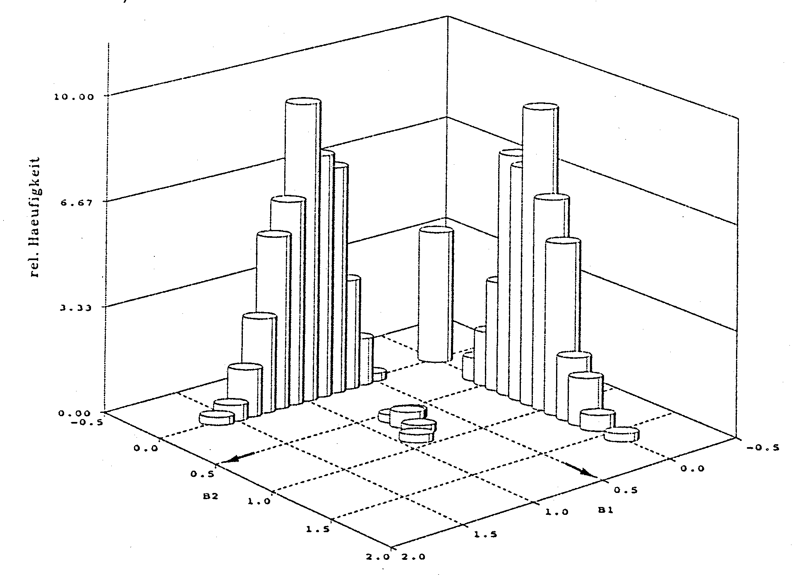
Selection and omission bias
Two correlated variables with weak effects
Small sample size, often one ‚representative‘ selected
Estimates of β₁ and β₂ from selected model
true β₂
true β₁

Slide 39
Selection bias !
Can we correct by shrinkage?

Slide 40
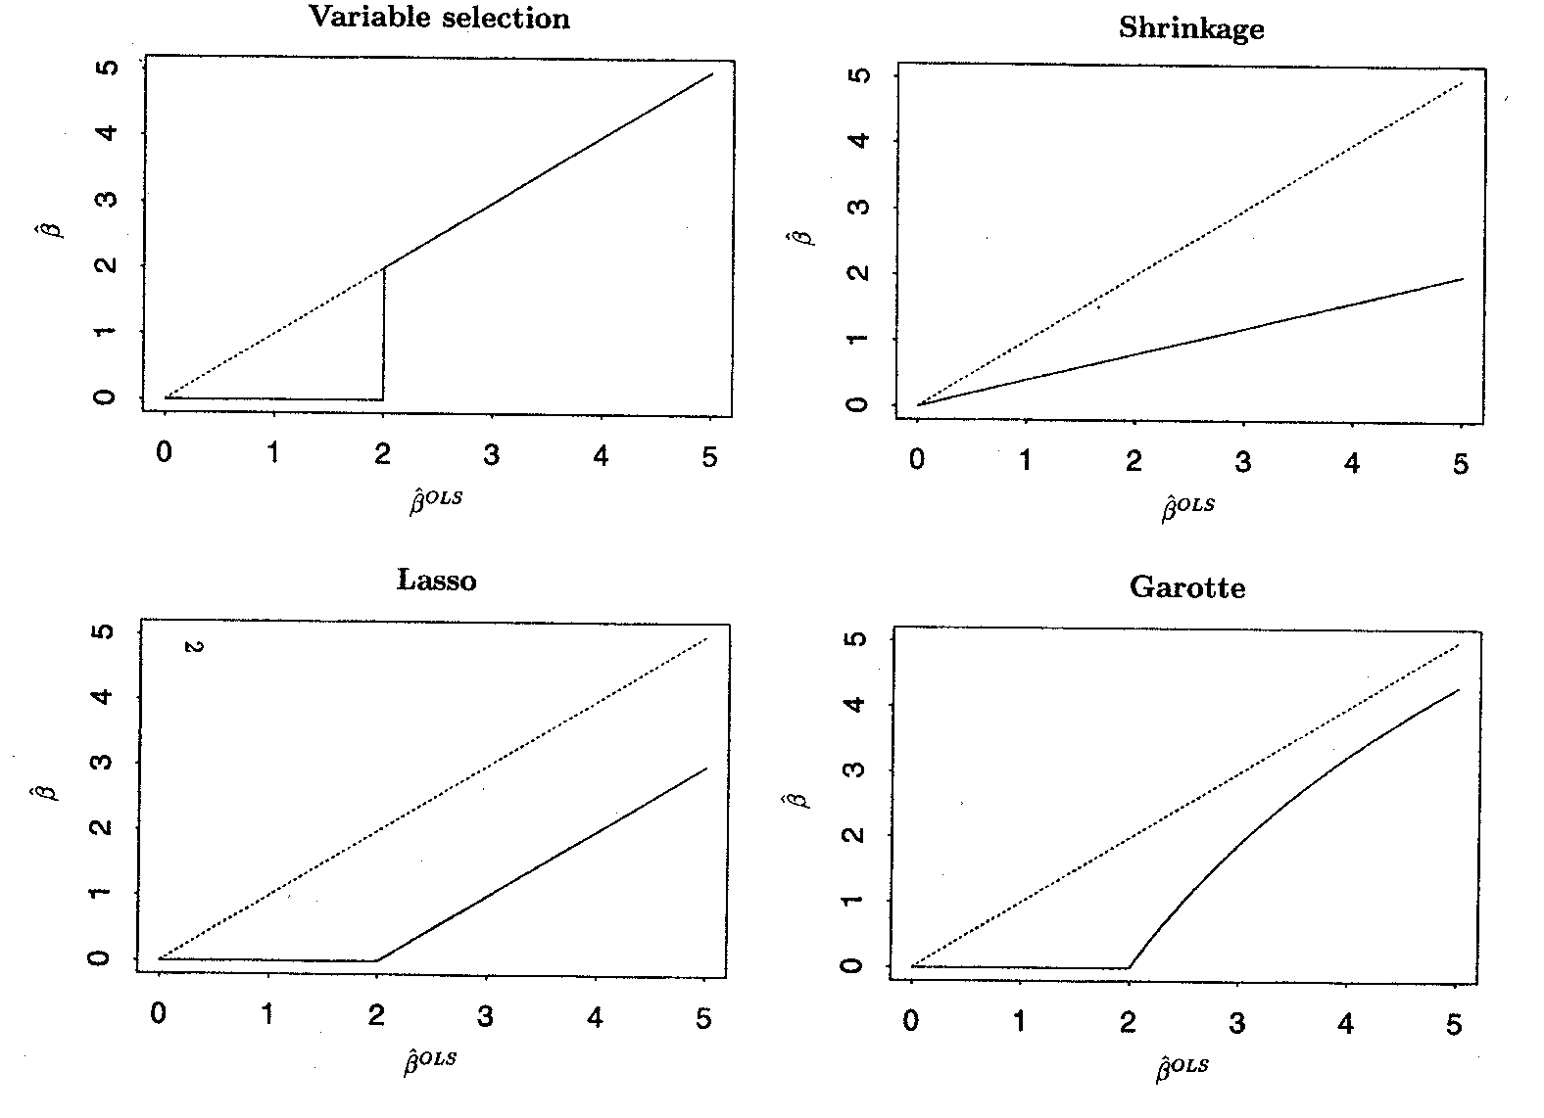
Variable Selection and Shrinkage
Regression coefficients as functions of OLS estimates
Principle for one variable
Regression coefficients zero ⇒ variable selection

Slide 41
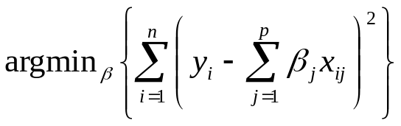

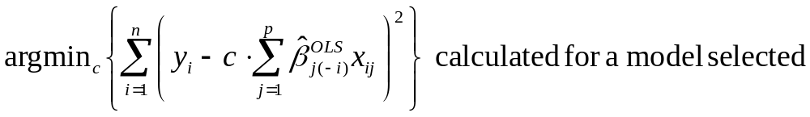
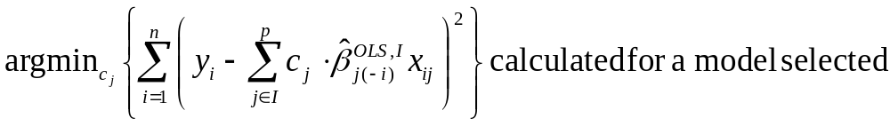
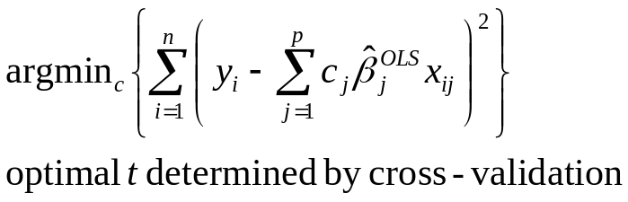
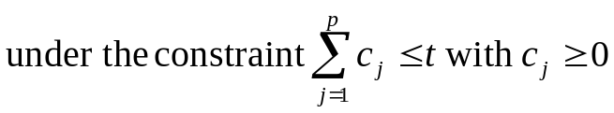
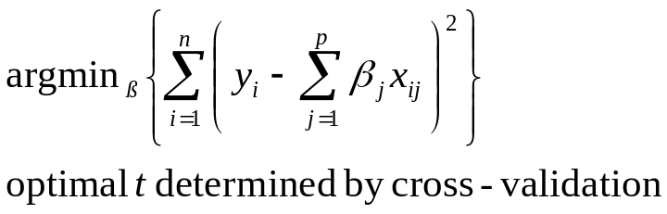
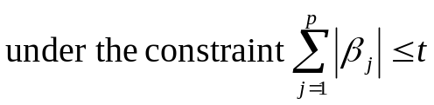
Variable selection and shrinkage
OLS
Var Sel
Shrinkage by CV calibration global
- PWSF
Garotte
Lasso

Slide 42
Selection and shrinkage
Ridge – Shrinkage, but no selection
Within estimation shrinkage
- Garotte, Lasso and newer variants
Combine variable selection and shrinkage, optimization under different constraints
Post estimation shrinkage using CV (shrinkage of a selected model)
- Global
- Parameterwise (PWSF, heuristic extension)

Slide 43
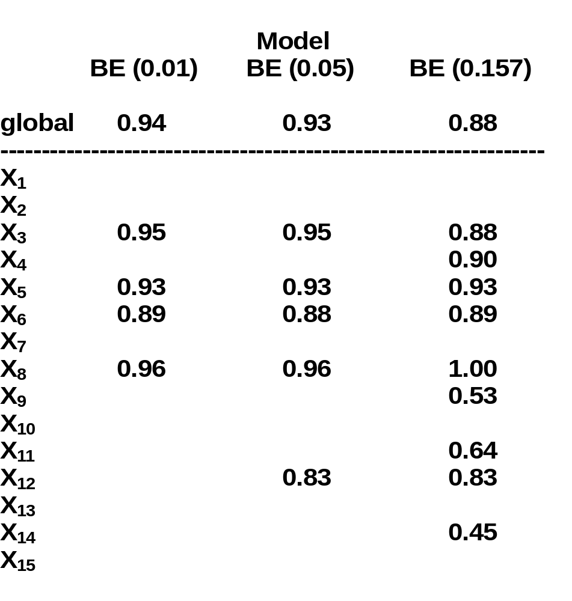
Glioma study
Global and parameterwise shrinkage factors
global – 0.80 for full model
Method may help to correct for selection bias

Slide 44
Complexity of models
Main (clinical) aim of the model has strong influence on choice of complexity
Variable selection strategies:
  AIC, BIC or stepwise strategies select on different nominal significance levels
Complexity has influence on problem of overfitting/ underfitting
Main aim prediction
Predictors are ‚dominated‘ by some strong factors

Slide 45
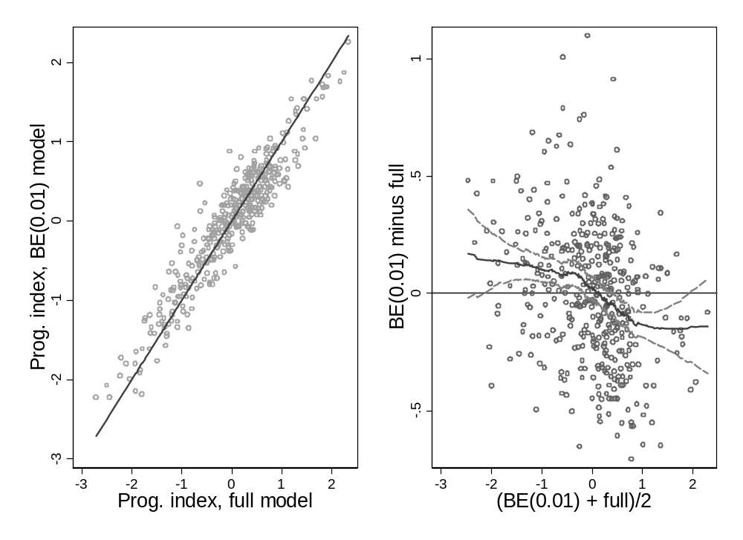
Very high correlation between predictors from simple and complex model
Glioma study (Full – 15 variables, BE – 4 variables)

Slide 46
Improvement of the publication of studies by more transparency
Standardization of the reports of clinical trials
CONSORT Statement, Begg et al. 1996/2001
Standardization of the reports of reviews
QUORUM Statement, Moher et al. Lancet 1999
Standardization of the reports of diagnostic trials
STARD Statement, Bossuyt et al. Ann Int Med 2003
Standardization of prognostic trials
REMARK Guidelines, McShane et al. JNCI 2005

Slide 47
CONSORT statement
Consolidated Standards of Reporting Trials
  http://www.consort-statement.org/
  Checklist with 22 points in 5 areas
  Flow chart for the assignment of patients
  Supported by > 50 journals
CONSORT Group, Ann Intern Med 2001

Slide 48


Slide 49
REMARK – 20 Items
Introduction (1 item)
Materials and Methods
Patients (2 items)
Specimen characteristics (1 item)
Assay methods (1 item)
Study design (4 items)
Statistical analysis methods (2 items)
Results
Data (2 items)
Analysis and presentation (5 items)
Discussion (2 items)

Slide 50
Further issues
Interpretability and Stability should be important features of a model.
Validation (internal and external) needs more consideration
Resampling methods
give important insight, but theoretically not well developed
should become integrated part of analysis
lead to more careful interpretation of results
Transportability and practical usefulness are important criteria
  (Prognostic models: clinically useful or quickly forgotten? Wyatt & Altman 1995)
Be carefull with too complex models

Slide 51
Summary (1)
Model building in observational studies
(many issues are easier in randomized trials)
All models are wrong, some, though are better than others and we can search for the better ones. Another principle is not to fall in love with one model, to the exclusion of alternatives (Mc Cullagh & Nelder 1983)

Slide 52
Summary (2)
More than 10 strategies for variable selection
Nominal significance level is the key factor
Usual estimates after selection may be (heavily) biased, especially for small studies
Specific aim of a study has
influence on selection strategy
influence on importance of the problems
- replication stability
- under- and overfitting
- biased estimation of regression parameters
- overoptimism
Personal preference against over complex models
Importance of other aspects as categorization, functional relationship often underrated (see part 2)

Slide 53
Discussion and Outlook
Properties of selection procedures need further study
More prominent role for complexity and stability in analyses required - resampling methods well suited
Combination of selection and shrinkage
Model uncertainty concept

