Slide 1


The use of fractional polynomials in multivariable regression modelling
Willi Sauerbrei
Institut of Medical Biometry and Informatics
University Medical Center Freiburg, Germany
Patrick Royston
MRC Clinical Trials Unit,
London, UK
Part II: Coping with continuous predictors

Slide 2
Overview
Context, motivation and data sets
The univariate smoothing problem
Introduction to fractional polynomials (FPs)
Multivariable FP (MFP) models
Robustness
Stability
Interactions
Other issues, software, conclusions, references

Slide 3
The problem …
“Quantifying epidemiologic risk factors using non-parametric regression: model selection remains the greatest challenge”
Rosenberg PS et al, Statistics in Medicine 2003; 22:3369-3381
Trivial nowadays to fit almost any model
To choose a good model is much harder

Slide 4
Overview
Context, motivation and data sets
The univariate smoothing problem
Introduction to fractional polynomials (FPs)
Multivariable FP (MFP) models
Robustness
Stability
Interactions
Other issues, software, conclusions, references

Slide 5
Motivation
Often have continuous risk factors in epidemiology and clinical studies – how to model them?
Linear model may describe a dose-response relationship badly
  ‘Linear’ = straight line = β₀ + β₁X + … throughout talk
Using cut-points has several problems
Splines recommended by some – but are not ideal (discussed briefly later)

Slide 6
Problems of cut-points
Use of cut-points gives a step function
  Poor approximation to the true relationship
  Almost always fits data less well than a suitable continuous function
‘Optimal’ cut-points have several difficulties
  Biased effect estimates
  P-values too small
  Not reproducible in other studies
Cut-points not considered further here

Slide 7
Example datasets
1. Epidemiology
Whitehall 1
  17,370 male Civil Servants aged 40-64 years
  Measurements include: age, cigarette smoking, BP, cholesterol, height, weight, job grade
  Outcomes of interest: coronary heart disease, all-cause mortality ⇒ logistic regression
  Interested in risk as function of covariates
  Several continuous covariates
    Some may have no influence in multivariable context

Slide 8
Example datasets
2. Clinical studies
German breast cancer study group - BMFT-2 trial
  Prognostic factors in primary breast cancer
  Age, menopausal status, tumour size, grade, no. of positive lymph nodes, hormone receptor status
  Recurrence-free survival time ⇒ Cox regression
  686 patients, 299 events
  Several continuous covariates
  Interested in prognostic model and effect of individual variables

Slide 9
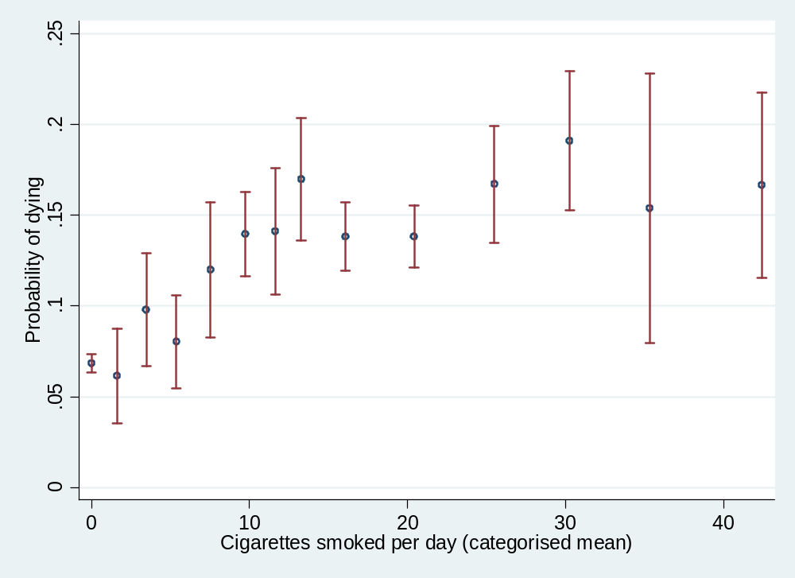
Example: all-cause mortality and cigarette smoking

Slide 10
Overview
Context, motivation and data sets
The univariate smoothing problem
Introduction to fractional polynomials (FPs)
Multivariable FP (MFP) models
Robustness
Stability
Interactions
Other issues, software, conclusions, references

Slide 11
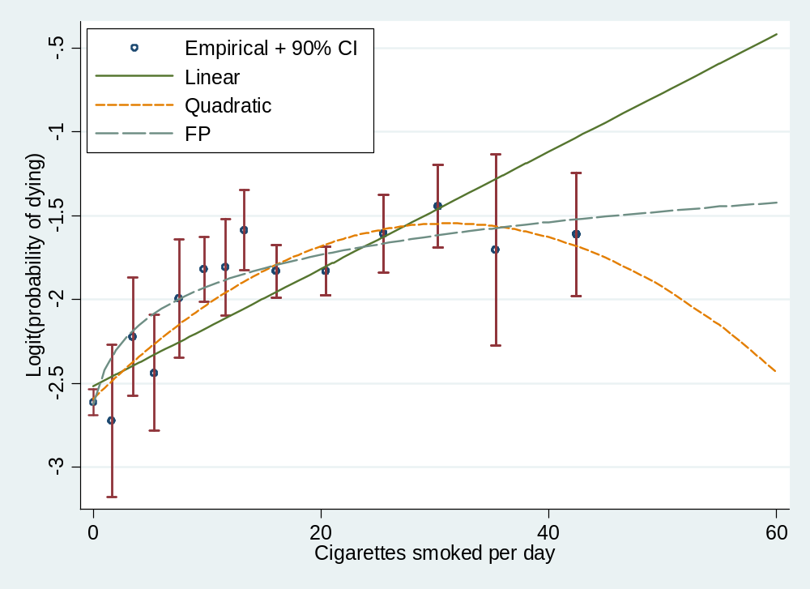
Example: all-cause mortality and cigarette smoking
Notes:
fig1.do
Underlying functional relationship is probably simple, but linear fits badly and quadratic is implausible
Notice how FP function smooths out artefacts in raw-data curve

Slide 12
Empirical curve fitting: Aims
Smoothing
Visualise relationship of Y with X
Provide and/or suggest functional form

Slide 13
Some approaches
‘Non-parametric’ (local-influence) models
  Locally weighted (kernel) fits (e.g. lowess)
  Regression splines
  Smoothing splines (used in generalized additive models)
Parametric (non-local influence) models
  Polynomials
  Non-linear curves
  Fractional polynomials

Slide 14
Local regression models
Advantages
  Flexible – because local!
  May reveal ‘true’ curve shape (?)
Disadvantages
  Unstable – because local!
  No concise form for models
    Therefore, hard for others to use – publication,compare results with those from other models
  Curves not necessarily smooth
  ‘Black box’ approach
  Many approaches – which one(s) to use?

Slide 15
Polynomial models
Do not have the disadvantages of local regression models, but do have others:
Lack of flexibility (low order)
Artefacts in fitted curves (high order)
Cannot have asymptotes
An alternative is fractional polynomials – considered next

Slide 16
Overview
Context, motivation and data sets
The univariate smoothing problem
Introduction to fractional polynomials (FPs)
Multivariable FP (MFP) models
Robustness
Stability
Interactions
Other issues, software, conclusions, references

Slide 17
Fractional polynomial models
Describe for one covariate, X
Fractional polynomial of degree m for X with powers p₁, … , p_{m} is given by
FPm(X) = β₁X^{p}₁ + … + β_{m}X^{p}_{m}
Powers p₁,…,p_{m} are taken from a special set
{−2, −1, −0.5, 0, 0.5, 1, 2, 3}
Usually m = 1 or m = 2 gives a good fit
These are called FP1 and FP2 models

Slide 18
FP1 and FP2 models
FP1 models are simple power transformations
1/X², 1/X, 1/√X, log X, √X, X, X², X³
  8 models
FP2 models are combinations of these
  For example β₁(1/X) + β₂(X²) = powers −1, 2
  28 models
Note ‘repeated powers’ models
  E.g. β₁(1/X) + β₂(1/X)log X = powers −1, −1
  8 models

Slide 19
FP1 and FP2 models: some properties
Many useful curves
A variety of features are available:
  Monotonic
  Can have asymptote
  Non-monotonic (single maximum or minimum)
  Single turning-point
Get better fit than with conventional polynomials, even of higher degree

Slide 20
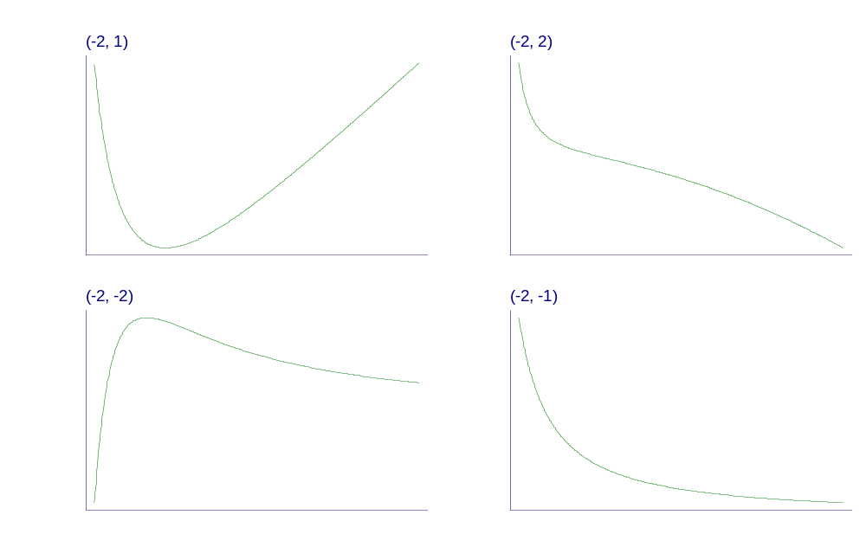
Examples of FP2 curves
- varying powers
Notes:
Fpexamp.gph, taken from c38\fig1a.gph.

Slide 21
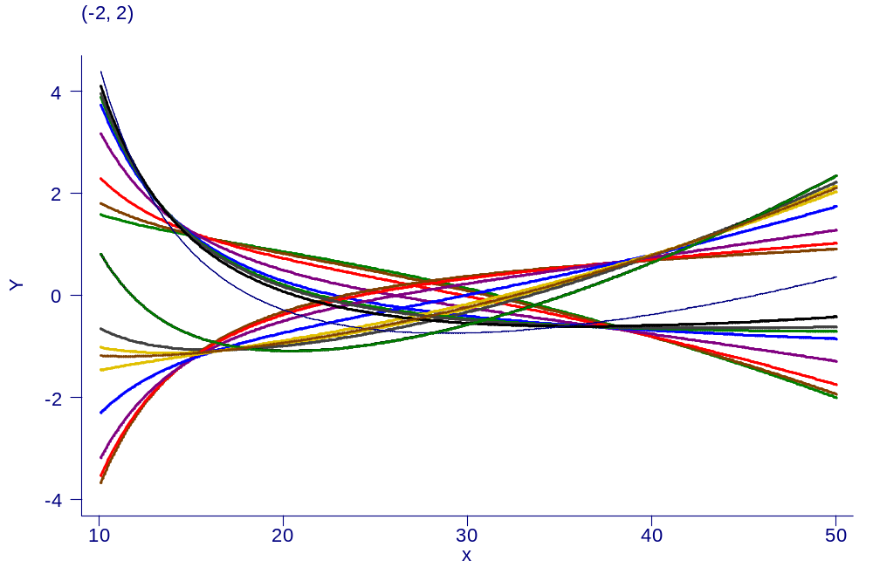
Examples of FP2 curves – same powers, different beta’s

Slide 22
A philosophy of function selection
Prefer simple (linear) model where appropriate
Use more complex (non-linear) FP1 or FP2 model if indicated by the data
Contrast to more local regression modelling
  That may already start with a complex model

Slide 23
Estimation and significance testing for FP models
Fit model with each combination of powers
  FP1: 8 single powers
  FP2: 36 combinations of powers
Choose model with lowest deviance (MLE)
Comparing FPm with FP(m−1):
  Compare deviance difference with χ² on 2 d.f.
  One d.f. for power, 1 d.f. for regression coefficient
  Supported by simulations; slightly conservative

Slide 24
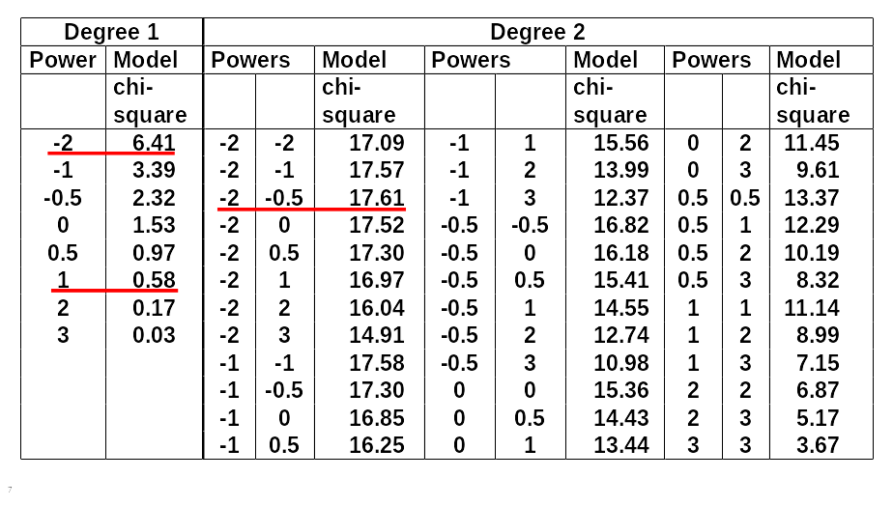
FP analysis for the effect of age (breast cancer data; age is x1)
Notes:
Many models often fit about the same
Could follow this up with fracpoly stcox x1, log to show what actually happens

Slide 25
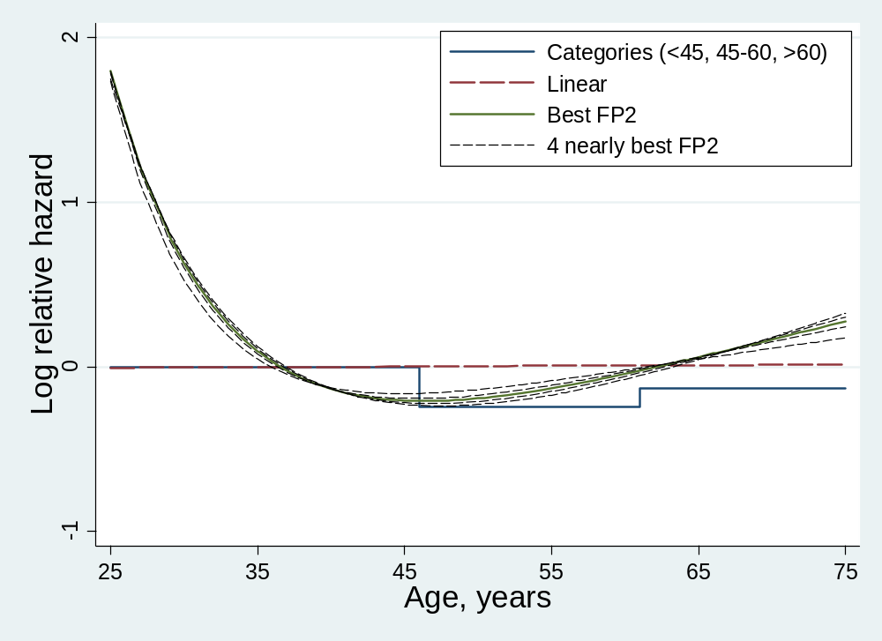
FP for age: plot
Notes:
Shows that several FP2 curves may fit nearly as well as each other.
Standardised to zero in first interval for categories (age<45)

Slide 26
Selection of FP function (1)
Closed test procedure
General principle developed during 1970’s
Preserves “familywise” (overall) type I error probability
Consider one-way ANOVA with several groups
Stop if global F-test is not significant
If significant, where are the differences?
  Test sub-hypotheses
Stop when no more tests are significant

Slide 27
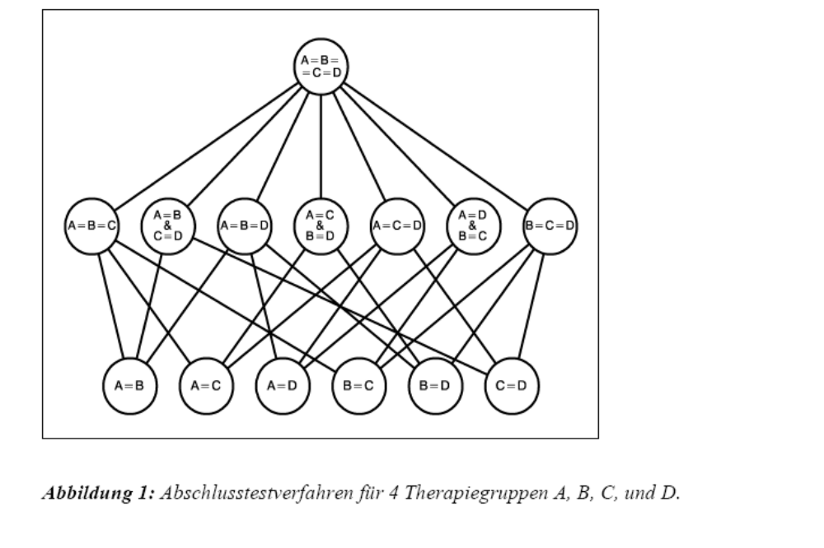
Closed test procedure
Closed test procedure for 4 treatment groups A, B, C, D

Slide 28
Selection of FP function (2)
Closed test procedure
Based on closed test procedure idea
Define nominal P-value for all tests (often 5%)
Use χ² approximations to get P-values
Fit linear, FP1 and FP2 models
Test FP2 vs. null
  Any effect of X at all? (χ² on 4 df)
Test FP2 vs linear
  Non-linear effect of X? (χ² on 3 df)
Test FP2 vs FP1
  More complex or simpler function required? (χ² on 2 df)

Slide 29
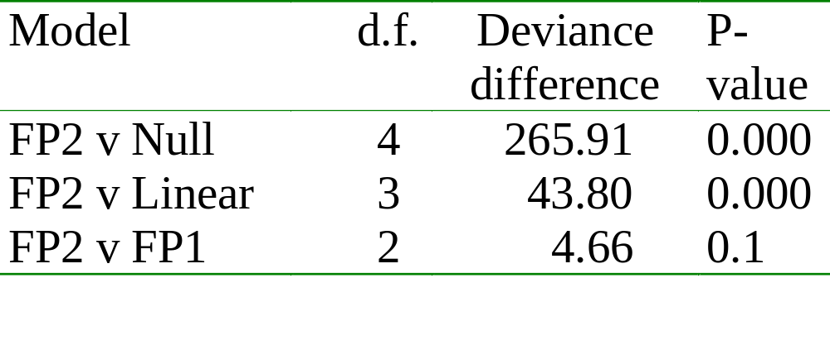
Example: All-cause mortality and cigarette smoking
FP models:
FP1 has power 0: β₁ lnX
FP2 has powers (−2, −1): β₁ X⁻¹ + β₂ X⁻²

Slide 30
Example: all-cause mortality and cigarette smoking
Notes:
fig1.do
Underlying functional relationship is probably simple, but linear fits badly and quadratic is implausible
Notice how FP function smooths out artefacts in raw-data curve

Slide 31
Why not splines?
Why care about FPs when splines are more flexible?
More flexible ⇒ more unstable
Many approaches – which one to use?
  No standard approach, even in univariate case
Even more complicated for multivariable case
In clinical epidemiology, dose-response relationships are often simple

Slide 32
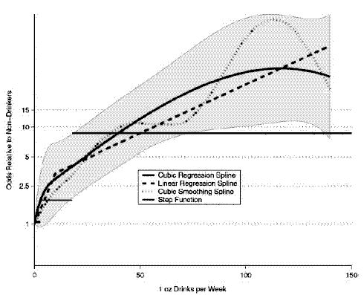
Example: Alcohol consumption and oral cancer
“Quantifying epidemiologic risk factors using non-parametric regression: model selection remains the greatest challenge” Rosenberg PS et al, Statistics in Medicine 2003; 22:3369-3381
OR for drinkers
Notes:
Case/control study
Y is OR for drinkers - referent is non-drinkers

Slide 33
Overview
Context, motivation and data sets
The univariate smoothing problem
Introduction to fractional polynomials (FPs)
Multivariable FP (MFP) models
Robustness
Stability
Interactions
Other issues, software, conclusions, references

Slide 34
Multivariable FP (MFP) models
Typically, have a mix of continuous and binary covariates
  Dummy variables for categorical predictors
Wish to find ‘best’ multivariable FP model
Impractical to try all combinations of powers for all continuous covariates
Requires iterative fitting procedure

Slide 35
The MFP algorithm
COMBINE backward elimination with a search for the best FP functions
START: Determine fitting order from linear model
UPDATE: Apply univariate FP model selection procedure to each continuous X in turn, adjusting for (last FP function of) each other X
UPDATE: Binary covariates similarly – but just in/out of model
CYCLE: until convergence – usually 2-3 cycles
Will be demonstrated on the computer

Slide 36
Example: Prognostic factors in breast cancer
Aim to develop a prognostic index for risk of tumour recurrence or death
Have 7 prognostic factors
  5 continuous, 2 categorical
Select variables and functions using 5% significance level

Slide 37
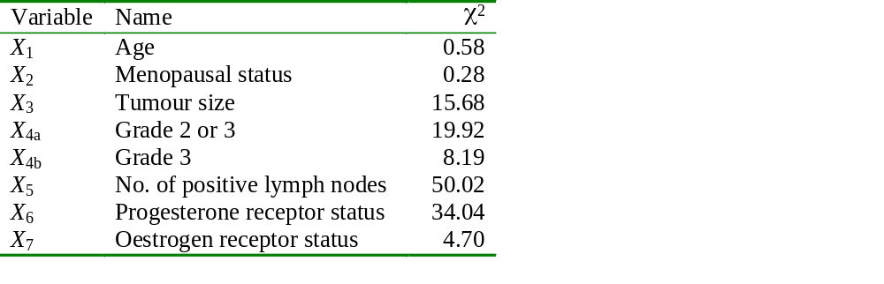
Univariate linear analysis
Notes:
Some people might choose to put all variables sig at 5% into multivariable model

Slide 38
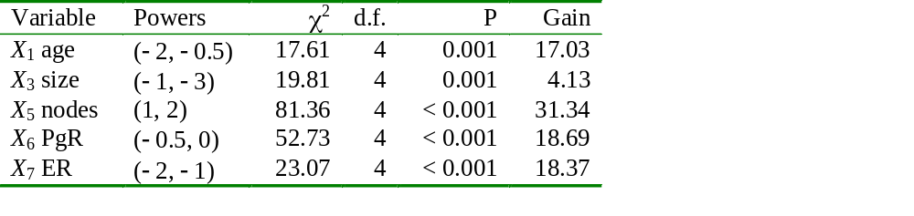
Univariate FP2 analysis
‘Gain’ assesses non-linearity (chi-square comparing FP2 with linear function, on 3 d.f.)
All factors except for X₃ have a non-linear effect

Slide 39
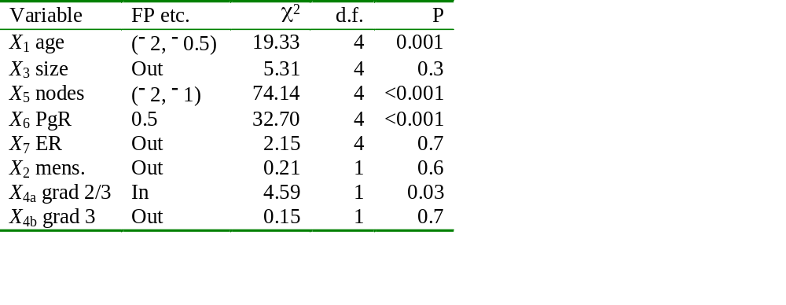
Multivariable FP analysis
P is P-to-enter for ‘Out’ variable, P-to-remove for ‘In’ variable

Slide 40
Computer demo of mfp in Stata
Fit full model for ordering of variables
Show mfp stcox x1 x2 x3 x4a x4b x5 x6 x7 hormon, select(0.05, hormon:1)
Show fracplot (use scheme lean1 for CIs to show up on beamer)

Slide 41
Comments on analysis
Conventional backwards elimination at 5% level selects x4a, x5, x6, and x1 is excluded
FP analysis picks up same variables as backward elimination, and additionally x1
Note considerable non-linearity of x1 and x5
x1 has no linear influence on risk of recurrence
FP model detects more structure in the data than the linear model

Slide 42
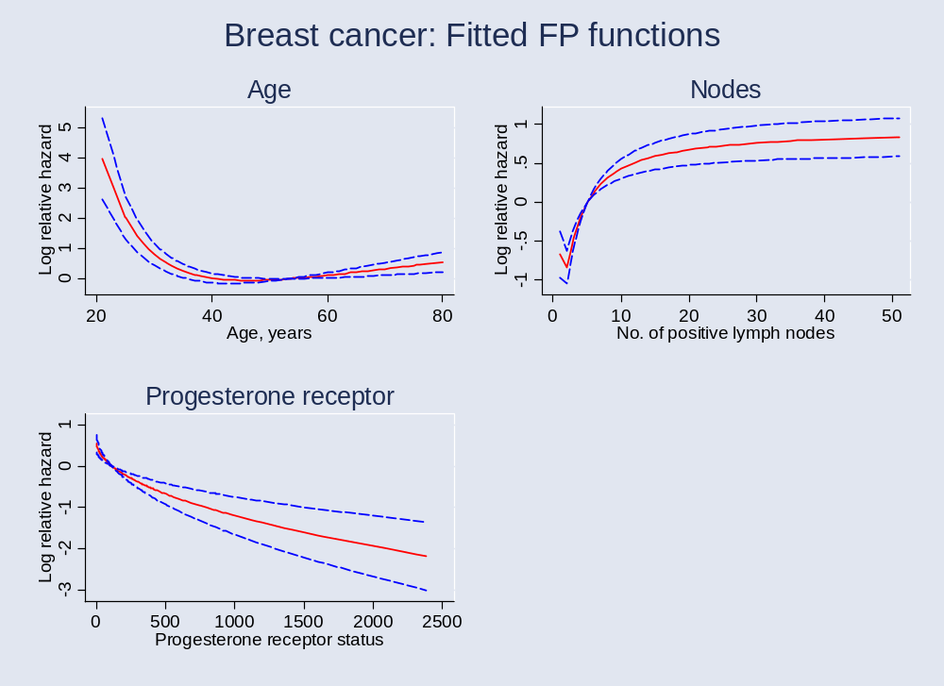
Presentation of FP models:
Plots of fitted FP functions
Notes:
inn2
Note non-monotonicity of x5 function
X1 etc. standardised to mean

Slide 43
Presentation of FP models: an approach to tabulation
The function + 95% CI gives the whole story
Functions for important covariates should always be plotted
In epidemiology, sometimes useful to give a more conventional table of results in categories
This can be done from the fitted function

Slide 44
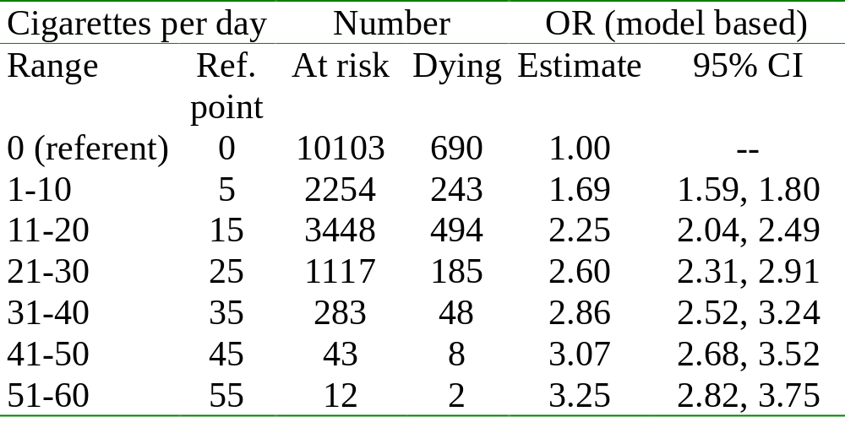
Example: Smoking and all-cause mortality (Whitehall 1)
Calculation of CI: see Royston, Ambler & Sauerbrei (1999)

Slide 45
Overview
Context, motivation and data sets
The univariate smoothing problem
Introduction to fractional polynomials (FPs)
Multivariable FP (MFP) models
Robustness
Stability
Interactions
Other issues, software, conclusions, references

Slide 46
Robustness of FP functions
Breast cancer example showed non-robust functions for nodes – not medically sensible
Situation can be improved by performing covariate transformation before FP analysis
Can be done systematically (Royston & Sauerbrei 2006)
Sauerbrei & Royston (1999) used negative exponential transformation of nodes
  exp(–0.12 * number of nodes)
Notes:
Give our approach – mention cube root

Slide 47
An approach to robustification
(Royston & Sauerbrei 2006)
Similar in spirit to double truncation of extreme covariate values
Reduces the leverage of extreme values
  Particularly important after extreme FP transformations – powers -2 or 3
Also includes a linear shift of origin to the right

Slide 48
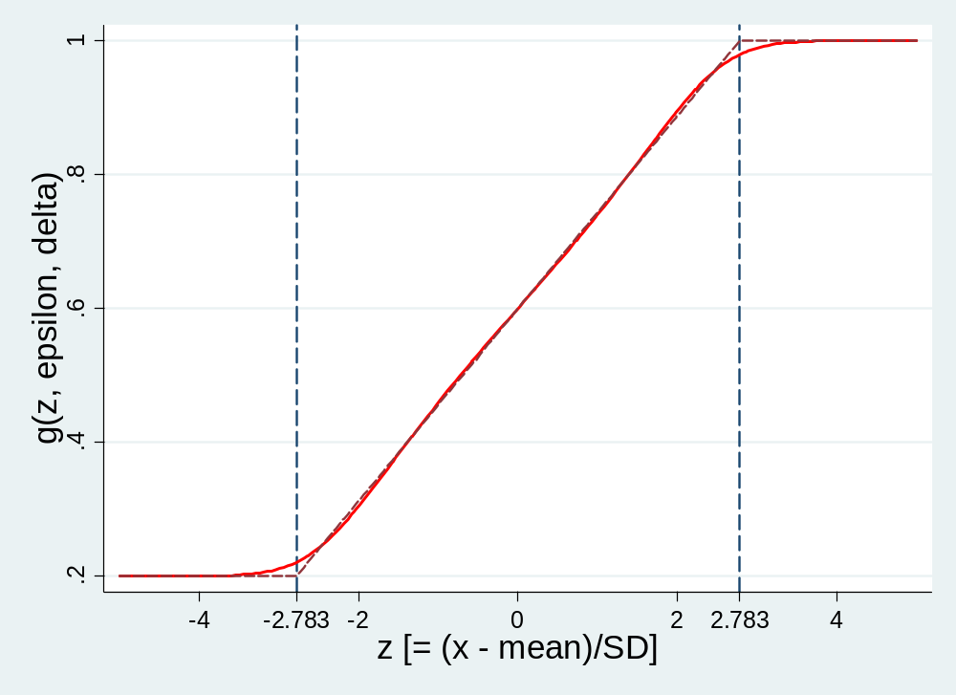
Robustifying transformation of X
Notes:
Note that epsilon=0.01 and delta=0.2

Slide 49
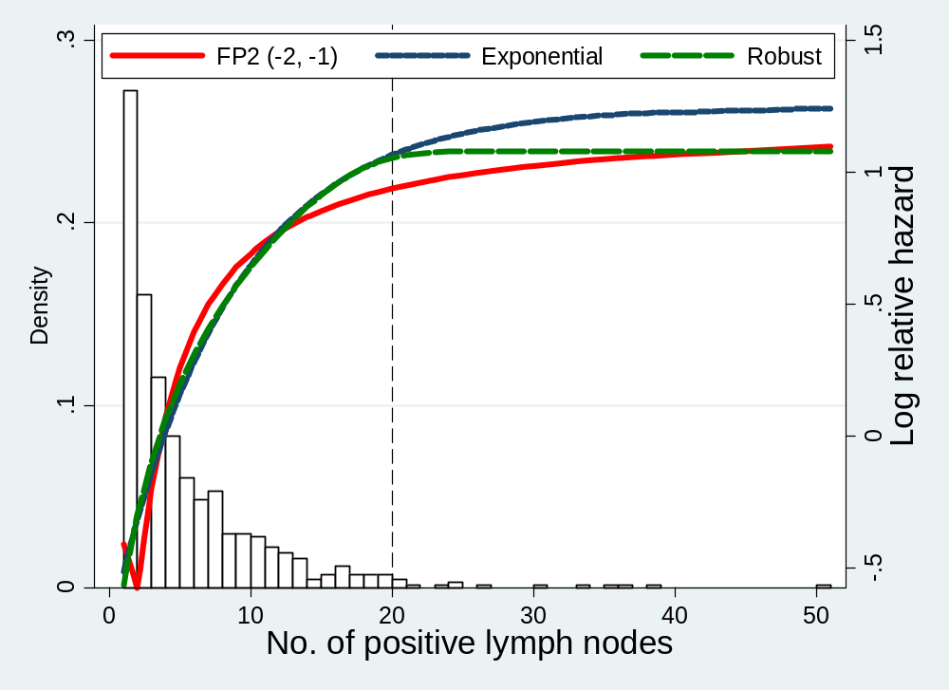
Making the function for lymph nodes more robust
Notes:
Fig2. Most of the data is at x5<=20. Vertical line is at 20 = 98th centile of distribution. 25 is 99th centile.

Slide 50
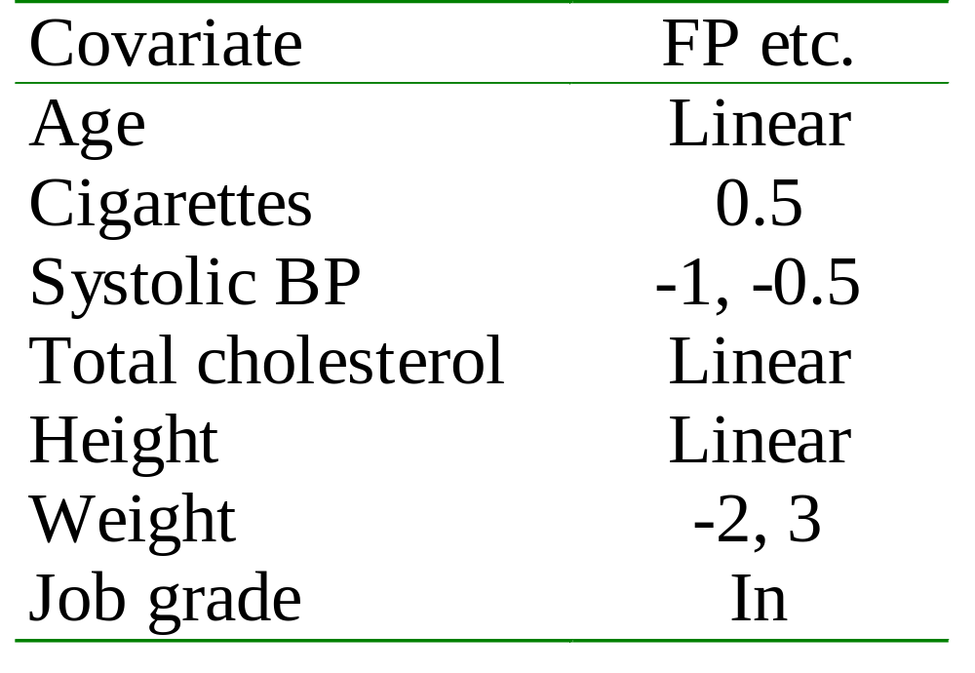
2nd example: Whitehall 1
MFP analysis and robustness
No variables were eliminated by the MFP algorithm
(Weight eliminated by linear backward elimination)

Slide 51
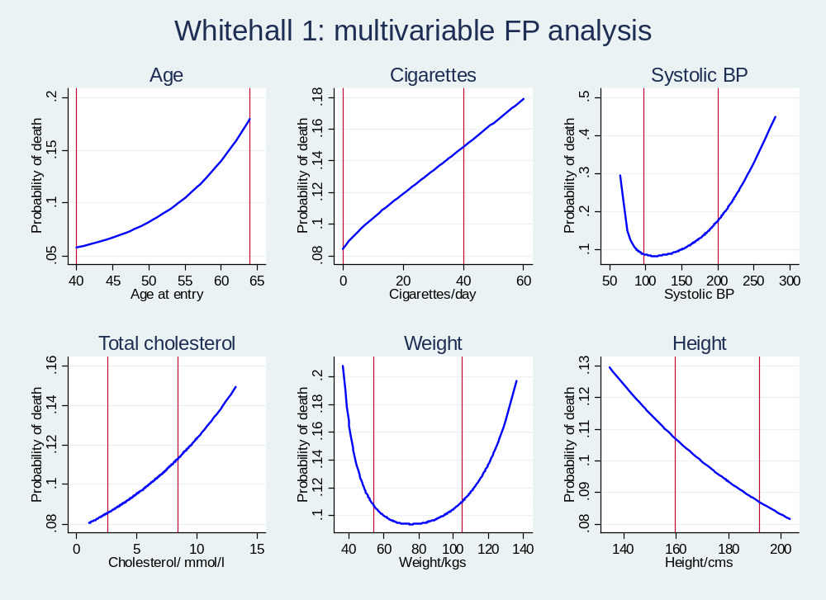
Plots of FP functions
Notes:
Add note about lines – 1 and 99 centiles also slide 44

Slide 52
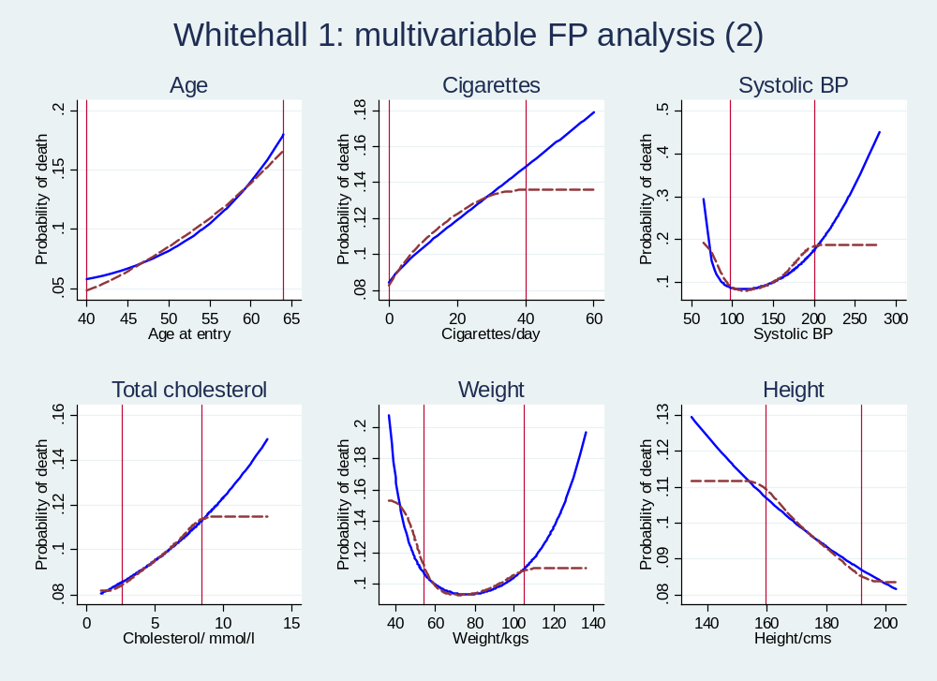
Robustified analysis (all variables)
Notes:
Vertical lines are 1 and 99th centiles of distribution of x

Slide 53
Overview
Context, motivation and data sets
The univariate smoothing problem
Introduction to fractional polynomials (FPs)
Multivariable FP (MFP) models
Robustness
Stability
Interactions
Other issues, software, conclusions, references

Slide 54
Stability (1)
As explained in Part I:
Models (variables, FP functions) selected by statistical criteria – cut-off on P-value
Approach has several advantages …
… and also is known to have problems
  Omission bias
  Selection bias
  Unstable – many models may fit equally well

Slide 55
Stability (2)
Instability may be studied by bootstrap resampling (sampling with replacement)
  Take bootstrap sample B times
  Select model by chosen procedure
  Count how many times each variable and each type of simplified function (e.g. monotonic) is selected
  Summarise inclusion frequencies & their dependencies
  Study fitted functions for each covariate
May lead to choosing several possible models, or a model different from the original one

Slide 56
Bootstrap stability analysis: breast cancer dataset (1)
5760 models considered – MFP selects one
5000 bootstrap samples taken
MFP algorithm with Cox model applied to each bootstrap sample
Resulted in 1222 different models (!!)
Nevertheless, could identify stable subset consisting of 60% of replications
  Judged by similarity of functions selected

Slide 57
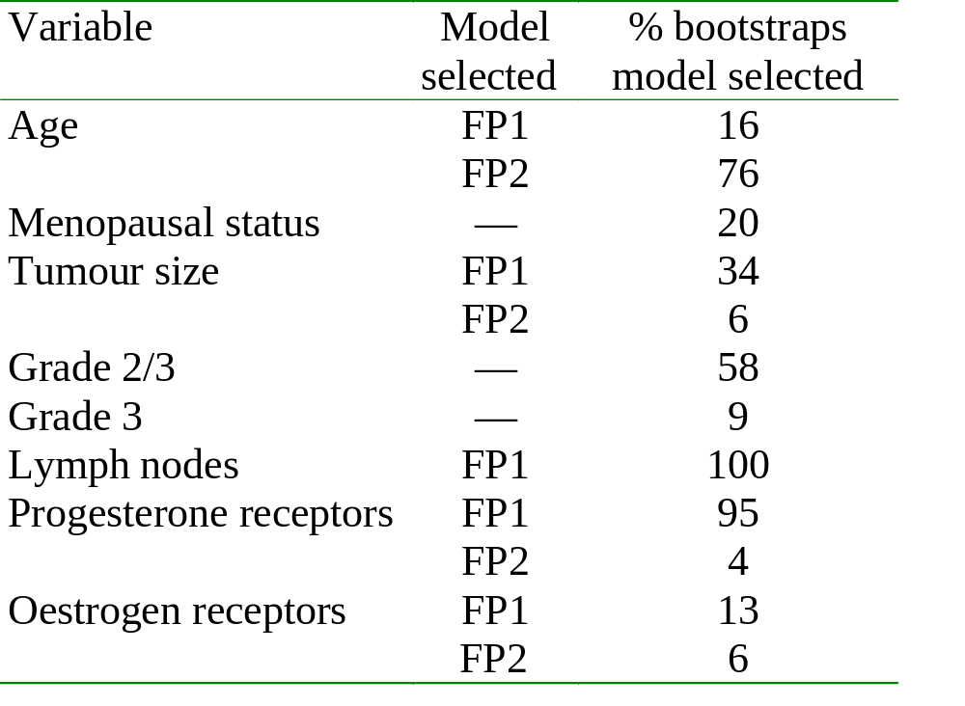
Bootstrap stability analysis: breast cancer dataset (2)

Slide 58
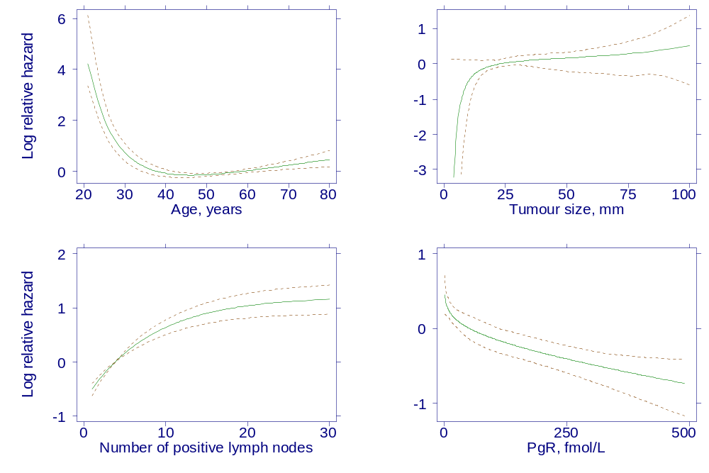
Bootstrap analysis: fitted curves from stable subset
Notes:
Stable subset comprised 60.1% of reps
Functions are when variable was selected

Slide 59
Overview
Context, motivation and data sets
The univariate smoothing problem
Introduction to fractional polynomials (FPs)
Multivariable FP (MFP) models
Robustness
Stability
Interactions
Other issues, software, conclusions, references

Slide 60
Interactions
Interactions are often ignored by analysts
Continuous × categorical has been studied in FP context because clinically very important
  Treatment-covariate interaction in clinical trial
  ‘MFPI’ method – Royston & Sauerbrei (2004)
Continuous × continuous is the most complex
  not yet done

Slide 61
Interactions – MFPI method
Have continuous X of interest, binary treatment variable T and other covariates Z
Select ‘adjustment’ model Z* on Z using MFP
Find best FP2 function of X (in all patients) adjusting for Z* and T
Test FP2(X) × T interaction (2 d.f.)
  Estimate β’s separately in 2 treatment groups
  Standard test for equality of β’s
May also consider simpler FP1 and linear functions

Slide 62
Interactions – treatment effect function
Have estimated two FP2 functions – one per treatment group
Plot difference between functions against X to show the interaction
  i.e. the treatment effect at different X
Pointwise 95% CI shows how strongly the interaction is supported at different values of X
  i.e. variation in the treatment effect

Slide 63
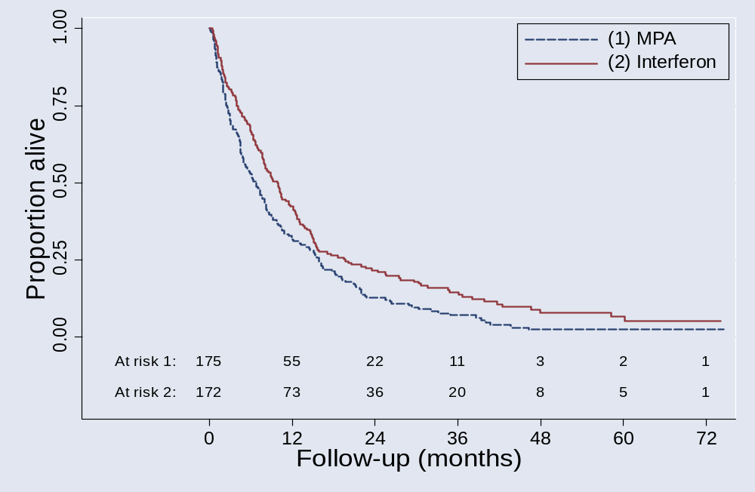
Example: MRC RE01 trial – MPA and interferon in kidney cancer

Slide 64
Overall: Interferon is better
P < 0.01; HR = 0.75; 95% CI (0.60, 0.93)
Is the treatment effect similar in all patients? Sensible question?
  Yes, from our point of view
Ten possible covariates available for the investigation of treatment-covariate interactions – only one is significant (WCC)

Slide 65
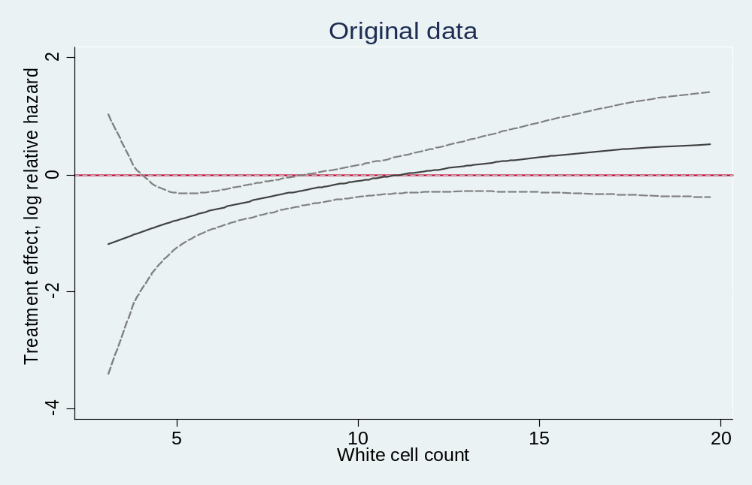
Analysis with the MFPI procedure: Treatment effect plot
Only a result of complex (mis-)modelling?

Slide 66
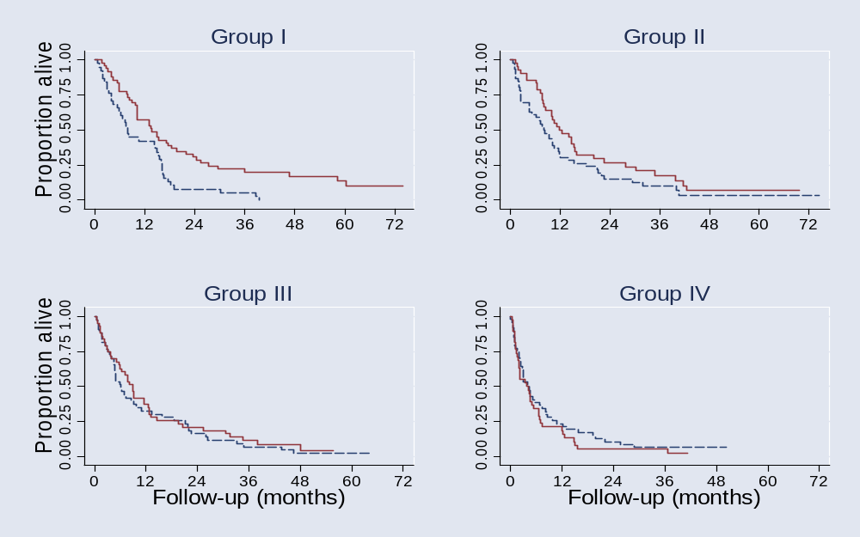
Does model agree with data?
Check proposed trend
Treatment effect in subgroups defined by WCC
HR (Interferon to MPA; adjusted values similar) overall: 0.75 (0.60 – 0.93)
I : 0.53 (0.34 – 0.83) II : 0.69 (0.44 – 1.07)
III : 0.89 (0.57 – 1.37) IV : 1.32 (0.85 –2.05)

Slide 67
Interactions in clinical trials – general issues
Many correctly criticise ‘subgroup analyses’
  E.g. Assmann et al (2000)
  We avoid subgrouping X
Several covariates – multiple testing is an obvious problem
Distinguish hypothesis generation from testing pre-specified interaction(s)
Complex modelling – check of the function is necessary

Slide 68
Overview
Context, motivation and data sets
The univariate smoothing problem
Introduction to fractional polynomials (FPs)
Multivariable FP (MFP) models
Robustness
Stability
Interactions
Other issues, software, conclusions, references

Slide 69
Other issues (1)
Handling continuous confounders
  May use a larger P-value for selection e.g. 0.2
  Not so concerned about functional form here

Slide 70
Other issues (2)
Time-varying effects in survival analysis
  Can be modelled using FP functions of time (Berger, 2003; also Sauerbrei & Royston, submitted 2006)
Checking adequacy of FP functions
  May be done by using splines
  Fit FP function and see if spline function adds anything, adjusting for the fitted FP function

Slide 71
Software sources
Most comprehensive implementation - Stata
  Command mfp is part of Stata 8/9
Versions for SAS and R are also available
  Visit
  http://www.imbi.uni-freiburg.de/biom/mfp
  to download a copy of the SAS macro
  R version available on CRAN archive - mfp package

Slide 72
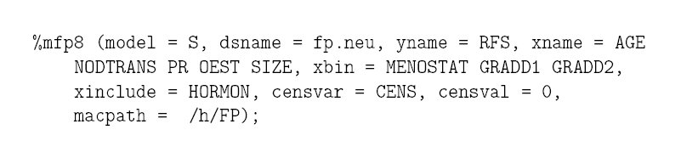
SAS: example of command
See Sauerbrei et al (2006)
Syntax diagram earlier in this paper:

Slide 73
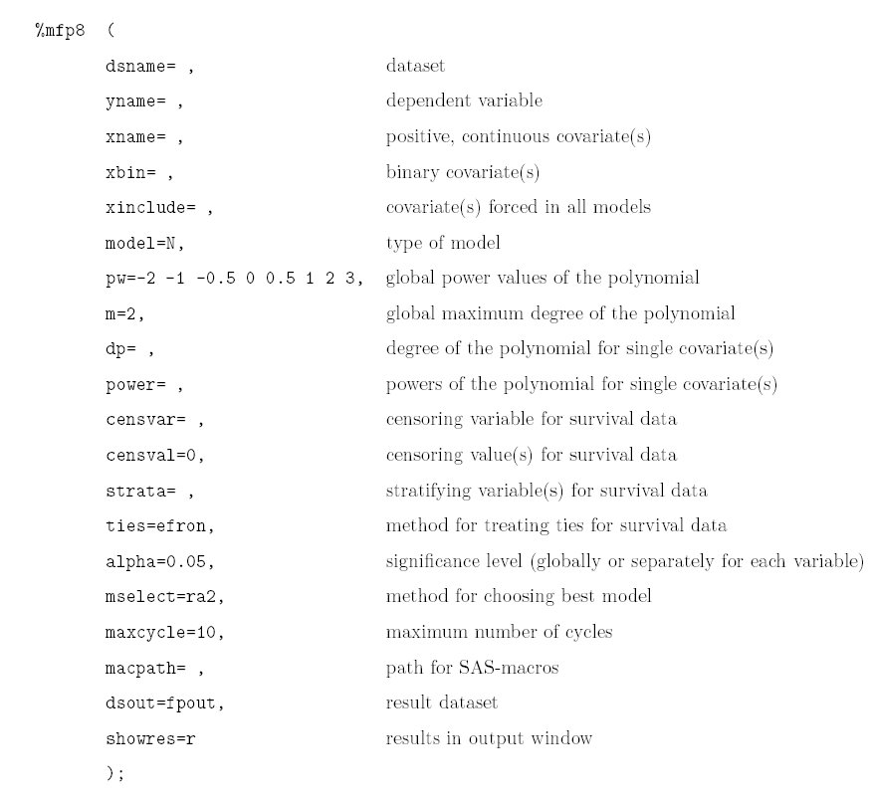
SAS syntax diagram

Slide 74
Concluding remarks (1)
FP method in general
  No reason (other than convention) why regression models should include only positive integer powers of covariates
  FP is a simple extension of an existing method
  Simple to program and simple to explain
  Parametric, so can easily get predicted values
  FP usually gives better fit than standard polynomials
  Cannot do worse, since standard polynomials are included

Slide 75
Concluding remarks (2)
Multivariable FP modelling
  Many applications in general context of multiple regression modelling
  Well-defined procedure based on standard principles for selecting variables and functions
  Aspects of robustness and stability have been investigated (and methods are available)
  Much experience gained so far suggests that method is very useful in clinical epidemiology

