Slide 1


Issues In Multivariable Model Building
With Continuous Covariates,
With Emphasis On Fractional Polynomials
Patrick Royston
MRC Clinical Trials Unit,
London, UK
Willi Sauerbrei
Institut of Medical Biometry and Informatics
University Medical Center Freiburg, Germany

Slide 2
Overview
Regression models
Methods for variable selection
Selection bias and shrinkage
Functional form for continuous covariates
Multivariable fractional polynomials (MFP)
Stability
Splines
Summary

Slide 3
Observational Studies
Several variables, mix of continuous and (ordered) categorical variables
Situation in mind:
5 to 20 variables, more than 10 events per variable
Main interest
Identify variables with (strong) influence on the outcome
Determine functional form (roughly) for continuous variables
The issues are very similar in different types of regression models (linear regression model, GLM, survival models ...)
Use subject-matter knowledge for modelling ...
... but for some variables, data-driven choice inevitable

Slide 4
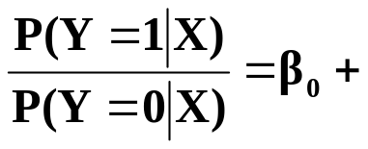
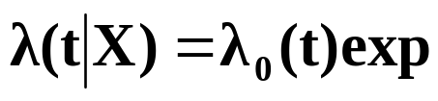
Regression models
X=(X₁, ...,X_{p}) covariate, prognostic factors
g(x) = ß₁ X₁ + ß₂ X₂ +...+ ß_{p} X_{p} (assuming effects are linear)
normal errors (linear) regression model
Y normally distributed
E (Y|X) = ß₀ + g(X)
Var (Y|X) = σ²I
logistic regression model
Y binary
Logit P (Y|X) = ln
survival times
T survival time (partly censored)
Incorporation of covariates
g(X)
(g(X))

Slide 5
Central issue
To select or not to select (full model)?
Which variables to include?

Slide 6





Which variables should be included?
Effect of underfitting and overfitting
Illustration by simp le example in linear regression models (mean of 3 runs)
3 predictors r_{1,2} = 0.5, r_{1,3} = 0, r_{2,3} = 0.7, N = 400, σ² = 1
Correct model M₁ y = 1 . x₁ + 2 . x₂ + ε
 | M₁ (true) | M₂ (overfitting) | M₃ (underfitting)
 | 1.050 (0.059) | 1.04 (0.073) | -
 | 1.950 (0.060) | 1.98 (0.105) | 2.53 (0.068)
 | - | -0.03 (0.091) | ₋
 | 1.060 | 1.060 | 1.90
R² | 0.875 | 0.875 | 0.77
M₂ overfitting y = ß₁x₁ + ß₂x₂ + ß₃x₃ + ε
Standard errors larger (variance inflation)
M₃ underfitting y = ß₂x₂ + ε
‚biased‘, different interpretation, R² smaller, stand. error (VIF↓, ↑)?

Slide 7
Continuous variables – The problem (1)
Often have continuous risk factors in epidemiology and clinical studies – how to model them?
Linear model may describe a dose-response relationship badly
  ‘Linear’ = straight line = β₀ + β₁ X + … throughout talk
Using cut-points has several problems
Splines recommended by some – but also have problems

Slide 8
Continuous variables – The problem (2)
“Quantifying epidemiologic risk factors using non-parametric regression: model selection remains the greatest challenge”
Rosenberg PS et al, Statistics in Medicine 2003; 22:3369-3381
Discussion of issues in (univariate) modelling with splines
Trivial nowadays to fit almost any model
To choose a good model is much harder

Slide 9
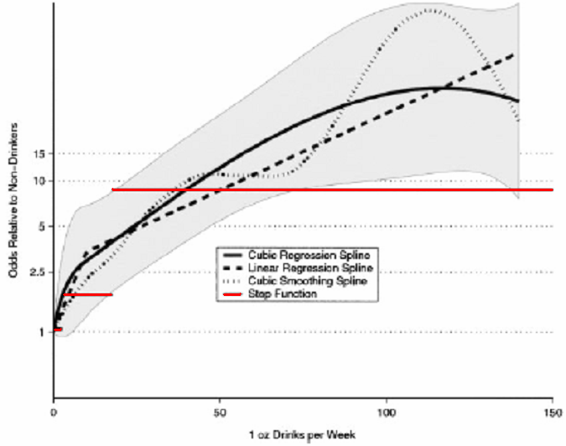
Alcohol consumption as risk factor for oral cancer
Rosenberg et al, StatMed 2003 (brief comments later)

Slide 10
Building multivariable regression models –
Preliminaries 1
  ‚Reasonable‘ model class was chosen
  Comparison of strategies
    Theory
        only for limited questions, unrealistic assumptions
    Examples or simulation
      Examples from literature
        simplifies the problem
        data clean
        ‚relevant‘ predictors given
        number predictors managable

Slide 11
Building multivariable regression models –
Preliminaries 2
  Data from defined population, relevant data available (‚zeroth problem‘, Mallows 1998)
  Examples based on published data
  rigorous pre-selection → what is a full model?

Slide 12
Building multivariable regression models –
Preliminaries 3
  Several ‚problems‘ need a decision before the analysis can start
  Eg. Blettner & Sauerbrei (1993), searching for hypotheses in a case-control study (more than 200 variables available)
  Problem 1. Excluding variables prior to model building.
  Problem 2. Variable definition and coding.
  Problem 3. Dealing with missing data.
  Problem 4. Combined or separate models.
  Problem 5. Choice of nominal significance level and selection procedure.

Slide 13
Building multivariable regression models –
Preliminaries 4
More problems are available,
see discussion on initial data analysis in Chatfield (2002) section ‚Tackling real life statistical problems‘ and
Mallows (1998)
‚Statisticians must think about the real problem, and must make judgements as to the relevance of the data in hand, and other data that might be collected, to the problem of interest ... one reason that statistical analyses are often not accepted or understood is that they are based on unsupported models. It is part of the statistician’s responsibility to explain the basis for his assumption.‘

Slide 14
Aims of multivariable models
Prediction of an outcome of interest
Identification of ‘important’ predictors
Adjustment for predictors uncontrollable by experimental design
Stratification by risk
... and many more
Aim has an important influence on the selection strategy

Slide 15
Building multivariable regression models
Before dealing with the functional form, the ‚easier‘ problem of model selection:
variable selection assuming that the effect of each continuous variable is linear

Slide 16

Multivariable models - methods for variable selection
Full model
  variance inflation in the case of multicollinearity
Stepwise procedures ⇒ prespecified (α_{in}, α_{out}) and
actual significance level?
    forward selection (FS)
    stepwise selection (StS)
    backward elimination (BE)
All subset selection ⇒ which criteria?
    C_{p} Mallows = (SSE / ) - n + p 2
    AIC Akaike Information Criterion = n ln (SSE / n) + p 2
    BIC Bayes Information Criterion = n ln (SSE / n) + p ln (n)
fit penalty
Bayes variable selection
MORE OR LESS COMPLEX MODELS?

Slide 17
Stepwise procedures
Central Issue: significance level
Criticism
FS and StS start with ‚bad‘ univariate models (underfitting)
BE starts with the full model (overfitting),
less critical
Multiple testing, P-values incorrect

Slide 18

Type I error of selection procedures
Actual significance level
(linear regression model, uncorrelated variables)
For all-subset methods in good agreement with asymptotic results for one additional variable (Teräsvirta & Mellin, 1986)
- for moderate sample size only slightly higher than
BE ~ α_{in}
All-AIC ~ 15.7 %
All-BIC ~ P ( > ln (n))
0.032 N = 100
0.014 N = 400
So, BE is the only of these approaches where the level can be chosen flexibly depending on the modelling needs!

Slide 19
"Recommendations" from the literature
(up to 1990, after more than 20 years of use and research)
  Mantel (1970)
  '... advantageous properties of the stepdown regression procedure (BE) ...‚ in comparison to StS
  Draper & Smith (1981)
  '... own preference is the stepwise procedure. To perform all regressions is not sensible, except when there are few predictors'
  Weisberg (1985)
  'Stepwise methods must be used with caution. The model selected in a stepwise fashion need not optimize any reasonable criteria for choosing a model. Stepwise may seriously overstate significance results'
  Wetherill (1986)
  `Preference should be given to the backward strategy for problems with a moderate number of variables‚ in comparison to StS
  Sen & Srivastava (1990)
  'We prefer all subset procedures. It is generally accepted that the stepwise procedure (StS) is vastly superior to the other stepwise procedures'.

Slide 20
Recent "Recommendations"
"Recommendations" from the past are mainly based on personal preferences, hardly any convincing scientific arguement
Harrell 2001, Regression Modeling Strategies
Stepwise variable selection ... violates every principle of statistical estimation and hypothesis testing.
... no currently available stopping rule was developed for data-driven variable selection. Stopping rules as AIC or Mallows´ C_{p} are intended for comparing only two prespecified models.
Full model fits have the advantage of providing meaningful confidence intervals
... Bayes … several advantages ...
LASSO-Variable selection and shrinkage
… AND WHAT TO DO?

Slide 21
Variable selection
All procedures have severe problems!
Full model? No!
Illustration of problems
Too often with small studies
(sample size versus no. variables)
Arguments for the full model
Often by using published data
Heavy pre-selection!
What is the full model?

Slide 22
Backward elimination is a sensible approach
Significance level can be chosen
Reduces overfitting
Of course required
Checks
Sensitivity analysis
Stability analysis

Slide 23
Problems caused by variable selection
  Biased estimation of individual regression parameter
  Overoptimism of a score
  Under- and Overfitting
  Replication stability (see part 2)
Severity of problems influenced by complexity of models selected
Specific aim influences complexity

Slide 24

Estimation after variable selection is often biased
  Reasons for the bias
  1. Omission Bias
  True model Y = X₁ β₁ + X₂ β₂ + ε
  Decision for model with subset X₁
  Estimation with new data
  E ( ) = β₁ + (X₁' X₁)⁻¹ X₁X₂ β₂
  |............................|
  Omission bias
  2. Selection Bias
  Selection and estimation from one data set
  Copas & Long (1991)
  Choice of variables depends on estimated coefficients rather than
  their true values. X is more likely to be included if the regression
  coefficient is overestimated.
  Miller (1990)
  Competition Bias: Best subset for fixed number of parameters
  Stopping Rule Bias: Criterion for number of parameters
  ...the more extensive the search for the choosen model the greater the
  selection bias

Slide 25
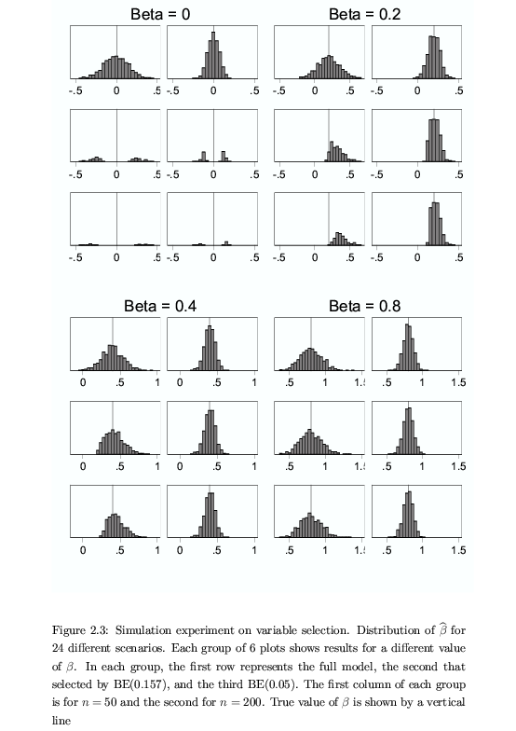
Selection bias: a problem of small sample size
n=50 n=200 n=50 n=200
Full
BE(0.05)
% incl. 4.2 4.0 28.5 80.4

Slide 26
Selection bias: a problem of small sample size (cont.)
n=50 n=200
Full
BE(0.05)
% incl. 100 100

Slide 27
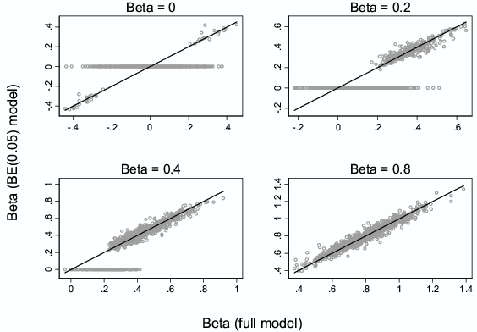
Selection bias
Estimate after variable selection with BE (0.05)
Simulation 5 predictors, 4 are ‚noise‘

Slide 28
Estimation of the parameters from a selected model
Uncorrelated variables (F – full, S - selected)
no omission bias
Z= β/ SE
in model if (approximately)
|Z| > Z(α) (1.96 for α=0.05)
if selected
β_{F} ≈ β_{S}
no selection bias if
|Z| large (β strong or N large)
selection bias if
|Z| small (β weak and N small)

Slide 29
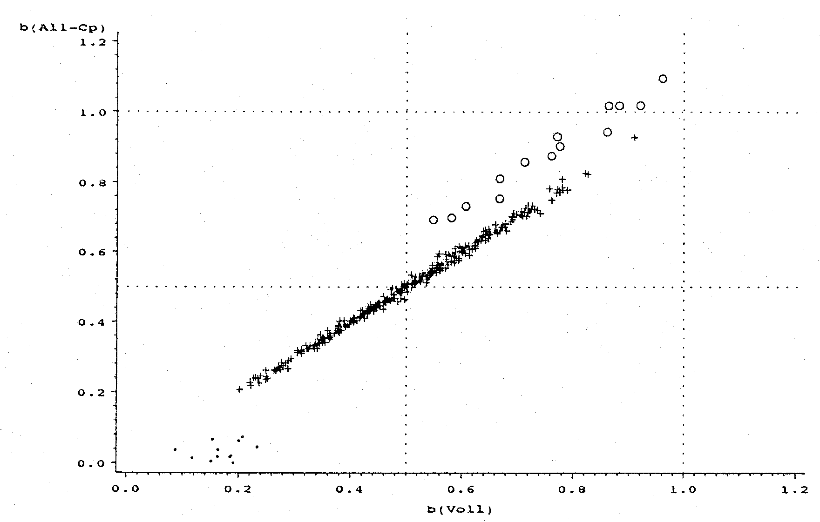
Selection and omission bias
Correlated variables, large sample size
Estimates from full and selected model
beta select
omission bias
partner not
selected
true
beta full
X₁ and X₂ in C_{p} model selected
X₂ in C_{p} model not selected
X₁ in C_{p} model not selected
true

Slide 30
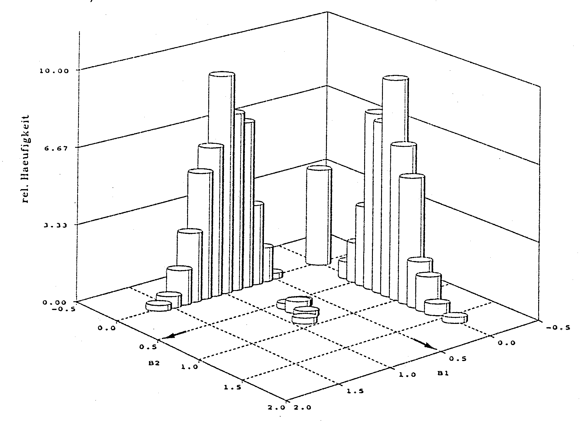
Selection and omission bias
Two correlated variables with weak effects
Small sample size, often one ‚representative‘ selected
Estimates of β₁ and β₂ from selected model
true β₂
true β₁

Slide 31
Selection bias !
Can we correct by shrinkage?

Slide 32
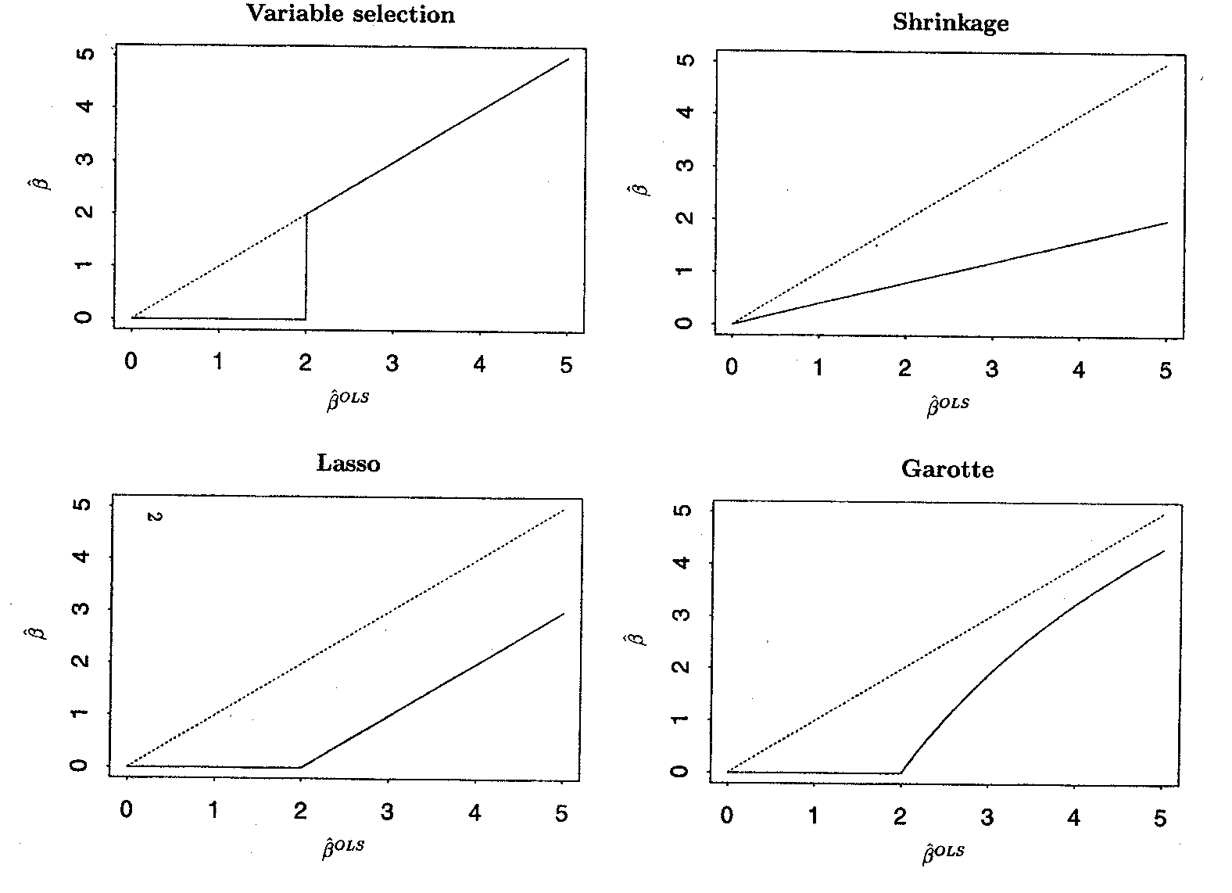
Variable Selection and Shrinkage
Regression coefficients as functions of OLS estimates
Principle for one variable
Regression coefficients zero ⇒ variable selection

Slide 33
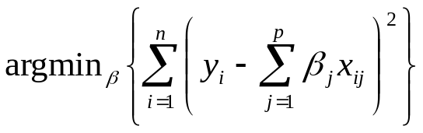

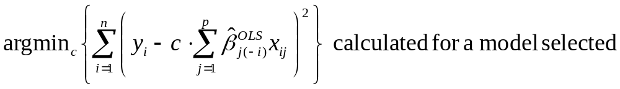
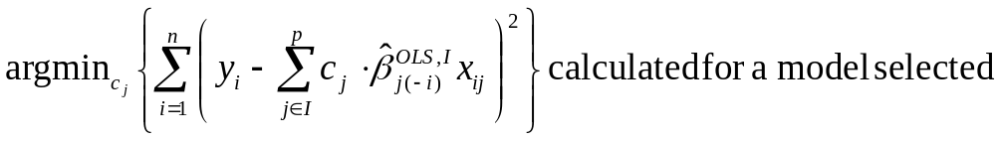
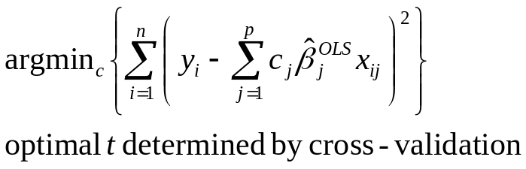
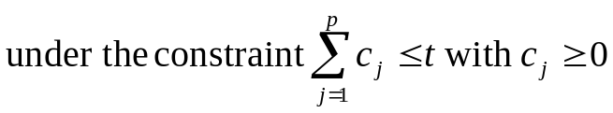
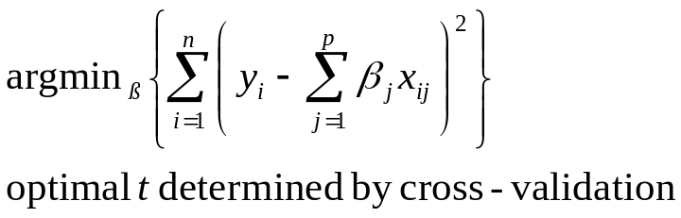
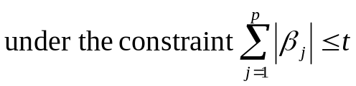
Variable selection and shrinkage
OLS
Var Sel
Shrinkage by CV calibration global
- PWSF
Garotte
Lasso

Slide 34
Selection and shrinkage
Ridge – Shrinkage, but no selection
Within estimation shrinkage
- Garotte, Lasso and newer variants
Combine variable selection and shrinkage, optimization under different constraints
Post estimation shrinkage using CV (shrinkage of a selected model)
- Global
- Parameterwise (PWSF, heuristic extension)

Slide 35
Continuous variables – what functional form?
Traditional approaches
a) Linear function
- may be inadequate functional form
- misspecification of functional form may lead to
wrong conclusions
b) ‘best‘ ‘standard‘ transformation
c) Step function (categorial data)
- Loss of information
- How many cutpoints?
- Which cutpoints?
- Bias introduced by outcome-dependent choice

Slide 36
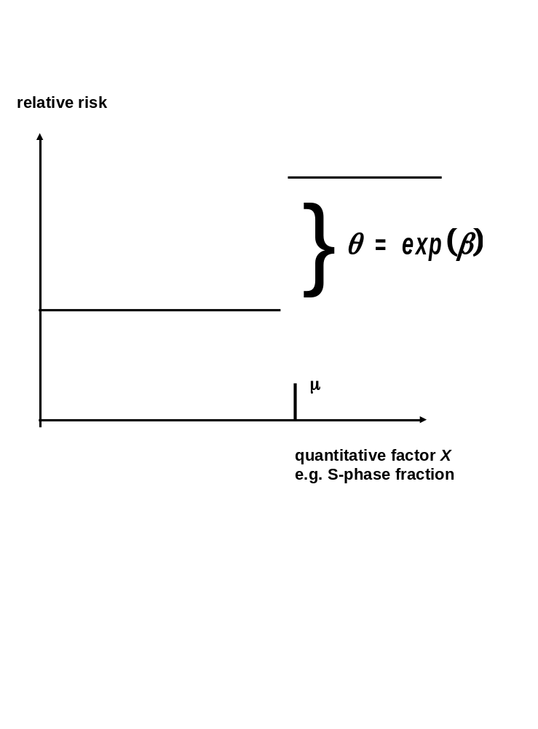
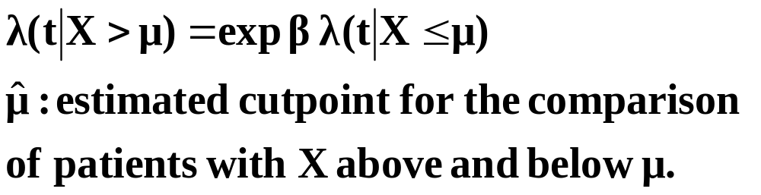
Step function - the cutpoint problem
In the Cox model

Slide 37
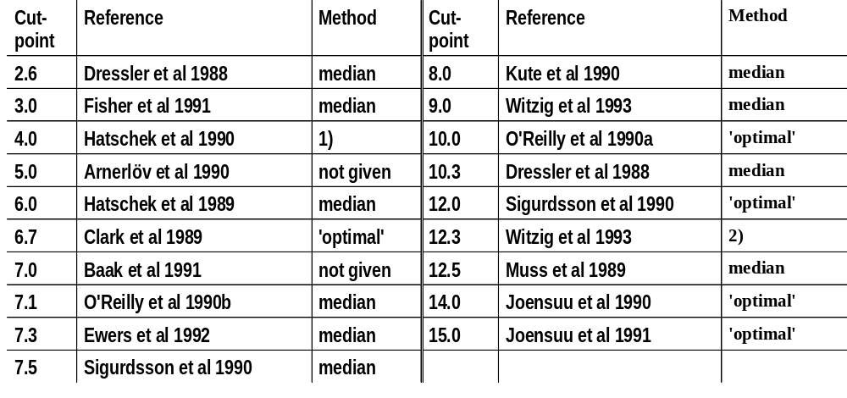
´New factors´ - Start with
univariate analysis
cutpoint for division into two groups
SPF-cutpoints used in the literature (Altman et al., 1994)
1) Three Groups with approx. Equal size 2) Upper third of SPF-distribution

Slide 38
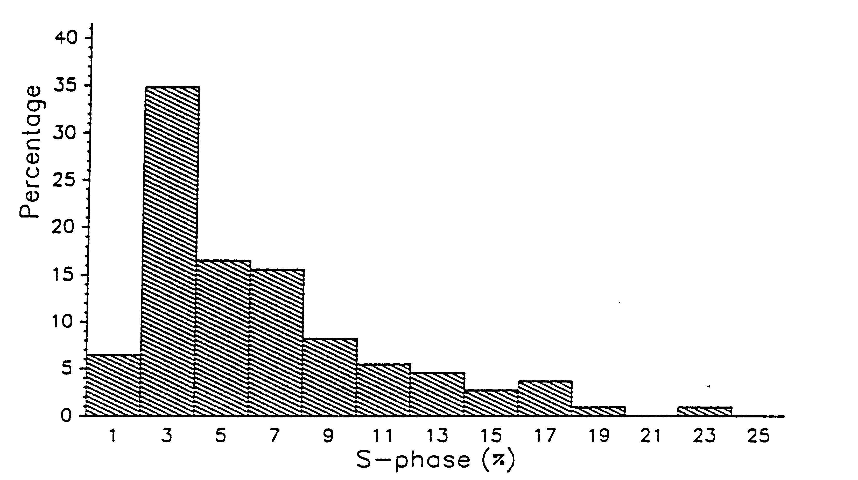
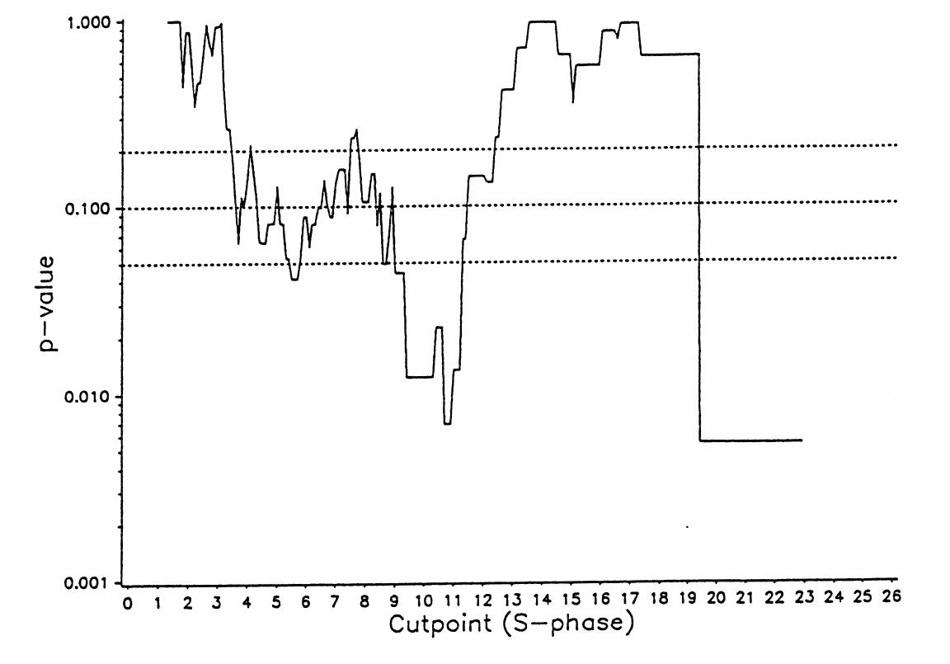
Searching for optimal cutpoint minimal p-value approach
SPF in Freiburg DNA study
Problem
multiple testing => inflated type I error

Slide 39
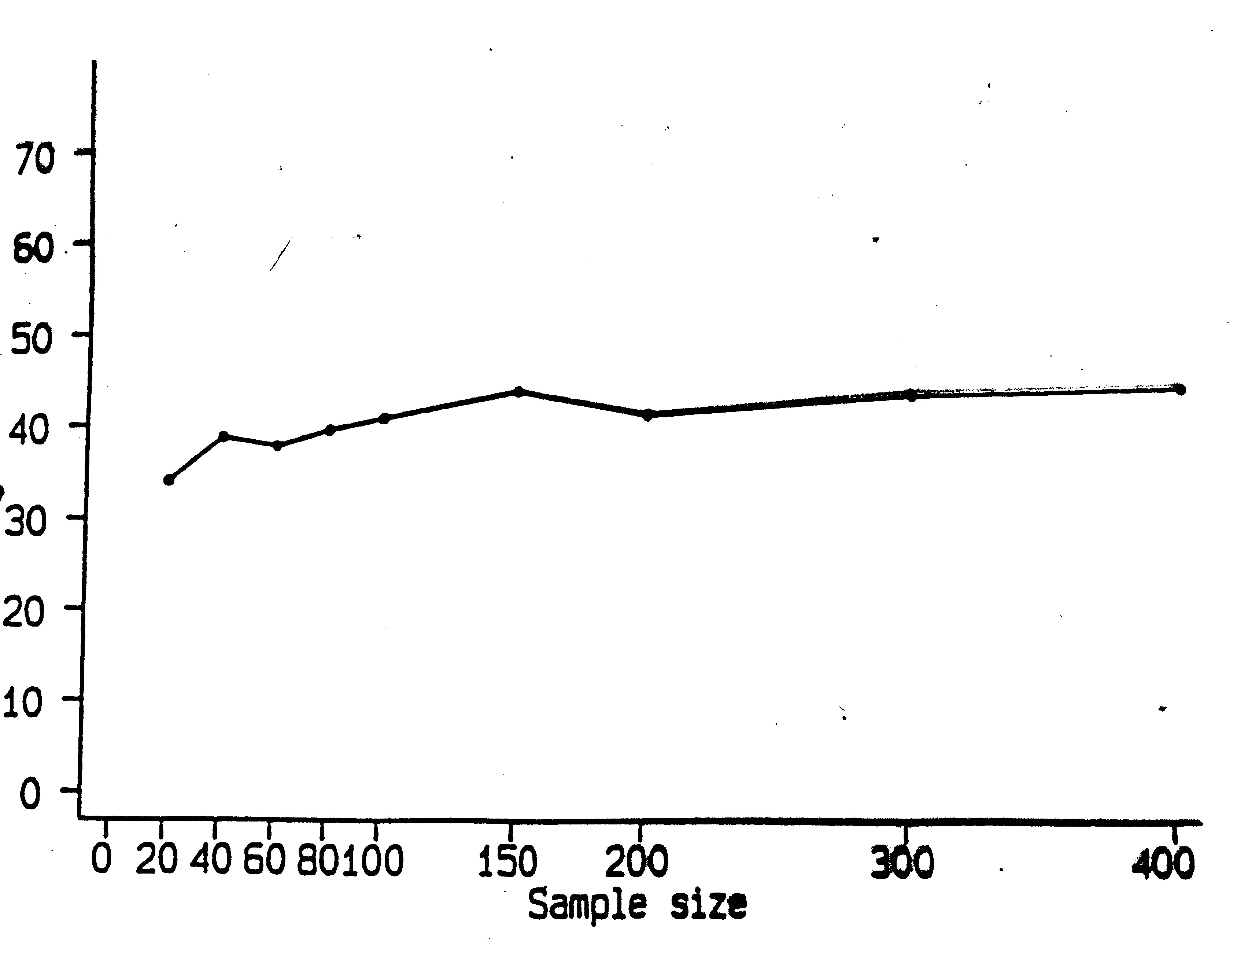
Searching for optimal cutpoint
Inflation of type I errors
(wrongly declaring a variable as important)
Cutpoint selection in inner interval (here 10% - 90%) of
distribution of factor
% significant
Sample size
Simulation study
Type I error about 40% istead of 5%
Increased type I error does not disappear with increased
sample size (in contrast to type II error)

Slide 40
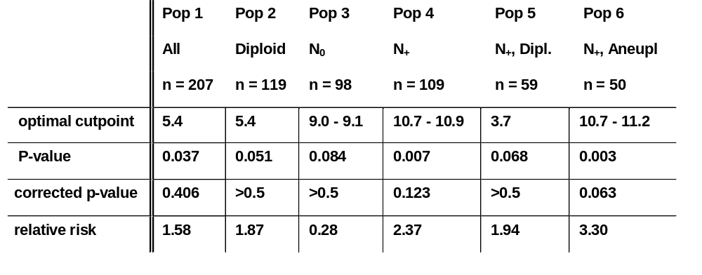
Freiburg DNA study
Study and 5 subpopulations (defined by nodal and ploidy status
Optimal cutpoints with P-value

Slide 41
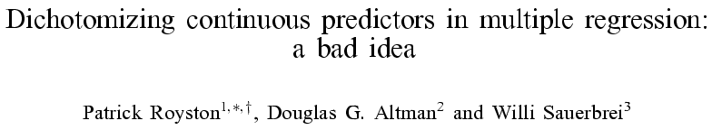
StatMed 2006, 25:127-141

Slide 42
Continuous variables – newer approaches
‘Non-parametric’ (local-influence) models
  Locally weighted (kernel) fits (e.g. lowess)
  Regression splines
  Smoothing splines
Parametric (non-local influence) models
  Polynomials
  Non-linear curves
  Fractional polynomials
    Intermediate between polynomials and non-linear curves

Slide 43
Fractional polynomial models
Describe for one covariate, X
  multiple regression later
Fractional polynomial of degree m for X with powers p₁, … , p_{m} is given by
FPm(X) = β₁ X ^{p1} + … + β_{m} X ^{pm}
Powers p₁,…, p_{m} are taken from a special set
{−2, − 1, − 0.5, 0, 0.5, 1, 2, 3}
Usually m = 1 or m = 2 is sufficient for a good fit
8 FP1, 36 FP2 models

Slide 44
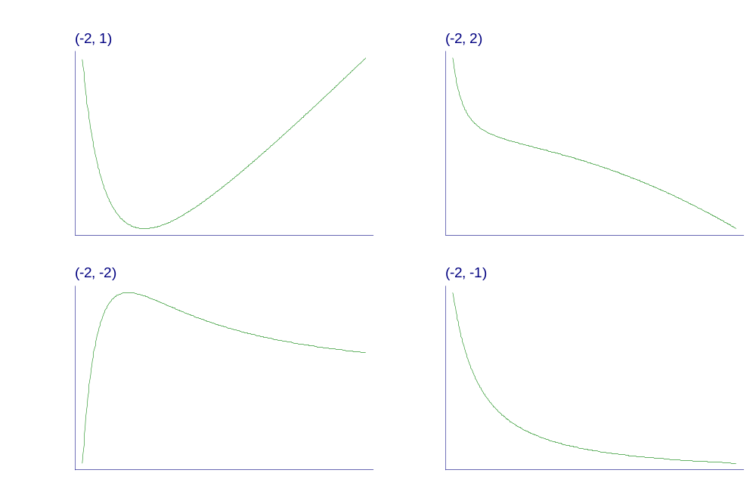
Examples of FP2 curves
- varying powers
Notes:
Fpexamp.gph, taken from c38\fig1a.gph.

Slide 45
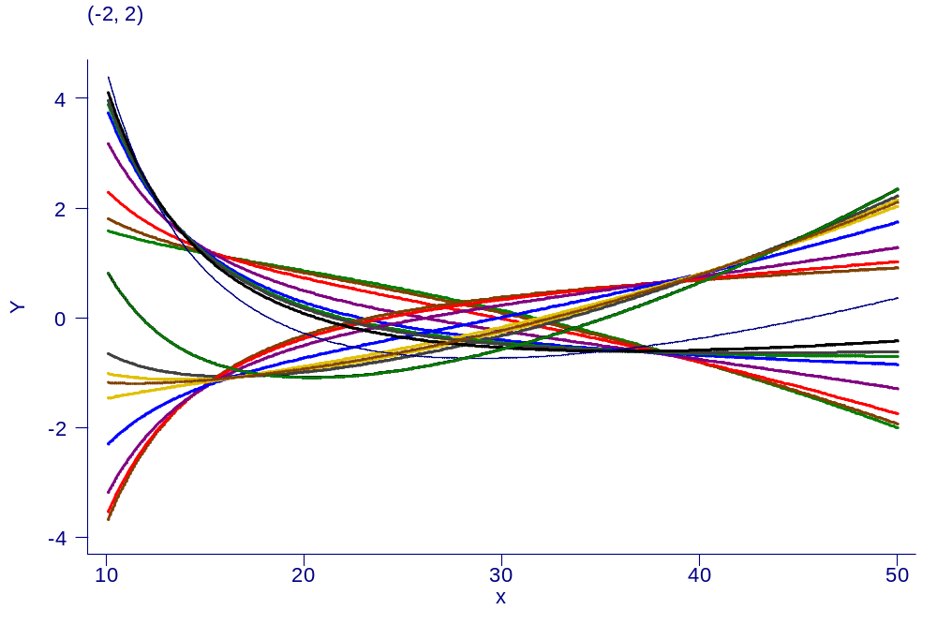
Examples of FP2 curves
- single power, different coefficients

Slide 46
Our philosophy of function selection
Prefer simple (linear) model
Use more complex (non-linear) FP1 or FP2 model if indicated by the data
Contrasts to more local regression modelling
  Already starts with a complex model

Slide 47
GBSG-study in node-positive breast cancer
299 events for recurrence-free survival time (RFS) in
686 patients with complete data
7 prognostic factors, of which 5 are continuous

Slide 48
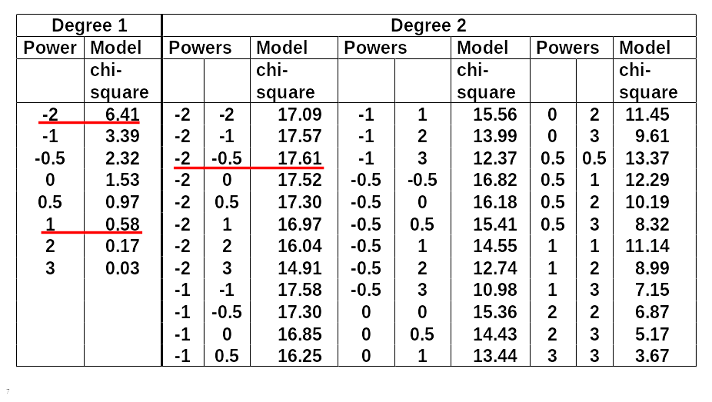
FP analysis for the effect of age

Slide 49
Effect of age at 5% level?
χ² df p-value
Any effect?
Best FP2 versus null 17.61 4 0.0015
Effect linear?
Best FP2 versus linear 17.03 3 0.0007
FP1 sufficient?
Best FP2 vs. best FP1 11.20 2 0.0037

Slide 50
Fractional polynomials (multiple predictors, MFP)
With multiple continuous predictors selection of best FP for each becomes more difficult → MFP algorithm as a standardized way to model selection
MFP algorithm combines
backward elimination with
FP function selection procedures

Slide 51
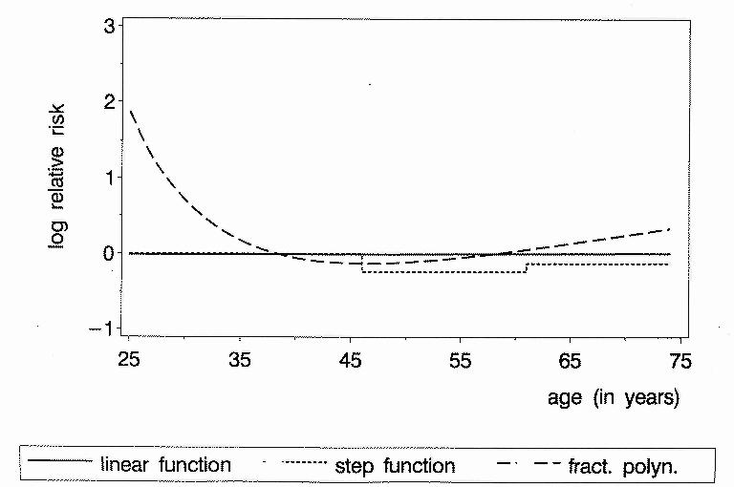
Continuous factors
Different results with different analyses
Age as prognostic factor in breast cancer (adjusted)
P-value 0.9 0.2 0.001

Slide 52
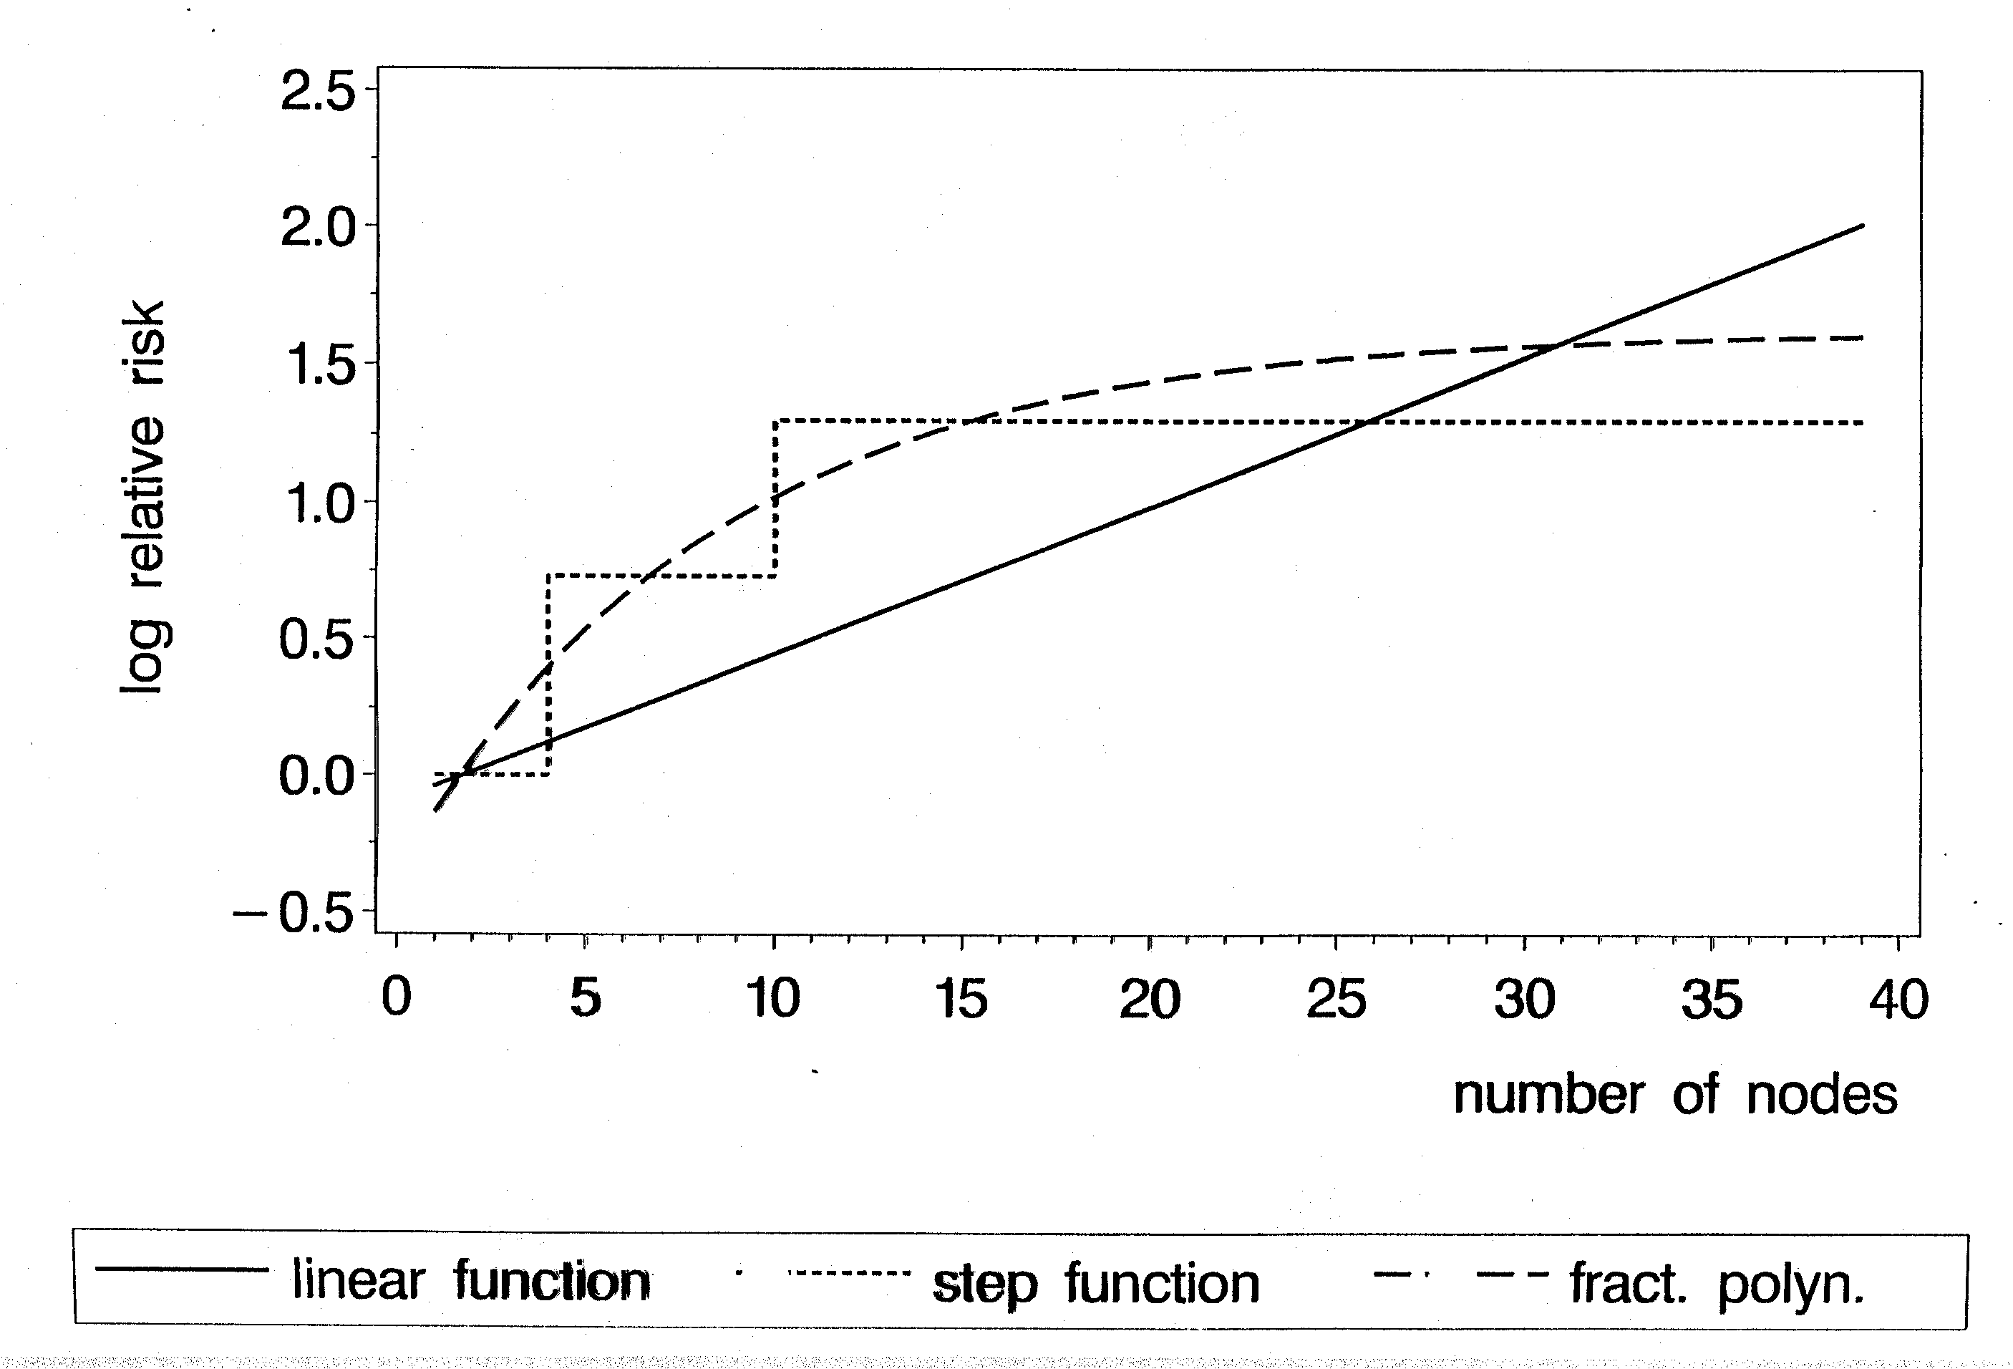
Results similar?
Nodes as prognostic factor in breast cancer (adjusted)
P-value 0.001 0.001 0.001

Slide 53
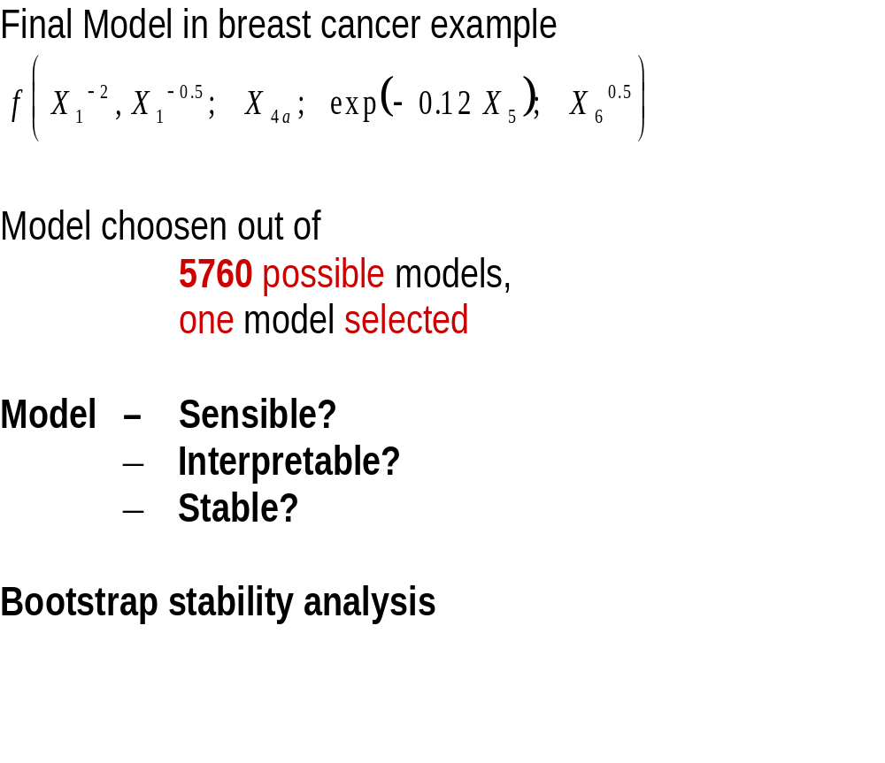
Multivariable FP

Slide 54
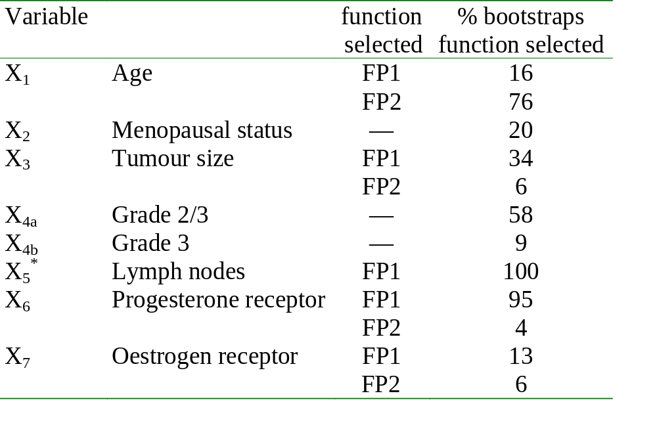
Bootstrap stability analysis: GBSG

Slide 55
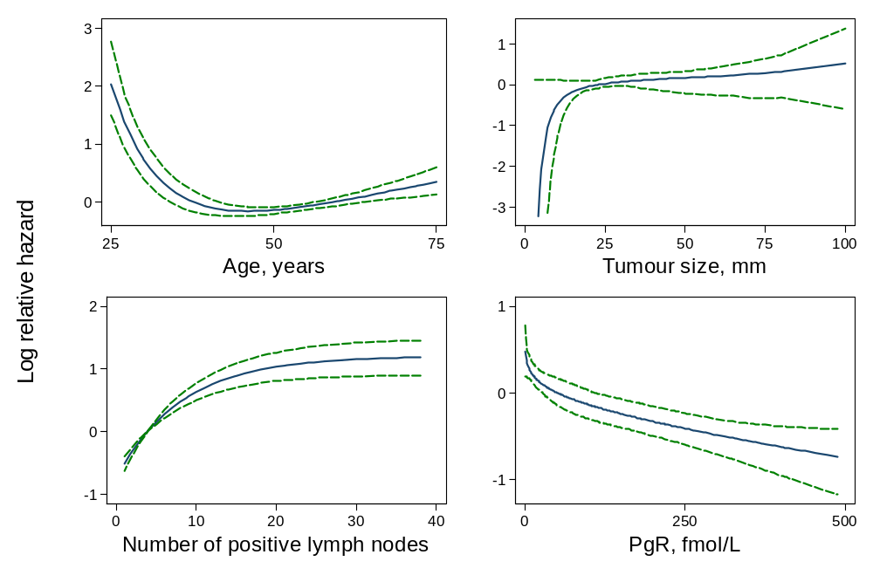
Bootstrap analysis: summaries of fitted curves from stable subset
Notes:
Stable subset comprised 60.1% of reps
Functions are when variable was selected

Slide 56
Alternative approach: Splines – some issues (1)
Two basic options (and corresponding problems):
Without penalization (e.g. regression splines)
  Only few knots and therefore selection of their number and location is critical and very difficult to perform automatically
  Generalization to several covariates very difficult if not impossible
Roughness penalty approach (e.g. smoothing splines, penalized B-splines) with one smoothing parameter per variable
  For a large number of covariates searching for smoothing parameters is a high-dimensional optimization problem
  Special software/routines needed (e.g. problematic for survival data)
  Standardized multivariable strategy still missing

Slide 57
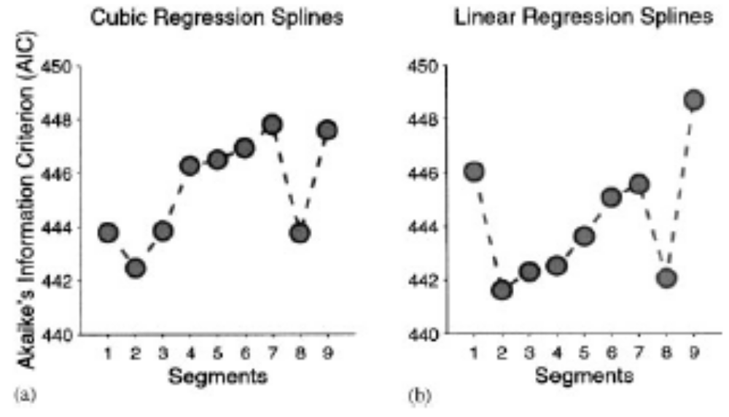
Issues with splines (2)
Example by Rosenberg et al.

Slide 58
Issues with splines (3)
Example by Rosenberg et al. (cont.)
Automatic identification of best fitting model (by automatic smoothing parameter selection) sometimes fails, i.e. can not be relyed on.
  Local minima in AIC/cross-validation curves
    May even happen with one variable/smoothing parameter
    With several variables one may even miss the global minimum
Therefore careful interpretation by expert necessary
  Compare/present all the models corresponding to all the (local) minima found. How to do with several variables?
  Local features potentially influenced by noise in the data

Slide 59
General issues for any function fitting/selection procedure
Robustness of functions
Interpretability & stability should be features of a model.
Validation (internal and external) needs more consideration
Transportability and practical usefulness are important criteria
  (Prognostic models: clinically useful or quickly forgotten? Wyatt & Altman 1995)
Resampling methods
give important insight, but theoretically not well developed
should become integrated part of analysis
lead to more careful interpretation of results
Avoid over-complex models
MFP has advantages:
it is easy to understand
above difficulties less pronounced

Slide 60
Software sources MFP
Most comprehensive implementation is in Stata
  Command mfp is part of Stata 8
Versions for SAS and R are now available
  SAS
  www.imbi.uni-freiburg.de/biom/mfp
  R version available on CRAN archive
    mfp package

Slide 61
Summary (1)
Model building in observational studies
All models are wrong, some, though are better than others and we can search for the better ones. Another principle is not to fall in love with one model, to the exclusion of alternatives (Mc Cullagh & Nelder 1983)

Slide 62
Summary (2)
Getting the big picture right is more important than optimising aspects and ignoring others
strong predictors
strong non-linearity
strong interactions
strong non-PH in survival model

Slide 63
Summary (3) – Multivariable model building
Variable selection often required, full model can be far away from ideal
Sufficient sample size required
Significance level is key factor
Despite of severe criticism, backward elimination is often a sensible approach
Splines are more flexible than FPs, but have also more problems
MFP
  Well-defined procedure based on standard principles for selecting variables and functions

Slide 64
Discussion and Outlook
Properties of selection procedures need further investigations
More prominent role for complexity and stability in analyses required - resampling methods well suited
Combination of selection and shrinkage
Model uncertainty concept

Slide 65
References
Harrell FE jr (2001): Regression Modeling Strategies. Springer.
Mallows C (1998): The zeroth problem. American Statistician, 52, 1-9.
Miller A (2002): Subset Selection in Regression. Chapman and Hall/CRC.
Royston, P, Altman DG (1994): Regression using fractional polynomials of continuous covariates: parsimonious parametric modelling (with discussion). Applied Statistics, 43, 429-467.
Royston P, Sauerbrei W (2003): Stability of multivariable fractional polynomial models with selection of variables and transformations: : a bootstrap investigation. Statistics in Medicine, 22, 639-659.
Royston P, Sauerbrei W (2004): A new approach to modelling interactions between treatment and continuous covariates in clinical trials by using fractional polynomials. Statistics in Medicine, 23, 2509-2525.
Royston P, Sauerbrei W (2005): Building multivariable regression models with continuous covariates, with a practical emphasis on fractional polynomials and applications in clinical epidemiology. Methods of Information in Medicine, 44, 561-571.
Ruppert D, Wand MP, Carroll R J (2003): Semiparametric Regression. Cambridge University Press.
Sauerbrei W (1999): The use of resampling methods to simplify regression models in medical statistics. Applied Statistics, 48, 313-329.
Sauerbrei W, Meier-Hirmer C, Benner A, Royston P (2006): Multivariable regression model building by using fractional polynomials: Description of SAS, STATA and R programs. Computational Statistics & Data Analysis, 50, 3464-3485.
Sauerbrei W, Royston P (1999): Building multivariable prognostic and diagnostic models: transformation of the predictors by using fractional polynomials. Journal of the Royal Statistical Society A, 162, 71-94.
Sauerbrei W, Schumacher M (1992): A Bootstrap Resampling Procedure for Model Building: Application to the Cox Regression Model, Statistics in Medicine, 11: 2093-2109.
Schumacher M, Holländer N, Schwarzer G, Sauerbrei W (2006): Prognostic Factor Studies. In Crowley J, Ankerst DP (ed.), Handbook of Statistics in Clinical Oncology, Chapman&Hall/CRC, 289-333.
Wood S N (2006): Generalized Additive Models. An Introduction with R. Chapman & Hall/CRC, Boca Raton.

