Slide 1


Multivariable regression models with continuous covariates
Willi Sauerbrei
Institut of Medical Biometry and Informatics
University Medical Center Freiburg, Germany
Patrick Royston
MRC Clinical Trials Unit,
London, UK
with a practical emphasis on fractional polynomials and applications in clinical epidemiology

Slide 2
The problem …
“Quantifying epidemiologic risk factors using non-parametric regression: model selection remains the greatest challenge”
Rosenberg PS et al, Statistics in Medicine 2003; 22:3369-3381
Trivial nowadays to fit almost any model
To choose a good model is much harder

Slide 3
Overview
Context and motivation
Introduction to fractional polynomials for the univariate smoothing problem
Extension to multivariable models
Robustness and stability
Software sources
Conclusions

Slide 4
Motivation
Often have continuous risk factors in epidemiology and clinical studies – how to model them?
Linear model may describe a dose-response relationship badly
  ‘Linear’ = straight line = β₀ + β₁ X + … throughout talk
Using cut-points has several problems
Splines recommended by some – but are not ideal
  Lack a well-defined approach to model selection
  ‘Black box’
  Robustness issues

Slide 5
Problems of cut-points
Step-function is a poor approximation to true relationship
  Almost always fits data less well than a suitable continuous function
‘Optimal’ cut-points have several difficulties
  Biased effect estimates
  Inflated P-values
  Not reproducible in other studies

Slide 6
Example datasets
1. Epidemiology
Whitehall 1
  17,370 male Civil Servants aged 40-64 years
  Measurements include: age, cigarette smoking, BP, cholesterol, height, weight, job grade
  Outcomes of interest: coronary heart disease, all-cause mortality ⇒ logistic regression
  Interested in risk as function of covariates
  Several continuous covariates
    Some may have no influence in multivariable context

Slide 7
Example datasets
2. Clinical studies
German breast cancer study group (BMFT-2)
  Prognostic factors in primary breast cancer
  Age, menopausal status, tumour size, grade, no. of positive lymph nodes, hormone receptor status
  Recurrence-free survival time ⇒ Cox regression
  686 patients, 299 events
  Several continuous covariates
  Interested in prognostic model and effect of individual variables

Slide 8
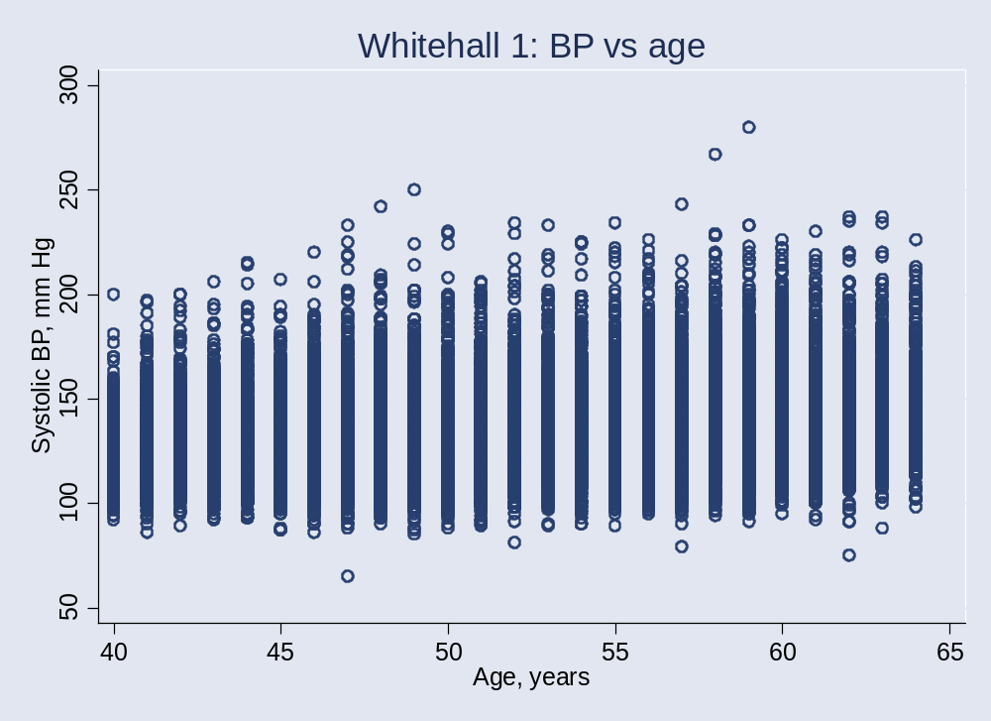
Example:
Systolic blood pressure vs. age

Slide 9
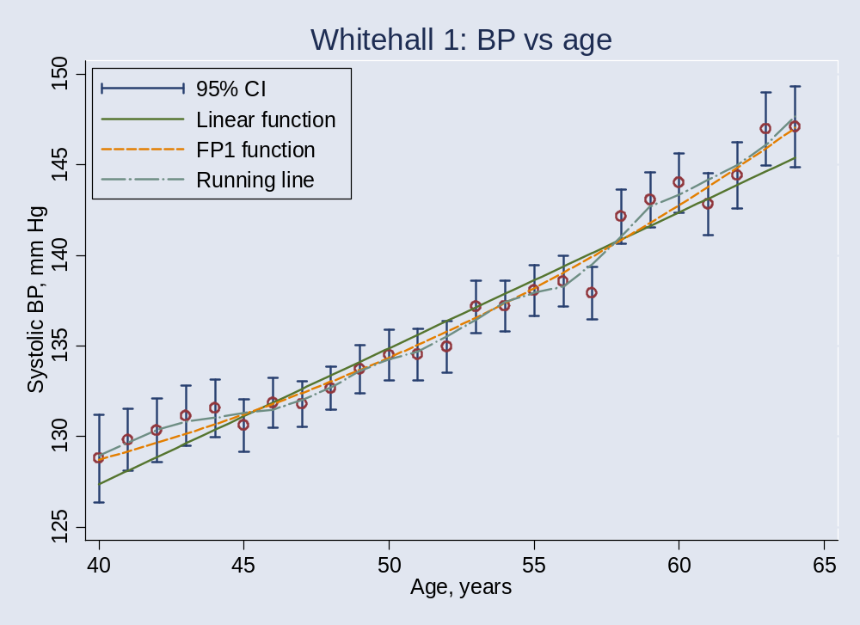
Example: Curve fitting
(Systolic BP and age – not linear)
Notes:
Inn1.do
Underlying functional relationship is probably simple, but linear fits badly
Notice how FP function smooths out complex, implausible irregularities in curve

Slide 10
Empirical curve fitting: Aims
Smoothing
Visualise relationship of Y with X
Provide and/or suggest functional form

Slide 11
Some approaches
‘Non-parametric’ (local-influence) models
  Locally weighted (kernel) fits (e.g. lowess)
  Regression splines
  Smoothing splines (used in generalized additive models)
Parametric (non-local influence) models
  Polynomials
  Non-linear curves
  Fractional polynomials
    Intermediate between polynomials and non-linear curves

Slide 12
Local regression models
Advantages
  Flexible – because local!
  May reveal ‘true’ curve shape (?)
Disadvantages
  Unstable – because local!
  No concise form for models
    Therefore, hard for others to use – publication,compare results with those from other models
  Curves not necessarily smooth
  ‘Black box’ approach
  Many approaches – which one(s) to use?

Slide 13
Polynomial models
Do not have the disadvantages of local regression models, but do have others:
Lack of flexibility (low order)
Artefacts in fitted curves (high order)
Cannot have asymptotes

Slide 14
Fractional polynomial models
Describe for one covariate, X
  multiple regression later
Fractional polynomial of degree m for X with powers p₁, … , p_{m} is given by
FPm(X) = β₁ X _{p1} + … + β_{m} X _{pm}
Powers p₁,…, p_{m} are taken from a special set
{−2, − 1, − 0.5, 0, 0.5, 1, 2, 3}
Usually m = 1 or m = 2 is sufficient for a good fit

Slide 15
FP1 and FP2 models
FP1 models are simple power transformations
1/X², 1/X, 1/√X, log X, √X, X, X², X³
  8 models
FP2 models are combinations of these
  For example β₁(1/X) + β₂(X²)
  28 models
Note ‘repeated powers’ models
  For example β₁(1/X) + β₂(1/X)log X
  8 models

Slide 16
FP1 and FP2 models: some properties
Many useful curves
A variety of features are available:
  Monotonic
  Can have asymptote
  Non-monotonic (single maximum or minimum)
  Single turning-point
Get better fit than with conventional polynomials, even of higher degree

Slide 17
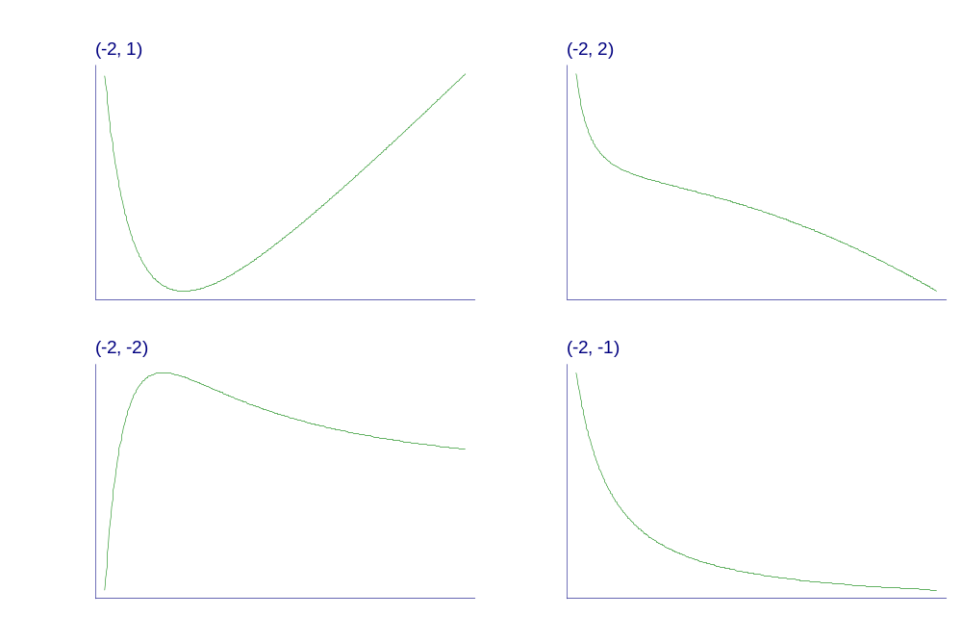
Examples of FP2 curves
- varying powers
Notes:
Fpexamp.gph, taken from c38\fig1a.gph.

Slide 18
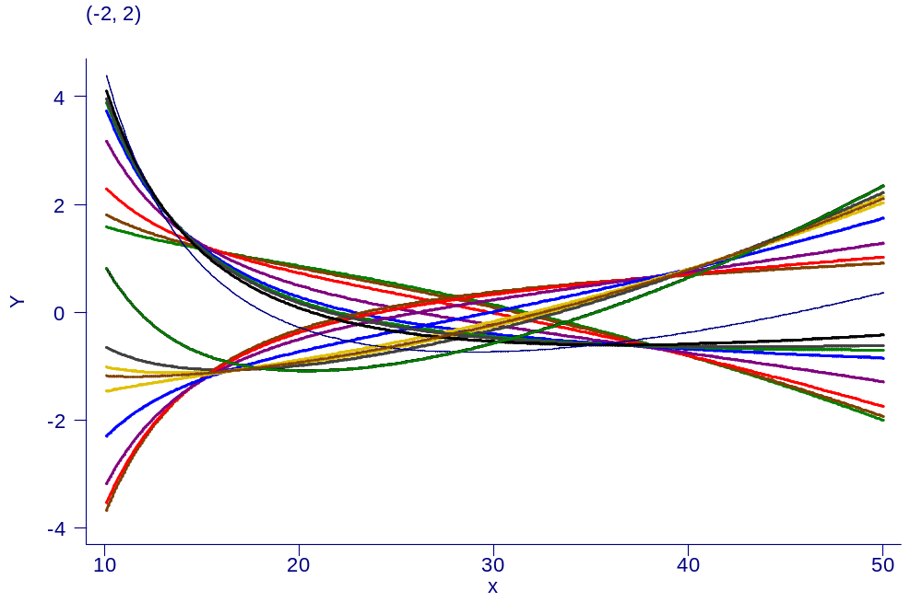
Examples of FP2 curves
- single power, different coefficients

Slide 19
A philosophy of function selection
Prefer simple (linear) model
Use more complex (non-linear) FP1 or FP2 model if indicated by the data
Contrast to local regression modelling
  Already starts with a complex model

Slide 20
Estimation and significance testing for FP models
Fit model with each combination of powers
  FP1: 8 single powers
  FP2: 36 combinations of powers
Choose model with lowest deviance (MLE)
Comparing FPm with FP(m − 1):
  compare deviance difference with χ² on 2 d.f.
  one d.f. for power, 1 d.f. for regression coefficient
  supported by simulations; slightly conservative

Slide 21
Selection of FP function
Has flavour of a closed test procedure
Use χ² approximations to get P-values
Define nominal P-value for all tests (often 5%)
Fit linear and best FP1 and FP2 models
Test FP2 vs. null – test of any effect of X (χ² on 4 df)
Test FP2 vs linear – test of non-linearity (χ² on 3 df)
Test FP2 vs FP1 – test of more complex function against simpler one (χ² on 2 df)

Slide 22
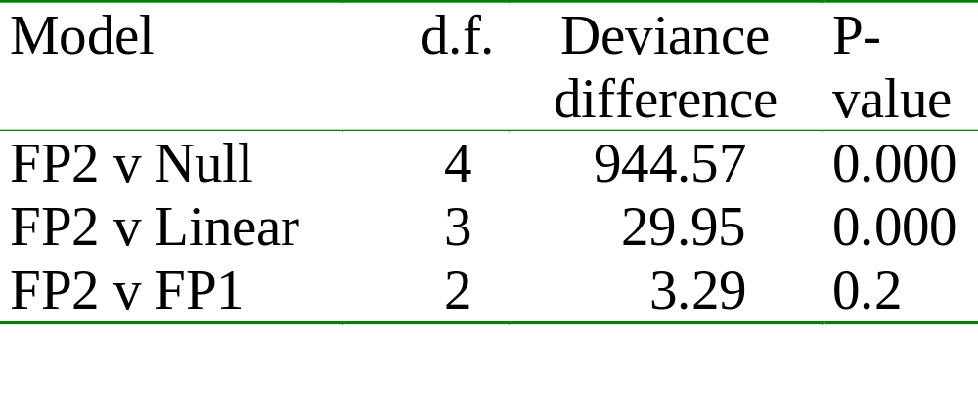
Example: Systolic BP and age
Reminder:
FP1 had power 3: β₁ X³
FP2 had powers (1,1): β₁ X + β₂ X log X

Slide 23
Aside: FP versus spline
Why care about FPs when splines are more flexible?
More flexible ⇒ more unstable
  More chance of ‘over-fitting’
In epidemiology, dose-response relationships are often simple
Illustrate by small simulation example

Slide 24
FP versus spline (continued)
Logarithmic relationships are common in practice
Simulate regression model y = β₀ + β₁log(X) + error
Error is normally distributed N(0, σ²)
Take β₀ = 0, β₁ = 1; X has lognormal distribution
Vary σ = {1, 0.5, 0.25, 0.125}
Fit FP1, FP2 and spline with 2, 4, 6 d.f.
Compute mean square error
Compare with mean square error for true model

Slide 25
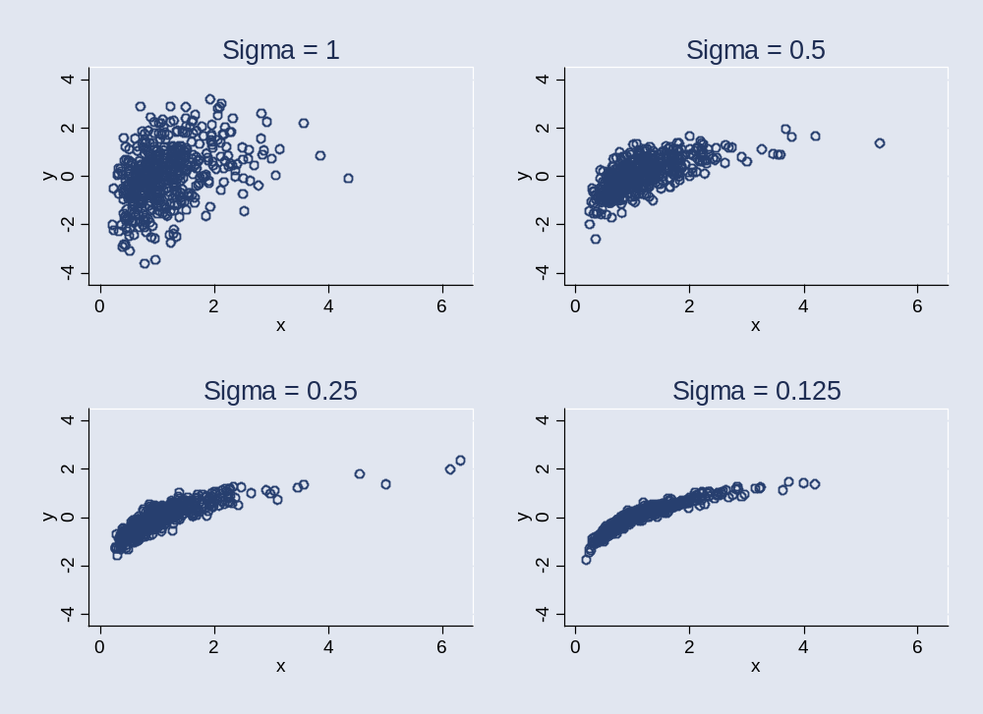
FP vs. spline (continued)
Notes:
Example of what data looks like

Slide 26
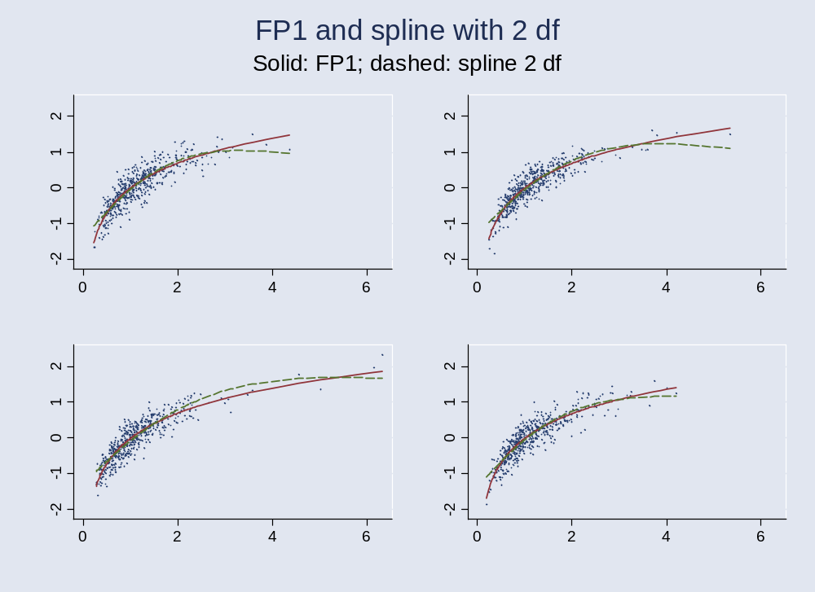
FP vs. spline (continued)

Slide 27
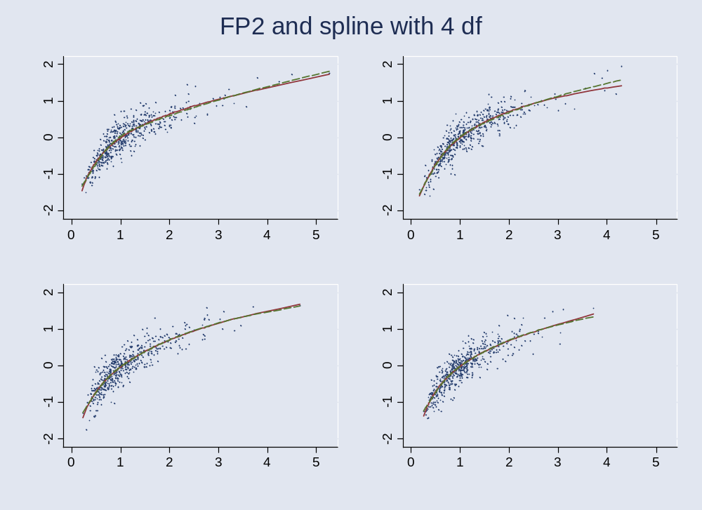
FP vs. spline (continued)

Slide 28
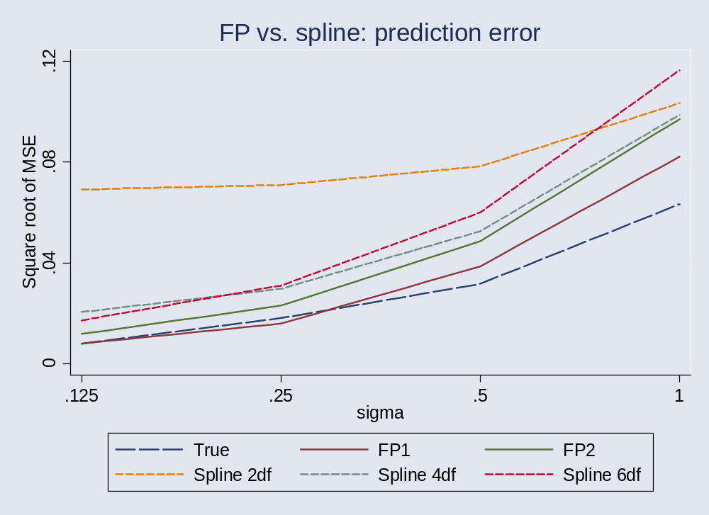
FP vs. spline (continued)
Notes:
200 replicates only

Slide 29
FP vs. spline (continued)
In this example, spline usually less accurate than FP
FP2 less accurate than FP1 (over-fitting)
FP1 and FP2 more accurate than splines
Splines often had non-monotonic fitted curves
  Could be medically implausible
Of course, this is a special example

Slide 30
Multivariable FP (MFP) models
Assume have k > 1 continuous covariates and perhaps some categoric or binary covariates
Allow dropping of non-significant variables
Wish to find best multivariable FP model for all X’s
Impractical to try all combinations of powers
Require iterative fitting procedure

Slide 31
Fitting multivariable FP models
(MFP algorithm)
Combine backward elimination of weak variables with search for best FP functions
Determine fitting order from linear model
Apply FP model selection procedure to each X in turn
  fixing functions (but not β’s) for other X’s
Cycle until FP functions (i.e. powers) and variables selected do not change

Slide 32
Example: Prognostic factors in breast cancer
Aim to develop a prognostic index for risk of tumour recurrence or death
Have 7 prognostic factors
  4 continuous, 3 categorical
Select variables and functions using 5% significance level

Slide 33
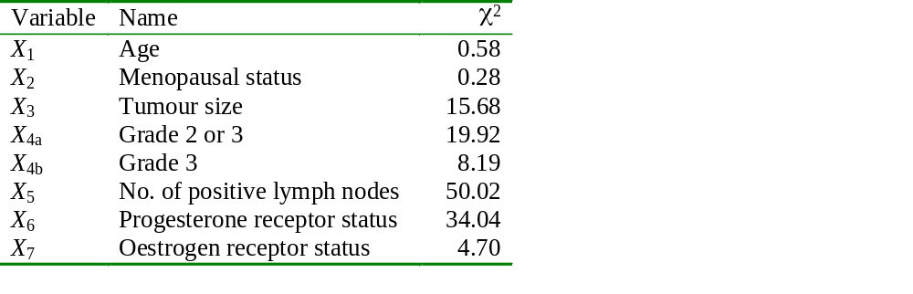
Univariate linear analysis
Notes:
Some people might choose to put all variables sig at 5% into multivariable model

Slide 34
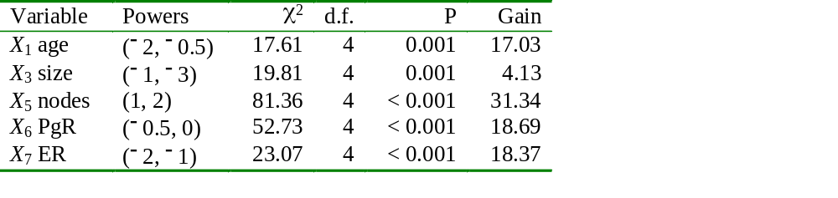
Univariate FP2 analysis
Gain compares FP2 with linear on 3 d.f.
All factors except for X₃ have a non-linear effect

Slide 35
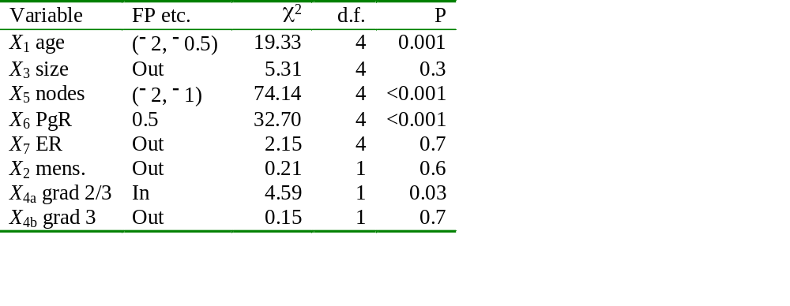
Multivariable FP analysis

Slide 36
Comments on analysis
Conventional backwards elimination at 5% level selects X_{4a}, X₅, X₆, and X₁ is excluded
FP analysis picks up same variables as backward elimination, and additionally X₁
Note considerable non-linearity of X₁ and X₅
X₁ has no linear influence on risk of recurrence
FP model detects more structure in the data than the linear model

Slide 37
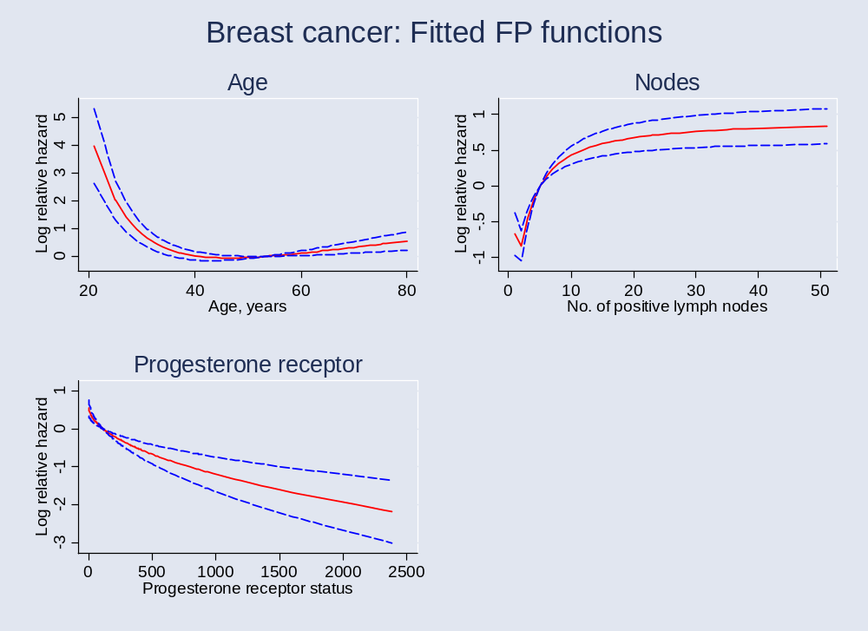
Plots of fitted FP functions
Notes:
inn2
Note non-monotonicity of x5 function

Slide 38
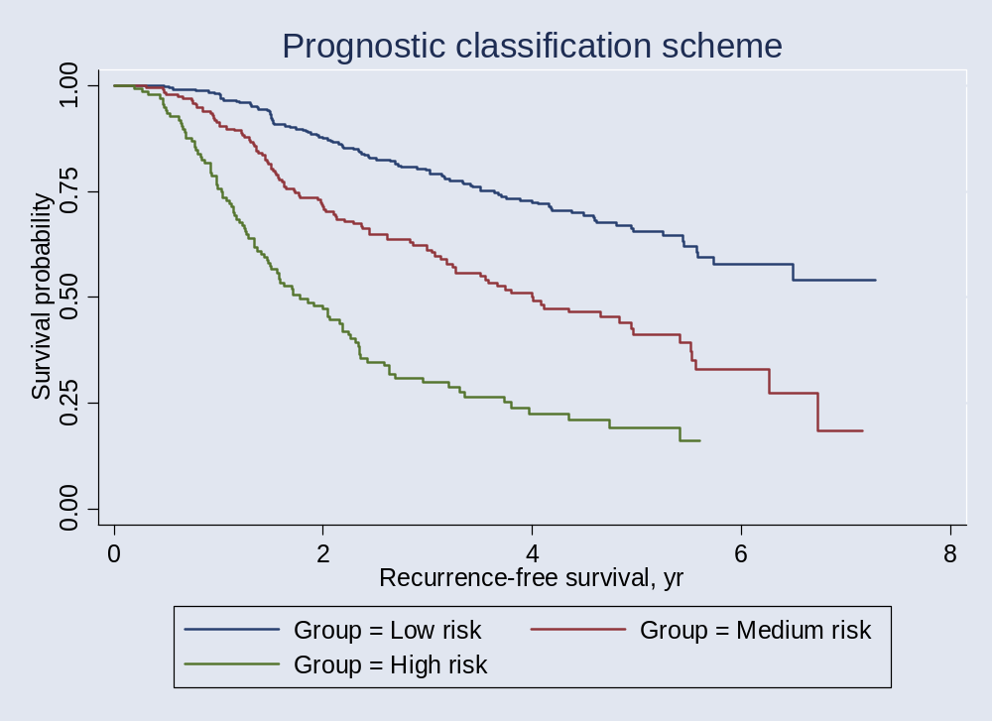
Survival by risk groups

Slide 39
Robustness of FP functions
Breast cancer example showed non-robust functions for nodes – not medically sensible
Situation can be improved by performing covariate transformation before FP analysis
Can be done systematically (work in progress)
Sauerbrei & Royston (1999) used negative exponential transformation of nodes
  exp(–0.12 * number of nodes)

Slide 40
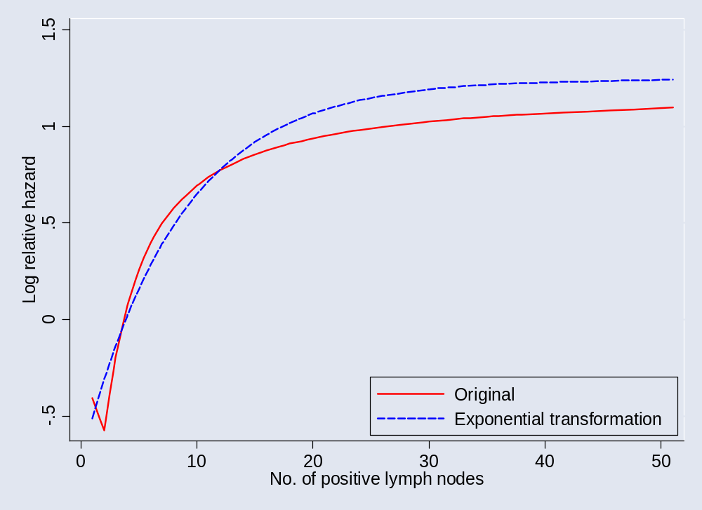
Making the function for lymph nodes more robust
Notes:
Inn2a

Slide 41
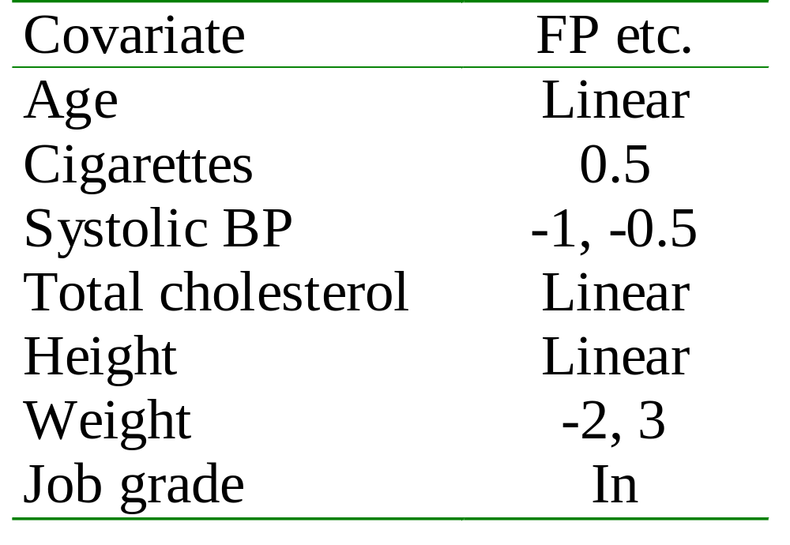
2nd example: Whitehall 1
MFP analysis
No variables were eliminated by the MFP algorithm
Weight is eliminated by linear backward elimination

Slide 42
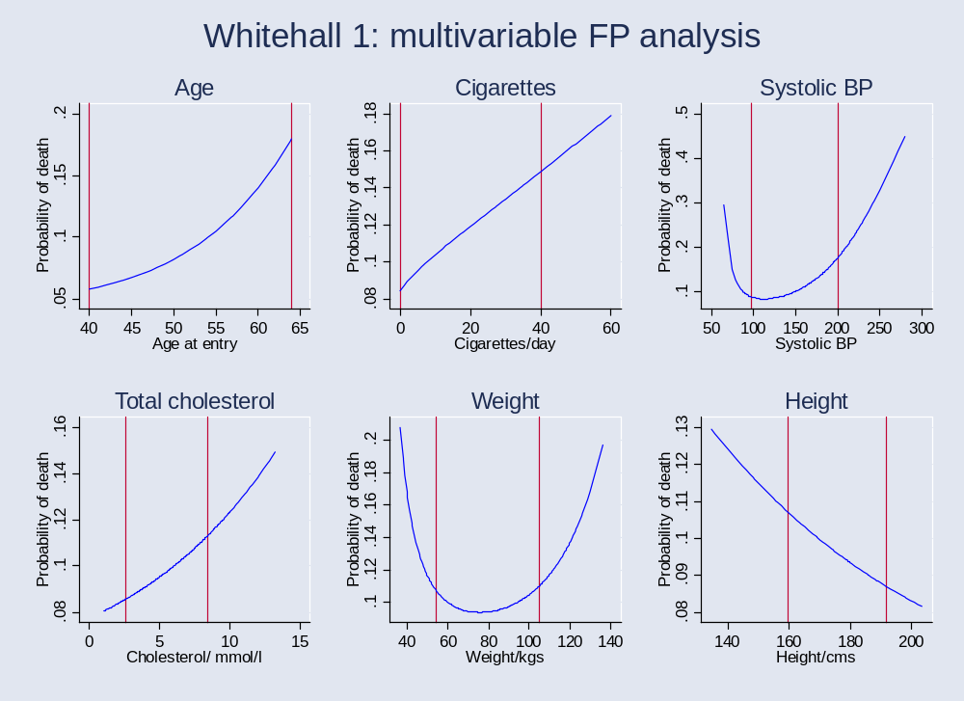
Plots of FP functions

Slide 43
Stability
Models (variables, FP functions) selected by statistical criteria – cut-off on P-value
Approach has several advantages …
… and also is known to have problems
  Omission bias
  Selection bias
  Unstable – many models may fit equally well

Slide 44
Stability
Instability may be studied by bootstrap resampling (sampling with replacement)
  Take bootstrap sample B times
  Select model by chosen procedure
  Count how many times each variable is selected
  Summarise inclusion frequencies & their dependencies
  Study fitted functions for each covariate
May lead to choosing several possible models, or a model different from the original one

Slide 45
Bootstrap stability analysis of the breast cancer dataset
5000 bootstrap samples taken (!)
MFP algorithm with Cox model applied to each sample
Resulted in 1222 different models (!!)
Nevertheless, could identify stable subset consisting of 60% of replications
  Judged by similarity of functions selected

Slide 46
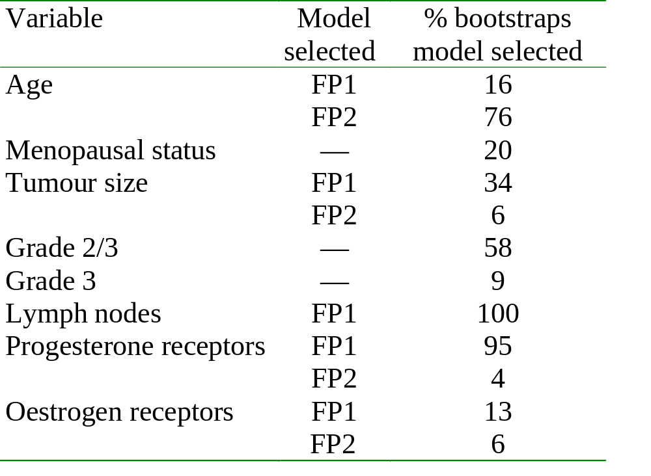
Bootstrap stability analysis of the breast cancer dataset

Slide 47
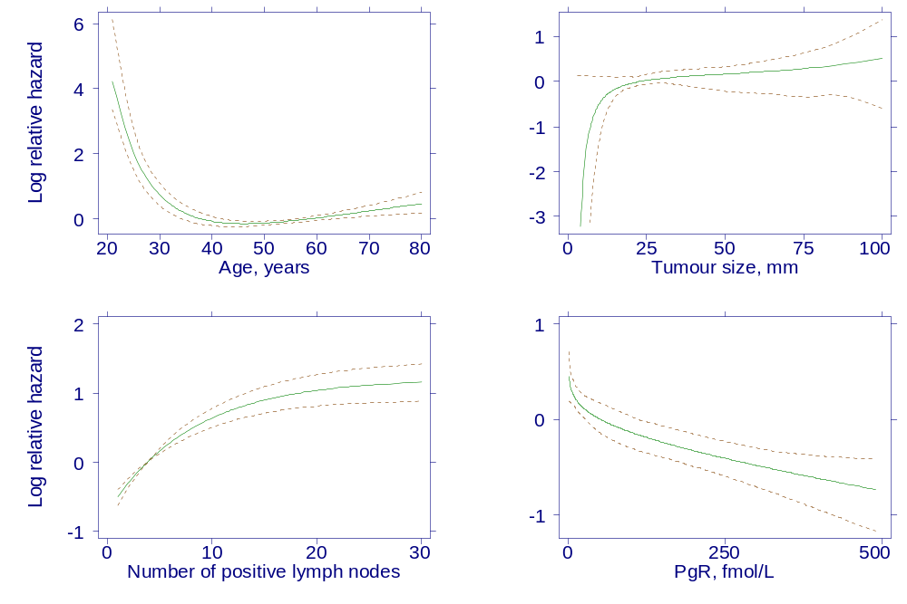
Bootstrap analysis: summaries of fitted curves from stable subset
Notes:
Stable subset comprised 60.1% of reps
Functions are when variable was selected

Slide 48
Presentation of models for continuous covariates
The function + 95% CI gives the whole story
Functions for important covariates should always be plotted
In epidemiology, sometimes useful to give a more conventional table of results in categories
This can be done from the fitted function

Slide 49
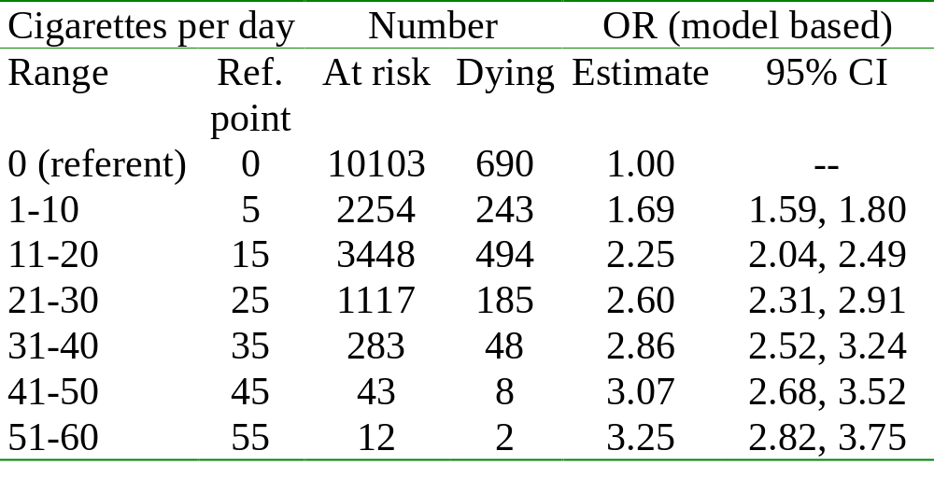
Example: Cigarette smoking and all-cause mortality (Whitehall 1)

Slide 50
Other issues (1)
Handling continuous confounders
  May use a larger P-value for selection e.g. 0.2
  Not so concerned about functional form here
Binary/continuous covariate interactions
  Can be modelled using FPs (Royston & Sauerbrei 2004)
  Adjust for other factors using MFP

Slide 51
Other issues (2)
Time-varying effects in survival analysis
  Can be modelled using FP functions of time (Berger; also Sauerbrei & Royston, in progress)
Checking adequacy of FP functions
  May be done by using splines
  Fit FP function and see if spline function adds anything, adjusting for the fitted FP function

Slide 52
Software sources
Most comprehensive implementation is in Stata
  Command mfp is part of Stata 8
Versions for SAS and R are now available
  Contact W Sauerbrei (wfs@imbi.uni-freiburg.de) to request a copy of the SAS macro
  R version available on CRAN archive
    mfp package

Slide 53
Concluding remarks (1)
FP method in general
  No reason (other than convention) why regression models should include only positive integer powers of covariates
  FP is a simple extension of an existing method
  Simple to program and simple to explain
  Parametric, so can easily get predicted values
  FP usually gives better fit than standard polynomials
  Cannot do worse, since standard polynomials are included

Slide 54
Concluding remarks (2)
Multivariable FP modelling
  Many applications in general context of multiple regression modelling
  Well-defined procedure based on standard principles for selecting variables and functions
  Aspects of robustness and stability have been investigated (and methods are available)
  Much experience gained so far suggests that method is very useful in clinical epidemiology

Slide 55
Some references
Royston P, Altman DG (1994) Regression using fractional polynomials of continuous covariates: parsimonious parametric modelling. Applied Statistics 43: 429-467
Royston P, Altman DG (1997) Approximating statistical functions by using fractional polynomial regression. The Statistician 46: 1-12
Sauerbrei W, Royston P (1999) Building multivariable prognostic and diagnostic models: transformation of the predictors by using fractional polynomials. JRSS(A) 162: 71-94. Corrigendum JRSS(A) 165: 399--400, 2002
Royston P, Ambler G, Sauerbrei W. (1999) The use of fractional polynomials to model continuous risk variables in epidemiology. International Journal of Epidemiology, 28: 964-974.
Royston P, Sauerbrei W (2004). A new approach to modelling interactions between treatment and continuous covariates in clinical trials by using fractional polynomials. Statistics in Medicine 23: 2509-2525.
Royston P, Sauerbrei W (2003) Stability of multivariable fractional polynomial models with selection of variables and transformations: a bootstrap investigation. Statistics in Medicine 22: 639-659.
Armitage P, Berry G, Matthews JNS (2002) Statistical Methods in Medical Research. Oxford, Blackwell.

