Slide 1


Multivariable model building with continuous data
Patrick Royston
MRC Clinical Trials Unit,
London, UK
Willi Sauerbrei
Institut of Medical Biometry and Informatics
University Medical Center Freiburg, Germany

Slide 2
Overview
Issues in regression models
Methods for variable selection
Functional form for continuous covariates
(Multivariable) fractional polynomials (MFP)
Summary

Slide 3
Observational Studies
Several variables, mix of continuous and (ordered) categorical variables
Different situations:
  prediction
  explanation
Explanation is the main interest here:
Identify variables with (strong) influence on the outcome
Determine functional form (roughly) for continuous variables
The issues are very similar in different types of regression models (linear regression model, GLM, survival models ...)
Use subject-matter knowledge for modelling ...
... but for some variables, data-driven choice inevitable

Slide 4
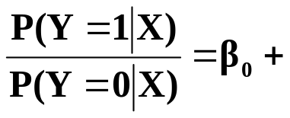
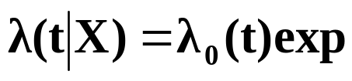
Regression models
X=(X₁, ...,X_{p}) covariate, prognostic factors
g(x) = ß₁ X₁ + ß₂ X₂ +...+ ß_{p} X_{p} (assuming effects are linear)
normal errors (linear) regression model
Y normally distributed
E (Y|X) = ß₀ + g(X)
Var (Y|X) = σ²I
logistic regression model
Y binary
Logit P (Y|X) = ln
survival times
T survival time (partly censored)
Incorporation of covariates
g(X)
(g(X))

Slide 5
Central issue
To select or not to select (full model)?
Which variables to include?

Slide 6
Continuous variables – The problem
“Quantifying epidemiologic risk factors using non-parametric regression: model selection remains the greatest challenge”
Rosenberg PS et al, Statistics in Medicine 2003; 22:3369-3381
Discussion of issues in (univariate) modelling with splines
Trivial nowadays to fit almost any model
To choose a good model is much harder

Slide 7
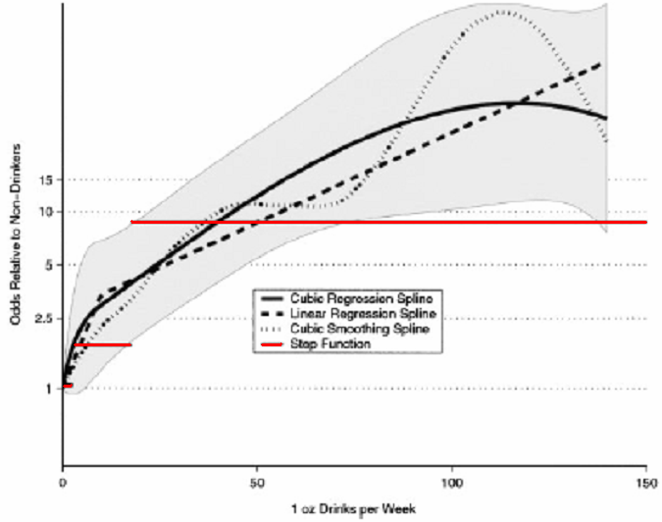
Alcohol consumption as risk factor for oral cancer
Rosenberg et al, StatMed 2003

Slide 8
Building multivariable regression models
Before dealing with the functional form, the ‚easier‘ problem of model selection:
variable selection assuming that the effect of each continuous variable is linear

Slide 9

Multivariable models - methods for variable selection
Full model
  variance inflation in the case of multicollinearity
Stepwise procedures ⇒ prespecified (α_{in}, α_{out}) and
actual significance level?
    forward selection (FS)
    stepwise selection (StS)
    backward elimination (BE)
All subset selection ⇒ which criteria?
    C_{p} Mallows = (SSE / ) - n + p 2
    AIC Akaike Information Criterion = n ln (SSE / n) + p 2
    BIC Bayes Information Criterion = n ln (SSE / n) + p ln(n)
fit penalty
Combining selection with Shrinkage
Bayes variable selection
Recommendations???
Central issue: MORE OR LESS COMPLEX MODELS?

Slide 10
Backward elimination is a sensible approach
Significance level can be chosen
Reduces overfitting
Of course required
Checks
Sensitivity analysis
Stability analysis

Slide 11
Continuous variables – what functional form?
Traditional approaches
a) Linear function
- may be inadequate functional form
- misspecification of functional form may lead to
wrong conclusions
b) ‘best‘ ‘standard‘ transformation
c) Step function (categorial data)
- Loss of information
- How many cutpoints?
- Which cutpoints?
- Bias introduced by outcome-dependent choice

Slide 12
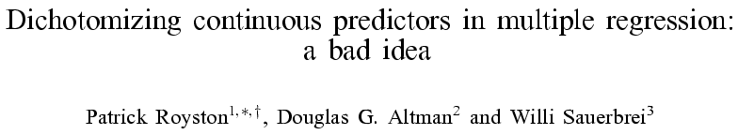
StatMed 2006, 25:127-141

Slide 13
Continuous variables – newer approaches
‘Non-parametric’ (local-influence) models
  Locally weighted (kernel) fits (e.g. lowess)
  Regression splines
  Smoothing splines
Parametric (non-local influence) models
  Polynomials
  Non-linear curves
  Fractional polynomials
    Intermediate between polynomials and non-linear curves

Slide 14
Fractional polynomial models
Describe for one covariate, X
Fractional polynomial of degree m for X with powers p₁, … , p_{m} is given by
FPm(X) = β₁ X ^{p1} + … + β_{m} X ^{pm}
Powers p₁,…, p_{m} are taken from a special set
{−2, − 1, − 0.5, 0, 0.5, 1, 2, 3}
Usually m = 1 or m = 2 is sufficient for a good fit
Repeated powers (p₁=p₂)
β₁ X ^{p1} + β₂ X ^{p1}log X
8 FP1, 36 FP2 models

Slide 15
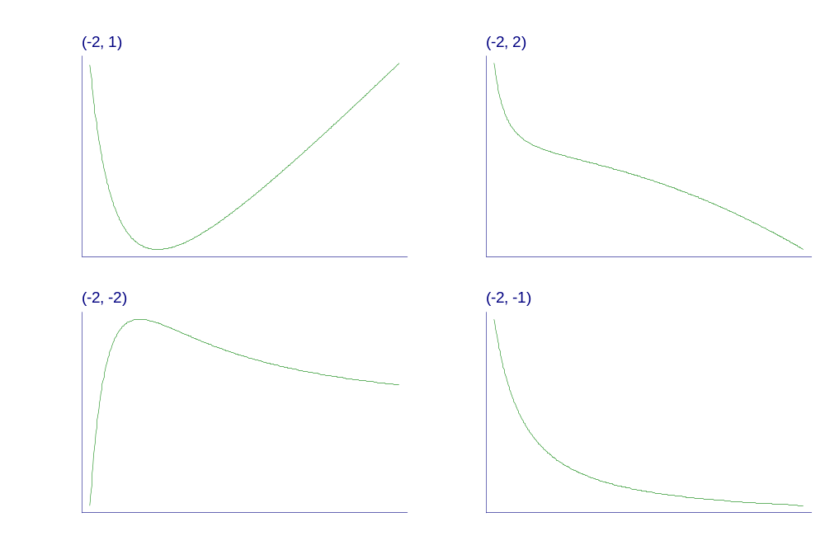
Examples of FP2 curves
- varying powers
Notes:
Fpexamp.gph, taken from c38\fig1a.gph.

Slide 16
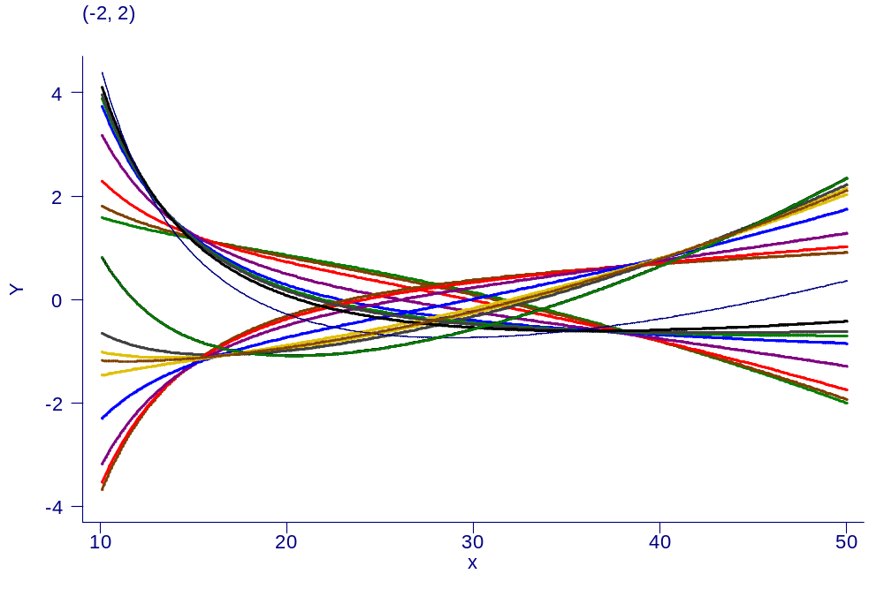
Examples of FP2 curves
- single power, different coefficients

Slide 17
Our philosophy of function selection
Prefer simple (linear) model
Use more complex (non-linear) FP1 or FP2 model if indicated by the data
Contrasts to more local regression modelling
  Already starts with a complex model

Slide 18
GBSG-study in node-positive breast cancer
299 events for recurrence-free survival time (RFS) in
686 patients with complete data
7 prognostic factors, of which 5 are continuous

Slide 19
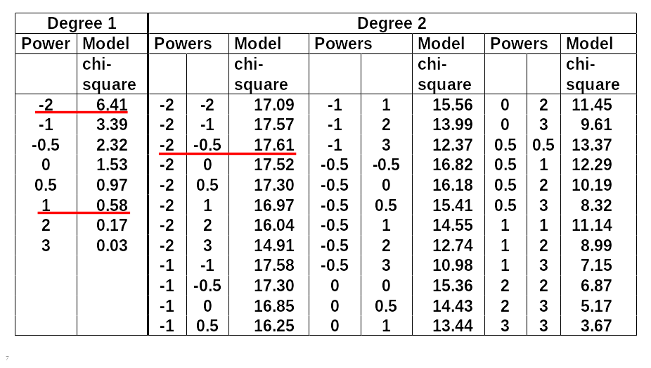
FP analysis for the effect of age

Slide 20
Function selection procedure (FSP)
Effect of age at 5% level?
χ² df p-value
Any effect?
Best FP2 versus null 17.61 4 0.0015
Linear function suitable?
Best FP2 versus linear 17.03 3 0.0007
FP1 sufficient?
Best FP2 vs. best FP1 11.20 2 0.0037

Slide 21
Many predictors – MFP
With many continuous predictors selection of best FP for each becomes more difficult → MFP algorithm as a standardized way to variable and function selection
(usually binary and categorical variables are also available)
MFP algorithm combines
  backward elimination with
  FP function selection procedures

Slide 22
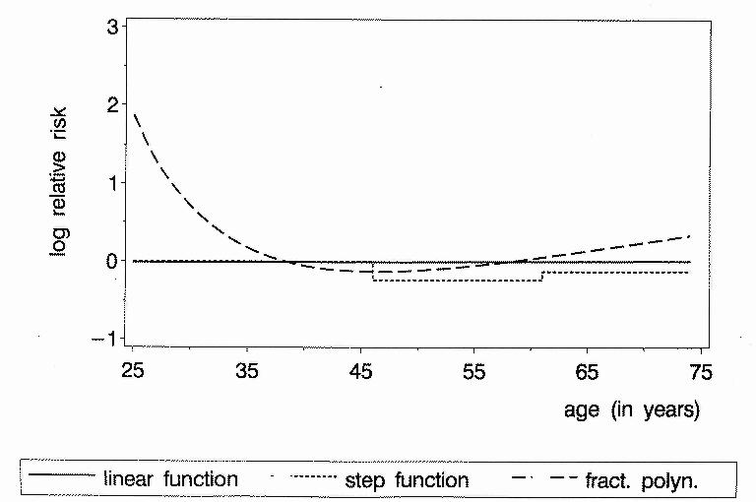
Continuous factors
Different results with different analyses
Age as prognostic factor in breast cancer (adjusted)
P-value 0.9 0.2 0.001

Slide 23
Software sources MFP
Most comprehensive implementation is in Stata
  Command mfp is part since Stata 8 (now Stata 10)
Versions for SAS and R are available
  SAS
  www.imbi.uni-freiburg.de/biom/mfp
  R version available on CRAN archive
    mfp package

Slide 24
Concluding comments – FPs
FPs use full information - in contrast to a priori categorisation
FPs search within flexible class of functions (FP1 and FP(2)-44 models)
MFP is a well-defined multivariate model-building strategy – combines search for transformations with BE
Important that model reflects medical knowledge,
e.g. monotonic / asymptotic functional forms
Bootstrap and shrinkage are useful ways to investigate model stability and bias in parameter estimates- particularly with flexible FPs and consequent danger of overfitting
Preliminary transformation to reduce ‘end-effects’ problem
MFP extensions
Need to compare FP approach with splines and other methods
but
    ‘standard‘ spline approach?
    reflect medical knowledge?

Slide 25
MFP extensions
MFPI – treatment/covariate interactions
MFPIgen – interaction between two continuous variables
MFPT – time-varying effects in survival data

Slide 26
Towards recommendations for model-building by selection of variables and functional forms for continuous predictors under several assumptions
Issue | Recommendation
Variable selection procedure | Backward elimination; significance level as key tuning parameter, choice depends on the aim of the study
Functional form for continuous covariates | Linear function as the 'default', check improvement in model fit by fractional polynomials. Check derived function for undetected local features
Extreme values or influential points | Check at least univariately for outliers and influential points in continuous variables. A preliminary transformation may improve the model selected. For a proposal see R & S 2007
Sensitivity analysis | Important assumptions should be checked by a sensitivity analysis. Highly context dependent
Check of model stability | The bootstrap is a suitable approach to check for model stability
Complexity of a predictor | A predictor should be 'as parsimonious as possible'

Slide 27
Summary
Getting the big picture right is more important than optimising aspects and ignoring others
strong predictors
strong non-linearity
strong interactions
strong non-PH in survival model

Slide 28
References
Harrell FE jr. (2001): Regression Modeling Strategies. Springer.
Royston P, Altman DG. (1994): Regression using fractional polynomials of continuous covariates: parsimonious parametric modelling (with discussion). Applied Statistics, 43, 429-467.
Royston P, Sauerbrei W. (2003): Stability of multivariable fractional polynomial models with selection of variables and transformations: : a bootstrap investigation. Statistics in Medicine, 22, 639-659.
Royston P, Sauerbrei W. (2004): A new approach to modelling interactions between treatment and continuous covariates in clinical trials by using fractional polynomials. Statistics in Medicine, 23, 2509-2525.
Royston P, Sauerbrei W. (2005): Building multivariable regression models with continuous covariates, with a practical emphasis on fractional polynomials and applications in clinical epidemiology. Methods of Information in Medicine, 44, 561-571.
Royston P, Sauerbrei W. (2007): Improving the robustness of fractional polynomial models by preliminary covariate transformation: a pragmatic approach. Computational Statistics and Data Analysis, 51: 4240-4253.
Royston, P., Sauerbrei, W. (2008): ‘Multivariable Model-Building – A pragmatic approach to regression analysis based on fractional polynomials for continuous variables’. Wiley.
Sauerbrei W. (1999): The use of resampling methods to simplify regression models in medical statistics. Applied Statistics, 48, 313-329.
Sauerbrei W, Meier-Hirmer C, Benner A, Royston P. (2006): Multivariable regression model building by using fractional polynomials: Description of SAS, STATA and R programs. Computational Statistics & Data Analysis, 50, 3464-3485.
Sauerbrei W, Royston P. (1999): Building multivariable prognostic and diagnostic models: transformation of the predictors by using fractional polynomials. Journal of the Royal Statistical Society A, 162, 71-94.
Sauerbrei, W., Royston, P., Binder H (2007): Selection of important variables and determination of functional form for continuous predictors in multivariable model building. Statistics in Medicine, 26: 5512-5528.
Sauerbrei W, Royston P, Look M. (2007): A new proposal for multivariable modelling of time-varying effects in survival data based on fractional polynomial time-transformation. Biometrical Journal, 49: 453-473.
Sauerbrei W, Royston P, Zapien K. (2007): Detecting an interaction between treatment and a continuous covariate: a comparison of two approaches. Computational Statistics and Data Analysis, 51: 4054-4063.
Schumacher M, Holländer N, Schwarzer G, Sauerbrei W. (2006): Prognostic Factor Studies. In Crowley J, Ankerst DP (ed.), Handbook of Statistics in Clinical Oncology, Chapman&Hall/CRC, 289-333.

