Slide 1


Flexible modeling of dose-risk relationships with fractional polynomials
Willi Sauerbrei
Institut of Medical Biometry and Informatics
University Medical Center Freiburg, Germany
Patrick Royston
MRC Clinical Trials Unit,
London, UK

Slide 2
Modelling in
(pharmaco-)epidemiology
Cohort study, case-control study, …
Several predictors, mix of continuous and categorical variables
The focus is on one risk factor – the rest are potential confounders
Wish to estimate the association of the risk factor with the outcome (adjusting for confounders)
If the risk factor is continuous, the ‘dose’-risk function is of interest
The issues are very similar in different types of regression models (linear regression model, logistic regn, GLM, survival models ...)

Slide 3
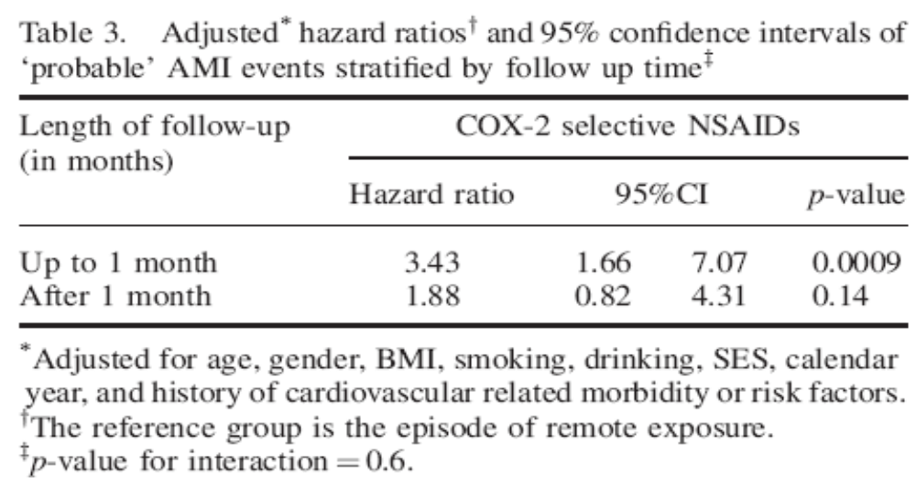
Example – AMI and NSAID use
(Hammad et al, PaDS 17:315, April 2008)
An analysis using length of follow-up as a continuous variable could be informative!

Slide 4
Continuous risk variables – the problem
“Quantifying epidemiologic risk factors using non-parametric regression: model selection remains the greatest challenge”
Rosenberg PS et al, Statistics in Medicine 2003; 22:3369-3381
Discussion of issues in modelling a single risk variable, mainly using cubic splines
Trivial nowadays to fit almost any model
To choose a good model is much harder

Slide 5
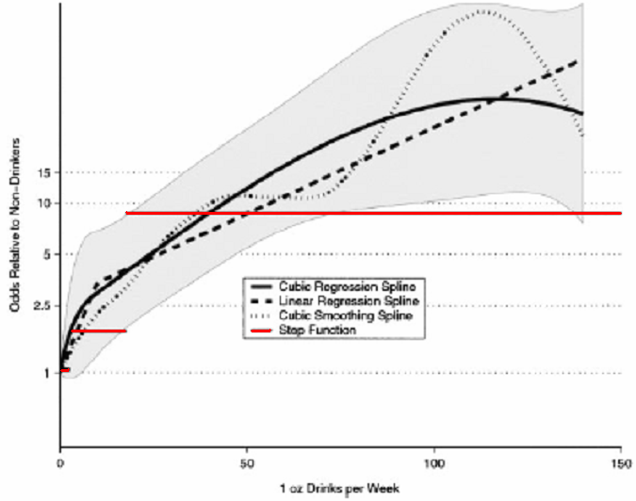
Alcohol consumption as risk factor for oral cancer
Odds relative to non-drinkers

Slide 6
Continuous risk factors – which functional form?
Traditional approaches
a) Linear function
- may be an inadequate description of reality
- misspecification of functional form may lead to
wrong conclusions
b) ’Best’ standard transformation (log, square root, etc)
c) Step function (categorical data)
- Loss of information
- How many cutpoints?
- Which cutpoints?
- Bias introduced by outcome-dependent choice

Slide 7
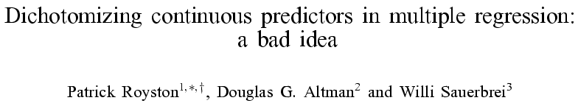
Stat in Med 2006, 25:127-141
(65 citations so far at July 2008)

Slide 8
Dichotomisation – the `optimal’ cutpoint method
‘Optimal’ cutpoint method is quite often used in clinical research
Searches for cutpoint on a continuous variable to minimise the P-value comparing 2 groups
But …
Multiple testing means P-value is not honest
  E.g. P <0.002 is really P < 0.05 after adjusting
‘Optimal’ cutpoint is clinically meaningless
Unstable – not reproducible between studies

Slide 9
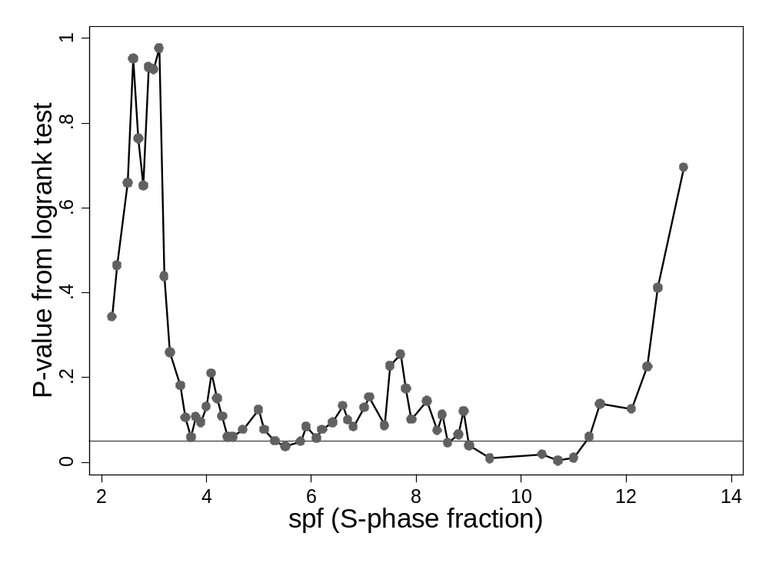
Example – S-phase fraction in node-positive breast cancer
`Optimal’: P = 0.007
Corrected: P = 0.12

Slide 10
Continuous risk factors – some newer approaches
‘Non-parametric’ models
  Local smoothers (e.g. running line, lowess, etc)
  Linear, quadratic or cubic regression splines
  Cubic smoothing splines
Parametric models
  Polynomials (quadratic, cubic, etc)
  Non-linear curves
  Fractional polynomials

Slide 11
Fractional polynomial (FP) models
Continuous risk variable, X
Fractional polynomial of degree m for X with powers
p₁, p₂ … , p_{m} is given by
FPm(X) = β₁ X ^{p1} + … + β_{m} X ^{pm}
Powers p₁,…, p_{m} are taken from a special set
{−2, − 1, − 0.5, 0, 0.5, 1, 2, 3} (0 means log)
Usually m = 1 or m = 2 is sufficient for a good fit
Repeated powers (p₁ = p₂)
β₁ X ^{p1} + β₂ X ^{p1} log X
8 FP1 models, 36 FP2 models
Systematically search for best fit among these models

Slide 12
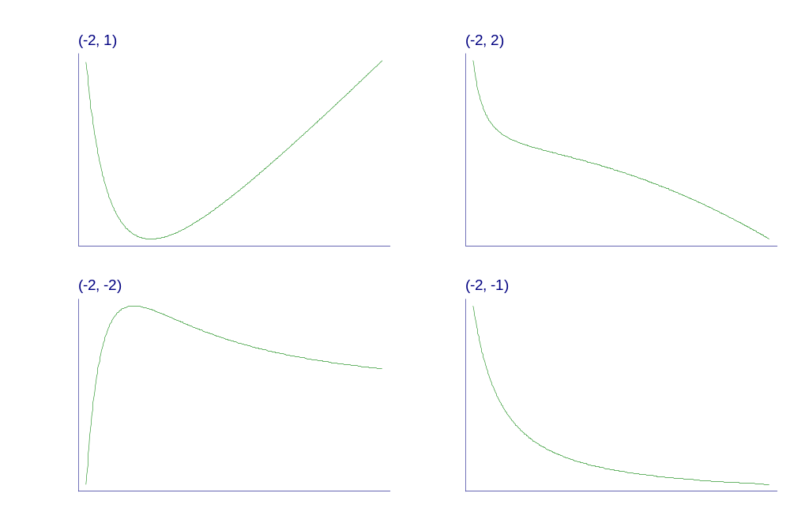
Examples of FP2 curves
- varying powers
Notes:
Fpexamp.gph, taken from c38\fig1a.gph.

Slide 13
Selecting FP functions with real data
Prefer the simplest (linear) model – if it fits well
Use a more complex (non-linear) FP1 or FP2 model only if indicated by the data
Apply a carefully designed function selection procedure to
  Control the type 1 error rate
  Reduce over-fitting
The function selection procedure:
  Starts with the most complex model (FP2)
  Applies a sequence of tests to reduce complexity if not supported by data

Slide 14
Example – Whitehall 1
Prospective cohort study of 18,403 male British Civil Servants initially aged 40-64
Complete 10-year follow up (n = 17,260)
Identified causes of death: all-cause, stroke, cancer, coronary heart disease
Aimed to examine socio-economic features as risk factors
We consider all-cause mortality (1,670 deaths) and systolic blood pressure – logistic regression

Slide 15
Function selection procedure for systolic blood pressure
χ²-difference df p-value
Any effect?
Best FP2 versus null 332.57 4 < 0.001
Linear function suitable?
Best FP2 versus linear 26.22 3 < 0.001
FP1 sufficient?
Best FP2 vs. best FP1 19.79 2 < 0.001

Slide 16
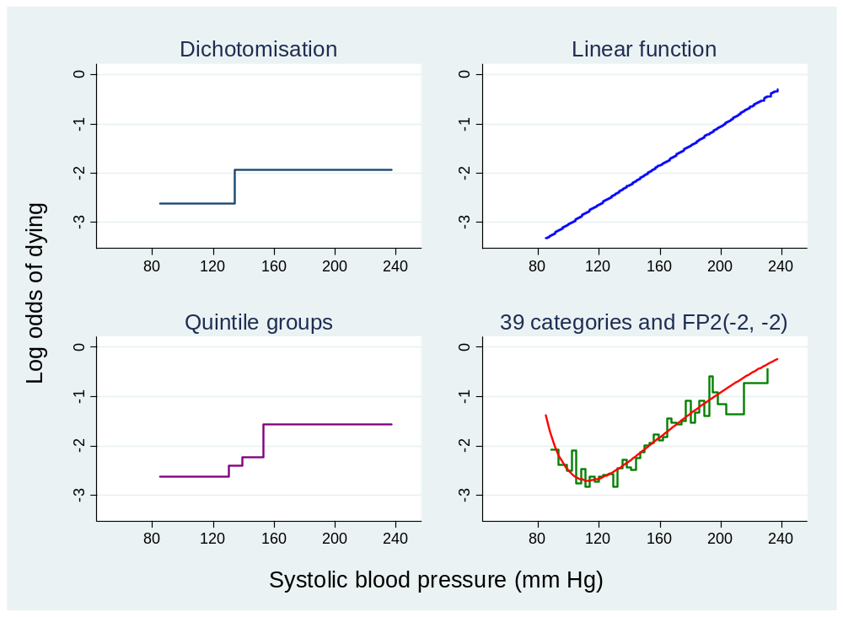
Whitehall 1 – Mortality and systolic blood pressure

Slide 17
Whitehall 1 example – remarks
Categorical models with 2 or 5 categories seriously ‘shrink’ the range of risk estimates
Linear model looks badly biased for low blood pressures – shape of function is wrong
FP2 model fits well and appears plausible
Results qualitatively similar if adjusted for age and other factors

Slide 18
Multivariable models
Can extend the FP method to multivariable modelling when have several continuous risk factors or confounders
This is known as MFP (multivariable fractional polynomials)
Royston & Sauerbrei (2008) explore MFP in detail
Our book is on the Wiley conference stand!
If desired, can select variables using a stepwise method (backward elimination)

Slide 19
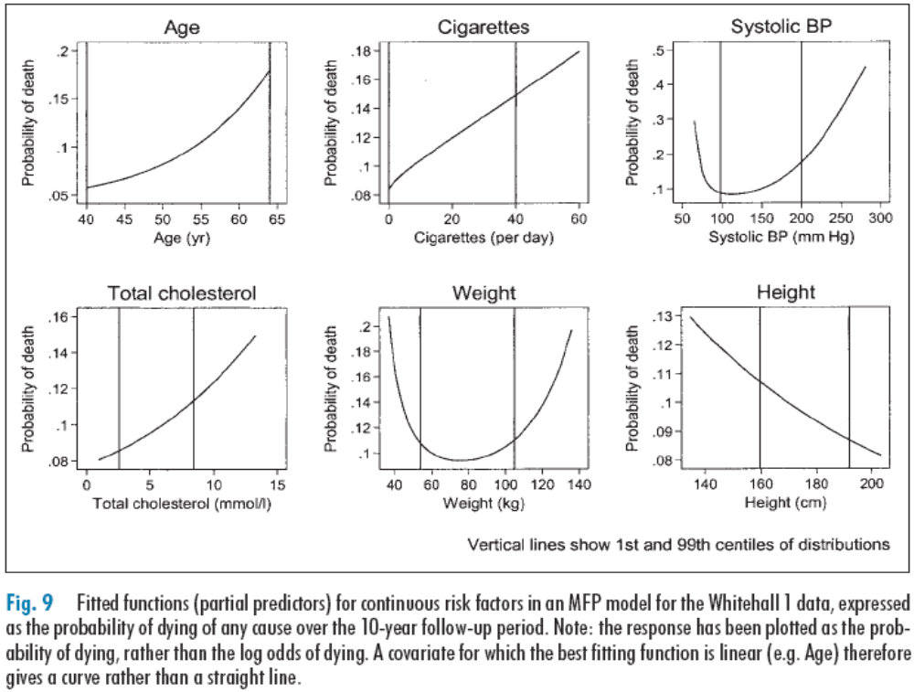
Example: MFP model, Whitehall 1 see Royston P & Sauerbrei W, Meth Inf Med 44:561-71 (2005)

Slide 20
Advantages of MFP
Avoids cut-points for continuous variables
Systematic selection of variables and FP functions
Informative about shape of risk relationship for any variable in the model
  not just the one of main interest

Slide 21
Concluding remarks
Pharmaco-epidemiology appears to have plenty of continuous risk variables and plenty of continuous confounders
(M)FP analysis may be very helpful in building parsimonious yet informative models with continuous risk variables
We will be more than happy to discuss applications of the methodology with individuals

