Slide 1


Multivariable regression modelling – a pragmatic approach based on fractional polynomials for continuous variables
Patrick Royston
MRC Clinical Trials Unit,
London, UK
Willi Sauerbrei
Institut of Medical Biometry and Informatics
University Medical Center Freiburg, Germany

Slide 2
Outline
Prognostic factor studies
Continuous variables
  categorizing data
  fractional polynomials
  interactions
Reporting
Conclusions

Slide 3
Mc Guire 1991
Guidelines for evaluating new prognostic factors
Begin with a biological hypothesis for the new factor
Differentiate between a pilot study and a definitve study
Perform sample size calculations prior to initiating the study
Identify possible patient selection biases
Validate the methodologies used to measure the new factor
Include optimal representations of the factor in the analyses
Perform multivariate analyses that also include standard factors
Validate the reproducibility of the results in internal and external validation sets

Slide 4
Observational Studies
one spezific variable of interest,
necessity to control for confounders
many variables measured, pairwise-
and multicollinearity present
• model should fit the data
• identification of important variables
• model and single effects
• sensible
• interpretable
Use subject-matter knowledge for modelling...
... But for some variables, data-driven choice inevitable
Modelling in the framework of
• Regression models
• Trees
• Neutral Net
Selection of important variables

Slide 5
Methods for variable selection
full model
- variance inflation in the case of multi-collinearity
* Wald-statistic
stepwise procedures
- prespecified (α_{in}, α_{out}) and actual selection level?
* forward selection (FS)
* stepwise selection (StS)
* backward elimination (BE)
all subset selection
- which criteria?
* C_{p} Mallows
* AIC Akaike
* SBC Schwarz
Bayes variable selection
MORE OR LESS COMPLEX MODELS?

Slide 6
Evaluation of prognostic factors is often based on historical data
Advantage
Patient data with long-term follow-up information available in a database
Disadvantages
Insufficient quality of data
Important variables not availabe
Study population heterogeneous with respect to prognostic factors and therapy

Slide 7
Assessment of a ‘new‘ factor
Population
ideally from a clinical trial
most often registry data from a clinic
often too small
Analysis
Often only univariate analysis
cutpoint for division into two groups
cutpoint derived data-dependently
multivariate analysis required

Slide 8
Example to demonstrate issues
Freiburg DNA study (Pfisterer et al 1995)
N= 266, Median follow-up 82 months
115 events for recurrence free survival time
Prognostic value of SPF
SPF missing: 2.5% of diploid tumours (N=122)
38.9% of aneuploid tumours (N=144)

Slide 9
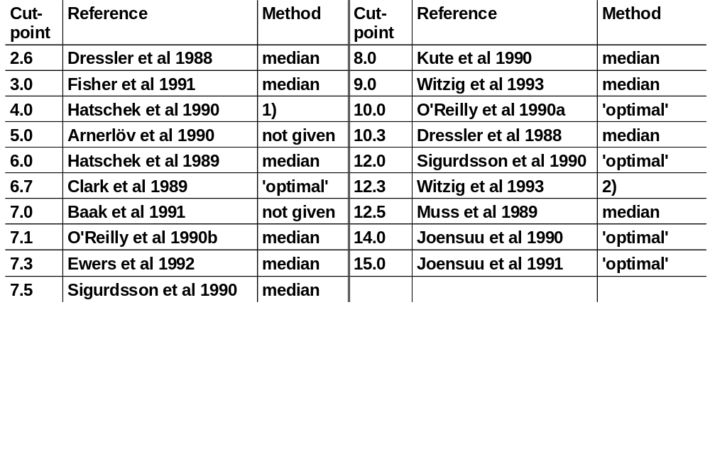
´Optimal´ cutpoint analysis – serious problem
SPF-cutpoints used in the literature (Altman et al 1994)
Three Groups with approx. equal size 2)Upper third of SPF-distribution

Slide 10
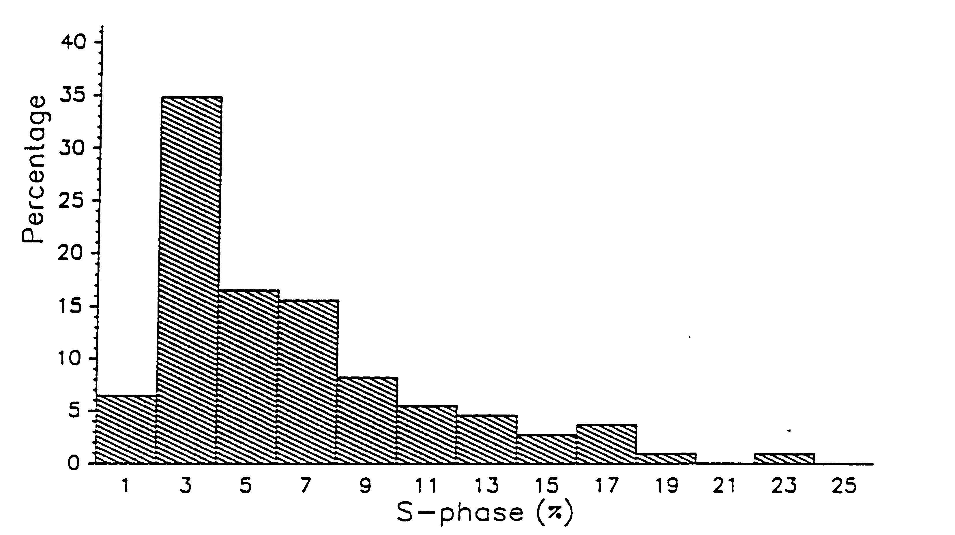
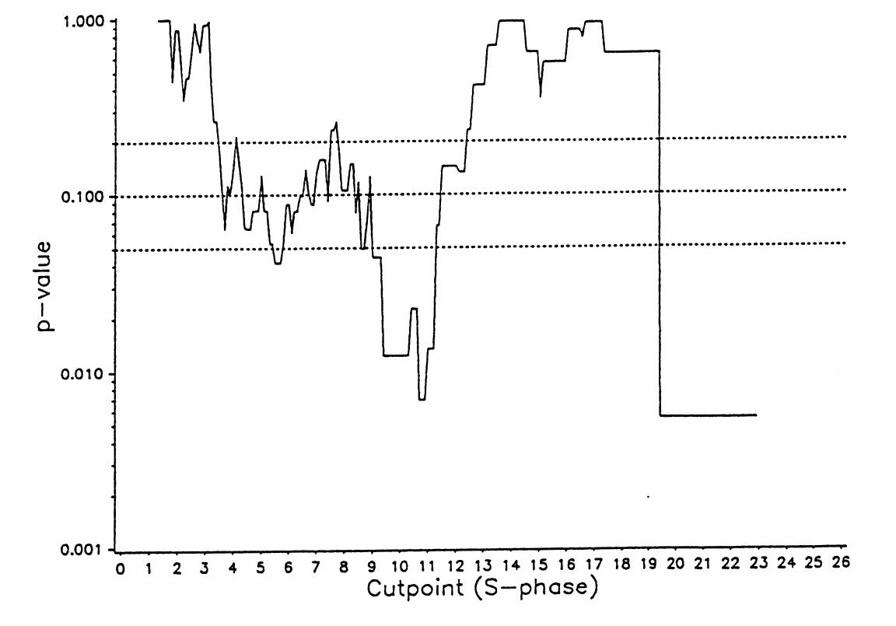
Searching for optimal cutpoint minimal p-value approach
SPF in Freiburg DNA study
Problem
multiple testing => inflated type I error

Slide 11
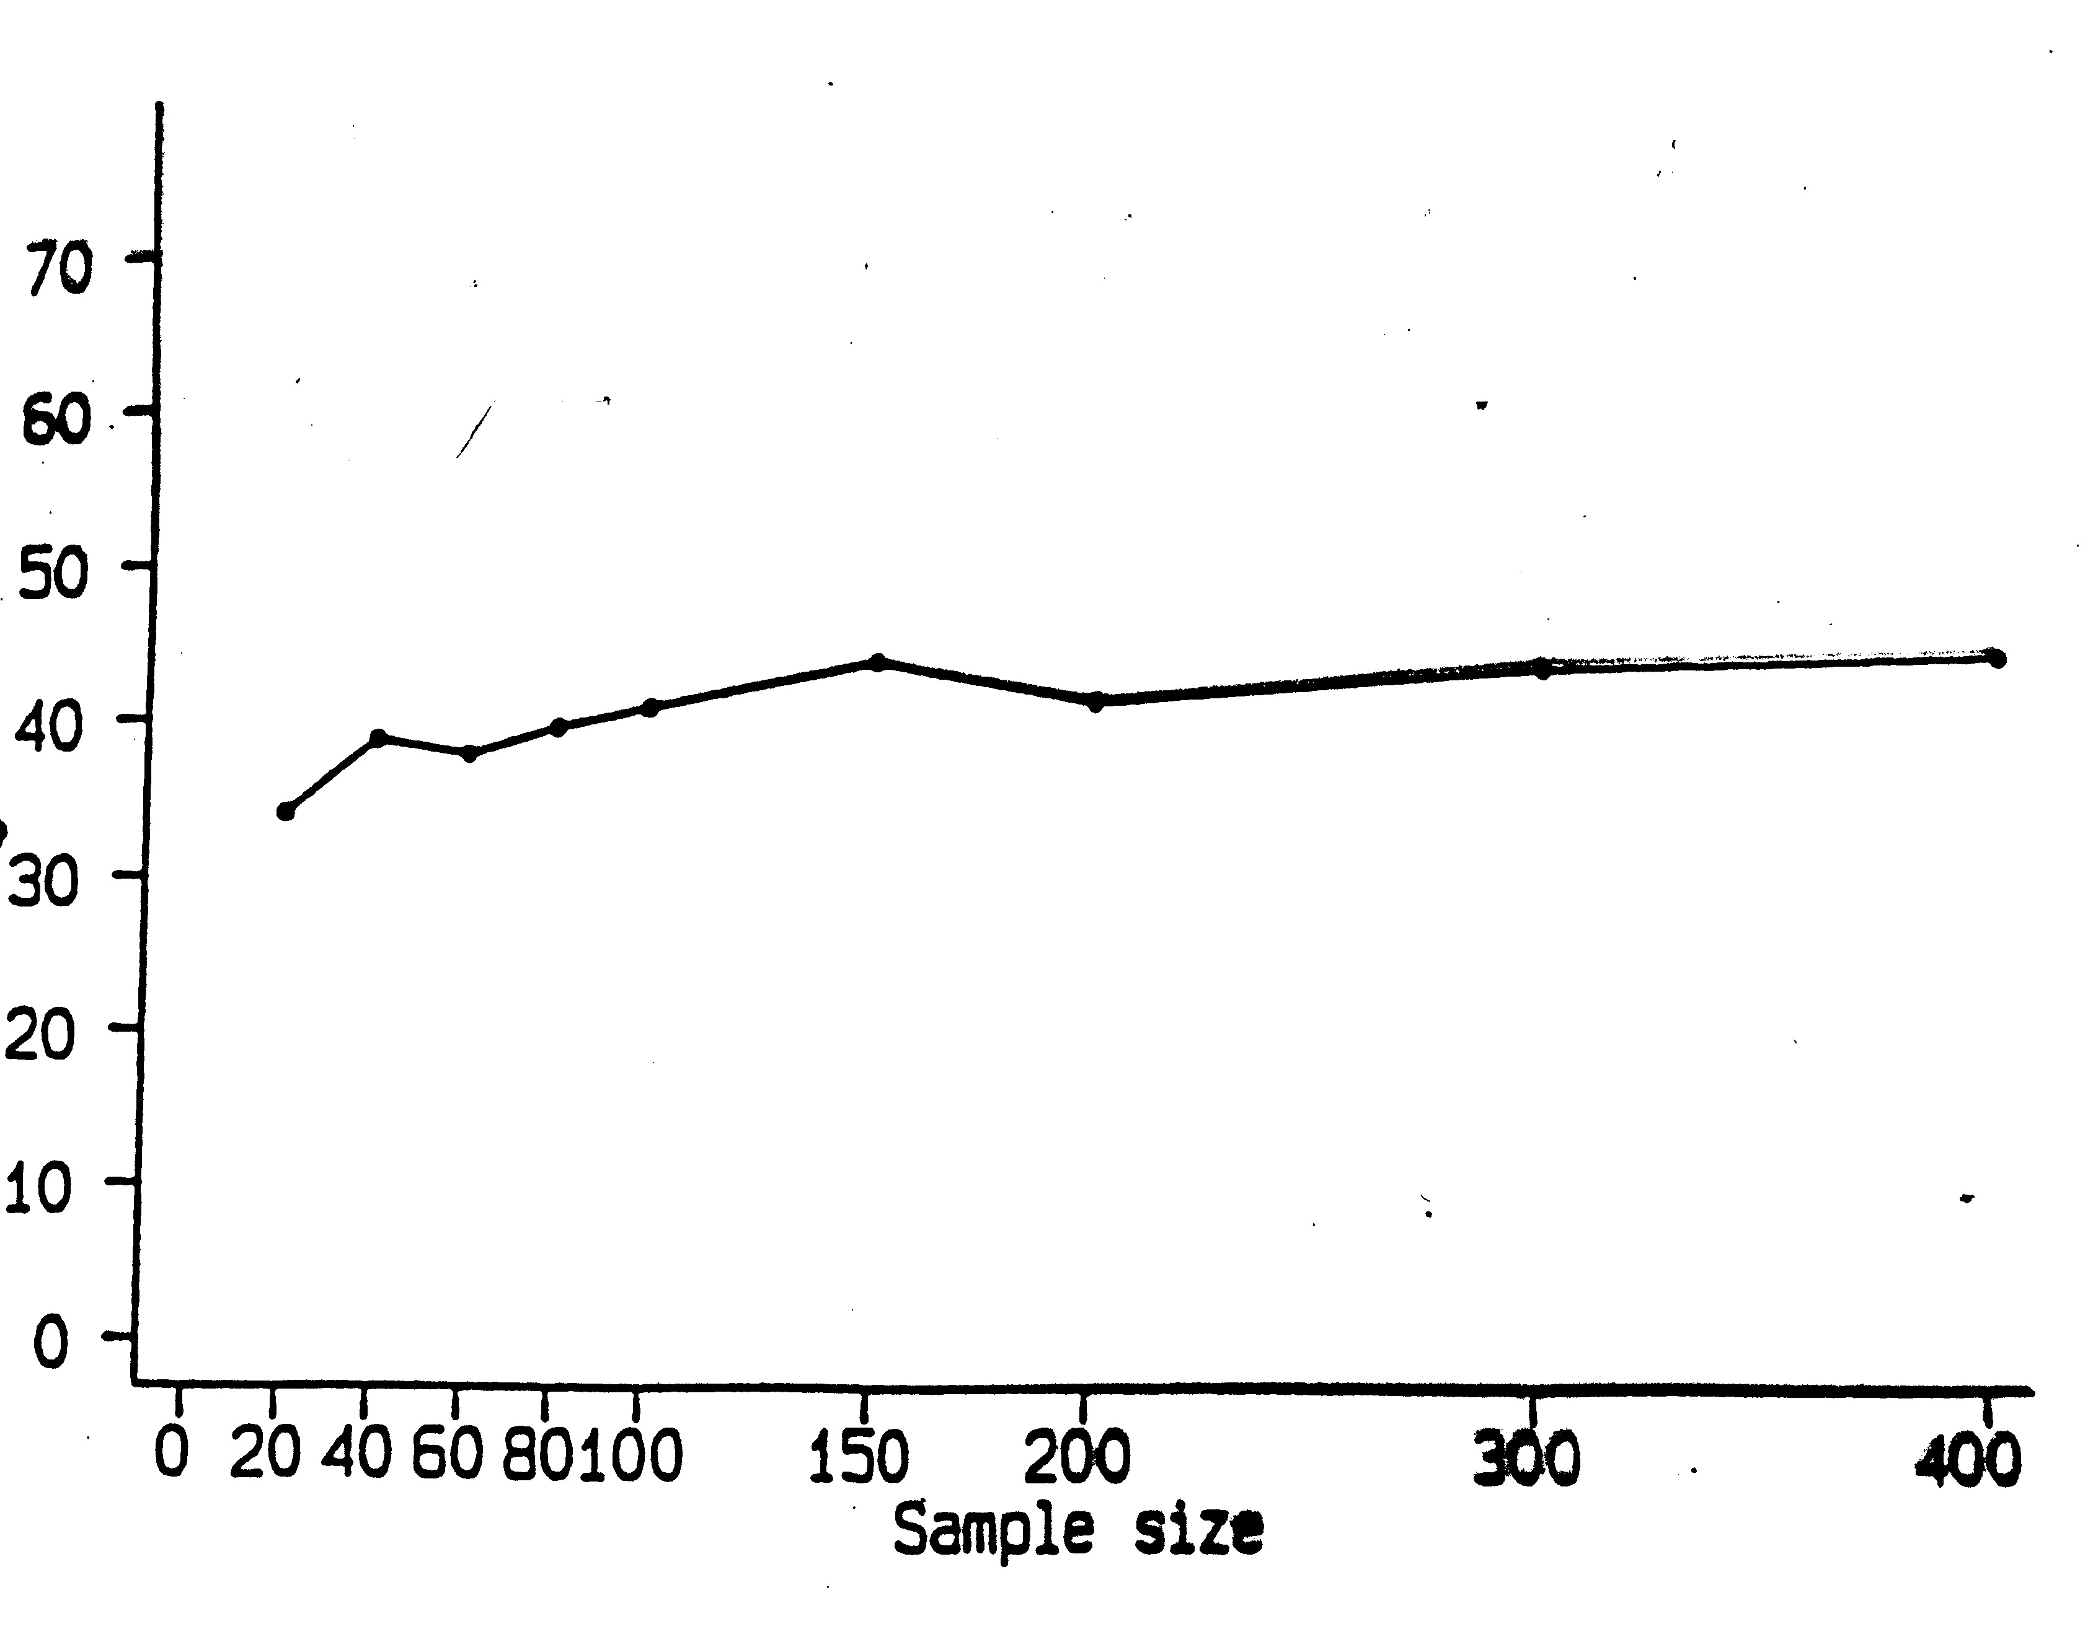
Searching for optimal cutpoint
Inflation of type I errors
(wrongly declaring a variable as important)
Cutpoint selection in inner interval (here 10% - 90%) of
distribution of factor
% significant
Sample size
Simulation study
Type I error about 40% istead of 5%
Increased type I error does not disappear with increased
sample size (in contrast to type II error)

Slide 12
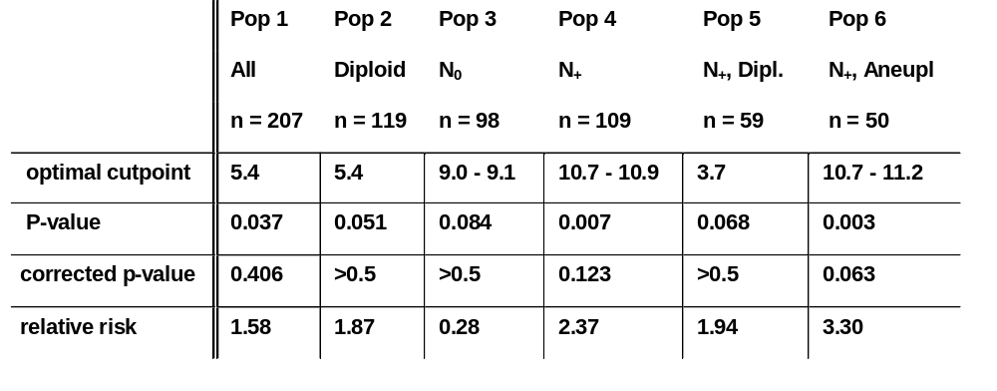
Freiburg DNA study
Study and 5 subpopulations (defined by nodal and ploidy status
Optimal cutpoints with P-value

Slide 13
Continuous factor
Categorisation or determination of functional form ?
a) Step function (categorical analysis)
  Loss of information
  How many cutpoints?
  Which cutpoints?
  Bias introduced by outcome-dependent choice
b) Linear function
  May be wrong functional form
  Misspecification of functional form leads to wrong
  conclusions
c) Non-linear function
  Fractional polynominals

Slide 14
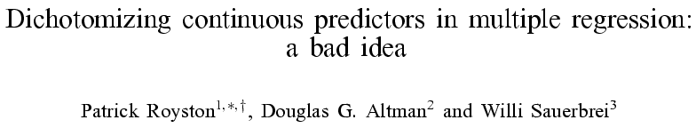
StatMed 2006, 25:127-141

Slide 15
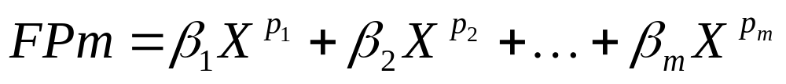
Fractional polynomial models
Fractional polynomial of degree m with powers p = (p₁,…, p_{m}) is defined as
Notation: FP1 means FP with one term (one power),
FP2 is FP with two terms, etc.
Powers p are taken from a predefined set S
We use S = {2,  1,  0.5, 0, 0.5, 1, 2, 3}
Power 0 means log X here
( conventional polynomial p₁ = 1, p₂ = 2, ... )

Slide 16
Fractional polynomial models
Describe for one covariate, X
  multiple regression later
Fractional polynomial of degree m for X with powers p₁, … , p_{m} is given by
FPm(X) = β₁ X ^{p1} + … + β_{m} X ^{pm}
Powers p₁,…, p_{m} are taken from a special set
{−2, − 1, − 0.5, 0, 0.5, 1, 2, 3}
Usually m = 1 or m = 2 is sufficient for a good fit
8 FP1, 36 FP2 models

Slide 17
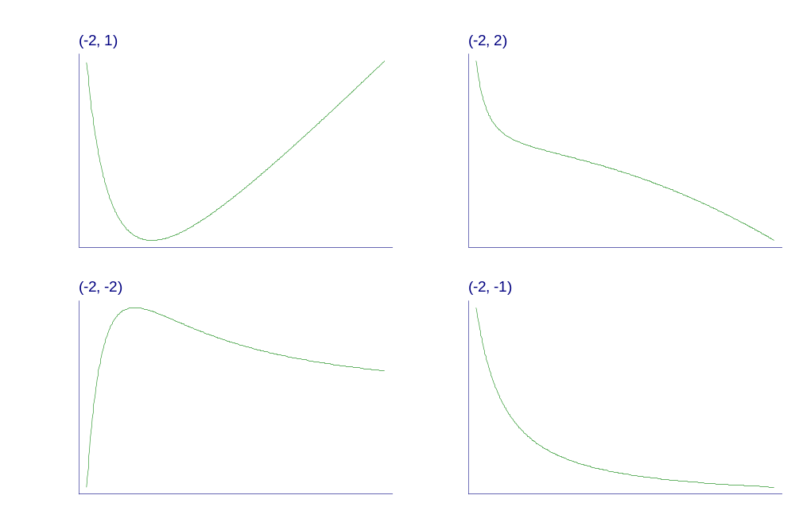
Examples of FP2 curves
- varying powers
Notes:
Fpexamp.gph, taken from c38\fig1a.gph.

Slide 18
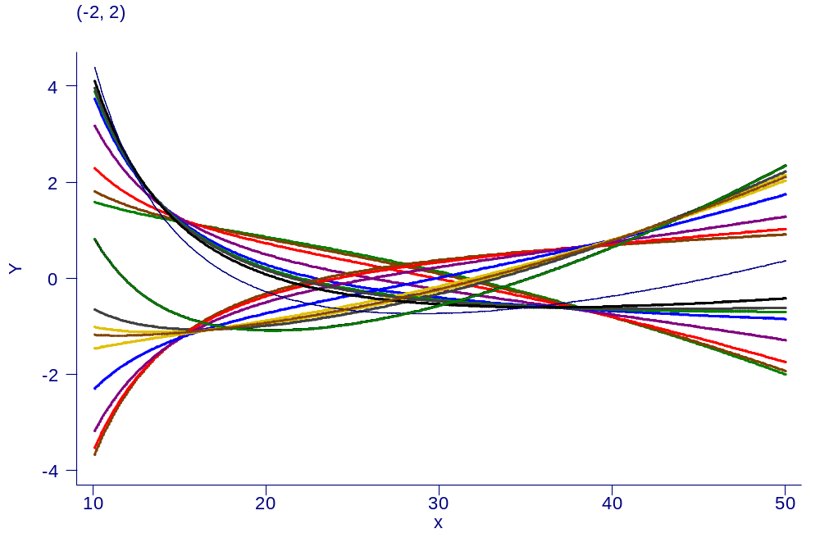
Examples of FP2 curves
- single power, different coefficients

Slide 19
Our philosophy of function selection
Prefer simple (linear) model
Use more complex (non-linear) FP1 or FP2 model if indicated by the data
Contrasts to more local regression modelling
  Already starts with a complex model

Slide 20
GBSG-study in node-positive breast cancer
299 events for recurrence-free survival time (RFS) in
686 patients with complete data
7 prognostic factors, of which 5 are continuous

Slide 21
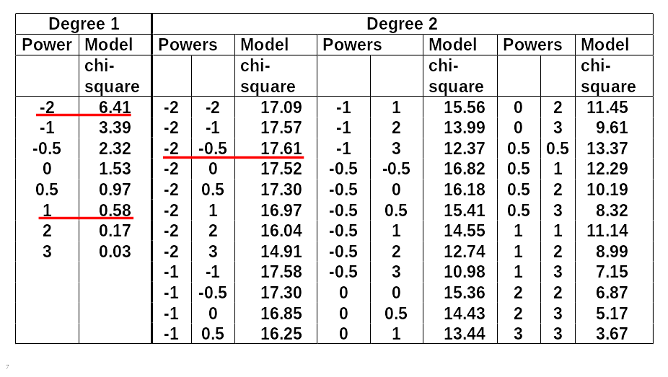
FP analysis for the effect of age

Slide 22
Effect of age at 5% level?
χ² df p-value
Any effect?
Best FP2 versus null 17.61 4 0.0015
Effect linear?
Best FP2 versus linear 17.03 3 0.0007
FP1 sufficient?
Best FP2 vs. best FP1 11.20 2 0.0037

Slide 23
Multivariable Fractional Polynomials (MFP)
With multiple continuous predictors selection
of best FP for each becomes more difficult →
MFP algorithm as a standardized way to
variable and function selection
MFP algorithm combines
backward elimination with
FP function selection procedures

Slide 24
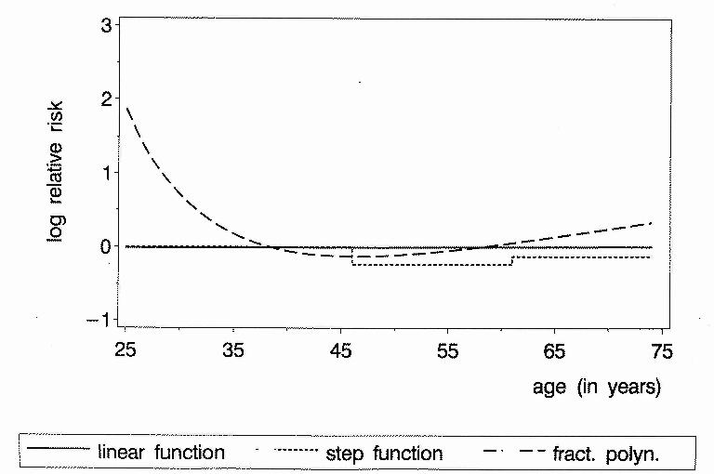
Continuous factors
Different results with different analyses
Age as prognostic factor in breast cancer (adjusted)
P-value 0.9 0.2 0.001

Slide 25
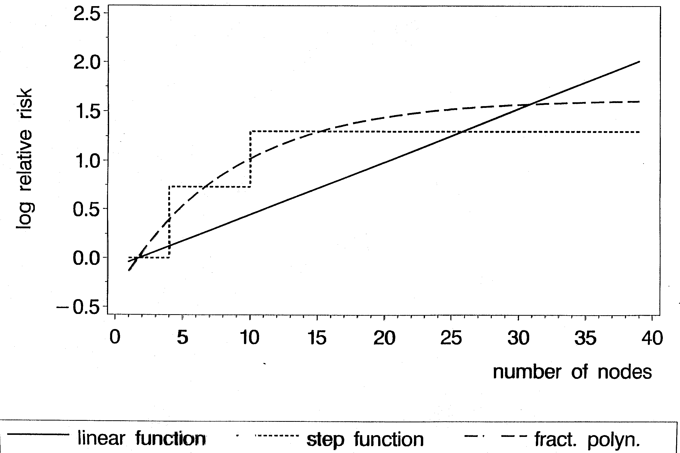
Results similar?
Nodes as prognostic factor in breast cancer(adjusted)
P-value 0.001 0.001 0.001

Slide 26
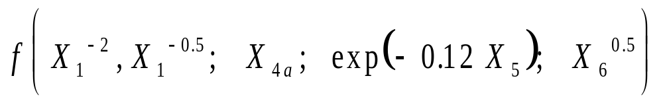
Multivariable FP
Final Model in breast cancer
Model choosen out of
5760 possible models,
one model selected
Model – Sensible?
– Interpretable?
– Stable?
Bootstrap stability analysis

Slide 27
Main interest of clinicians:
Individualized treatment
This requires knowledge about several predictive factors

Slide 28
Detecting predictive factors
Most popular approach
  Treatment effect in separate subgroups
  Has several problems (Assman et al 2000)
Test of treatment/covariate interaction required
  For `binary`covariate standard test for interaction available
Continuous covariate
  Often categorized into two groups

Slide 29
Categorizing a continuous covariate
How many cutpoints?
Position of the cutpoint(s)
Loss of information ⇒ loss of power

Slide 30
FP approach can also be used
to investigate predictive factors

Slide 31
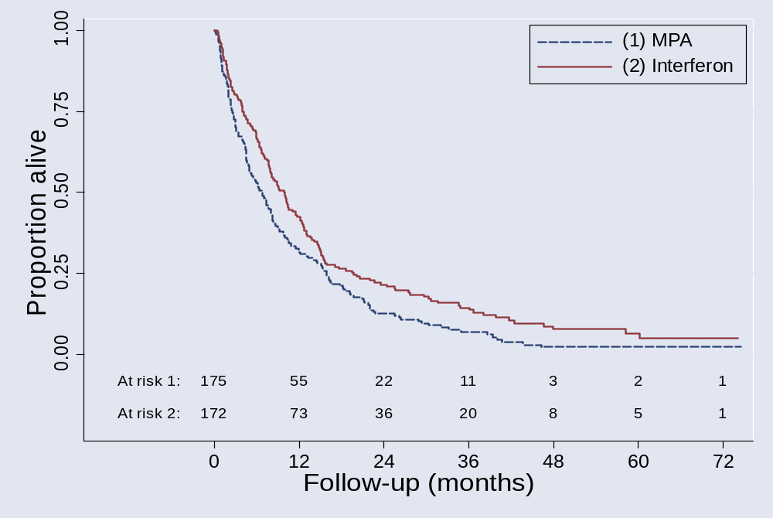
MRC RE01 trial
RCT in metastatic renal carcinoma
N = 347; 322 deaths

Slide 32
Renal Carcinoma
Overall conclusion:
Interferon is better (p<0.01)
MRCRCC, Lancet 1999
Is the treatment effect
similar in all patients?

Slide 33
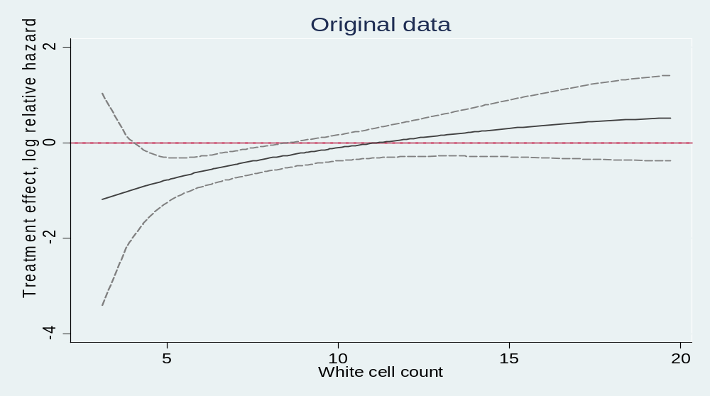
Predictive factors
Treatment – covariate interaction
Treatment effect function for WCC
Only a result of complex (mis-)modelling?

Slide 34
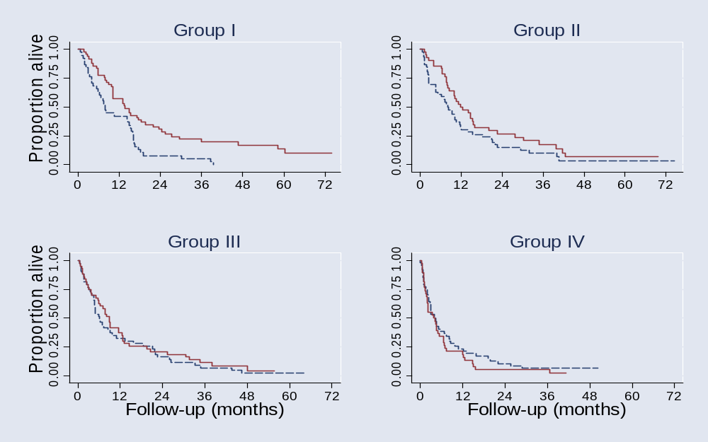
Check result of MFPI modelling
Treatment effect in subgroups defined by WCC
HR (Interferon to MPA) overall: 0.75 (0.60 – 0.93)
I : 0.53 (0.34 – 0.83) II : 0.69 (0.44 – 1.07)
III : 0.89 (0.57 – 1.37) IV : 1.32 (0.85 –2.05)

Slide 35
Assessment of WCC as a predictive factor
Retrospective, searching for hypothesis
10 factors investigated, for one an interaction was identified
‚Dose-response‘ effect in RE01 trial
Validation in independent data
Worldwide collaboration:
Don‘t we have other trials to check this result?

Slide 36
REPORTING –
Can we believe in the published literature?
Selection of published studies
Insufficient reporting for assessment of quality of
  planing
  conducting
  analysis
too early publications
Usefullness for systematic review (meta-analysis)
Begg et al (1996) Improving the Quality of Reporting of
Randomized Controlled Trials – The CONSORT
Statement, JAMA,276:637-639
Moher et al JAMA (2001), Revised Recommendations

Slide 37
Reporting of prognostic markers
Riley et al BJC (2003)
Systematic review of tumor markers for neuroblastoma
260 studies identified, 130 different markers
The reporting of these studies was often inadequate,
in terms of both statistical analysis and presentation,
and there was considerable heterogeneity for many
important clinical/statistical factors. These problems
restricted both the extraction of data and the
meta-analysis of results from the primary studies,
limiting feasibility of the evidence-based approach.

Slide 38
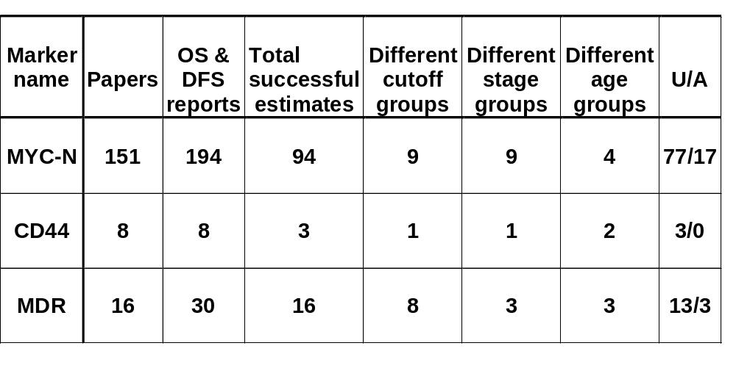
Papers useful for overview ?
Prognostic markers for neuroblastoma

Slide 39
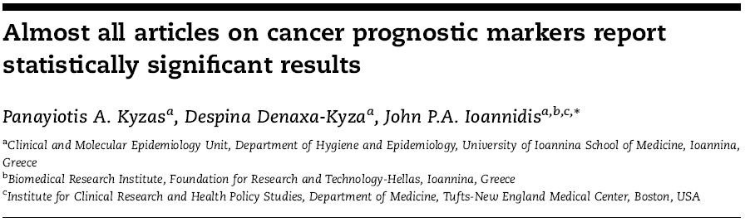
EJC 2007, 43:2559-79
Database 1: 340 articles included in meta-analysis
Database 2: 1575 articles published in 2005

Slide 40
examined whether the abstract reported any statistically significant prognostic effect for any marker and any outcome (‘positive’ articles).
‘Positive’ prognostic articles comprised 90.6% and 95.8% in Databases 1 and 2, respectively.
‘Negative’ articles were further examined for statements made by the investigators to overcome the absence of prognostic statistical significance.
Most of the ‘negative’ prognostic articles claimed significance for other analyses,expanded on non-significant trends or offered apologies that were occasionally remote from the original study aims.
Only five articles in Database 1 (1.5%) and 21 in Database 2 (1.3%) were fully ‘negative’ for all presented results in the abstract and without efforts to expand on non-significant trends or to defend the importance of the marker with other arguments.
Of the statistically non-significant relative risks in the meta-analyses, 25% had been presented as statistically significant in the primary papers using different analyses compared with the respective meta-analysis.
Under strong reporting bias, statistical significance loses its discriminating ability for the importance of prognostic markers.

Slide 41

We expect some improvements by the REMARK guidelines
published simultaneously in 5 journals, August 2005

Slide 42
Prognostic markers – current situation
number of cancer prognostic markers validated as clinically useful is
pitifully small
Evidence based assessment is required, but
collection of studies difficult to interpret due to
inconsistencies in conclusions or a lack of comparability
Small underpowered studies, poor study design, varying and sometimes inappropriate statistical analyses, and differences in assay methods or endpoint definitions
More complete and transparent reporting
distinguish carefully designed and analyzed studies from
haphazardly designed and over-analyzed studies
Identification of clinically useful cancer prognostic factors: What are we missing?
McShane LM, Altman DG, Sauerbrei W; Editorial JNCI July 2005

Slide 43
Concluding comments – MFP
FPs use full information - in contrast to a priori categorisation
FPs search within flexible class of functions (FP1 and FP(2)-44 models)
MFP is a well-defined multivariate model-building strategy – combines search for transformations with BE
Important that model reflects medical knowledge, e.g. monotonic / asymptotic functional forms
    MFP extensions
    Interactions
    Time-varying effects
Investigation of properties required
Comparison to splines required

Slide 44
References
McShane LM, Altman DG, Sauerbrei W, Taube SE, Gion M, Clark GM for the Statistics Subcommittee of the NCI-EORTC Working on Cancer Diagnostics (2005): REporting recommendations for tumor MARKer prognostic studies (REMARK). Journal of the National Cancer Institute, 97: 1180-1184.
Royston P, Altman DG. (1994): Regression using fractional polynomials of continuous covariates: parsimonious parametric modelling (with discussion). Applied Statistics, 43, 429-467.
Royston P, Altman DG, Sauerbrei W. (2006): Dichotomizing continuous predictors in multiple regression: a bad idea. Statistics in Medicine, 25: 127-141.
Royston P, Sauerbrei W. (2005): Building multivariable regression models with continuous covariates, with a practical emphasis on fractional polynomials and applications in clinical epidemiology. Methods of Information in Medicine, 44, 561-571.
Royston P, Sauerbrei W. (2008): Multivariable Model-Building - A pragmatic approach to regression analysis based on fractional polynomials for continuous variables.Wiley.
Sauerbrei W, Meier-Hirmer C, Benner A, Royston P. (2006): Multivariable regression model building by using fractional polynomials: Description of SAS, STATA and R programs. Computational Statistics & Data Analysis, 50: 3464-3485.
Sauerbrei W, Royston P. (1999): Building multivariable prognostic and diagnostic models: transformation of the predictors by using fractional polynomials. Journal of the Royal Statistical Society A, 162, 71-94.
Sauerbrei, W., Royston, P., Binder H (2007): Selection of important variables and determination of functional form for continuous predictors in multivariable model building. Statistics in Medicine, to appear
Sauerbrei W, Royston P, Look M. (2007): A new proposal for multivariable modelling of time-varying effects in survival data based on fractional polynomial time-transformation. Biometrical Journal, 49: 453-473.
Sauerbrei W, Royston P, Zapien K. (2007): Detecting an interaction between treatment and a continuous covariate: a comparison of two approaches. Computational Statistics and Data Analysis, 51: 4054-4063.
Schumacher M, Holländer N, Schwarzer G, Sauerbrei W. (2006): Prognostic Factor Studies. In Crowley J, Ankerst DP (ed.), Handbook of Statistics in Clinical Oncology, Chapman&Hall/CRC, 289-333.

