Slide 1


Improved Use of Continuous Data-
Statistical Modeling instead of Categorization
Willi Sauerbrei
Institut of Medical Biometry and Informatics
University Medical Center Freiburg, Germany
Patrick Royston
MRC Clinical Trials Unit,
London, UK

Slide 2
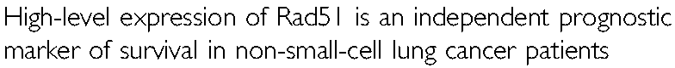
Qiao et al, BJC June 2005, 137-143
What is the evidence for this statement?

Slide 3
Study (first report on Rad51 in NSCLC)
340 NSCLC patients, median FU 34 months
Immunhistochemistry (IHC)
Proportion of positively stained tumor cells (positive-cell index, PCI)
PCI continuous variable, but
‚an optimal cutoff point of marker index was determined that allowed best separation ... for prognosis‘
IHC scores ≤ 10% - low level expression (70%)
IHC scores > 10% - high level expression (30%)

Slide 4
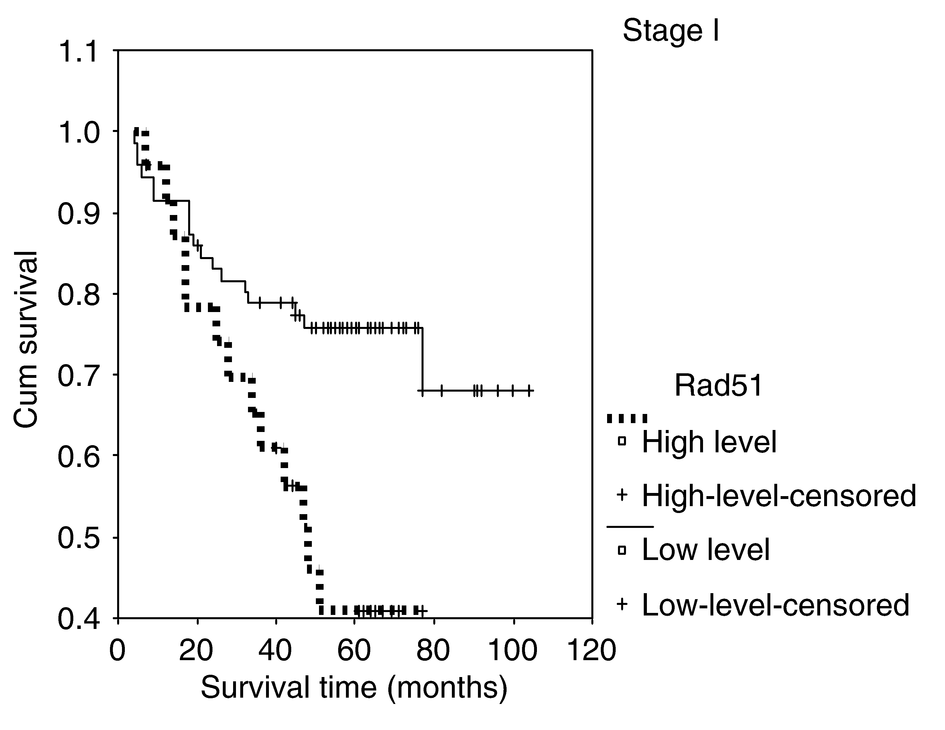
Overall population
RR (95%CI):
1.93 (1.44-2.59)
multivariate analysis
adjusting for N Status,
Stage, Differentiation
Is such a large effect believable?
Dangers of using optimal cutpoints ... JNCI 1994

Slide 5
Contents
Categorisation or
determination of functional form
Problems of optimal cutpoint approach
Fractional polynomials
Prognostic markers – current situation

Slide 6
Continuous marker
Categorisation or determination of functional form ?
a) Step function (categorical analysis)
  Loss of information
  How many cutpoints?
  Which cutpoints?
  Bias introduced by outcome-dependent choice
b) Linear function
  May be wrong functional form
  Misspecification of functional form leads to wrong
  conclusions
c) Non-linear function
  Fractional polynominals

Slide 7
Example 1
Freiburg DNA study in breast cancer patients
N= 266, median follow-up 82 months
115 events for event free survival time
Prognostic value of SPF

Slide 8
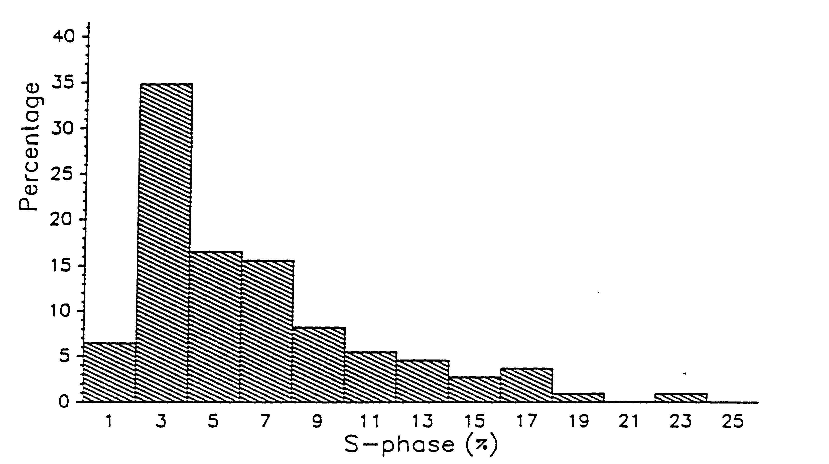
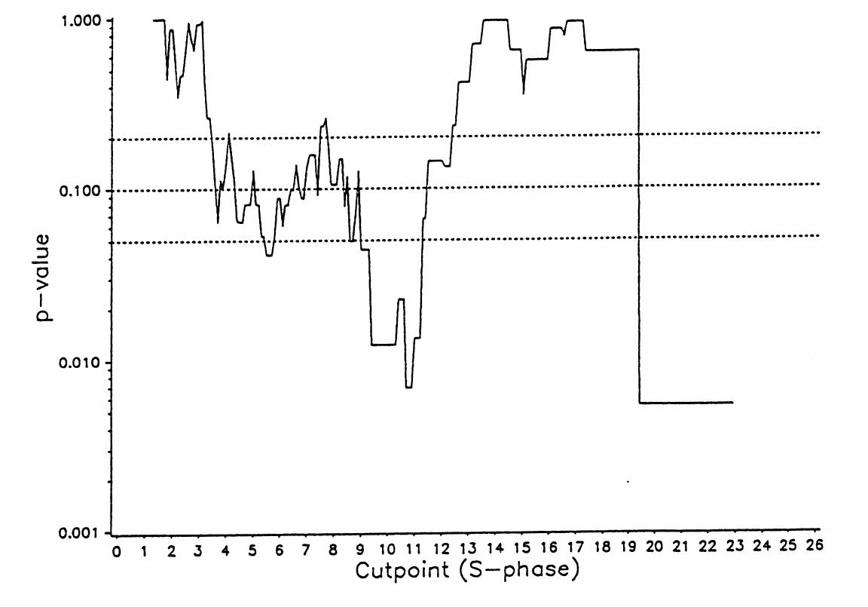
Searching for optimal cutpoint
SPF in Freiburg DNA study, N+ patients

Slide 9
Problems of the ‚optimal‘ cutpoint
Multiple testing increases Type I error
(~ 40% instead of 5%)
p-value correction is possible
    SPF (N+ patients)
    p-value 0.007
    corr. p-value 0.123
Size of effect overestimated
Different cutpoints in different studies

Slide 10
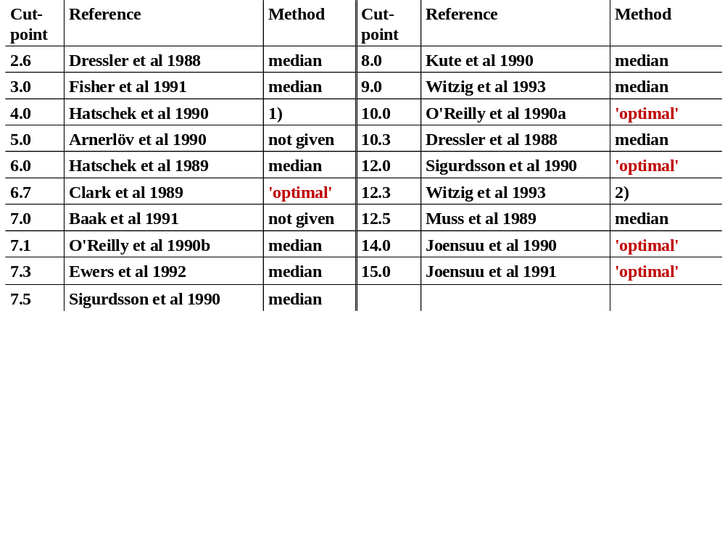
‚Optimal‘ cutpoint analysis – serious problem
SPF-cutpoints used in the literature(Altman et al 1994)
1) Three Groups with approx. equal size 2) Upper third of SPF-distribution

Slide 11
Continuous factor
Categorisation or determination of functional form ?
a) Step function (categorical analysis)
  Loss of information
  How many cutpoints?
  Which cutpoints?
  Bias introduced by outcome-dependent choice
b) Linear function
  May be wrong functional form
  Misspecification of functional form leads to wrong
  conclusions
c) Non-linear function
  Fractional polynominals

Slide 12
Fractional polynomial models
Conventional polynomial of degree 2 with powers p = (1, 2) is defined as
β₁ X ¹ + β₂ X ²
Fractional polynomial of degree 2 with powers p = (p₁, p₂) is defined as
FP2 = β₁ X ^{p1} + β₂ X ^{p2}
Powers p are taken from a predefined set
S = {−2, − 1, − 0.5, 0, 0.5, 1, 2, 3}
Notes:
Mention repeated powers

Slide 13
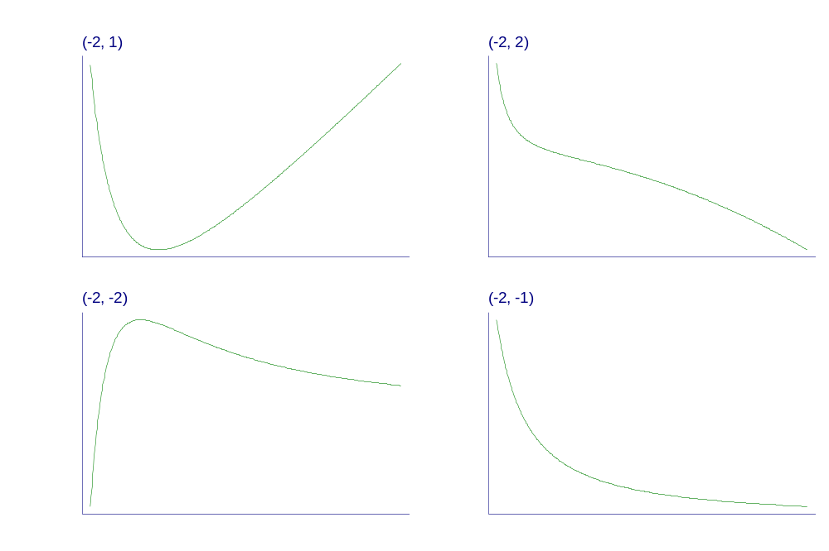
Some examples of fractional polynomial curves
Royston P, Altman DG (1994) Applied Statistics 43: 429-467.
Sauerbrei W, Royston P, et al (1999) British Journal of Cancer 79:1752-60.
Notes:
There are many problems with using cut-points to model continuous predictors like age (particularly “optimal” ones).
So, we want to keep continuous predictors continuous in the analysis.
But, not all relationships are accurately modelled as straight lines.
Instead, can use fractional polynomials which are a sensible compromise between really complex curves and over-simplified straight lines.

Slide 14
Example 2
German Breast Cancer Study Group - 2
n = 686 patients, median follow-up 5 years,
299 events for event-free survival time (EFS)
Prognostic markers
5 continuous, 1 ordinal, 1 binary factor

Slide 15
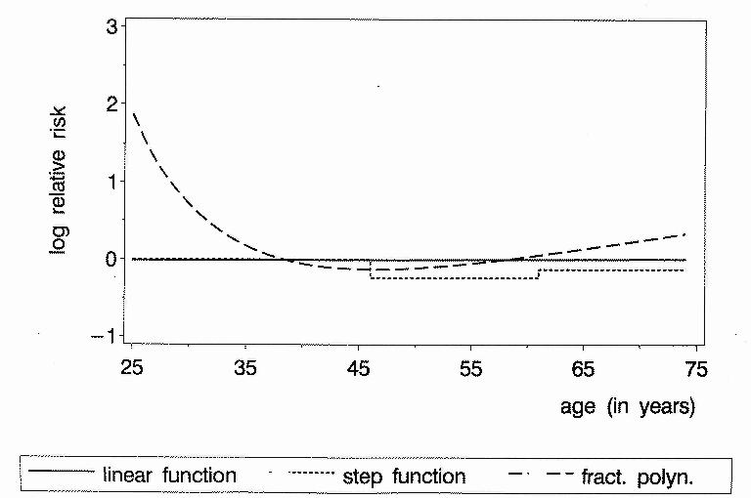
Continuous factors
– Different results assuming different functions
Example: Prognostic effect of age
P-value 0.9 0.2 0.001

Slide 16
FP approach can also be used
to investigate predictive factors

Slide 17
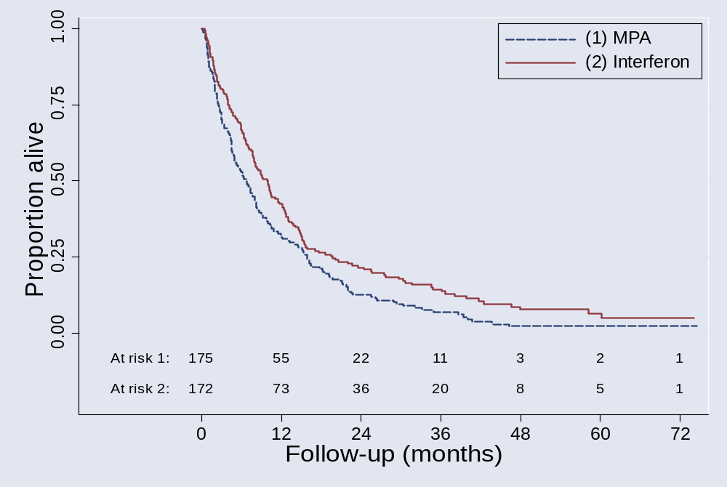
Example 3
RCT in metastatic renal carcinoma
N = 347; 322 deaths

Slide 18
Overall conclusion:
Interferon is better (p<0.01)
MRCRCC, Lancet 1999
Is the treatment effect
similar in all patients?

Slide 19
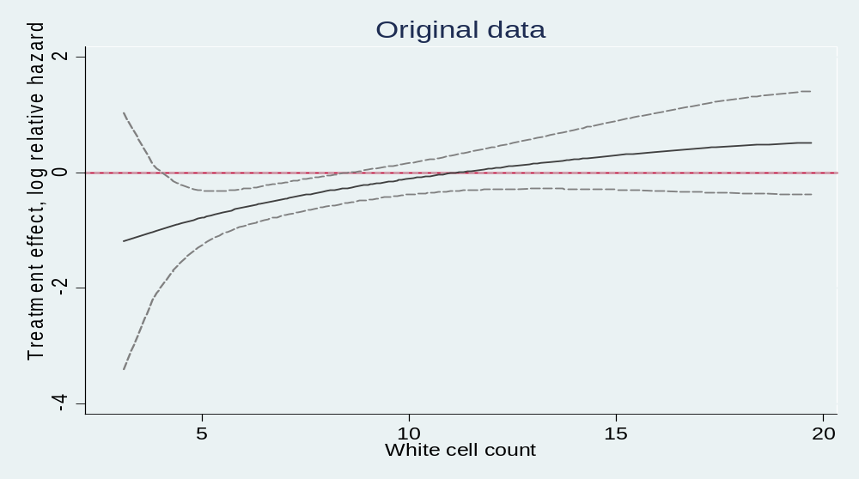
Treatment – covariate interaction
Treatment effect function for WCC
Only a result of complex (mis-)modelling?

Slide 20
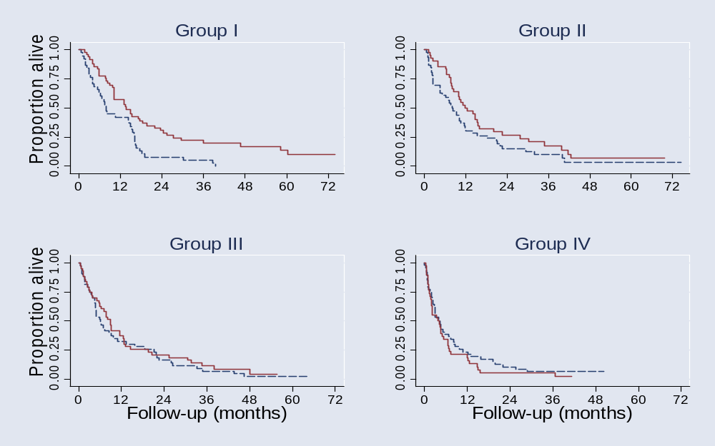
Check result of FP modelling
Treatment effect in subgroups defined by WCC
HR (Interferon to MPA) overall: 0.75 (0.60 – 0.93)
I : 0.53 (0.34 – 0.83) II : 0.69 (0.44 – 1.07)
III : 0.89 (0.57 – 1.37) IV : 1.32 (0.85 –2.05)

Slide 21
Prognostic markers – current situation
number of cancer prognostic markers validated as clinically useful is
pitifully small
Evidence based assessment is required, but
collection of studies difficult to interpret due to
inconsistencies in conclusions or a lack of comparability
Small underpowered studies, poor study design, varying and sometimes inappropriate statistical analyses, and differences in assay methods or endpoint definitions
More complete and transparent reporting
distinguish carefully designed and analyzed studies from
haphazardly designed and over-analyzed studies
Identification of clinically useful cancer prognostic factors: What are we missing?
McShane LM, Altman DG, Sauerbrei W; Editorial JNCI July 2005

Slide 22

We expect some improvements by REMARK guidelines
published simultaneously in 5 journals, August 2005

Slide 23
Conclusions
Cutpoint approaches have several problems
Analyses are required in which continuous markers are kept continuous
More power by using all information from continuous markers
FPs are well-suited to the task
FP analyses may detect important effects which may be missed by standard methodology

Slide 24
Substantial improvement in research in prognostic and predictive markers is required, similar problems
  in risk factors in epidemiology
  analysis of genomic data
  gene-environmental interactions …
Improvement by more collaboration
  within disciplines
  between disciplines

Slide 25
References
Altman DG, Lausen B, Sauerbrei W, Schumacher M. Dangers of using “Optimal” cutpoints in the evaluation of prognostic factors. Journal of the National Cancer Institute 1994; 86:829-835.
McShane LM, Altman DG, Sauerbrei W. Identification of clinically useful cancer prognostic factors: What are we missing? (Editorial). Journal of the National Cancer Institute 2005.
McShane LM, Altman DG, Sauerbrei W, Taube SE, Gion M, Clark GM for the Statistics Subcommittee of the NCI-EORTC Working on Cancer Diagnostics. REporting recommendations for tumor MARKer prognostic studies (REMARK). Simultaneous Publication in Journal of Clinical Oncology, Nature Clinical Practice Oncology, Journal of the National Cancer Institute, European Journal of Cancer, British Journal of Cancer, 2005.
Pfisterer J, Kommoss F, Sauerbrei W, Renz H, du Bois A, Kiechle-Schwarz M, Pfleiderer A. Cellular DNA content and survival in advanced ovarian carcinoma. Cancer 1994; 74:2509-2515.
Qiao G-B, Wu Y-L, Yang X-N et al. High-level expression of Rad5I is an independent prognostic marker of survival in non-small-cell lung cancer patients. BJC 2005; 93:131-143.
Rosenberg et al. Quantifying epidemiologic risk factors using non-parametric regression: Model selection remains the greatest challenge. Stat Med 2003; 22:3369-3381.
Royston, P, Altman DG. Regression using fractional polynomials of continuous covariates : parsimonious parametric modelling (with discussion). Applied Statistics 1994; 43:429-467.
Royston P, Sauerbrei W, Ritchie A. Is treatment with interferon-alpha effectiv in all patients with metastatic renal carcinoma? A new approach to the investigations of interactions. British Journal of Cancer 2004; 90:794-799.
Sauerbrei, W., Meier-Hirmer, C., Benner, A., Royston, P. Multivariable regression model building by using fractional polynomials: description of SAS, STATA and R programs, Computational Statistics and Data Analysis 2005, to appear.
Sauerbrei W, Royston P. Building multivariable prognostic and diagnostic models: transformation of the predictors by using fractional polynomials. Journal of the Royal Statistical Society A 1999; 162:71-94.
Sauerbrei W, Royston P, Bojar H, Schmoor C, Schumacher M. and the German Breast Cancer Study Group (GBSG). Modelling the effects of standard prognostic factors in node positive breast cancer. British Journal of Cancer 1999; 79:1752-1760.

