Slide 1


Detecting an interaction between treatment and a continuous covariate: a comparison between two approaches
Willi Sauerbrei
Institut of Medical Biometry and Informatics
University Medical Center Freiburg, Germany
Patrick Royston
MRC Clinical Trials Unit,
London, UK

Slide 2
Overview
Continuous predictive factors
  STEPP
  MFPI
Example
Stability
Conclusions

Slide 3
Detecting predictive factors
Most popular approach
  Treatment effect in separate subgroups
  Has several problems (Assman et al 2000)
Test of treatment/covariate interaction required
  For `binary`covariate standard test for interaction available
Continuous covariate
  Often categorized into two groups

Slide 4
Categorizing a continuous covariate
How many cutpoints?
Position of the cutpoint(s)
Loss of information ⇒ loss of power

Slide 5
New approaches for continuous covariates
STEPP
  Subpopulation treatment effect pattern plots
  Bonetti & Gelber 2000
MFPI
  Multivariable fractional polynomial
  interaction approach
  Royston & Sauerbrei 2004

Slide 6
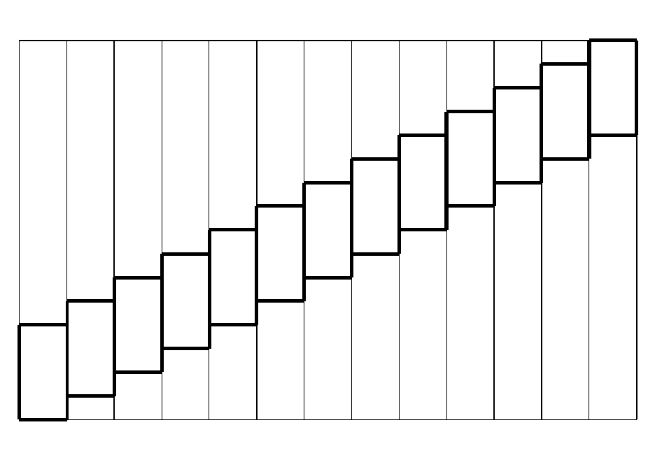
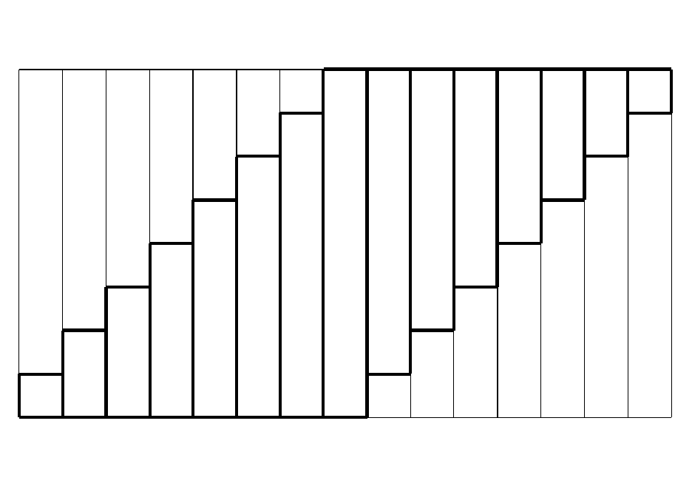
STEPP
Sequences of overlapping subpopulations
Sliding window Tail oriented

Slide 7
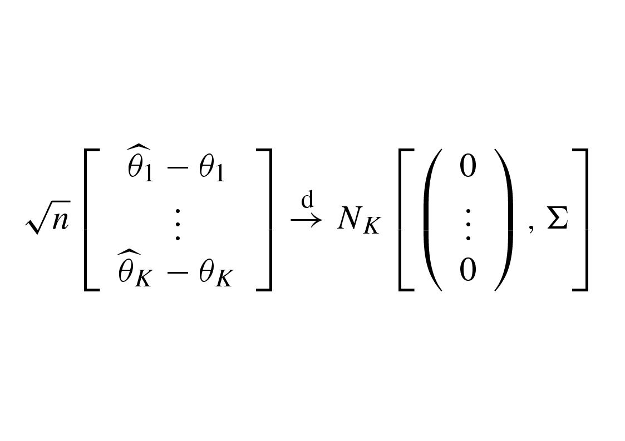
STEPP
Estimates in subpopulations
θ1,...,θk treatment effect in subpopulation P1,...,Pk
ˆ ˆ

Slide 8
STEPP
Overlapping populations, therefore correlation between θ1,...,θk
Simultaneous confidence band and tests proposed
ˆ ˆ

Slide 9
Fractional polynomial models
Fractional polynomial of degree 2 with powers p = (p₁,p₂) is defined as
FP2 = β₁ X ^{p1} + β₂ X ^{p2}
Powers p are taken from a predefined set
S = {−2, − 1, − 0.5, 0, 0.5, 1, 2, 3}
Notes:
Mention repeated powers

Slide 10
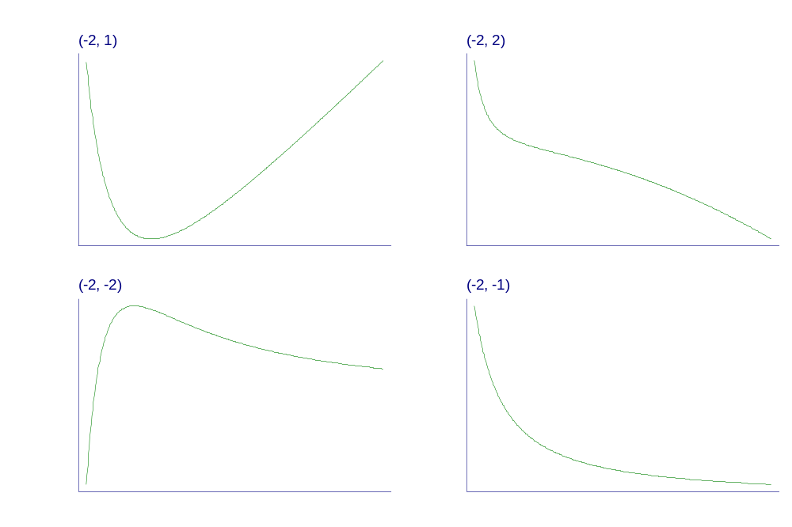
Some examples of fractional polynomial curves
Notes:
There are many problems with using cut-points to model continuous predictors like age (particularly “optimal” ones).
So, we want to keep continuous predictors continuous in the analysis.
But, not all relationships are accurately modelled as straight lines.
Instead, can use fractional polynomials which are a sensible compromise between really complex curves and over-simplified straight lines.

Slide 11
MFPI
Have one continuous factor X of interest
Use other prognostic factors to build an adjustment model, e.g. by MFP
MFP – combine backward elimination with search for best FP function
Find best FP2 transformation of X with same powers in each treatment group
LRT of equality of reg coefficients
Test against main effects model(no interaction) based on χ² with 2df
Distinguish
predefined hypothesis - hypothesis searching

Slide 12
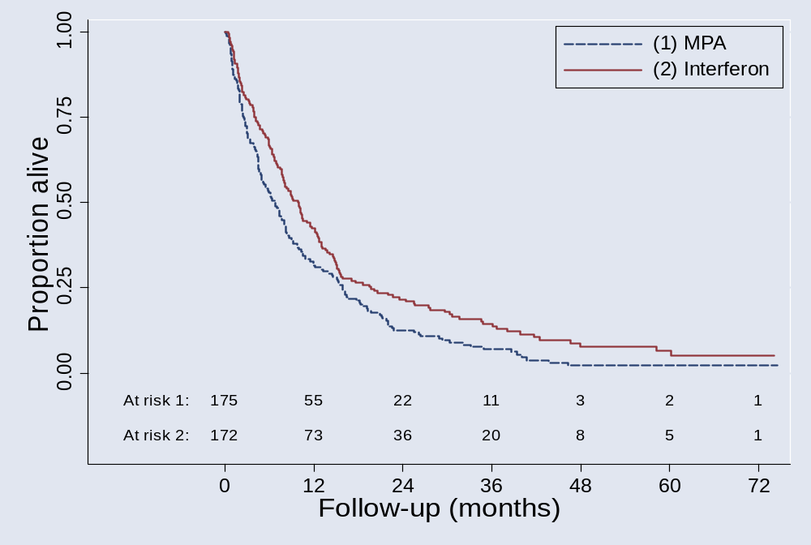
RCT: Metastatic renal carcinoma
Comparison of MPA with interferon N = 347, 322 Death

Slide 13
Overall: Interferon is better (p<0.01)
Is the treatment effect similar in all patients?
Sensible questions?
  Yes, from our point of view
Ten factors available for the investigation of treatment – covariate interactions

Slide 14
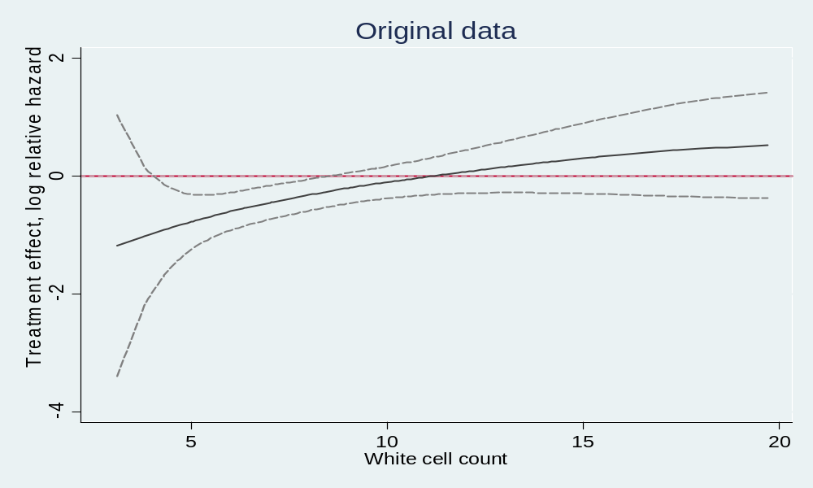
MFPI
Treatment effect function for WCC
Only a result of complex (mis-)modelling?

Slide 15
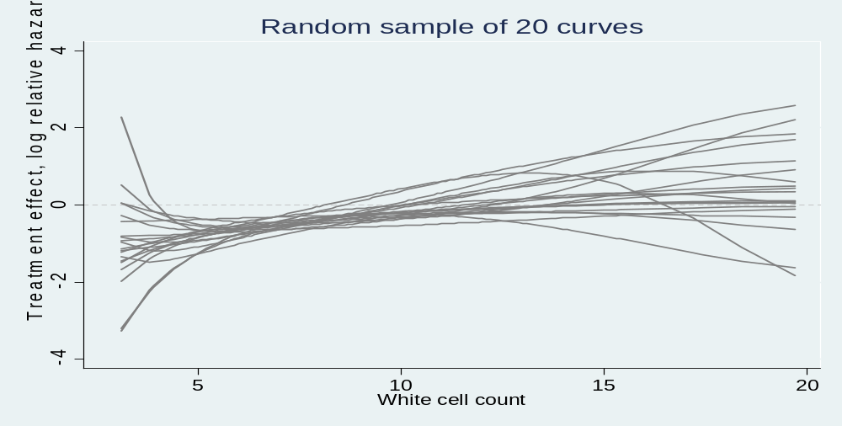
MFPI
Stability investigation of the treatment effect function for WCC
100 bootstrap replications of the MFPI procedure
In each replication:
1.Step: Select adjustment model
2.Step: Estimate treatment effect function

Slide 16
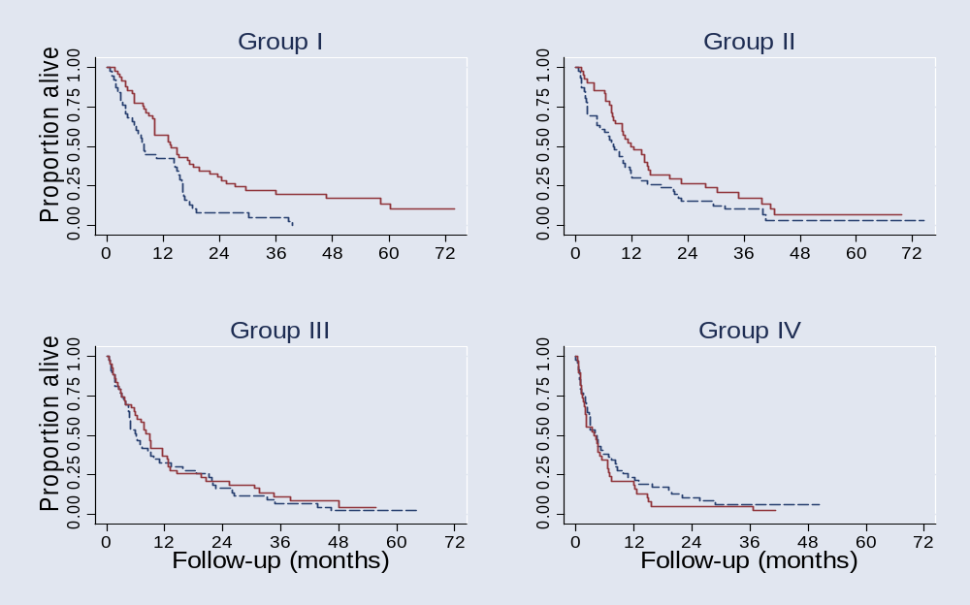
Does the MFPI model agree with the data?
Check proposed trend
Treatment effect in subgroups defined by WCC
HR (Interferon to MPA; adjusted values similar) overall: 0.75 (0.60 – 0.93)
I : 0.53 (0.34 – 0.83) II : 0.69 (0.44 – 1.07)
III : 0.89 (0.57 – 1.37) IV : 1.32 (0.85 –2.05)

Slide 17
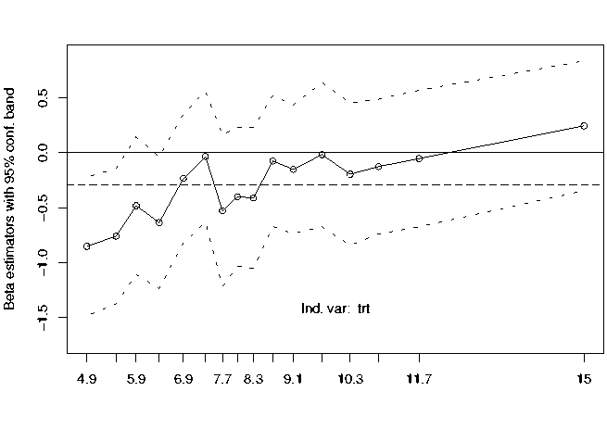
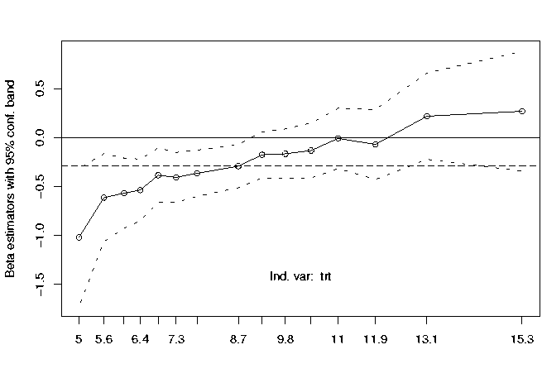
STEPP – Interaction with WCC
SLIDING WINDOW (n1 = 25, n2 = 40)
TAIL ORIENTED (g = 8)

Slide 18
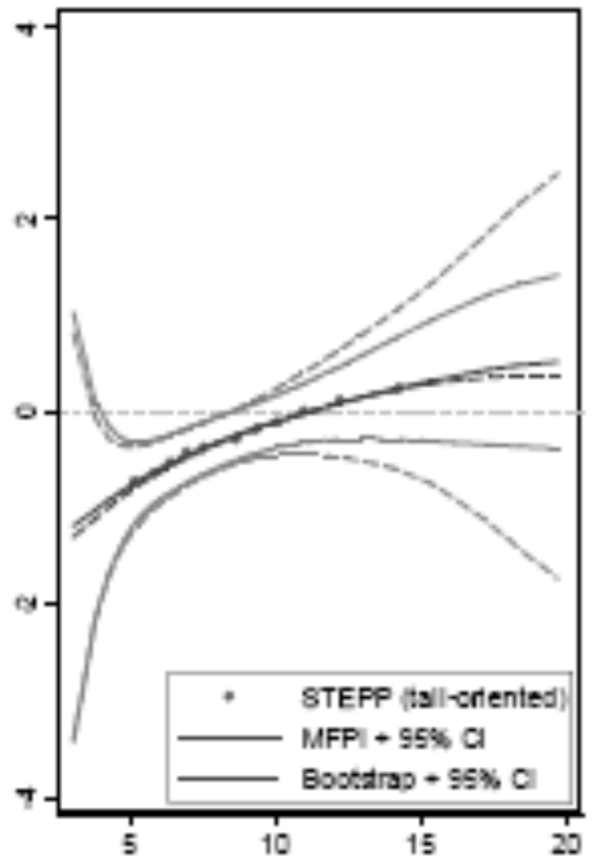
STEPP as check of MFPI

Slide 19
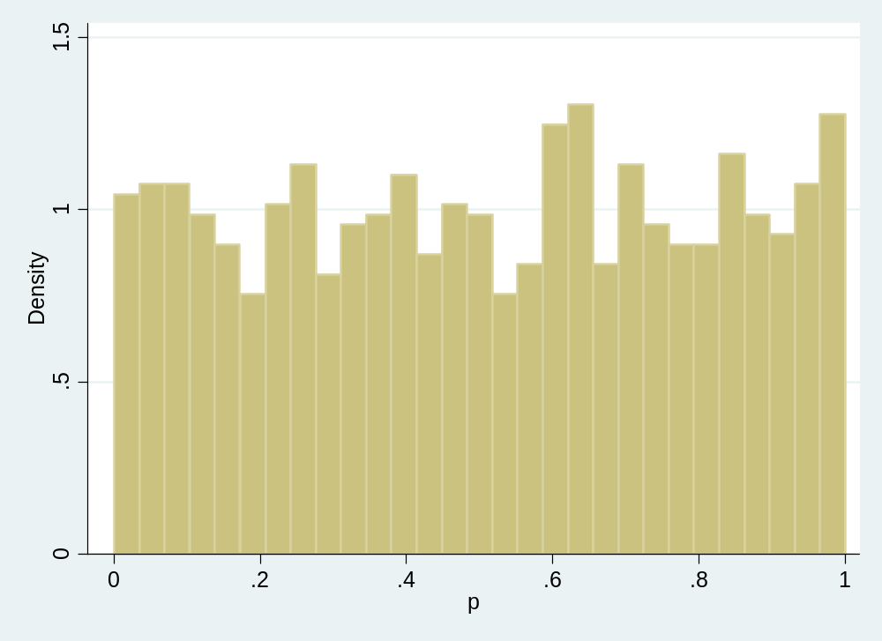
MFPI – Type I error
Random permutation of a continuous covariate
(haemoglobin)
→ no interaction
Distribution of P-value from test of interaction
1000 runs, Type I error: 0.054

Slide 20
Conclusions
Cutpoints approaches have several problems
More power by using all information from continuous factors
STEPP and MFPI may detect important predictive effects which may be missed by standard methodology
STEPP: step in the right direction, still depends on cutpoints and is more unstable
MFPI: no cutpoints required, estimates continuous treatment effect function, promising results from stability and type I error investigations
Important differentiation:
prespecified hypothesis or hypothesis generation (interpretation, multiple testing)

Slide 21
References
Assman SF, Pocock S, Enos LE, Kasten LE (2000): Subgroup analysis and other (mis)uses of baseline data in clinical trials. Lancet, 355, 1064-1069.
Bonetti M, Gelber RD (2000): A graphical method to assess treatment-covariate interactions using the Cox model on subsets of the data. Statistics in Medicine, 19, 2595-2609.
Bonetti M, Gelber RD (2004): Patterns of treatment effects in subsets of patients in clinical trials. Biostatistics, 5,465-481.
Royston P, Sauerbrei W (2004): A new approach to modelling interactions between treatment and covariates in clinical trials by using fractional polynomials. Statistics in Medicine, 23, 2509-2525.
Royston P, Sauerbrei W, Ritchie A (2004): Is treatment with interferon-a effective in all patients with metastatic renal carcinoma? A new approach to the investigation of interactions. British Journal of Cancer, 90, 794-799.
Sauerbrei W, Royston P (1999): Building multivariable prognostic and diagnostic models: transformation of the predictors by using fractional polynomials. Journal of the Royal Statistical Society A, 162, 71-94.
Sauerbrei W, Royston P, Zapien K (2006): Detecting an interaction between treatment and a continuous covariate: a comparison between two approaches, submitted.

