Slide 1


Modelling continuous exposures - fractional polynomials
Patrick Royston
MRC Clinical Trials Unit,
London, UK
Willi Sauerbrei
Institut of Medical Biometry and Informatics
University Medical Center Freiburg, Germany

Slide 2
Overview
Part 1 | General issues in regression models
Part 2 | Fractional polynomial models - Univariate - multivariate
Part 3 | Interactions

Slide 3
Observational Studies
Several variables, mix of continuous and (ordered) categorical variables
Different situations:
  prediction
  explanation
  confounders only
Explanation is the main interest here:
Identify variables with (strong) influence on the outcome
Determine functional form (roughly) for continuous variables
The issues are very similar in different types of regression models (linear regression model, GLM, survival models ...)
Use subject-matter knowledge for modelling ...
... but for some variables, data-driven choice inevitable

Slide 4
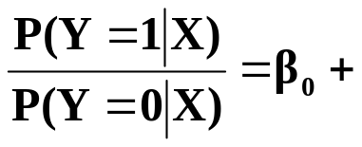
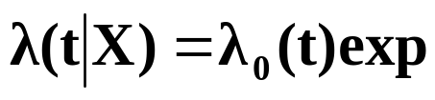
Regression models
X=(X₁, ...,X_{p}) covariate, prognostic factors
g(x) = ß₁ X₁ + ß₂ X₂ +...+ ß_{p} X_{p} (assuming effects are linear)
normal errors (linear) regression model
Y normally distributed
E (Y|X) = ß₀ + g(X)
Var (Y|X) = σ²I
logistic regression model
Y binary
Logit P (Y|X) = ln
survival times
T survival time (partly censored)
Incorporation of covariates
g(X)
(g(X))

Slide 5
Central issue
To select or not to select (full model)?
Which variables to include?
How to model continuous variables?

Slide 6
Continuous variables – The problem
“Quantifying epidemiologic risk factors using non-parametric regression: model selection remains the greatest challenge”
Rosenberg PS et al, Statistics in Medicine 2003; 22:3369-3381
Discussion of issues in (univariate) modelling with splines
Trivial nowadays to fit almost any model
To choose a good model is much harder

Slide 7
Building multivariable regression models
Before dealing with the functional form, the ‚easier‘ problem of model selection:
variable selection assuming that the effect of each continuous variable is linear

Slide 8

Multivariable models – methods for variable selection
Full model
  variance inflation in the case of multicollinearity
Stepwise procedures ⇒ prespecified (α_{in}, α_{out}) and
actual significance level?
    forward selection (FS)
    stepwise selection (StS)
    backward elimination (BE)
All subset selection ⇒ which criteria?
    C_{p} Mallows = (SSE / ) - n + p 2
    AIC Akaike Information Criterion = n ln (SSE / n) + p 2
    BIC Bayes Information Criterion = n ln (SSE / n) + p ln(n)
fit penalty
Combining selection with Shrinkage
Bayes variable selection
Recommendations???
Central issue: MORE OR LESS COMPLEX MODELS?

Slide 9
Backward elimination is a sensible approach
Significance level can be chosen
Reduces overfitting
Of course required
Checks
Sensitivity analysis
Stability analysis

Slide 10
Continuous variables – what functional form?
Traditional approaches
a) Linear function
- may be inadequate functional form
- misspecification of functional form may lead to
wrong conclusions
b) ‘best‘ ‘standard‘ transformation
c) Step function (categorial data)
- Loss of information
- How many cutpoints?
- Which cutpoints?
- Bias introduced by outcome-dependent choice

Slide 11
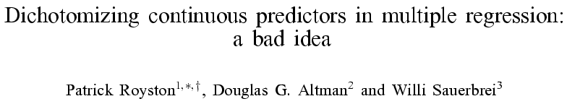
StatMed 2006, 25:127-141

Slide 12
Fractional polynomial models
Describe for one covariate, X
Fractional polynomial of degree m for X with powers p₁, … , p_{m} is given by
FPm(X) = β₁ X ^{p1} + … + β_{m} X ^{pm}
Powers p₁,…, p_{m} are taken from a special set
{−2, − 1, − 0.5, 0, 0.5, 1, 2, 3}
Usually m = 1 or m = 2 is sufficient for a good fit
Repeated powers (p₁=p₂)
β₁ X ^{p1} + β₂ X ^{p1}log X
8 FP1, 36 FP2 models

Slide 13
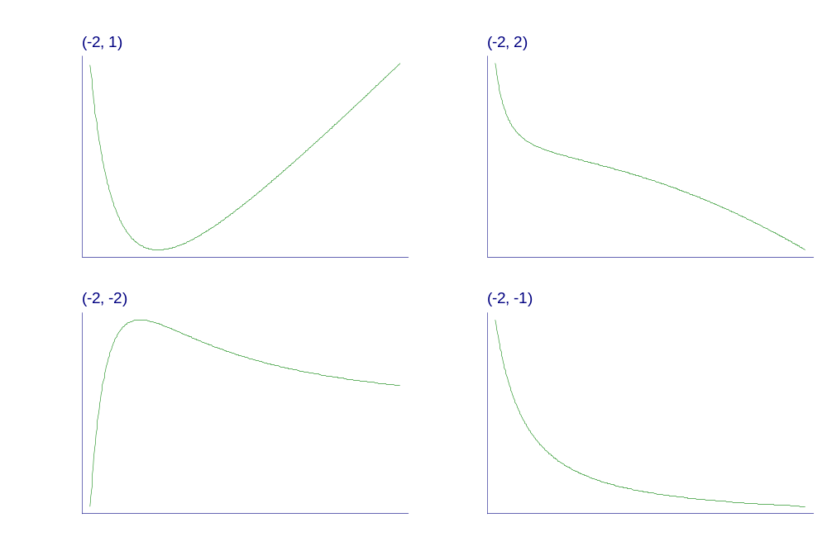
Examples of FP2 curves
- varying powers
Notes:
Fpexamp.gph, taken from c38\fig1a.gph.

Slide 14
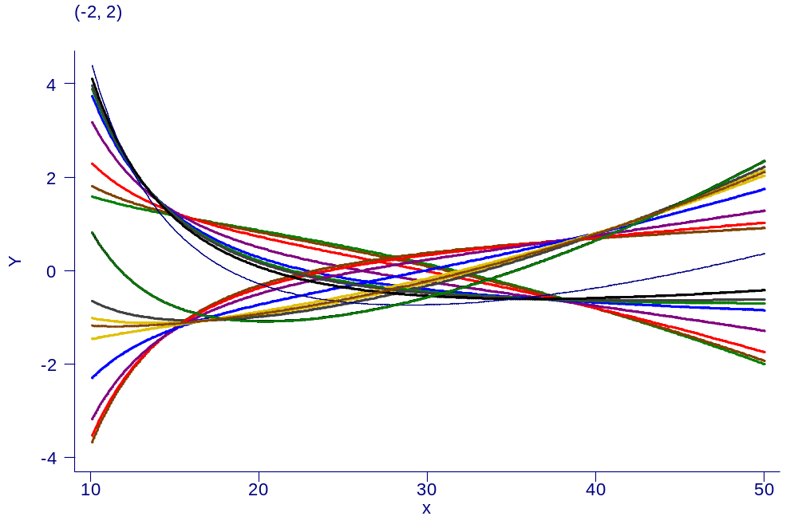
Examples of FP2 curves
- single power, different coefficients

Slide 15
Our philosophy of function selection
Prefer simple (linear) model
Use more complex (non-linear) FP1 or FP2 model if indicated by the data
Contrasts to more local regression modelling
  Already starts with a complex model

Slide 16
Example 1: Prognostic factors
GBSG-study in node-positive breast cancer
299 events for recurrence-free survival time (RFS) in
686 patients with complete data
7 prognostic factors, of which 5 are continuous

Slide 17
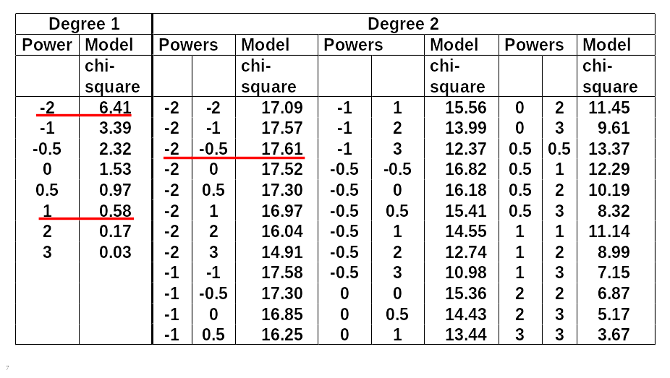
FP analysis for the effect of age

Slide 18
Function selection procedure (FSP)
Effect of age at 5% level?
χ² df p-value
Any effect?
Best FP2 versus null 17.61 4 0.0015
Linear function suitable?
Best FP2 versus linear 17.03 3 0.0007
FP1 sufficient?
Best FP2 vs. best FP1 11.20 2 0.0037

Slide 19
Many predictors – MFP
With many continuous predictors selection of best FP for each becomes more difficult →
MFP algorithm as a standardized way to variable and function selection
(usually binary and categorical variables are also available)
MFP algorithm combines
  backward elimination with
  FP function selection procedures

Slide 20
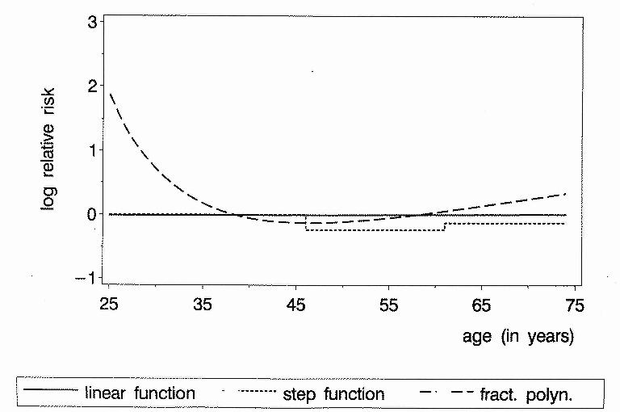
Continuous factors
Different results with different analyses
Age as prognostic factor in breast cancer (adjusted)
P-value 0.9 0.2 0.001

Slide 21
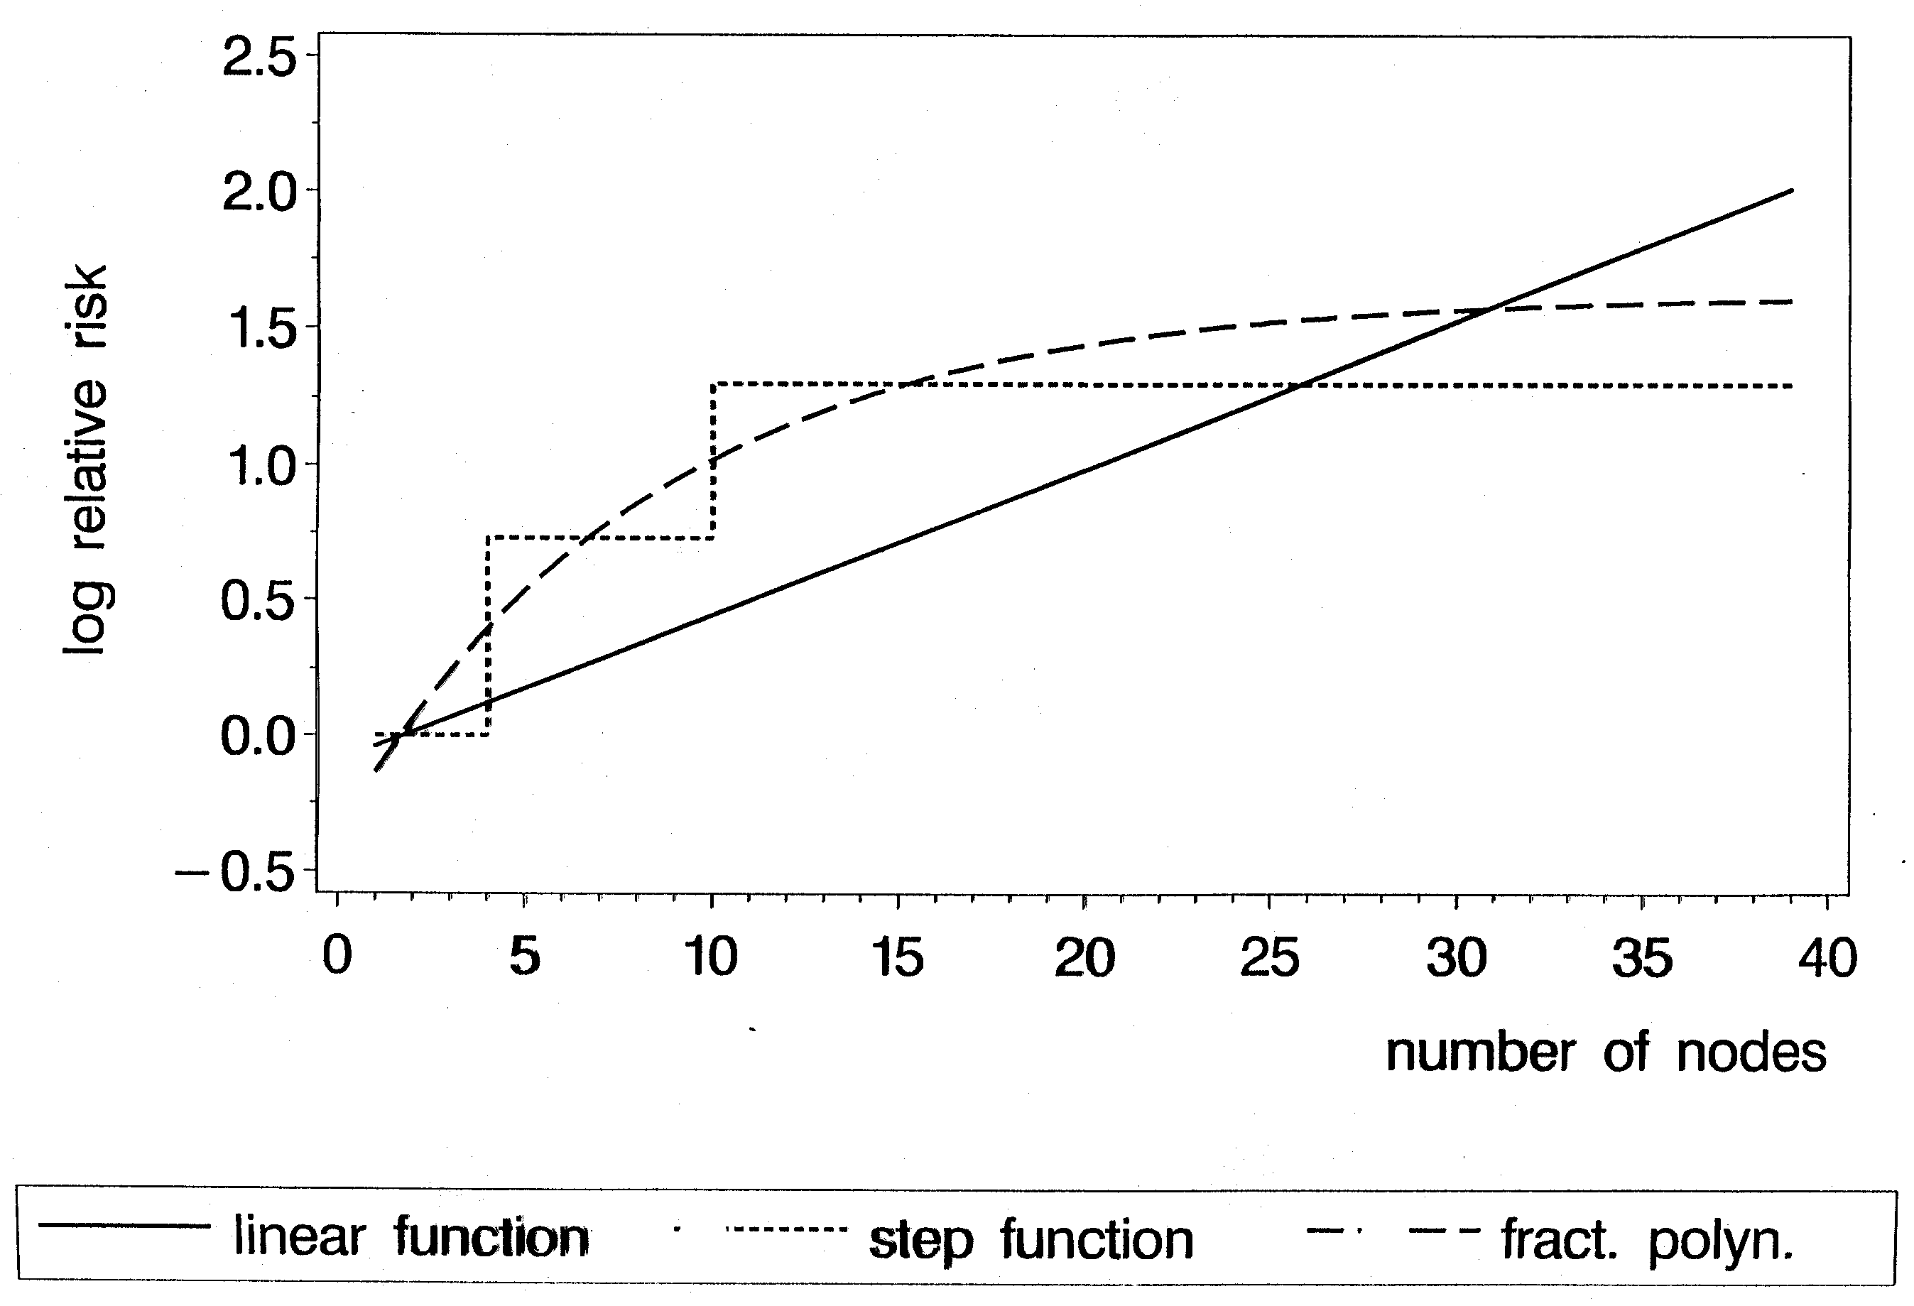
Results similar?
Nodes as prognostic factor in breast cancer (adjusted)
P-value 0.001 0.001 0.001

Slide 22
Example 2: Risk factors
Whitehall 1
  17,370 male Civil Servants aged 40-64 years, 1670 (9.7%) died
  Measurements include: age, cigarette smoking, BP, cholesterol, height, weight, job grade
  Outcomes of interest: all-cause mortality at 10 years ⇒ logistic regression

Slide 23
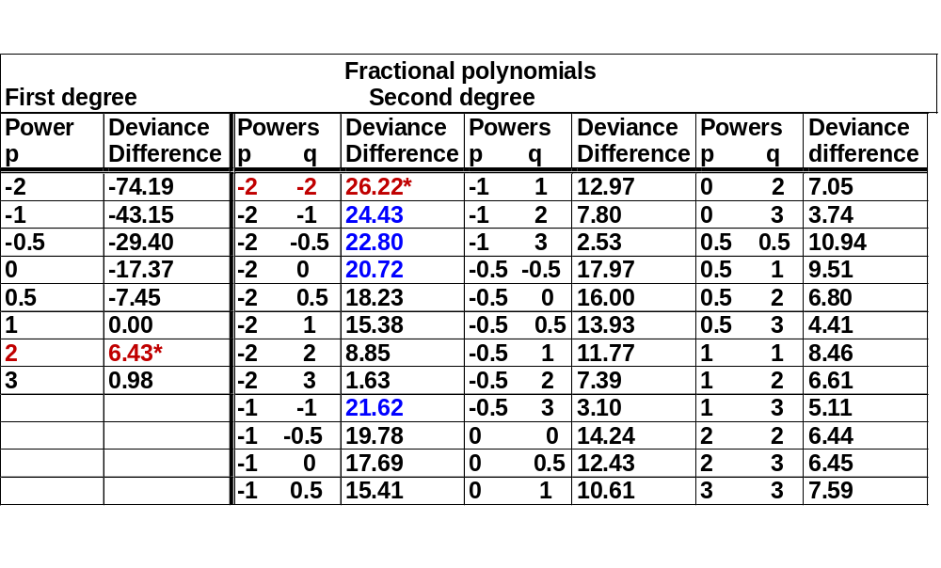
Whitehall 1
Systolic blood pressure
Deviance difference in comparison to a straight line for FP(1)
and FP(2) models

Slide 24
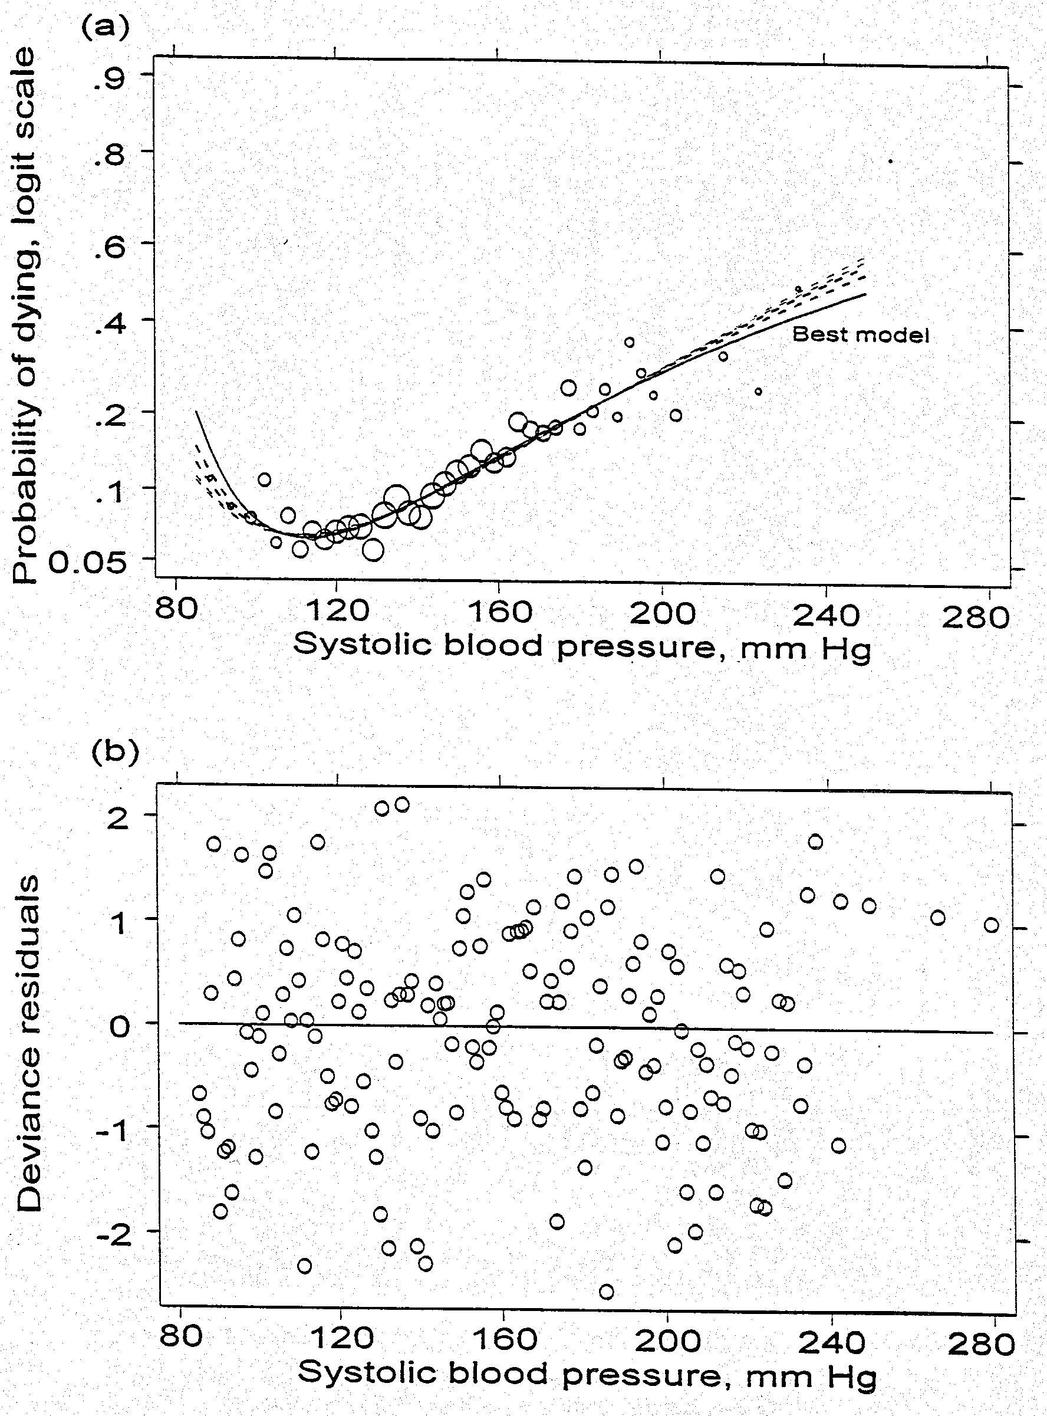
Similar fit of several functions

Slide 25
Presentation of models for continuous covariates
The function + 95% CI gives the whole story
Functions for important covariates should always be plotted
In epidemiology, sometimes useful to give a more conventional table of results in categories
This can be done from the fitted function

Slide 26
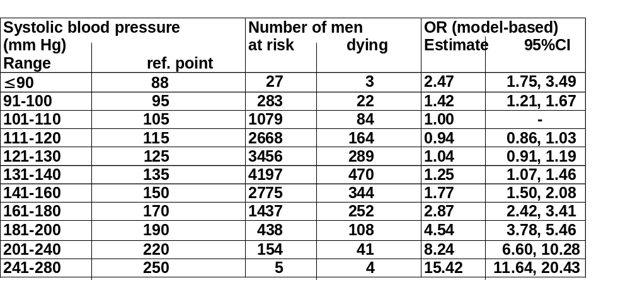
Whitehall 1
Systolic blood pressure
Odds ratio from final FP(2) model
LogOR= 2.92 – 5.43X⁻² –14.30* X ^{–2} log X
Presented in categories

Slide 27
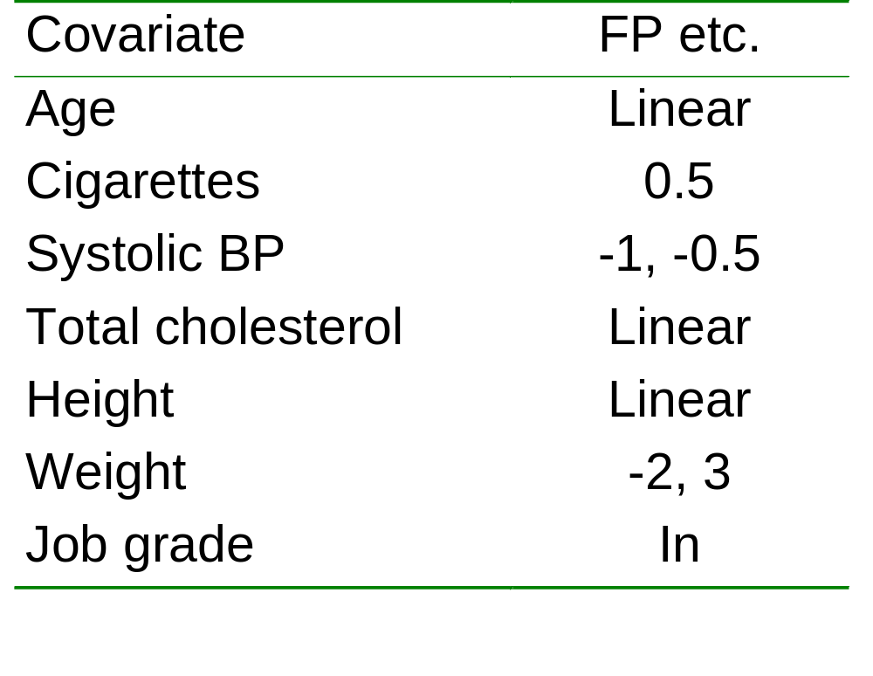
Whitehall 1
MFP analysis
No variables were eliminated by the MFP algorithm
Assuming a linear function weight is eliminated by backward elimination

Slide 28
Interactions
Motivation – I
Detecting predictive factors (interaction with treatment)
Don’t investigate effects in separate subgroups!
Investigation of treatment/covariate interaction requires statistical tests
Care is needed to avoid over-interpretation
Distinguish two cases:
  Hypothesis generation: searching several interactions
  Specific predefined hypothesis

Slide 29
Motivation - II
Continuous by continuous interactions
usually linear by linear product term
not sensible if main effect is non-linear
mismodelling the main effect may introduce spurious interactions

Slide 30
(Searching for) treatment – covariate interaction
Most popular approach
  Treatment effect in separate subgroups
  Has several problems (Assman et al 2000)
Test of treatment/covariate interaction required
  For `binary`covariate standard test for interaction available
Continuous covariate
  Often categorized into two groups
    loss of information, loss of power
    which cutpoint?

Slide 31
Interactions with treatment - MFPI
Have one continuous factor X of interest
Use other prognostic factors to build an adjustment model, e.g. by MFP
Interaction part – with or without adjustment
Find best FP2 transformation of X with same powers in each treatment group
LRT of equality of reg coefficients
Test against main effects model(no interaction) based on χ² with 2df
Interpretation
predefined hypothesis or hypothesis searching?

Slide 32
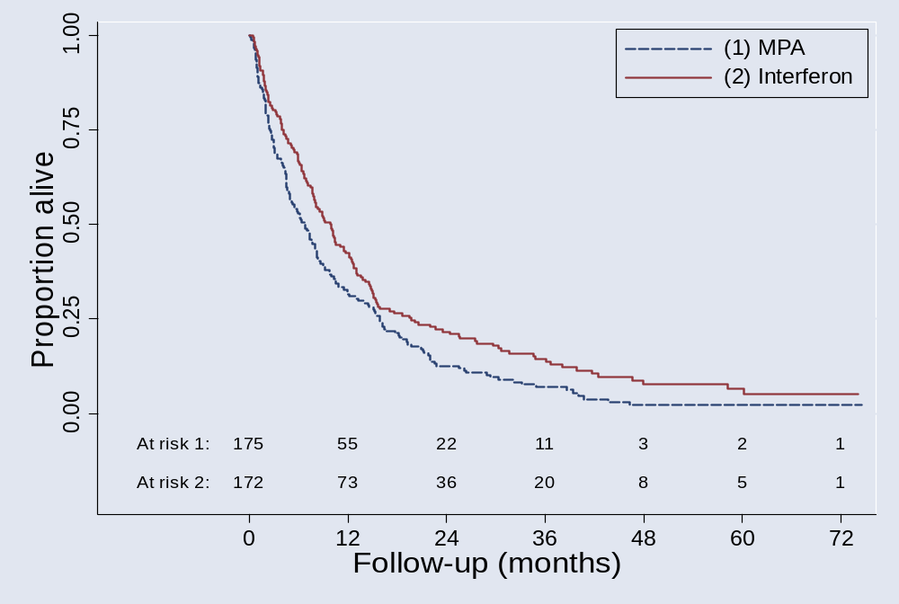
RCT: Metastatic renal carcinoma
Comparison of MPA with interferon N = 347, 322 Death

Slide 33
Overall: Interferon is better (p<0.01)
Is the treatment effect similar in all patients?
Sensible questions?
  Yes, from our point of view
Ten factors available for the investigation of treatment – covariate interactions
  ⇒ Interaction with WCC is significant

Slide 34
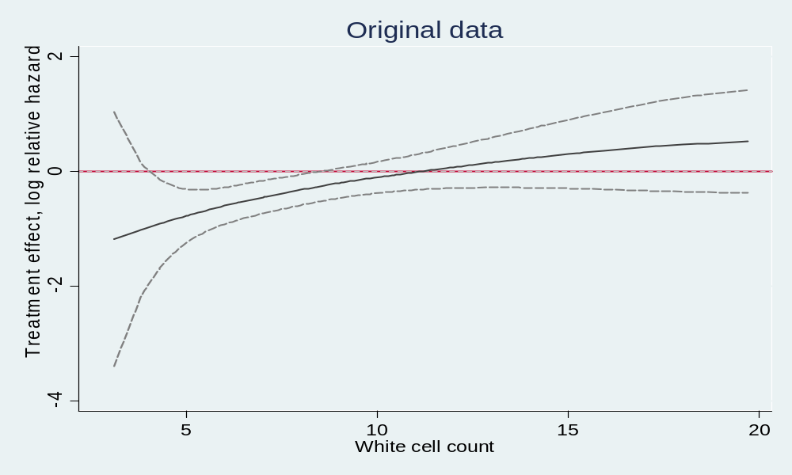
MFPI
Treatment effect function for WCC
Only a result of complex (mis-)modelling?

Slide 35
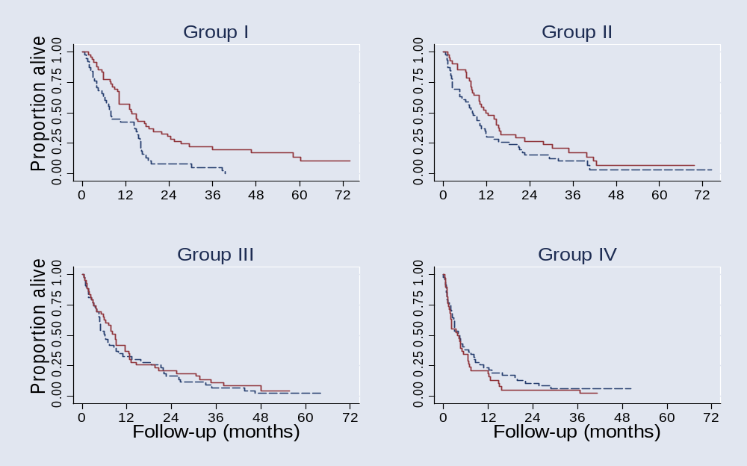
Does the MFPI model agree with the data?
Check proposed trend
Treatment effect in subgroups defined by WCC
HR (Interferon to MPA; adjusted values similar) overall: 0.75 (0.60 – 0.93)
I : 0.53 (0.34 – 0.83) II : 0.69 (0.44 – 1.07)
III : 0.89 (0.57 – 1.37) IV : 1.32 (0.85 –2.05)

Slide 36
Continuous by continuous interactions
MFPIgen
Have Z₁, Z₂ continuous and X confounders
Apply MFP to X, Z₁ and Z₂, forcing Z₁ and Z₂ into the model.
  FP functions f₁(Z₁) and f₂(Z₂) are selected for Z₁ and Z₂
Often f₁(Z₁) and/or f₂(Z₂) are linear
Add term f₁(Z₁)* f₂(Z₂) to the model chosen and use LRT for test of interaction
Check (graphically) interactions for artefacts
Check all pairs of continuous variables for an interaction
Use forward stepwise if more than one interaction remains
Low significance level for interactions

Slide 37
Interactions – continuous by continuous
Whitehall 1
Consider only age and weight
Main effects:
age – linear
weight – FP2 (-1,3)
Interaction?
Include age*weight⁻¹ + age*weight³
into the model
LRT: χ² = 5.27 (2df, p = 0.07) ⇒ no (strong) interaction

Slide 38
Erroneously assume that the effect of weight is linear
Interaction?
Include age*weight into the model
LRT: χ² = 8.74 (1df, p = 0.003)
⇒ intercation appears higly significant

Slide 39
Interactions: checking the model
Model check:
  categorize age in (equal sized) groups (e.g. 4 groups)
Compute running line smooth of the binary outcome on weight in each group
Plot results for each group

Slide 40
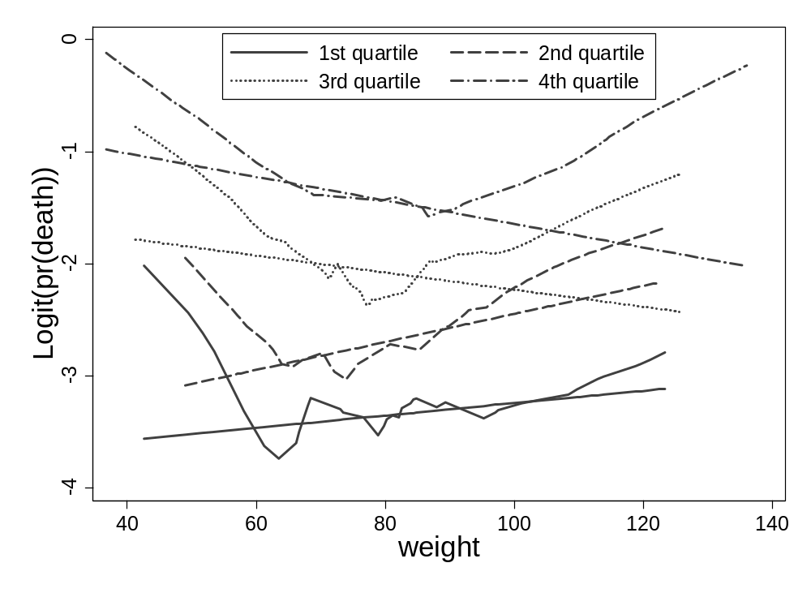
Whitehall 1: check of age × weight interaction
– 4 subgroups for age

Slide 41
Interpreting the plot
Running line smooth are roughly parallel across age groups ⇒ no (strong) interactions
Erroneously assume that the effect of weight is linear ⇒ estimated slopes of weight in age-groups indicate strong qualitative interaction between age und weight

Slide 42
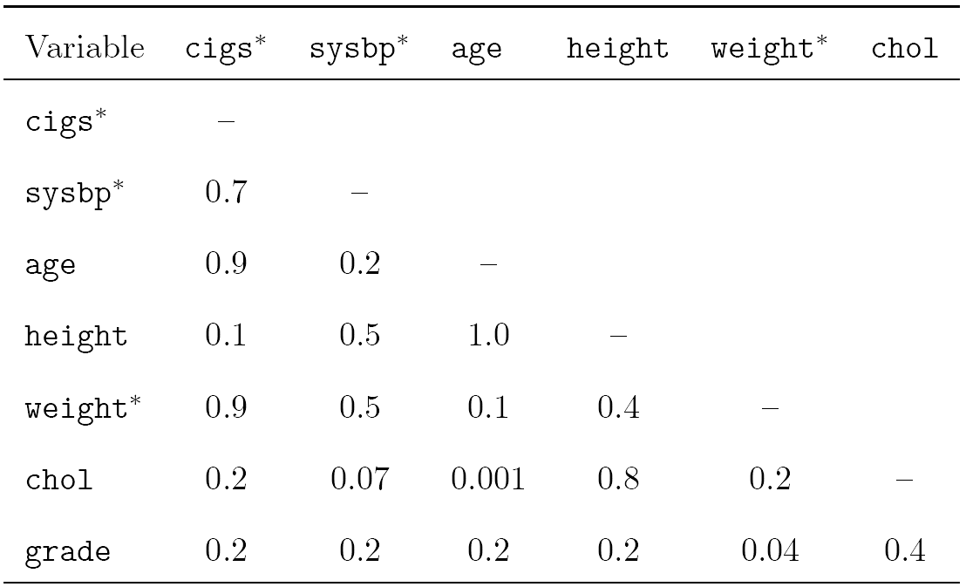
Whitehall 1: 7 variables – any interactions?
P-values for two-way interactions from MFPIgen
*FP transformations
=> chol∗age highly significant, but needs checking

Slide 43
Software sources MFP
Most comprehensive implementation is in Stata
  Command mfp is part since Stata 8 (now Stata 10)
Versions for SAS and R are available
  SAS
  www.imbi.uni-freiburg.de/biom/mfp
  R version available on CRAN archive
    mfp package
Extensions to investigate interactions
    So far only in Stata

Slide 44
Concluding comments – MFP
FPs use full information - in contrast to a priori categorisation
FPs search within flexible class of functions (FP1 and FP2 - 44 models)
MFP is a well-defined multivariate model-building strategy – combines search for transformations with BE
Important that model reflects medical knowledge,
e.g. monotonic / asymptotic functional forms

Slide 45
Towards recommendations for model-building by selection of variables and functional forms for continuous predictors under several assumptions
Issue | Recommendation
Variable selection procedure | Backward elimination; significance level as key tuning parameter, choice depends on the aim of the study
Functional form for continuous covariates | Linear function as the 'default', check improvement in model fit by fractional polynomials. Check derived function for undetected local features
Extreme values or influential points | Check at least univariately for outliers and influential points in continuous variables. A preliminary transformation may improve the model selected. For a proposal see R & S 2007
Sensitivity analysis | Important assumptions should be checked by a sensitivity analysis. Highly context dependent
Check of model stability | The bootstrap is a suitable approach to check for model stability
Complexity of a predictor | A predictor should be 'as parsimonious as possible'
Sauerbrei et al. SiM 2007

Slide 46
Interactions
Interactions are often ignored by analysts
Continuous × categorical has been studied in FP context because clinically very important
Continuous × continuous is more complex
Interaction with time important for long-term FU survival data

Slide 47
MFP extensions
MFPI – treatment/covariate interactions
MFPIgen – interaction between two continuous variables
MFPT – time-varying effects in survival data

Slide 48
Summary
Getting the big picture right is more important than optimising aspects and ignoring others
strong predictors
strong non-linearity
strong interactions
strong non-PH in survival model

Slide 49
References
Harrell FE jr. (2001): Regression Modeling Strategies. Springer.
Royston P, Altman DG. (1994): Regression using fractional polynomials of continuous covariates: parsimonious parametric modelling (with discussion). Applied Statistics, 43:429-467.
Royston P, Ambler G, Sauerbrei W. (1999): The use of fractional polynomials to model continuous risk variables in epidemiology. International Journal of Epidemiology, 28:964-974.
Royston P, Sauerbrei W. (2004): A new approach to modelling interactions between treatment and continuous covariates in clinical trials by using fractional polynomials. Statistics in Medicine, 23:2509-2525.
Royston P, Sauerbrei W. (2007): Improving the robustness of fractional polynomial models by preliminary covariate transformation: a pragmatic approach. Computational Statistics and Data Analysis, 51:4240-4253.
Royston P, Sauerbrei W (2008): Multivariable Model-Building - A pragmatic approach to regression analysis based on fractional polynomials for continuous variables. Wiley.
Royston P, Sauerbrei W (2008): Two techniques for investigating interactions between treatment and continuous covariates in clinical trials. Stata Journal, to appear.
Sauerbrei W. (1999): The use of resampling methods to simplify regression models in medical statistics. Applied Statistics, 48, 313-329.
Sauerbrei W, Meier-Hirmer C, Benner A, Royston P. (2006): Multivariable regression model building by using fractional polynomials: Description of SAS, STATA and R programs. Computational Statistics & Data Analysis, 50:3464-3485.
Sauerbrei W, Royston P. (1999): Building multivariable prognostic and diagnostic models: transformation of the predictors by using fractional polynomials. Journal of the Royal Statistical Society A, 162:71-94.
Sauerbrei W, Royston P, Binder H (2007): Selection of important variables and determination of functional form for continuous predictors in multivariable model building. Statistics in Medicine, 26:5512-28.
Sauerbrei W, Royston P, Zapien K. (2007): Detecting an interaction between treatment and a continuous covariate: a comparison of two approaches. Computational Statistics and Data Analysis, 51:4054-4063.

