Slide 1


Building multivariable survival models with time-varying effects: an approach using fractional polynomials
Willi Sauerbrei
Institut of Medical Biometry and Informatics
University Medical Center Freiburg, Germany
Patrick Royston
MRC Clinical Trials Unit,
London, UK

Slide 2
Overview
Extending the Cox model
Assessing PH assumption
Model time-by covariate interaction
Fractional Polynomial time algorithm
Illustration with breast cancer data

Slide 3
Cox model
λ(t|X) = λ₀(t)exp(β΄X)
λ₀(t) – unspecified baseline hazard
Hazard ratio does not depend on time,
failure rates are proportional ( assumption 1, PH)
Covariates are linked to hazard function by exponential function (assumption 2)
Continuous covariates act linearly on log hazard function (assumption 3)

Slide 4
Extending the Cox model
Relax PH-assumption
dynamic Cox model
λ(t | X) = λ₀(t) exp (β(t) X)
HR(x,t) – function of X and time t
Relax linearity assumption
λ(t | X) = λ₀(t) exp (β f (X))

Slide 5
Causes of non-proportionality
Effect gets weaker with time
Incorrect modelling
  omission of an important covariate
  incorrect functional form of a covariate
  different survival model is appropriate

Slide 6
Non-PH - What can be done ?
Non-PH - Does it matter ?
- Is it real ?
Non-PH is large and real
      stratify by the factor
      λ(t|X, V=j) = λ_{j} (t) exp (Xβ )
        effect of V not estimated, not tested
        for continuous variables grouping necessary
      Partition time axis
      Model non-proportionality by time-dependent covariate

Slide 7
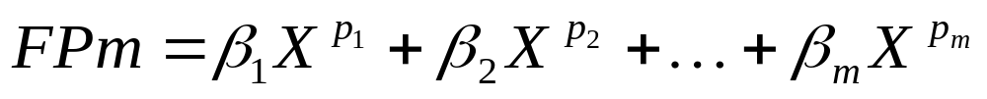
Fractional polynomial models
Fractional polynomial of degree m with powers p = (p₁,…, p_{m}) is defined as
( conventional polynomial p₁ = 1, p₂ = 2, ... )
Notation: FP1 means FP with one term (one power),
FP2 is FP with two terms, etc.
Powers p are taken from a predefined set S
We use S = {−2, − 1, − 0.5, 0, 0.5, 1, 2, 3}
Power 0 means log X here
Notes:
Mention repeated powers

Slide 8
Estimation and significance testing for FP models
Fit model with each combination of powers
  FP1: 8 single powers
  FP2: 36 combinations of powers
Choose model with lowest deviance (MLE)
Comparing FPm with FP(m − 1):
  compare deviance difference with χ² on 2 d.f.
  one d.f. for power, 1 d.f. for regression coefficient
  supported by simulations; slightly conservative

Slide 9
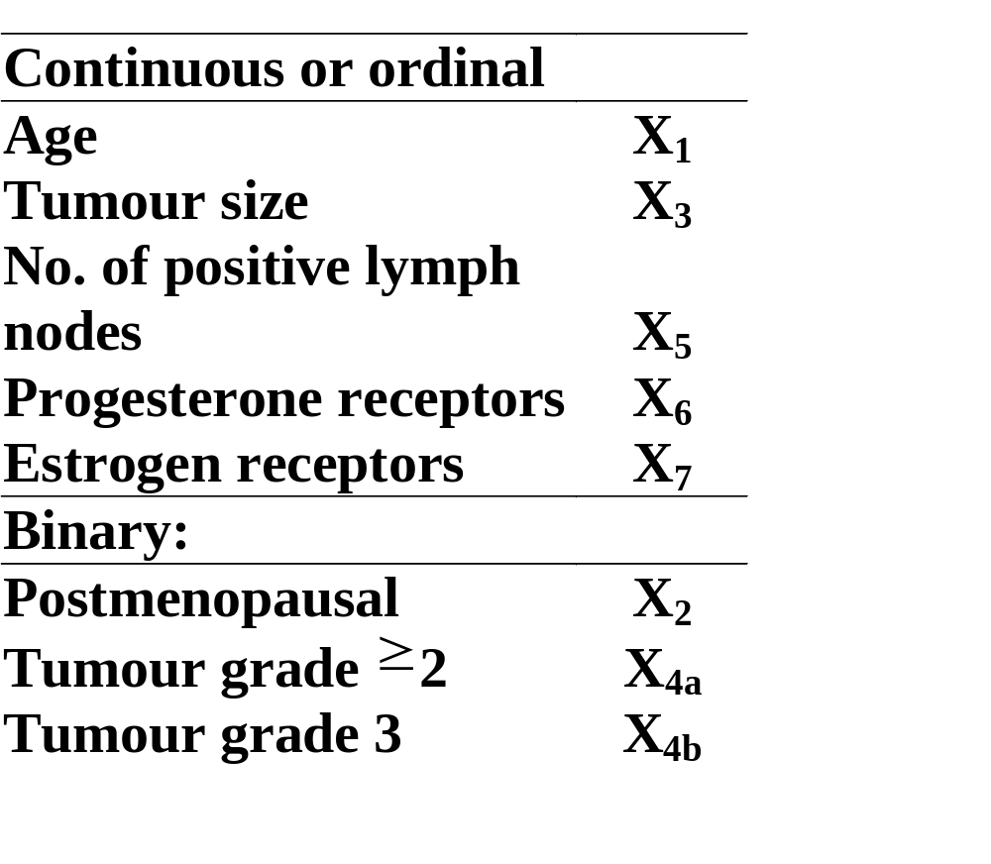
Data: GBSG-study in node-positive breast cancer
Tamoxifen (yes / no), 3 vs 6 cycles chemotherapy
299 events for recurrence-free survival time (RFS) in 686 patients with complete data
Standard prognostic factors

Slide 10
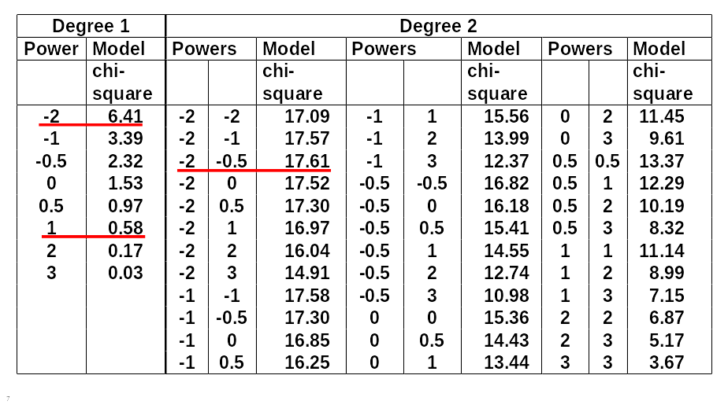
FP analysis for the effect of age

Slide 11
Effect of age at 5% level?
χ² df
Any effect?
Best FP2 versus null 17.61 4
Effect linear?
Best FP2 versus linear 17.03 3
FP1 sufficient?
Best FP2 vs. best FP1 11.20 2

Slide 12
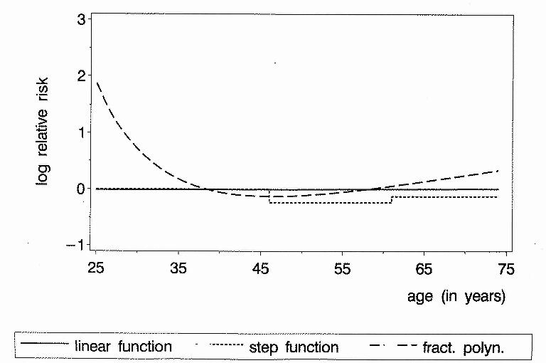
Continuous factors - different results with
different analyses
Age as prognostic factor in breast cancer
P-value 0.9 0.2 0.001

Slide 13
Rotterdam breast cancer data
2982 patients
1 to 231 months follow-up time
1518 events for RFI (recurrence free interval)
Adjuvant treatment with chemo- or hormonal therapy
according to clinic guidelines
70% without adjuvant treatment
Covariates
continuous
age, number of positive nodes, estrogen, progesterone
categorical
menopausal status, tumor size, grade

Slide 14
Treatment variables ( chemo , hormon) will be
analysed as usual covariates
9 covariates , partly strong correlation
(age-meno; estrogen-progesterone;
chemo, hormon – nodes )
variable selection
Use multivariable fractional polynomial approach
for model selection in the Cox proportional
hazards model

Slide 15
Assessing PH-assumption
Plots
  Plots of log(-log(S(t))) vs log t should be parallel for
  groups
  Plotting Schoenfeld residuals against time to identify patterns in regression coefficients
  Many other plots proposed
Tests
    many proposed, often based on Schoenfeld residuals,
    most differ only in choice of time transformation
Partition the time axis and fit models seperatly to each time interval
Including time-by-covariate interaction terms in the model and estimate the log hazard ratio function

Slide 16
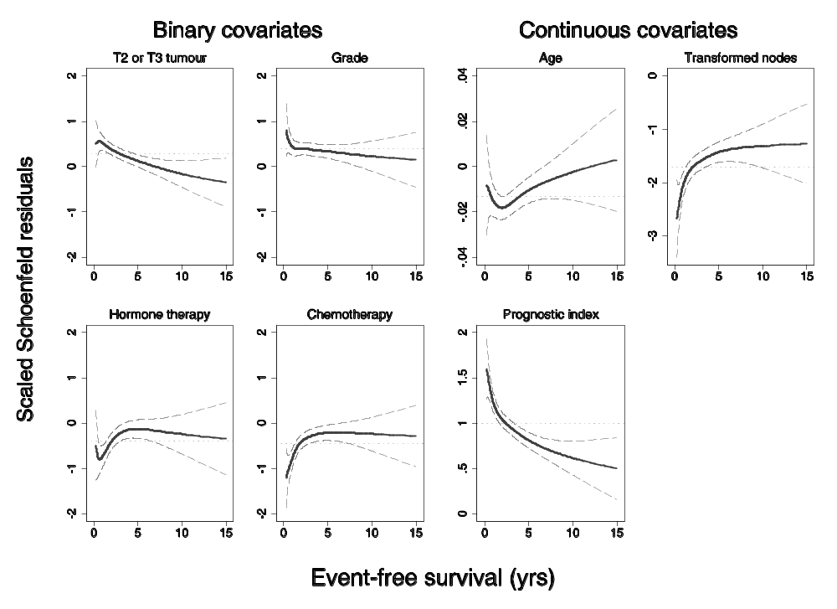
Smoothed Schoenfeld residuals

Slide 17
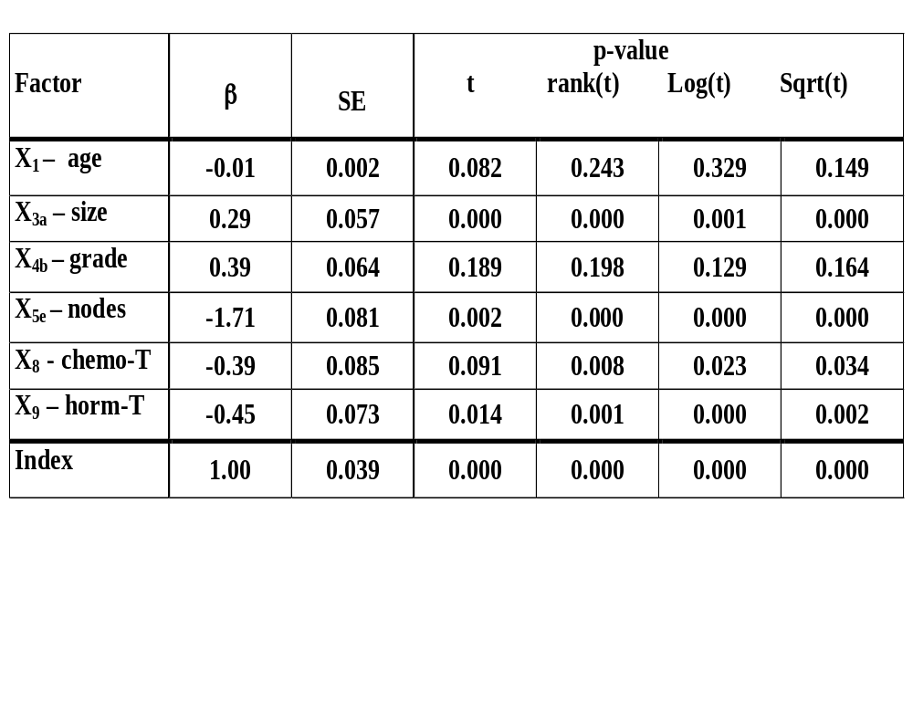
Selected model with MFP
test of time-varying effect for
different time transformations
estimates

Slide 18
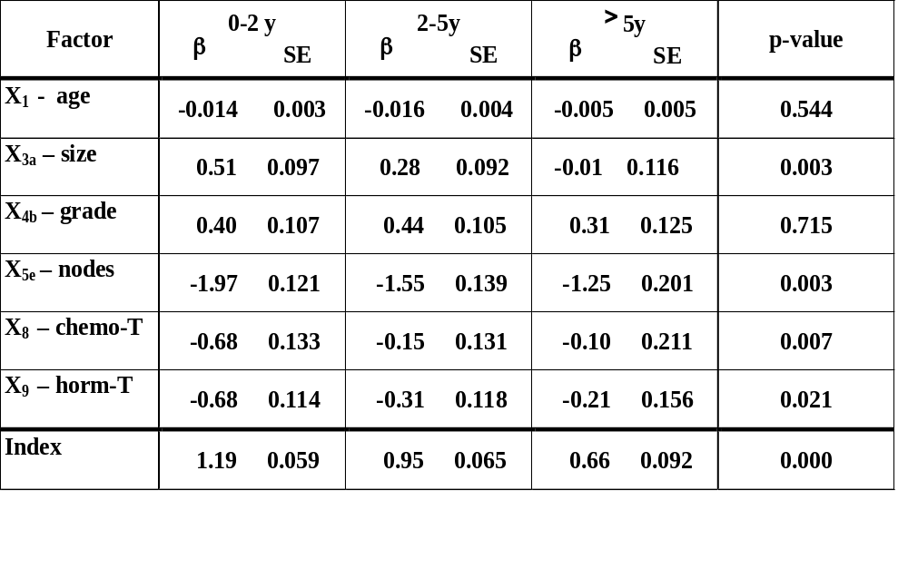
Selected model with MFP(time-fixed)
Estimates in 3 time periods

Slide 19

Including time – by covariate interaction
(Semi-) parametric models for β(t)
model β(t) x = β x + γ x g(t)
  calculate time-varying covariate x g(t)
  fit time-varying Cox model and test for γ 0
  plot β(t) against t
g(t) – which form?
  ‘usual‘ function, eg t, log(t)
  piecewise
  splines
  fractional polynomials

Slide 20
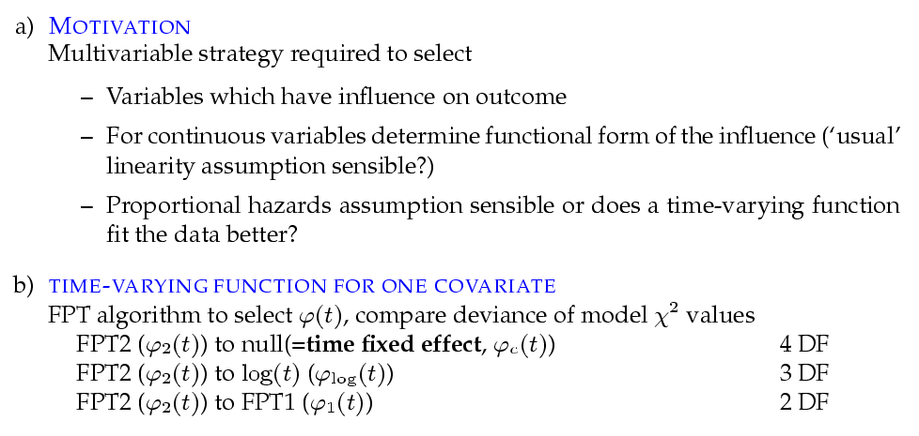
Motivation

Slide 21
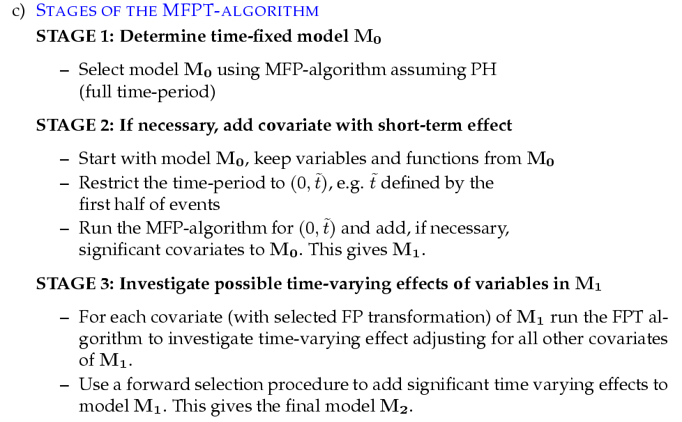
Motivation (cont.)

Slide 22
MFP-time algorithm (1)
Determine (time-fixed) MFP model M₀
possible problems
variable included, but effect is not constant in time
variable not included because of short term effect only
Consider short term period only
Additional to M₀ significant variables?
This given M1

Slide 23
MFP-time algorithm (2)
For all variables (with transformations) selected from full time-period and short time-period
Investigate time function for each covariate in
forward stepwise fashion - may use small P value
Adjust for covariates from selected model
To determine time function for a variable
compare deviance of models ( χ²) from
FPT2 to null (time fixed effect) 4 DF
FPT2 to log 3 DF
FPT2 to FPT1 2 DF
Use strategy analogous to stepwise to add
time-varying functions to MFP model M1

Slide 24
First step of the MFPT procedure
Varia ble | Power(s) of t |  | Step 1
 |  |  | Deviance difference & P-value from FP2
 | FP2 | FP1 | Constant(PH) |  | Log |  | FP1
X1 | 0,0 | -2 | 10.9 | 0.028 | 10.0 | 0.018 | 4.8 | 0.092
X3a | -0.5,2 | 0 | 26.9 | 0.000 | 0.5 | 0.928 | 0.5 | 0.795
X3b | -0.5,-0.5 | 0 | 12.9 | 0.012 | 0.0 | 0.999 | 0.0 | 0.990
X4 | -2,3 | -2 | 5.9 | 0.204 | 1.1 | 0.767 | 0.6 | 0.749
X5e(2) | -2,1 | -0.5 | 21.8 | 0.000 | 2.4 | 0.486 | 2.0 | 0.371
logX6 | -0.5,3 | 0 | 84.5 | 0.000 | 4.2 | 0.243 | 4.2 | 0.124
X8 | -2,-2 | 0.5 | 3.3 | 0.508 | 2.6 | 0.450 | 2.6 | 0.274
X9 | 0,0.5 | -2 | 13.5 | 0.009 | 9.2 | 0.027 | 4.2 | 0.123
o o

Slide 25
Further steps of the MFPT procedure
Varia ble | Power(s) of t |  | Step 2 |  |  |  |  |  | Step 3
 |  |  | Deviance difference & P-value from FP2 |  |  |  |  |  | FP2 v null
 | FP2 | FP1 | Constant(PH) |  | Log |  | FP1 |  | P-value
X1 | 0,0 | -2 | 11.3 | 0.023 | 10.3 | 0.016 | 4.8 | 0.089 | 0.028
X3a | -0.5,2 | 0 | 17.4 | 0.002 | 0.4 | 0.950 | 0.4 | 0.838 | -
X3b | 0,3 | 0 | 9.5 | 0.050 | 0.2 | 0.984 | 0.2 | 0.923 | 0.368
X4 | -1,-1 | -2 | 1.2 | 0.877 | 0.9 | 0.828 | 0.1 | 0.949 | 0.911
X5e(2) | -2,1 | -0.5 | 16.8 | 0.002 | 2.2 | 0.535 | 1.2 | 0.545 | 0.056
logX6 | - | [0] | - | - | - | - | - | - | -
X8 | 2,2 | 0.5 | 4.6 | 0.336 | 2.7 | 0.446 | 2.6 | 0.268 | 0.237
X9 | 0,0.5 | -2 | 12.0 | 0.017 | 9.2 | 0.026 | 4.4 | 0.110 | 0.014
o o

Slide 26
Development of the model
Variable | Model M0 |  | Model M1 |  | Model M2
 | β | SE | β | SE | β | SE
X1 | -0.013 | 0.002 | -0.013 | 0.002 | -0.013 | 0.002
X3b | - | - | 0.171 | 0.080 | 0.150 | 0.081
X4 | 0.39 | 0.064 | 0.354 | 0.065 | 0.375 | 0.065
X5e(2) | -1.71 | 0.081 | -1.681 | 0.083 | -1.696 | 0.084
X8 | -0.39 | 0.085 | -0.389 | 0.085 | -0.411 | 0.085
X9 | -0.45 | 0.073 | -0.443 | 0.073 | -0.446 | 0.073
X3a | 0.29 | 0.057 | 0.249 | 0.059 | - 0.112 | 0.107
logX6 | - | - | -0.032 | 0.012 | - 0.137 | 0.024
X3a(log(t)) | - | - | - | - | - 0.298 | 0.073
logX6(log(t)) | - | - | - | - | 0.128 | 0.016
Index | 1.000 | 0.039 | 1.000 | 0.038 | 0.504 | 0.082
Index(log(t)) | - | - | - | - | -0.361 | 0.052

Slide 27
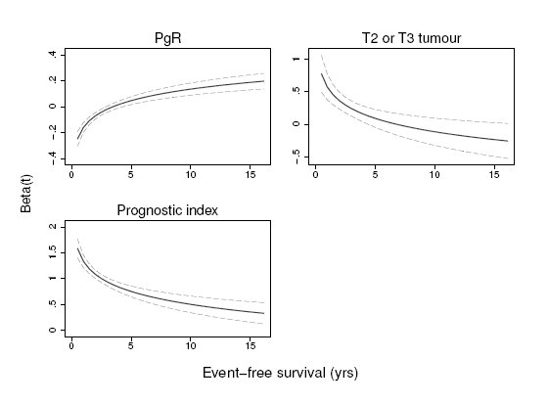
Time-varying effects in final model

Slide 28
Final model includes time-varying
functions for
progesterone ( log(t) ) and
tumor size ( log(t) )
Prognostic ability of the Index vanishes in time

Slide 29
GBSG data
Model III from S&R (1999)
Selected with a multivariable FP procedure
Model III (tumor grade (0,1), exp(-0.12 * number nodes), (progesterone + 1) ** 0.5, age (-2, -0.5))
Model III – false – replace age-function by age linear
p-values for g(t)
Mod III Mod III – false
t log(t) t log(t)
global 0.318 0.096 0.019 0.005
age 0.582 0.221 0.005 0.004
nodes 0.644 0.358 0.578 0.306

Slide 30
Summary
Time-varying issues get more important with long
term follow-up in large studies
Issues related to ´correct´ modelling of non-linearity
of continuous factors and of inclusion of
important variables
⇒ we use MFP
MFP-time combines
selection of important variables
selection of functions for continuous variables
selection of time-varying function

Slide 31
Summary (continued)
Beware of ´too complex´ models
Our FP based approach is simple, but needs
´fine tuning´ and investigation of properties
Another approach based on FPs showed
promising results in simulation (Berger et al 2003)

Slide 32
Literature
Berger, U., Schäfer, J, Ulm, K: Dynamic Cox Modeling based on Fractional Polynomials: Time-variations in Gastric Cancer Prognosis,
Statistics in Medicine, 22:1163-80(2003)
Hess, K.: Graphical Methods for Assessing Violations of the Proportional Hazard Assumption in Cox Regression, Statistics in Medicine, 14,
1707 – 1723 (1995)
Gray, R.: Flexible Methods for Analysing Survival Data Using Splines, with Applications to Breast Cancer Prognosis, Journal of the American Statistical Association, 87, No 420, 942 – 951 (1992)
Sauerbrei, W., Royston, P.: Building multivariable prognostic and diagnostic models : Transformation of the predictors by using fractional polynomials, Journal of the Royal Statistical Society, A. 162:71-94 (1999)
Sauerbrei, W.,Royston, P., Look,M.: A new proposal for multivariable modelling of time-varying effects in survival data based on fractional polynomial time-transformation, submitted
Therneau, T., Grambsch P.: Modeling Survival Data, Springer, 2000

