Slide 1


Use of FP and Other Flexible Methods to Assess Changes in the Impact of an exposure over time
Patrick Royston
MRC Clinical Trials Unit,
London, UK
Willi Sauerbrei
Institut of Medical Biometry and Informatics
University Medical Center Freiburg, Germany

Slide 2
Overview
Extending the Cox model
Assessing PH assumption
Model time by covariate interaction
Fractional Polynomial time algorithm
Further approaches to assess time-varying effects
Illustration with breast cancer data

Slide 3
Cox model
λ(t|X) = λ₀(t)exp(β΄X)
λ₀(t) – unspecified baseline hazard
Hazard ratio does not depend on time, failure rates are proportional ( assumption 1, PH)
Covariates are linked to hazard function by exponential function (assumption 2)
Continuous covariates act linearly on log hazard function (assumption 3)

Slide 4
Extending the Cox model
Relax PH-assumption
dynamic Cox model
λ(t | X) = λ₀(t) exp (β(t) X)
HR(X, t) – function of X and time t
Relax linearity assumption
λ(t | X) = λ₀(t) exp (β f (X))

Slide 5
Non-PH
Causes
  Effect gets weaker with time
  Incorrect modelling
    omission of an important covariate
    incorrect functional form of a covariate
    different survival model is appropriate
Is it real?
Does it matter?

Slide 6
Rotterdam breast cancer data
2982 patients, 1 to 231 months follow-up time
1518 events for RFS (recurrence free survival)
Adjuvant treatment with chemo- or hormonal
therapy according to clinic guidelines. Will be
analysed as usual covariates.
9 covariates , partly strong correlation
(age-meno; estrogen-progesterone;
chemo, hormon – nodes )

Slide 7
Assessing PH-assumption
Plots
  Plots of log(-log(S(t))) vs log t should be parallel for groups
  Plotting Schoenfeld residuals against time to identify patterns in regression coefficients
  Many other plots proposed
Tests
  many proposed, often based on Schoenfeld residuals,
  most differ only in choice of time transformation
Partition the time axis and fit models separately to each time interval
Including time by covariate interaction terms in the model and estimate the log hazard ratio function

Slide 8
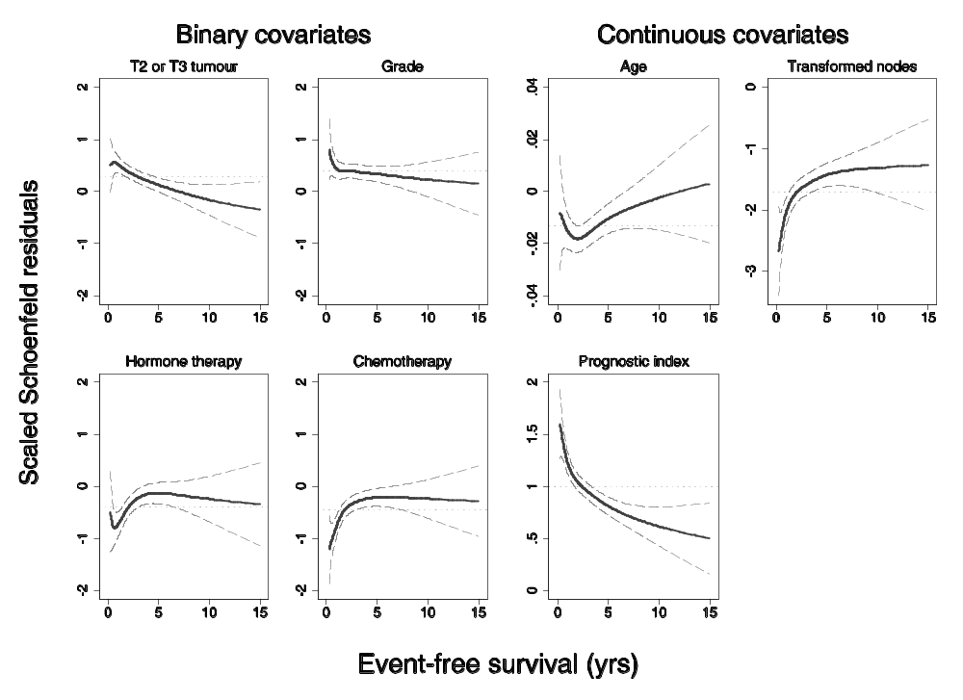
Smoothed Schoenfeld residuals
- univariate models

Slide 9
Including time by covariate interaction
(Semi-) parametric models for β(t)
model β(t) x = β x + γ x g(t)
  calculate time-varying covariate x g(t)
  fit time-varying Cox model and test for γ ≠ 0
  plot β(t) against t
g(t) – which form?
  ‘usual‘ function, eg t, log(t)
  piecewise
  splines
  fractional polynomials

Slide 10
MFP-time algorithm (1)
Stage 1: Determine (time-fixed) MFP model M₀
  possible problems
    variable included, but effect is not constant in time
    variable not included because of short term effect only
Stage 2: Consider short term period (e.g. first half of events) only
  Additional to M₀ significant variables?
  Run MFP with M₀ included
  This gives the PH model M₁ (often M₀ = M₁)

Slide 11
MFP-time algorithm (2)
For all variables (with transformations) selected from full time-period and short time-period (M1)
Investigate time function for each covariate in forward stepwise fashion - may use small P value
Adjust for covariates from selected model
To determine time function for a variable compare deviance of models ( χ2) from
FPT2 to null (time fixed effect) 4 DF
FPT2 to log 3 DF
FPT2 to FPT1 2 DF
Use strategy analogous to stepwise to add time-varying functions to MFP model M1

Slide 12
Development of the model
Variable | Model M0 |  | Model M1 |  | Model M2
 | β | SE | β | SE | β | SE
X1 | -0.013 | 0.002 | -0.013 | 0.002 | -0.013 | 0.002
X3b | - | - | 0.171 | 0.080 | 0.150 | 0.081
X4 | 0.39 | 0.064 | 0.354 | 0.065 | 0.375 | 0.065
X5e(2) | -1.71 | 0.081 | -1.681 | 0.083 | -1.696 | 0.084
X8 | -0.39 | 0.085 | -0.389 | 0.085 | -0.411 | 0.085
X9 | -0.45 | 0.073 | -0.443 | 0.073 | -0.446 | 0.073
X3a | 0.29 | 0.057 | 0.249 | 0.059 | - 0.112 | 0.107
logX6 | - | - | -0.032 | 0.012 | - 0.137 | 0.024
X3a(log(t)) | - | - | - | - | - 0.298 | 0.073
logX6(log(t)) | - | - | - | - | 0.128 | 0.016
Index | 1.000 | 0.039 | 1.000 | 0.038 | 0.504 | 0.082
Index(log(t)) | - | - | - | - | -0.361 | 0.052

Slide 13
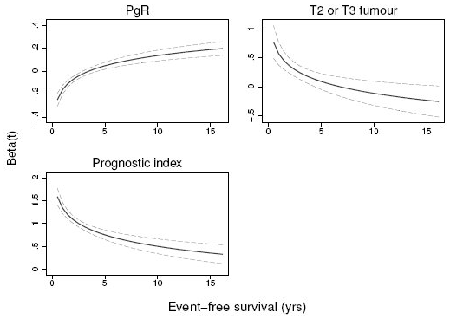
Time-varying effects in final model log(t) for PgR and tumor size
log(t)
for the index

Slide 14
Alternative approach
Joint estimation of time-dependent and non-linear effects of continuous covariates on survival
M. Abrahamowicz and T. MacKenzie, Stat Med 2007
Main differences
  Regression splines instead of FPs
  Simultaneous modelling of non-linear and time-dependent effect
  No specific consideration of short term period

Slide 15
Methods to investigate for TV effects in a given PH model
 | Selection of TV effects
MFPT (Step 3) | For each variable, check whether a TV function (from the class of Fractional Polynomial (FP) functions) improves the fit compared to a time constant effect. Simple functions are preferred. Use forward selection to add TV effects to the PH model.
Dynamic Cox model | Add the best fitting TV functions (from the class of FP functions) to the PH model using a backfitting procedure.
Semiparametric extended Cox model (Timecox) | Test for TV effects using nonparametric cumulative regression functions. No selection algorithm is implemented, but backward elimination from a model with all effects varying in time is proposed.
Reduced rank model | Model TV effects as covariate by time-function interactions. Time-functions are modelled as B-splines, other choices are possible. No selection algorithm is implemented, all effects are TV.
Empirical Bayes model | Model TV effects as Bayesian B-splines using mixed model methodology. No selection algorithm is implemented, models are compared using BIC.

Slide 16
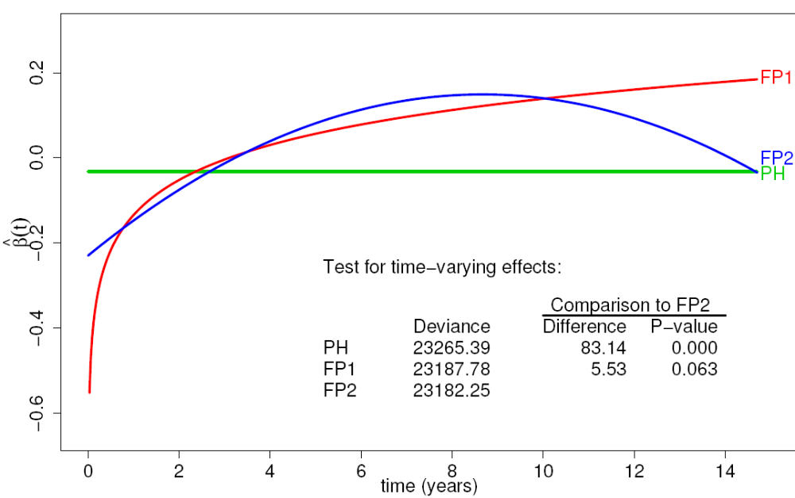
Rotterdam data
Progesterone has the strongest TV effect
Which FP function?
After 10 years FP2 fits a bit better, but not significantly

Slide 17
Philosophy
Getting the big picture right is more important than optimising certain aspects and ignoring others
Strong predictors
Strong non-linearity
Strong interactions (here with time)
Beware of ´too complex´ models

Slide 18
Summary
Time-varying issues get more important with long term follow-up in large studies
Issues related to ´correct´ modelling of non-linearity of continuous factors and of inclusion of important variables
⇒ we use MFP
MFP-Time combines
  selection of important variables
  selection of functions for continuous variables
  selection of time-varying function

Slide 19
Summary (continued)
Further extension of MFP
  Interaction of a continuous variable with treatment or between two continuous variables
Our FP based approach is simple, but needs ´fine tuning´ and investigation of properties
Comparison to other approaches is required

Slide 20
References - FP methodology
Royston P, Altman DG. (1994): Regression using fractional polynomials of continuous covariates: parsimonious parametric modelling (with discussion). Applied Statistics, 43, 429-467.
Royston P, Altman DG, Sauerbrei W. (2006): Dichotomizing continuous predictors in multiple regression: a bad idea. Statistics in Medicine, 25: 127-141.
Royston P, Sauerbrei W. (2005): Building multivariable regression models with continuous covariates, with a practical emphasis on fractional polynomials and applications in clinical epidemiology. Methods of Information in Medicine, 44, 561-571.
Royston P, Sauerbrei W. (2008): Interactions between treatment and continuous covariates – a step towards individualizing therapy (Editorial).JCO, 26:1397-1399.
Royston P, Sauerbrei W. (2008): Multivariable Model-Building - A pragmatic approach to regression analysis based on fractional polynomials for modelling continuous variables. Wiley.
Sauerbrei W, Royston P. (1999): Building multivariable prognostic and diagnostic models: transformation of the predictors by using fractional polynomials. Journal of the Royal Statistical Society A, 162, 71-94.
Sauerbrei, W., Royston, P., Binder H (2007): Selection of important variables and determination of functional form for continuous predictors in multivariable model building. Statistics in Medicine, to appear
Sauerbrei W, Royston P, Look M. (2007): A new proposal for multivariable modelling of time-varying effects in survival data based on fractional polynomial time-transformation. Biometrical Journal, 49: 453-473.

Slide 21
References – Time-varying effects
Abrahamovicz M, MacKenzie TA. (2007): Joint estimation of time-dependent and non-linear effects of continuous covariates on survival. Statistics in Medicine.
Berger U, Schäfer J, Ulm K. (2003): Dynamic Cox modelling based on fractional polynomials: time-variations in gastric cancer prognosis. Statistics in Medicine, 22:1163–1180
Kneib T, Fahrmeir L. (2007): Amixedmodel approach for geoadditive hazard regression. Scandinavian Journal of Statistics, 34:207–228.
Perperoglou A, le Cessie S, van Houwelingen HC. (2006): Reduced-rank hazard regression for modelling non-proportional hazards. Statistics in Medicine, 25:2831–2845.
Sauerbrei W, Royston P, Look M. (2007): A new proposal for multivariable modelling of timevarying effects in survival data based on fractional polynomial time-transformation. Biometrical Journal, 49:453–473.
Scheike T H, Martinussen T. (2004): On estimation and tests of time-varying effects in the proportionalhazards model. Scandinavian Journal of Statistics, 31:51–62.

