Slide 1


Use of FP and Other Flexible Methods to Assess Changes of an Exposure Over Time
Willi Sauerbrei
Institut of Medical Biometry and Informatics
University Medical Center Freiburg, Germany
Patrick Royston
MRC Clinical Trials Unit,
London, UK

Slide 2
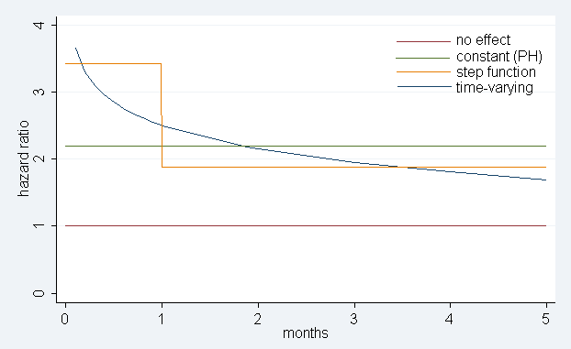
Example – AMI and NSAID use
(Hammad et al, PaDS 2008, 17:315)
… the risk of AMI was increased during the first months .., but not later (3.43 (95% CI 1.66-7.07); 1.88 (0.82-4.31))

Slide 3
Overview
Cox model
  Effect constant in time (proportional hazards, PH)
  Varying in time
Assessing PH assumption
Model a time-varying function (FPT)
Further approaches
Prognostic factors in breast cancer data

Slide 4
Cox model
Hazard function at time t
λ(t|X) = λ₀(t)exp(β΄X)
λ₀(t) – unspecified baseline hazard
β΄X – predictors summarizing the effects of covariates
2 important assumptions
Continuous covariates act linearly on log hazard function (talk Royston)
Hazard ratio does not depend on time, failure rates are proportional (this talk)

Slide 5
Extending the Cox model
Relax linearity assumption
  λ(t | X) = λ₀(t) exp (β f(X))
Relax proportional hazards assumption
Effect of covariate X may change in time
λ(t | X) = λ₀(t) exp (β(t) X)

Slide 6
Effect changes over time
Causes
  Effect gets weaker with time
  Incorrect modelling
    omission of an important covariate
    incorrect functional form of a covariate
    different survival model is appropriate
Is it real?
Does it matter?

Slide 7
Assessing PH-assumption
Plots
  Plots of log(-log(S(t))) vs log t should be parallel for groups
  Plotting Schoenfeld residuals against time to identify patterns in regression coefficients
  Many other plots proposed
Tests
  many proposed, often based on Schoenfeld residuals
  most differ only in choice of time transformation
Partition the time axis and fit models separately to each time interval
Include time by covariate interaction terms in the model and estimate the log hazard ratio function

Slide 8
Rotterdam breast cancer data
2982 patients, 1 to 231 months follow-up time
1518 events for RFS (recurrence free survival)
Adjuvant treatment with chemo- or hormonal
therapy according to clinic guidelines. Will be
analysed as usual covariates.
9 covariates , partly strong correlation
(age-meno; estrogen-progesterone;
chemo, hormon – nodes )

Slide 9
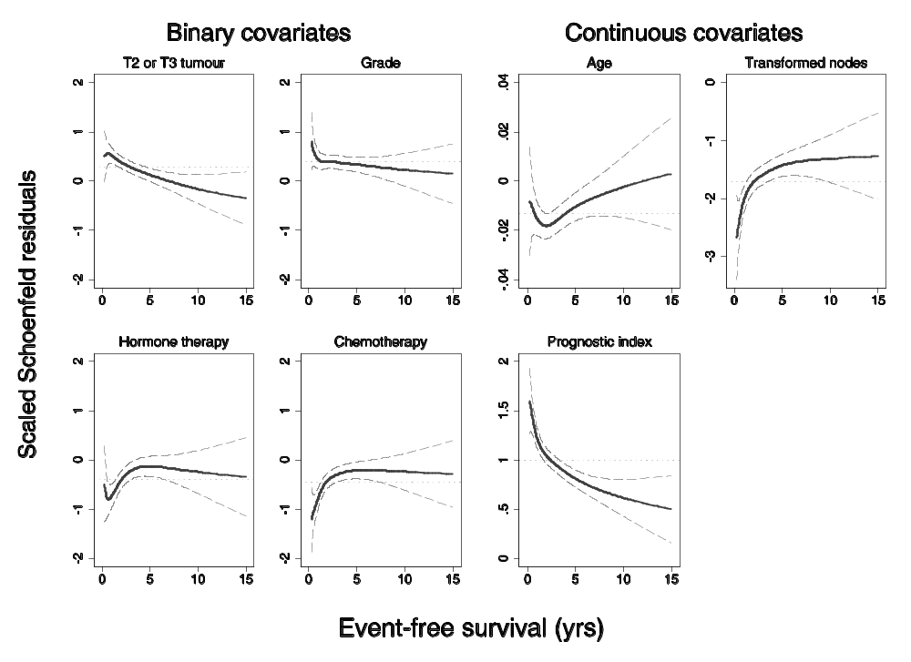
Smoothed Schoenfeld residuals
- univariate models

Slide 10
Model the time-varying effect
Time-varying effects are interactions with time,
but which functional form?
  ‘usual‘ function, eg t, log(t)
  Piecewise (step)
  splines
  fractional polynomials

Slide 11
FP-time algorithm
Determine the function which describes the interactions with time best. Most complex function FPT2. Best fit, but instable and perhaps not required. Proposed algorithm compares
FPT2 to null (time fixed effect) 4 DF
FPT2 to log 3 DF
FPT2 to FPT1 2 DF

Slide 12
Multivariable FP-time algorithm
Stage 1: Determine (time-fixed) MFP model M₀
  possible problems
    variable included, but effect is not constant in time
    variable not included because of short term effect only
Stage 2: Consider short term period (e.g. first half of events) only
  Additional variables significant in this period?
Stage 3: Check every variable selected for a time-varying effect
  Use forward stepwise to add time-varying effects

Slide 13
Breast cancer – Development of the model
Variable | Model M0 |  | Model M1 |  | Model M2
 | β | SE | β | SE | β | SE
X1 | • | • | • | • | • | •
X3b | - | - | • | • | • | •
X4 | • | • | • | • | • | •
[exp(-0.12X₅)]² | • | • | • | • | • | •
X8 | • | • | • | • | • | •
X9 | • | • | • | • | • | •
X3a | • | • | • | • | • | •
logX6 | - | - | • | • | • | •
X3a ∗ log(t) | - | - | - | - | • | •
logX6 ∗ log(t) | - | - | - | - | • | •
Index | 1.000 | 0.039 | 1.000 | 0.038 | 0.504 | 0.082
Index * log(t) | - | - | - | - | -0.361 | 0.052
Add variables with short term effect only
Add time-varying effects
Models for the three indices

Slide 14
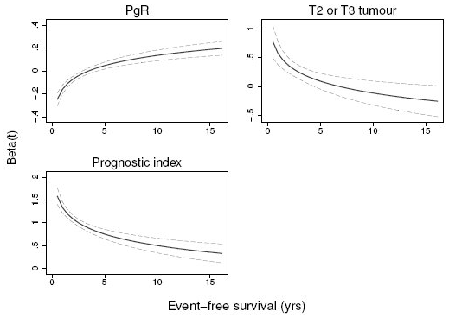
Time-varying effects in final model log(t) for PgR and tumor size
log(t)
for the index

Slide 15
Alternative approach
Joint estimation of time-dependent and non-linear effects of continuous covariates on survival
M. Abrahamowicz and T. MacKenzie, Stat Med 2007
Main differences
  Regression splines instead of FPs
  Simultaneous modelling of non-linear and time-dependent effect
  No specific consideration of short term period
There are at least 4 other methods which can be used to assess TV effects in a given model (see references)

Slide 16
Philosophy
Getting the big picture right is more important than optimising certain aspects and ignoring others
Strong predictors
Strong non-linearity
Strong interactions (here with time)
Beware of ´too complex´ models

Slide 17
Summary
Time-varying issues get more important with long term follow-up in large studies
Time-varying issues are related to ´correct´ modelling of non-linearity of continuous factors and of inclusion of important variables
⇒ we use MFP
MFP-Time combines
  selection of important variables
  selection of functions for continuous variables
  selection of time-varying function

Slide 18
Summary (continued)
Our FP based approach is simple, but needs ´fine tuning´ and investigation of properties
Comparison to other approaches is required
Further extension of MFP
  Interaction of a continuous variable with treatment or between two continuous variables

Slide 19
References - FP methodology
Royston P, Altman DG. (1994): Regression using fractional polynomials of continuous covariates: parsimonious parametric modelling (with discussion). Applied Statistics, 43, 429-467.
Royston P, Altman DG, Sauerbrei W. (2006): Dichotomizing continuous predictors in multiple regression: a bad idea. Statistics in Medicine, 25: 127-141.
Royston P, Sauerbrei W. (2005): Building multivariable regression models with continuous covariates, with a practical emphasis on fractional polynomials and applications in clinical epidemiology. Methods of Information in Medicine, 44, 561-571.
Royston P, Sauerbrei W. (2008): Interactions between treatment and continuous covariates – a step towards individualizing therapy (Editorial).JCO, 26:1397-1399.
Royston P, Sauerbrei W. (2008): Multivariable Model-Building - A pragmatic approach to regression analysis based on fractional polynomials for modelling continuous variables. Wiley.
Sauerbrei W, Royston P. (1999): Building multivariable prognostic and diagnostic models: transformation of the predictors by using fractional polynomials. Journal of the Royal Statistical Society A, 162, 71-94.
Sauerbrei, W., Royston, P., Binder H (2007): Selection of important variables and determination of functional form for continuous predictors in multivariable model building. Statistics in Medicine, to appear
Sauerbrei W, Royston P, Look M. (2007): A new proposal for multivariable modelling of time-varying effects in survival data based on fractional polynomial time-transformation. Biometrical Journal, 49: 453-473.

Slide 20
References – Time-varying effects
Abrahamovicz M, MacKenzie TA. (2007): Joint estimation of time-dependent and non-linear effects of continuous covariates on survival. Statistics in Medicine.
Berger U, Schäfer J, Ulm K. (2003): Dynamic Cox modelling based on fractional polynomials: time-variations in gastric cancer prognosis. Statistics in Medicine, 22:1163–1180
Kneib T, Fahrmeir L. (2007): Amixedmodel approach for geoadditive hazard regression. Scandinavian Journal of Statistics, 34:207–228.
Perperoglou A, le Cessie S, van Houwelingen HC. (2006): Reduced-rank hazard regression for modelling non-proportional hazards. Statistics in Medicine, 25:2831–2845.
Sauerbrei W, Royston P, Look M. (2007): A new proposal for multivariable modelling of timevarying effects in survival data based on fractional polynomial time-transformation. Biometrical Journal, 49:453–473.
Scheike T H, Martinussen T. (2004): On estimation and tests of time-varying effects in the proportionalhazards model. Scandinavian Journal of Statistics, 31:51–62.

