Slide 1


Making fractional polynomial models more robust
Patrick Royston
MRC Clinical Trials Unit,
London, UK
Willi Sauerbrei
Institut of Medical Biometry and Informatics
University Medical Center Freiburg, Germany

Slide 2
An interesting dataset
From Johnson (J Statistics Education 1996)
Percent body fat measurements in 252 men
13 continuous covariates comprising age, weight, height, 10 body circumference measurements
Used by Johnson to illustrate some of the problems of multiple regression analysis (collinearity etc.)

Slide 3
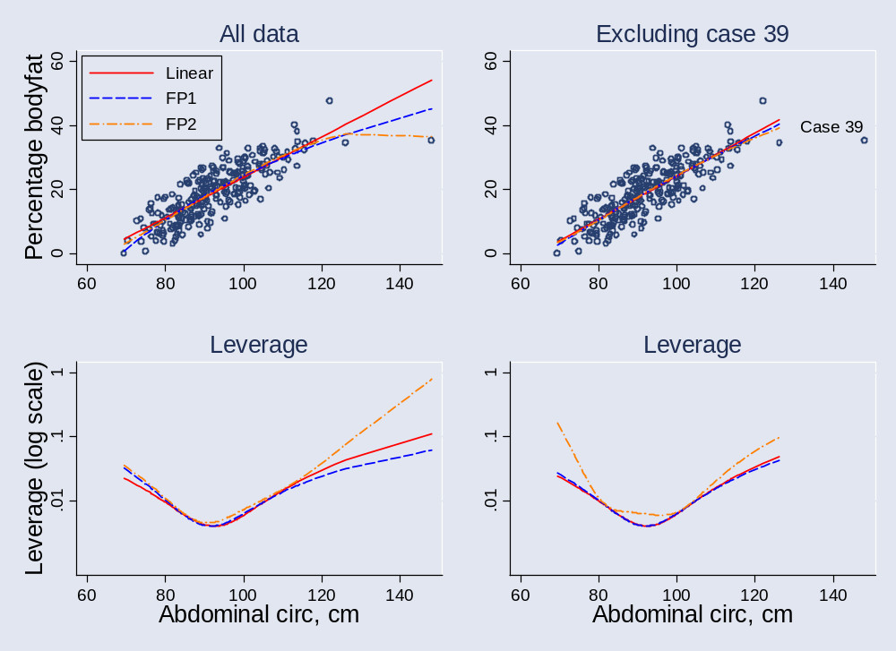
The problem …
Notes:
Note that data comprise %body fat measurements in 252 men, with 13 continuous covariates including age, weight, height, 10 body circumference measurements (Johnson (1996))

Slide 4
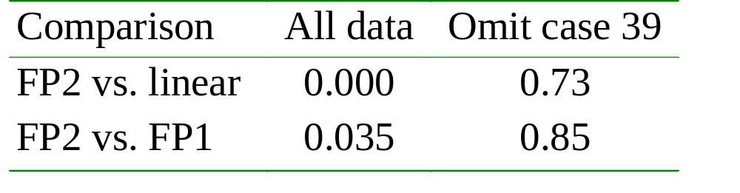
Effect of case 39 on FP analysis
(P-values for non-linear effects)
Non-linearity depends on case 39
This case has an undue influence on the results of the FP analysis
Would have similar influence on other flexible models, e.g. splines

Slide 5
Brief reminder:
Fractional polynomial models
For one covariate, X
Fractional polynomial of degree m for X with powers p₁, … , p_{m} is given by
FPm(X) = β₁ X^{p1} + … + β_{m} X^{pm}
Powers p₁,…, p_{m} are taken from a special set
{−2, − 1, − 0.5, 0, 0.5, 1, 2, 3}
In clinical data, m = 1 or m = 2 is usually sufficient for a good fit

Slide 6
FP1 and FP2 models
FP1 models are simple power transformations
1/X², 1/X, 1/√X, log X, √X, X, X², X³
  8 models of the form β₀ + β₁X^{p}
FP2 models have combinations of the powers
  For example β₀ + β₁(1/X) + β₂(X²)
  28 models
Also ‘repeated powers’ models
  For example (1, 1): β₀ + β₁X + β₂X log X
  8 models

Slide 7
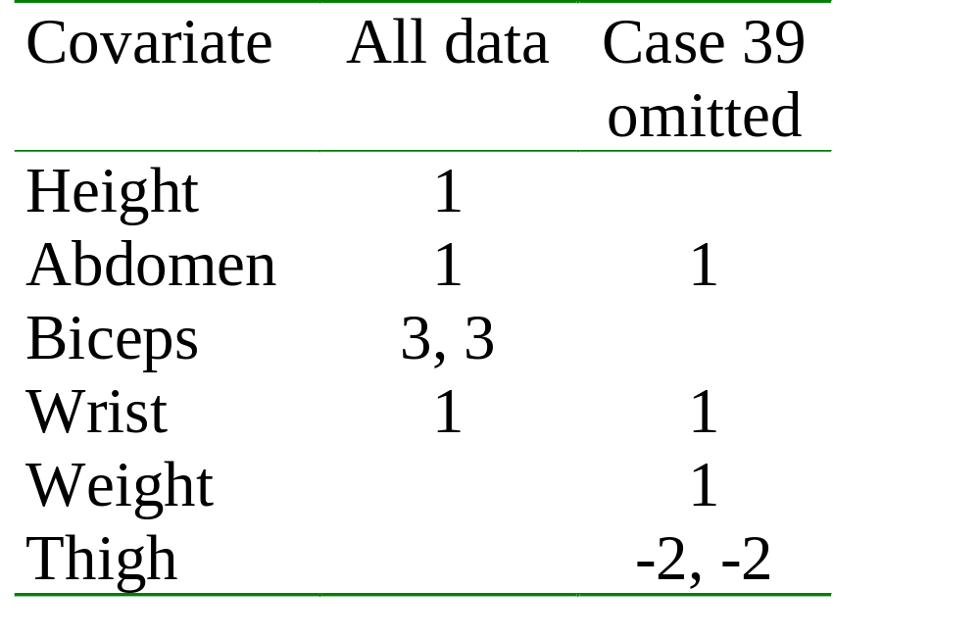
Bodyfat: Case 39 also influences a multivariable FP model
Case 39 is extreme for several covariates

Slide 8
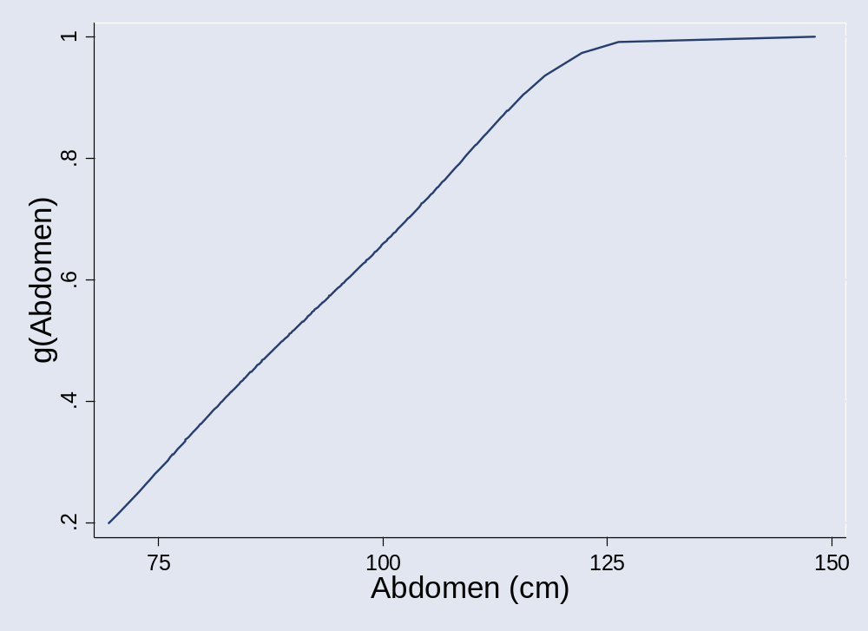
A conceptual solution: preliminary transformation of X

Slide 9
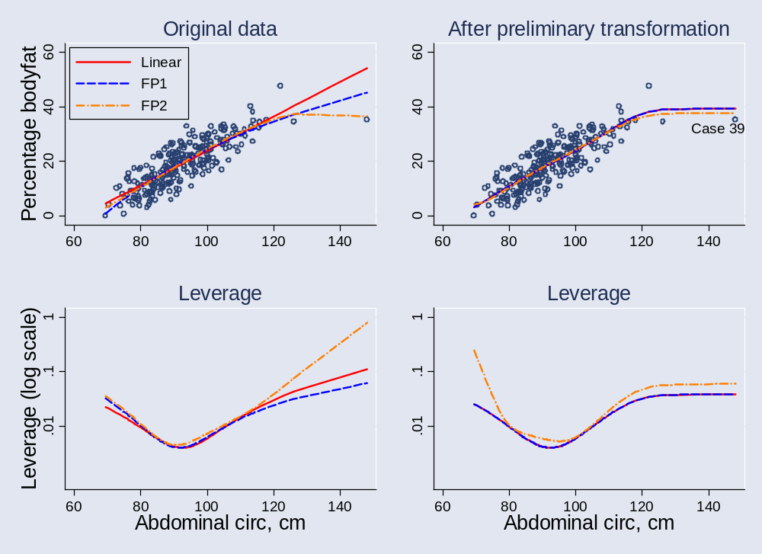
Bodyfat revisited

Slide 10
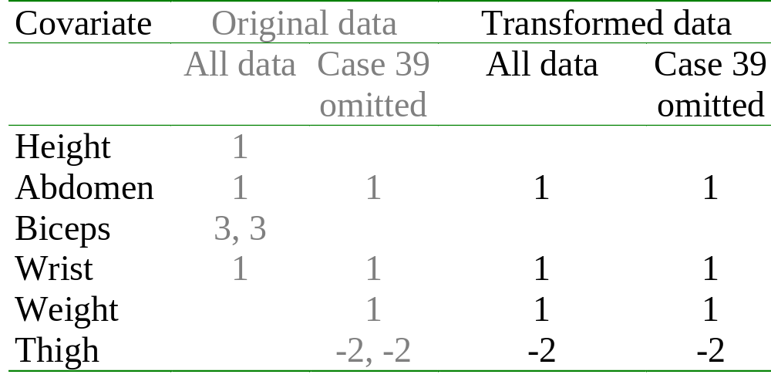
Preliminary transformation: effect on multivariable FP analysis
Apply preliminary transformation to all predictors in bodyfat data

Slide 11
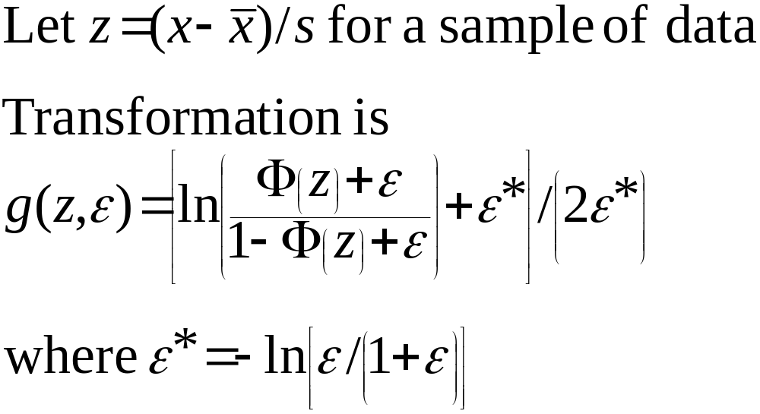
The transformation (1)
Take ε = 0.01 for best results

Slide 12
The transformation (2)
0 < g(z, ε) < 1 for any z and ε
g(z, ε) tends to asymptotes 0 and 1 as z tends to ±∞
g(z, ε) looks like a straight line centrally, smoothly truncated at the extremes

Slide 13
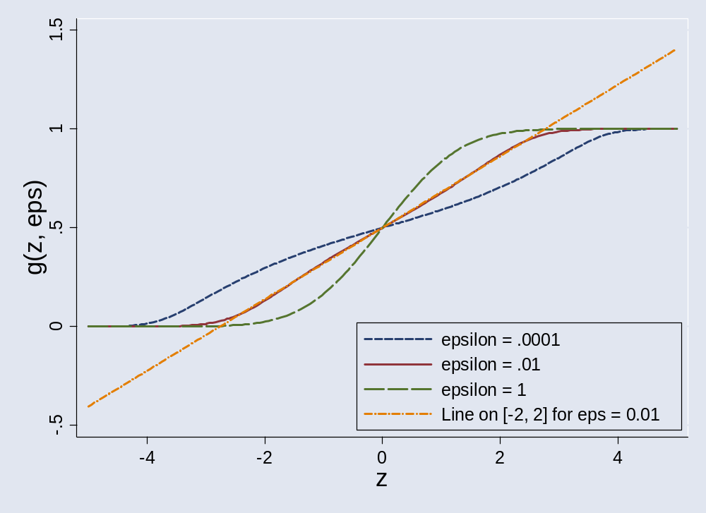
The transformation (3)
ε = 0.01 is nearly linear in central region

Slide 14
The transformation (4)
FP functions (including transformations such as log) are sensitive to values of x near 0
To avoid this effect, shift the origin of g(z, ε) to the right
Simple linear transformation of g(z, ε) to the interval (δ, 1) does this
Simulation studies support δ = 0.2

Slide 15
Example 2 – Whitehall 1 study
17,370 male Civil Servants aged 40-64 years
Covariates: age, cigarette smoking, BP, cholesterol, height, weight, job grade
Outcomes of interest: all-cause mortality ⇒ logistic regression
Interested in risk as function of covariates
Several continuous covariates
Risk functions ± preliminary transformation

Slide 16
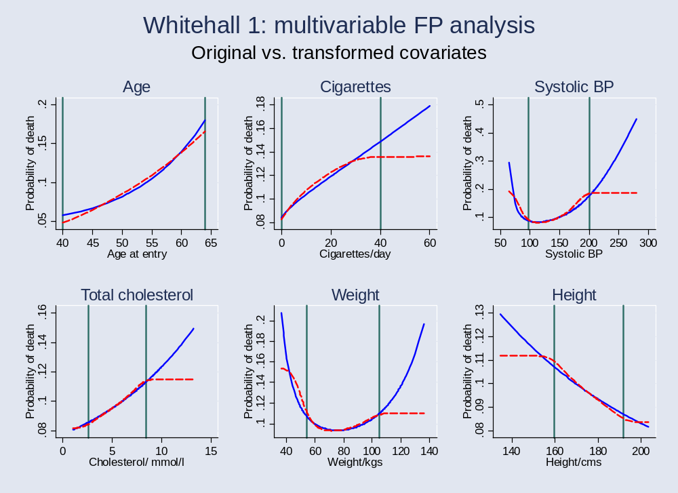
Multivariable FP modelling with or without preliminary transformation
Green vertical lines show 1 and 99th centiles of X

Slide 17
Comments and conclusions
Issue of robustness affects FP and other models
Standard analysis of influence may identify problematic points but does not tell you what to do
Proposed preliminary transformation is effective in reducing leverage of extreme covariate values
  Lowers the chance that FP and other flexible models will contain artefacts in curve shape
  Transformation looks complicated, but graph shows idea is really quite simple – like double truncation
May be concerned about possible bias in fit at extreme values of X following transformation

