Slide 1


Modelling continuous variables with a spike at zero – on issues of a fractional polynomial based procedure
Willi Sauerbrei
Institut of Medical Biometry and Informatics
University Medical Center Freiburg, Germany
Patrick Royston
MRC Clinical Trials Unit,
London, UK

Slide 2
1. Motivation
Problem: A variable X has value 0 for a proportion of individuals “spike at zero”), and a quantitative value for the others
Examples: cigarette consumption, occupational exposure.
How to model this?
Setting here: case-control study

Slide 3
1. Motivation
Example : Distribution of smoking in a lung cancer case-control study
______________________________________________________
Controls Cases
n % n %
No cigarettes/day
0 (Non-smokers) 289 21.5 16 2.7
1-9 78 8
10-19 247 73
20-29 459 78.5 273 97.3
30-39 184 123
40+ 86 107 .
100.0 100.0

Slide 4
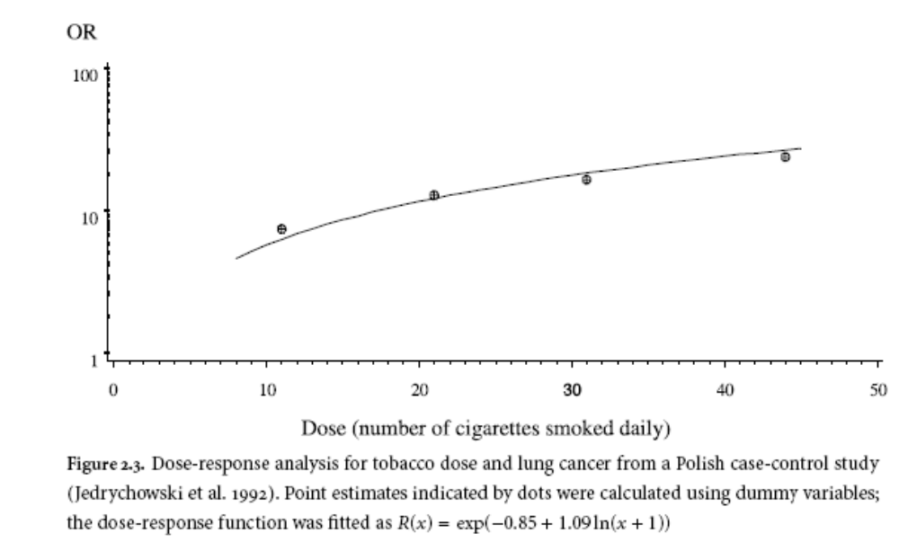
Ad hoc solution:
Adding binary variable smoker yes/no
appropriate?

Slide 5
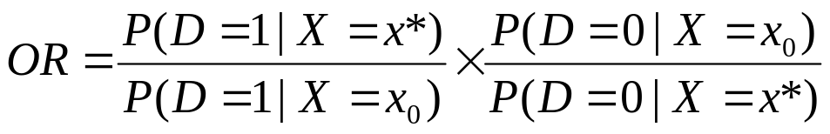
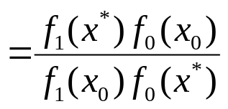
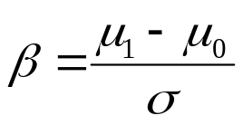
2. Theoretical results
The odds ratio
can be expressed as
where f₁ and f₀ are the probability density functions of X in cases and controls, respectively
Simplest case:
X is normal distributed with expectations μ_{i} with i=0 (1) for controls (cases) and equal variance σ².
We get OR_{X=x vs X=x0} = exp (β(x-x₀)) with .

Slide 6
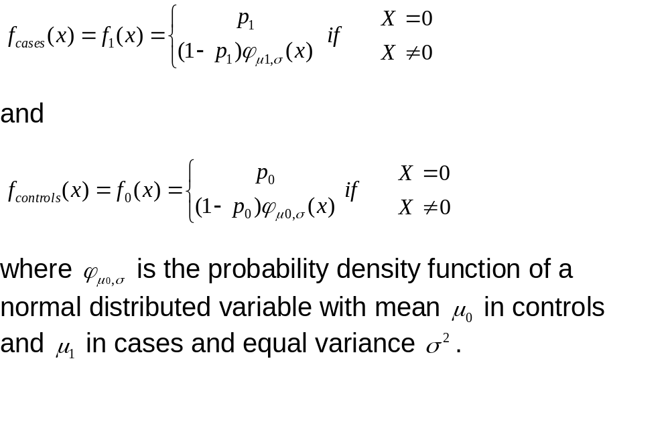
Next case (spike at zero):
2. Theoretical results
.

Slide 7

2. Theoretical results

Slide 8
2. Theoretical results
So we have theoretically shown that the above situation requires the binary indicator for the correct model.
Some other distributions also have simple solutions
In reality, we rarely have simple distributions
→ procedures are more complicated
New proposal:
Extension of fractional polynomial procedure

Slide 9
3. Fractional polynomial models
Standard procedure (FP degree 2, FP2 for one covariate X)
Fractional polynomial of degree 2 for X with powers p₁, p₂ is given by
FP2(X) = β₁ X ^{p1} + β₂ X ^{p2}
Powers p₁, p₂ are taken from a special set
{−2, − 1, − 0.5, 0, 0.5, 1, 2, 3} (0 = log )
Repeated powers (p₁=p₂)
β₁ X ^{p1} + β₂ X ^{p1}log X
36 FP2 models
8 FP1 models
Linear pre-transformation of X such that values are positive

Slide 10
3. Fractional polynomial models
Standard procedure for one variable:
Test best FP2 against
Null model – not significant ⇒ no effect
Straight line – not significant ⇒ X linear
Best FP1
  Not significant ⇒ FP1
  significant ⇒ FP2

Slide 11
3. Fractional polynomial models
Extended procedure for variable with spike at zero
Generate binary indicator for exposure
Fit the most complex model (binary indicator z + 2nd degree FP)
If significant, follow same FP function selection procedure WITH z included (first stage)
Test both z and the remaining FP (resp the linear component) for removal
(second stage)

Slide 12
4. Examples
4.1 Cigarette consumption and lung cancer
Case-control study, 600 cases, 1343 controls.
X – average number of cigarettes smoked per day
FP2 Model with added binary variable:

Slide 13
4. Examples
4.1 Cigarette consumption and lung cancer
Model | Deviance | diff. | d.f. | P | Power
First stage
Null | 2402.1 | 225.7 | 5 | <0.001 | -
Linear + z | 2195.4 | 19.0 | 3 | <0.001 | 1
FP1⁺ + z | 2177.0 | 0.6 | 2 | 0.76 | -0.5
FP2⁺ + z | 2176.4 | - | - | - | -2, -1
Second stage
FP1⁺ + z | 2177.0 | - | 3 |  | -0.5
FP1⁺ [dropping z] | 2384.9 | 208.0 | 1 | <0.001 | -0.5
z [dropping FP1] | 2259.4 | 82.4 | 2 | <0.001 | -
Standard FP analysis (as alternative) | 2176.8 |  |  |  | -1, -1

Slide 14
4. Examples
4.1 Cigarette consumption and lung cancer
Result:
First step: selects FP1 transformation
Second step: Both the binary and the FP1 term are required
FP2 without binary term gives similar result

Slide 15
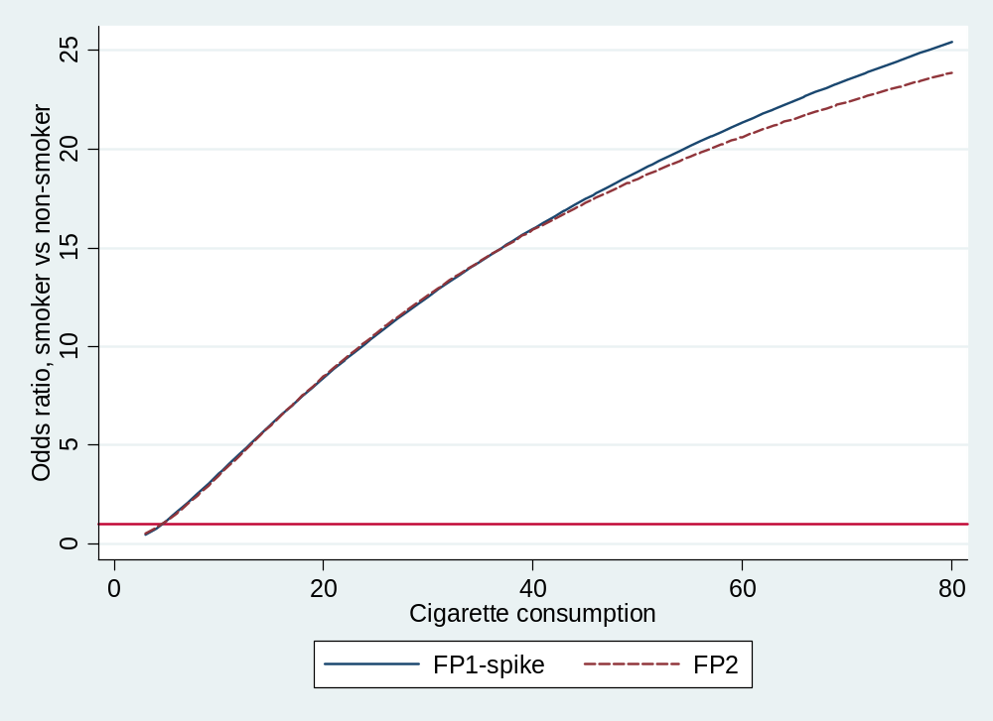
4. Examples
4.1 Cigarette consumption and lung cancer

Slide 16
4. Examples
4.2 Gleason Score and prostate cancer (predictors of PSA level)
Model | Deviance | Dev. diff. | d.f. | P | Power
First stage
Null | 302.1 | 29.8 | 5 | <0.001 | −
Linear + z | 273.7 | 1.4 | 3 | 0.73 | 1
FP1⁺ + z | 272.7 | 0.4 | 2 | 0.84 | −0.5
FP2⁺ + z | 272.3 | − | − | − | 1, 3
Second stage
Linear + z | 273.7 | − | 2 | −
Linear [dropping z] | 282.7 | 9.0 | 1 | 0.003
z [dropping linear] | 276.7 | 2.5 | 1 | 0.1

Slide 17
4. Examples
4.2 Gleason Score and prostate cancer
Result:
The selected model from first stage is Linear + z
Dropping the linear does not worsen the fit
Dropping the binary is highly significant
→ The selected model only comprises the binary variable

Slide 18
4. Examples
4.3 Alcohol consumption and breast cancer
(case-control study, 706 cases, 1381 controls)
Model | Deviance | diff | d.f. | P | Power
First stage
Null | 2670.9 | 35.5 | 5 | 0.000 | -
Linear + z | 2644.1 | 8.7 | 3 | 0.033 | 1
FP1⁺ + z | 2642.5 | 7.1 | 2 | 0.028 | 2
FP2⁺ + z | 2635.4 | - | - | - | -0.5, 0.5
Second stage
FP2⁺ + z | 2635.4 | - | 5 |  | -0.5, 0.5
FP2⁺ [dropping z] | 2661.31 | 24.9 | 1 | 0.000 | -0.5, 0.5
z [dropping FP2] | 2665.17 | 29.8 | 4 | 0.000 | -
Standard FP analysis (as alternative) | 2636.2 |  |  |  | 0, 0.5

Slide 19
4. Examples
4.3 Alcohol consumption and breast cancer
Result:
First step: FP2 is best transformation
Second step: Dropping of FP2 or binary variable worsens fit
  ⇒ FP2⁺ + z is best model
Standard FP (other powers!) has similar fit

Slide 20
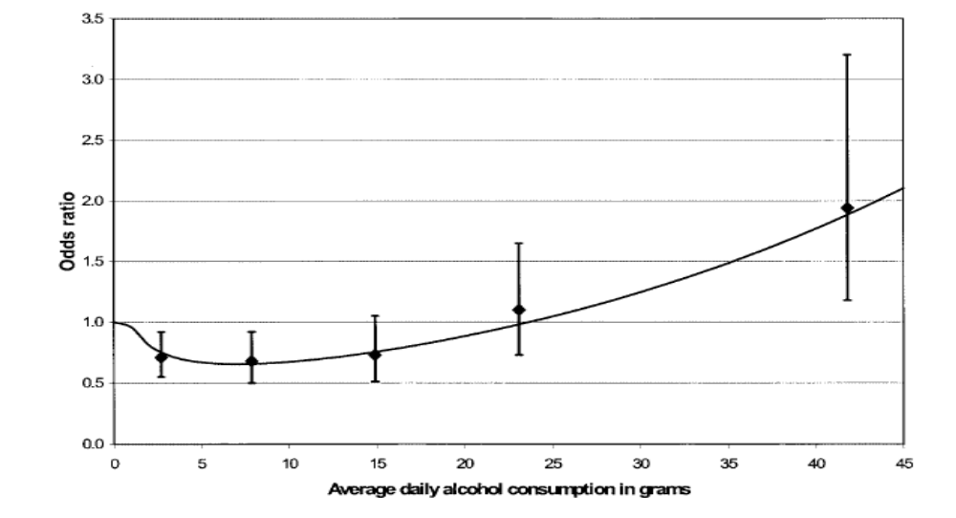
4. Examples
4.3 Alcohol consumption and breast cancer

Slide 21
5. Summary
Procedure to add binary indicator supported by theoretical results
Subject matter knowledge (SMK) is an important criteria to decide whether inclusion of indicator is required
SMK: indicator required – procedure useful to determine dose-response part
SMK: indicator not required – nevertheless, indicator may improve model fit
Suggested 2-step FP procedure with adding binary indicator appears to be a useful in practical applications

Slide 22
References
Becher, H. (2005). General principles of data analysis: continuous covariables in epidemiological studies, in W. Ahrens and I. Pigeot (eds), Handbook of Epidemiology, Springer, Berlin, pp. 595–624.
Robertson, C., Boyle, P., Hsieh, C.-C., Macfarlane, G. J. and Maisonneuve, P. (1994). Some statistical considerations in the analysis of case-control studies when the exposure variables are continuous measurements, Epidemiology 5: 164–170.
Royston P, Sauerbrei W (2008) Multivariable model-building - a pragmatic approach to regression analysis based on fractional polynomials for modelling continuous variables. Wiley.

