Slide 1
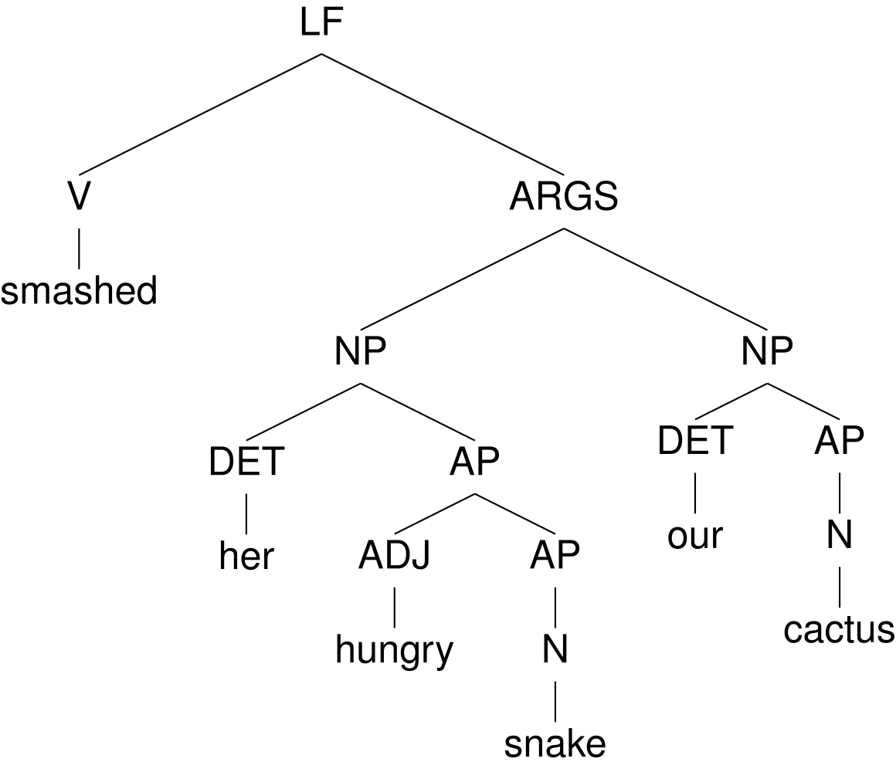
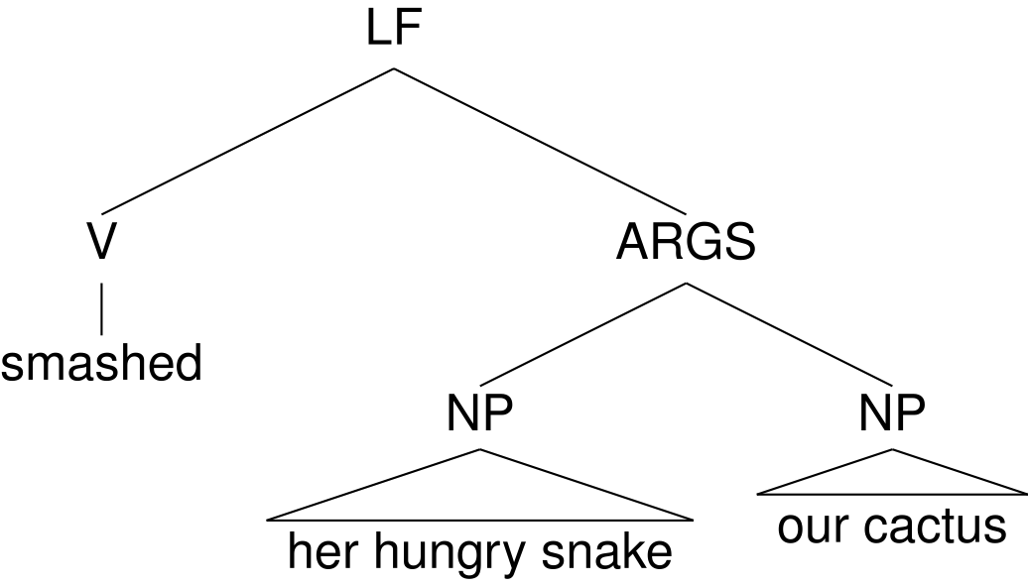
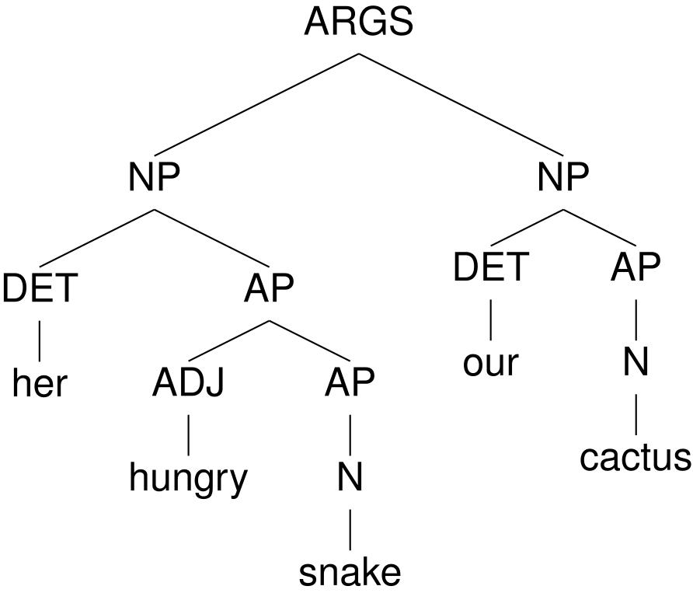
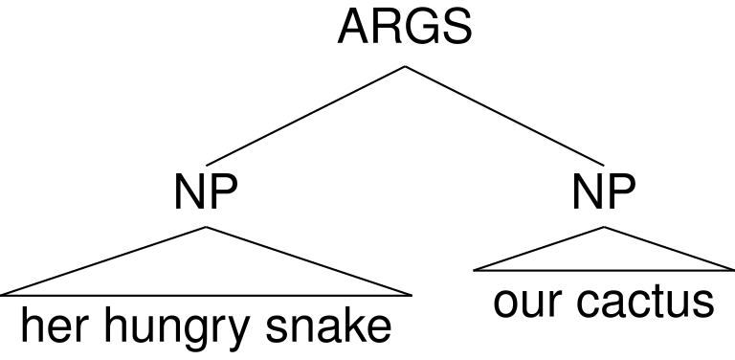
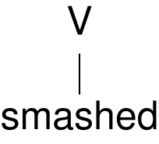


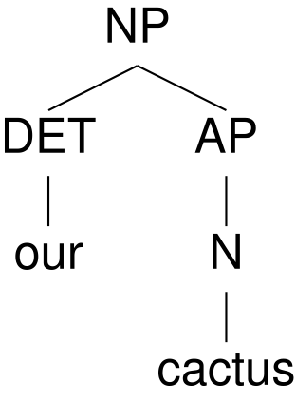
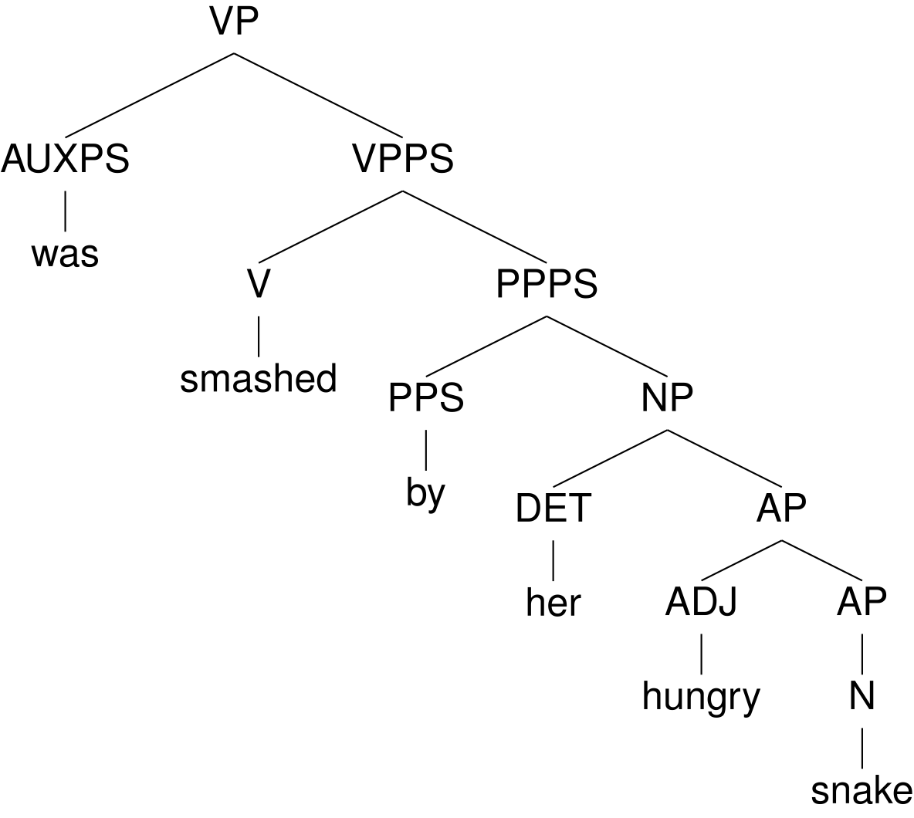
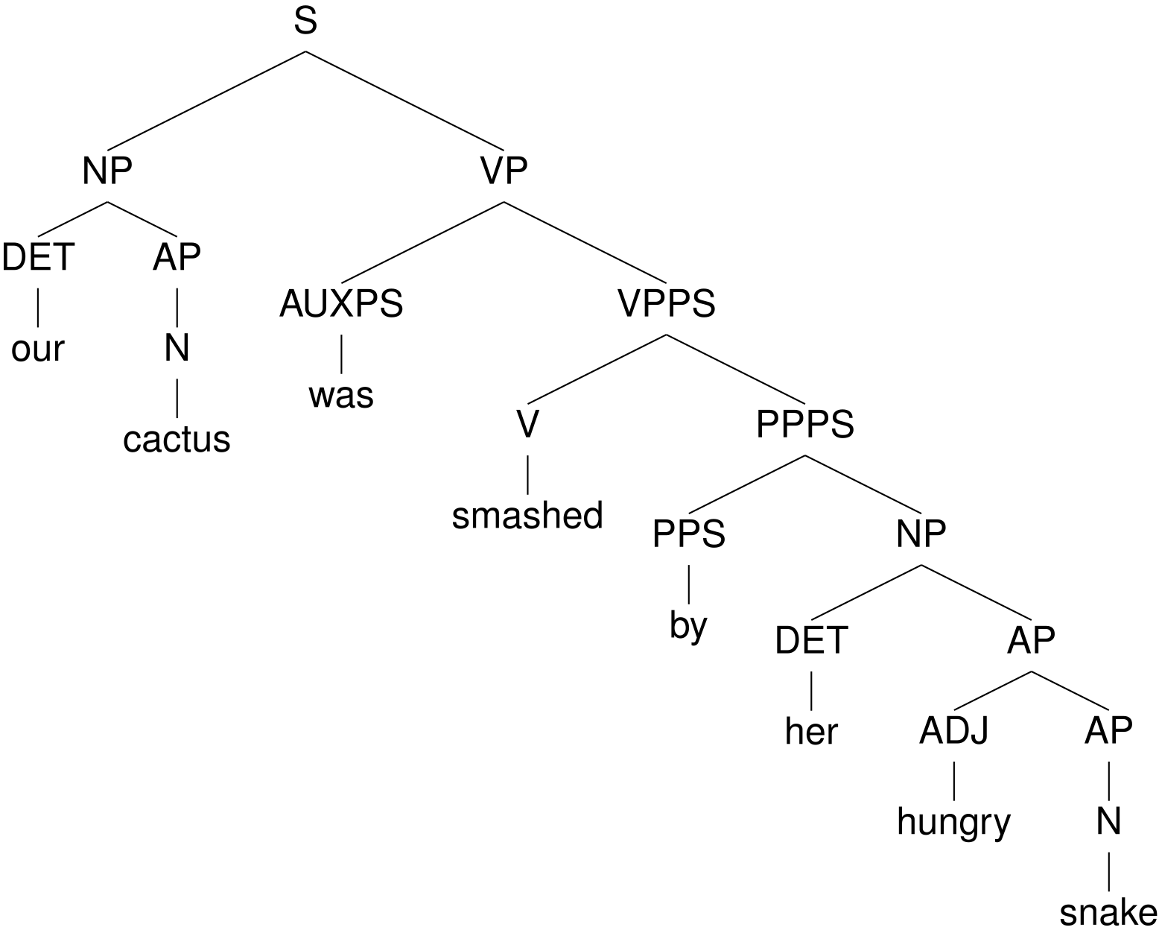
Step 1
cdr
Step 2
car
Step 3
cdr
Step 4
cons
Tree Memory
S
cons
Step 28

Slide 2
Tree Memory
Agent/
Interpreter
Step 0
car
Step 1
cdr
Step 2
cons
Step 3
VP
Step 26
cons
S
Step 27
cons
Output

Slide 3
Tree Memory
Agent/
Interpreter
Step 0
VP
Step 26
cons
car
S
Step 27
cons
Step 1
cdr
Step 2
cons
Step 3
Output

Slide 4
left
argument
R
right
argument
car
cdr
cons
root
symbol

Slide 5
Step 1
cdr
Step 2
car
Step 3
cdr
Step 4
cons
Tree Memory
S
cons
Step 28

Slide 6
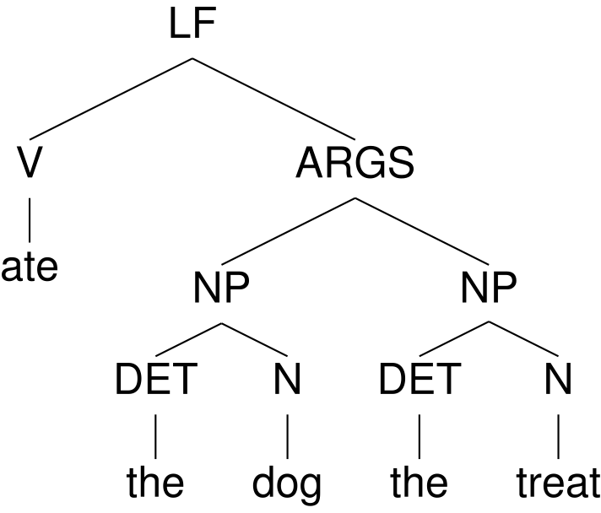
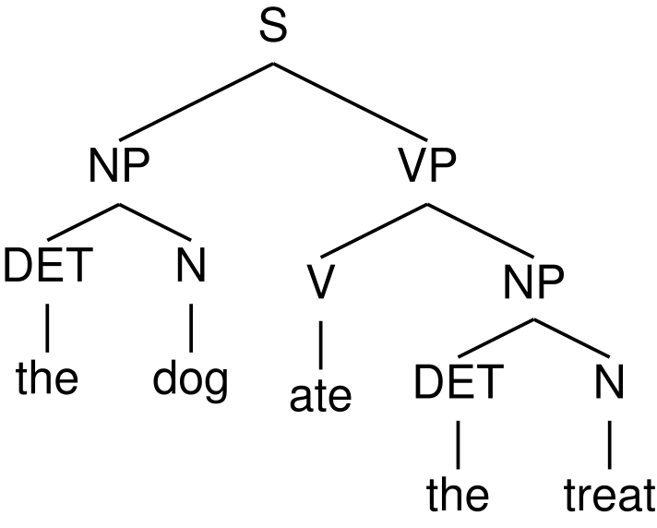
Differentiable Tree Machine (DTM)
Neural
Tree Agent
Differentiable
Tree Interpreter
Tree
Memory

