Slide 1
JDBC

Slide 2
Table of Contents
Introduction on JDBC
Basics steps to be followed in any JDBC program
Difference between Statement and PreparedStatement
Transactions
Metadata
BLOB (Binary Large Objects) and CLOB (Character Large Objects)
Summary and Further Study.
Notes:
Omkar

Slide 3
Introduction
JDBC (Java DataBase Connection) is standard API which acts like an interface between java and database
JDBC
Database
JAVA
MySQL
MS SQL
Oracle
Postgres
Notes:
Omkar

Slide 4
Steps to Implement JDBC :
Import the Package (import java.sql.*).
Load and Register the driver for the database you want to work with. (automatically handled in JDBC version > 4.0)
Establish the connection.
Create the statement (sql query).
Execute the statement.
Process the ResultSet (incase of DQL).
Close the connection.
Notes:
Omkar

Slide 5
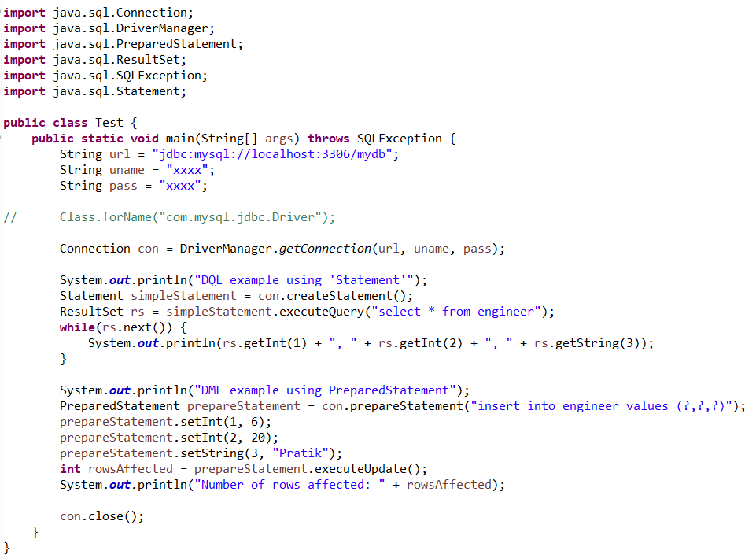
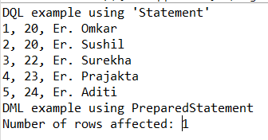
Sample JDBC program
OUTPUT
Notes:
Omkar

Slide 6
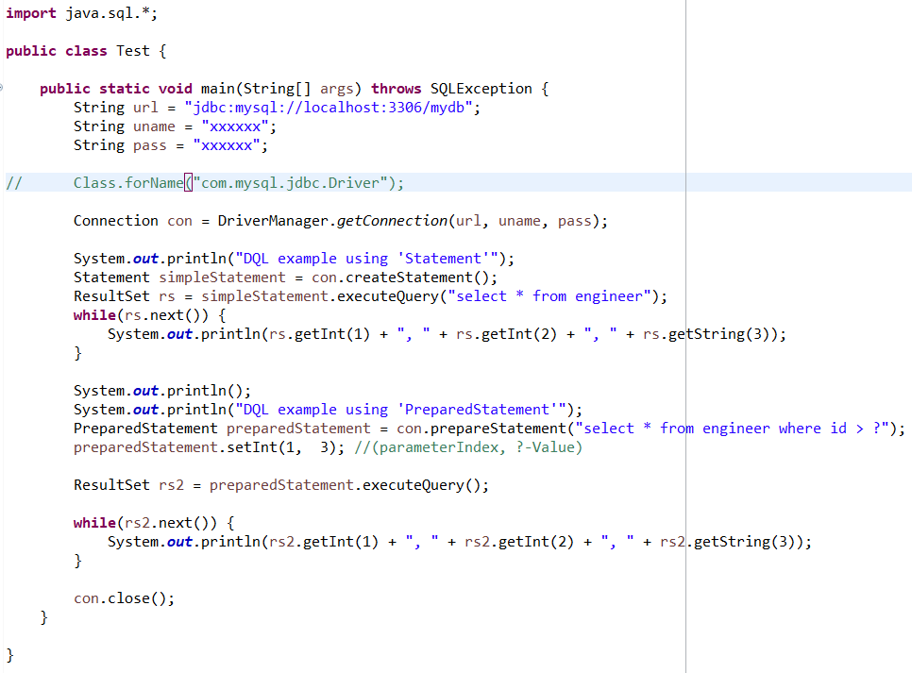
Step 1 and Step 2
Notes:
Omkar

Slide 7

Step 3
Basic Syntax of JDBC URL
jdbc:<driver_protocol>:<driver_connection_details>
Example:
MS SQL Server → jdbc:odbc:DemoDSN
Oracle Server → jdbc:oracle:thin@myServer:1521:database
MySQL Server → jdbc:mysql://localhost:3306/database
Exception thrown by DriverManager.getConnection() method is ‘SQLException’
Notes:
Omkar

Slide 8
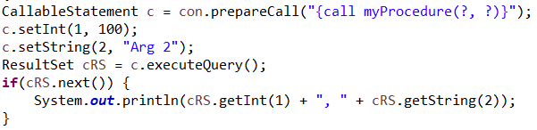
Step 4
Types of statements
Query
Procedure Call
Statement
con.createStatement()
PreparedStatement
con.prepareStatement(“query”)
CallableStatement
con.prepareCall(“query”)
Notes:
Pratik

Slide 9
Step 5
Query Type
DQL
DML
stmt.executeQuery()
-> returns ResultSet
stmt.execute()
-> returns boolean
stmt.executeUpdate()
-> returns int
While Using Statement Object pass query in execute Methods
Eg: Statement st = con.createStatement()
st.execute_____(“query here”);
While Using PreparedStatement or CallableStatement Object pass query in statement creation step
Eg: PreparedStatement st = con.prepareStatement(“query here”)
st.execute_____();
Notes:
Pratik

Slide 10

Step 6
ID (1) | Name (2) | Age (3)
1001 | Omkar | 22
1002 | Pratik | 23
ResultSet rs = stmt.executeQuery();
int rowsAffected = stmt.executeUpdate();
boolean queryExecuted = stmt.execute();
Gives the number of rows affected.
Returns true if first result is a ResultSet object else returns false. Further we can get ResultSet or number of rows affected by calling stmt.getResultSet() and stmt.getUpdateCount() methods respectively.
Notes:
Pratik

Slide 11
Step 7
Notes:
Pratik

Slide 12
Statement | Prepared Statement
Slow | Fast
BLOB and CLOB is not supported | BLOB and CLOB is supported
Does not accept run time parameters | It accepts run time parameters
Vulnerable to SQL Injection attack | Prevents SQL Injection attack
Notes:
Pratik

Slide 13
Transactions
By default, auto Commit is set to true in Connection object
Methods used in case of transactions on Connection object
con.setAutoCommit(false)
con.commit()
con.rollback()
Notes:
Omkar overview and me code

Slide 14
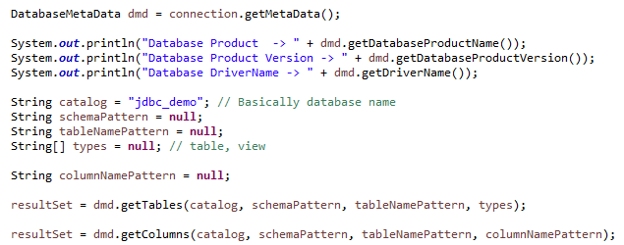
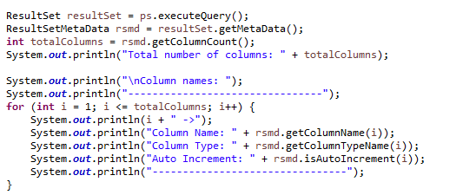
Metadata
Database Metadata
ResultSet Metadata
Notes:
Pratik

Slide 15
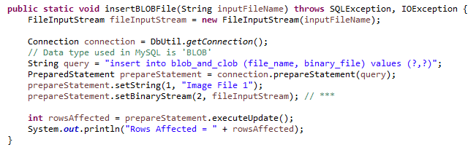
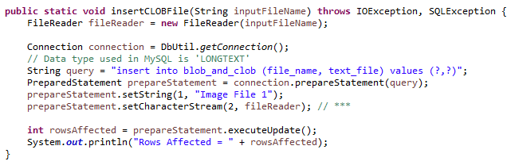
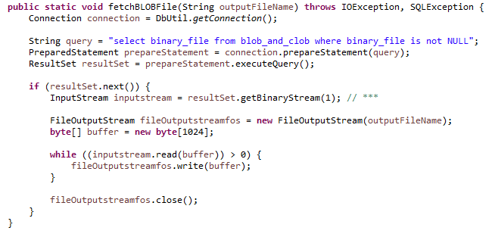
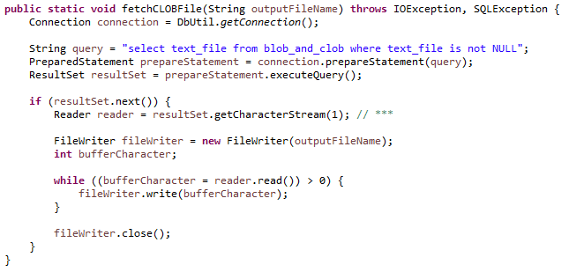
BLOB and CLOB
Notes:
Pratik

Slide 16
Packages and Classes
Java.sql Package
DriverManger
Connection
Statement
PreparedStatement
ResultSet
Callable
CallableStatement
Javax.sql Package
DataSource (for connection pooling)
Click Here for more details.
Notes:
Omkar

