Slide 1
Data Mining Presentation
Name – Shrey Patel
UCID – spp92
Email – spp92@njit.edu

Slide 2
GraphLIME: Local Interpretable Model Explanations for Graph Neural Networks
Authors: Qiang Huang, Makoto Yamada, Yuan Tian, Dinesh Singh, Yi Chang
Affiliations: Jilin University, Kyoto University, RIKEN AIP

Slide 3
Contents
Abstract
What this paper is about?
Deep Neural Networks
Graph Stuctured Data
Graph Neural Networks
Introduction to GraphLIME
Related works
Proposed method: Procedures and Algorithm
Experiments
Code
Results and evaluation
Conclusion and future direction
Screenshots of complete code

Slide 4
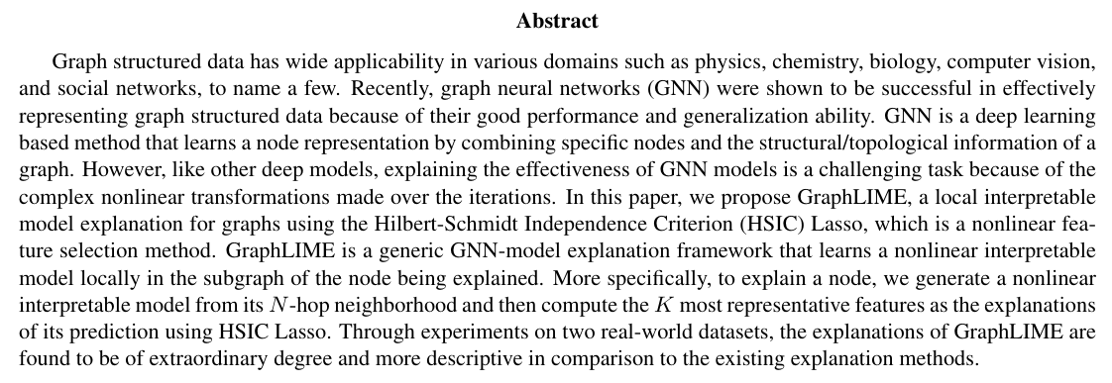

Slide 5
What this paper is about?
This paper introduces a model agnostic explanation framework named GraphLIME which is specifically designed for Graph Neural Networks (GNNs)
Impact:
Sets a foundation for interpretable machine learning in graph-based domains.
Demonstrated effectiveness on real-world datasets (Cora and Pubmed) using popular GNN models (GraphSAGE, GAT).
Provides practical tools for trust evaluation and classifier comparison, advancing the usability of GNNs in critical applications like social networks, biology, and recommendation systems.

Slide 6
Deep Neural Networks (DNNs) Overview
What are DNNs?
Definition: A machine learning model based on a discriminant approach.
Capabilities:
Solves complex, nonlinear problems.
Learns abstract features from data.
Can effectively process and analyze data with numerous dimensions and variables.
Can be continuously trained and improved with additional data.

Slide 7
Deep Neural Networks (DNNs) Overview (2)
Applications:
Image recognition
Automatic speech recognition
Disease diagnosis
Natural language processing
Autonomous vehicles
Financial services

Slide 8
Strengths of DNNs
Powerful Representation:
High degree of nonlinearity enables modeling complex relationships.
Versatility:
Applicable across diverse domains.
Example: Improves prediction/classification performance through feature abstraction.

Slide 9
Challenges with DNNs
The Black-Box Problem:
Lack of Interpretability:
Predictions and underlying processes are difficult to explain.
Trust Issues:
Example: High-accuracy medical systems may not be adopted if they lack understandable explanations.
Need for Interpretability:
Helps users understand:
What the model learns.
Why it makes specific decisions.
Data Hunger:
They need massive amounts of high-quality data to train effectively.
Diversity of the data can impact the model’s performance

Slide 10
Research Routes for DNN Interpretability
Local Approximation Models:
Approximate DNN behavior using interpretable models (e.g., linear regression).
Focus on Relevant Components:
Identify most representative features or influential input instances.
Methods: Feature selection and data influence analysis.

Slide 11
Graph-Structured Data
What is Graph-Structured Data?
Graph-structured data is a data format that represents entities and their relationships.
Non-Euclidean data lacking regular spatial structures
It consists of:
Nodes (Vertices): Entities or objects.
Edges: Connections between nodes, representing relationships.

Slide 12
Graph-Structured Data (2)
Examples:
Social networks
Citation networks
Protein/molecular structures
Recommendation systems
Financial patterns

Slide 13
Graph-Structured Data (3)
Key Challenge:
Combining node feature information and graph structure information effectively for analysis.
Efficiently processing and analyzing graphs with millions or billions of nodes and edges.
Adapting to changes in graph structure and node attributes over time.

Slide 14
Graph Neural Networks (GNNs)
Why GNNs for Graph Data?
Incorporates:
Feature Information: Attributes of nodes.
Structure Information: Relationships and edges in the graph.
Operates in non-Euclidean domains.
They learn meaningful representations for nodes based on their local and global context.
GNNs have achieved state-of-the-art results on various graph-based tasks.

Slide 15
Graph Neural Networks (GNNs) (2)
Limitation of GNNs:
Interpretability Issue:
Reduces transparency and trust in the model.
GNNs operate in non-Euclidean domains, so it makes explanations difficult.
Predictions are influenced by both node features and graph topology.
Existing interpretation methods for DNNs fail to consider graph structure.

Slide 16
Existing Interpretation Methods
GNNExplainer:
Identifies subgraphs and node features for explanations.
Identifies important nodes and edges contributing to a specific prediction.
Provides a clear visualization of the decision-making process.
Focuses more on graph structures; lacks emphasis on useful features.

Slide 17
Existing Interpretation Methods
LIME:
Employs linear explanation models.
Highlights the most influential features (nodes and edges) for a given prediction.
Challenges with GNNs:
Ignores graph structure information.
Struggles with highly nonlinear relationships in GNN predictions.

Slide 18
Limitations of LIME for GNNs
Linear Explanation Models:
Poor performance with highly nonlinear GNN models.
Fail to incorporate critical graph structure information.
Need for Improvement:
A method that:
Captures nonlinear dependencies.
Integrates both graph structure and feature information.

Slide 19
Introducing GraphLIME
What is GraphLIME?
A powerful technique for understanding the decision-making process of Graph Neural Networks (GNNs).
A nonlinear, model-agnostic interpretation framework for GNNs.
Provides locally faithful explanations for graph-based predictions.

Slide 20
Introducing GraphLIME (2)
Core Features:
Samples N-hop neighbors of the explained node.
Uses HSIC Lasso to identify nonlinear dependencies between features and predictions.
Finds the most representative features as explanations.
We will see this in detail, in further slides.

Slide 21
GraphLIME: Key Characteristics
Comparison to LIME:
GraphLIME is a nonlinear graph-variant of LIME.
Unlike LIME:
Considers perturbations near the node in the graph.
Employs a nonlinear explanation model for faithful explanations.
Performance Advantage:
Outperforms linear methods in producing accurate and descriptive explanations.

Slide 22
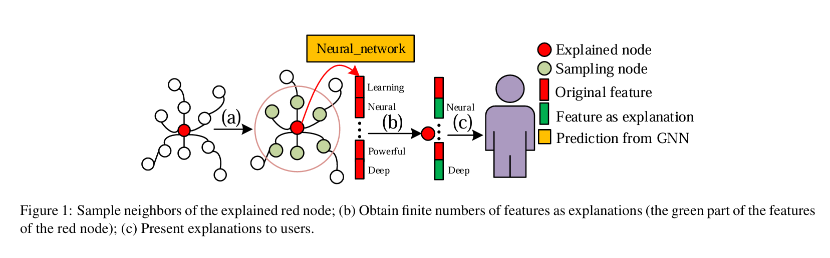

Slide 23
GraphLIME Explanation Process
Procedure:
Node Sampling:
Collect N-hop neighbors of the red node (node to be explained).
Feature Extraction:
Identify key features from the neighborhood (green features in Figure 1).
Feature-Explanation Mapping:
Use HSIC Lasso to generate explanations linking features to predictions.

Slide 24
Benefits of GraphLIME
Faithful Local Explanations:
Captures complex, nonlinear feature-prediction relationships.
Model-Agnostic:
Can be applied to any GNN-based model.
Enhanced Transparency:
Improves trust and usability of GNNs in real-world applications.

Slide 25
Experimental Validation
Datasets Used:
Two real-world datasets.
Results:
GraphLIME provides explanations of an extraordinary degree:
More descriptive and interpretable than existing methods.

Slide 26
Contributions Before This Paper (Related works)
Graph Neural Networks:
GraphSAGE : Local neighborhood aggregation.
GAT : Attention mechanisms for node weighting.
GaAN : Gated attention control for feature fusion.
Interpretability Methods:
LIME : Linear explanations for classifiers.
DeepLIFT : Feature attribution for neural networks.
GNNExplainer : Subgraph extraction for GNN interpretation.
Saliency Maps : Highlighting important features.

Slide 27
Related works (2)
Key Advancements:
GraphSAGE :
Inductive framework for node embedding using local neighborhood aggregation.
Graph Attention Network (GAT) :
Employs attention mechanisms to assign weights to important nodes.
Dual Graph Convolutional Network :
Semi-supervised learning with minimal labeled data, focusing on local and global consistency.

Slide 28
Related works (3)
Approaches to Interpretability:
Surrogate Models:
Approximate the main model using simpler interpretable models.
Examples:
LIME : Linear explanations near the prediction.
BETA : Balances fidelity and interpretability.
Feature Attribution:
Identifies important features or input components for predictions.
Examples:
DeepLIFT : Assigns scores based on reference activation.
Saliency Maps : Highlights critical input features.

Slide 29
Related works (4)
Then why GraphLIME?
Utilizes predicted labels from the node and its neighbors.
Captures local nonlinear dependencies.
Provides a finite number of features as intuitive explanations.

Slide 30
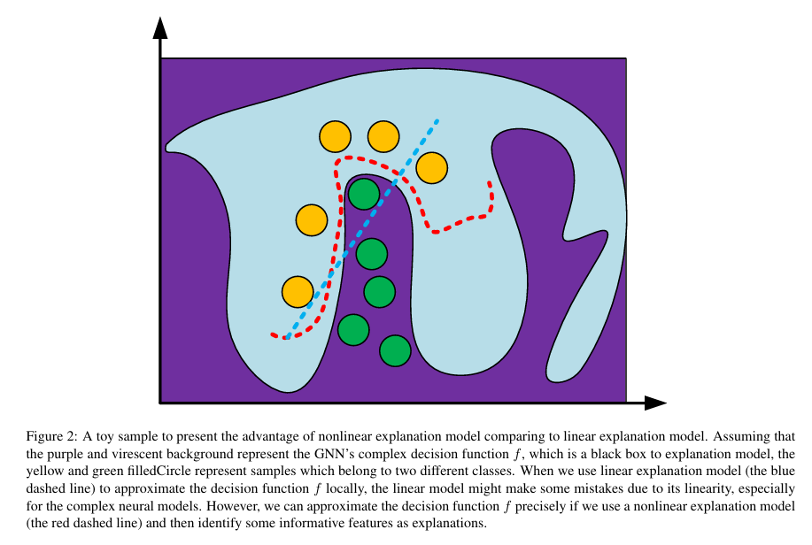

Slide 31
Nonlinear vs Linear Explanation Models
Linear Models (Blue Line):
Struggle to approximate complex decision boundaries in GNNs.
Nonlinear Models (Red Line):
Accurately approximate decision functions.
Identify more informative features for explanations.
(refer to above figure)

Slide 32
Takeaway from Related Work
GNNs Have Powerful Representation Capabilities:
Recent developments enable learning from complex graph data.
Interpretability Remains a Key Challenge:
Existing methods (LIME, saliency maps, etc.) are inadequate for GNNs.
GraphLIME’s Novelty:
Nonlinear explanation framework that captures both feature dependencies and graph structure.

Slide 33
Proposed Method
Before getting deeper into proposed method of GraphLIME, let us get an overview again.
GraphLIME: Local Interpretable Model Explanation for GNNs.
Objective:
Provide nonlinear, locally faithful explanations for GNN predictions.
Identify representative features in the subgraph of the node being explained.
Key Advantage: Model-agnostic framework that works with any GNN.

Slide 34
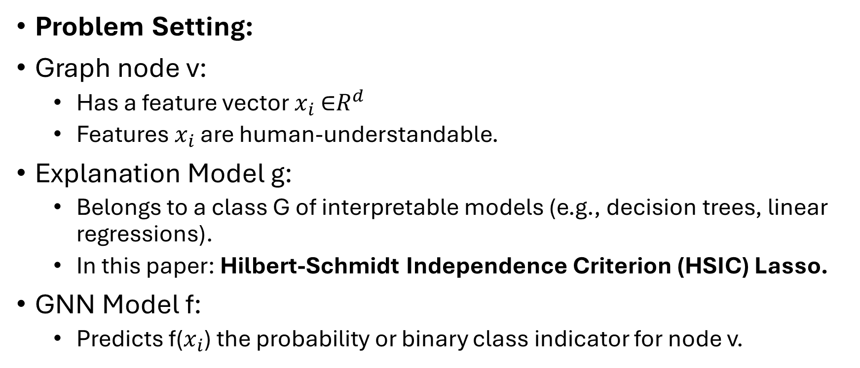
GraphLIME Formulation
Problem Setting:
Graph node v:
Has a feature vector $x_{i}$∈$R^{d}$
Features $x_{i}$​ are human-understandable.
Explanation Model g:
Belongs to a class G of interpretable models (e.g., decision trees, linear regressions).
In this paper: Hilbert-Schmidt Independence Criterion (HSIC) Lasso.
GNN Model f:
Predicts f($x_{i}$) the probability or binary class indicator for node v.

Slide 35
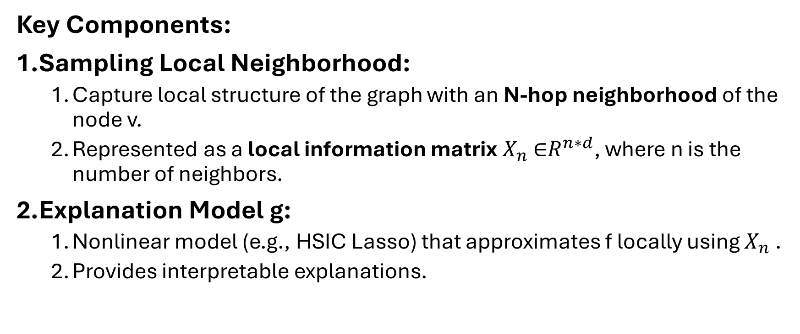
GraphLIME Explanation Process
Key Components:
Sampling Local Neighborhood:
Capture local structure of the graph with an N-hop neighborhood of the node v.
Represented as a local information matrix $X_{n}$∈$R^{n∗d}$, where n is the number of neighbors.
Explanation Model g:
Nonlinear model (e.g., HSIC Lasso) that approximates f locally using $X_{n}$.
Provides interpretable explanations.

Slide 36
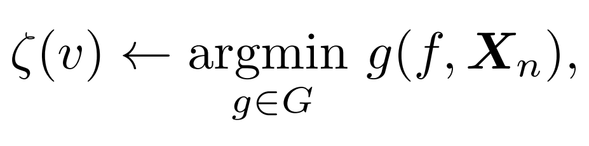
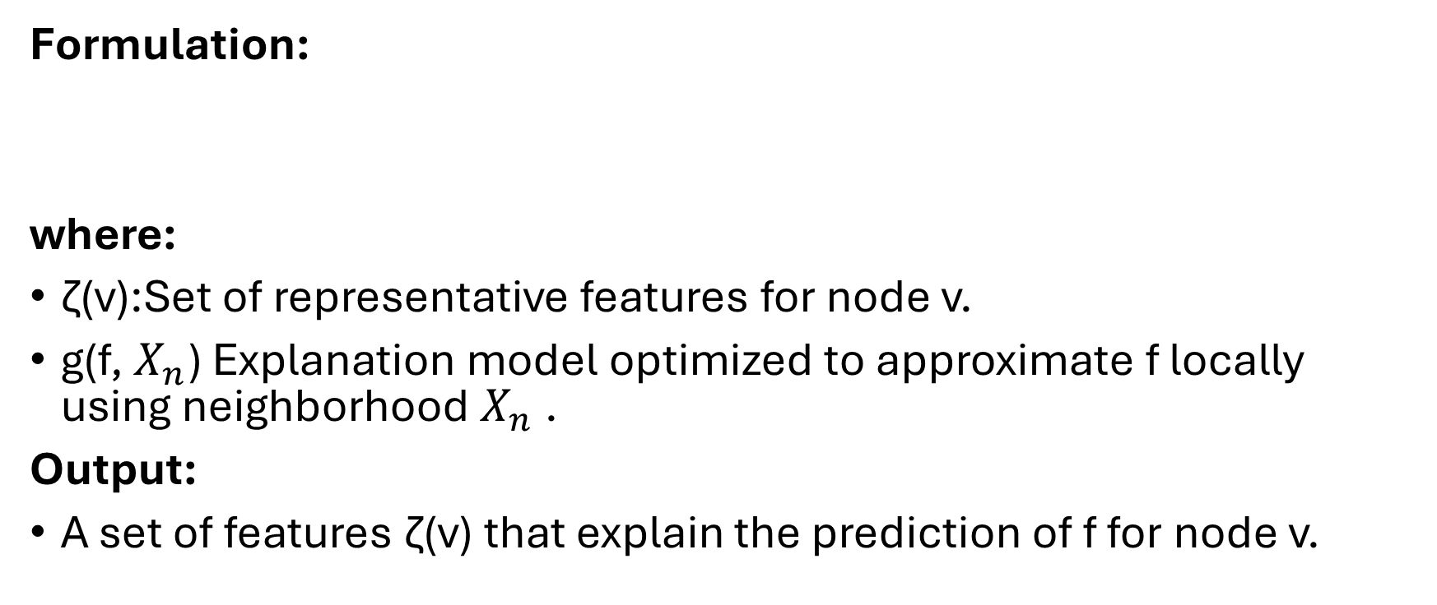
GraphLIME Optimization Objective
Formulation:
where:
ζ(v):Set of representative features for node v.
g(f, $X_{n}$) Explanation model optimized to approximate f locally using neighborhood $X_{n}$​.
Output:
A set of features ζ(v) that explain the prediction of f for node v.

Slide 37
Nonlinear Explanation Models
Why Nonlinear Models?
GNNs have nonlinear decision boundaries.
Linear models may fail to approximate these boundaries faithfully.
HSIC Lasso:
Kernel-based feature selection algorithm.
Captures nonlinear dependencies between features and outputs.

Slide 38
Neighborhood Sampling
Why N-Hop Neighborhoods?
GNN predictions depend on the local graph structure.
Sampling N-hop neighbors ensures explanations are:
Localized: Focus on immediate context of the node.
Faithful: Capture structural and feature dependencies.
Subgraph Formation:
Sampled neighbors form a subgraph around v.
This subgraph is used as input for the explanation model g.

Slide 39
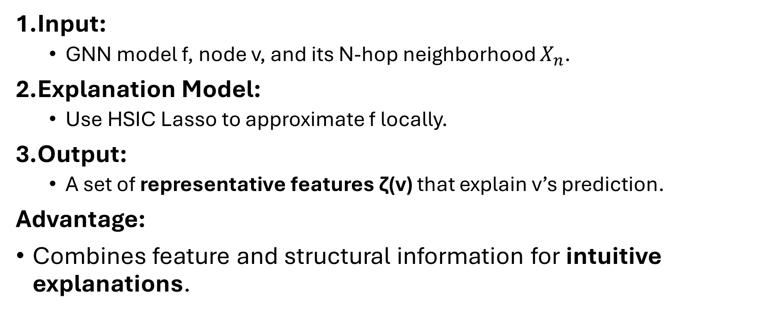
GraphLIME Framework Recap
Input:
GNN model f, node v, and its N-hop neighborhood $X_{n}$.
Explanation Model:
Use HSIC Lasso to approximate f locally.
Output:
A set of representative features ζ(v) that explain v’s prediction.
Advantage:
Combines feature and structural information for intuitive explanations.

Slide 40
Sampling for Local Exploration
Why Consider Neighbors in Graphs?
GNNs predict a node’s label based on:
The node’s own features.
Correlations with the features of neighboring nodes.
Key Idea:
Local explanations must capture the information aggregation between a node and its neighbors.

Slide 41
N-hop Network Neighbors
What is an N-hop Network?
Definition:
A subgraph containing a node v and all nodes within N hops from v.
Includes all edges connecting these nodes.
Why N-hop Sampling?
Captures local behavior of the GNN model.
Ensures explanations reflect both feature and structure correlations.

Slide 42
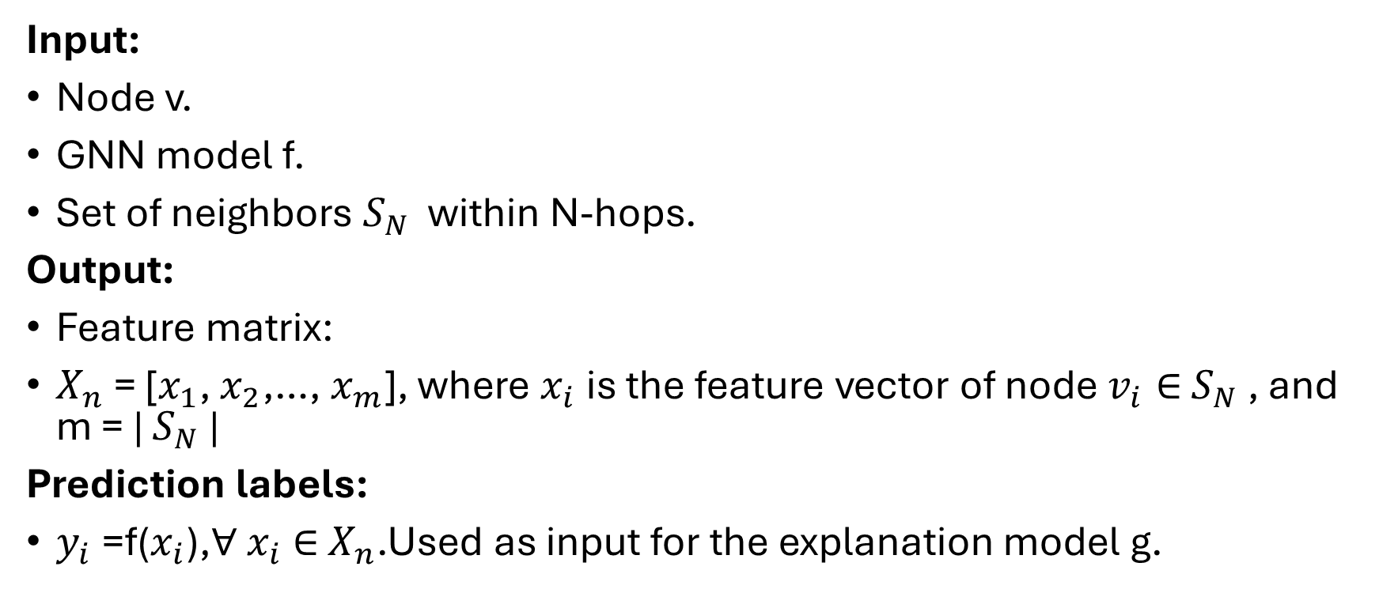
N-hop Sampling Notation
Input:
Node v.
GNN model f.
Set of neighbors $S_{N}$​ within N-hops.
Output:
Feature matrix:
$X_{n}$= [$x_{1}$, $x_{2}$,…, $x_{m}$], where $x_{i}$is the feature vector of node $v_{i}∈$ $S_{N}$, and m = | $S_{N}$|
Prediction labels:
$y_{i}$=f($x_{i}$),∀ $x_{i}$∈ $X_{n}$.Used as input for the explanation model g.

Slide 43
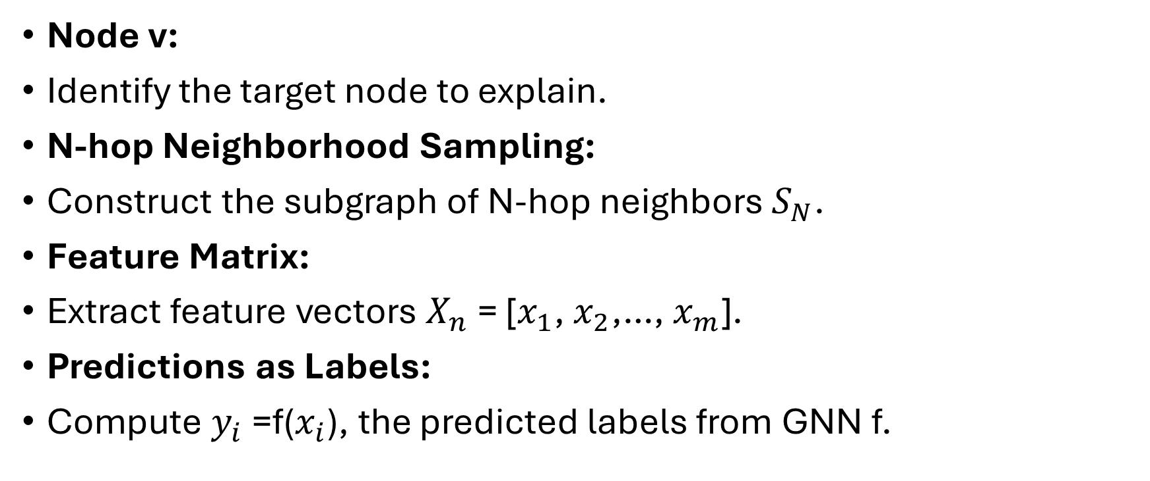
GraphLIME Sampling Process
Node v:
Identify the target node to explain.
N-hop Neighborhood Sampling:
Construct the subgraph of N-hop neighbors $S_{N}$​.
Feature Matrix:
Extract feature vectors $X_{n}$= [$x_{1}$, $x_{2}$,…, $x_{m}$].
Predictions as Labels:
Compute $y_{i}$=f($x_{i}$), the predicted labels from GNN f.

Slide 44
Advantages of N-hop Sampling
Localized Explanations:
Focuses on the immediate context of the node.
Faithful Representation:
Includes both:
Node feature dependencies.
Structural correlations in the graph.
Scalability:
Flexible choice of N ensures adaptability to large and small graphs.

Slide 45
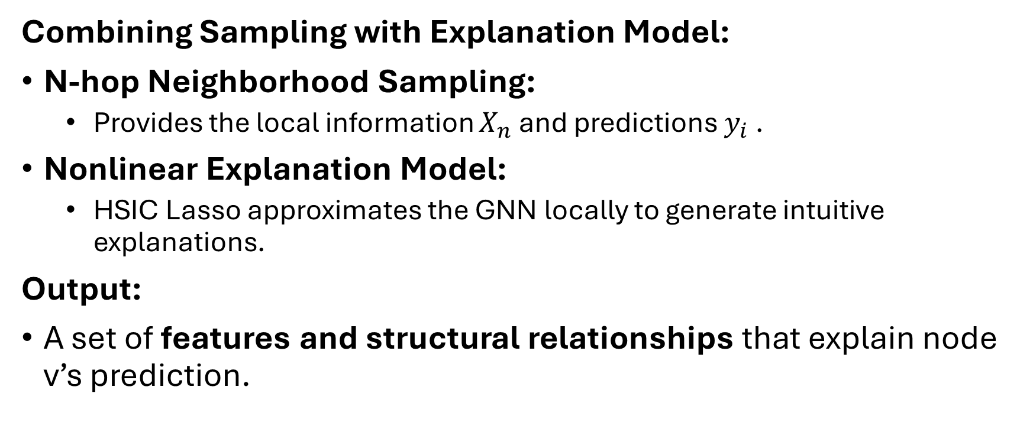
GraphLIME Framework Recap
Combining Sampling with Explanation Model:
N-hop Neighborhood Sampling:
Provides the local information $X_{n}$and predictions $y_{i}$​.
Nonlinear Explanation Model:
HSIC Lasso approximates the GNN locally to generate intuitive explanations.
Output:
A set of features and structural relationships that explain node v’s prediction.

Slide 46
Nonlinear Explanation Model: HSIC Lasso
What is HSIC Lasso?
A supervised nonlinear feature selection method.
Captures nonlinear dependencies between features and predictions.
Used as the explanation model in GraphLIME.
Why HSIC Lasso?
Selects the most representative features from the N-hop neighborhood.
Provides sparse, interpretable explanations.

Slide 47
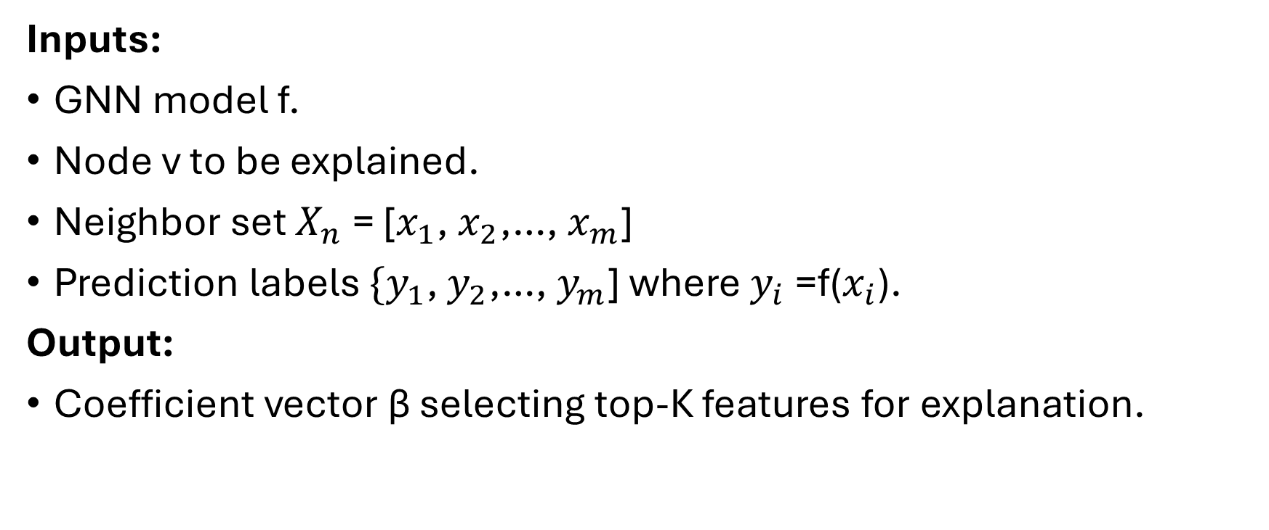
HSIC Lasso Input and Output
Inputs:
GNN model f.
Node v to be explained.
Neighbor set $X_{n}$= [$x_{1}$, $x_{2}$,…, $x_{m}$]
Prediction labels $\{y_{1}$, $y_{2}$,…, $y_{m}$] where $y_{i}$=f($x_{i}$).
Output:
Coefficient vector β selecting top-K features for explanation.

Slide 48
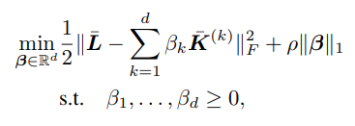
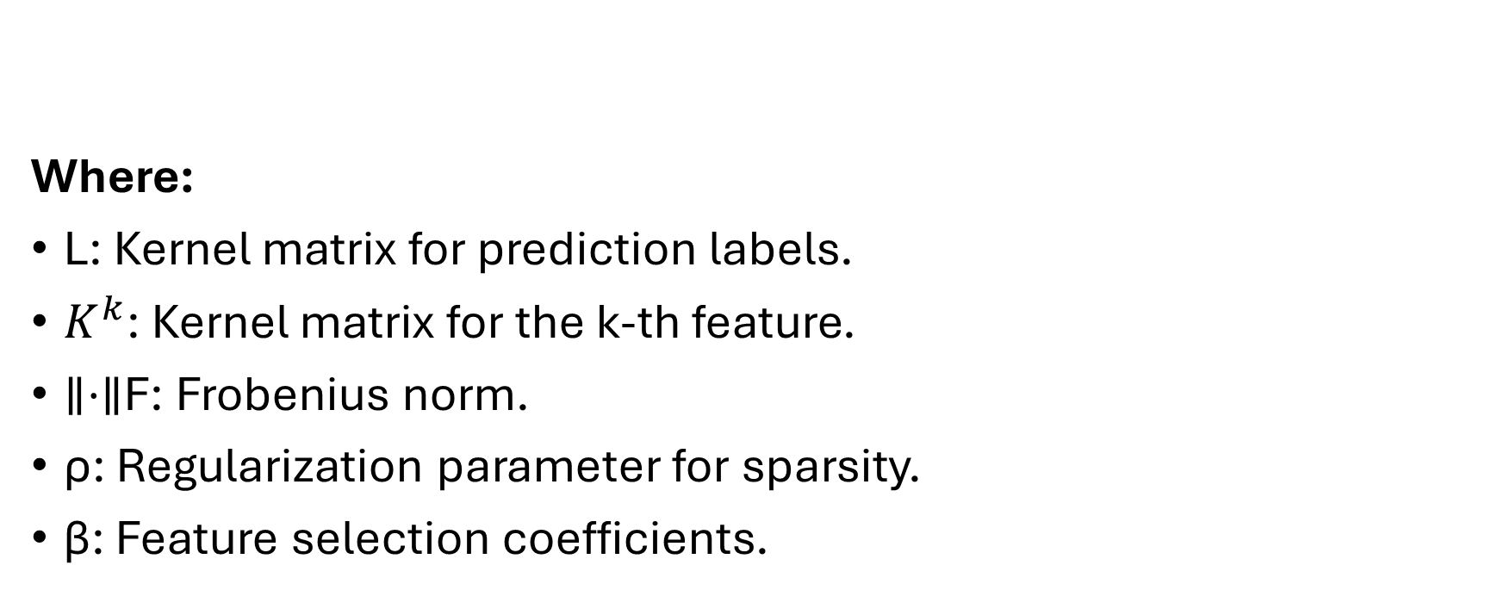
HSIC Lasso Optimization Objective
Where:
L: Kernel matrix for prediction labels.
$K^{k}$: Kernel matrix for the k-th feature.
∥⋅∥F​: Frobenius norm.
ρ: Regularization parameter for sparsity.
β: Feature selection coefficients.

Slide 49
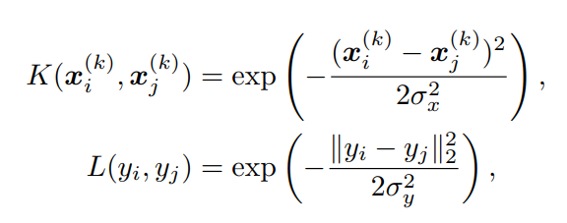
Kernel Definitions
Parameters:
σx, σy​: Gaussian kernel widths.
Gaussian kernels ensure smooth, nonlinear mapping.

Slide 50
Incorporating Graph Information
For Graphs:
Include adjacency matrix A with self-loops: K∘A and L∘A
∘: Elementwise product.
Why?
Embeds structural information directly into the kernel matrices.
Improves fidelity of explanations for graph data.

Slide 51
Optimization Process
Algorithm:
Use nonnegative least angle regression (LARS) to optimize the objective.
Solve for the sparse coefficient vector β:
Enforces sparsity with ℓ1​-norm.
Select top-K features with the largest coefficients in β.
Output:
Top-K features explaining the prediction of node v.

Slide 52
Advantages of HSIC Lasso
Nonlinear Feature Selection:
Captures complex dependencies between features and predictions.
Sparse Explanations:
Identifies only the most important features.
Graph Compatibility:
Integrates graph structure with adjacency matrix A.
Interpretable Results:
Provides human-understandable explanations.

Slide 53
Interpretation of HSIC Lasso
Core Concepts:
HSIC Lasso combines principles of:
Minimum Redundancy Maximum Relevance (mRMR):
Selects features with high dependency on outputs while reducing redundancy.
Hilbert-Schmidt Independence Criterion (HSIC):
Measures independence between two random variables.
Larger HSIC value → Stronger dependency.

Slide 54
Interpretation of HSIC Lasso (2)
Why It Works:
Selects features with maximum relevance to predictions (NHSIC(fk,y))
Eliminates redundant features by minimizing dependency between selected features (NHSIC(fk​,fm​)).

Slide 55
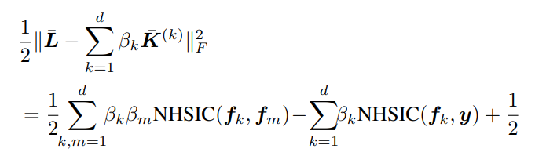
Key Equation for HSIC Lasso
Rewriting the HSIC Lasso objective (simplified):
Interpretation:
NHSIC(fk,y):
Measures dependency of feature fk and fm on the output y.
Larger NHSIC(fk,y) → Feature is more relevant.
NHSIC(fk,fm):
Measures redundancy between features fk​ and fm​.
Larger NHSIC(fk​,fm​) → Features are redundant

Slide 56
Feature Selection by HSIC Lasso
How HSIC Lasso Works:
Relevant features (NHSIC(fk,y)):
Large βk values for features strongly dependent on y.
Redundant features (NHSIC(fk,fm)):
Ensures βk​ or βm is minimized when fk and fm​ are redundant.
Outcome:
Selects the most relevant and non-redundant features.

Slide 57
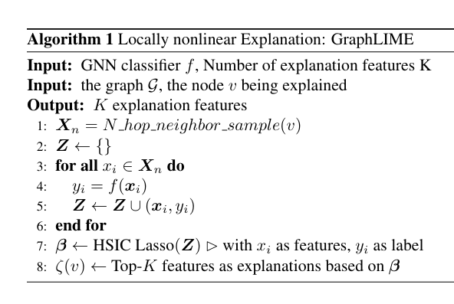

Slide 58
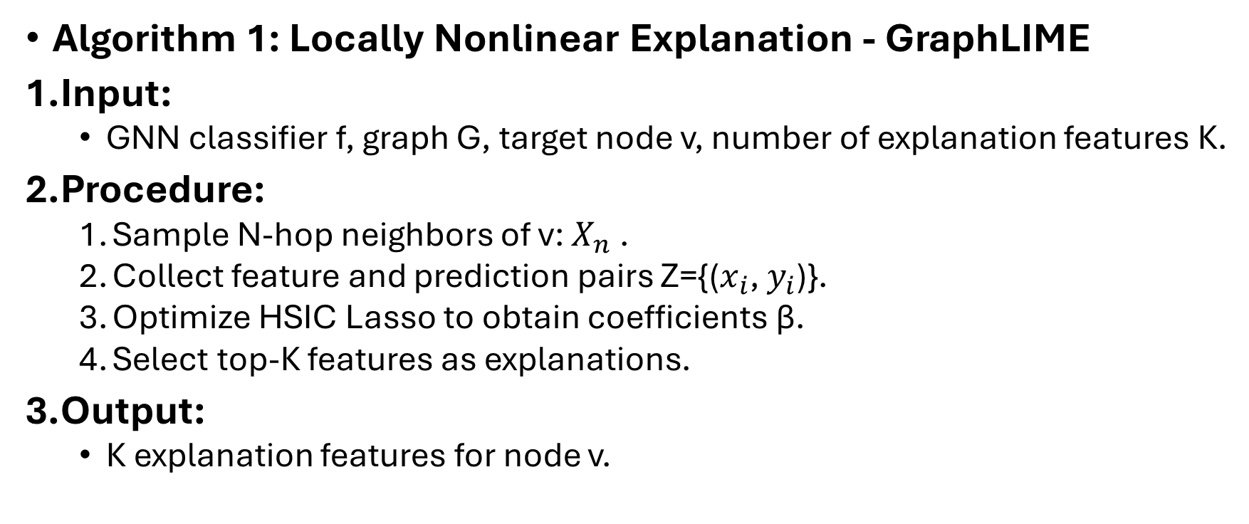
GraphLIME Algorithm
Algorithm 1: Locally Nonlinear Explanation - GraphLIME
Input:
GNN classifier f, graph G, target node v, number of explanation features K.
Procedure:
Sample N-hop neighbors of v: $X_{n}$​.
Collect feature and prediction pairs Z={($x_{i}$, $y_{i}$)}.
Optimize HSIC Lasso to obtain coefficients β.
Select top-K features as explanations.
Output:
K explanation features for node v.

Slide 59
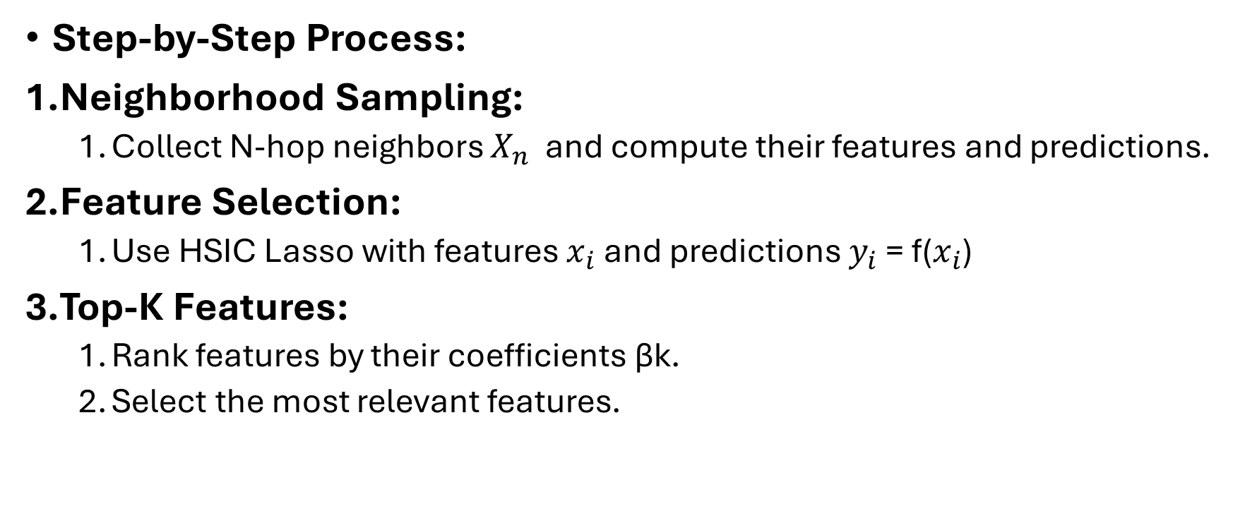
GraphLIME Procedure in Detail
Step-by-Step Process:
Neighborhood Sampling:
Collect N-hop neighbors $X_{n}$​ and compute their features and predictions.
Feature Selection:
Use HSIC Lasso with features $x_{i}$and predictions $y_{i}$ = f($x_{i}$)
Top-K Features:
Rank features by their coefficients βk​.
Select the most relevant features.

Slide 60
GraphLIME Dataset Statistics
Datasets Used in Experiments:
Why These Datasets?
Cora: Citation network with rich node attributes.
Pubmed: Large-scale medical publication dataset.
Dataset | Classes | Nodes | Features | Links
Cora | 7 | 2708 | 1433 | 5429
Pubmed | 3 | 19717 | 500 | 44338

Slide 61
Advantages of GraphLIME
Nonlinear Interpretability:
Captures complex relationships between features and predictions.
Local Faithfulness:
Explanations reflect the N-hop neighborhood of the target node.
Feature Relevance and Redundancy:
Ensures only the most informative features are selected.
Scalability:
Works effectively on large-scale graph datasets like Pubmed.

Slide 62
Experiments Overview
Objective:
Investigate the performance of GraphLIME and compare it to existing explanation methods for GNNs.
Key Questions Addressed:
Does the explainer select real informative features from noisy graph data?
Do the explanations increase user trust in predictions?
Do the explanations improve classifier selection?
Experimental Setup:
Datasets: Cora, Pubmed.
GNN Models: GraphSAGE, GAT.
Hardware: Intel Xeon CPU, Tesla P100 GPU.

Slide 63
Methods Compared
Explanation Methods:
GraphLIME (Proposed): Nonlinear, model-agnostic explanations using HSIC Lasso.
LIME : Linear explanation model using perturbations.
GNNExplainer : Uses mutual information to find subgraphs for explanations.
Greedy Procedure : Greedily removes the most contributory features until prediction changes.
Random Procedure: Randomly selects features as explanations.

Slide 64
Datasets and Settings
Datasets description:
Cora:
Features: Presence/absence of words in publications.
Classes: 7.
Pubmed:
Features: TF/IDF values of words in publications.
Classes: 3.
Procedure:
Sampled 2-hop neighbors for explanations.
Data Split:
80% Training, 20% Testing.

Slide 65
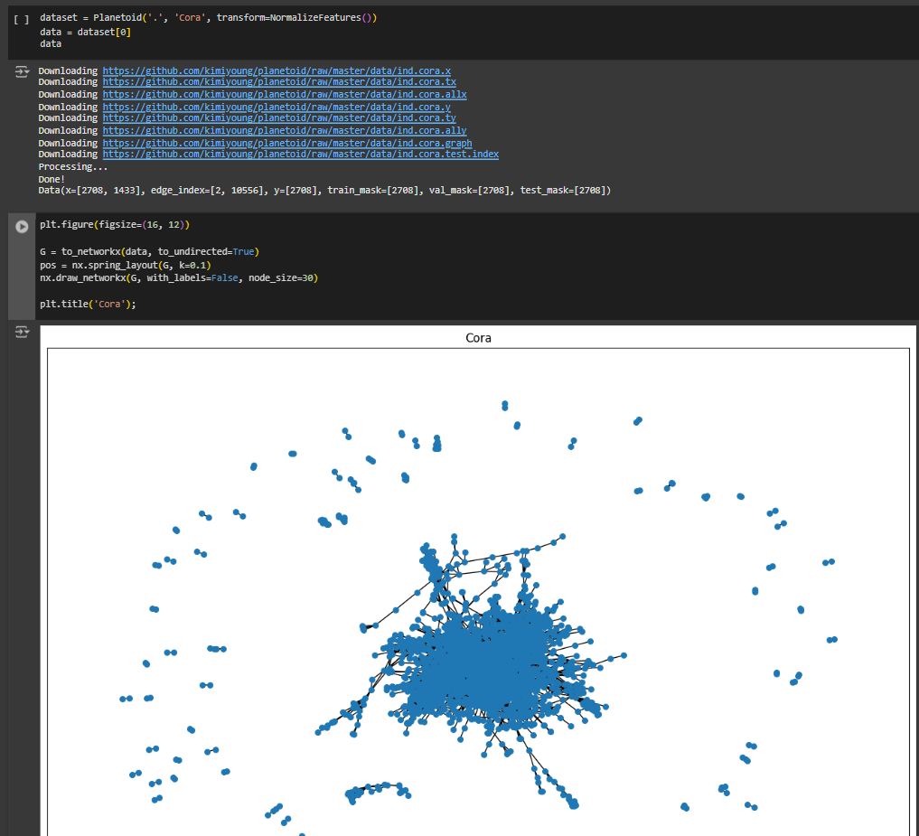
Code: getting the data

Slide 66
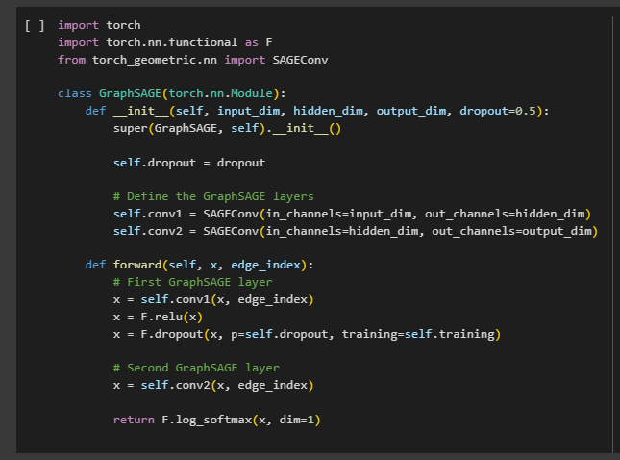
Code: GNN model1

Slide 67
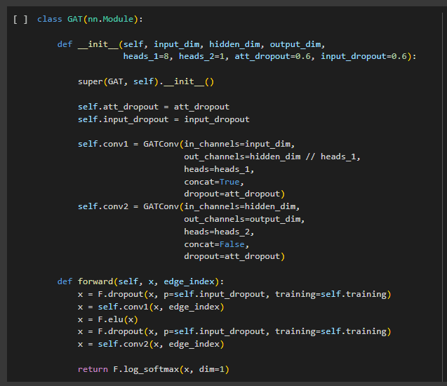
Code: GNN model2

Slide 68
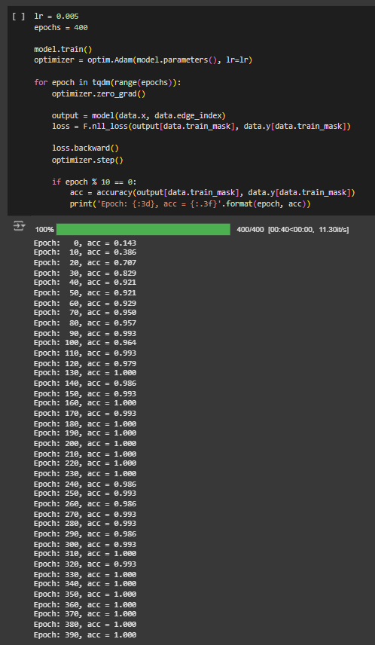
Code: model training

Slide 69
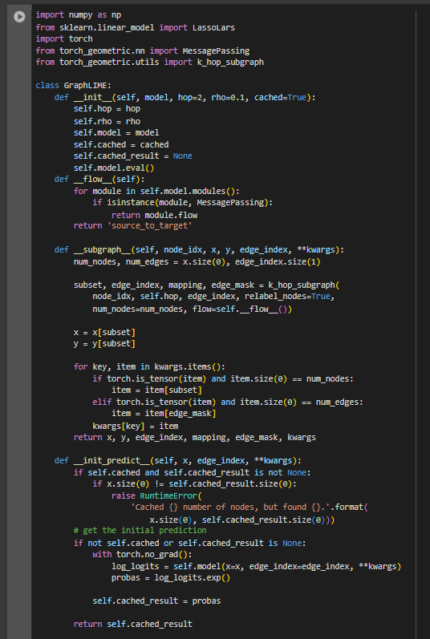
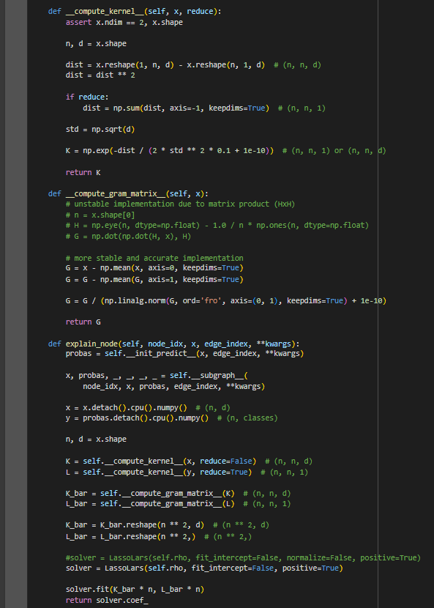
Code: GraphLIME

Slide 70
Evaluation Metrics
Noise Distribution:
Analyze the distribution of noisy features in explanations.
Compare GraphLIME to other methods.
Visualization:
Figure 3 shows distributions for:
(a) Cora (GraphSAGE).
(b) Pubmed (GraphSAGE).
(c) Cora (GAT).
(d) Pubmed (GAT).

Slide 71
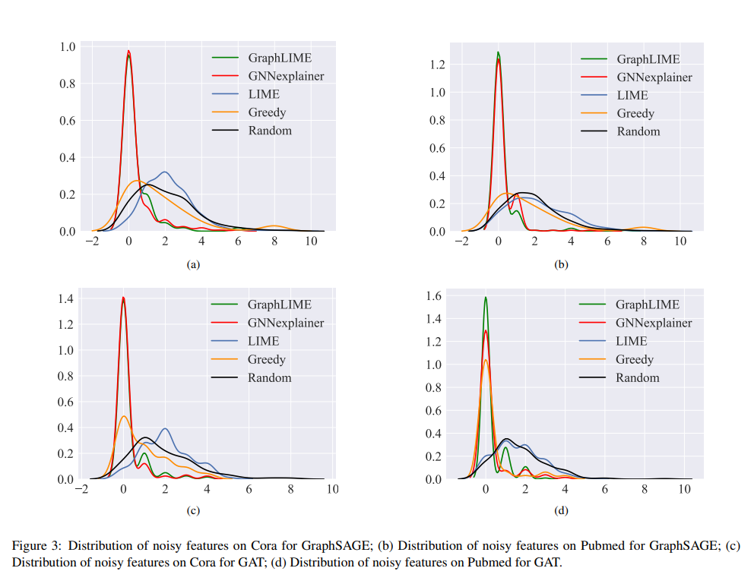

Slide 72
Results: Noise Distribution Analysis
Observations from Figure 3:
GraphLIME (Green Curve):
Consistently identifies informative features with minimal noise.
Rarely selects noisy features.
Peaks close to 0 noisy features.
GNNExplainer (Red Curve):
Focuses on subgraphs but includes more noisy features than GraphLIME. Performs similarly to GraphLIME in filtering noise.
LIME (Blue Curve):
Struggles to ignore noisy features, with peaks around 1–4 noisy features.
Greedy Procedure (Orange Curve):
Performs better than random but less effective than GraphLIME.
Random (Black Curve):
High distribution of noisy features.

Slide 73
Conclusion from Experiments
GraphLIME’s Strength:
Delivers reliable, noise-resistant feature explanations.
Comparison with Existing Methods:
Outperforms LIME, GNNExplainer, Greedy, and Random approaches.
Significance:
Enhances trust and interpretability in GNN predictions
Dataset Dependency:
Cora (smaller dataset) exhibits slightly more variation compared to Pubmed.
Model Performance:
GraphLIME maintains robustness across GraphSAGE and GAT architectures.

Slide 74
Filtering Useless Features
Objective:
Investigates whether GraphLIME can filter noisy features and select only informative ones.
Setup:
Artificially added 10 noisy features to each node’s feature vector.
Trained GraphSAGE and GAT models to achieve >80% test accuracy.
Generated explanations for 200 test samples across explanation frameworks.
Methods Evaluated:
GraphLIME, GNNExplainer, LIME, Greedy, Random.

Slide 75
Evaluation Methodology
Frequency Distribution Analysis:
Compared the number of noisy features selected by each explanation framework.
Used Kernel Density Estimation (KDE) with a Gaussian kernel to analyze distributions.
Datasets:
Cora: Publication dataset with binary features (word presence).
Pubmed: Publication dataset with continuous features (TF/IDF values).

Slide 76
Trustworthiness Evaluation
Metric:
F1-Score of Trustworthiness across different K values (number of explanation features).
Models:
Evaluated on GraphSAGE and GAT models.

Slide 77
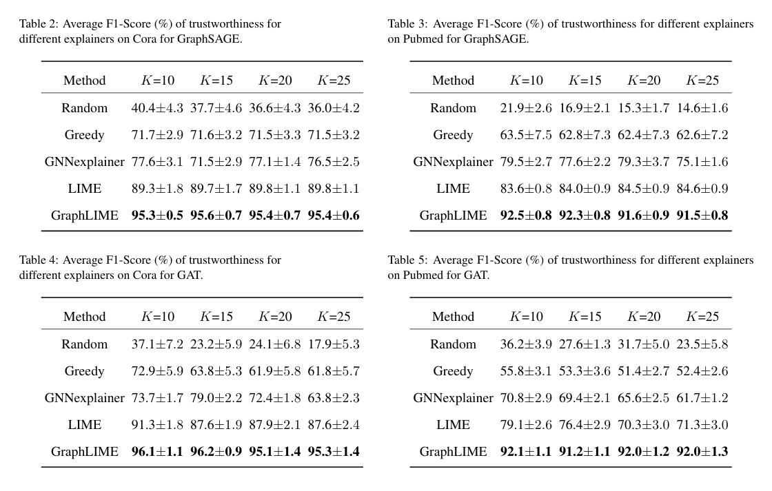

Slide 78
Evaluation Framework
Method:
Use Submodular Pick to select B representative samples for evaluation.
Metrics:
Accuracy of Selecting the Better Classifier as B varies from 5 to 30.
Frameworks Compared:
GraphLIME
GNNExplainer
LIME
Random Choice

Slide 79
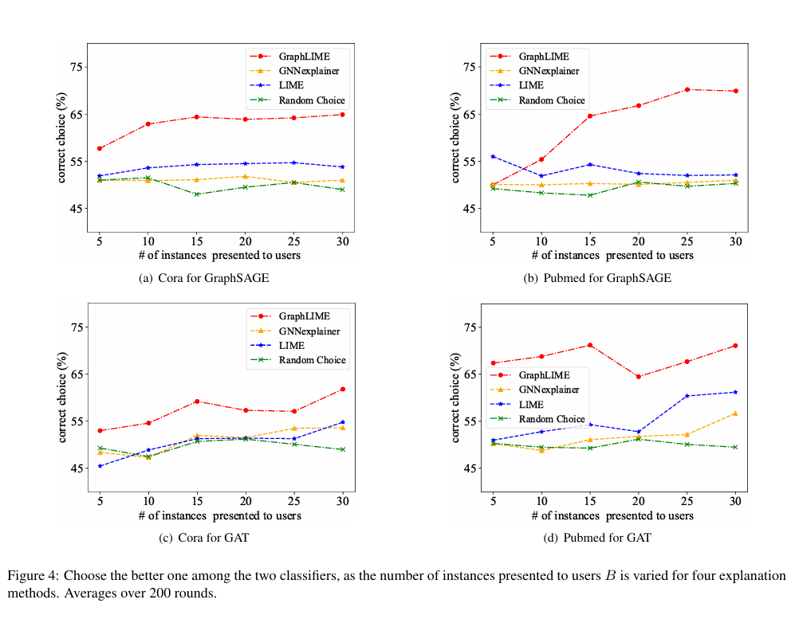

Slide 80
Results: Model Selection
GraphLIME (Red Curve):
Outperforms all methods consistently.
Accuracy increases as B increases.
GNNExplainer (Orange Curve):
Performs slightly better than LIME but less consistent.
LIME (Blue Curve):
Underperforms compared to GraphLIME.
Random Choice (Green Curve):
Lowest accuracy, highlighting the importance of explanation frameworks.

Slide 81
Model Selection Accuracy by Dataset
Key Observations:
GraphSAGE Results:
GraphLIME achieves nearly 70% accuracy with only 15 instances (Cora and Pubmed).
Other methods require more instances to approach similar accuracy.
GAT Results:
GraphLIME remains the top performer as B increases.
Random choice consistently underperforms across all settings.

Slide 82
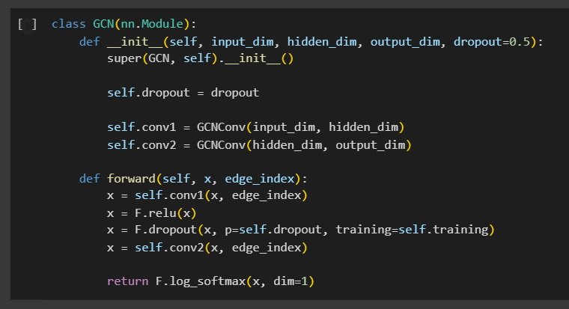
Trying something new!
Experimenting with another model- Graph Convolutional Network.

Slide 83
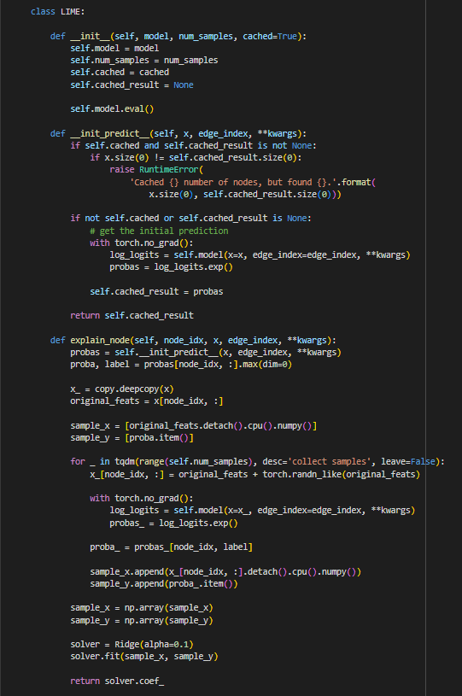
Code: LIME

Slide 84
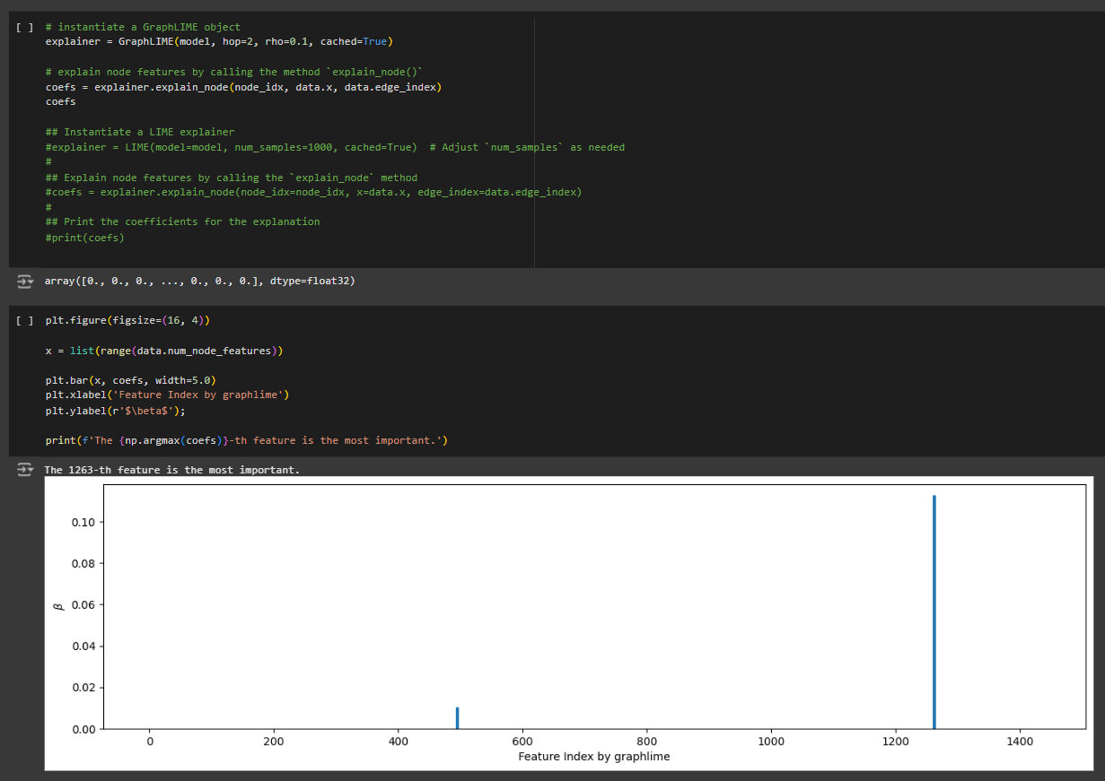

Slide 85
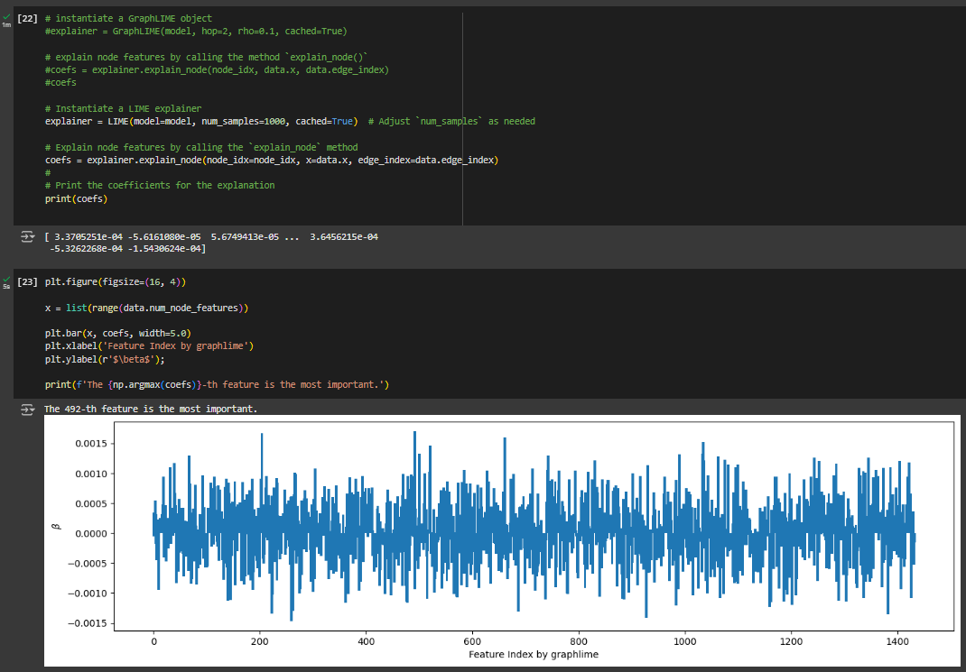

Slide 86
Observations: GraphLIME
The result is highly sparse: only few features have non-zero importance.
The visualization suggests that GraphLIME effectively filters out irrelevant or noisy features which focuses only on the most important ones.
Minimal noise in the explanation due to HSIC Lasso’s ability to handle nonlinear dependencies.
GraphLIME’s explanation is concise and identifies key features that contribute to the GNN's prediction.
This sparsity is a strength while interpreting results, as it minimizes distraction from unimportant features.

Slide 87
Observations: LIME
The result is dense: almost all features have small but non-zero coefficients.
The explanation lacks sparsity, with many noisy features contributing to the result.
LIME’s linear nature is less effective in handling nonlinear dependencies in GNNs which leads to noise in the output.
LIME struggles to filter out irrelevant features.

Slide 88
Aspect | GraphLIME | LIME
Sparsity | Very sparse, highlights key features | Dense, with most features contributing
Noise Filtering | Excellent, minimal noise | Struggles to filter noisy features
Interpretability | Easy to interpret due to concise results | Hard to interpret due to noise
Feature Importance | Strong focus on the most important feature | Feature importance is marginal

Slide 89
Conclusion
Key Contributions of the paper:
Introduced GraphLIME, a model-agnostic explanation framework for GNNs.
Leverages N-hop neighborhood features and predicted labels.
Utilizes HSIC Lasso for capturing nonlinear dependencies.
Produces concise, interpretable explanations with finite features.

Slide 90
Future Directions
Structural Graph Patterns:
Extend GraphLIME to explain subgraph structures influencing GNN predictions.
Identify the most important graph patterns affecting outcomes.
Explaining Node Sets:
Move beyond single-node explanations.
Provide explanations for sets of nodes belonging to the same class.
Goal:
Improve GraphLIME’s scalability and flexibility for broader applications.

Slide 91
Thank You

Slide 92
Link to the paper and reference for images- https://ieeexplore.ieee.org/document/9811416

Slide 93
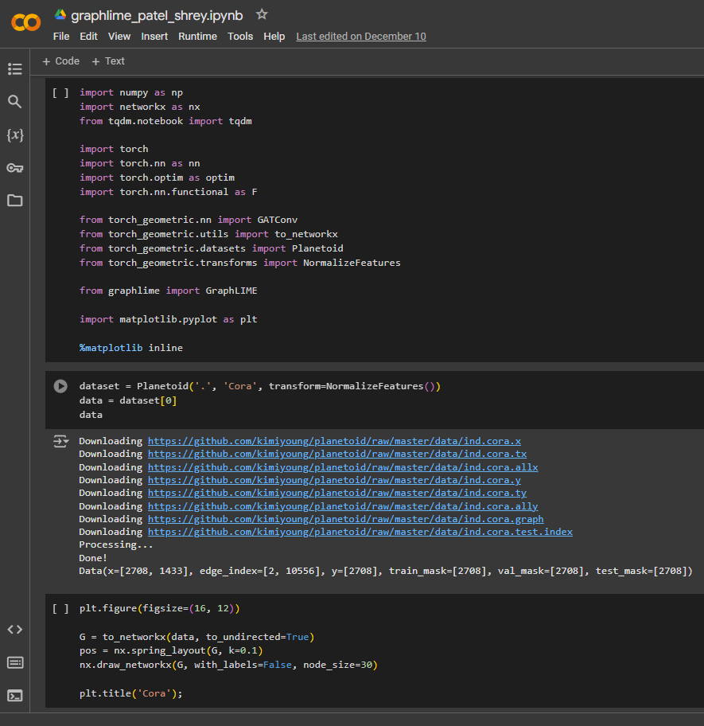
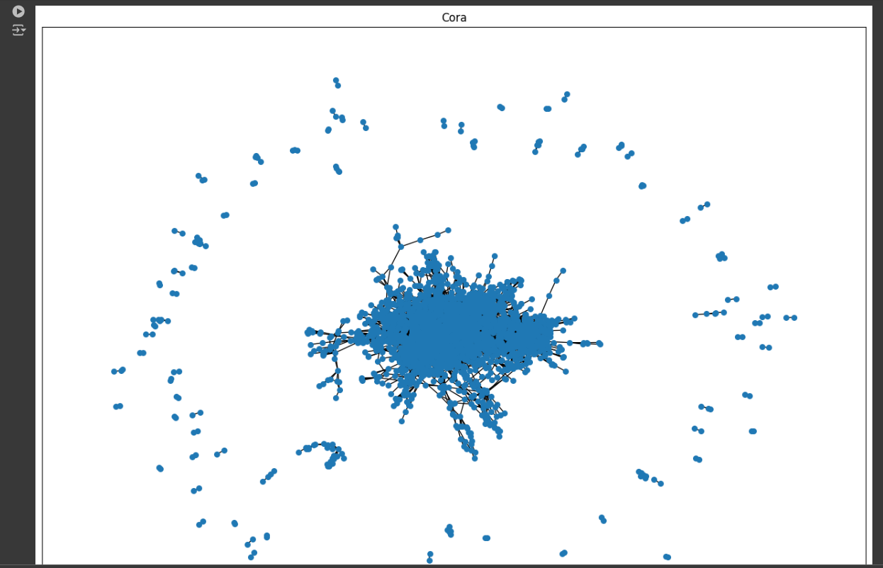

Slide 94
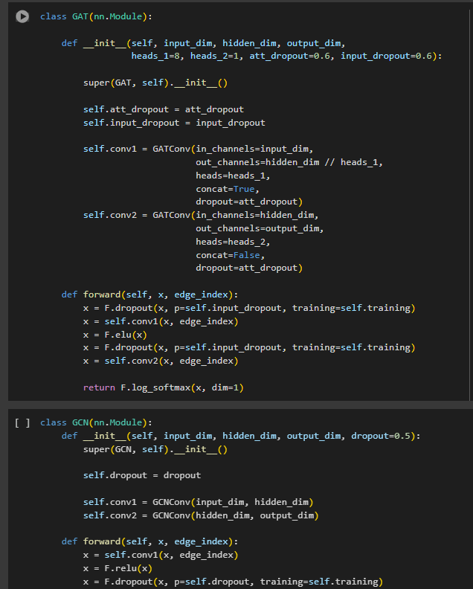
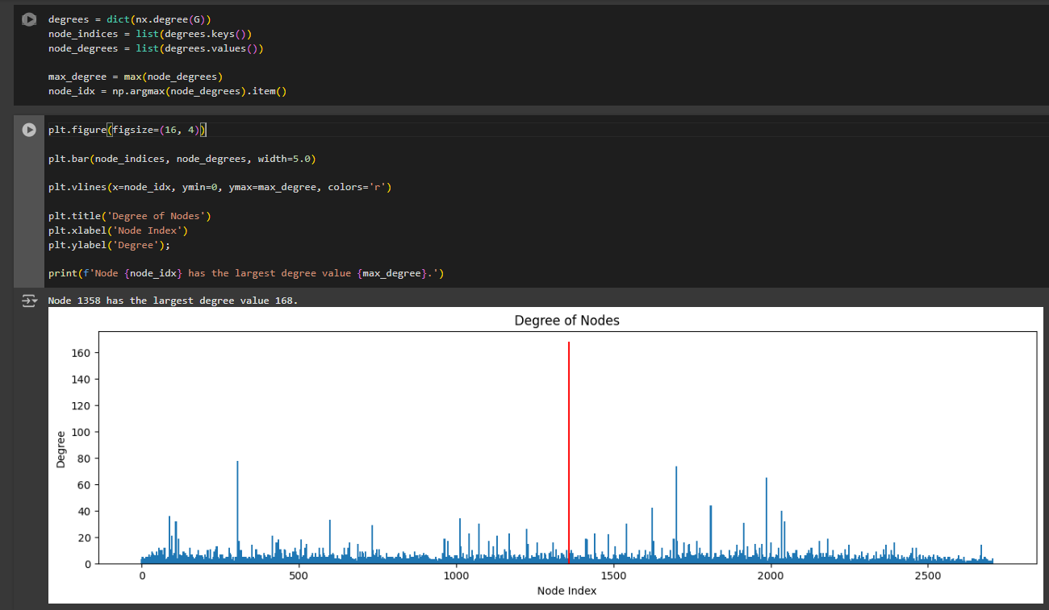

Slide 95
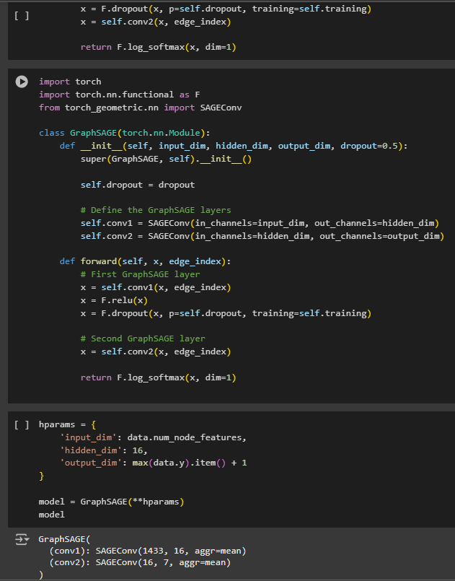
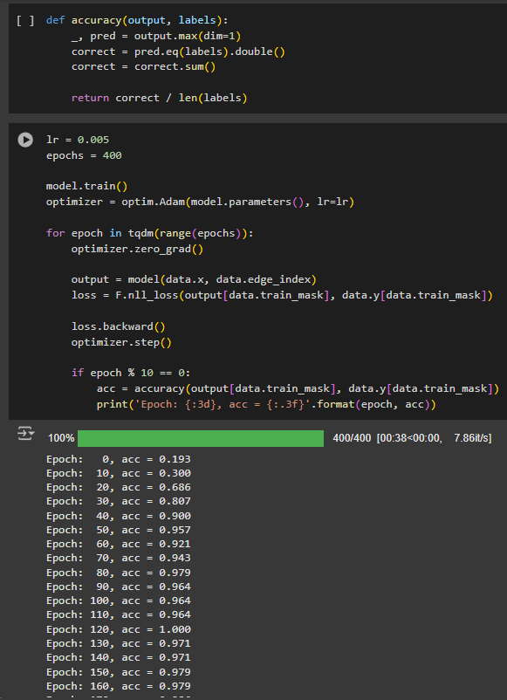

Slide 96
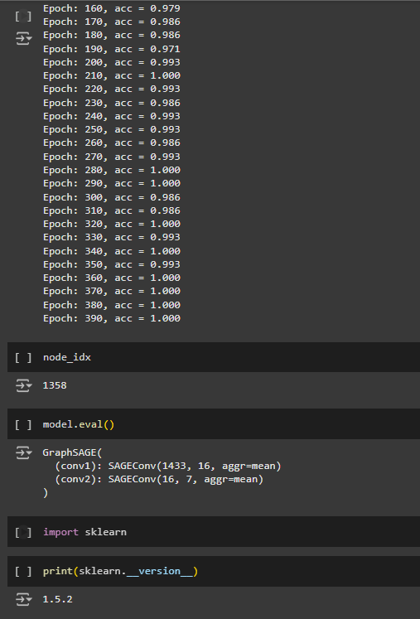
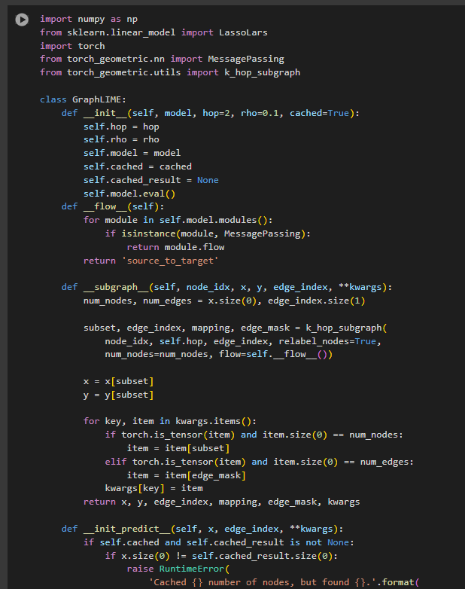

Slide 97
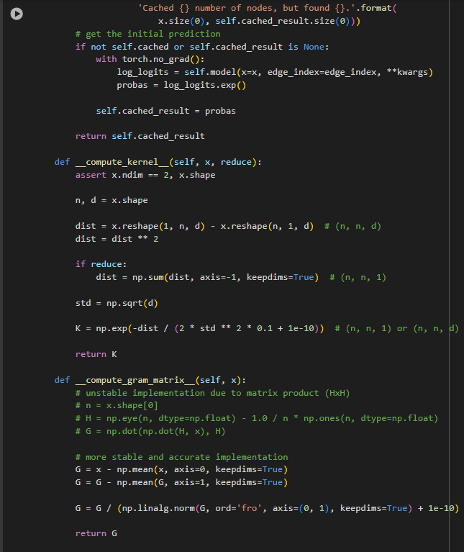
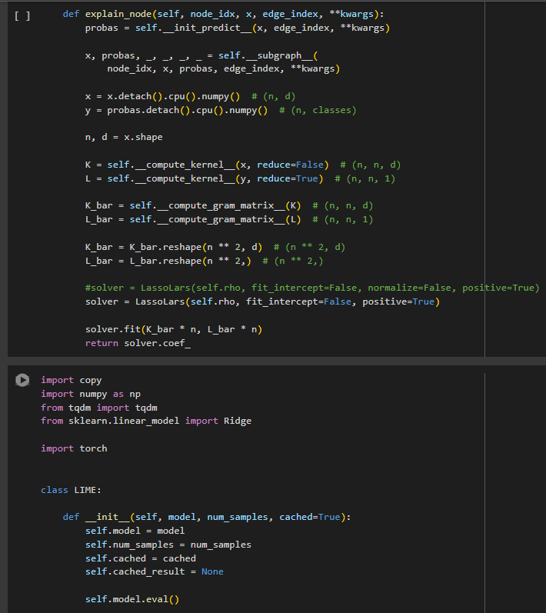

Slide 98
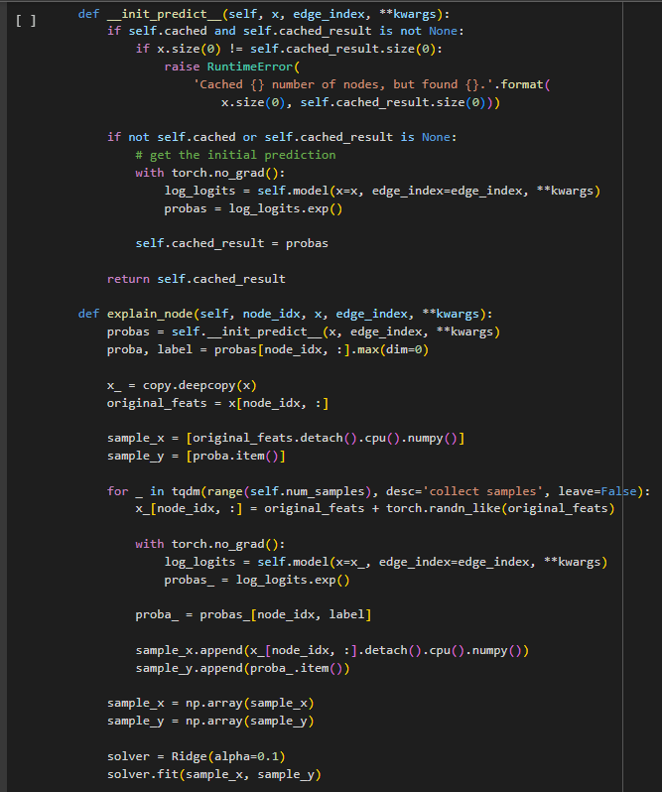
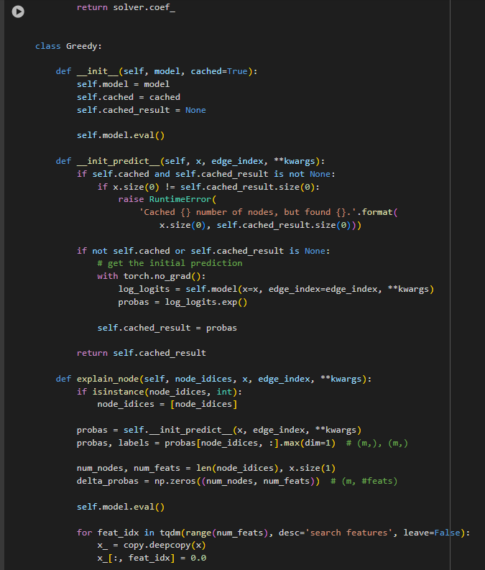

Slide 99
