Slide 1

Presentation Title
Data-Driven Insights for Strategic Decisions
Your Name | March 2026

Slide 2
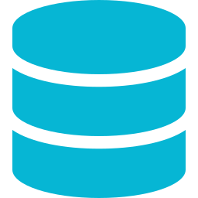



Core Capabilities
What sets our analytics platform apart
Data Integration
Advanced Analytics
Enterprise Security
Automation
Connect to 200+ data sources with real-time ingestion and automated schema detection.
ML-powered forecasting, anomaly detection, and trend analysis at scale.
SOC 2 Type II certified with row-level security and full audit logging.
Scheduled reports, alerting pipelines, and self-service data workflows.
THEME SAMPLE

Slide 3



Platform Overview
Why It Matters
Global Coverage
Modern organizations generate data at unprecedented scale. Without the right infrastructure, insights remain buried and decisions rely on intuition rather than evidence.
42 regions
Data Processed
12 PB / day
Real-time data pipeline monitoring
Cross-functional team dashboards
Automated compliance reporting
Active Users
1.2 M+

Slide 4

Key Metrics
Performance snapshot — last 12 months
99.97%
< 50ms
4.8×
87
Uptime SLA
Avg Query Latency
ROI Increase
Net Promoter Score
Insight: Query latency improved 3× after migrating to the new columnar engine in Q3.

Slide 5
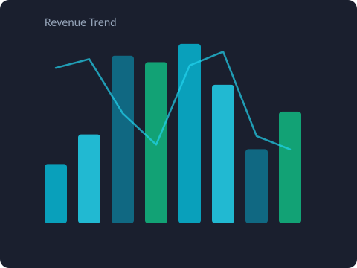

Deep Dive
Revenue grew 34% year-over-year, driven primarily by enterprise adoption in the EMEA region. Self-service analytics now accounts for 62% of all platform queries.
+34%
62%
YoY Growth
Self-Service
Revenue Trend — FY 2025
Explore full report

