Slide 1
Large Scale Data Collection and preprocessing in Spark
Team Members:
Karan Patel - kxp173930
Pandit Joshi - pxj171830
Prashanth - sxp178231

Slide 2
Goal
To summarize the news articles published by various news sites and possible mark the duplicate articles which share the same content.

Slide 3
Our Approach
Stage 1: Web Scraping & Article Storage
Stage 2: UD-parse and PETRARCH-2
Stage 3: Preprocessing and running DBSCAN algorithm to find the duplicate articles

Slide 4
Stage 1: Web Scraping & Article Storage
We feed a list of spanish news website URLs as input.
We use Scrapy’s spider module to get all links from these URLs.
We filter the above links to only those which are articles.
The links obtained in step 3 are then fed to Newsplease one at a time, which retrieves the article and its metadata such as:
Title
Authors
Description
Language
Source domain
Text
Main image URL
Published date
Article URL

Slide 5
Stage 1: Web Scraping & Article Storage
The articles are stored in json format in MongoDB.
We then proceed to the next stage - NLP processing

Slide 6
Stage 2: NLP processes on raw news data.
Raw news data is read from mongodb and processed using stanfordnlp pipeline
Performed - tokenization , POS tagging.
Generated dependency trees for sentences
Stored all the data in Mongodb

Slide 7
Stage 3: Preprocessing and running DBSCAN algorithm to find the duplicate articles
We are using the DBSCAN algorithm on the output data after processing the raw data by the UD-parse and PETRARCH2.

Slide 8
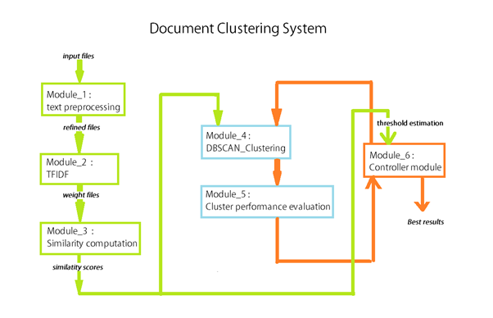

Slide 10
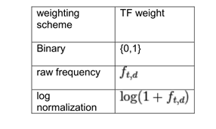
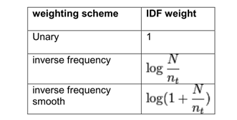
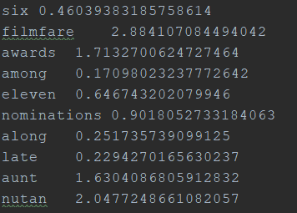

Module 1: Removed stopwords, decapitalization, punctuation, numbers.
Module 2: TF-IDF

Slide 11
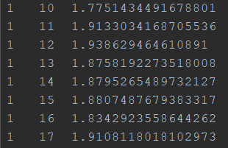
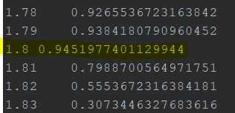


Module 3: Computation of semantic distance between two documents.
norm_weight_A(cw1) = weight_A(cw1) / total_weight_A
Score(cw1) = abs(norm_weight_A(cw1) - norm_weight_B(cw1))
Score(wca1) =norm_ weight_A(wca1)
Score(wcb4) = norm_weight_B(wcb4)
Module 4: Clustering procedure along with clustering performance evaluation to find the duplicate articles.
Using known duplicate articles to fall into same cluster and using this metrics with Adjusted Rand Index we came up with the best value for the threshold - distance between the documents to be marked duplicate.

Slide 12
Advantage of DBSCAN
1. DBSCAN does not require one to specify the number of clusters in the data a priori, as opposed to k-means.
2. DBSCAN can find arbitrarily shaped clusters. It can even find a cluster completely surrounded by (but not connected to) a different cluster. Due to the MinPts parameter, the so-called single-link effect (different clusters being connected by a thin line of points)is reduced.
3. DBSCAN has a notion of noise, and is robust to outliers.
4. DBSCAN requires just two parameters and is mostly insensitive to the ordering of the points in the database. (However, points sitting on the edge of two different clusters might swap cluster membership if the ordering of the points is changed, and the cluster assignment is unique only up to isomorphism.)
5. The parameters minPts and ε can be set by a domain expert, if the data is well understood.

Slide 13
Question?

