Slide 1
A/B Test Report & Machine Learning Insights
Generated Automatically with Python

Slide 2
A/B Test Summary
• Conversion Rate (Group A): 2.69%
• Conversion Rate (Group B): 4.89%

Slide 3
Statistical Significance Results
P-Values from Statistical Tests:
Chi-Square Test Test: 0.0022 (Significant)
Z-Test for Proportions: 0.0016 (Significant)

Slide 4
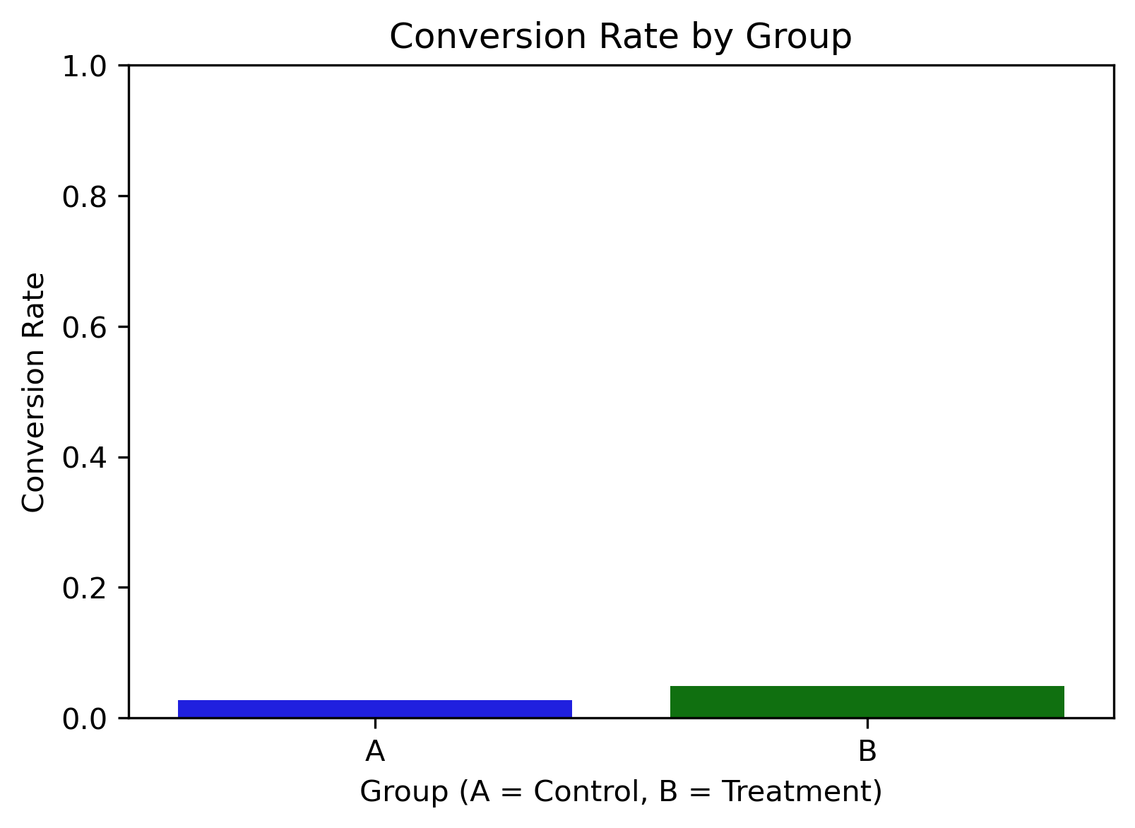
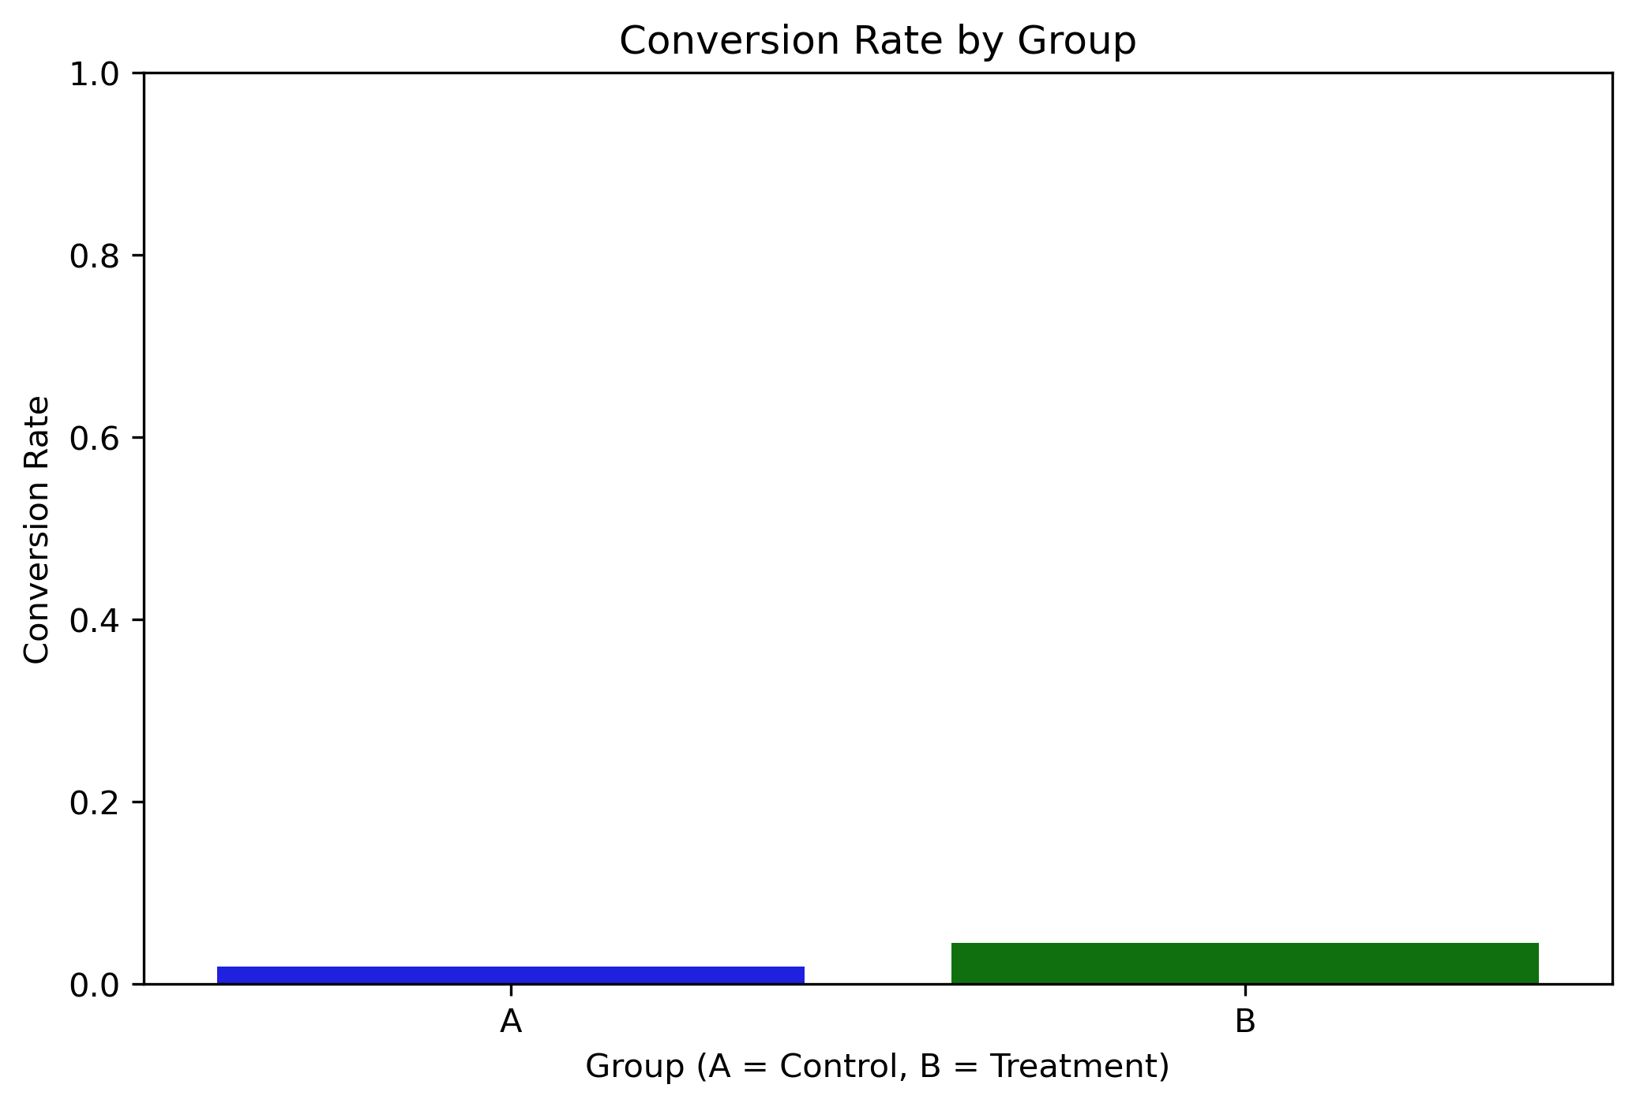
Conversion Rate Comparison

Slide 5
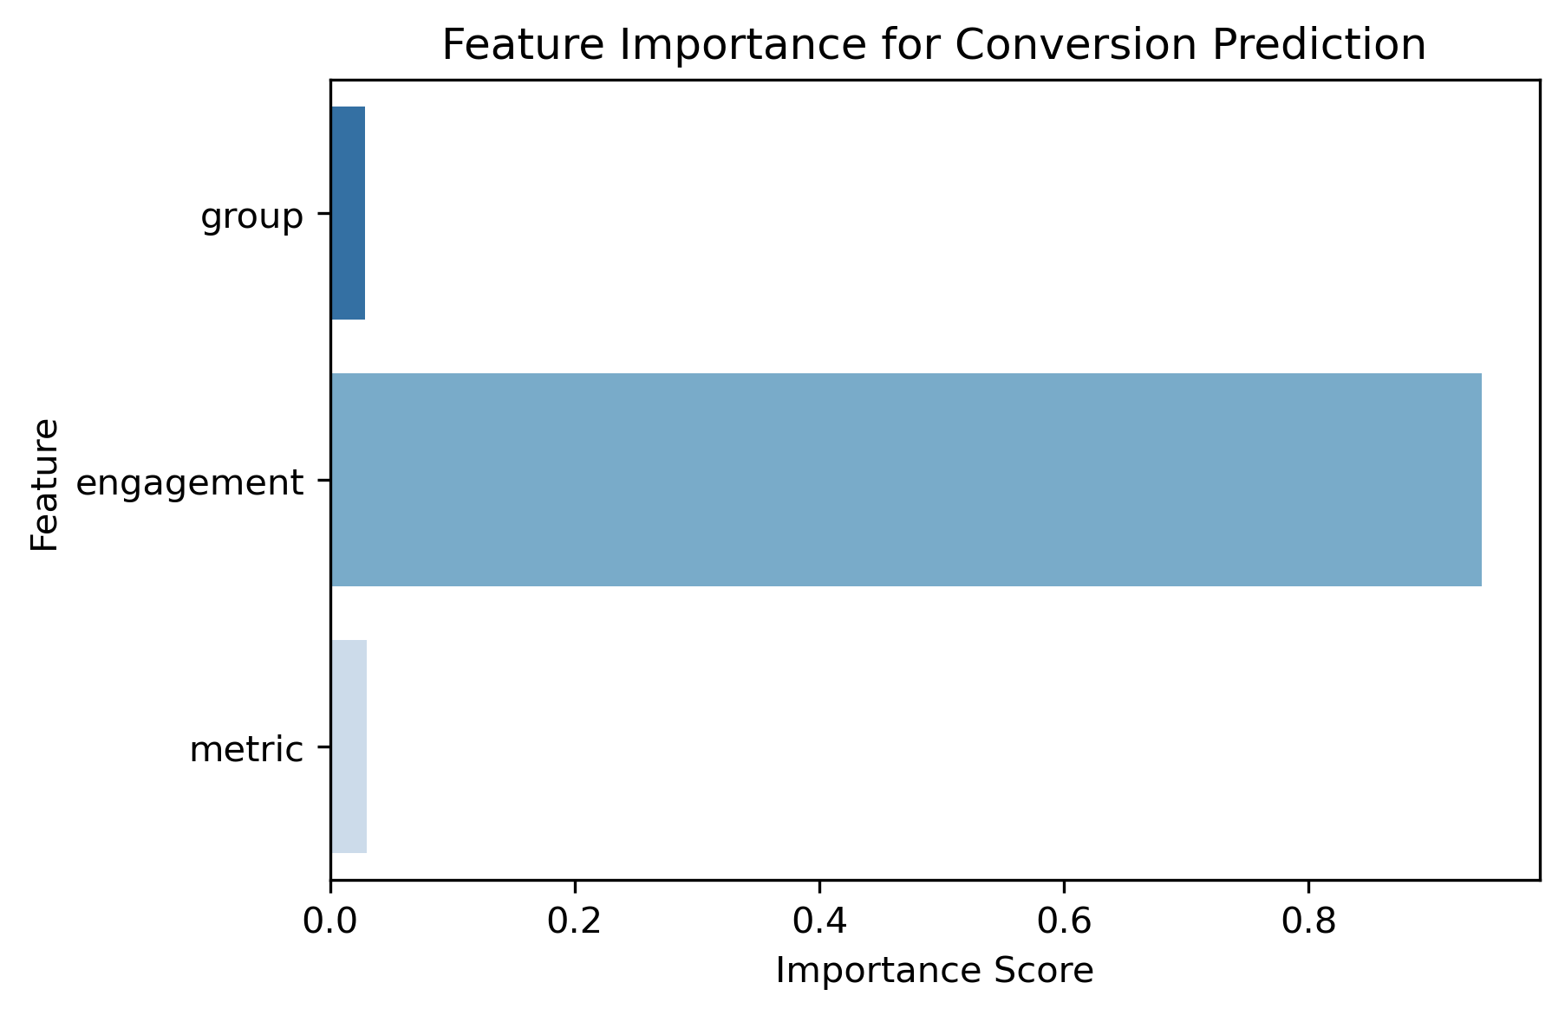
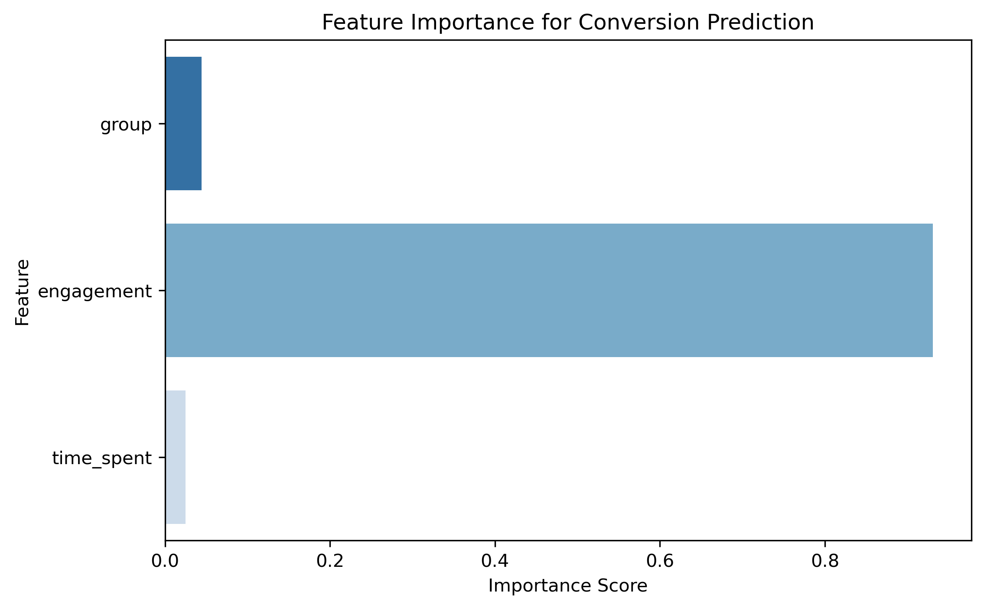
Feature Importance

