Slide 1
A/B Test Report & Machine Learning Insights
Generated Automatically with Python

Slide 2
A/B Test Summary
• Conversion Rate (Group A): 1.92%
• Conversion Rate (Group B): 4.52%

Slide 3
Statistical Significance Results
P-Values from Statistical Tests:
Chi-Square Test: 0.0000 (Significant)
Fisher's Exact Test: 0.0000 (Significant)
Z-Test for Proportions: 0.0000 (Significant)

Slide 4
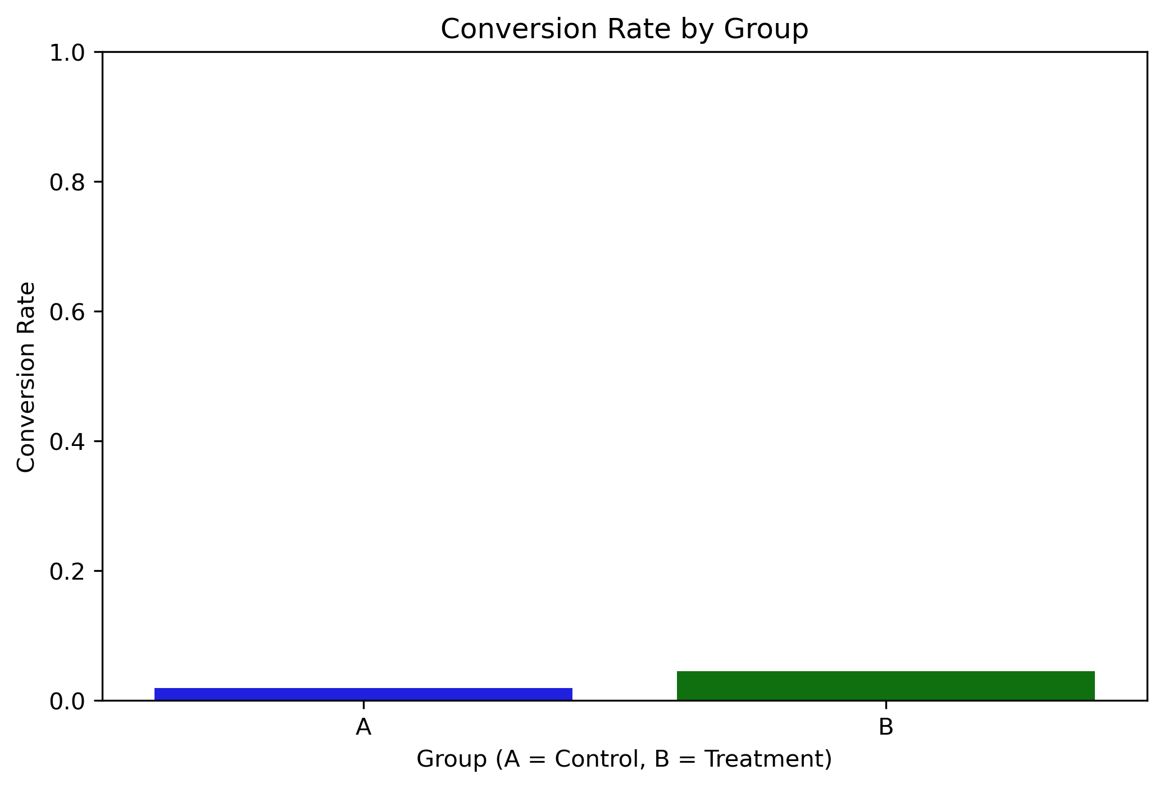
Conversion Rate Comparison

Slide 5
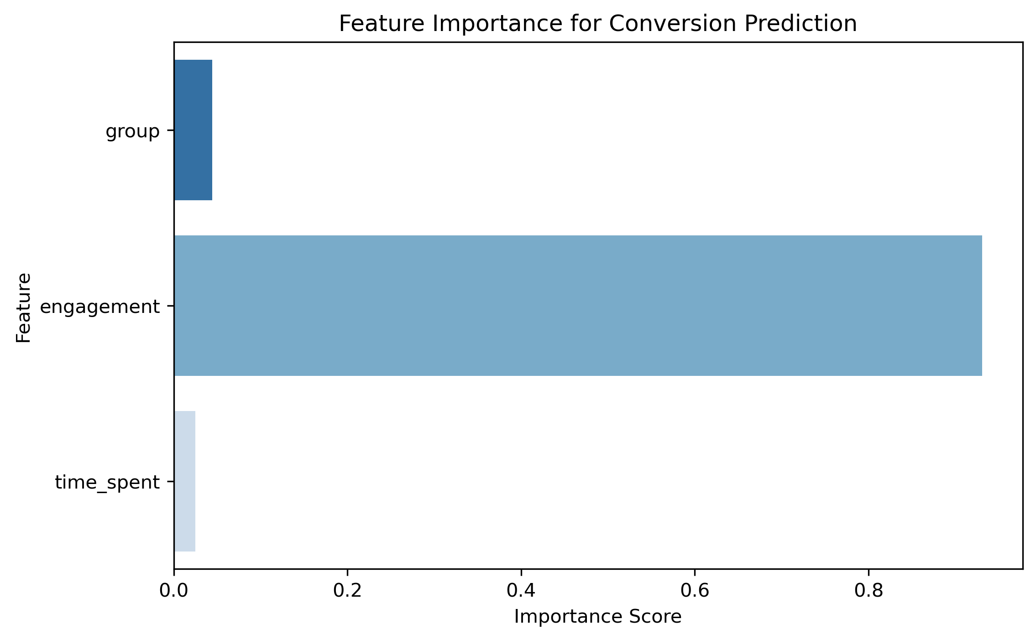
Feature Importance

