Slide 1





M5 Forecasting Accuracy
In this Assignment, I will use modern machine learning models to forecast the time series data for next 7 days of products in Walmart.
https://www.kaggle.com/c/m5-forecasting-accuracy

Slide 2
Walmart’s Product Sales Forecasting
Topics
Business Understanding and Problem Formulation
Data Understanding / EDA process
Modelling: Model / Feature selection
Model Evaluation
Business Impact / Insights

Slide 3
Walmart’s Product Sales Forecasting
Business Understanding and Problem Formulation
In Walmart, the world's largest company by revenue, Sales Forecasting is a crucial area in the field of Business Management. It helps the store retailers to maintain their Stocks according to the demand they are expecting, thus maximizing the profit and minimizing the loss of time and stock. Forecasting can drive sales by processing just-in-time orders efficiently.
The data covers stores in three US states (California, Texas, and Wisconsin) and includes item level, department, product categories, and store details. In addition, it has explanatory variables such as price, promotions, day of the week, and special events. Together, this robust dataset can be used to improve forecasting accuracy.
Thus, I addressed the objective to 2 main following questions:
What are the main features influencing the sales of the product in Walmart?
- Is different months and weekdays affect the sales of the product?

Slide 4
Walmart’s Product Sales Forecasting
Data Understanding / EDA Process
Dataset
The data comprises 3049 individual products from 3 categories and 7 departments, sold in 10 stores in 3 states. The hierarchical aggregation captures the combinations of these factors. For instance, we can create 1 time series for all sales, 3 time series for all sales per state, and so on. The largest category is sales of all individual 3049 products per 10 stores for 30490 time series.
sales_train.csv: this is our main training data. It includes the IDs for item, department, category, store, and state. The number of rows is 30490 for all combinations of 30490 items and 10 stores.
sell_prices.csv: the store and item IDs together with the sales price of the item as a weekly average.
calendar.csv: dates together with related features like day-of-the week, month, year, and an 3 binary flags for whether the stores in each state allowed purchases with SNAP food stamps at this date (1) or not (0).

Slide 5
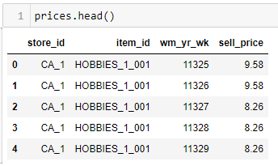
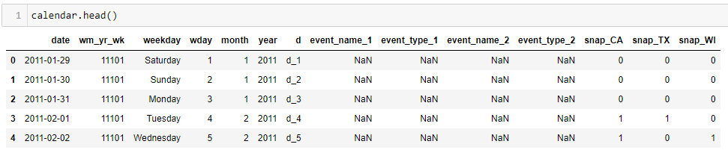
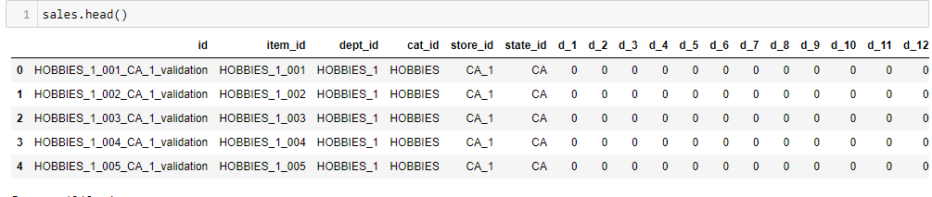
Walmart’s Product Sales Forecasting
Data Understanding / EDA Process
In this process, I retrieving the dataset from csv and observing it multiple angle. From the help of merging and combining table, different visualization from different view can be performed.

Slide 6
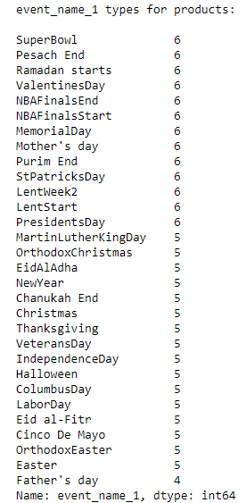
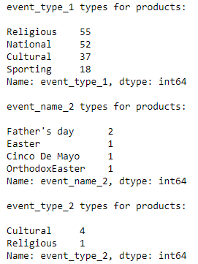
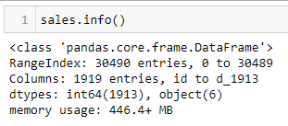

Walmart’s Product Sales Forecasting
Data Understanding / EDA Process
Dataset Shape
Dataset unique value
Feature Categories
Numerical and Categorical features

Slide 7
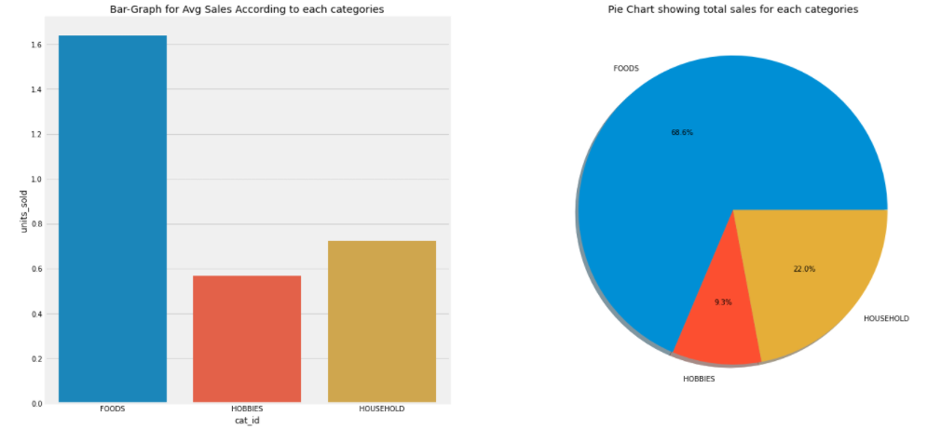
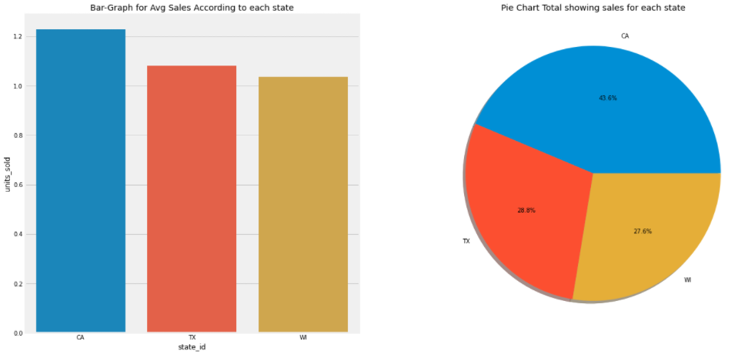
Walmart’s Product Sales Forecasting
Data Understanding / EDA Process
Graph for Avg Sales According to each categories
Graph for Avg Sales According to each state

Slide 8
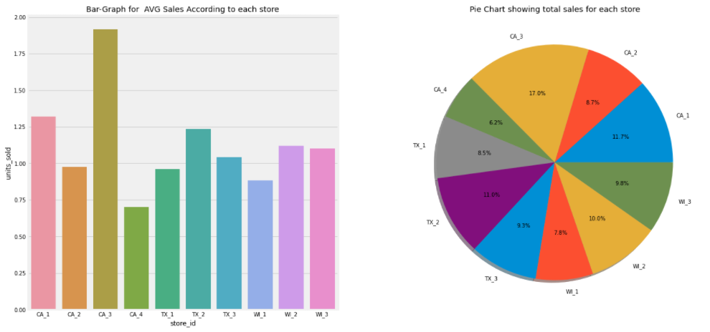
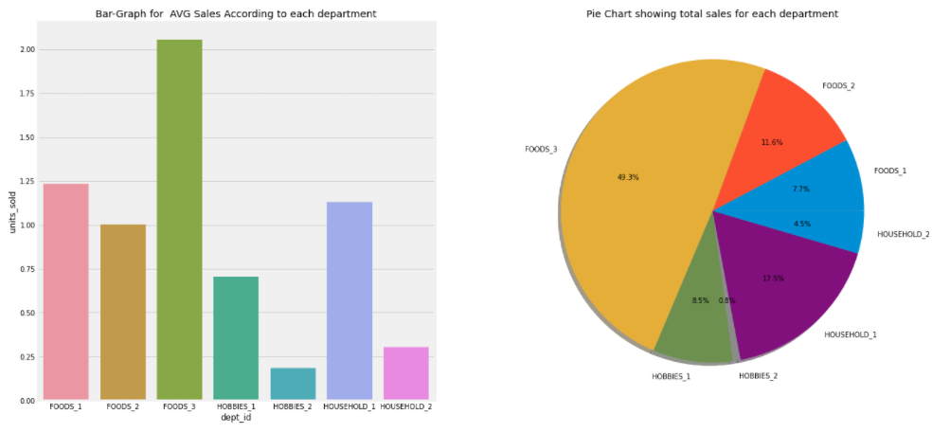
Walmart’s Product Sales Forecasting
Data Understanding / EDA Process
Graph for AVG Sales According to each store
Graph for AVG Sales According to each department

Slide 9
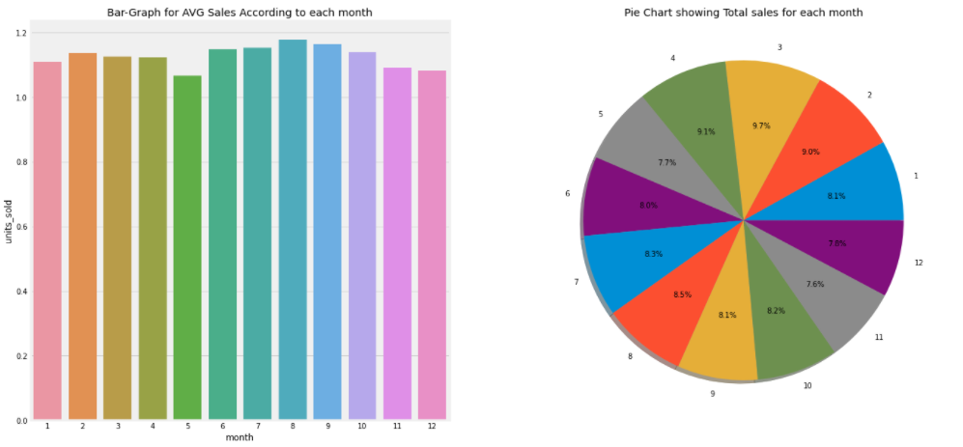
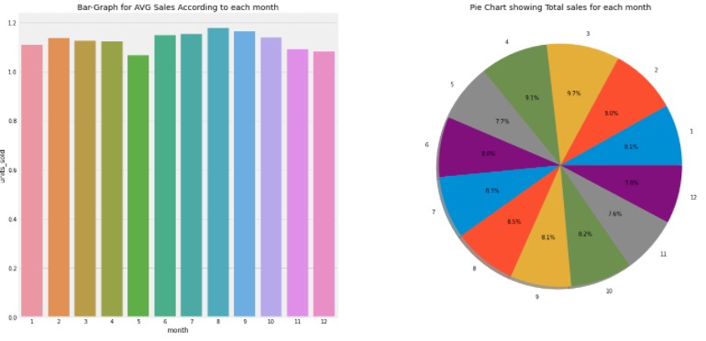
Walmart’s Product Sales Forecasting
Data Understanding / EDA Process
Graph for AVG Sales According to each week day
Graph for AVG Sales According to each month

Slide 10
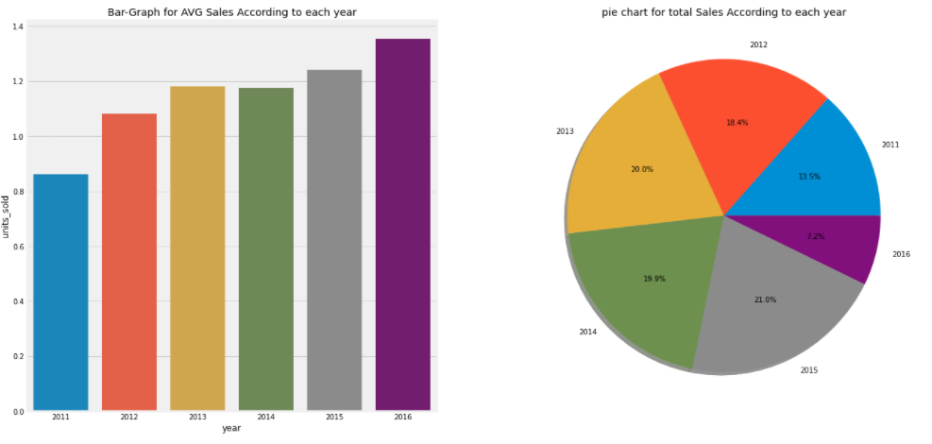
Walmart’s Product Sales Forecasting
Data Understanding / EDA Process
Graph for AVG Sales According to each month

Slide 11
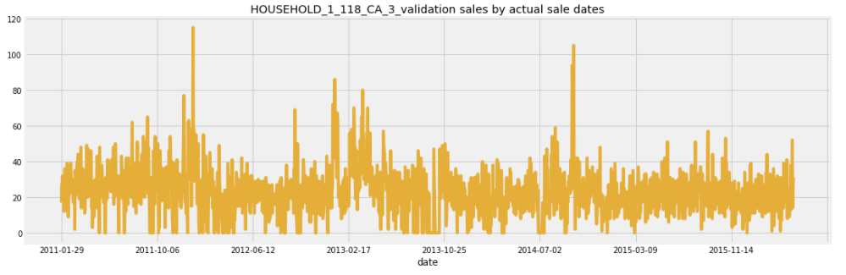
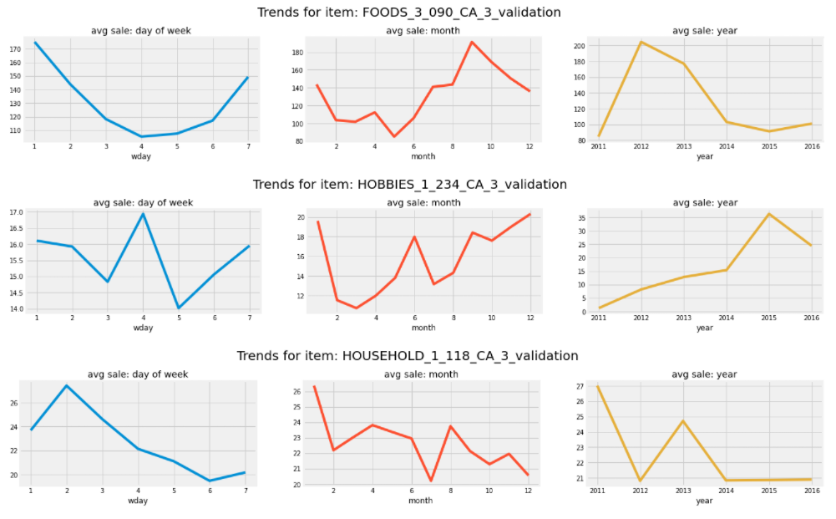
Walmart’s Product Sales Forecasting
Data Understanding / EDA Process
Values relation to the time features can be visualize. As we can see from the product example plot, drilled down to the weekday, months and year axis. For example analysis on this chart:
In week, Food and Household product tends to have a higher sales in the weekend but Hobbies tends to distributed around. On the other hands, in month and years, Food and Hobbies product tends to increase in sales in the end of the month but Household tends to decrease.

Slide 12
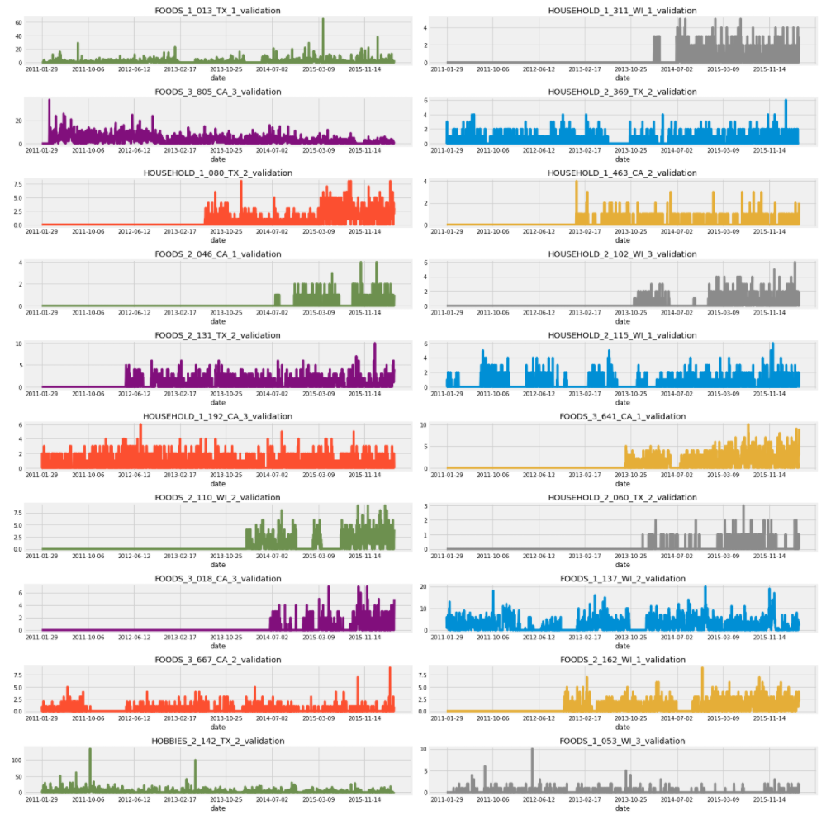
Walmart’s Product Sales Forecasting
Data Understanding / EDA Process
Example of random 20 product plot

Slide 13
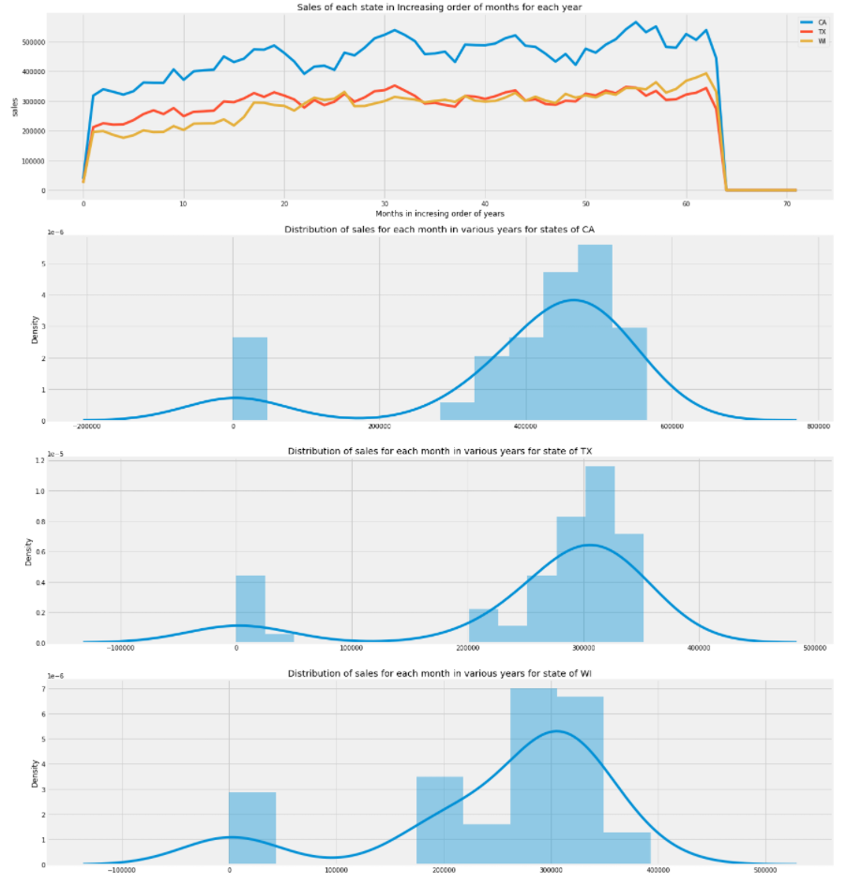
Walmart’s Product Sales Forecasting
Data Understanding / EDA Process
Sales of each state in Increasing order of months for each year
Distribution of sales of each state

Slide 14
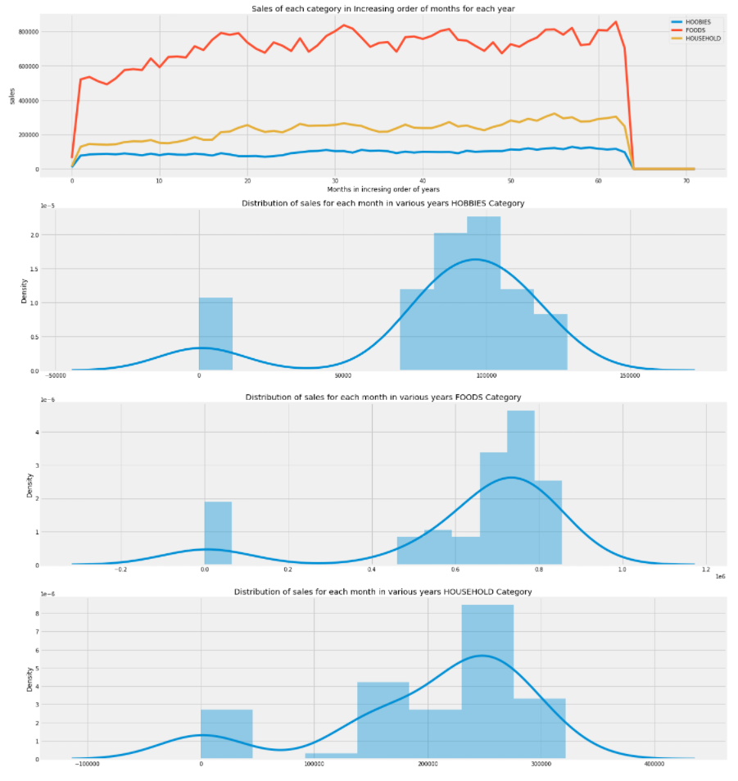
Walmart’s Product Sales Forecasting
Data Understanding / EDA Process
Sales of each categories in Increasing order of months for each year
Distribution of sales of each categories

Slide 15
Walmart’s Product Sales Forecasting
Model and Feature selection
In this analysis, Features that we could generate in this section will be
Units sold related feature:
Rolling mean 7 days on Unit_sold
Rolling mean 30 days on Unit_sold
Rolling mean 90 days on Unit_sold
Rolling mean 180 days on Unit_sold
Rolling std 7 days on Unit_sold
Rolling std 7 days on Unit_sold
Lagged Unit sold from 7 – 30 days
Time related feature:
Week numbers
Days
Quarter number
Seasonal
Price related feature:
Price change in 7 days
Price change in 30 days
Rolling std 7 days on Price
Rolling std 30 days on Price
After several attempt of iteration in model training. Unfortunately, there are some problems running in the process due to the lag of memory in my computing resources, so I decided to:
Reduce the data to around one year from the latest date
Drop the category to food only since it have the highest portion in total sale (68.6%)

Slide 16
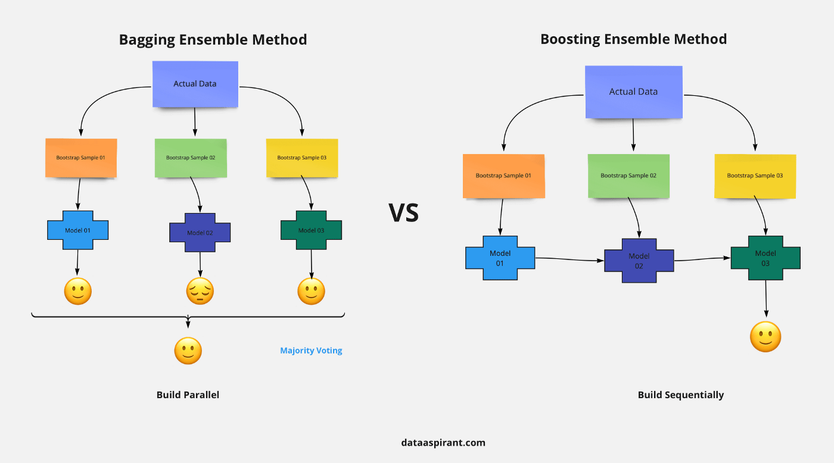
Walmart’s Product Sales Forecasting
Model and Feature selection
In model selection, I will start on XGBoosting model and Random forest regression which is tree-based model to prevent the over-fitting in the model and could handle a large dataset the high dimensionality
Random Forest
XGBoosting

Slide 17



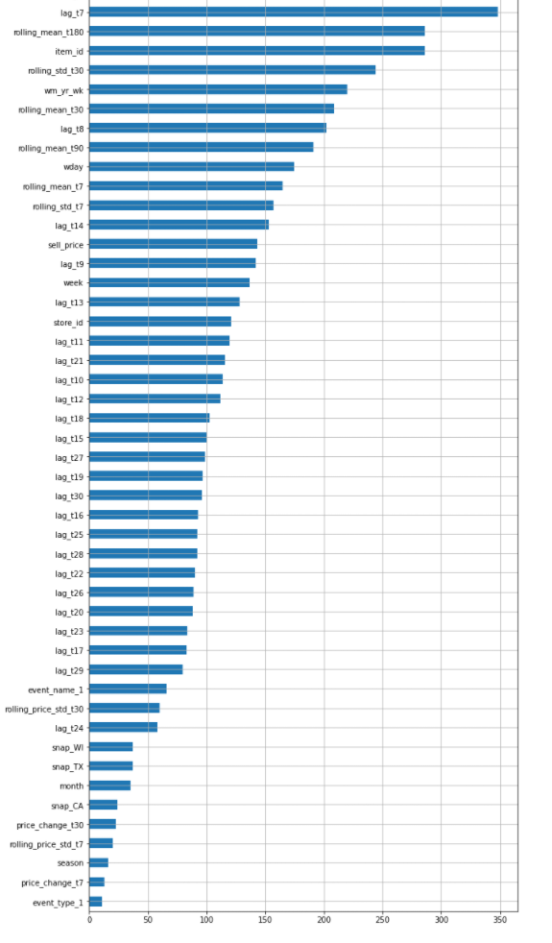
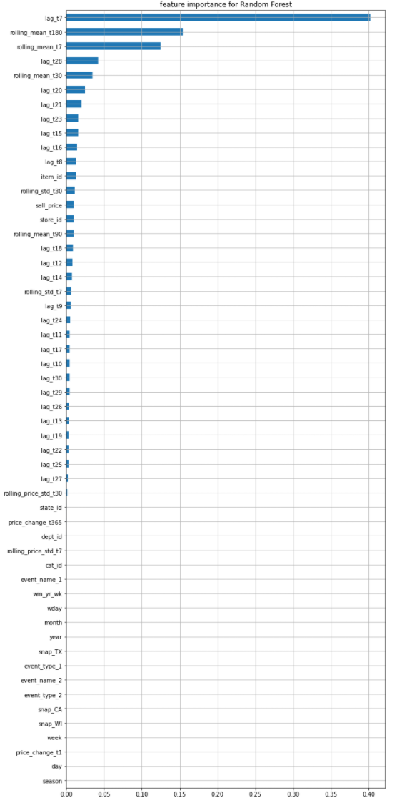
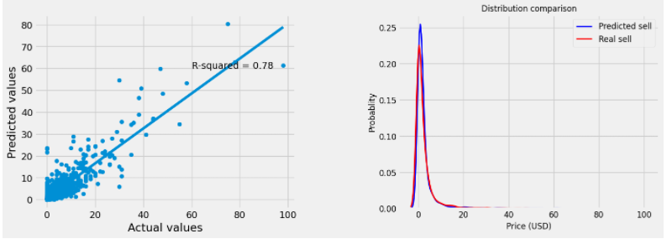
Walmart’s Product Sales Forecasting
Model Evaluation
Model Refining
w/GridSearchCV
XGBoosting
Random Forest
Random Forest
(Hyper param tuning)

Slide 18
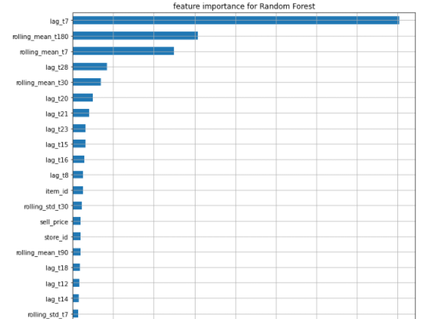
Walmart’s Product Sales Forecasting
Business Impact/Insight
What are the main features influencing the sales of the product in Walmart?
What are the main features influencing the sales of product in Walmart?
To summarize, from the prediction result we could see that the feature importances of the food product sales is:
1) lag_t7 (40%)
2) rolling_mean_t180 (16%)
3) rolling_mean_t7 (12.5%)
4) lag_t28 (4%)
5) rolling_mean_t30 (3%)
This could imply that the most importance features would fall in the time series categories such as amount of product sold last 7, 28 days, moving average of unit sell 7, 30, 180 days. From features that not related to time, item_id sell_price and store_id come to account that Walmart should focus on.
This model will benefits in multiple ways, for example:
Stocking - it will helps the store retailers to maintain there Stocks according to demand they are expecting
Creating a promotion for time to time, weekly, event, etc.

Slide 19
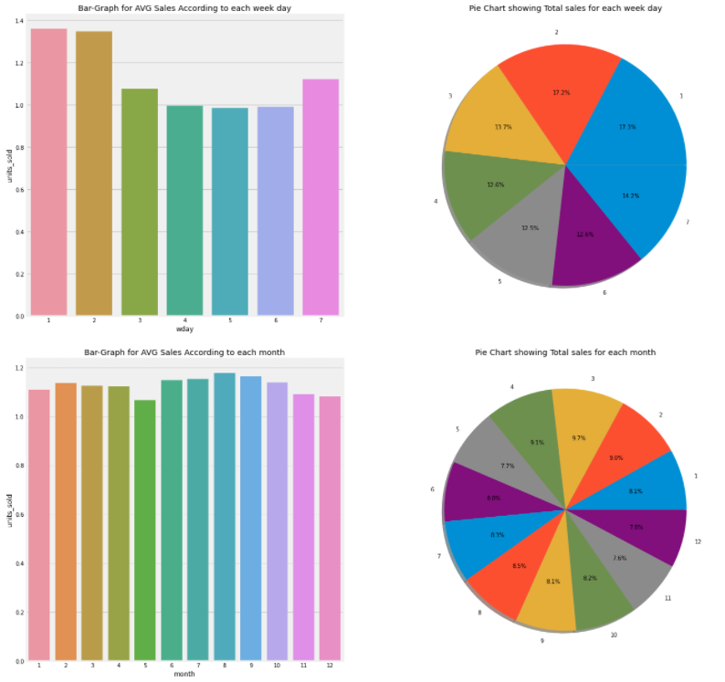
Walmart’s Product Sales Forecasting
Business Impact/Insight
Is different months and weekdays affect the sales of the product?
Yes, According to the chart, For weekdays, we can see that on the weekend especially Saturday(1), Sunday(2) are the days that have higher average sales than others. In the time dimension, we could imply that if Walmart wants to contribute the higher product sales on weekdays, they could use the campaign strategies to influence the customer to come and buy the product on weekdays.
For the month chart as well, the customer tend to buy a product in Q3 more than other quarter

Slide 20
Walmart’s Product Sales Forecasting
Future Work and Improvement
To improve the model performance, we could
Getting more data, since, very unfortunately I have to remove 4 years of historical data due to memory lacking, this could lead to huge amount of error
- Reduce the overfitting by better tunning on hyperparameters
Try other model such LSTM or other deep learning to improve the accuracy
- Clustering technique to get more insightful information from the data.

