Slide 1
Freehand Raster Georeferencer
http://gvellut.github.io/FreehandRasterGeoreferencer/
Clifford Snow

Slide 2
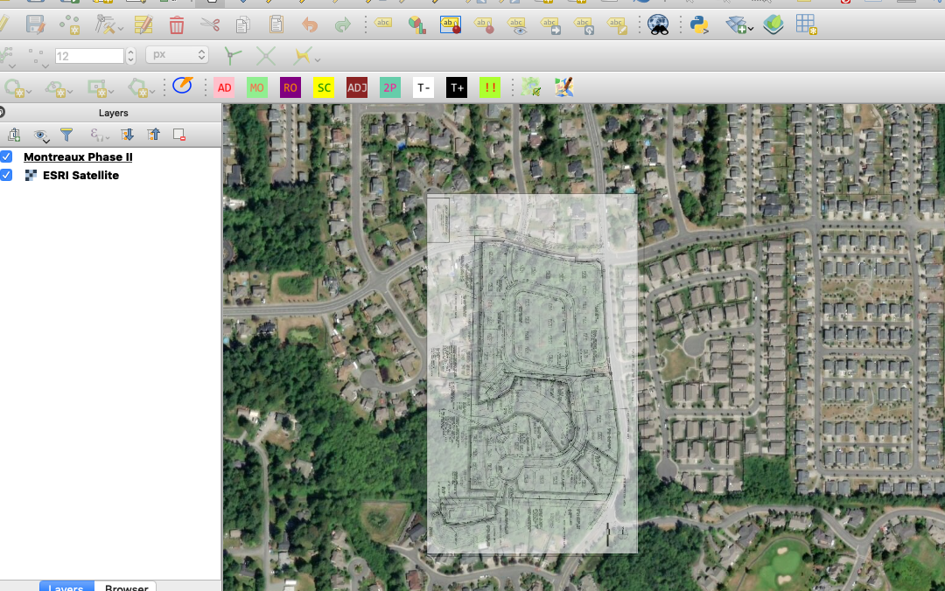
Freehand Raster Georeferencer

Slide 3

Steps to Finished Product
Image suitable for georeferencing
Add a raster background
  Zoom in
Use the tools to georeference the image
Use the !! icon to save as a png with world file.

Slide 4
Freehand Tool
AD Add Image
MO Move Image
RO Rotate Image
SC Scale Image
ADJ Adjust sides of Image
2P Combine move, rotate and scale image
T- T+ Adjust transparency
!! Save georeferenced Image

