Slide 1

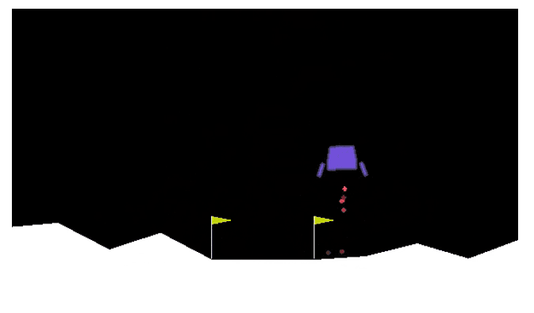
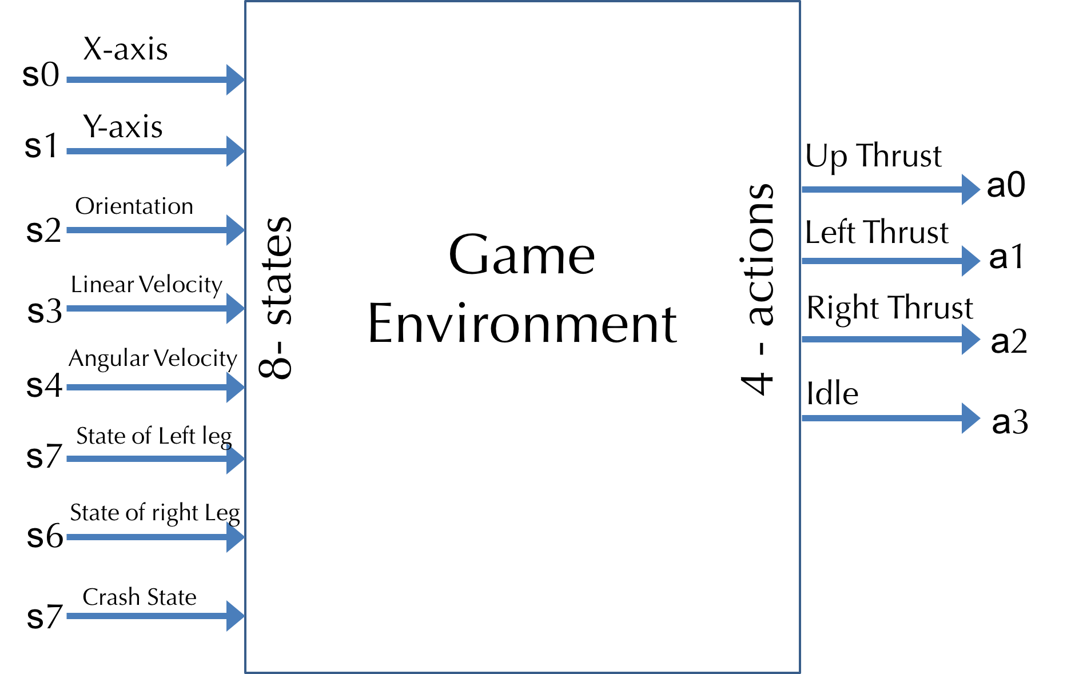
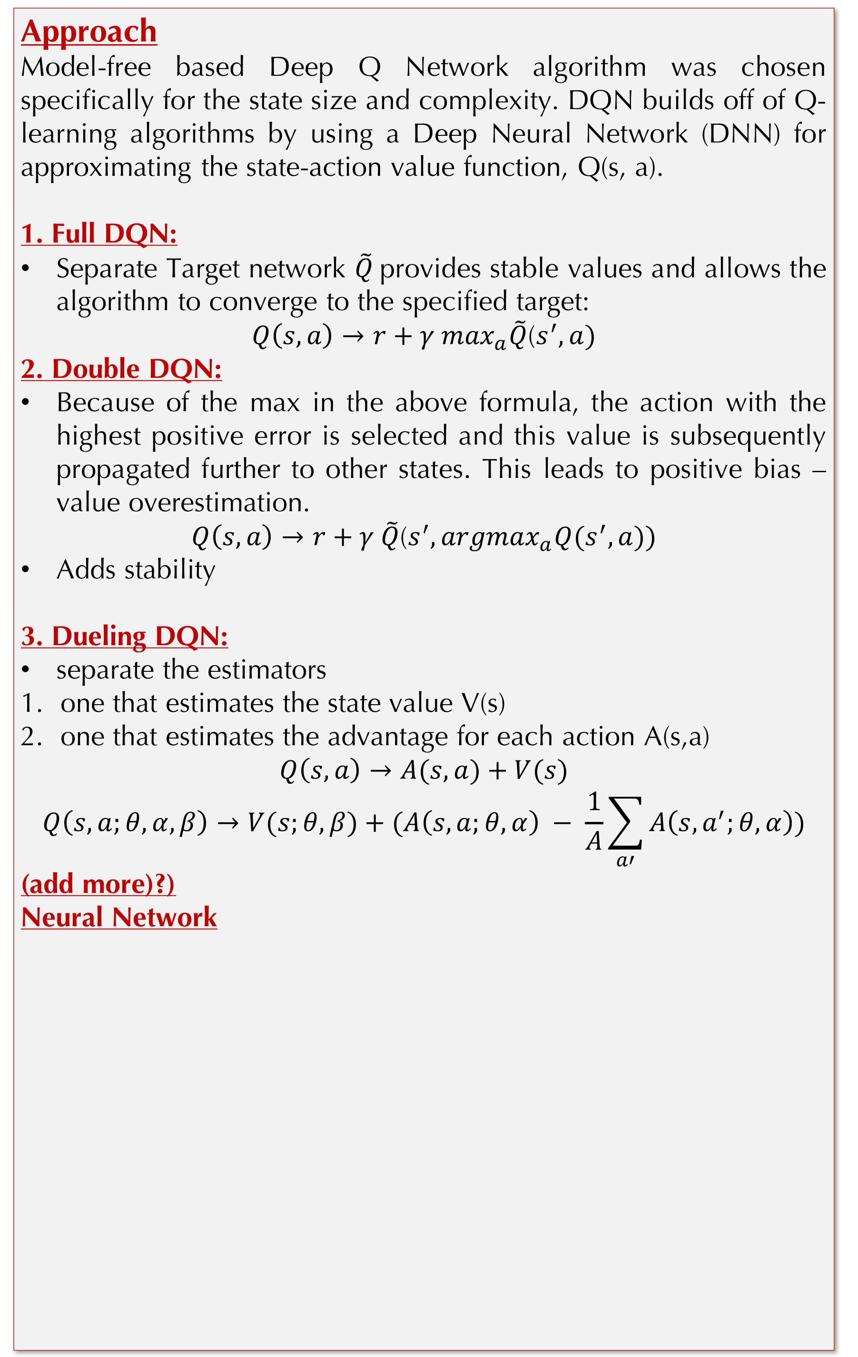
An AI Agent for Lunar Lander
CS 221, Fall 2018, Category: Reinforcement Learning
Prabhjot Singh Rai (prabhjot), Abhishek Bharani (abharani), Amey Naik (ameynaik)
Motivation
Reinforcement Learning (RL) has gained popularity in designing and training game-playing agents since the publication of DeepMind’s Deep Q-Learning algorithm applied to games.
In this project, we explore different variants of the Deep Q-Learning algorithm combined with different recent advancements of RL techniques to play Lunar Lander game.
Approach
Model-free based Deep Q Network algorithm was chosen specifically for the state size and complexity. DQN builds off of Q-learning algorithms by using a Deep Neural Network (DNN) for approximating the state-action value function, Q(s, a).
1. Full DQN:
Separate Target network $\tilde{Q}$provides stable values and allows the algorithm to converge to the specified target:
$Q\left(s,a\right)→r+γ \max_{a}\tilde{Q}$($s^{′}, a)$
2. Double DQN:
Because of the max in the above formula, the action with the highest positive error is selected and this value is subsequently propagated further to other states. This leads to positive bias – value overestimation.
$Q\left(s,a\right)→r+γ \tilde{Q}$($s^{′},{argmax}_{a}Q(s^{′}, a))$
Adds stability
3. Dueling DQN:
separate the estimators
one that estimates the state value V(s)
one that estimates the advantage for each action A(s,a)
$$Q\left(s,a\right)→A(s, a)+V(s)$$
$$Q\left(s,a;θ, α,β\right)→V(s;θ,β)+(A\left(s,a;θ, α\right) − \frac{1}{A}\sum_{a′}{A\left(s, a^{′};θ, α\right)})$$
(add more)?)
Neural Network
Results & Analysis
- Compare episodes vs rewards for all the 4 approaches.
Comparing different gammas?/alphas?
Max scores for each model (comment on the top score)
Comment on steepness of the learning.
Better than baseline? Reaches oracle?
Observation on how and why the models have different behaviours? (psr?)
Problem Definition
AI agents need to safely land on a landing pad.
Landing pad is always at coordinates (0,0).
Reward for reaching the landing pad is about 100 to 140 points, depending on the speed.
Episode finishes if the lander crashes or comes to rest, receiving additional -100 or +100 points.
Each leg ground contact is +10. Firing main engine is -0.3 points each frame. Solved is 200 points.
Goal- Agents task is to learn to take optimal actions that maximizes their cumulative, long-term reward. A successful solution is expected to consistently land safely on the target area with both legs touching the ground, with an average cumulative reward of 200 over 100 trials.
Metrics
Performance of an algorithm for the agent is based on
Number of episodes taken to achieve average rewards of 200 points.
Least Space and Time Complexity.
Future Work
- Currently our algorithm takes ???? Episodes to learn and consistently win the game. We plan to try Prioritized Experience Replay and A3C algorithm to improve the DQN convergence speed.
We also plan to reduce the replay memory size requirement and DNN layer size to overall reduce the Space Complexity of the algorithm without compromising the performance.
conduct more extensive hyperparameter tuning.
Hyperparameters | DQN | DDQN
gamma | 0.99
Epsilon(max, min, decay) | (1, 0, 0.998)
Learning Rate | 0.0001
DNN layers | [Dense128, Dense64]
Loss function | MSE
Batch | 2^5
Replay Memory Size | 2^16
References

Slide 2

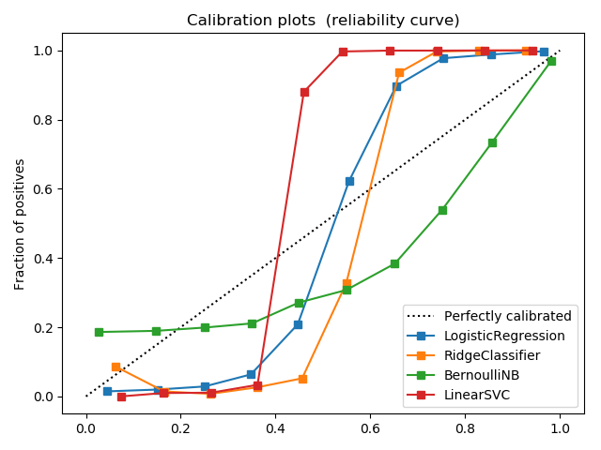
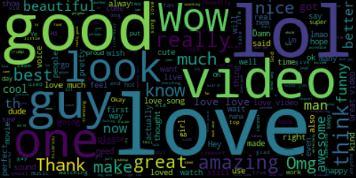
Content Analysis of YouTube Data
cs229,Autumn 2017; Category : Natural Language
Afshin Moin (afshinm), Abhishek Bharani (abharani), and Peng Seng Kuok (pkuok)
Motivation
The popularity of social media is increasing rapidly because it is easy to use and simple to create and share images, video even for users who are technically unaware of social media. You-tube is most popular video sharing with millions of users uploading videos and billions of comments on the videos.
In our project we do Sentiment analysis of the comments, categorize videos based on their comments by predicting it’s category, predict the popularity of the video based on sentiments and ratings given.
Data
We used data from Kaggle competition which contains top 200 videos per day along with their comments ,category and tags.
https://www.kaggle.com/datasnaek/youtube
Feature Extraction
We extracted features like sentiment polarity using TextBlob. TextBlob provides a consistent API for diving into common natural language processing (NLP) tasks such as part-of-speech tagging, noun phrase extraction, sentiment polarity, and more. TF-IDF, finds frequent words across comments.
Approach I
First we use the features extracted like sentiment polarity to train classification methods to decide the polarity of new comment. We ran three different classification techniques on the data like Bernoulli Naïve Bayes and Ridge Classifier and SVM. Analyzing the sentiments from comments helped us to separate positive and negative comments and identify most used words. We used python wordcloud library to generate the wordcloud of positive and negative words.
Second we do category classification to categorize the YouTube videos based on the comments by computing the joint distribution of category and comments.
Approach II : Dimensionality Reduction
Sentiment Classification Summary
Category Classification Summary
Model | Acc. (train/test)
Logistic Reg. | 95.64/94.47
Ridge Classifier | 93.98/90.46
Bernoulli NB | 72.15/71.53
Linear SVM | 96.89/95.14
Model | Acc. (train/test)
Logistic Reg. | 60.70/53.21
Ridge Classifier | 65.77/55.91
Bernoulli NB | 45.53/41.61
Linear SVM | 68.95/57.79
Future work
Category classification based on tags
Automatic generation of tags based on category
Generation of automatic comments given category, sentiment and length
Logistic regression returns well calibrated results between range 0 to 1. Bernoulli NB tends to push results to 0 or 1 due to independence assumption which does not hold true here. Ridge Classifier and SVM are partially calibrated between range 0 to 1.
Bag of positive words extracted from comments
References
sklearn, numpy, pandas, TextBlob were used in our development. Our classifiers assumed the default hyperparameters provided by the respective libraries
G. Toderici, H. Aradhye, M. Pasca, L. Sbaiz, and J. Yagnik. Finding meaning on youtube: Tag recom- mendation and category discovery. In Computer Vision and Pattern Recognition, 2010.

Slide 3
s0
X-axis
s1
Y-axis
Up Thrust
Orientation
4 - actions
a0
s2
8- states
Game
Environment
Left Thrust
a1
s3
Linear Velocity
Right Thrust
Angular Velocity
a2
s4
Idle
a3
s7
State of Left leg
s6
State of right Leg
s7
Crash State

Slide 4
Hyperparameters | DQN | DDQN
gamma

