Slide 1

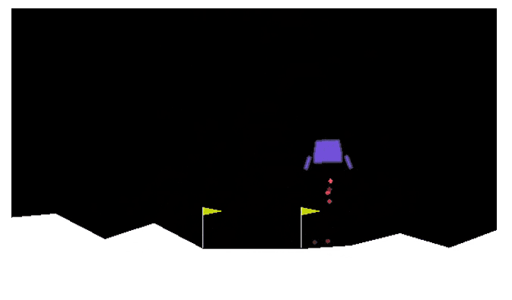
An AI Agent for Lunar Lander
CS 221, Fall 2018, Category: Reinforcement Learning
Prabhjot Singh Rai (prabhjot), Abhishek Bharani (abharani), Amey Naik (ameynaik)
Motivation
Reinforcement Learning (RL) has gained popularity in designing and training game-playing agents since the publication of DeepMind’s Deep Q-Learning algorithm applied to Atari games.
In this project, we explore different variants of the Deep Q-Learning algorithm combined with different recent advancements of RL techniques to play Lunar Lander game.
Approach
Model-free based Deep Q Network algorithm was chosen specifically for the state size and complexity. DQN builds off of Q-learning algorithms by using a Deep Neural Network (DNN) for approximating the state-action value function, Q(s, a).
DQN: Equation/ theory
Double DQN: Equation/ theory
Double DQN with PER: Equation/ theory
Dueling DQN with PER: Equation/ theory
Results & Analysis
- Compare episodes vs rewards for all the 4 approaches.
Comparing different gammas?/alphas?
Problem Definition
To build an AI agent to play Lunar Lander game to safely land on a landing pad. Landing pad is always at coordinates (0,0). Reward for reaching the landing pad is about 100 to 140 points, depending on the speed. If lander moves away from landing pad it loses reward back. Episode finishes if the lander crashes or comes to rest, receiving additional -100 or +100 points. Each leg ground contact is +10. Firing main engine is -0.3 points each frame. Solved is 200 points.
Future Work
Goal- Agents task is to learn to take optimal actions that maximizes their cumulative, long-term reward. A successful solution is expected to consistently land safely on the target area with both legs touching the ground, with an average cumulative reward of 200 over 100 trials.
Neural Network & Hyperparameters
Add table for hyperparameters
References
Challenges/Metrics
Reinforcement Learning (RL) has gained popularity in designing and training game-playing agents since the publication of DeepMind’s Deep Q-Learning algorithm applied to Atari games.
In this project, we explore different variants of the Deep Q-Learning algorithm combined with different recent advancements of RL techniques to play Lunar Lander game.

Slide 2

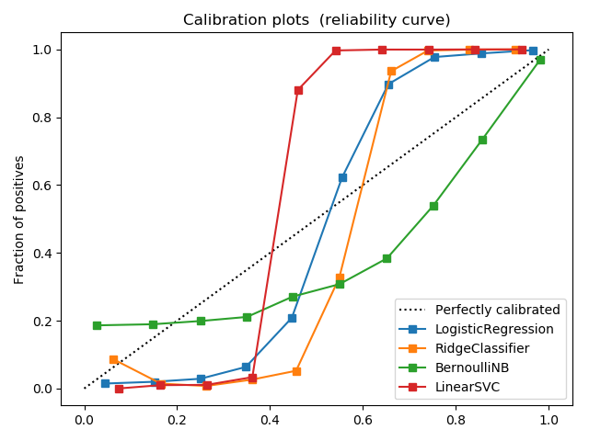
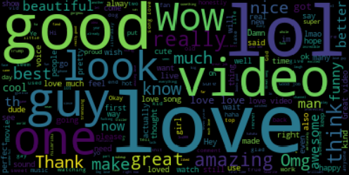
Content Analysis of YouTube Data
cs229,Autumn 2017; Category : Natural Language
Afshin Moin (afshinm), Abhishek Bharani (abharani), and Peng Seng Kuok (pkuok)
Motivation
The popularity of social media is increasing rapidly because it is easy to use and simple to create and share images, video even for users who are technically unaware of social media. You-tube is most popular video sharing with millions of users uploading videos and billions of comments on the videos.
In our project we do Sentiment analysis of the comments, categorize videos based on their comments by predicting it’s category, predict the popularity of the video based on sentiments and ratings given.
Data
We used data from Kaggle competition which contains top 200 videos per day along with their comments ,category and tags.
https://www.kaggle.com/datasnaek/youtube
Feature Extraction
We extracted features like sentiment polarity using TextBlob. TextBlob provides a consistent API for diving into common natural language processing (NLP) tasks such as part-of-speech tagging, noun phrase extraction, sentiment polarity, and more. TF-IDF, finds frequent words across comments.
Approach I
First we use the features extracted like sentiment polarity to train classification methods to decide the polarity of new comment. We ran three different classification techniques on the data like Bernoulli Naïve Bayes and Ridge Classifier and SVM. Analyzing the sentiments from comments helped us to separate positive and negative comments and identify most used words. We used python wordcloud library to generate the wordcloud of positive and negative words.
Second we do category classification to categorize the YouTube videos based on the comments by computing the joint distribution of category and comments.
Approach II : Dimensionality Reduction
Sentiment Classification Summary
Category Classification Summary
Model | Acc. (train/test)
Logistic Reg. | 95.64/94.47
Ridge Classifier | 93.98/90.46
Bernoulli NB | 72.15/71.53
Linear SVM | 96.89/95.14
Model | Acc. (train/test)
Logistic Reg. | 60.70/53.21
Ridge Classifier | 65.77/55.91
Bernoulli NB | 45.53/41.61
Linear SVM | 68.95/57.79
Future work
Category classification based on tags
Automatic generation of tags based on category
Generation of automatic comments given category, sentiment and length
Logistic regression returns well calibrated results between range 0 to 1. Bernoulli NB tends to push results to 0 or 1 due to independence assumption which does not hold true here. Ridge Classifier and SVM are partially calibrated between range 0 to 1.
Bag of positive words extracted from comments
References
sklearn, numpy, pandas, TextBlob were used in our development. Our classifiers assumed the default hyperparameters provided by the respective libraries
G. Toderici, H. Aradhye, M. Pasca, L. Sbaiz, and J. Yagnik. Finding meaning on youtube: Tag recom- mendation and category discovery. In Computer Vision and Pattern Recognition, 2010.

Slide 3
s0
X-axis
s1
Y-axis
Up Thrust
Orientation
4 - actions
a0
s2
8- states
Game
Environment
Left Thrust
a1
s3
Linear Velocity
Right Thrust
Angular Velocity
a2
s4
Idle
a3
s7
State of Left leg
s6
State of right Leg
s7
Crash State

