Slide 1
GERAB LOGO
ARAMAM LOGO
PROPOSAL · DIGITAL TRANSFORMATION OF OPERATIONS & FINANCE
Run the whole group
on one system.
Microsoft Dynamics 365 Business Central for Aramam — outlet inventory and procurement, recipe-driven consumption from POS, and a finance function that closes on time.
Prepared for Aramam Restaurants
Prepared by Gerab System Solutions · September 2026
↑ Full-bleed background image placeholder — right-click this rectangle → Format Shape → Picture fill, then delete this note.
Notes:
Open on the ambition, not the software. Aramam is scaling — a cloud kitchen is coming — and the operating system underneath has to change before the volume arrives.

Slide 2
AGENDA
What we will cover
Roughly thirty minutes, then discussion. Stop us wherever it is useful.
01
Who we are
Gerab System Solutions — what we do and who we do it for.
02
Where Aramam is today
The current operating and finance setup, and what it costs.
03
Why Business Central
The platform, and why it fits a growing restaurant group.
04
The three focus areas
Inventory & procurement · Recipe & consumption · Finance & MIS.
05
Compliance and scale
VAT, e-invoicing readiness, and the cloud kitchen.
06
How we deliver
Roadmap, responsibilities and next steps.
Gerab System Solutions · Microsoft Dynamics 365 Business Central for Aramam
2

Slide 3
WHO WE ARE
Gerab System Solutions
We are a UAE-based enterprise technology company. We design, implement and support the business systems that groups like yours run on — ERP, Microsoft 365 and SharePoint, Power Platform and business intelligence, infrastructure and cloud, and the managed support that keeps all of it running afterwards.
We are a Microsoft partner with delivery experience across construction, trading, manufacturing and services businesses in the UAE — the same operating realities as a multi-outlet restaurant group: many locations, tight margins, and a finance team that needs the numbers early.
PHOTO PLACEHOLDER
Gerab office / delivery team · landscape 3:2
Microsoft partner
Single accountable partner
UAE-based delivery
Post go-live support
Dynamics 365, Microsoft 365 and Azure.
Licensing, implementation and support in one contract.
Local consultants, local hours, on-site when it matters.
Managed services and an AMS desk after hypercare.
Gerab System Solutions · Microsoft Dynamics 365 Business Central for Aramam
3
Notes:
Keep this short. Establish credibility, then move to their business. Insert real figures (years in the UAE, team size, number of implementations) before presenting.

Slide 4






OUR PRACTICE
What we deliver
One partner across the stack — so the ERP, the reporting layer and the infrastructure underneath are not three different conversations.
ERP — Dynamics 365 Business Central
Microsoft 365 & SharePoint
Power Platform & BI
Finance, inventory, purchasing, production and projects on Microsoft's cloud ERP.
Document management, records, intranet and collaboration.
Power BI dashboards, Power Apps forms and Power Automate workflows.
Cloud & infrastructure
Security
Managed services & support
Azure, networking, servers and backup — designed, migrated and managed.
Identity, access control, endpoint and email security.
AMS desk, enhancements and version upgrades after go-live.
Gerab System Solutions · Microsoft Dynamics 365 Business Central for Aramam
4

Slide 5
SELECTED CLIENTS
Delivered in production, across sectors
Portals, document management, workflow and business systems for organisations that cannot afford downtime.
CLIENT LOGO
CLIENT LOGO
CLIENT LOGO
CLIENT LOGO
Dubai World Trade Centre
Petrofac — PetroNet
ASG
Total Security Solutions
EVENTS & VENUES
OIL & GAS SERVICES
IT & BUSINESS SOLUTIONS
SECURITY SERVICES
CLIENT LOGO
CLIENT LOGO
CLIENT LOGO
CLIENT LOGO
VIVA
AAB
ASCO
Corporate Group Portal
AVIATION
DIVERSIFIED GROUP
DISTRIBUTION
TRADING / SERVICES
Gerab System Solutions · Microsoft Dynamics 365 Business Central for Aramam
5

Slide 6




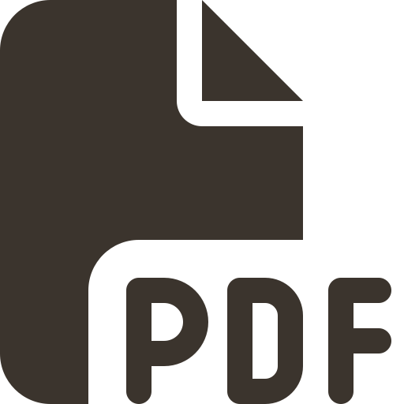
WHERE ARAMAM IS TODAY
How a sale becomes a number today
As we understand it from our discussions. Correct us where we have it wrong — the detail matters.
→
→
→
→
Outlets sell
Monthly summary
One finance desk
Re-keyed into Tally
Reports, eventually
POS records the sale at each outlet.
Sales consolidated by hand at month end.
Everything lands with the central finance person.
Ledgers entered manually, entry by entry.
MIS assembled in Excel, weeks after the fact.
Meanwhile, off the system entirely
Purchases, GRNs and supplier prices tracked on spreadsheets and messages
Outlet-to-outlet transfers agreed informally, rarely recorded
Recipes and portion costs held in people's heads, not in a system
Closing stock arrived at by count and estimate, not by movement
Gerab System Solutions · Microsoft Dynamics 365 Business Central for Aramam
6
Notes:
Say this back to them as their story, not as criticism. If they correct a step, that is a good sign — they are engaged.

Slide 7






THE PROBLEM
Six things this setup cannot do
None of these are people problems. They are what happens when a group's operations run on manual consolidation and a desktop ledger.
You find out a month late
Every number is typed twice
Stock visibility stops at the outlet door
Sales reach finance as a monthly summary. By the time a problem is visible in the books, the month that caused it is already closed.
Manual re-entry into Tally is slow, error-prone and unauditable — and it rests on one person. That is a single point of failure for the entire group.
There is no live group-wide stock position, no controlled transfer between outlets, and no reliable answer to "what do we actually hold right now?"
Buying without control
Food cost is estimated, not measured
Reporting is a monthly craft project
No requisition-to-PO-to-GRN discipline, no approved supplier price lists, no price history — so purchase price creep goes unnoticed.
Without recipes linked to POS sales, theoretical consumption cannot be calculated — so wastage, over-portioning and pilferage stay invisible.
MIS is rebuilt by hand in Excel each month. Outlet-wise profitability, on demand, is not currently possible.
Gerab System Solutions · Microsoft Dynamics 365 Business Central for Aramam
7

Slide 8



THE COST OF STANDING STILL
And this is the base you are about to scale
A cloud kitchen adds a production location, new SKUs, new transfer routes and new delivery-channel revenue — on top of a process that is already manual.
~30 days
1 person
0
Unmeasured
between a sale happening and a reviewed, posted number
carrying the group's ledger — a single point of failure
live, system-held stock positions across outlets
food cost variance — no theoretical vs actual to compare
Compliance is tightening
Volume is about to jump
Decisions run on stale data
The UAE is moving to mandatory e-invoicing. Manual ledgers and offline entry are the wrong starting point for that transition.
New location, new channels, more transactions — the manual month-end does not scale linearly, it breaks.
Menu, pricing and supplier decisions are being made on numbers that are already a month old.
Gerab System Solutions · Microsoft Dynamics 365 Business Central for Aramam
8
Notes:
This is the pivot slide. Land the point that the problem is not today's pain — it is what today's pain becomes at twice the volume.

Slide 9
WHAT GOOD LOOKS LIKE
The same business, running on evidence
Nothing here is aspirational software talk — each row is a specific change in how a day at Aramam works.
TODAY
WITH BUSINESS CENTRAL
Sales reach finance
Monthly, as a typed summary
Daily, posted automatically from POS
Stock position
Counted, estimated, argued about
Live by outlet, by item, by batch
Buying
Ad-hoc orders, prices unverified
Requisition → approval → PO → GRN → invoice match
Transfers between outlets
Informal, largely unrecorded
Transfer orders with in-transit visibility
Food cost
A number arrived at after the fact
Recipe-driven theoretical vs actual, per dish, per outlet
Management reporting
Rebuilt in Excel each month
Role-based dashboards, refreshed daily
Gerab System Solutions · Microsoft Dynamics 365 Business Central for Aramam
9

Slide 10


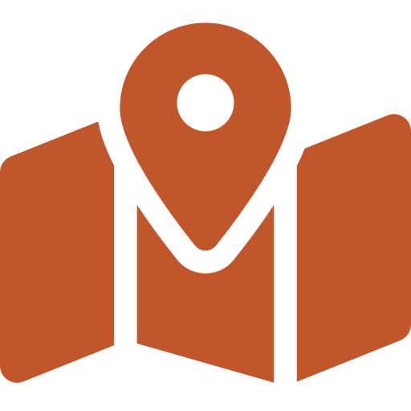


THE RECOMMENDATION
Microsoft Dynamics 365 Business Central
MICROSOFT / D365 LOGO
One cloud ERP covering finance, inventory, purchasing and production — not four disconnected tools stitched together with spreadsheets.
One system, not four
Cloud, from Microsoft
Your team already knows it
Finance, stock, purchasing and recipe costing share the same data. Post once, see it everywhere.
No servers to buy or patch. Updated twice a year, backed by Microsoft's SLA and security.
Native Excel, Outlook and Teams integration. Finance can still work in Excel — on live data.
Built for many locations
Power BI included in the story
UAE-ready
Locations, dimensions and inter-company are standard, not bolted on. Adding an outlet is configuration.
Role centres in the app, and full Power BI dashboards for management and owners.
VAT handling, audit trail and a clear path to the UAE e-invoicing mandate through accredited providers.
Gerab System Solutions · Microsoft Dynamics 365 Business Central for Aramam
10

Slide 11


SCOPE
Three focus areas, one foundation
These are the three areas you asked us to solve. They are not three projects — they are three views of the same data.
01
02
03
Inventory & procurement
Recipe & consumption
Finance, dashboards & MIS
Central store, outlet and cloud-kitchen locations
Requisition → PO → GRN → invoice matching
Outlet-to-outlet transfer orders
Counts, batch and expiry, reorder points
Recipe cards with yield and portion cost
POS sales mapped to recipes automatically
Theoretical consumption posted per outlet
Theoretical vs actual variance and wastage
Automated posting from sales and purchases
Outlet-wise P&L through dimensions
VAT, AP/AR, banking, fixed assets, budgets
Management dashboards and the monthly MIS pack
Shared foundation: one chart of accounts · dimensions for Outlet, Brand and Cost centre · one item master · approval workflows · user roles and permissions
Gerab System Solutions · Microsoft Dynamics 365 Business Central for Aramam
11

Slide 12
FOCUS AREA 1 OF 3
Inventory and procurement across every outlet
One item master, one stock ledger, and every movement recorded as a transaction — receipts, issues, transfers, wastage and counts.
Item master with real units. Purchase in kg, box or crate; consume in grams or portions. Conversions handled once, centrally.
A location per outlet. Central store, each outlet and the cloud kitchen are separate locations with their own stock and their own reorder rules.
Procure-to-pay with control. Purchase requisition → approval → purchase order → goods receipt → three-way invoice match. Nothing is paid that was not received.
Supplier price lists and history. Approved prices per vendor, with variance flagged when an invoice does not match the order.
Transfer orders between outlets. Requested, approved, shipped and received — with in-transit stock visible, so nothing disappears between two branches.
Counts, batch and expiry. Cycle counts and full physical counts on a tablet; batch and expiry tracking for perishables.
Reorder points and replenishment. Minimum and maximum levels per item per location, with suggested purchase and transfer orders.
SCREENSHOT PLACEHOLDER
Business Central — item availability by location
or purchase order list · 16:9
ONE STOCK LEDGER, FOUR PLACES IT LIVES
Central store
↔
Outlet A
↔
Outlet B
↔
Cloud kitchen
Transfer orders move stock between locations with approval and in-transit tracking.
Gerab System Solutions · Microsoft Dynamics 365 Business Central for Aramam
12

Slide 13







FOCUS AREA 2 OF 3
Recipes, and consumption driven by POS
This is the piece that turns food cost from an opinion into a measurement. Every dish sold consumes its recipe, automatically.
→
→
→
→
1 Dish sold
2 Recipe applied
3 Consumption calculated
4 Stock reduced
5 Variance exposed
POS records 12 × Chicken Mandi at Outlet A.
Each dish is mapped to a recipe with exact quantities and yield.
Theoretical raw-material usage is derived — rice, chicken, spice mix.
Inventory at that outlet is drawn down automatically. No manual issue notes.
Theoretical vs counted actual shows exactly where wastage or loss sits.
Sub-recipes
Live dish costing
Wastage & staff meals
Sauces, marinades and bases are recipes in their own right, reused across dishes and costed once.
When a supplier price changes, every recipe using that item is re-costed — so menu margin is always current.
Recorded as their own transactions, so they are visible and controllable rather than hidden in variance.
Gerab System Solutions · Microsoft Dynamics 365 Business Central for Aramam
13
Notes:
If they push on POS integration feasibility, move straight to the architecture slide. Confirm the POS product and whether it exposes an API or scheduled export.

Slide 14
FOCUS AREA 3 OF 3
Finance that closes, MIS that arrives early
Entries post themselves from the transactions that created them. Finance moves from data entry to review and analysis.
IN THE LEDGER
Automated posting. Daily sales from POS and purchase invoices post to the GL without re-keying.
Dimensions, not sub-ledgers. Tag every entry with Outlet, Brand and Cost centre — outlet-wise P&L becomes a filter, not a rebuild.
AP, AR and banking. Supplier ageing, payment runs and bank reconciliation in one place.
VAT and returns. Tax posting groups configured for UAE VAT, with the return prepared from the ledger.
Budgets vs actual. Budget by outlet and by cost line, compared automatically each period.
Fixed assets. Kitchen equipment and fit-out tracked with depreciation schedules.
Approvals and audit trail. Nothing edits silently — every posted entry traces back to its source document.
SCREENSHOT PLACEHOLDER
Power BI management dashboard
or Business Central role centre · 16:9
THE MONTHLY MIS PACK
Daily sales flash by outlet
Outlet-wise P&L
Food cost % vs target
Dish margin — top and bottom
Purchase price variance
Stock ageing and wastage
AP ageing and cash position
Budget vs actual by outlet
Gerab System Solutions · Microsoft Dynamics 365 Business Central for Aramam
14

Slide 15
HOW IT FITS TOGETHER
The solution architecture
Your POS stays where it is. Business Central becomes the system of record behind it, and Power BI becomes the window onto both.
Channels
Outlet POS terminals (dine-in & takeaway) · delivery aggregators · cloud-kitchen ordering · catering and events
Integration layer
Scheduled sales import or API connector · menu-item to recipe mapping · aggregator settlement reconciliation · error and exception log
Dynamics 365 Business Central
Finance & GL · Inventory & locations · Purchasing · Assembly / production for recipes · Fixed assets · VAT · Approvals
Insight
Power BI management dashboards · Business Central role centres · refreshable Excel reports · scheduled MIS distribution
Microsoft platform
Azure cloud hosting · Microsoft Entra ID single sign-on and MFA · encryption in transit and at rest · backup and Microsoft SLA
Gerab System Solutions · Microsoft Dynamics 365 Business Central for Aramam
15
Notes:
Reassure them: we are not asking them to replace the POS. Integration is scoped in discovery once we confirm the POS product and its export or API options.

Slide 16




COMPLIANCE
Ready for what the UAE is asking for next
The move to structured, system-generated invoicing is not a reason to change ERP on its own — but it makes a manual desktop ledger an expensive place to be standing.
UAE VAT
E-invoicing readiness
Corporate tax ready books
A real audit trail
Tax posting groups, tax invoice formats and the VAT return prepared directly from the ledger rather than reconstructed.
Business Central supports structured electronic invoicing and integrates with accredited service providers for the UAE's phased mandate.
A clean, dimension-tagged audit trail and consistent period close — the foundation any corporate tax computation needs.
Posted entries cannot be silently edited. Every figure traces to a source document, a user and a timestamp.
Worth saying plainly: e-invoicing obligations in the UAE are being introduced in phases, and the applicable date depends on the entity. We will confirm Aramam's position with you in discovery — but a system that produces structured invoices natively is a far easier place to comply from than manual entry into a desktop ledger.
Gerab System Solutions · Microsoft Dynamics 365 Business Central for Aramam
16
Notes:
Do not quote a specific mandate date unless you have verified Aramam's revenue band and the current MoF phase schedule. Keep it as a readiness argument.

Slide 17

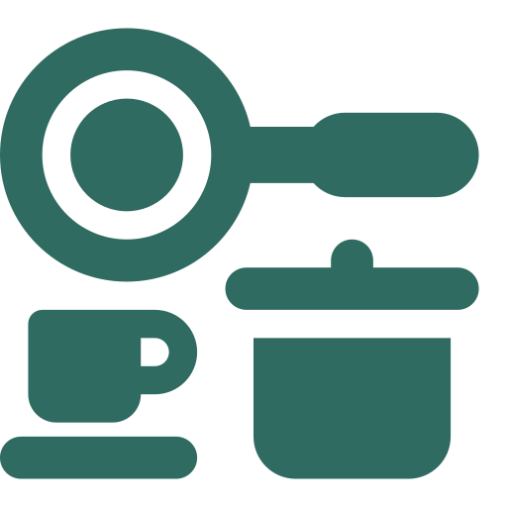




BUILT FOR WHAT IS COMING
The cloud kitchen, from day one
PHOTO PLACEHOLDER
cloud kitchen / central production
The hardest time to put a system in is after the new site opens. Doing it now means the cloud kitchen launches onto a platform that already works.
A new site is configuration, not a project
Central production, distributed outlets
Delivery channels tracked separately
Add a location, assign users, inherit the item master and the approval rules. Days, not months.
Produce in the cloud kitchen, transfer to outlets on transfer orders, and keep one accurate stock position across both.
Aggregator and direct-delivery revenue posted to their own dimensions, with commission and settlement visible.
Channel-level profitability
Licensing follows users, not sites
One process, repeated
See what a dish actually earns on delivery versus dine-in, once commission and packaging are in the cost.
Opening another location does not multiply the licence cost — you add the users who need access.
The SOPs, approvals and reports built in this project apply to the next site unchanged.
Gerab System Solutions · Microsoft Dynamics 365 Business Central for Aramam
17

Slide 18
OUR DELIVERY MODEL
Product capability + Gerab expertise = your solution
Microsoft supplies a world-class platform. What makes it work at Aramam is the configuration, the recipes, the integration and the training around it.
YOUR SOLUTION
A working system configured to your outlets, your menu, your suppliers and your approval rules.
GERAB CONSULTING, CONFIGURATION & INDUSTRY EXPERTISE
Process design, POS integration, recipe and data migration, training, and support after go-live.
PRODUCT CAPABILITY — MICROSOFT DYNAMICS 365 BUSINESS CENTRAL
Finance, inventory, purchasing, production, security and reporting — maintained by Microsoft.
Gerab System Solutions · Microsoft Dynamics 365 Business Central for Aramam
18

Slide 19
HOW WE DELIVER
An indicative implementation roadmap
Sequenced so the highest-pain areas — stock control and the finance close — come under control first. Durations are confirmed after discovery.
01
02
03
04
05
Discovery & blueprint
Configure & build
Data migration
UAT & training
Go-live & hypercare
2–3 weeks
4–6 weeks
2 weeks, parallel
2–3 weeks
4 weeks
Process study: outlets, store, finance
Chart of accounts & dimensions
Item, supplier & recipe templates
POS integration assessment
Company, locations & approvals
Purchasing, transfers & inventory
Recipes & production setup
POS connector & Power BI
Item, supplier & customer masters
Opening balances from Tally
Opening stock by location
Reconciliation & sign-off
Scenario testing with your team
Training: outlet, store, finance
SOP documentation
Go-live readiness checklist
Cutover over a weekend
On-site support in week one
First month-end close, supported
Handover to the AMS desk
Indicative only. The sequence and durations are confirmed in the discovery phase and agreed with you before we commit to a plan.
Gerab System Solutions · Microsoft Dynamics 365 Business Central for Aramam
19

Slide 20
WORKING TOGETHER
What each side brings
Implementations fail on availability, not on software. Being explicit about this now is the cheapest insurance in the project.
Gerab delivers
Aramam provides
Solution design and system configuration
POS and aggregator integration build
Data migration tooling and load
Recipe and costing setup with your chefs
Power BI dashboards and the MIS pack
Role-based training and SOP documentation
Go-live cutover, hypercare and ongoing AMS
An executive sponsor who can unblock decisions
A process owner each for operations, store and finance
Cleaned item, supplier and recipe data in our templates
Access to the POS vendor for the integration
Availability of outlet and store staff for UAT and training
Timely sign-off at each phase gate
Agreement on the cutover weekend
Gerab System Solutions · Microsoft Dynamics 365 Business Central for Aramam
20

Slide 21
COMMERCIALS
How Business Central is licensed
Named users on a monthly subscription, plus a one-time implementation and an annual support agreement. No server hardware, no perpetual licence.
Essentials
Premium
Team Members
For most of the group
Where production is needed
For light, read-mostly users
Finance and GL
Inventory and locations
Purchasing and approvals
Sales and receivables
Project and job costing
Warehouse basics
Everything in Essentials
Manufacturing and production orders
Assembly and recipe BOMs
Service management
Recommended for kitchen production users
Read all data
Approve and enter time
Update existing records
Suited to outlet managers who consume reports
Lowest cost per user
Commercial proposal: user counts, licence mix, implementation fee and annual support are set out in the separate commercial document. [Insert summary figure or leave for the commercial meeting.]
Gerab System Solutions · Microsoft Dynamics 365 Business Central for Aramam
21
Notes:
Do not quote per-user pricing from memory — confirm current Microsoft UAE list pricing before the meeting, or defer to the commercial document.

Slide 22
THE CASE FOR THIS APPROACH
Why Business Central, and why Gerab
Why Business Central
Why Gerab System Solutions
PLATFORM STRENGTHS
DELIVERY STRENGTHS
Microsoft's ERP for mid-sized business — proven, current, and not going anywhere
Finance, stock, purchasing and production in one data model
Multi-location and multi-company are standard capability
Native Excel, Outlook, Teams and Power BI integration
Cloud-delivered: no servers, automatic updates, Microsoft SLA
Structured invoicing and a clean audit trail for UAE compliance
Wide skills availability — you are not locked to one consultant
Microsoft partner delivering Dynamics 365 and the wider Microsoft stack
UAE-based consultants who understand local compliance and local operations
Experience across construction, trading, manufacturing and services groups
Integration capability — POS, aggregators and third-party systems
One partner for licensing, implementation, BI and ongoing support
Power BI and SharePoint capability to extend the platform later
A support desk after go-live, not a handover email
Gerab System Solutions · Microsoft Dynamics 365 Business Central for Aramam
22

Slide 23
NEXT STEPS
Let the detail decide it.
Before anyone signs anything, we would rather walk the floor. Two days with one outlet, the central store and the finance desk will tell us — and you — exactly what this project is.
01
02
03
Discovery walkthrough
Scoped proposal
Tailored demo
Half a day at one outlet and the central store, half a day with finance. No cost, no obligation.
A fixed scope, a phased plan and a commercial proposal built on what we saw — not on assumptions.
Business Central shown with your menu, your outlets and your recipes — not a generic demo dataset.
[Your name] · Business Development, Gerab System Solutions · [email] · [mobile]
GERAB LOGO
↑ Full-bleed background image placeholder — replace this rectangle's fill with a photo, then delete this note.
Notes:
Close by asking for the walkthrough, not for the decision. It is a small yes that puts you inside the operation.

