Slide 1
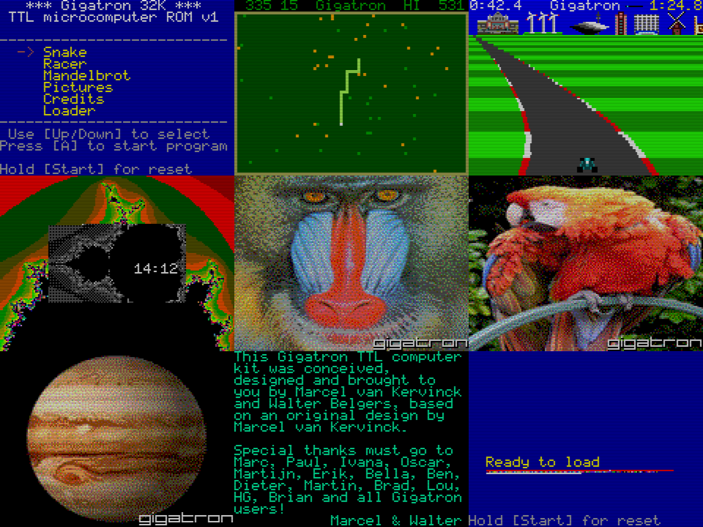
EPROM contents of Gigatron TTL computer
VGA
video card
16-bit vCPU
Cold start
4 channel synthesizer
8-bit v6502
Interrupts
LED runner
Character generator
Input controller
SPI driver
Accelerators
Entropy mixer
Virtual hardware
< 10%
File storage
> 90%

