Slide 1

FINAL SUBMISSION
RAD-SMART
AI-assisted radiotherapy scheduling inside CARE: one standing time per course, re-planning in seconds after a breakdown, and messages to patients in their own language
Cancer track · Use case 04: Clinic Operations & Patient Flow
TEAM NAME RAD-SMART
TEAM CODE YU8PAK
HEALTH-A-THON 2026 • TITLE

Slide 2
Team Overview & Background
Clinicians from the department RAD-SMART is built for, and the engineers who built it
THE TEAM
THE DEPARTMENT
Radiotherapy department, Manipal
One linear accelerator, an Elekta Versa HD; a second machine arrives in 2027
70–90 patients a day, from 08:30 until about 01:00
Its technologists and doctors answered our questions in writing on 21 Sep and 24 Oct; their rules are in the code
Shared 55 days of records (3,137 visits) as anonymised totals
AD
SL
UV
Dr Akshay Dinesan
Team leader · doctor partner
Clinical owner and pilot sponsor. Wrote the problem statement from daily work in the department
Dr Shirley Lewis Salins
Doctor partner
Clinical review of the department's rules and of the design; joins the pilot
Dr Umesh Velu
Doctor partner
Clinical review of the department's rules and of the design; joins the pilot
AT
PR
THE PLATFORM
CARE, the open-source hospital information system of the Open Healthcare Network.
RAD-SMART is a CARE plugin: it uses CARE's own patients, users and roles, with no change to CARE's code.
Abhinand T M
Technical lead
Coordinates the team, the doctors and the submissions; reviews the build
P S Raghotham Rao
Lead engineer
Built the scheduling engine, the digital twin, the CARE plugin and the Sarvam AI layer; ran the evaluation
HEALTH-A-THON 2026 • FINAL SUBMISSION

Slide 3
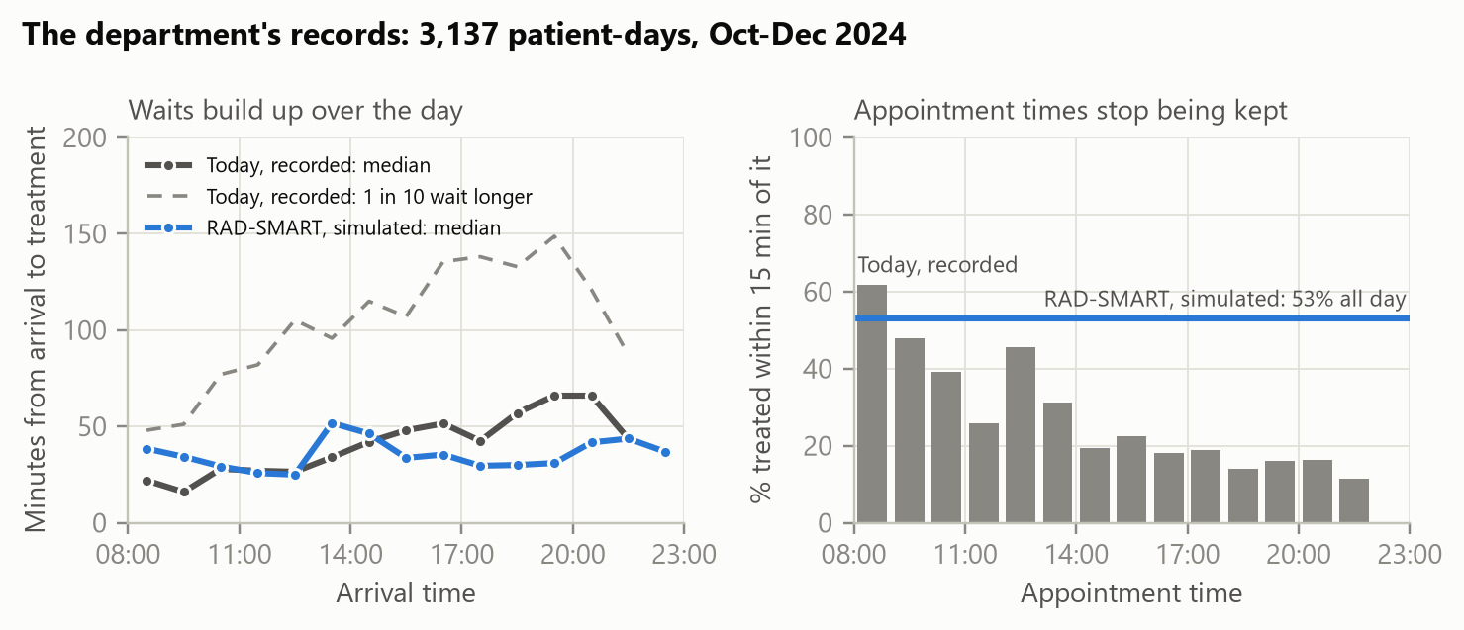
Problem Statement and Supporting Evidence
One machine, 70–90 patients a day, times given by hand: waits build up every day of a 1–7 week course
109 min
1 patient in 10 waits longer than this, from arrival to treatment
22%
are treated more than an hour after their appointment time
29%
are treated within 15 minutes of their appointment time
69%
of India's radiotherapy facilities have only one machine, like this one
WHY IT MATTERS
Patients come every weekday for 1–7 weeks, usually with a family member, many by public transport or the hospice bus.
WHAT GOES WRONG TODAY
Times are given by hand, without knowing how long each session takes, so too many patients are asked to come at once
A breakdown is handled by phone calls and guesswork; patients already on a bus are not told
WHAT MUST IMPROVE
Times that are kept, a fast and fair answer to breakdowns, and patients told early, in their own language.
The department's records: 55 working days, Oct–Dec 2024, 3,137 visits, anonymised totals. Blue: RAD-SMART in the calibrated digital twin.
HEALTH-A-THON 2026 • FINAL SUBMISSION

Slide 4
Target Users and Use Case
Setting: a radiotherapy department with one linear accelerator, running the CARE hospital system
Radiation oncologist
NEEDS
A time that fits the treatment plan, without phone calls
IN RAD-SMART
Enters the course from the patient's visit; approves the first day and one standing daily time
Radiation therapy technologist
NEEDS
A day that runs to time, and a quick answer when the machine breaks
IN RAD-SMART
Runs the day board (arrived, in room, out); declares a breakdown and approves the re-plan; sends messages
Reception
NEEDS
Fast, certain check-in
IN RAD-SMART
Scans the QR code on the patient's phone, or types its six letters
Patient and family
NEEDS
To know when to come, in their own language, before leaving home
IN RAD-SMART
Open one private link: today's time, any change, a voice note, and four reply buttons
Head of department
NEEDS
Evidence that long waits are falling
IN RAD-SMART
Sees waiting times and punctuality on Insights, from the times the board records
HOW IT FITS THE WORKFLOW
Inside CARE
A RADSMART button on the patient's visit page; CARE's own logins, roles and patient records
On the day
One board at the machine console and a check-in page at reception; one tap per patient
For patients
One private link with no app or login; messages open in WhatsApp, which patients already use
HEALTH-A-THON 2026 • FINAL SUBMISSION

Slide 5
Solution Overview, Key Features & Impact
An assistive scheduler inside CARE: it predicts, plans, re-plans and tells; a person approves every change
1
Predict
2
Plan
3
Re-plan
4
Tell
How many minutes each session takes on the machine, from technique, site and patient needs
Each course gets a first day and one standing daily time, from an optimiser that cannot break the department's hard rules
After a breakdown, a new plan in 10 to 14 seconds under the department's own rules
Messages and voice notes in Kannada, Malayalam, Hindi or Konkani by Sarvam AI, on WhatsApp and a phone page
KEY FEATURES, BUILT AND WORKING
Standing slots
One time per course, free on every treatment date
Day board
Arrival, in room, out, and a live check of 9 hard rules
Breakdown re-plan
A proposal for each remaining patient, approved by a person
Requests
Patients ask for another daily time; staff decide
Messages
Drafted after every approval, translated, with a voice note
Patient phone page
Today's time, changes and replies; no app, no login
QR check-in
Reception scans the code on the patient's phone
Explain and Insights
Why this time, in plain words; waits from the board
A person approves every change. RAD-SMART decides only when a patient is treated, never whether or how.
HEALTH-A-THON 2026 • FINAL SUBMISSION

Slide 6
Solution Overview, Key Features & Impact
The journey, from the doctor's course entry to the patient's phone, and the impact we expect
DOCTOR
Enter the course
In: Prescription, technique, needs and a priority checklist, from the visit in CARE
Out: A first day and a standing time, with reasons and an alternative
DOCTOR
Approve
In: The proposal
Out: The course is booked; the patient's link and QR code are ready
TECHNOLOGIST
Run the day
In: Arrived, in room and out taps on the day board
Out: A live rule check; real session minutes recorded
TECHNOLOGIST
Breakdown
In: The fault and its expected length
Out: A re-plan in seconds; a person approves it
PATIENT
Is told
In: The approved time or change
Out: A WhatsApp message and voice note in their language; check-in by QR
EXPECTED IMPACT
−35%
90th-percentile wait on the department's 55 days: 108.6 → 70.4 min
22% → 5.7%
of patients treated more than an hour late
29% → 50%
of patients treated within 15 minutes of their time
104 → 39 min
median wait after a 150-min breakdown, re-planned live; new plan in 14 s
Replayed in a digital twin calibrated on the department's records (it reproduces today's long wait: 106 against 109 min), and on synthetic breakdown days. Not yet a live trial: the 90-day pilot targets a 90th-percentile wait at least 25% below 109 min.
HEALTH-A-THON 2026 • FINAL SUBMISSION

Slide 7
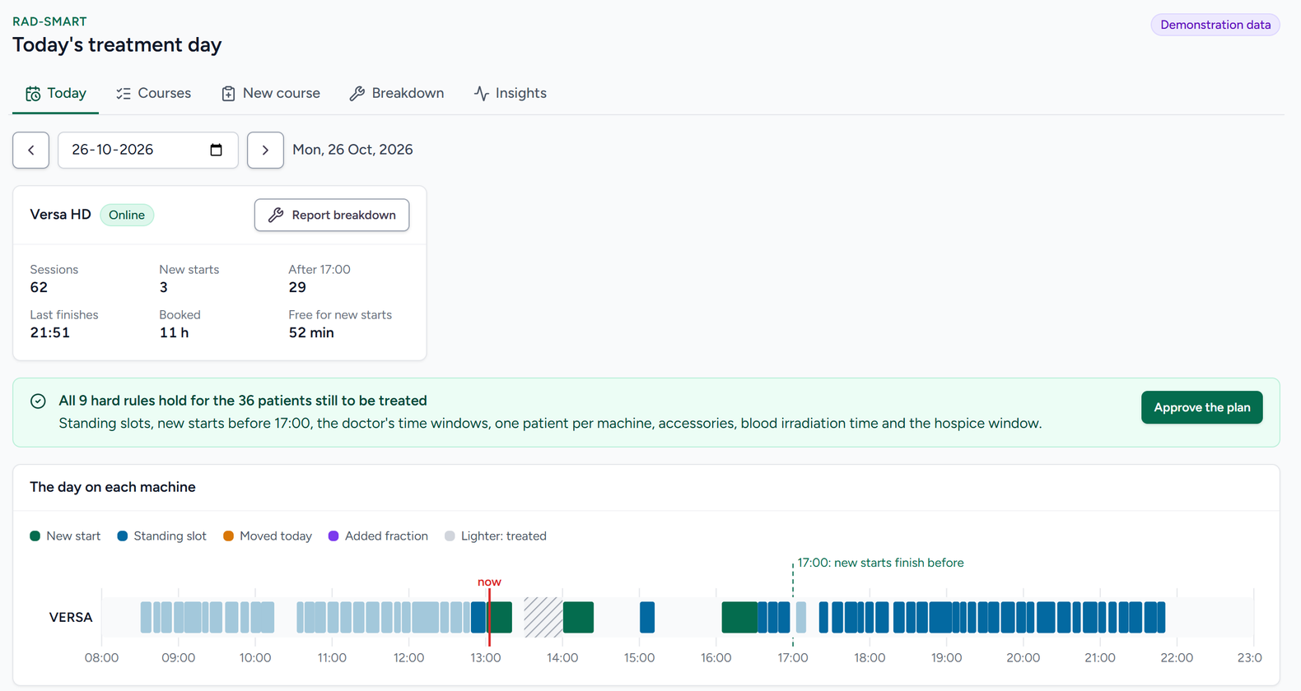
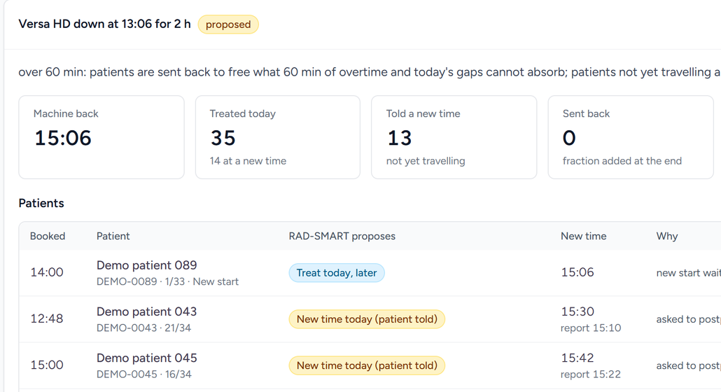
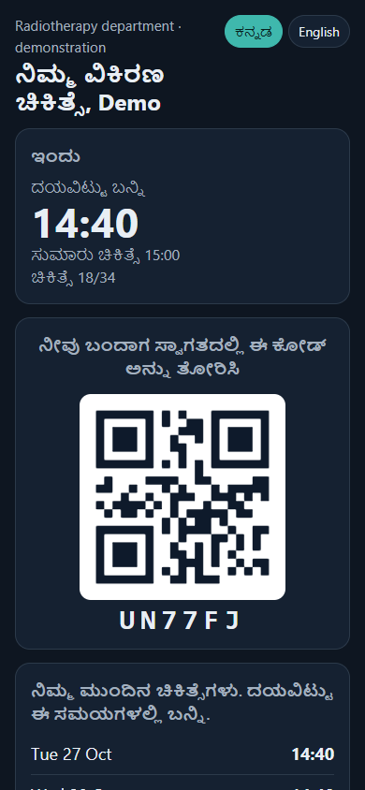
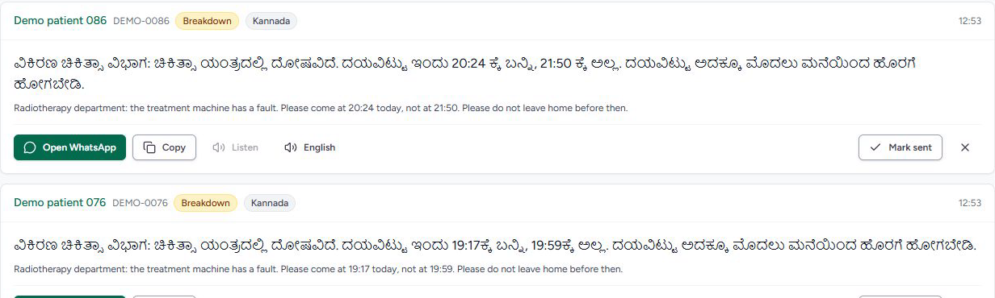
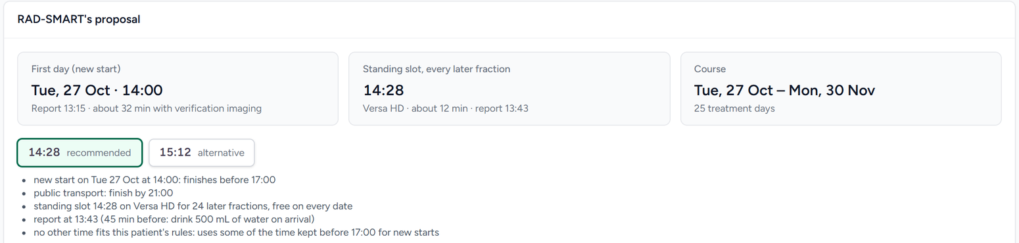
Solution Working MVP / Demo
A working application inside CARE today, shown here with synthetic patients
Breakdown: a proposal per patient, approved by a person
Today: the machine card, the live check of 9 hard rules, the day's timeline
Messages: Kannada and English, voice note, WhatsApp
DEMO VIDEO · 3¾ MIN, NARRATED
The real app, one day from course entry to a breakdown and the patient's phone
Watch it on the project website
Code on GitHub
Patient's phone page, in Kannada, with the check-in QR code
Course: a first day and a standing time, with reasons; a doctor approves
HEALTH-A-THON 2026 • FINAL SUBMISSION

Slide 8
Technology, Tools and AI Approach
Each part does what it is best at: the optimiser guarantees the rules; language models only translate and explain
INPUT
Course in CARE
The doctor's entry on the patient's visit page
1 · PREDICT
Gradient boosting
scikit-learn: minutes each session takes
2 · PLAN, RE-PLAN
Mixed-integer optimiser
SciPy with HiGHS: the rules are hard constraints
SAFETY GATE
Check and approve
An independent rule checker, then a person approves
3 · TELL
Sarvam AI
Translate, Bulbul v3 voice, Sarvam-105B explanations; every output checked
OUTPUT
The patient
WhatsApp message, voice note and phone page
TESTING, DATA, INTEGRATIONS AND STACK
Digital twin
A simulation calibrated on the department's 55 days; it reproduces today's long wait (106 against 109 min)
Tests every plan and measures with and without RAD-SMART before patients are affected
Data
Department records, 55 days, as anonymised totals: calibrate the twin
Synthetic patients: train the minute model, run the demo and the evaluation
Real session minutes: recorded by the day board from the first pilot day
Integrations
CARE's patients, users and roles; installs as a plugin
WhatsApp: a message opens in the department's own WhatsApp; staff press send
QR check-in by USB scanner or camera
Sarvam over HTTPS; everything else runs offline
Stack
Python, Django REST framework, PostgreSQL (CARE)
React and TypeScript (CARE frontend plugin)
scikit-learn, SciPy with HiGHS, NumPy
Docker Compose · about 10,600 lines of code
HEALTH-A-THON 2026 • FINAL SUBMISSION

Slide 9
Build Sprint Journey and Progress
From a Round 1 engine to a working CARE application with a patient side (sprint: 5 Oct – 8 Nov)
19 Sep
22 Sep
5 Oct
21 Oct
24 Oct
25 Oct
By 8 Nov
Round 1 entry: engine, digital twin, results page
Department's first answers built in; twin calibrated on its 55 days
Shortlisted; build sprint starts
Technical guide and maths notes for the department
Department's second answers built in; a working app inside CARE
Sarvam AI layer, patient page, QR check-in, evaluation, narrated video
Technologist trial, native-speaker ratings, final submission
FUNCTIONAL NOW
Course entry with a standing time, approved by a doctor
Day board: arrival, in room, out, live rule check
Breakdown re-planning, approved by a person
Requests for another time, decided by staff
Messages in 4 Indian languages with voice notes, opened in WhatsApp
Patient phone page, replies and QR check-in
Plain-words explanations, with a time check
Insights · 20 automated safety tests
HOW IT CHANGED
From idea to app: Round 1 was an engine with a simulation; it now runs inside CARE, with a patient side.
After the department's answers: one standing time per course; new starts finish before 17:00; their 60-minute breakdown rule; only a doctor approves a course.
Challenges found in testing, fixed: Kannada attaches suffixes to times; Konkani turned "the next working day" into "next week", so messages now name the date; an explanation used the proposed time; one patient button was unclear.
NOT YET BUILT
Automatic WhatsApp sending (needs the hospital's Meta business verification)
Spoken replies from patients
A Tulu voice (no Sarvam model; staff can record one)
Importing Excel lists and paper prescriptions
Changing rules in plain words
A read-only feed from MOSAIQ or ARIA
Live planning for two machines (forecast only)
HEALTH-A-THON 2026 • FINAL SUBMISSION

Slide 10
Evaluation and User Validation
Scheduling: the department's own 55 days replayed in a calibrated digital twin, and synthetic scenarios
90TH-PERCENTILE WAIT, MINUTES: WITHOUT AND WITH RAD-SMART
22.2% → 5.7%
treated more than an hour late, on the department's days
28.9% → 49.5%
treated within 15 minutes of their time
104 → 39 min
median wait after the breakdown; a new plan in 14 s
0
hard rules broken on any evaluation day, by an independent checker
Limitation: a replay, not a live trial. The pilot measures the gain for real.
Same patients and the same random events with and without RAD-SMART. The breakdown row is 300 synthetic days with a 150-minute fault at 10:00.
HEALTH-A-THON 2026 • FINAL SUBMISSION

Slide 11
Evaluation and User Validation
The AI parts are measured, and the department's feedback and our tests changed the design
2.15 min
session-length error on 2,000 held-out synthetic sessions (2.62 for a table of averages)
7.1 s
to a proven optimum for an 87-patient day, about 4,800 variables, on a laptop
112 / 112
Sarvam translations kept every clock time: Kannada, Malayalam, Hindi, Konkani
76–80
median back-translation score (chrF) by language: meaning kept, a rough check
20 / 20
Sarvam-105B explanations accepted, with no invented time
USER VALIDATION SO FAR
The department's technologists and doctors answered in writing on 21 Sep and 24 Oct: roles, standing slots, breakdown rules and the screens they need. All of it is built.
Planned before 8 Nov: technologists run the demo day on the app, and native speakers rate all 112 translations (the rating sheet is ready).
Evidence: every translation with its back-translation, and the full results, are in docs/evaluation in the code repository.
IMPROVED FROM THE RESULTS
The time check reads times in every Indian script; Kannada suffixes were missed at first
Messages name the date: Konkani turned "the next working day" into "next week"
Explanations use the time in force, not the proposed one
An unclear patient button was reworded
20 automated safety tests now guard all of this
LIMITATIONS
Scheduling results are a replay, not a live trial
Session lengths are synthetic until the board records real ones
If patients keep arriving very early, the busy-day wait is 110 min, not 76
Back-translation is a rough check; native speakers must rate
Sarvam has no Tulu model: Tulu speakers get Kannada
HEALTH-A-THON 2026 • FINAL SUBMISSION

Slide 12
Safety and Responsible AI
RAD-SMART proposes and people decide; the AI is fenced in, and patients' details stay out of it
HUMAN OVERSIGHT AND SAFEGUARDS
A doctor approves each course and its time; a technologist or doctor approves every change on the day, breakdowns included. The approver and time are recorded
Hard rules are optimiser constraints, so a plan that breaks one cannot be made; an independent checker re-checks every plan
It decides only when, never whether or how; it is not a diagnostic or treatment-planning tool
If a hard rule is broken during the pilot, the department returns to manual scheduling
AI LIMITS AND ERROR HANDLING
Language models never schedule; they translate and explain decisions already approved
A translation that drops, changes or adds a clock time is discarded: the patient gets English
An explanation with a time not in the engine's facts is rejected; the prompt forbids medical advice
If Sarvam is down, messages go in English: scheduling never depends on it. Staff read both texts before sending
PRIVACY, CONSENT AND SECURITY
No names, hospital numbers or phone numbers go to Sarvam: only message text with times and dates
Patient page: a long random link, first name only, six replies a day at most; the QR holds a six-letter code
Sent from the department's own WhatsApp by a person; demo and evaluation data are synthetic
Pilot: DPDP Act 2023 and Rules 2025 (notice and consent for messaging) and ethics committee review
FAIRNESS, ACCESS AND INCLUSION
Older patients, patients on public transport or the hospice bus, and doctors' time windows are protected by explicit rules, not left to chance
Messages in Kannada, Malayalam, Hindi and Konkani, with voice notes for those who read little
Tulu speakers read Kannada; staff can record a Tulu voice note
Works on any phone with a browser: no app, no login; the page switches between the patient's language and English
Patients can ask for another daily time from the page; staff decide
HEALTH-A-THON 2026 • FINAL SUBMISSION

Slide 13
Deployment, Cost and Sustainability Plan
Installs as a CARE plugin on the hospital's own server; about ₹1 a message to run
WHAT A PILOT NEEDS
A CARE instance (the hospital's, or a VM running CARE with Docker Compose); RAD-SMART installs as a backend and a frontend plugin
A laptop or tablet at the machine console and at reception; a USB QR scanner or the camera
The department's WhatsApp on a staff phone or WhatsApp Web
Internet and an API key for Sarvam; everything else works offline
Approval by the head of department, the ethics committee and hospital IT
Item, with the pricing assumption | Estimate (₹)
ONE-TIME
Server with UPS (₹0 on an existing hospital VM) | 0 – 1,50,000
Tablets for console and reception (₹0 on existing PCs) | 0 – 60,000
QR scanner and labels | 5,000 – 15,000
Software licence (open source) | 0
ONGOING
Per message, about 190 characters: translation ₹0.38 + voice ₹0.57 | about 1
Per course: about 3 messages, plus explanations under ₹0.10 | about 3 – 5
Per facility per month: about 85 new courses, plus breakdown messages | about 400 – 850
Hosting on the hospital's own server or VM | 0
INTEGRATION
Uses CARE's own patients, facilities, users and permissions, adds its own tables, and installs and removes like any CARE plugin. Next: a read-only feed from the oncology information system (MOSAIQ or ARIA, HL7 v2 or FHIR R4), so courses are not typed twice; later, the WhatsApp Business API.
Sarvam list prices, to confirm before the pilot: Translate ₹20 and Bulbul v3 ₹30 per 10,000 characters; Sarvam-105B ₹4 and ₹16 per million tokens in and out. About 1,000 courses a year. Voice notes are made only when played.
Scale and sustain: a 90-day pilot on the Versa HD, then the second machine in 2027, then other hospitals that run CARE. 69% of India's radiotherapy centres have one machine. Open source and a few thousand rupees a year to run, so the department's own staff can keep it going after the pilot.
HEALTH-A-THON 2026 • FINAL SUBMISSION

Slide 14
What Next? Plans to Take It Forward
Validate with the department, then a 90-day pilot on the Versa HD
By 8 Nov 2026
Technologist trial of the demo; native speakers rate every translation
PILOT BUDGET
Up to about ₹2.3 lakh for a server, tablets and a QR scanner, or close to nothing on existing hospital PCs and a VM; Sarvam about ₹5,000–10,000 a year. No licence fee.
Nov – Dec 2026
Head of department approval; ethics committee review; hospital IT sign-off; patient notice and consent for messaging
Jan 2027
Pilot phase 1, two weeks: measure today's waits with the day board
MAKE THE SOLUTION PUBLIC?
Yes
The code, website, deck, research paper and demo video are already public and open source.
Feb 2027
Pilot phase 2, three weeks in shadow mode: RAD-SMART proposes, staff still schedule by hand, and we compare
Feb – Apr 2027
Pilot phase 3, eight weeks live; retrain the minute model on real minutes. Target: 90th-percentile wait at least 25% below 109 min
Later in 2027
WhatsApp Business API, spoken replies, the second machine, a read-only OIS feed, and the plugin offered to other CARE hospitals
HEALTH-A-THON 2026 • FINAL SUBMISSION

Slide 15
Thank you
RAD-SMART • YU8PAK
Contact: Dr Akshay Dinesan (team leader), Manipal, akshay.dinesan@manipal.edu
MVP and website: psraghothamrao8.github.io/RAD-SMART
Demo video: psraghothamrao8.github.io/RAD-SMART/#demo
Code repository: github.com/psraghothamrao8/RAD-SMART
Health-a-thon 2026
HEALTH-A-THON 2026

