Slide 1

FINAL SUBMISSION
RAD-SMART
Radiotherapy appointments that hold: one daily time per patient, a new plan in seconds when the machine breaks down, and messages in the patient's own language
TEAM NAME RAD-SMART
TEAM CODE YU8PAK
HEALTH-A-THON 2026 • TITLE
Notes:
RAD-SMART schedules radiotherapy inside CARE, the open-source hospital system, for a department with one machine.

Slide 2
Team Overview & Background
Doctors from the department RAD-SMART is built for, and the engineers who built it with them.
Dr Akshay Dinesan
Team leader, doctor partner
Wrote the problem statement from daily work; owns the clinical rules and the pilot
The department
Radiotherapy, Kasturba Medical College, Manipal (MAHE). One Elekta Versa HD treats 70 to 90 patients a day, 08:30 until about 01:00; a second machine arrives in 2027.
The doctor partner's role
Dr Akshay Dinesan brought the problem and the department's own records. The technologists' and doctors' written answers (21 Sep, 24 Oct) are in the code as rules, and their feedback (27 Oct) added preferred times and treating patients out of turn.
The platform
CARE, the open-source hospital information system of the Open Healthcare Network. RAD-SMART is a plugin: it uses CARE's patients, staff and roles, with no change to CARE.
Dr Shirley Lewis Salins
Doctor partner
Clinical review of the department's rules and the design
Dr Umesh Velu
Doctor partner
Clinical review of the department's rules and the design
Abhinand T M
Technical lead
Coordinates the team, the doctors and the submissions; reviews the build
P S Raghotham Rao
Lead engineer
Built the scheduling engine, the digital twin, the CARE plugin and the Sarvam AI layer
HEALTH-A-THON 2026 • FINAL SUBMISSION
Notes:
Five people: three doctors from the department and two engineers.

Slide 3
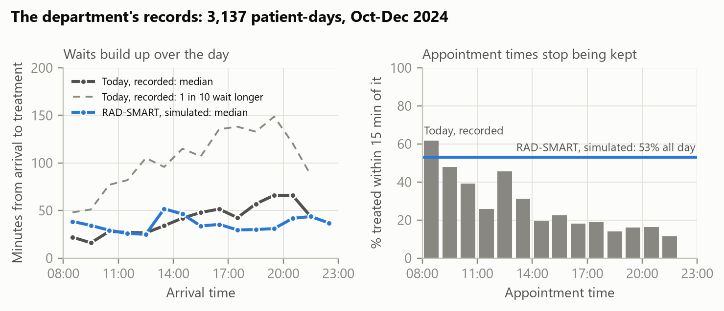
Problem Statement and Supporting Evidence
One machine, 70 to 90 patients a day, and the delay builds up every day of a one to seven week course.
109 min
one patient in ten waits longer than this, from arrival to treatment
22%
are treated more than an hour after their appointment time
69%
of India's radiotherapy facilities have only one machine, like this one
55 working days, used only as anonymised totals.
Times are given by hand, without knowing how long a session takes. A breakdown is handled by phone, and patients already on the bus are not told.
HEALTH-A-THON 2026 • FINAL SUBMISSION
Notes:
The waits come from the way times are given, not from the machine being too slow.

Slide 4
Target Users and Use Case
Five people shape a patient's day. Each gets one screen inside CARE, which the hospital already uses.
Who
What they need
What RAD-SMART gives them
Radiation oncologist
A time that fits the treatment plan
Enters the course from the patient's visit; approves a first day and one daily time
Technologist
To run the machine's day, and a fast answer when it breaks
The day board: Call next, Priority for an emergency, a re-plan in seconds after a breakdown
Reception
Fast, certain check-in
Scans the code on the patient's phone
Patient and family
To know when to come, in their language
One private link: times, voice notes, one-tap replies, morning, afternoon or evening
Head of department
Evidence that long waits are falling
Insights from the times the board records
Setting: a radiotherapy department with one linear accelerator, every weekday from 08:30 to about 01:00, running CARE.
HEALTH-A-THON 2026 • FINAL SUBMISSION
Notes:
The technologist is the heaviest user: the day board is open all day at the console.

Slide 5
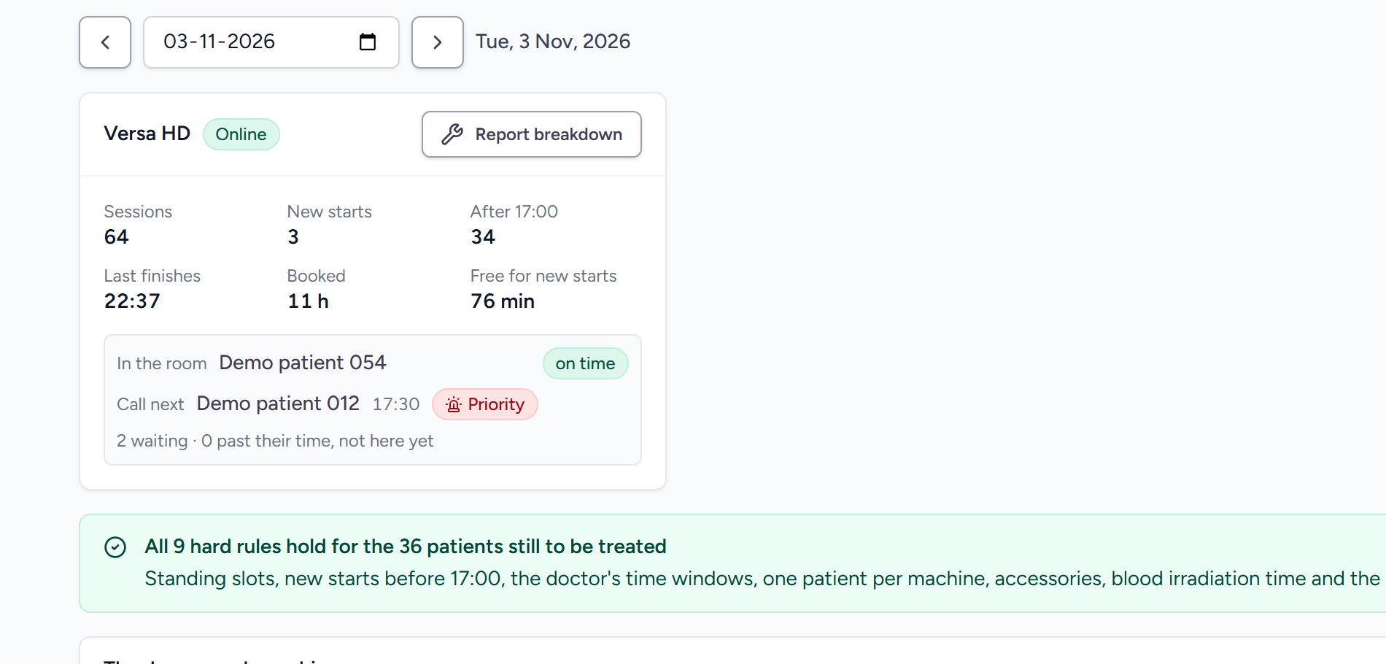
Solution Overview, Key Features & Impact
RAD-SMART predicts, plans, re-plans and tells. A person approves every change.
1
Predict
how many minutes each session will take, from the technique, site and the patient's needs.
2
Plan
each course a first day and one daily time, with an optimiser that cannot break a department rule.
3
Re-plan
the rest of the day in about 10 to 14 seconds when the machine breaks down.
4
Tell
patients in Kannada, Malayalam, Hindi or Konkani, with a voice note, on a phone page and WhatsApp.
The day board on the live demonstration: who is in the room, whom to call next, and the rule check.
RAD-SMART decides only when a patient is treated, never whether or how. Staff can always override it: take a patient in out of turn, or put one first.
HEALTH-A-THON 2026 • FINAL SUBMISSION
Notes:
Four steps; the optimiser guarantees the rules and a person approves.

Slide 6
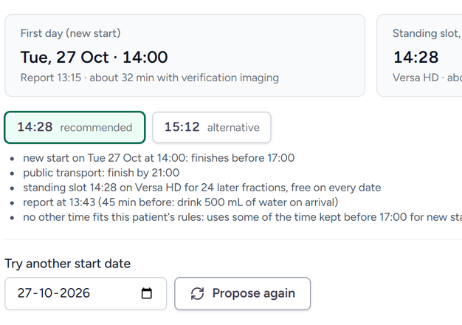
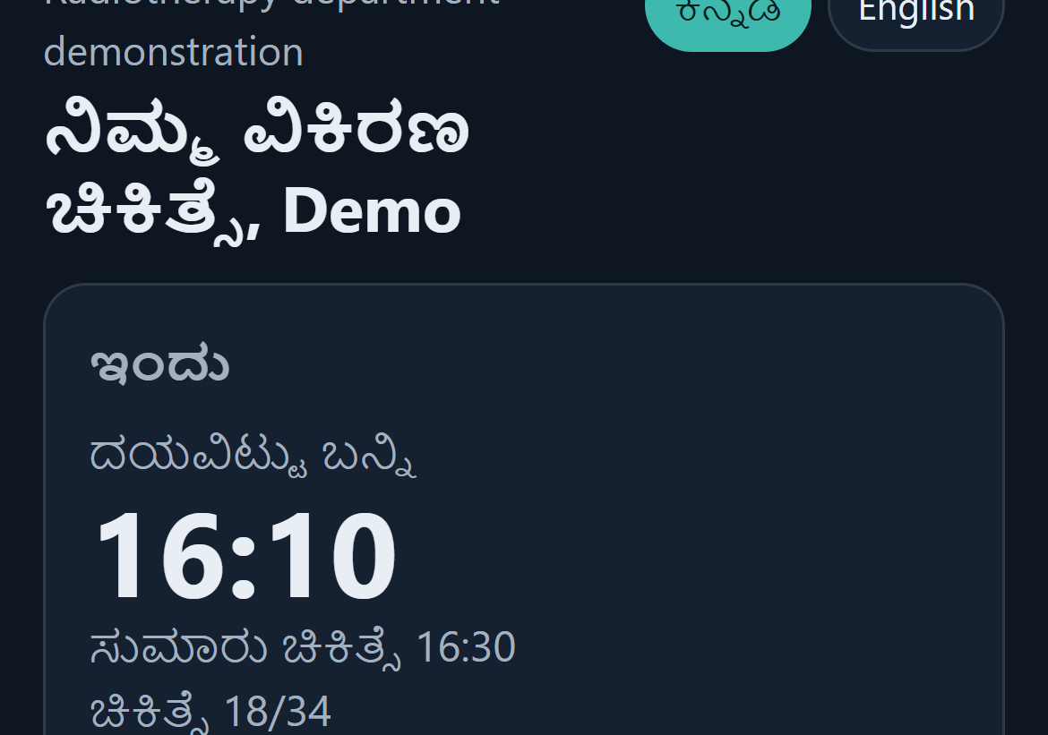
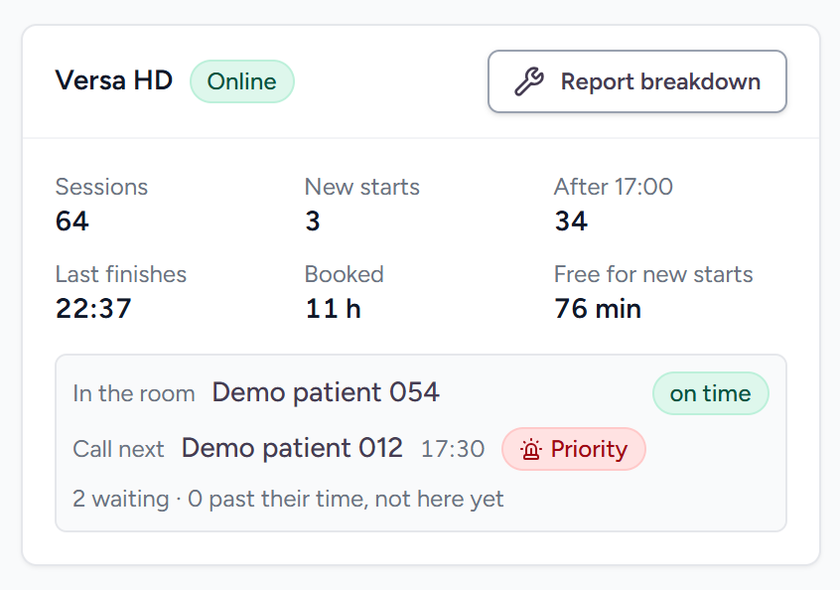
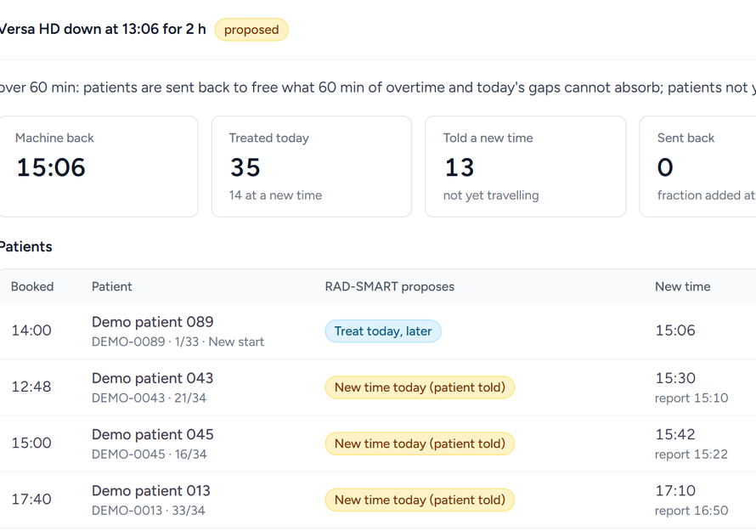
Solution Overview, Key Features & Impact
From the doctor's prescription to the patient's phone, and what it does to the waiting.
Doctor
Enters the course; approves a first day and a daily time, with reasons
Patient
One private link: the time to come, a voice note, a QR code
Technologist
Call next, out of turn with a reason, Priority for an emergency
Breakdown
A re-plan under the department's rules; approved by a person
−35%
90th-percentile wait, 108.6 to 70.4 min, on the department's own 55 days
22% to 5.7%
of patients treated more than an hour late
29% to 50%
treated within 15 minutes of their time
104 to 39 min
median wait after a 150-minute breakdown, with a new plan in 14 s
Expected impact: the department's recorded days re-planned in a digital twin calibrated on them, and synthetic breakdown days. A pilot measures it live.
HEALTH-A-THON 2026 • FINAL SUBMISSION
Notes:
The impact is a replay, not yet a trial: the pilot measures it for real.

Slide 7
Technology, Tools and AI Approach
Each part does what it is best at: the optimiser guarantees the rules; language models only translate and explain.
Course in CARE
the doctor's prescription and checklist
Session minutes
gradient boosting, scikit-learn
The plan
mixed-integer optimiser, SciPy with HiGHS
Rule checker
independent of the optimiser
A person approves
doctor or technologist
Sarvam AI
Translate, Bulbul v3 voice, Sarvam-105B explanations
The patient
phone page, WhatsApp
Green: the safety gate. A plan that breaks a hard rule cannot be produced, and nothing reaches a patient before a person approves it.
Why this mix
Only optimisation guarantees the rules; only language models talk to patients in their language. We scored five approaches and this hybrid was the only one that does both.
The language models never schedule. Every translation and explanation is checked for changed times.
Data
The department's records: 55 days, anonymised totals, to calibrate the digital twin.
Synthetic patients for training and every demonstration.
Real session minutes, recorded by the board's In room and Out taps, for retraining in the pilot.
Stack and integrations
Django and React plugins in CARE; PostgreSQL.
One Docker image on Microsoft Azure Container Apps.
WhatsApp from the department's phone; QR check-in; Telegram in the demonstration only.
HEALTH-A-THON 2026 • FINAL SUBMISSION
Notes:
Hybrid by design: guarantees from optimisation, language from Sarvam.

Slide 8
Build Sprint Journey and Progress
From a Round 1 engine to a working app inside CARE, live on Azure and shaped by the department.
19 Sep
5 Oct
24 Oct
25 Oct
26 Oct
27 Oct
3 Nov
Round 1: engine, digital twin
Shortlisted
Department's rules; app inside CARE
Sarvam AI, patient page, QR check-in
Live on Microsoft Azure
Preferred times, live queue
Priority override, emergency starts, guided demo
Working now
Course intake with a standing daily time, approved by a doctor
Day board: Call next, out of turn, Priority, rule check
Breakdown re-planning under the department's rules
Preferred part of the day, with better-time offers
Messages in four Indian languages, with voice notes
Patient phone page, QR check-in, Insights
How it changed
Round 1 was an engine and a simulation; now it runs inside CARE
The department's answers became rules: one standing time, new starts by 17:00, the 60-minute breakdown rule
Testing fixed four translation and wording problems before anyone saw them
Not built yet
Automatic WhatsApp sending (needs Meta verification)
Spoken replies from patients
Reading the oncology system (MOSAIQ, ARIA)
Live planning for two machines
HEALTH-A-THON 2026 • FINAL SUBMISSION
Notes:
Milestones are outputs delivered, each in the repository and on the live server.

Slide 9
Evaluation and User Validation
Replayed on the department's own days and on synthetic ones: long waits fall, and no rule is broken.
−35%
90th-percentile wait on the department's 55 days, 108.6 to 70.4 min
14 s
for a new plan after a breakdown; median wait 104 to 39 min
0
hard rules broken on any evaluation day, by an independent checker
Method: the same patients and events with and without RAD-SMART, in a digital twin that reproduces today's long wait (106 against 109 min).
HEALTH-A-THON 2026 • FINAL SUBMISSION
Notes:
Two datasets kept apart: the department's own days, and synthetic scenarios.

Slide 10
Evaluation and User Validation
The AI parts are measured, and the department's feedback changed the design.
Part
Test
Result
What the department changed
21 Sep and 24 Oct, written answers from the technologists and doctors: one standing time per course, new starts by 17:00, the 60-minute breakdown rule, who approves what.
27 Oct, the doctor partner: patients choose morning, afternoon or evening; a late patient's turn goes to whoever is ready.
3 Nov: staff can put a patient first, and an emergency starts the same day.
Fixed in testing
Kannada suffixes on times; Konkani's “next week” (messages now name the date); an explanation using the proposed time; an unclear button.
Session-minute prediction
2,000 held-out synthetic sessions
2.15 min mean error, against 2.62 for a table of averages
Optimiser
87-patient day, about 4,800 variables
Proven optimum in 7.1 s on a laptop
Sarvam Translate
112 messages in Kannada, Malayalam, Hindi and Konkani
112 of 112 kept every time; back-translation chrF 76 to 80
Sarvam-105B explanations
20 synthetic plans
20 of 20 accepted, 0 invented times
Safety guards
49 automated tests, the engine's run by GitHub on every change
All pass
Limits, said plainly
A replay, not a trial: the pilot measures the gain live.
Session lengths are synthetic until the board has recorded real ones.
Still to come: native speakers rating every translation, and a technologist trial.
HEALTH-A-THON 2026 • FINAL SUBMISSION
Notes:
Every number here is reproducible from the repository's evaluation scripts.

Slide 11
Safety and Responsible AI
RAD-SMART proposes and people decide. The language models are fenced in, and patients' details stay out of them.
People decide
A doctor approves each course and its time; a technologist approves every change on the day
Hard rules are optimiser constraints, re-checked by an independent checker
Staff can always override: out of turn with a reason, or Priority; it warns, never blocks
If a rule breaks in practice, the department returns to manual scheduling
The AI, fenced in
Language models never schedule; they translate and explain
A translation that drops or changes a time is discarded: the patient gets English
An explanation that mentions a time not in the plan is rejected
Without Sarvam, everything still works in English
Privacy and consent
No names, hospital or phone numbers go to Sarvam: only the message text
The patient page shows a first name only, behind a long random link
Synthetic data in every demonstration; the department's records only as totals
The pilot follows the DPDP Act 2023 and Rules 2025, with ethics review
Fairness and access
Older patients, public transport, the hospice bus and time windows are explicit rules
Messages in Kannada, Malayalam, Hindi and Konkani, with voice notes for those who read little
Patients choose morning, afternoon or evening; staff agree any change with them
HEALTH-A-THON 2026 • FINAL SUBMISSION
Notes:
The safety case rests on three things: hard constraints, human approval, checked AI output.

Slide 12
Deployment, Cost and Sustainability Plan
Live today on Microsoft Azure as one Docker image; the pilot runs the same image with demonstration mode off.
To pilot it
A CARE instance: the hospital's own, or our image; RAD-SMART installs as a plugin
A laptop or tablet at the console and at reception; a USB scanner or camera
The department's WhatsApp on a staff phone; internet for Sarvam
Approval by the head of department, hospital IT and the ethics committee
Integration
Uses CARE's own patients, users and roles; no change to CARE
Next: a read-only feed from the oncology system (MOSAIQ or ARIA, HL7 v2 or FHIR), so courses are not typed twice
Scale and sustain
Versa HD pilot, then the second machine (2027), then other CARE hospitals: 69% of Indian centres have one machine
Open source, no licence fee; the department's own staff can run it
One-time
Server, or an existing hospital VM
₹0 to 1,50,000
Tablets or existing PCs; QR scanner
₹5,000 to 75,000
Software licence
₹0
Ongoing
Per message: translation and voice note
about ₹1
Per course: about 3 messages and explanations
₹3 to 5
Per month, on the hospital's server
about ₹500 to 900
Per month, on Azure Central India instead
about ₹4,500 to 7,000
Assumptions: Sarvam list prices (Translate ₹20 and Bulbul v3 ₹30 per 10,000 characters); a message of about 190 characters; about 1,000 courses a year. Azure: one always-on container (0.5 vCPU) and a small managed database. WhatsApp Business API costs come later.
HEALTH-A-THON 2026 • FINAL SUBMISSION
Notes:
Running costs are a few thousand rupees a year on the hospital's own server.

Slide 13
What Next? Plans to take initiative forward (if any)
Validate with the department, then a 90-day pilot on the Versa HD.
Nov to Dec 2026
Technologist trial and native-speaker ratings; approvals from the head of department, hospital IT and the ethics committee; patient notice and consent for messages
Make all the solution information publicly available?
Yes
The code, website, deck, research paper and demo video are already public and open source.
Jan 2027
Pilot, phase 1: two weeks measuring today's waits with the day board
Feb 2027
Phase 2: three weeks in shadow mode, RAD-SMART proposing while staff schedule by hand
Feb to Apr 2027
Phase 3: eight weeks live. Target: a 90th-percentile wait at least 25% below 109 minutes
Later in 2027
WhatsApp Business API, spoken replies, the second machine, an oncology-system feed, and the plugin offered to other CARE hospitals
HEALTH-A-THON 2026 • FINAL SUBMISSION
Notes:
We want the department to run it after the pilot, and other CARE hospitals to install it.

Slide 14
Thank you
RAD-SMART • YU8PAK
Contact: akshay.dinesan@manipal.edu
Try the live demo: https://radsmart.braveglacier-5f9807f7.uaenorth.azurecontainerapps.io/api/care_radsmart/try/
Demo video: https://psraghothamrao8.github.io/RAD-SMART/#demo
Code: https://github.com/psraghothamrao8/RAD-SMART
Health-a-thon 2026
HEALTH-A-THON 2026
Notes:
Thank you. The live demo needs no password: every step is one click.

