Slide 1
REPRESENTATION LEARNING ON GRAPHS USING NODE2VEC
18-July-23
Pankaj, Rajoria
MSc. Data Science

Slide 2
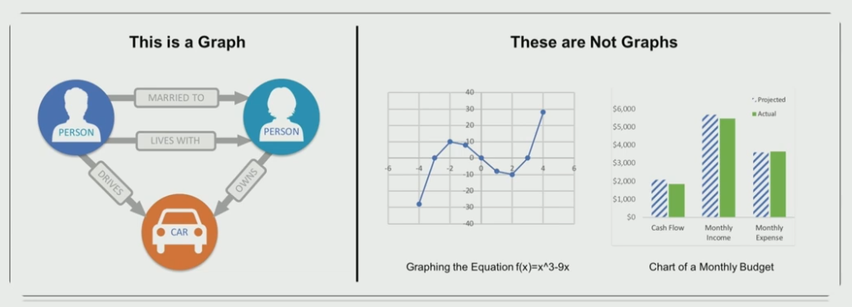
Graphs
Ubiquitous Data Structure that capture interactions between individual units.
Social Networks
Biological Networks
Recommendation Systems

Slide 3
Outline
Graph Learning
Representation Learning
Node Embedding
Node2vec
Implementation - tbd
Notes:
Papers with EDA for this

Slide 4
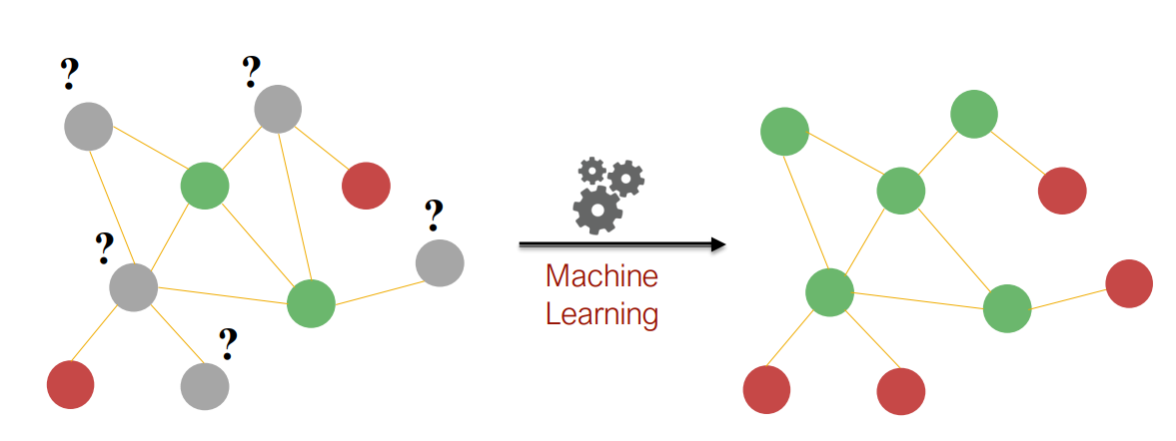
Graph Learning
Process to incorporate graph structure info into a ML model.
Traditional Approaches:
Node degree, centrality, clustering coefficient
Local/global neighborhood overlap
Kernel Functions

Slide 5
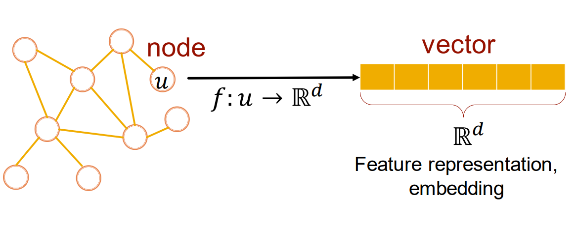
Representation Learning
Mapping that embed nodes, (sub)graphs into low dimensional vector space.
Reflects structure of the original graph

Slide 6
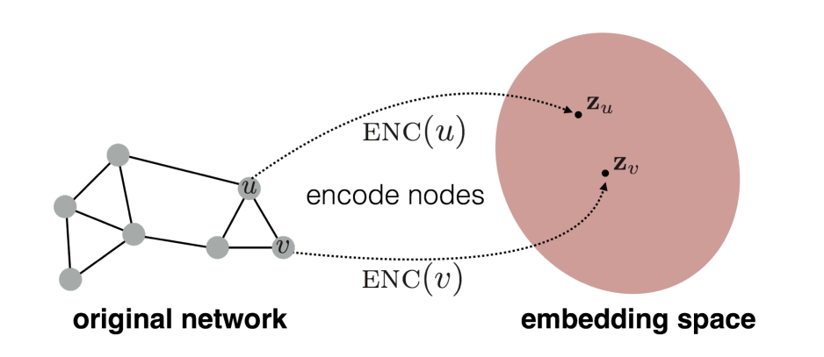
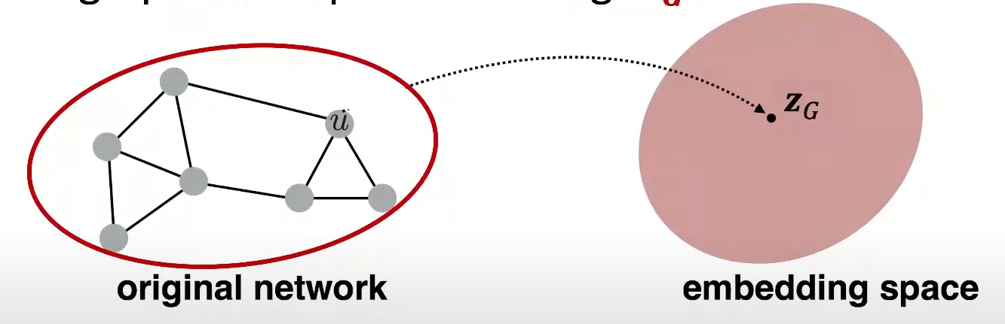
Representation Learning
Node Embedding
Auto-encoder approach
E.g. GraRep, DeepWalk, node2vec
Graph Embedding
Sum-based approaches
E.g. GNNs

Slide 7
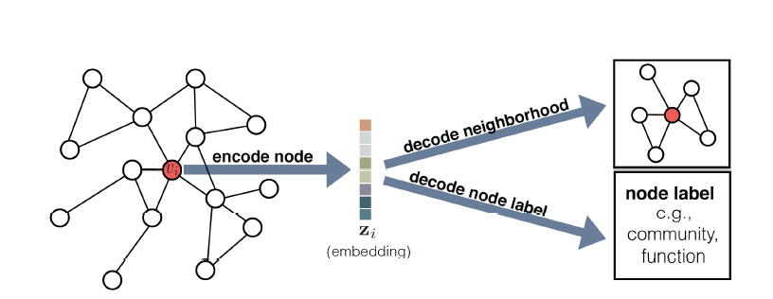
Node Embedding
Encoder Maps from nodes to embeddings
Similarity Function Measures the similarity between nodes
Decoder Reconstructs pairwise similarity values from the generated embeddings
Loss Function measuring the discrepancy between the decoded (i.e., estimated) similarity values and the true values

Slide 8
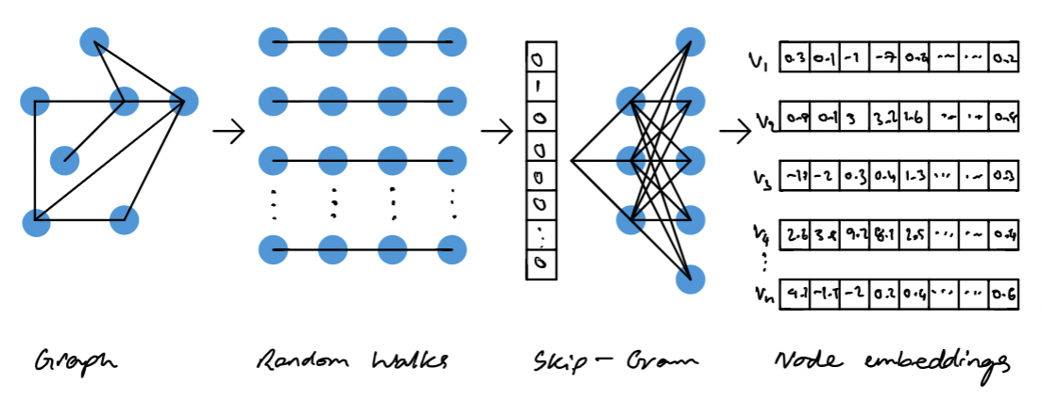
Node2vec
Semi-supervised Algorithm for scalable feature learning
Optimize objective function
Use a decoder based on inner product
Optimize embedding based on random walks

Slide 9
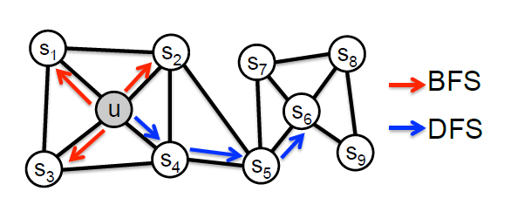
Sampling Strategy
Breadth-first Sampling (BFS) Restricted to nodes which are immediate neighbors of the source.
Depth-first Sampling (DFS)
Consists of nodes sequentially sampled at increasing distances from the source node.

Slide 10
Random Walks
A random path to a node from a selected node with a walk length l
A
D
E
F
H
C
G
B
I
Random walk(3) : H → G → C → A

Slide 11
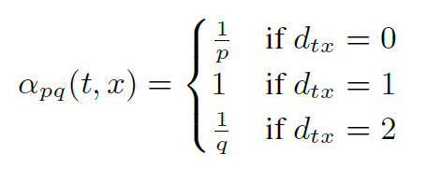
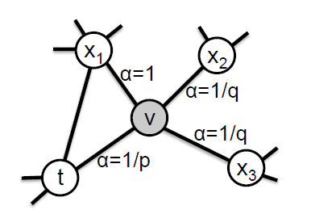
Search Bias
Second order random walk.
Return parameter(p) controls the likelihood of immediately revisiting a node in the walk.
In-out parameter(q) Allows the search to differentiate
between “inward” and “outward” nodes
p (> max(q; 1)) → Less likely to sample an already visited node i.e. DFS
if q > 1 → BFS
elif q<1 → DFS

Slide 12



Objective Function
→ G = (V;E) be a given network
→ f : V → Rd be the mapping function
where f is a matrix of size |V| x d parameters
→ ∀ u ϵ V, N_{S}(u) с V → network neighborhood of node u generated through a neighborhood sampling strategy S
log-probability of observing a network neighborhood N_{S}(u)
Assuming Conditional independence and Symmetry in feature space model the conditional likelihood of every source-neighborhood node pair as a SoftMax unit parametrized by a dot product of their features:

Slide 13
Optimizing the Objective Function
→ Using Negative sampling with Skip-gram algorithm

Slide 14
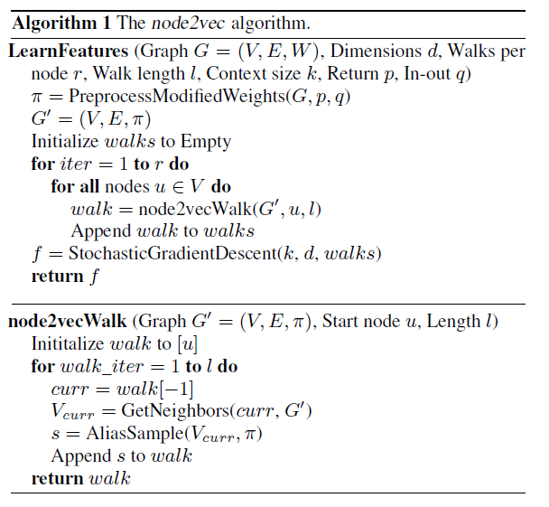
Algorithm

Slide 15
Implementation
Implement a python code for Node2vec to measure the F1 score with different datasets and compare it with other methods such as DeepWalk

