Slide 1
GE Healthcare – QARA & Legal Program
2021 Q4: Quarterly Business Review
12-Jan-2022

Slide 2
Agenda
1
GE Updates
2
Action points from previous QBR
3
Engagement Summary
4
Delivery Updates
5
Metrics
6
Automation updates
7
Delivery Excellence Value Adds
8
Voice of Customer
9
Q&A - Discussions

Slide 3
Action points
Sr# | Feedback/Suggestions | Solution | Status
1 | Continuous Improvement: Track post Go Live defects | RCA for Production Defects | Completed

Slide 4
Production Defects RCA Q4 till date
S.No | Application | Defect Summary | Release | RCA | Action Taken
1 | PQM | Submitting the FDA, entered or existed data is cleared out in H10s fields.. | Pega Upgrade- 2021 | Test Scenario was missed by Dev and QA. | Written new Script for missed scenario. PA: Reviewing test cases with Application owner.
2 | Product Holds | GEINC10639443 :Holds users are unable to select QA Approvers and RA owners from dropdown. Agent activity has bug which led to null values in Additional Access Group column in Data base. Hence users were not able to get values in dropdown. | Dec Release | Agent activity fails QA : Not in Scope. Issue is not replicated in Lower Environments | Agent Activity was fixed by Dev Team Additional Access Group values are stored in database. PA : DEV team to have a checklist for Deployment.
3 | Custom Apps | MTP: Training assignment report not getting downloaded. | Nov Release | This issue is not replicated in Lower Environments(Stage) .

Slide 5
Engagement Summary
Engagement Health (Overall)
Previous Period | Current | Projected Next Period
G
G
G
Major Indicators
 | Status | Comments
Scope |  | No deviations reported
Schedule |  | No Schedule deviation
Delivery |  | No deviations reported
Cost |  | No deviations reported
Resources |  | Attrition : Retention in progress.
Governance |  | No deviations reported
Invoices |  | Invoices raised on time
G
G
G
G
Y
G
G
G
On Track
Y
Low Risk
R
High Risk

Slide 6
Delivery Updates
Q4 Accomplishments
App Name | # Releases | Release Name | Highlights
AST | 1 | Release - 5 | 7 Bi-weekly releases deployed critical functionalities to production. Extensively tested below functionality. SSP Authentication, TO Webform(Translations), MMA (Manage my Absence).
QIS | 1 | R3 Release | R3 Release -> Successfully completed Production move on 21-Nov..
PQM | 2 | Pega Upgrade Release -2021 Nov-2021 Release | Pega Upgrade Release completed on 17th Oct. Nov Release successfully completed on 30th Nov.
Torus | 1 | Nov 2021 Release | Successfully moved below functionality to production on Nov-17th. RP Case- Field size increase, RS Case- , Removal of Special character Validation, Notifying the Owners on RS case approval. DM Case- All Items Button enhancement., Help Links Addition.
Product Holds | 2 | Nov- 2021 Release Dec- 2021 Release | Successfully moved below functionality to production on 17th-Nov. Revising/Completing the Holds form Email Process Links. Agent activity build Release is completed on Dec-27th.
Custom Apps | 6 | MTP: OCT, Dec Release CHU AI: Nov NEO- Oct, Nov, Dec Release | MTP - Azure Migration Testing - data comparison and functional testing of complete application CHU AI - Mammo modality testing, compare files on AzureProd with AzureDev NEO - different US testing in Sprint 1,2,3
TrackwiseDigital | - |  | Automation of 15 Scripts completed.

Slide 7
Testing Metrics: Quality & Legal

Slide 8
Automation foot print
Total # of Automation Candidate TCs: 78
Initiatives & Next steps
Application | Current Status | Recommendations / Comments
Trackwise Digital | 15 Test scripts were automated. | Plan to execute15 scripts for Feb Release.
PQM | Updated 10 Automation Scripts from Regression Stack. | Automation is in progress.
AST, Product Holds | Major upgrades have completed and application is more stable. 30 Regression Test cases to be automated | Product Holds: Scripts modification is in progress.( 4 scripts are updated)

Slide 9
Value Adds 2021
# | Test Accelerators | Project | Effort Save (Hrs.)
1 | Selenium- Validating the PDF files using PDF Box JAR file. | Product Holds | 88
2 | AST-Workflow Data Creation | AST | 50
3 | AST-SSP interface testing (Initial phase-Request submission). Flow is as follows- A requisition request is submitted from AST to SSP, SSP creates a requisition number for the request ID and interfaces back to AST system | AST | In Progress
4 | Regulatory Program workflow automation | Torus | In Progress
5 | PQM Automation Suite (Regression) | PQM | In Progress
6 | Product Holds Automation Suite (Regression) | Apps Testing | In Progress
7 | Excel Data comparison macro | Custom Applications | 50
8 | Email validation using Selenium | TWD | 40
9 | Automated BIX manual job for processing of failed records | PQM | 45
Total Savings from Accelerators
273 Hrs

Slide 10
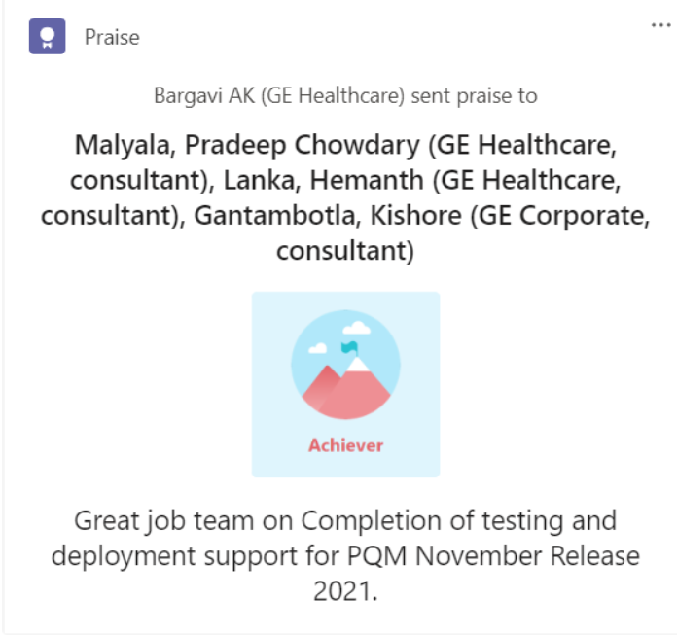
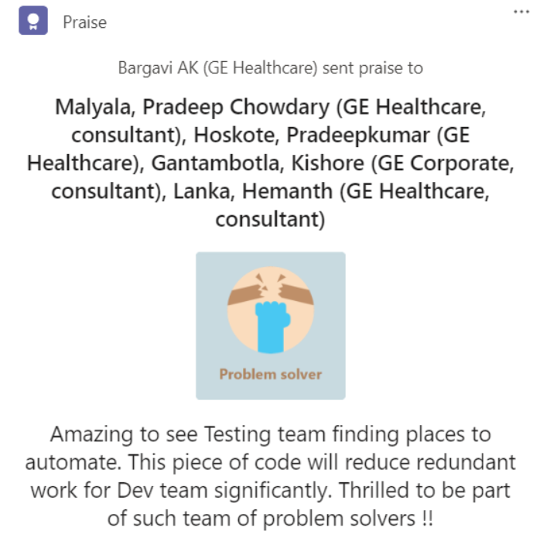
VoCs - Voice Of Customers
Notes:
Mahesh: PQM Testing Feedback is to be added

Slide 11
Exec Summary

